Slide 1

Use Case: 1.2
Solution Approach and Model Selection
Predicting Customer Churn for a Telecommunication Company
Objective: Estimate the likelihood of customer churn using predictive modeling
Data Understanding:
- Key Features:
- Gender, SeniorCitizen, Partner, Dependents, tenure, PhoneService, MultipleLines, InternetService, OnlineSecurity, OnlineBackup, DeviceProtection, TechSupport, StreamingTV, StreamingMovies, Contract, PaperlessBilling, PaymentMethod, MonthlyCharges, TotalCharges.
Exploratory Data Analysis (EDA):
- Findings:
- Senior citizens have a higher churn rate.
- Longer tenure correlates with lower churn.
- Monthly charges impact churn likelihood.

Slide 2
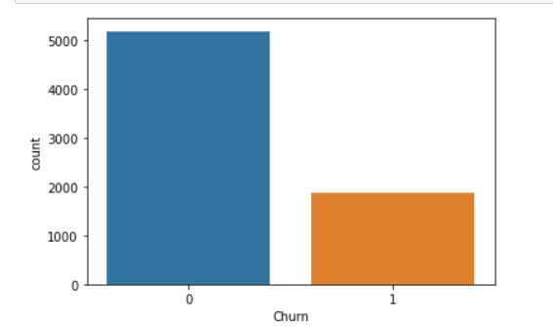
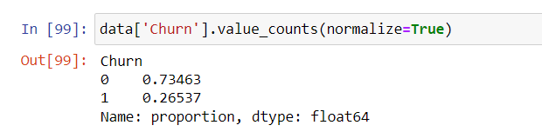
Visualization:
The dataset is imbalanced only 27% of the customers has churned

Slide 3
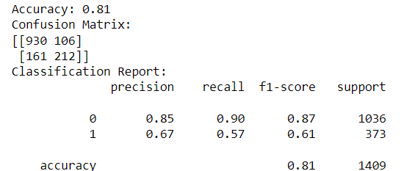
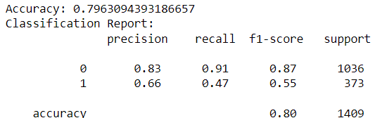
MODEL 1 : Logistic regression on imbalanced dataset
Fitted logistic regression on imbalanced data and received an accuracy of 0.81
MODEL 2: Random Forest on imbalanced dataset
Fitted Random forest on imbalanced data and got an accuracy of 0.79

Slide 4
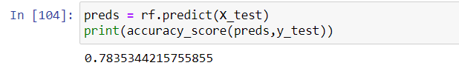
MODEL : Random forest on balanced dataset
Conclusion:
- Both models provide valuable insights into customer churn.
Key Takeaways:
- Model Performance: Both models show good performance
Feature Importance: Understanding key drivers of churn can help in developing targeted retention strategies.
Thank You

