Slide 1

Mahatma Education Society’s Pillai College of Engineering, Panvel Department of Computer Engineering’s
Mini Project Presentation on
Grocery Store GUI
Under the Guidance of
Prof. Sangeetha Selvan.
Group Members:-
Laxmisneha Chilukuri (CEA310)-Leader
Omkar Desai (CEA317)
Saloni Dongare (CEA319)

Slide 2
OVERVIEW
ACKNOWLEDMENT
INTRODUCTION
SYSTEM REQIUREMENTS
FLOWCHART
RESULT
FUTURE WORK
BIBLIOGRAPHY
CONCLUSION

Slide 3
ACKNOWLEDGEMENT
The project has been a lot of work, but we couldn’t have done it without the support and guidance from some very important people. We want to thank Prof. Sangeeta Selvan Mam for all their help with this project; they provided us with resources as well as essential information that was needed to complete our task successfully.
Thank you also goes out to our parents and friends who were there every step of the way during this time period-without them, I’m not sure what would’ve happened!
We also want to thank all of the people who have been working alongside us on this project. It’s so great that you are willing to help out when we need it! Thank you for your hard work and dedication, which has made our success possible

Slide 4
INTRODUCTION
Topic: Grocery Store
GROCERY STORE
This project is python based grocery shopping system which is made with the help of programing language python and Tkinter, Sqlite3.
Online shopping is the process whereby consumers directly buy goods or services from a seller in real-time, without an intermediary service, over the Internet. It is a form of electronic commerce. This project is an attempt to provide the advantages of online grocery shopping to customers. It helps buying the products like apple, orange, jamun, grapes, berries, guava, etc in the shop anywhere through internet.

Slide 5
SYSTEM REQIREMENTS
I.OPERATING SYSTEM : WINDOWS 7 AND ABOVE
II. PROCESSOR: : PENTIUM(ANY) OR AMD
ATHALON (3800+- 4200+ DUAL CORE)
III. MOTHERBOARD : 1.845 OR 915,995 FOR PENTIUM 0R MSI
K9MM-V VIA K8M800+8237R PLUS
CHIPSET FOR AMD ATHALON
IV. RAM : 512MB+
V. Hard disk : SATA 40 GB OR ABOVE
VI. CD/DVD r/w multi drive : (If back up required)
combo
VII. FLOPPY DRIVE 1.44 MB : (If Backup required)
VIII. MONITOR : 14.1 or 15 -17 inch
IX. Key board and mouse
X. Printer : (if print is required – [Hard copy])
SOFTWARE REQUIREMENTS:
I. Windows OS
II. Python Tkinter
III. Sqlite3

Slide 6
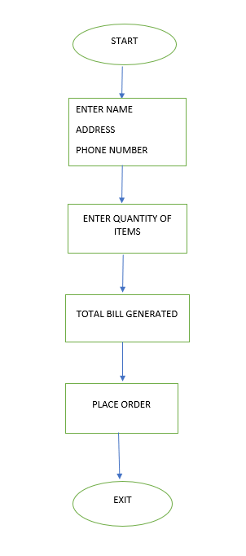
FLOWCHART

Slide 7
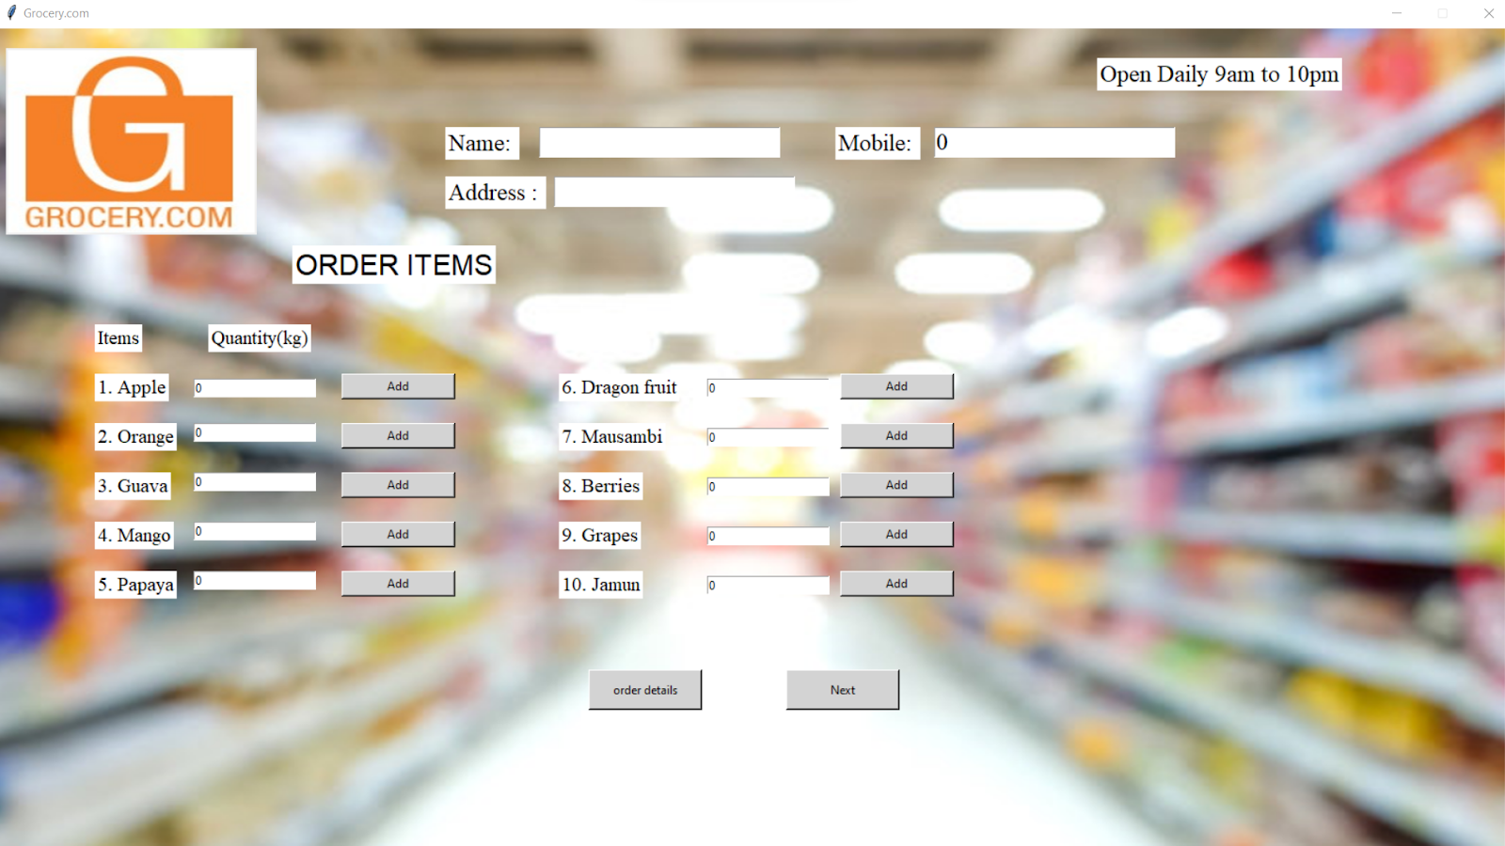
RESULT

Slide 8
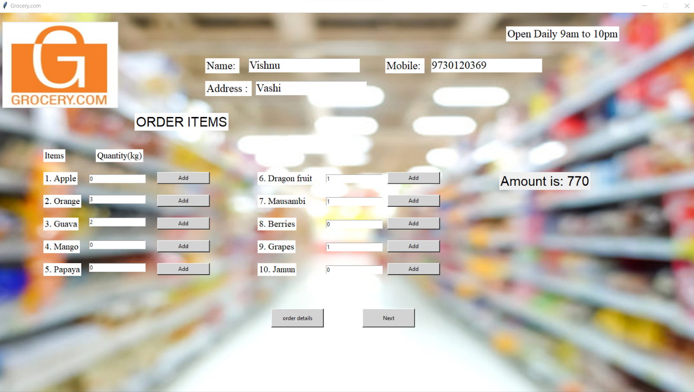
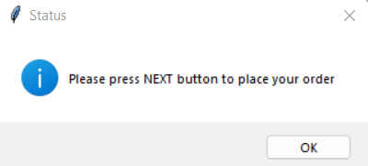

Slide 9
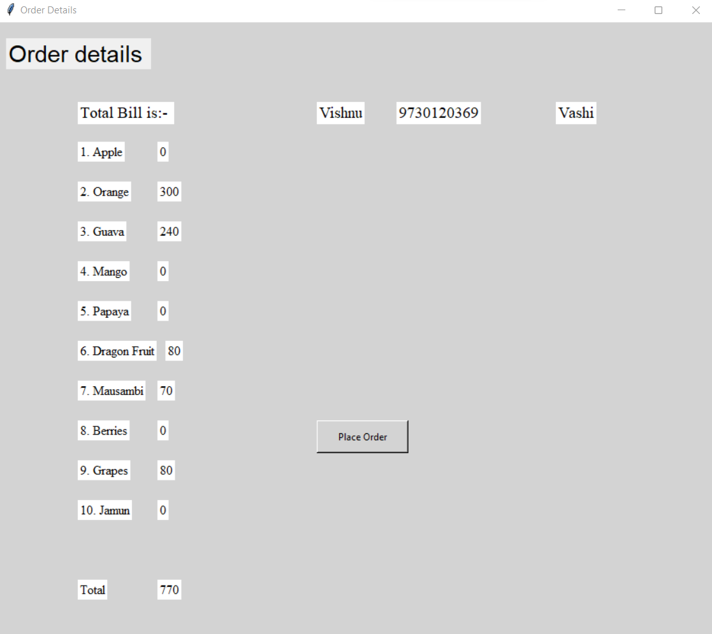
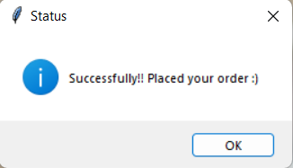

Slide 10
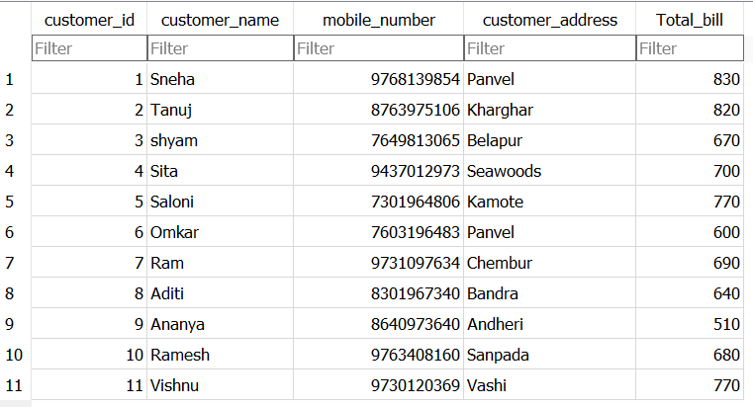
CUSTOMER TABLE

Slide 11
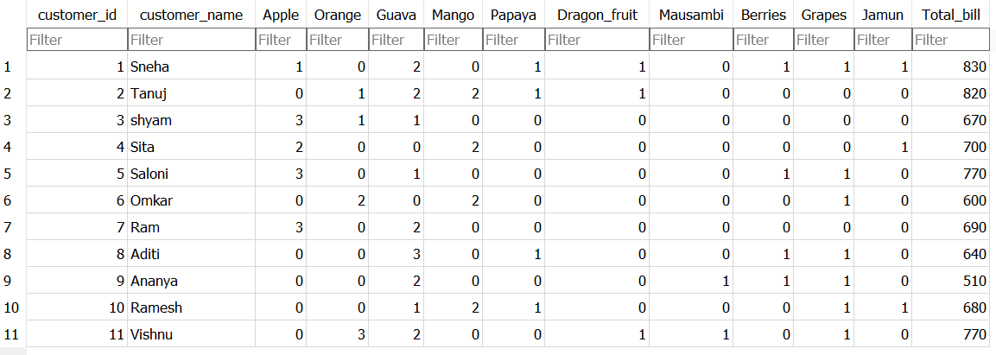
ORDERS TABLES

Slide 12
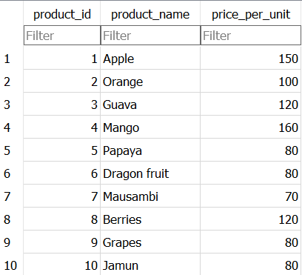
PRODUCTS TABLE

Slide 13
FUTURE WORK
1.The GUI of this would be updated.
2.Place order section would be modified.
3.The non place object would not be shown in place order as 0.
4.Search bar for searching the object would be added.
5.Image will also be shown with the object.
6. Floating numbers for quantity will also taken as input.

Slide 14
BIBLIOGRAPHY
1. https://www.geeksforgeeks.org/open-a-new-window-with-a-button-in-python-tkinter/amp/
2. https://www.geeksforgeeks.org/how-to-use-images-as-backgrounds-in-tkinter/amp/
3. https://stackoverflow.com/questions/7966119/display-fullscreen-mode-on-tkinter
4. https://www.geeksforgeeks.org/how-to-use-images-as-backgrounds-in-tkinter/

Slide 15
CONCLUSION
The project entitled GROCERY STORE was completed successfully. The system has been developed with much care and free of errors and at the same time it is efficient and less time consuming. The purpose of this project was to develop a platform for purchasing grocery items.
This project helped us in gaining valuable information and practical knowledge on several topics like Sqlite3, Tkinter and help understanding different features and function in Python language.
This project has given us great satisfaction in having designed a platform which can be implemented by everyone for shopping grocery items.

Slide 16
THANK YOU

