Slide 1
Floral Fashion(E-Commerce Website)
By Laxmisneha Chilukuri-410
Saloni Dongare-419
Omkar Desai-417
Pooja Jadhav-422

Slide 2
Introduction
Welcome to our mini project presentation on the floral jewelry store!
Our project is about designing an e-commerce website for a floral jewelry store.
Floral jewelry is a growing trend, and e-commerce enables businesses to reach customers worldwide.
We will demonstrate the code we developed to implement the website's features and functionality.
Our goal is to showcase how technology and our code can enable businesses to succeed in the floral jewelry industry.

Slide 3
Problem Statement
The floral jewelry industry is growing rapidly as people look for unique and eco-friendly alternatives to traditional jewelry. However, many floral jewelry businesses are limited by their local reach and struggle to expand their customer base.
This project aims to address this problem by designing an e-commerce website for a floral jewelry store, enabling the business to reach a global audience and increase sales.
The challenge is to create an effective and user-friendly website that showcases the beauty and uniqueness of floral jewelry while providing a seamless online shopping experience for customers.

Slide 4
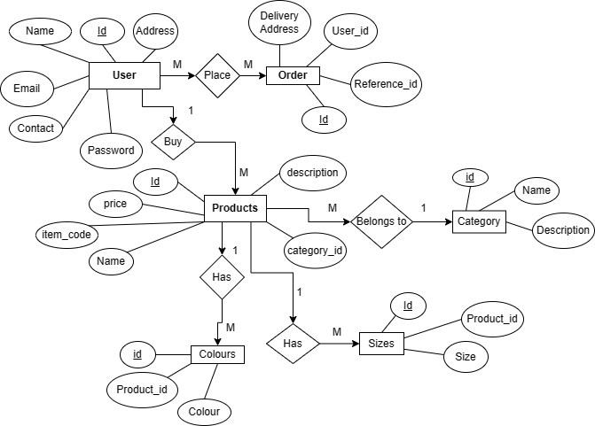
ER Diagram

Slide 5
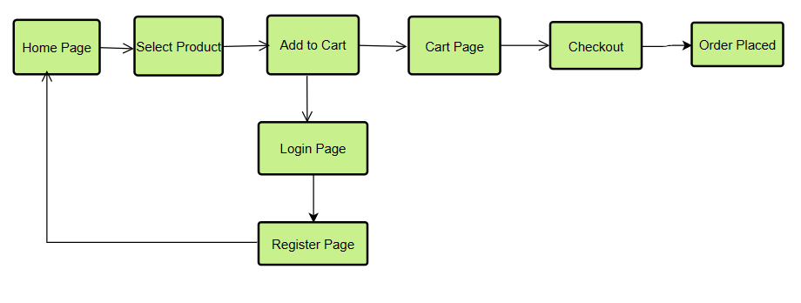
Flow of Program

Slide 6
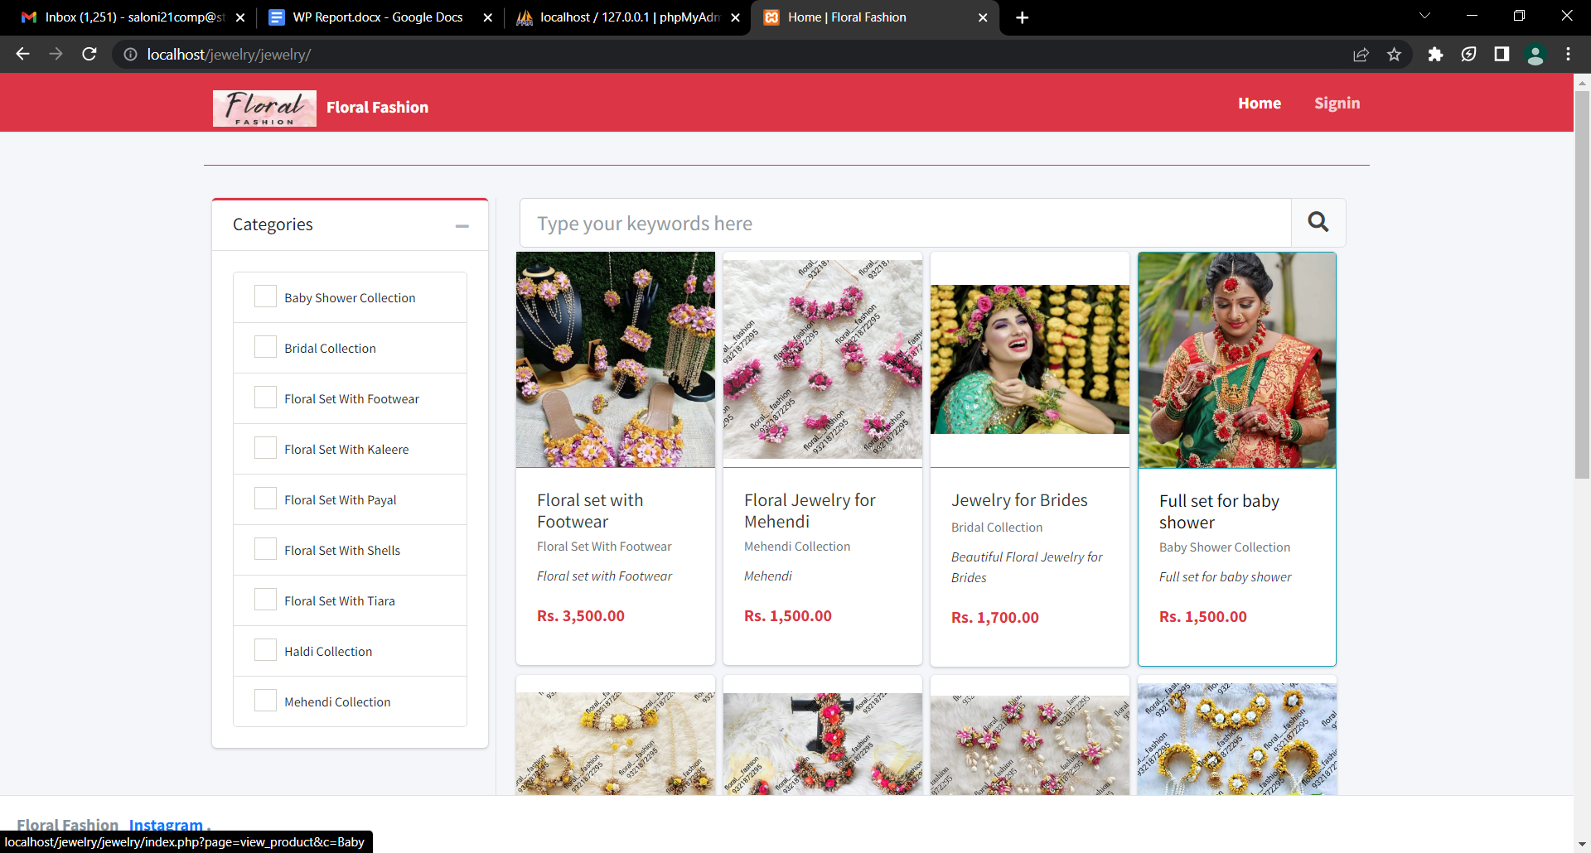
Project Screenshots

Slide 7
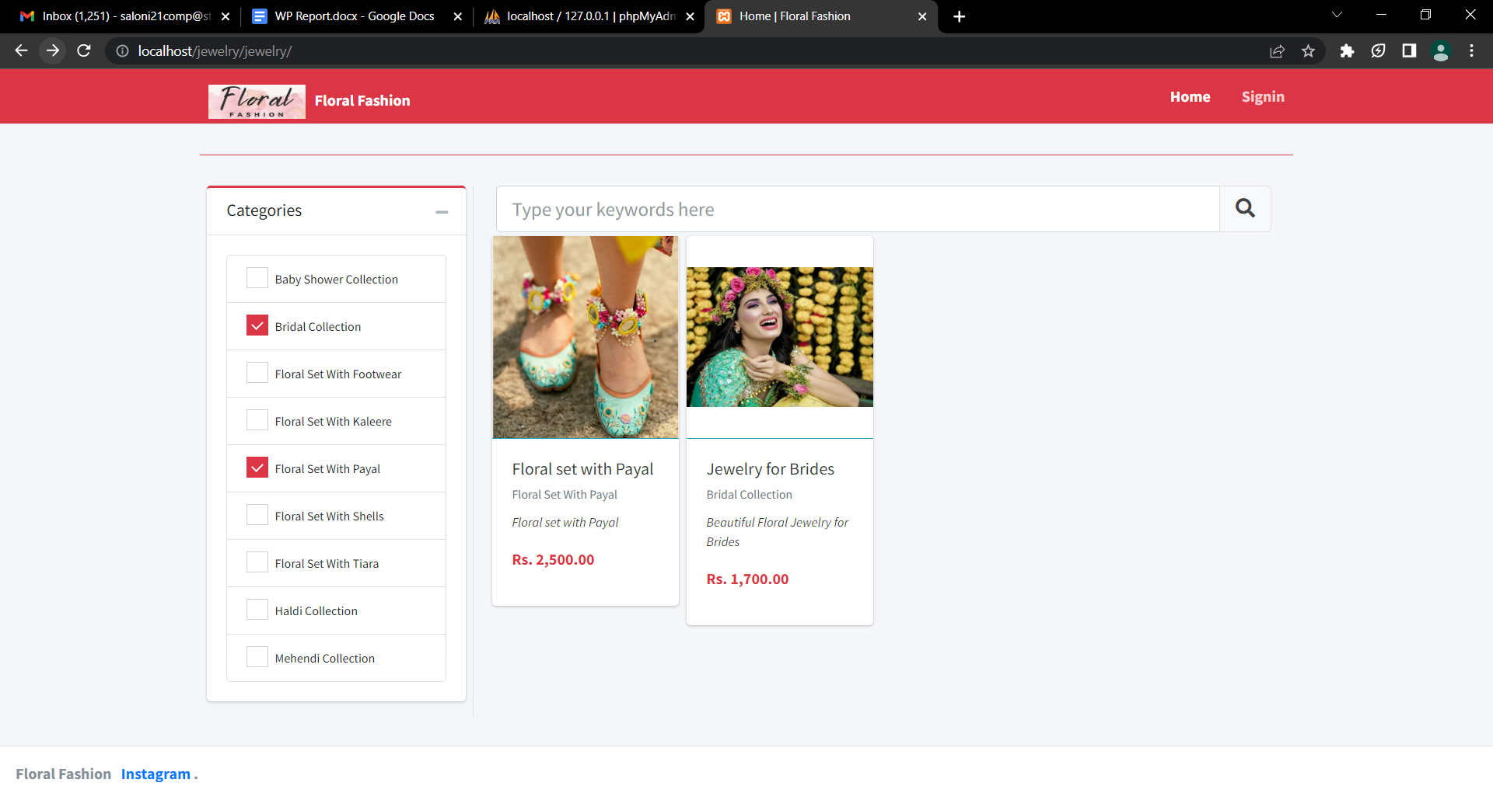

Slide 8
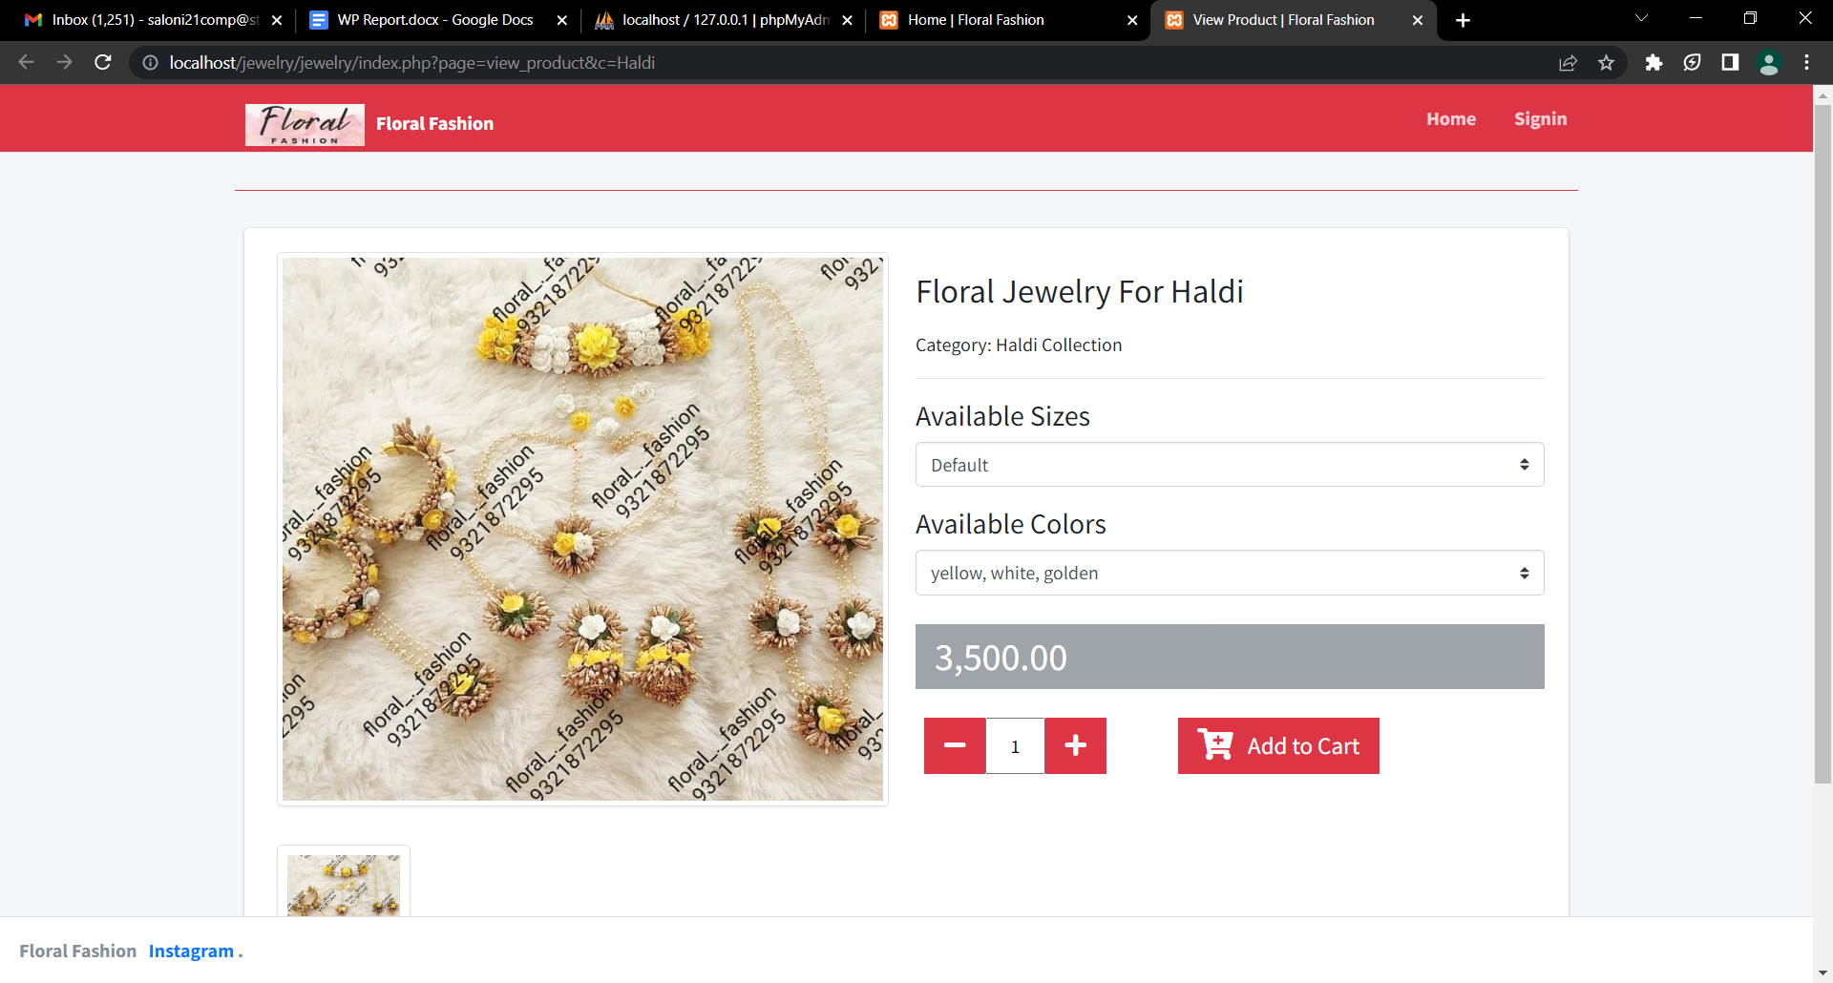

Slide 9
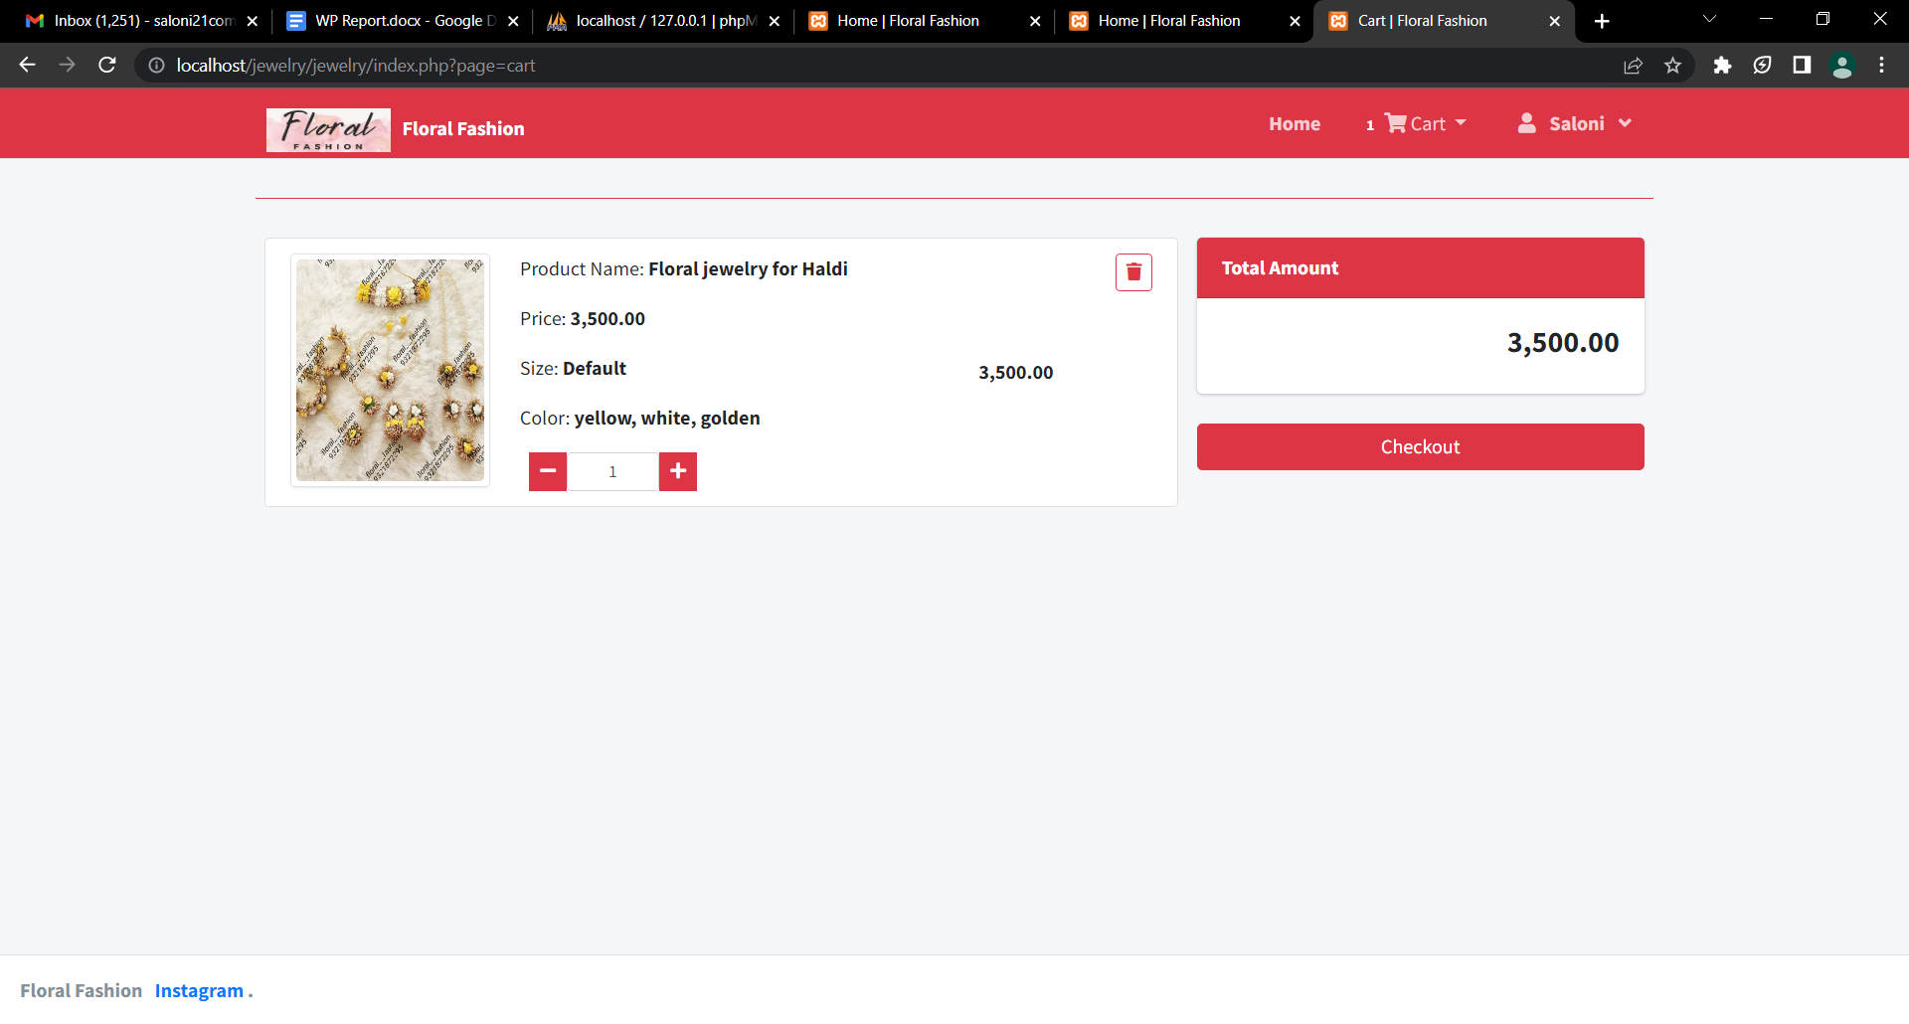

Slide 10
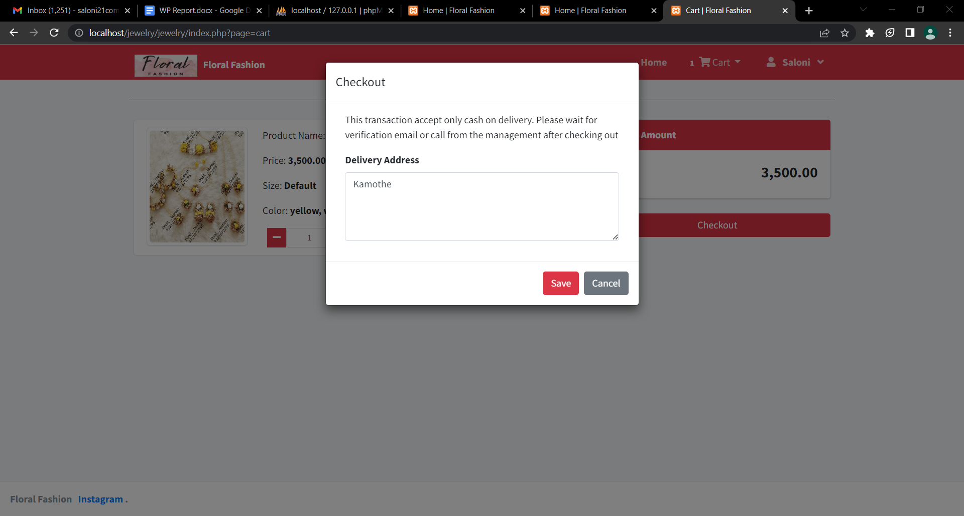

Slide 11
Conclusion
The floral jewelry store mini project examined a niche market in the jewelry industry that attracts customers who value nature and unique designs. The project addressed essential aspects of running a floral jewelry store, including sourcing materials, designing and creating pieces, marketing and sales strategies, and brand building. The project emphasized the importance of combining creativity, quality craftsmanship, and effective business practices to succeed in this market. Ultimately, it was an informative and engaging exploration of a distinct aspect of the jewelry industry.

