Slide 1

Title: Federated Document Classification for Movie Reviews
Subtitle: Privacy-Preserving Sentiment Analysis
Presenter: Arinze M. Emeti & Layân ID YASSINE Date: 18/12/2024

Slide 2
Project Definition
Goal: Classify movie reviews (e.g., positive or negative) while keeping user data private.
Data stays on user devices → Ensures privacy.
Why Federated Learning?
No need to centralize user reviews.
Applications: Sentiment analysis, movie recommendations, content filtering.

Slide 3
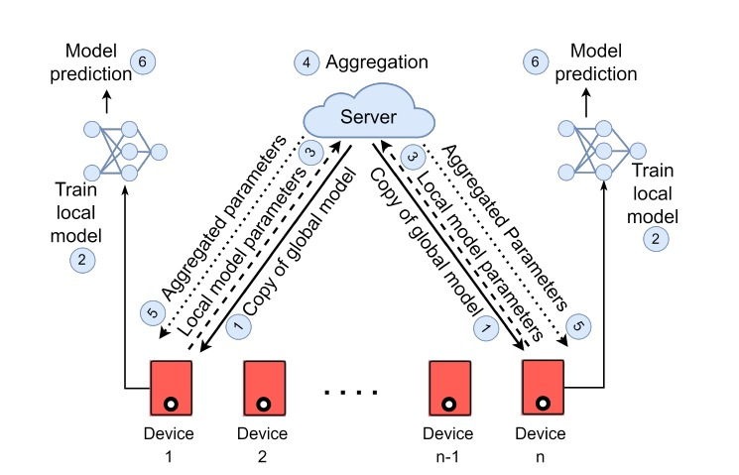
What is Federated Learning?
Definition:
Federated learning enables distributed model training where data remains local and only model updates are shared.
Advantages:
Privacy-Preserving: No raw data leaves the user's device.
Efficient: Reduces the need for data transfer, saving bandwidth.
Diagram of federated learning process

Slide 4
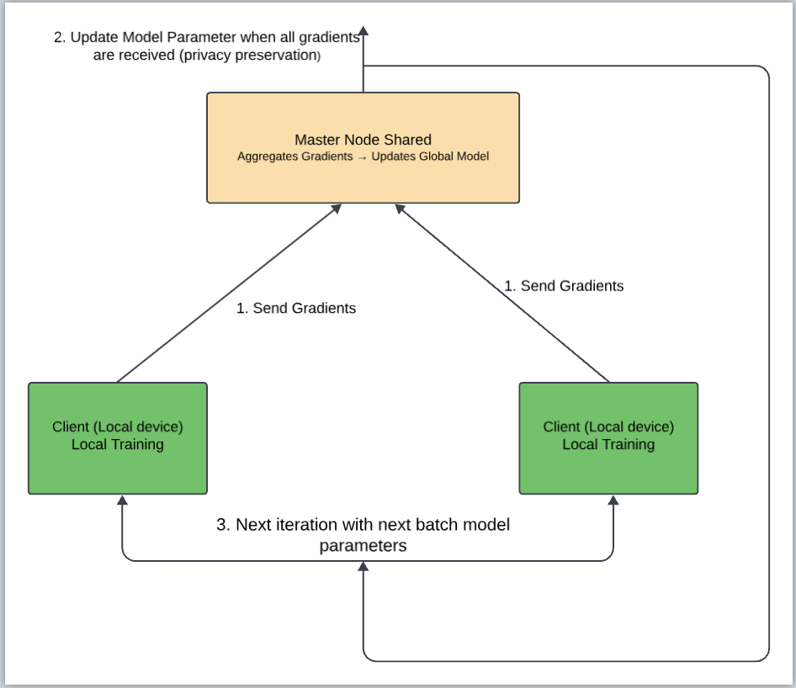
Proposed Method
Federated Learning Steps:
Local Training: Each device trains a model on its local data (movie reviews).
Share Updates: Devices send model updates (weights) to a central server.
Server Aggregation: The server aggregates updates to improve the global model.
Model Choice:
Logistic Regression (simple, efficient, and well-suited for text classification tasks with balanced data).
Preprocessing:
Tokenization, embeddings (e.g., Word2Vec, GloVe).

Slide 5




Challenges
Non-IID Data:
Device Constraints:
Communication Overhead:
Data on different devices is non-identical and independent (Non-IID).
Devices may have varying data distributions, leading to inconsistencies in training.
Some devices have limited resources like low computational power, memory, or battery life.
Frequent updates between devices and the central server may cause high communication costs or latency.

Slide 6

Data used in our federated learning experience
Dataset: Large Movie Review Dataset v1.0
Details:
50,000 movie reviews
25,000 for training | 25,000 for testing
Class balance:
12,500 positive and 12,500 negative reviews in the training set and in the test set.
Polarized reviews: positive/negative
Purpose: Sentiment classification for text models
Source: Andrew L. Maas et al. (2011)
Learning Word Vectors for Sentiment Analysis, ACL 2011.
Notes:
For this project, we used the Large Movie Review Dataset v1.0, which contains movie reviews for a sentiment classification task. This dataset consists of 50,000 reviews, split into 25,000 for training and 25,000 for testing. The data is perfectly balanced: there are 12,500 positive reviews and 12,500 negative reviews in each set, both for training and testing. The goal is to classify these reviews to determine whether a review is positive or negative.
-
This dataset was introduced by Andrew L. Maas et al. in their paper Learning Word Vectors for Sentiment Analysis, ACL 2011.

Slide 7



What Are the Objectives of Federated Learning ?
Goals:
Accuracy: Federated learning models should match or be very close to centralized model accuracy.
Communication Efficiency: Federated learning reduces data transfer compared to centralized methods.
Privacy: Maintains privacy by sharing model updates, not raw data.
Notes:
The main objective of federated learning is to achieve results that are close to, or even equivalent to, those of centralized learning models, while maintaining a key advantage: data confidentiality. Federated learning reduces communication costs, as only model updates are exchanged, not the data itself. Thus, federated learning combines accuracy, communication efficiency, and data confidentiality.

Slide 8
Federated Learning Experiment
Number of Rounds: 50
Number of Clients Tested: 3, 5, 10
Model Used: Logistic Regression with TF-IDF embeddings
Notes:
With Moses, we used federated learning with the logistic regression model. We designed a code that allows us to set the number of rounds and the number of clients for training the model. After several tests, we chose to use 50 rounds, as it proved to be the most optimal for model convergence. We also tested 3 main configurations for the number of clients: 3, 5, and 10, to analyze the impact of this data division on the model's performance.

Slide 9


Results
Running federated learning with 3 clients :
Running federated learning with 5 clients :
Running federated learning with 10 clients :
Notes:
On this slide, we present the results obtained after testing federated learning with 3, 5, and 10 clients, using 50 rounds for each configuration.
-
- With 3 clients, the model achieved an accuracy and an F1 score of 0.8420.
-
- With 5 clients, performance dropped slightly, with an accuracy of 0.8202 and an F1 score of 0.8171.
- With 10 clients, the model achieved its best performance with an accuracy and an F1 score of 0.8694.
-
-
The accuracy and F1 score are very similar in this case because the positive and negative classes are perfectly balanced in the dataset (12,500 positive reviews and 12,500 negative reviews in both the training and testing sets). When the classes are balanced, these two metrics converge to similar values since prediction errors are proportionally distributed across the two classes.

Slide 10
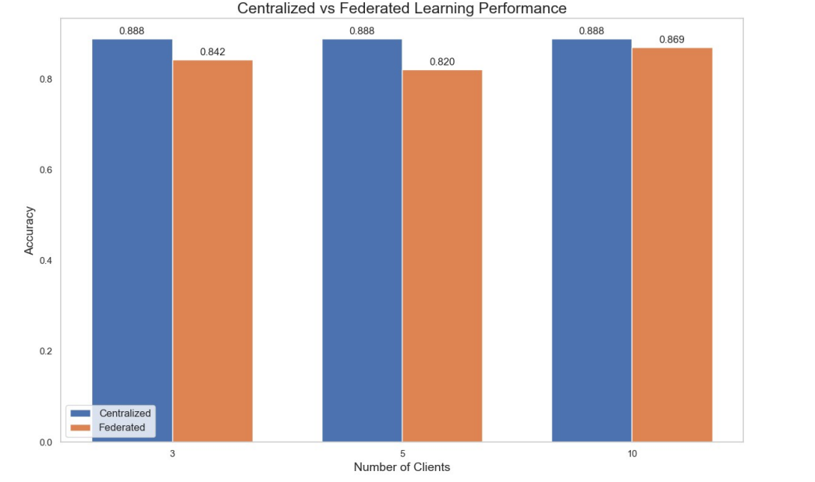
Results
Notes:
Thus, we observe that dividing the data among 10 clients results in a better overall score, with an accuracy and an F1 score of 0.8694, and also improves the convergence of the federated model towards the performance of centralized learning. This demonstrates that increasing the number of clients enhances the model's generalization while approaching centralized results, despite the non-uniform distribution of data among clients.

Slide 11
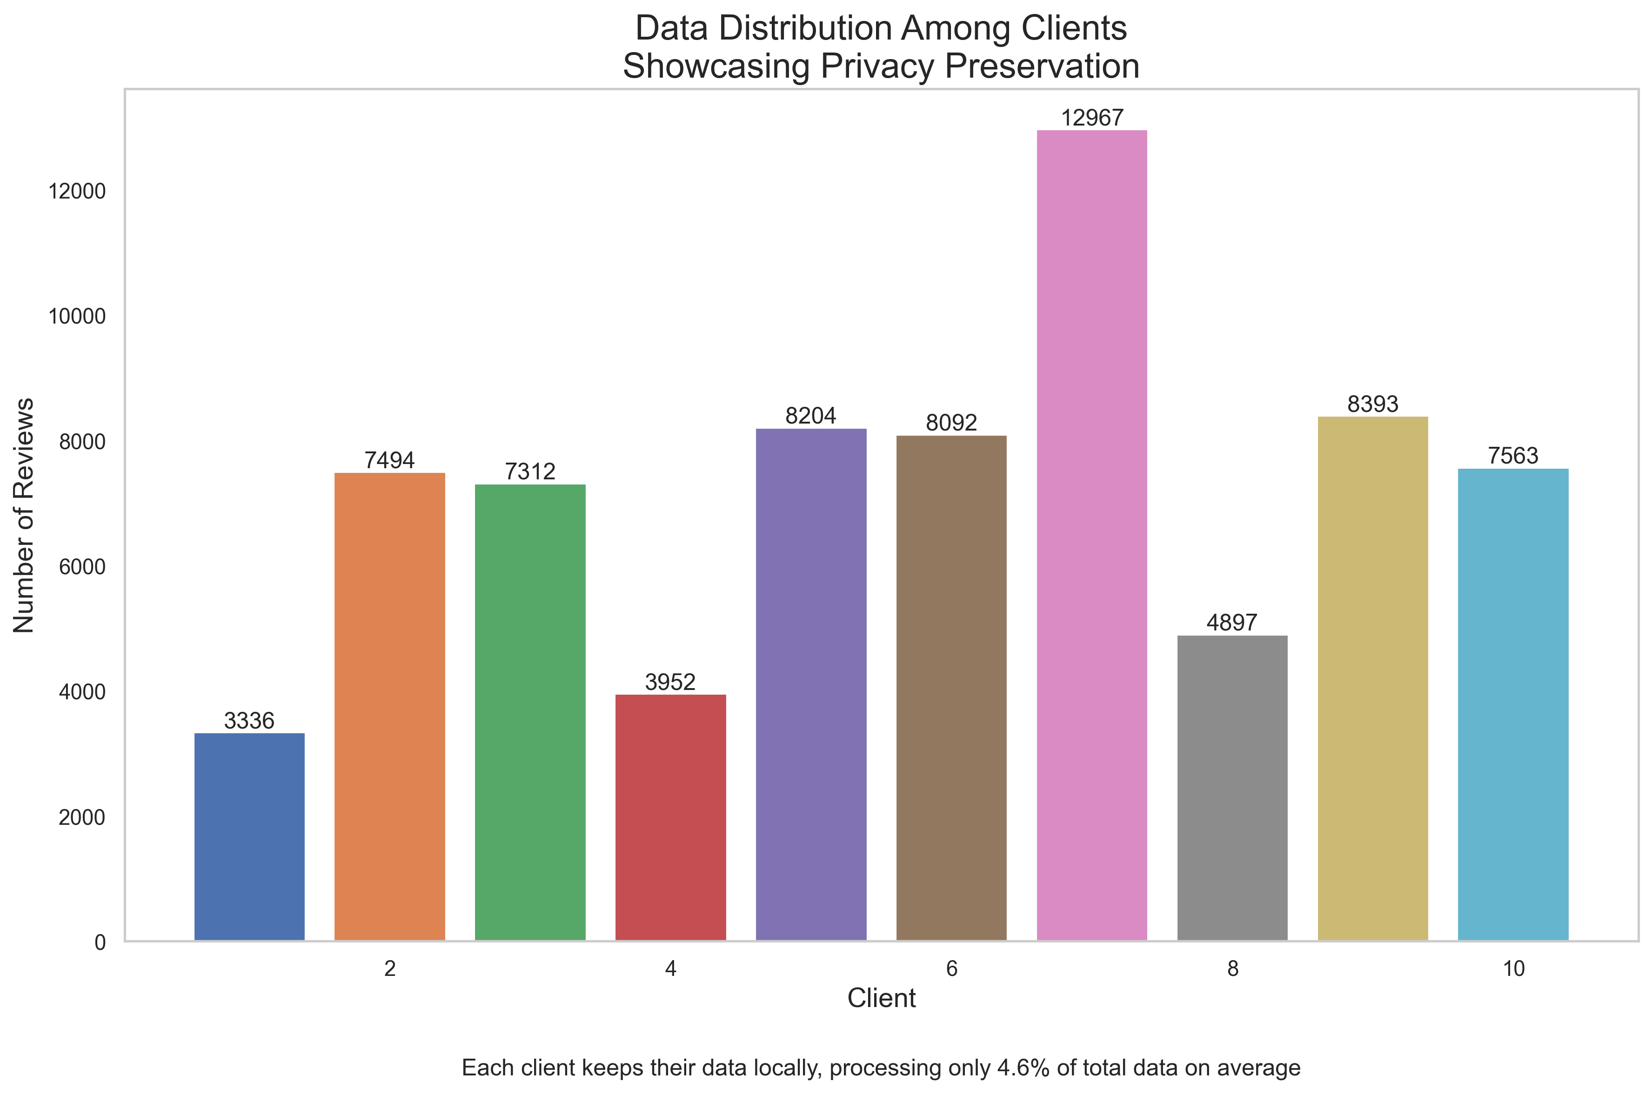
Random Data distribution
Notes:
This slide shows a non-uniform distribution of data among clients, with some clients processing significantly more data than others. On average, each client processes 4.6% of the total data, with possible overlap, ensuring data privacy in a federated learning context.

Slide 12

Conclusion
Performance and Privacy:
Federated learning achieves performance close to centralized learning while ensuring data privacy.
Optimal Configuration:
50 rounds proved to be the most suitable for ensuring model convergence.
Dividing the data among 10 clients produced the best results with an accuracy and F1 score of 0.8694 for our project.
Key Insight:
Increasing the number of clients improves both generalization and convergence of the model, despite the non-uniform distribution of data.
Notes:
In conclusion, our project demonstrates that federated learning achieves performance close to centralized learning while ensuring data confidentiality. Using 10 clients with 50 rounds yielded the best results, with an accuracy and F1 score of 0.8694, comparable to the 0.888 obtained locally with the centralized model. This highlights the importance of proper configuration to optimize model convergence while retaining the advantages of federated learning.

Slide 13
Github
https://github.com/Layan-iy/Project-3-NLP

