Slide 1

HOTEL AGGREGATOR ANALYSIS
-TABLEAU-
BY Layasri Batta

Slide 2
TABLE OF CONTENTS
Overview of this presentation
Problem Statement | Brief Explanation of the aim of this project and what we want to achieve.
Dataset cleaning & Prep | Getting to know our Dataset, describing, cleaning and preparing it for analysis.
Analysis in Tableau | Data Analysis using Tableau for clear Visualization
Findings | Showcasing our results in a Tableau Dashboard and reports.
Recommendations | Providing the fruit of our Analysis and visualization as recommendations.

Slide 3

Problem Statement
We will cover the experience of analysing a hotel aggregator dataset using Tableau, including visualizations, trends, patterns,
and factors influencing listing performance in order to provide actionable insights for improving listing quality and competitiveness.

Slide 4

Dataset Cleaning and Preparation
Step1
Step2
Step3
Connecting Tableau to
our Dataset
Checking for null/duplicate/irrelevant values or columns
Starting up our Data exploration & Analysis

Slide 5
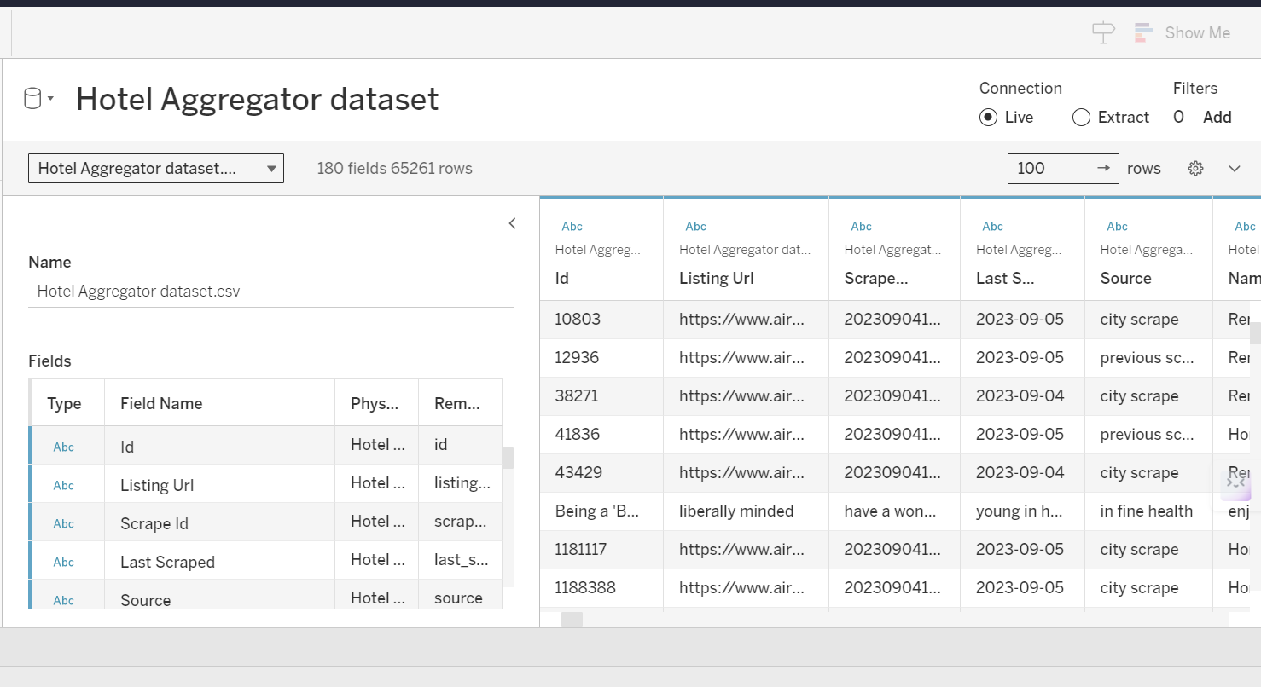

Setting up our Dataset in Tableau
01
₀₂ Data cleaning
& Prep

Slide 6
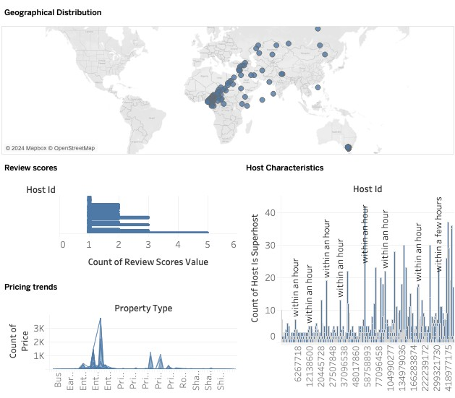
03
Starting up our Data exploration & Analysis in Tableau

Slide 7




Data Analysis in Tableau
Pricing trends
We analyse pricing trends based on property types, room types, and accommodation capacity.
Geographical distribution
To identify popular neighbourhoods, we Explore the geographical concentration of listings and host locations.
Host characteristics
Including superhost status, response times, and verification methods.
Review scores
We try to identify areas for improvement based on specific review categories.

Slide 8

Findings
Dashboards
Interactive Tableau dashboards illustrating our analysis and visualizations results.
Reports
Reports on availability patterns, property and room preferences, and factors influencing guest satisfaction.

Slide 9
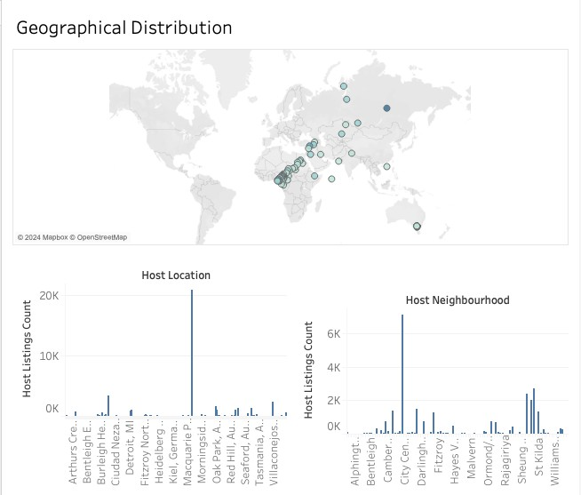
Geographical Distributions Dashboard
Melbourne, Australia as Most popular Location with 20866 listings.
➢
Central Business district
as most
popular neighborhood with 7147 listings.

Slide 10
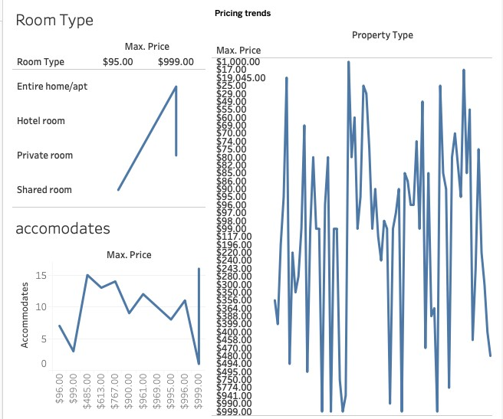
Pricing Trends Dashboard

Slide 11
Pricing Trends Dashboard
Highest Price | $ 999.00
Property Type | Entire Home Entire rental unit Entire Villa Private room in rental unit Room in serviced appartement
Room Type | Entire Home/Apt Hotel room Private room
Accommodation Capacity | 16
 |  | Lowest Price
Property Type | Shared room in serviced appartement | $17.00
Room Type | Shared room | $95.00
Accommodation Capacity | 7 | $96.00

Slide 12
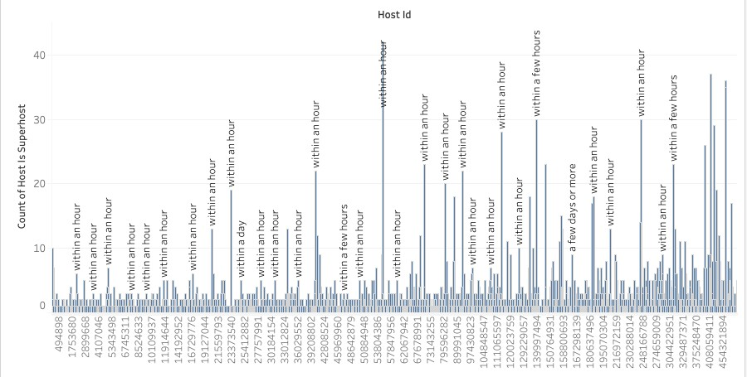
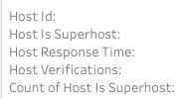
Host characteristics

Slide 13
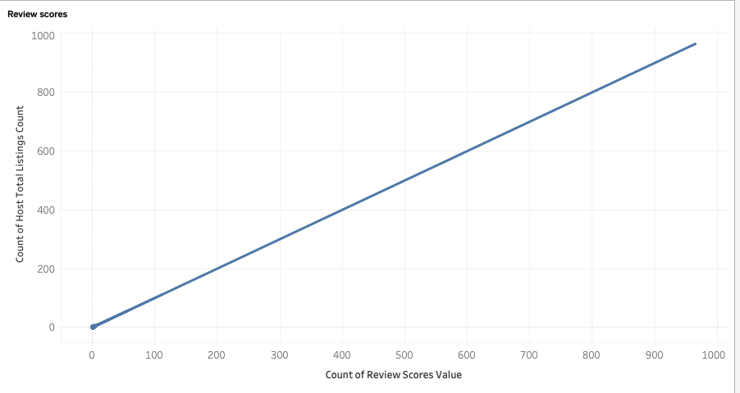
Review Scores
The more review scores value increases the more Nmbr of Listings increases which leads to hotel popularity

Slide 14
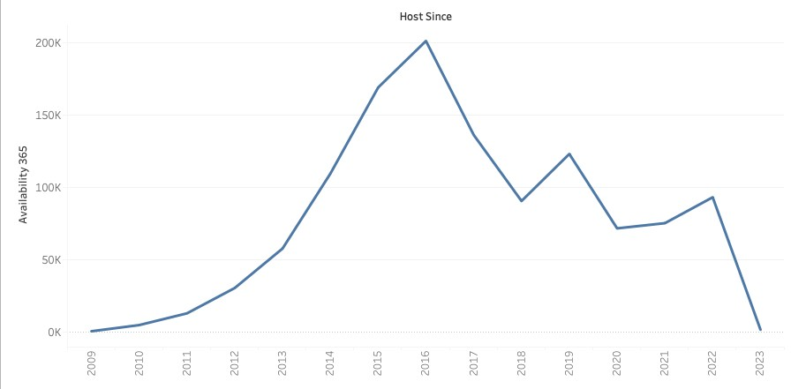
Availability

Slide 15
Recommendations
Since 2016, the yearly avilability is highly decreasing. Therefore,
it is important to work on Increasing the availability on yearly level.
Capacity of accomodation doesn’t have a proportional relationship
with the price.
The shared room type is the only type that can be affordable.
The response rate doesn’t affect the superhost status.
There is a strong and clear proportional relationship between the count of total reviews and the total listings count. Thus, giving more the opportunity for rating makes the hosts more popular.

Slide 16


