Slide 1

HOSPITAL MANAGEMENT DATABASE SYSTEM -

Slide 2
HOSPITAL MANAGEMENT DATABASE SYSTEM
A Comprehensive Solution for Healthcare Management
Presented by: Layba & Marwa
Group: 1
Course: BAI-443 Database Systems
Supervisor: Mr. Anwar Ali
Department of Computer Science
BBSUL University, Karachi

Slide 3
AGENDA
Presentation Agenda
Introduction & Problem Statement
System Design & Architecture
Database Schema & ER Diagram
Key Features & Modules
Implementation Details
Testing & Results
Conclusion & Future Work

Slide 4
INTRODUCTION
Why This System?
Inefficient Paper Systems
Manual Errors
Fragmented Data
Traditional paper-based systems are inefficient
Manual processes lead to errors and delays
No centralized patient information
Reporting Difficulty
Security Concerns
Difficulty in generating reports
Security and privacy concerns

Slide 5

PROBLEM STATEMENT
Key Challenges:
Slow Information Retrieval
Slow information retrieval (5+ minutes)
Data Redundancy
Data redundancy and inconsistency
Billing Errors
Manual billing calculations with errors
No Recovery Mechanism
No backup and recovery mechanism
Limited Scalability
Limited scalability
Lack of Real-time Analytics
Lack of real-time analytics

Slide 6
PROJECT OBJECTIVES
Project Objectives
1
2
3
Database Design
Patient Automation
Appointment Scheduling
Design normalized database (3NF/BCNF)
Automate patient registration & management
Implement appointment scheduling system
4
5
6
Financial Tracking
Medical Records
Data Security
Create billing & payment tracking
Develop medical records management
Ensure data security with encryption
7
Real-time Reporting
Generate real-time reports & analytics

Slide 7
SYSTEM ARCHITECTURE
Technology Stack
Component
Technology
Database
MySQL 8.0
Backend
PHP 7.4+
Frontend
HTML5, CSS3, JavaScript
Framework
Bootstrap 5
Web Server
Apache/Nginx

Slide 8
DATABASE DESIGN
Key Entities:
PATIENT
DOCTOR
Patient demographics & medical info
Doctor profiles & specializations
APPOINTMENT
MEDICAL_RECORD
Scheduling management
Diagnosis & treatment
BILLING
STAFF
Financial transactions
Employee management
DEPARTMENT
USER
Hospital departments
Access control

Slide 9
ENTITY RELATIONSHIPS
Entity Relationships
Relationship
Entities
Cardinality
Books
Schedules
PATIENT → APPOINTMENT
1:N
Books
Schedules
DOCTOR → APPOINTMENT
1:N
Schedules
Has
PATIENT → MEDICAL_RECORD
1:N
Has
Creates
DOCTOR → MEDICAL_RECORD
1:N
Creates
Generates
APPOINTMENT → BILLING
1:1
Generates
These relationships form the backbone of our relational database, ensuring data integrity and efficient querying.

Slide 10
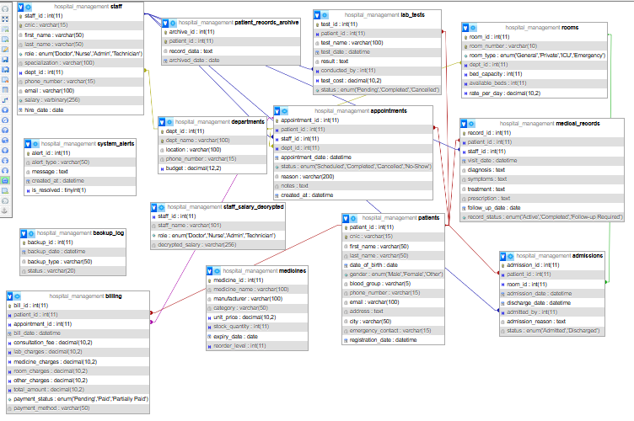
ENTITY DIAGRAM

Slide 11
NORMALIZATION
Achieved 3NF/BCNF
Normalization Steps
Benefits
1NF: Atomic values, no repeating groups
85%
—
2NF: No partial dependencies
3NF: No transitive dependencies
BCNF: Every determinant is a candidate key
Data Redundancy Reduction
Improved Integrity
Improved data integrity
Eliminated data redundancy by 85%
—
Easier Maintenance
Easier maintenance and updates

Slide 12
System Modules
The system is structured around six core modules, each designed for specific user roles and functions.
Module
Key Features
Admin
Complete system control, user management
Patient
Registration, history, appointments
Doctor
Schedule, medical records, prescriptions
Appointment
Booking, conflict detection, reminders
Billing
Invoicing, payments, financial reports
Staff
Employee records, salary (encrypted)

Slide 13
Key Features - Security
Security was a paramount concern in the system design, incorporating multiple layers of protection.
Role-based access control (RBAC)
AES-256 encryption for sensitive data
Password hashing with BCrypt
SQL injection prevention
Audit logging

Slide 14
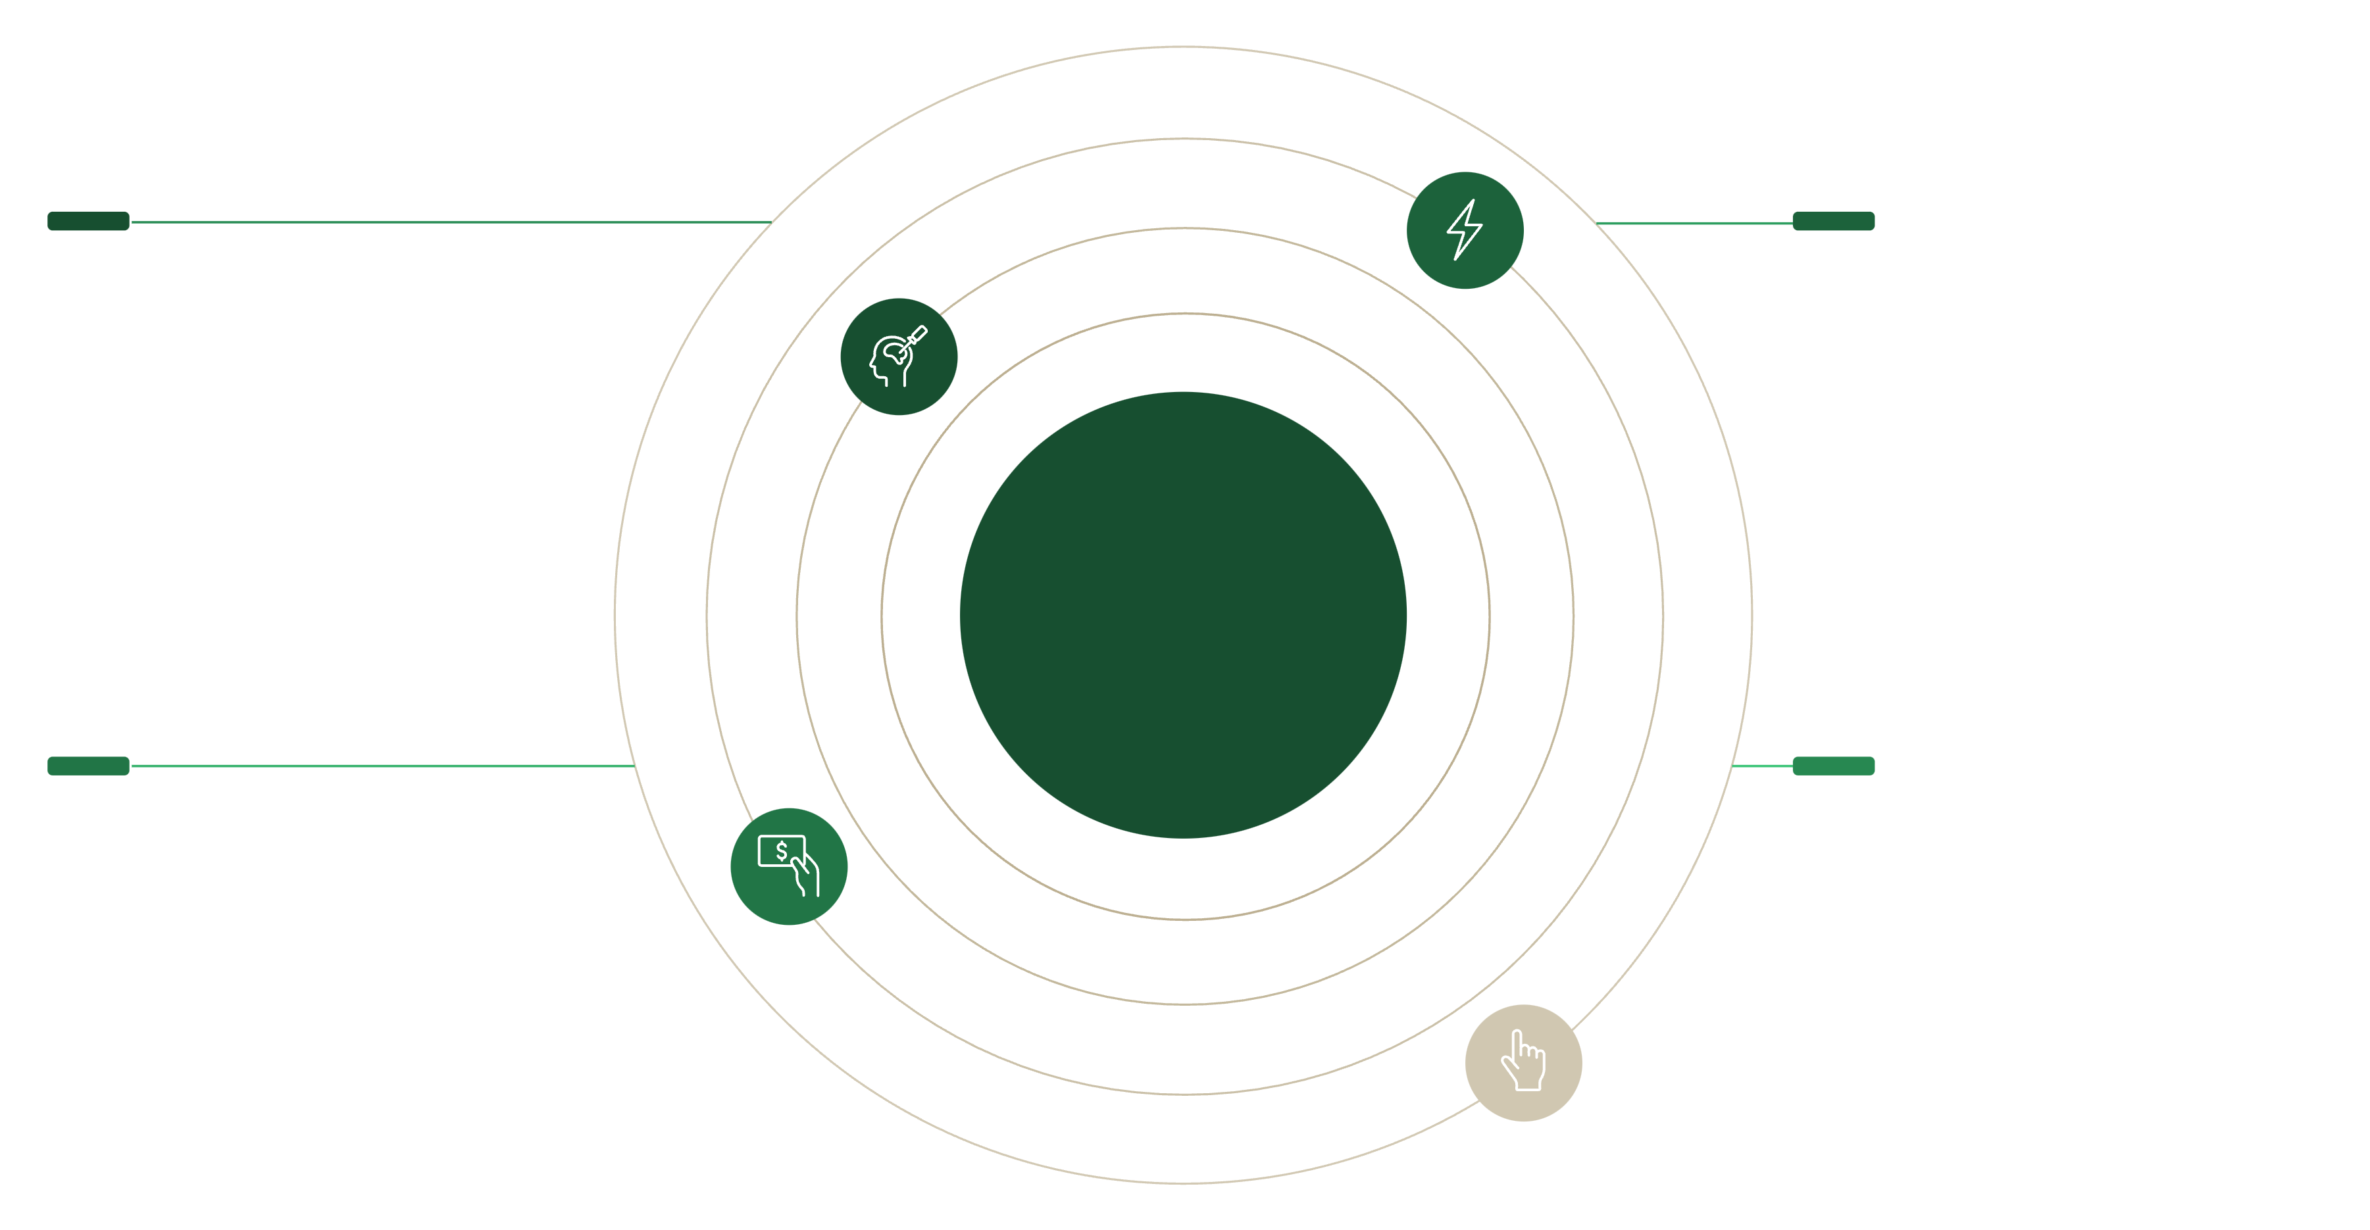
Advanced Database Features
Leveraging advanced database capabilities ensures performance, consistency, and integrity.
Performance & Efficiency
Integrity & Automation
Stored Procedures: 12 procedures for complex operations
Triggers: 5 automation triggers for data consistency
Indexes: 15 strategic indexes for performance
Transactions: ACID compliance for data integrity
Views: 6 reporting views for analytics
Stored Procedures
Triggers
Encapsulated logic for consistent operations
Automated responses to data changes
Database
Transactions
Indexes
Atomic units ensuring data integrity
Optimized lookup for query performance

Slide 15
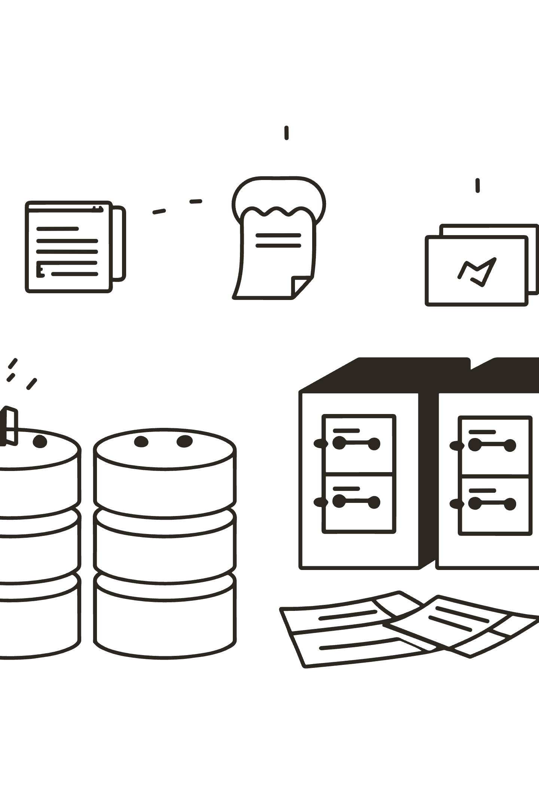
Implementation Highlights
1
Database Layer
8 normalized tables
Foreign key constraints for referential integrity
CHECK constraints for data validation
Default values and timestamps
2
Application Layer
MVC architecture pattern
Prepared statements for security
Responsive web interface

Slide 16
Testing & Results: Performance Metrics
The system exceeded all key performance targets during testing.
0.8 sec
100+
99.7%
93%
Response Time
Concurrent Users
Database Uptime
Query Performance
Target: < 2 sec
Target: 50+
Target: > 99%
Faster than baseline

Slide 17
Benefits Realized: Operational Efficiency
The new system dramatically reduces time spent on critical administrative tasks.
Patient Registration
15 min
2 min
85% faster
Record Retrieval
5 min
15 sec
95% faster
Billing Process
20 min
2 min
90% faster
Report Generation
2 hours
2 min
98% faster

Slide 18
Testing & Security
Security Testing Results
All Security Tests Passed ✓
SQL Injection: All attack vectors blocked
Authentication: BCrypt hashing working
Access Control: RBAC properly enforced
Data Encryption: AES-256 verified
Session Security: Auto-logout implemented
Security Incidents: Zero during testing

Slide 19
Challenges Overcome
Key hurdles successfully navigated during development:
Designing normalized schema while maintaining performance
Implementing complex business logic through triggers
Balancing security with usability
Ensuring data consistency across concurrent transactions
Optimizing queries for large datasets
Handling CNIC and Pakistani phone number formats
k

Slide 20
Conclusion
Successfully designed & implemented normalized database
Achieved 93% query performance improvement
Reduced operational time by 85-98%
Zero security incidents during testing
High user satisfaction (4.6/5.0)
Ready for real-world deployment
This system demonstrates how proper database design creates powerful healthcare solutions.
Thank You!
Presented by: Layba & Marwa
Group 1 - BSAI 4th Semester
Supervisor: Mr. Anwar Ali
Department of Computer Science
BBSUL University, Karachi

