Slide 1
A Visual Hashing scheme for TrustID
Master’s Project at ELCA – Adrien Laydu

Slide 2
Presentation outline
Context
Problem
Project goal
(Maybe) Existing schemes
Our new approach – Fourier hash
Discussion
Further improvements

Slide 3
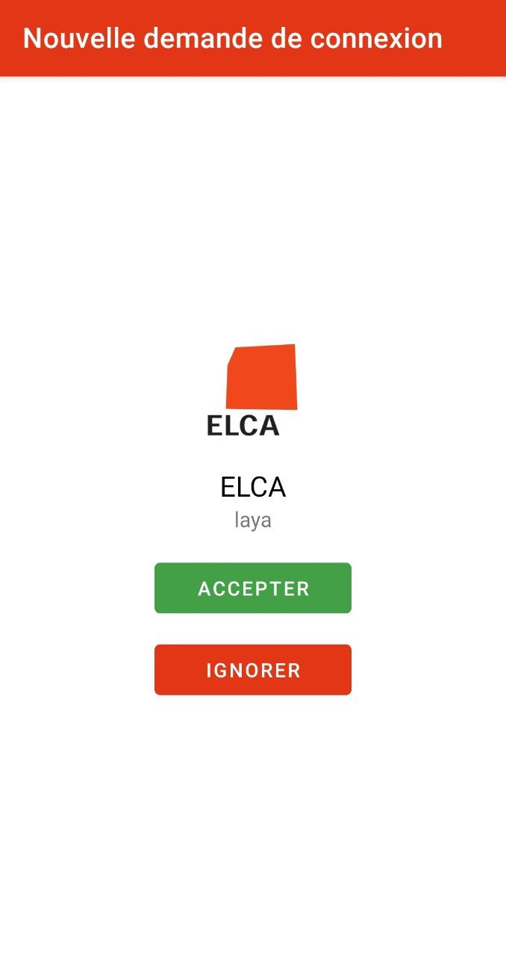
Context
Currently, TrustID offers only an «accept» button during transaction validation
For the user: no way to ensure that the transaction is the one they initiated.
Risk of errors, or attacks.

Slide 4


Transaction verification
We use a cryptographic hash function to verify a transaction: each transaction gets an identifier (a tag).
The user checks that the transaction they accept on their phone is the right one
75b9…2fa0c
75b9
…
2fa0c

Slide 5
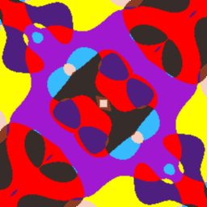
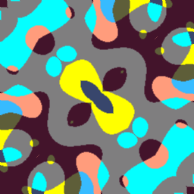
Project goal
Problem: most users would probably not bother compare strings
Solution (?): encode the hash as a picture so that differences instantly pop to the eye
75b9bce343839d7faa6c3e0c9152fa0c
75b9bce34383957faa6c3e0c9152fa0c

Slide 6
What we want to avoid
Different hashes -> close images

Slide 7
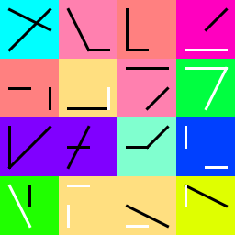
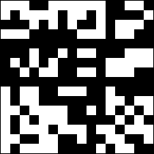
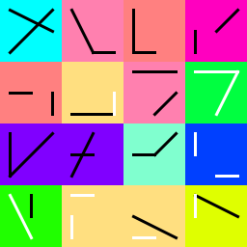
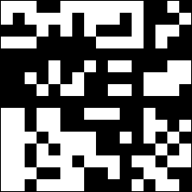
Existing schemes – Deterministic
Map bits (or groups of bits) to pixels, shapes and colors
Problem: 256 (or even 128) bits is A LOT of information (remainder : comparison)

Slide 8
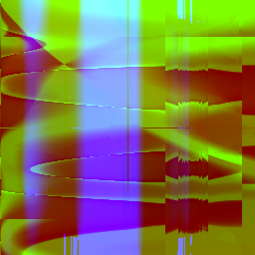
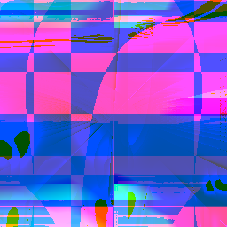
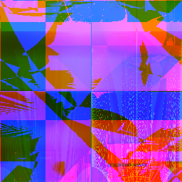
Existing schemes – PRNG-based
Idea : seed a PRNG with the input hash and let randomness do the job
All the information is used
Offer no guarantee
Must trust the PRNG

Slide 9
A word about Fourier transforms
Fourier transform maps functions to frequences, and its inverse maps frequences back to a (unique) function.
A picture can be considered a 2D function.
Spectrum concentrated around the axes -> less noisy images, easier to process for humans

Slide 10
Fourier Hashing - 0
Mapping bits to fréquences
Same importance for every bit

Slide 11
Our scheme – Fourier Hashing
Instead of generating an image, we generate a 2D Fourier spectrum.
To get enough information, we repeat the process 3 times.

Slide 12
Our scheme – Fourier Hashing 2
Once the functions are generated, we sample the colors directly from the hash.

Slide 13
Our scheme – Fourier Hashing 3
Finally, we add symmetry, to help recognizability.
The symmetry mode (e.g vertical, horizontal, diagonal,…) is extracted from the hash

Slide 14
Discussion
Main issue: no definite metric to assess whether two outputs are close
The scheme is heavily assumption-based

Slide 15
Next steps
Implementation
Formalisation
Testing ?

