Slide 1
A Visual Hashing scheme for TrustID
Master’s Project at ELCA – Adrien Laydu

Slide 2
Presentation outline
Context
Problem
Project goal
(Maybe) Existing schemes
Our new approach – Fourier hash
Discussion
Further improvements

Slide 3
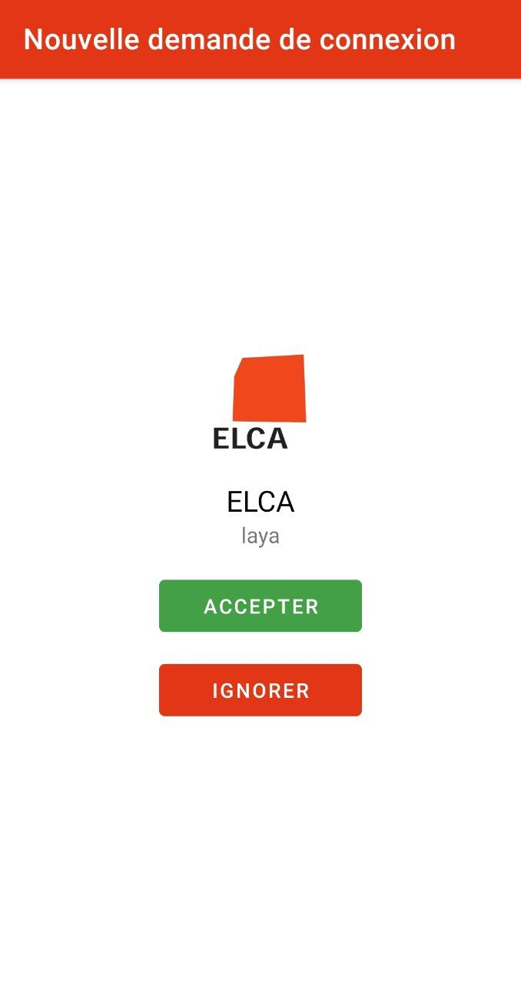
Context
Currently, TrustID offers only an «accept» button during transaction validation
For the user: no way to ensure that the transaction is the one they initiated.
Risk of errors, or attacks.

Slide 4
Transaction verification
We use a cryptographic hash function to verify a transaction: each transaction gets an identifier (a tag).
The user checks that the transaction they accept on their phone is the right one
h1 = 75b9bce343839d7faa6c3e0c9152fa0c
h2 = 75b9bce34383957faa6c3e0c9152fa0c
Problem: digests are cumbersome to compare -> most users would probably not bother
Solution (?): encode the hash as a picture so that differences pop instantly to the eye

Slide 5
Project goal
Schema ?

Slide 6
Existing schemes
Determistic schemes are often not diverse enough
Random schemes offer no guarantees

Slide 7
A word about Fourier transforms
Fourier transform maps functions to frequences, and its inverse maps frequences back to a (unique) function.
A picture can be considered a 2D function.
Pictures with spectra concentrated around the axes are less noisy, thus easier to process for humans

Slide 8
Our scheme – Fourier Hashing
Instead of generating an image, we generate a 2D Fourier spectrum.
To get enough information, we repeat the process 3 times.

Slide 9
Our scheme – Fourier Hashing 2
Once the functions are generated, we sample the colors directly from the hash.

Slide 10
Our scheme – Fourier Hashing 3
Finally, we add symmetry, to help recognizability.
The symmetry mode (e.g vertical, horizontal, diagonal,…) is extracted from the hash

Slide 11
Discussion
Main issue: no definite metric to assess whether two outputs are close
The scheme is heavily assumption-based
Main challenge: every bit of the hash must have the same «importance» in the process of the image generation

