Slide 1

Visual Hashing for TrustID
Adrien Laydu
Internal Presentation
11.05.2022
Master’s Project at ELCA

Slide 2
Context
Project Goal
First approaches
Our new approach: Fourier Hashing
Current results
Future work
01
02
03
04
05
06

Slide 3
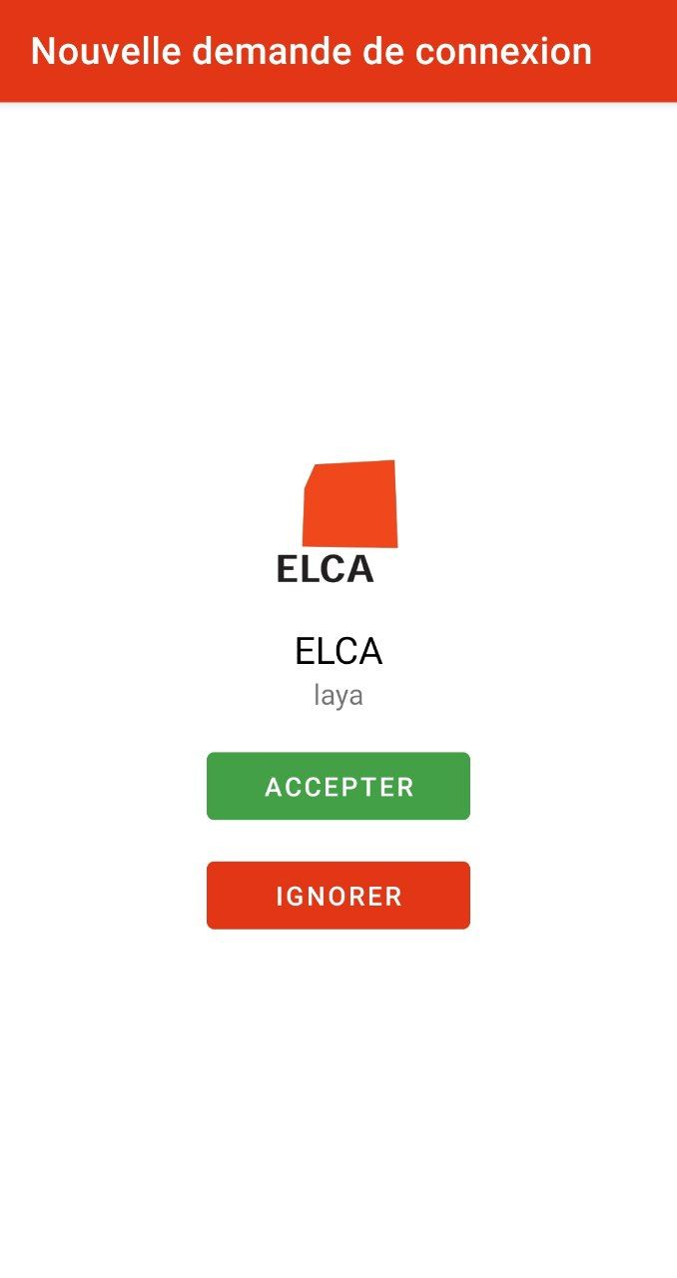
Context
Currently, TrustID offers only «accept» and «deny» buttons during the express-of-will step
No way for the user to identify what they are accepting
Risk of attacks or errors

Slide 4


Transaction verification
We use a cryptographic hashing function to verify a transaction: each transaction gets an identifier (hash).
The user checks that the hashes are the same.
75b9…2fa0c
75b9
…
2fa0c

Slide 5
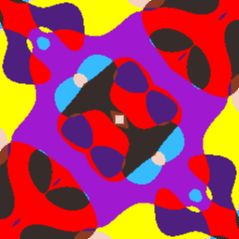
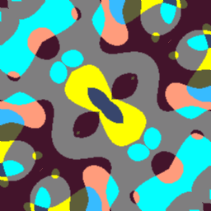
Transaction verification
75b9bce343839d7faa6c3e0c9152fa0c
75b9bce34383957faa6c3e0c9152fa0c
Problems:
Strings are hard to compare
Most users would probably not even try
One solution:
Generate an image from the hash so that differences instantly pop to the eye

Slide 6
Visual Hashing Terminology
Hash : 10010101011…1010
Fingerprint :
Visual hashing: produce a fingerprint from a hash.
Distance between hashes: #bits that are different between them

Slide 7
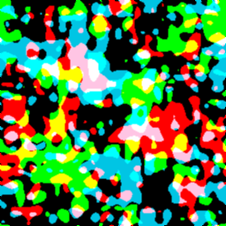
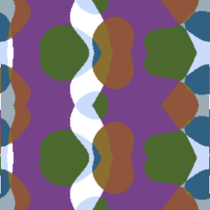
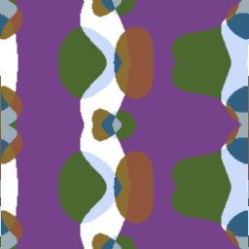

Goal of the project
Design a visual hashing scheme such that comparison between fingerprints is easy
Fingerprints are "simple", aesthetic images
Two different hashes produce "different enough" fingerprints
1cfa48…3b1d
338ee2…aa14

Slide 8
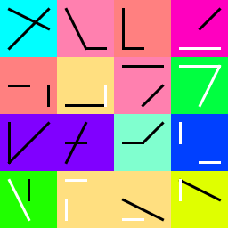
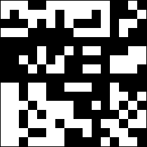
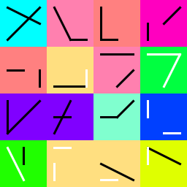
First approach – Naive
Map bits (or groups of bits) to pixels, shapes and colors
Problem: every bit of the hash must have a significant impact on the fingerprint
  256 (or even 128) bits is a lot for a limited visual space
11100111111…

Slide 9
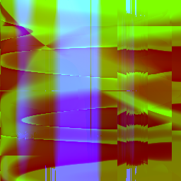
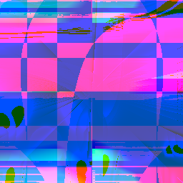
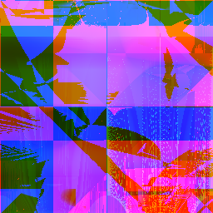
Second approach – PRNG-based
Idea: seed a PRNG with the input hash and let randomness do the job
Pro:
  Every bit of information used
Cons:
  Must trust the PRNG
  No guarantee on visual distance
0b1111
0b1101
0b1100
$$f\left(x,y\right)= \sqrt{x} −y+(xy −\sin\left(x^{2} mod ….\right)))$$

Slide 10
Fourier Hash

Slide 11


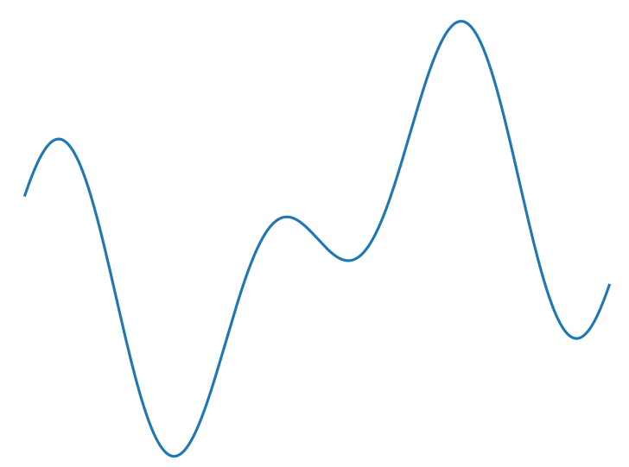
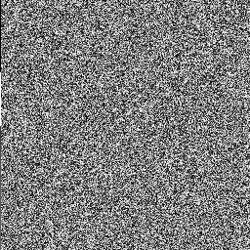
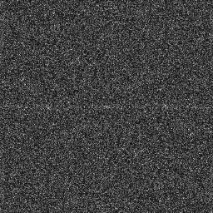

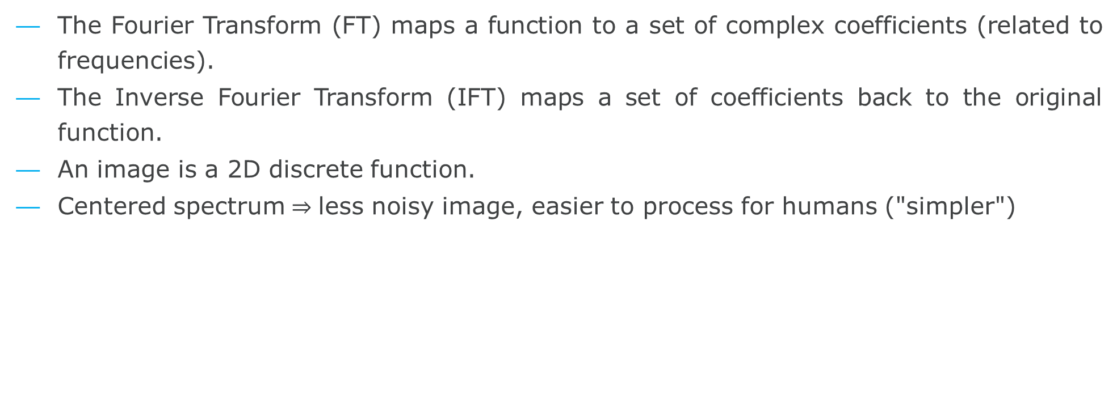


Fourier Transform
The Fourier Transform (FT) maps a function to a set of complex coefficients (related to frequencies).
The Inverse Fourier Transform (IFT) maps a set of coefficients back to the original function.
An image is a 2D discrete function.
Centered spectrum less noisy image, easier to process for humans ("simpler")
FT
…
$$r_{0}e^{iθ_{0}}$$
$$r_{1}e^{iθ_{1}}$$
$$r_{2}e^{iθ_{2}}$$
IFT

Slide 12

Fourier Hash
Instead of generating an image, we generate a 2D array of coefficients. We can do it fast (FFT).
Problem: not all coefficients are equally impactful.
Solution: use every group of bits twice to equalize their distance to center
$$re^{iθ}$$
110110101………1110110

Slide 13
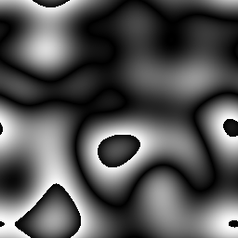
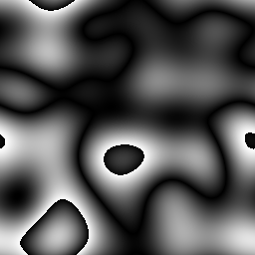
Fourier Hash
1 bit
Observations:
  The difference is VERY subtle
  High contrast zones catch the eye

Slide 14


Fourier Hash
Observation:
  The difference is visible, but not at first glance
We are using ~40 bits of information: not enough!

Slide 15


Fourier Hash
Observations:
  Ever-so-slightly better, but far from goal yet.
Let us diversify colors.

Slide 16

Fourier Hash
1101…1110

Slide 17
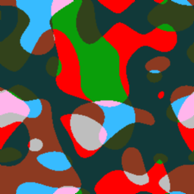
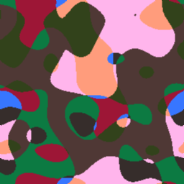
Fourier Hash
Observations:
  The difference is clear (for most people).
  We can still do better.

Slide 18


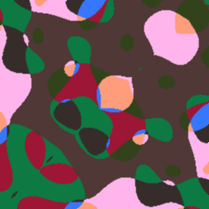
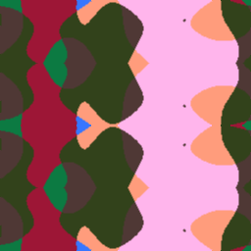
Fourier Hash
We add symmetry to the fingerprints.
Assumption: we do not introduce too many collisions.
1101…1110

Slide 19

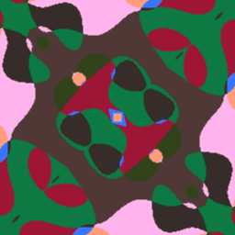
Fourier Hash
Observations:
  The result achieves a satisfying level of difference.

Slide 20
Fourier Hash
3x
1101…1110
IFT
Filter

Slide 21


Fourier Hash – Current results
128-bit hashes only
Idea: higher distance between hashes -> higher difference between spectra -> higher difference between fingerprints (to be proven)
Worst case scenarios when few bits are changed
Distance | 1 bit | 2 bits | n bits, n odd | n bits, n even
Functions (shapes) | Very small diff | Small diff | Diff grows with n | Diff grows with n
Palette (colors)
Symmetry
Change
OR

Slide 22
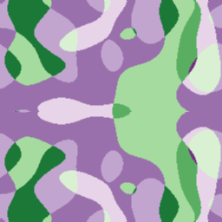
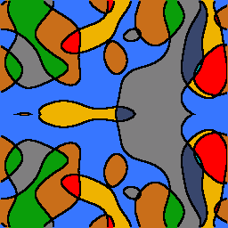
Future work
Implement Fourier Hash into TrustID
Take colorblindness into account
Number of bits
Formalize and prove as much as possible
Testing ?

Slide 23

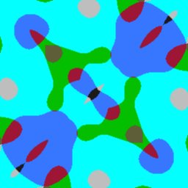


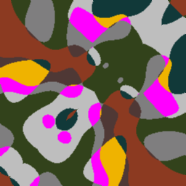

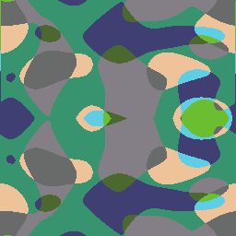
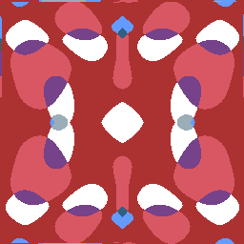

Thank you for listening !
Any questions ?

Slide 24
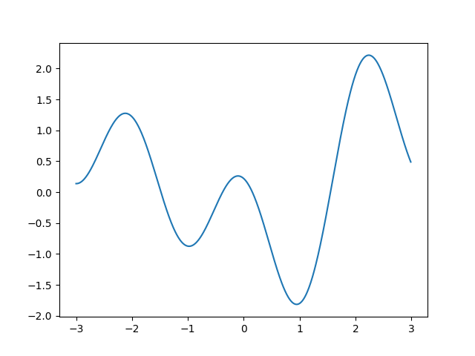
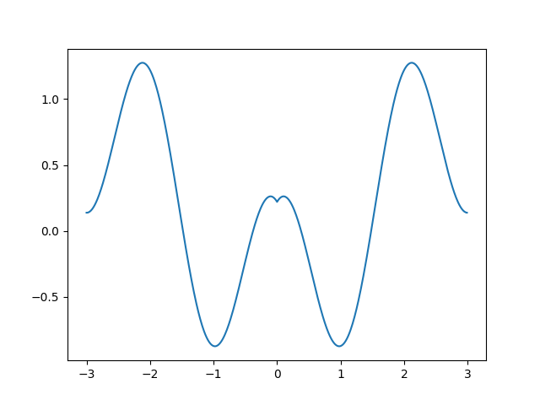
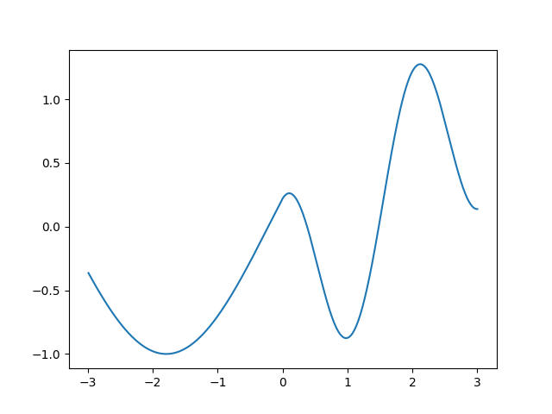
Insights about symmetry
Idea : not enough precision to create too much collisions easily.
8
5
9
22
8
5
9
11

Slide 25
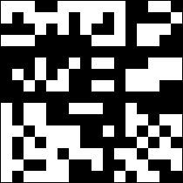
Naive scheme
75 bits of distance

Slide 26
Quick pros and cons
Good results and guarantees
Fast computation of images
Based on assumptions
Hard to test

