Slide 1
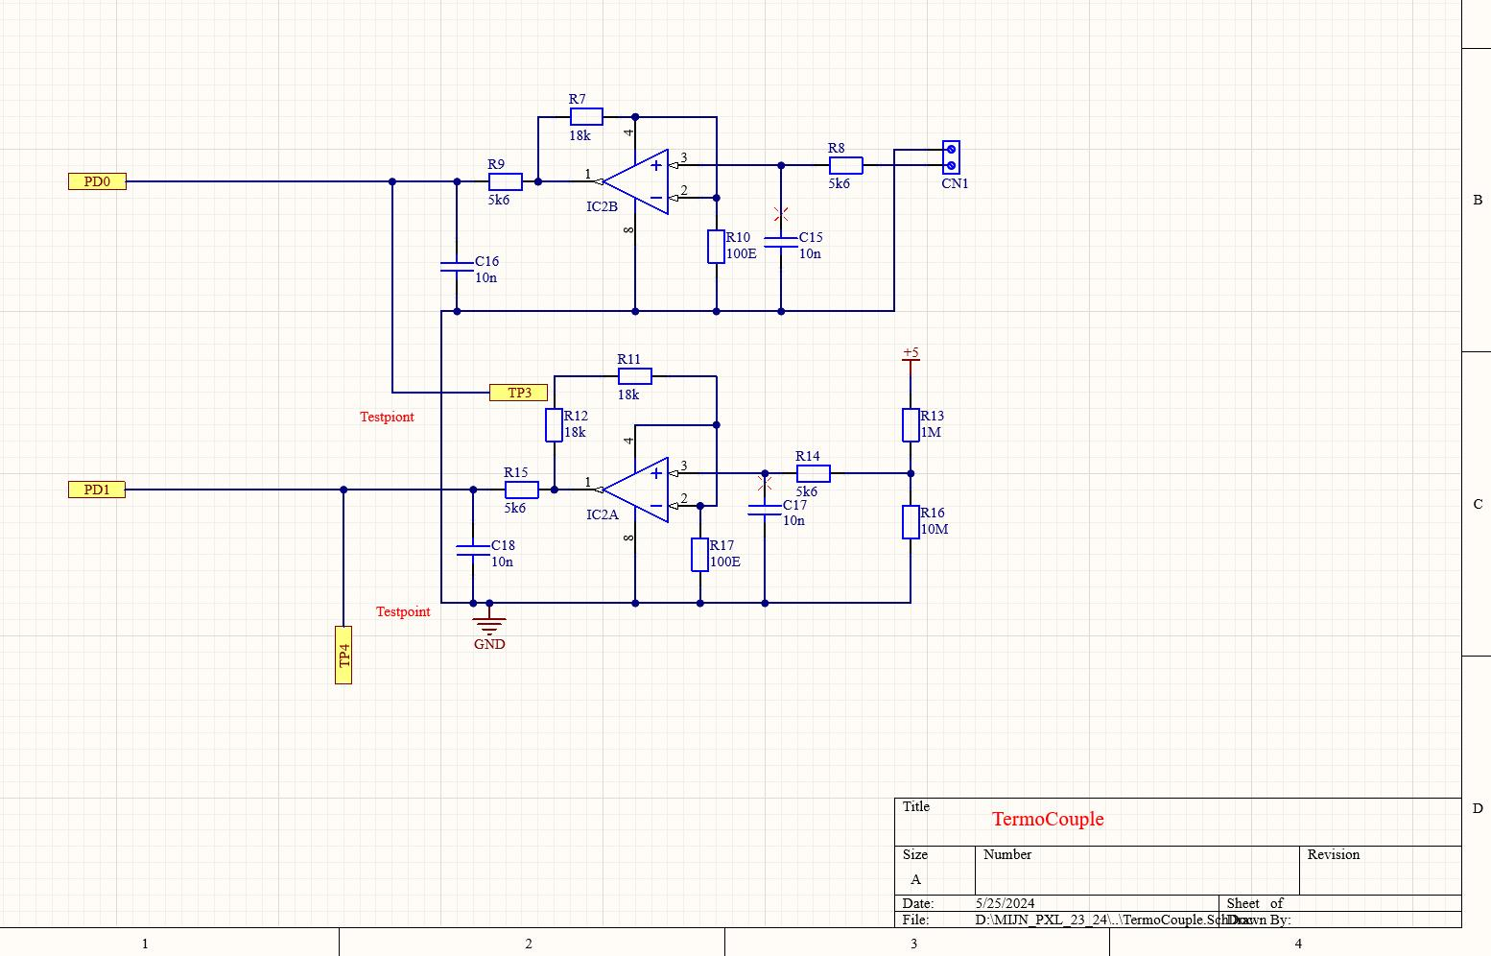
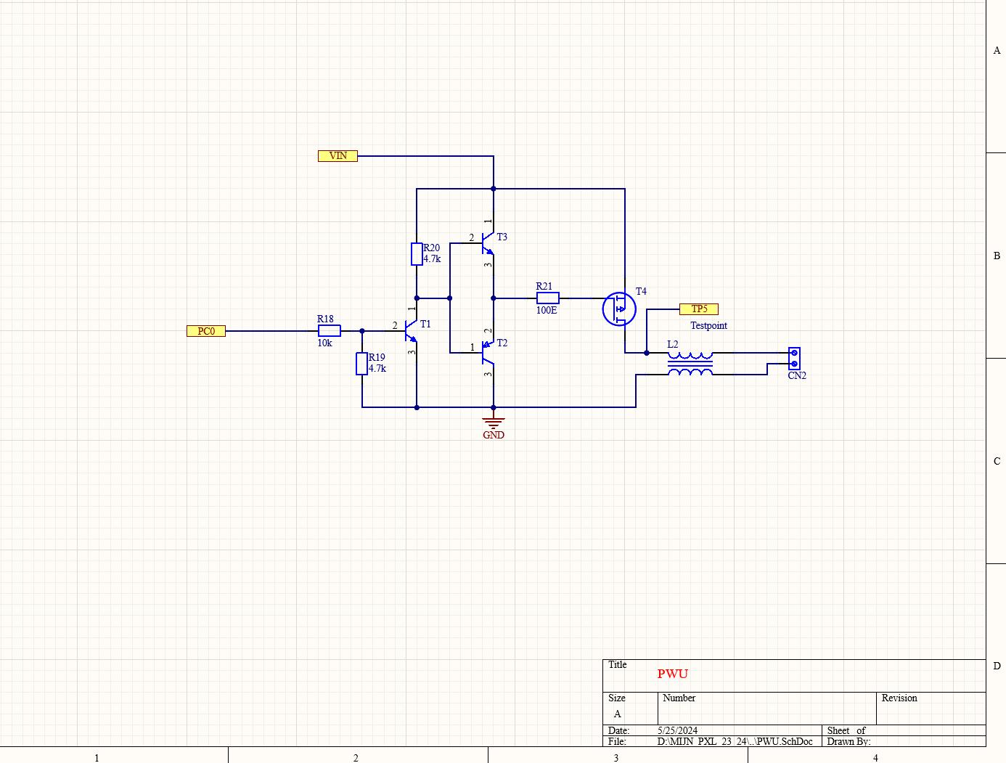
Overview of the PCB Design
Laye Aziz Kone
Thermocouple, PWU, CPU, and Power Supply
Thermocouple:
Monitors and controls temperature
PWU (Power Unit):
Manages power distribution

Slide 2
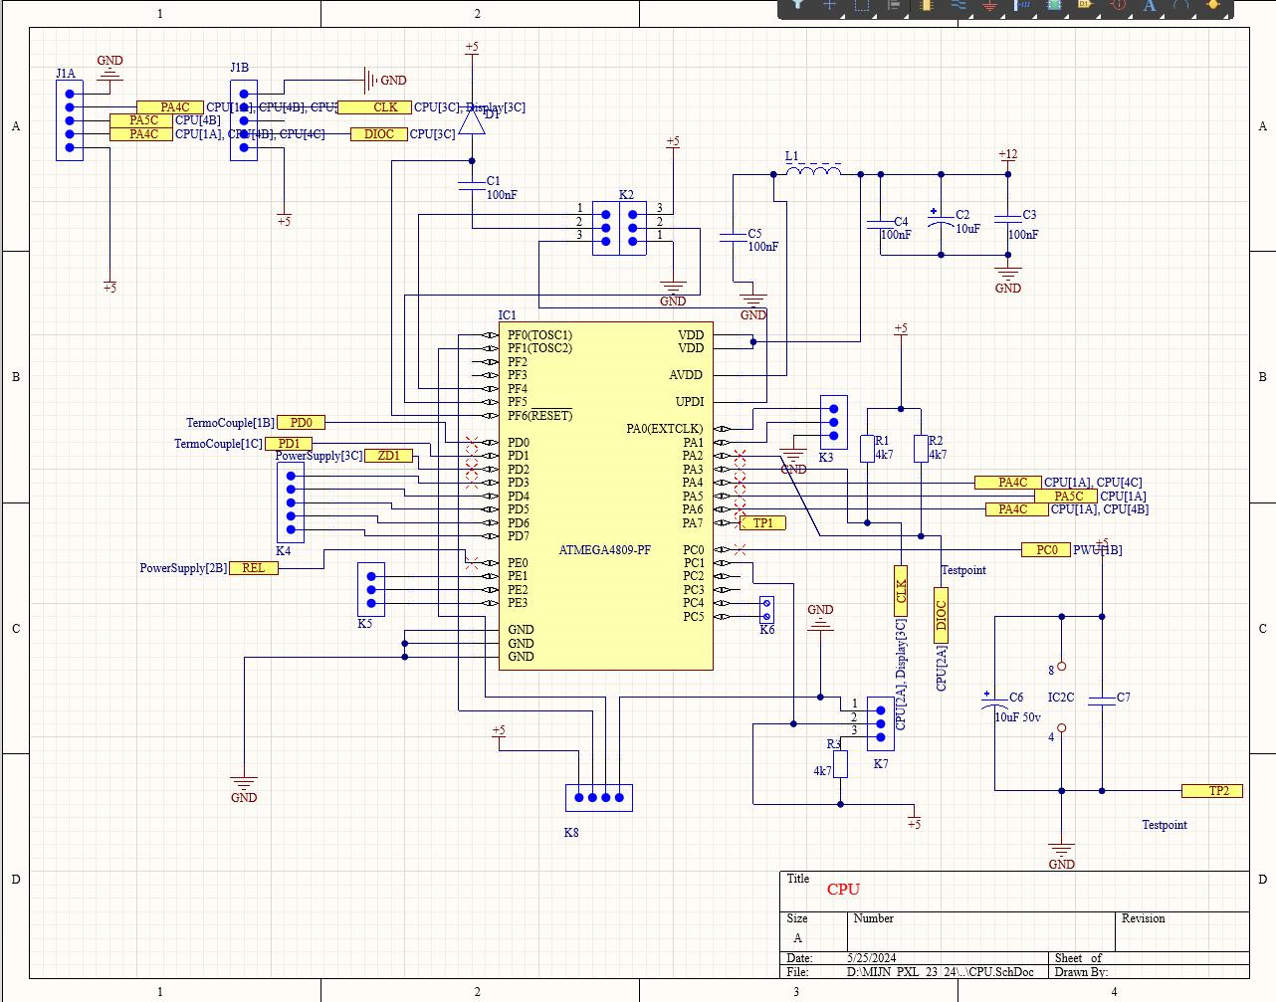
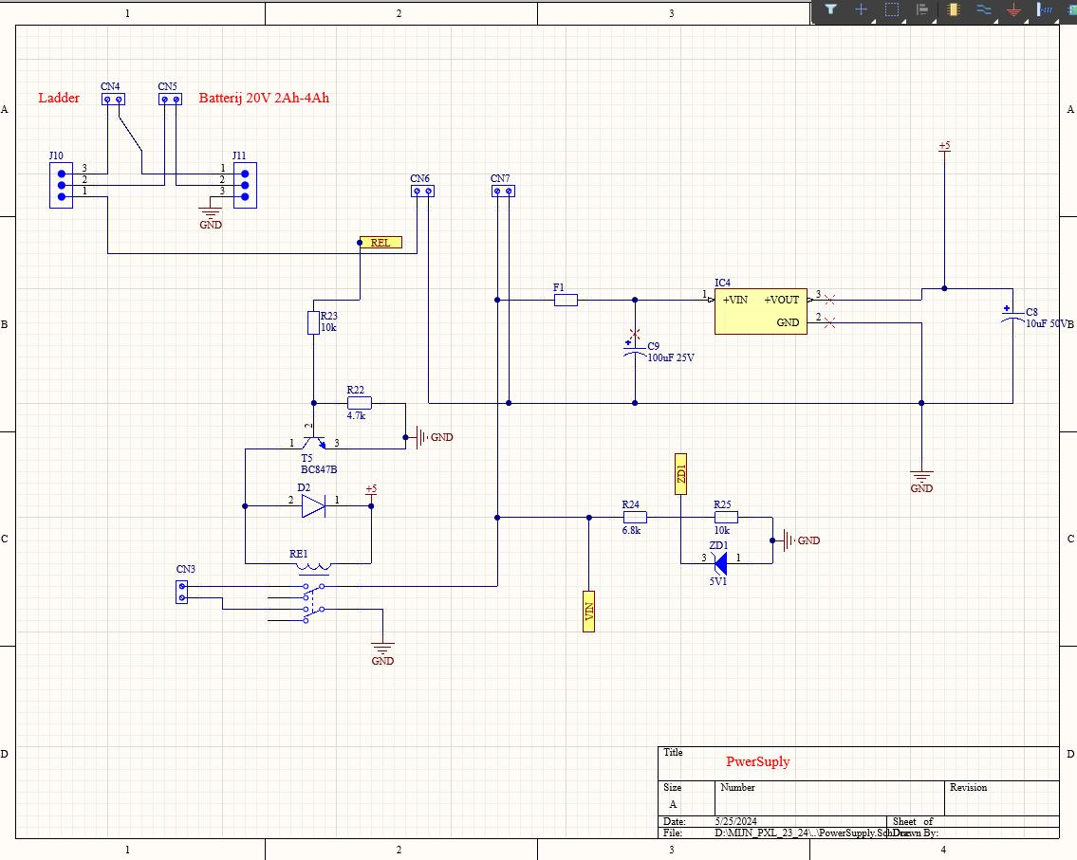
Overview of the PCB Design
Laye Aziz Kone
Thermocouple, PWU, CPU, and Power Supply
CPU: Central processing unit
Power Supply:
Provides necessary voltages

Slide 3
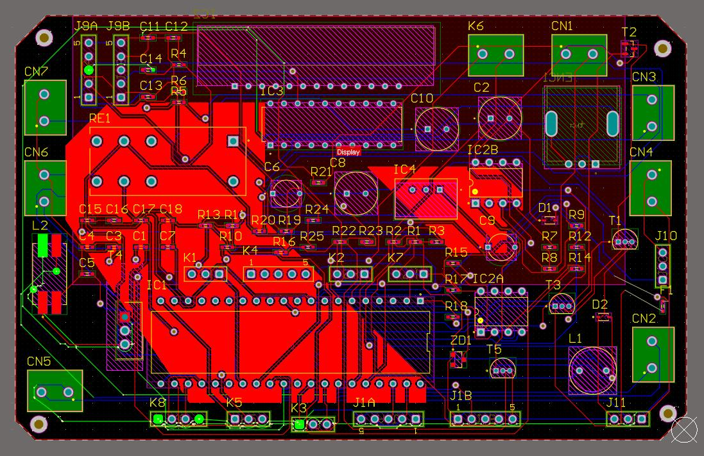
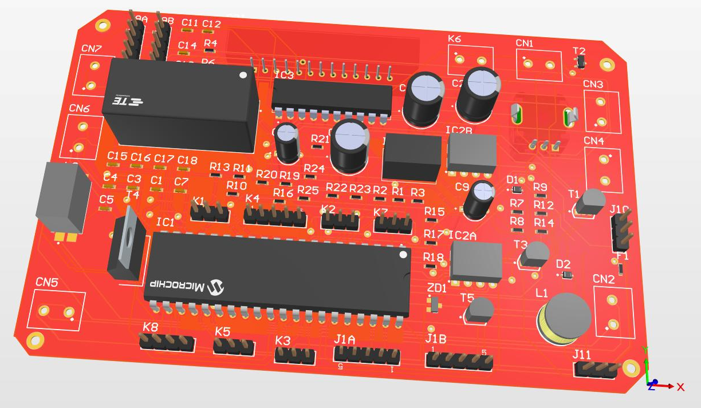
Overview of the PCB Design
Laye Aziz Kone
PCB Layout and Components
PCB Layout - Major sections: Power supply, control section, connectors
Key Components: - Resistors and Capacitors: Control current and stabilize voltages (R1, R2, C1, C2) - Integrated Circuits (ICs): Main processing units (IC1, IC2B) - Connectors: Interface points for external connections (CN1, CN2)

Slide 4
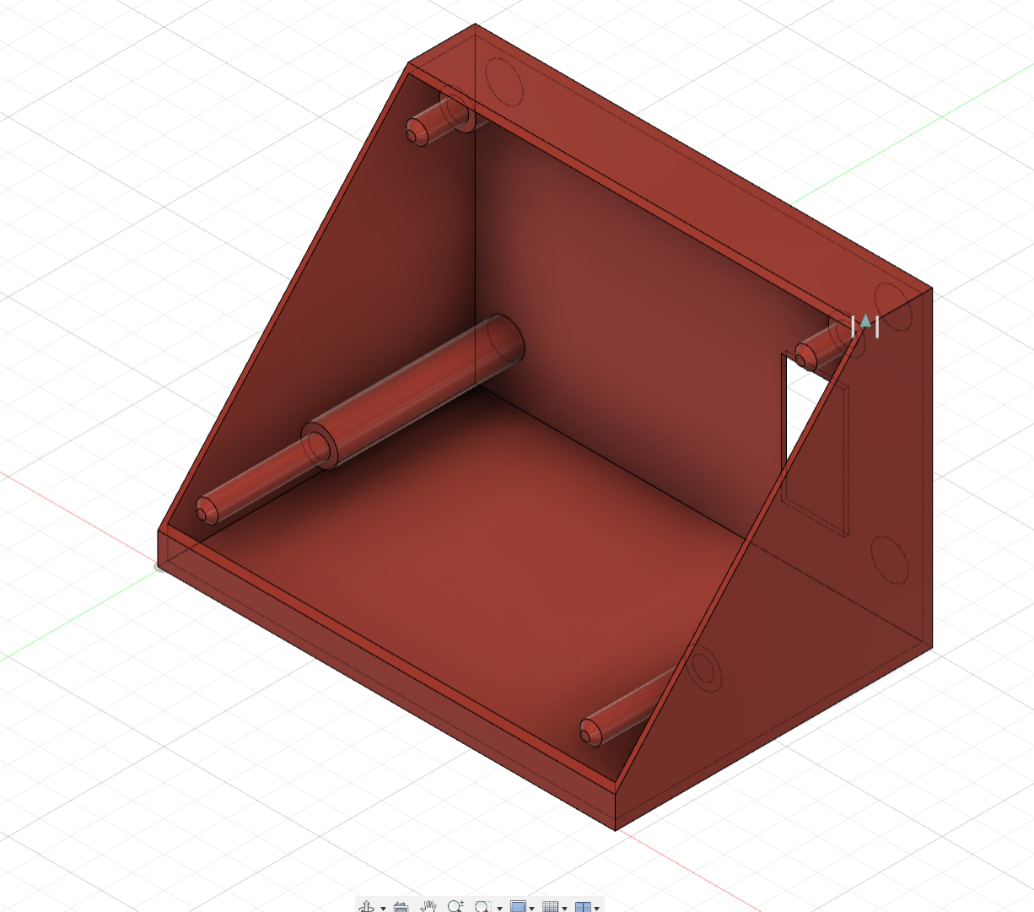
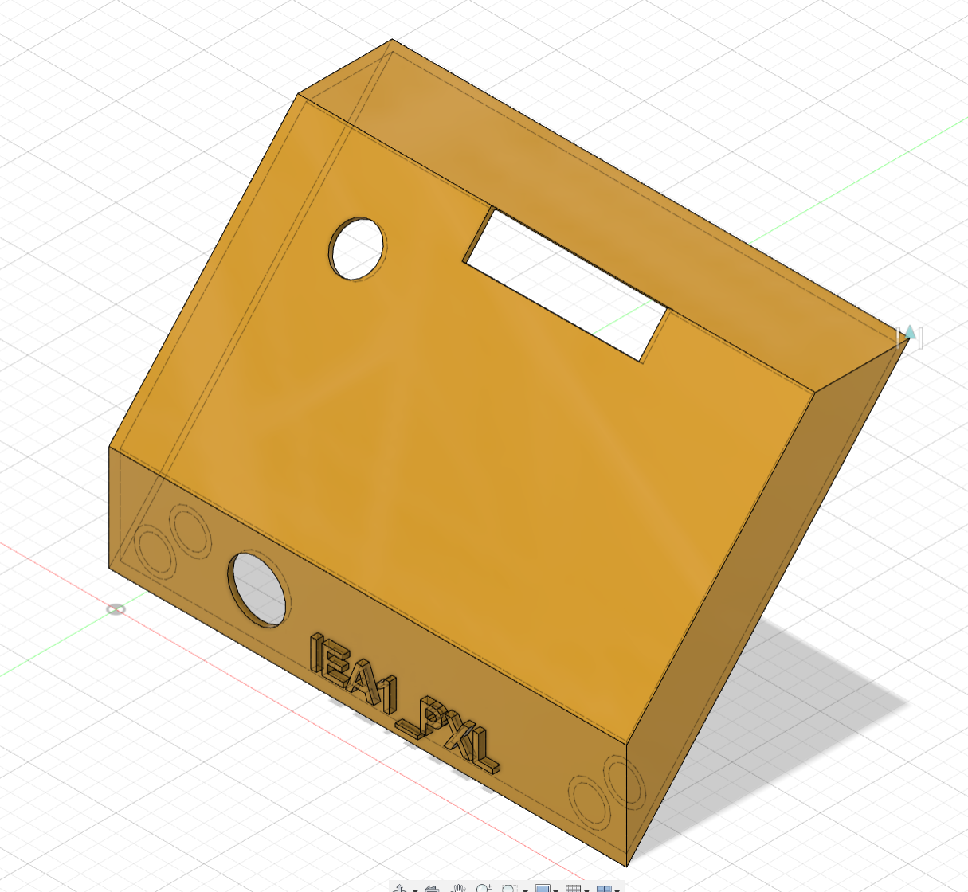
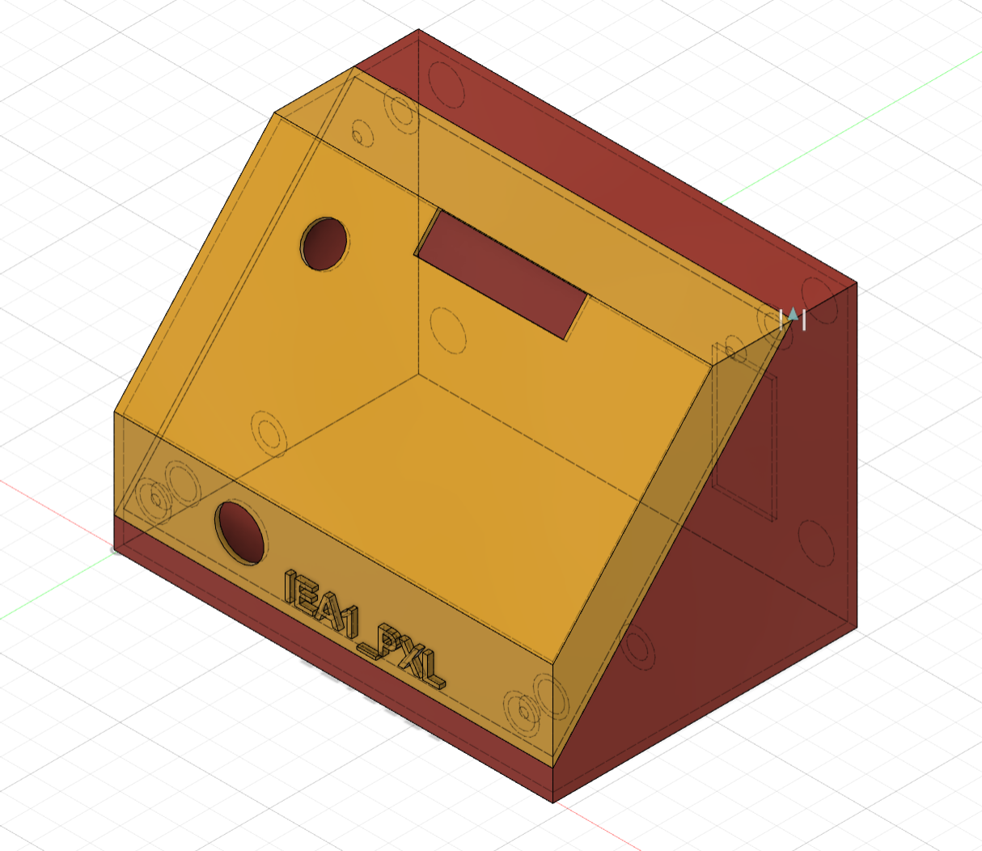
Overview of the PCB CASE
Laye Aziz Kone
3D Model Design for Custom Enclosure: Front and Side View
Back panel and base plate for structural support
Front and side panels, including the angled front face and port openings
Front and side panels, including the angled front face and port openings

Slide 5
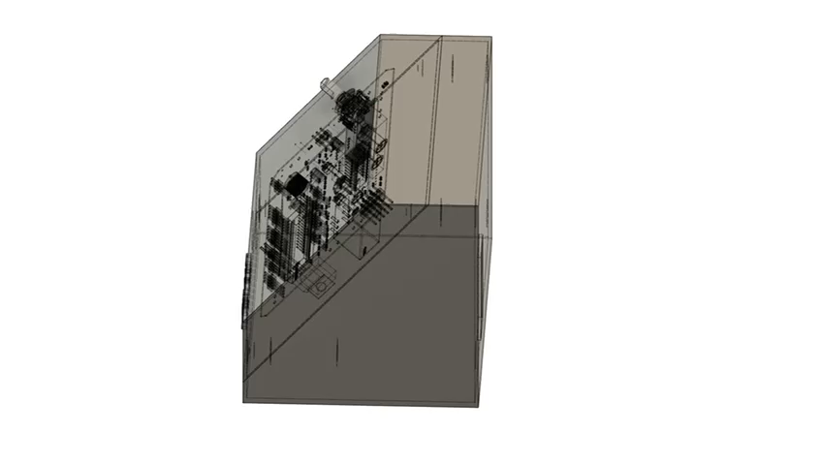
Overview of the PCB Design
Laye Aziz Kone
Internal View of Custom Enclosure with Mounted PCB
Key Features:
PCB Mounting: The red PCB is securely mounted within the enclosure
Component Protection: Ensuring the electronic components are well-protected within the enclosure

