Slide 1
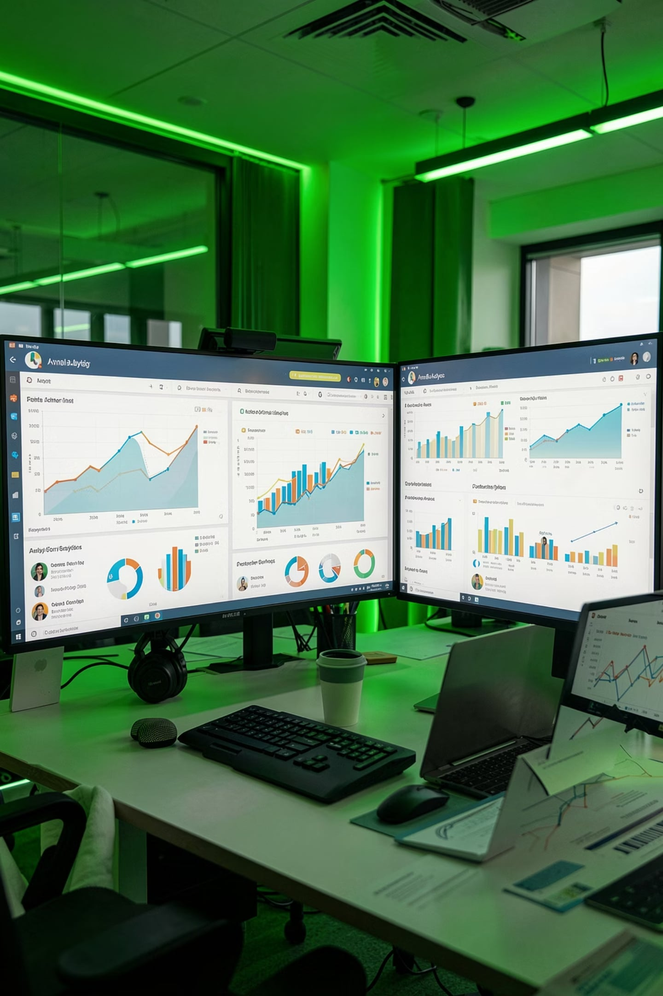
Customer Shopping Behavior Analysis
End-to-end analytics on 3,900 transactions — uncovering patterns in revenue, demographics, and purchasing behavior.
PYTHON · POSTGRESQL · POWER BI

Slide 2

Business Objective
Revenue Trends
Track spending patterns by gender, age, and season
Customer Insights
Demographics, subscriptions & loyalty behavior
Product Performance
Top products, ratings & discount impact
Actionable Strategy
Optimize marketing, retention & revenue growth

Slide 3
Dataset at a Glance
3,900
18
37
Records
Attributes
Missing Values
Review Rating column
Key Features
Age, Gender, Location, Subscription Status
Item, Category, Purchase Amount, Season
Discount, Promo Code, Review Rating
Purchase Frequency, Shipping Type

Slide 4
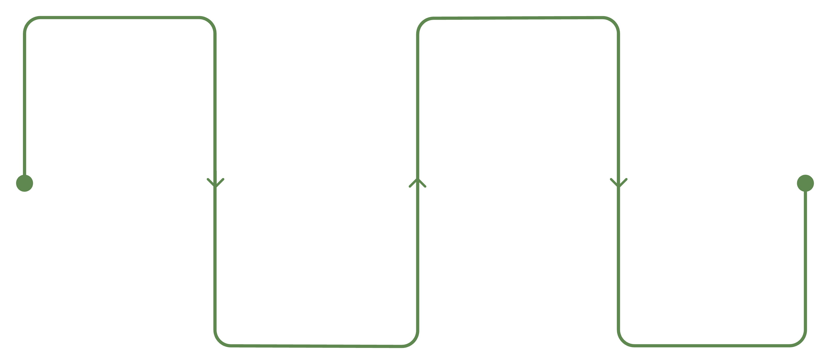
Data Cleaning & Preprocessing
Load Data
Standardize
Read CSV into Pandas
Convert column names to snake_case
Handle Missing
Feature Eng
Impute median by category
Create age group and purchase freq
Redundant Promo Code Used column removed. Cleaned data loaded into PostgreSQL via SQLAlchemy.

Slide 5
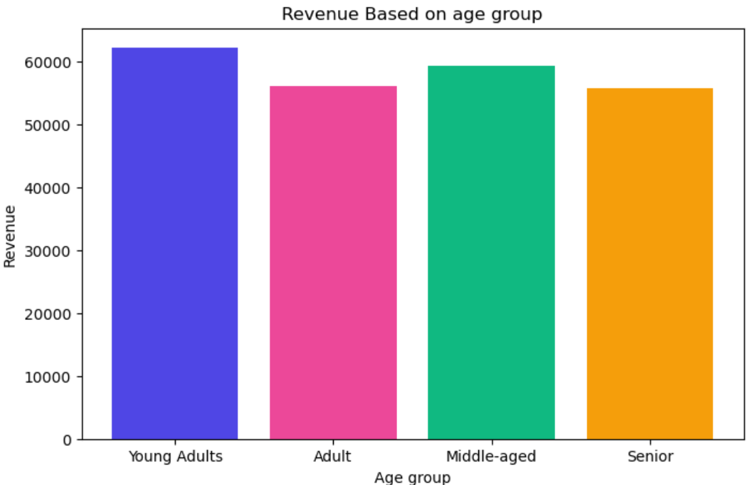
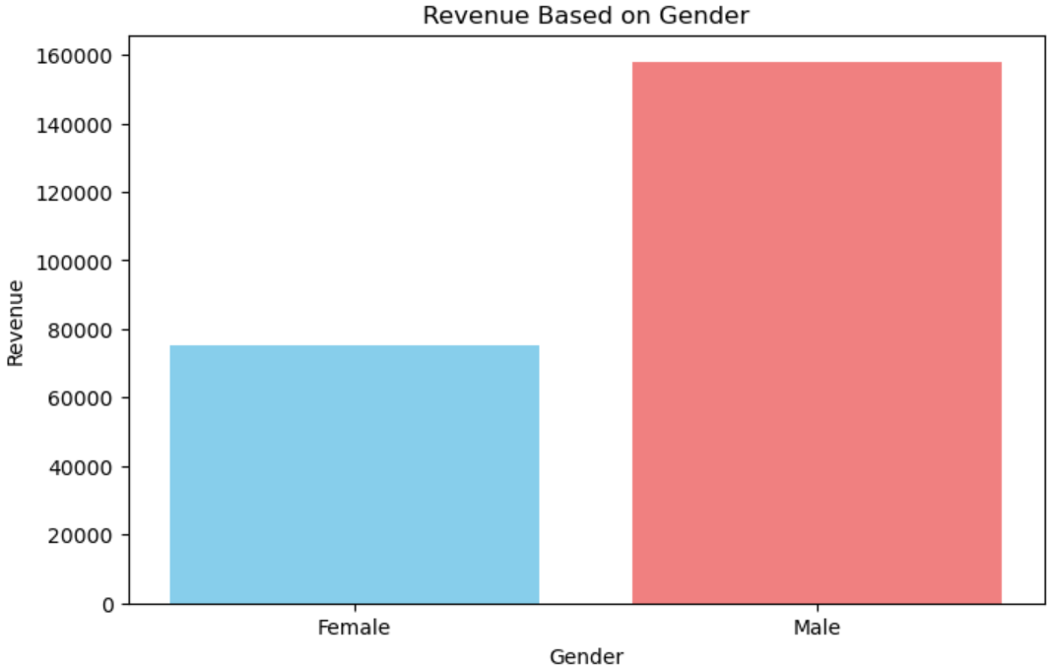
Revenue Analysis
By Age Group
By Gender
Adult and young adult customers generated the majority of overall revenue.

Slide 6
Customer & Product Insights
Subscribers Spend More
Top-Rated Products
Discount Dependency
Higher average spend vs. non-subscribers
Top 5 products by rating & most-purchased per category
Certain products rely heavily on discounts to drive sales

Slide 7
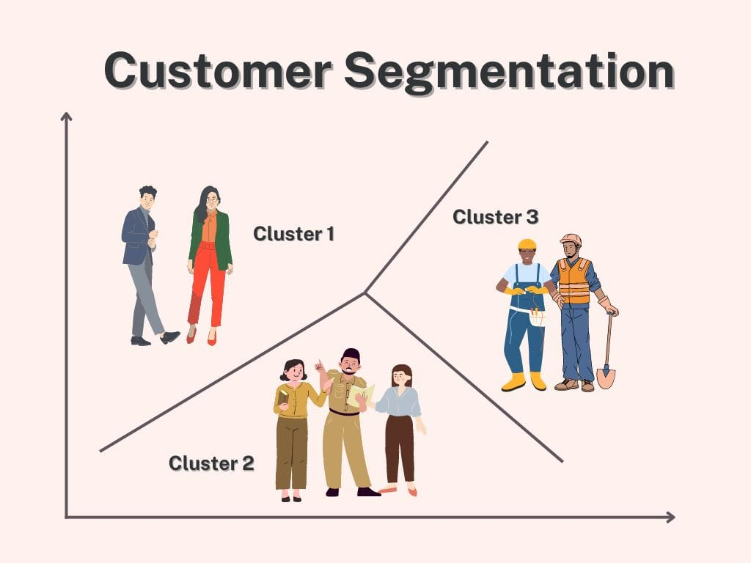

Customer Segmentation
Three Customer Groups
New Customers
Fewer previous purchases
Returning Customers
Moderate purchase history
Loyal Customers
Large share of total purchases

Slide 8





Power BI Dashboard
Revenue Overview
Demographics
Purchase Trends
Product Performance
Interactive Filters

Slide 9

Key Findings & Recommendations
Boost Subscriptions
Exclusive discounts & premium benefits
Strengthen Loyalty
Retain high-value repeat customers
Optimize Discounts
Improve profitability while maintaining engagement
Target High-Value Segments
Focus on adult & young adult revenue drivers
Promote Express Shipping
Higher purchase values linked to faster delivery

Slide 10

Tools & Conclusion
Tech Stack
End-to-End Workflow
From raw data to interactive insights — this project demonstrates a complete analytics pipeline supporting data-driven business decisions.
Python / Pandas
Cleaning & Preprocessing
SQLAlchemy
Database Connectivity
PostgreSQL
SQL Analysis
Prepared by Deepika Layek — Data Analyst | Python | SQL | Power BI | PostgreSQL
Power BI
Dashboard Development
Git / GitHub
Version Control

