Slide 1

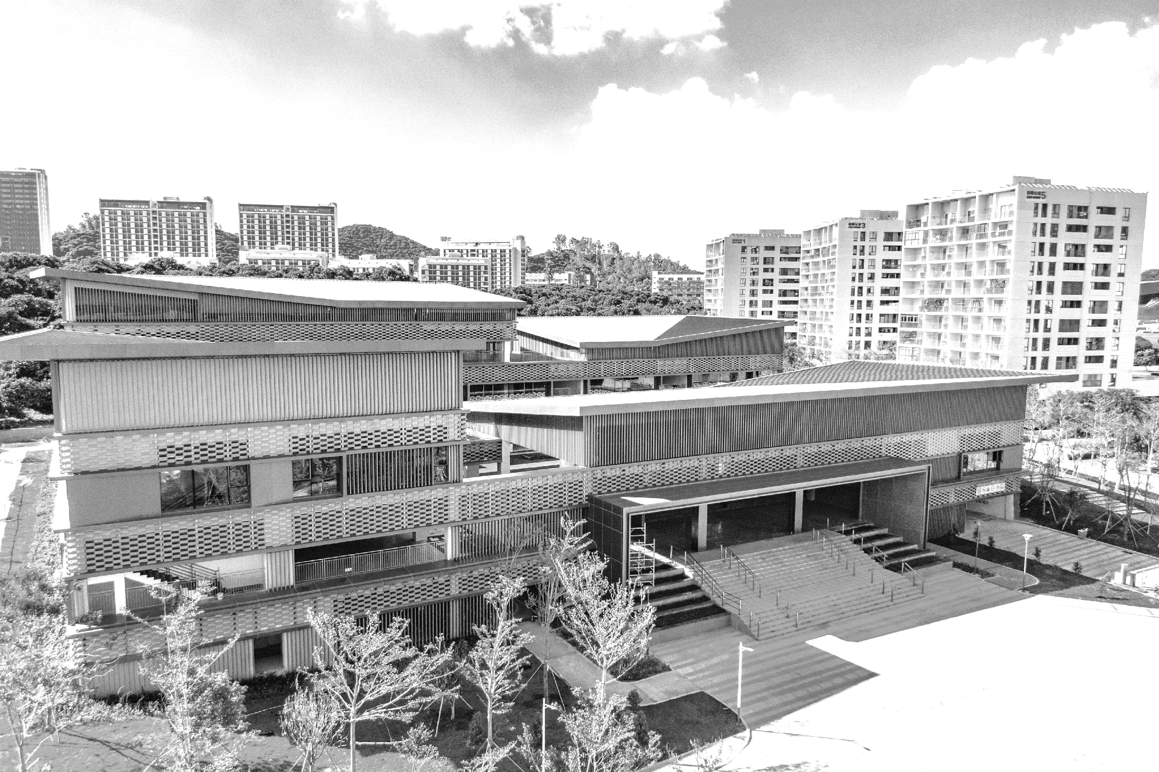
LLM Detective: A Comparative Study of Supervised and Zero-Shot Methods for Detecting Texts by LLMs
Final Project Defense
Jaouhara Zerhouni Khal 12211456
Hok Layheng 12210736
Harrold Tok Kwan Hang 12212025

Slide 2

03
Future Work
CONTENTS
02
Experiment Results
01
Methodology

Slide 3
01
Methodology

Slide 4
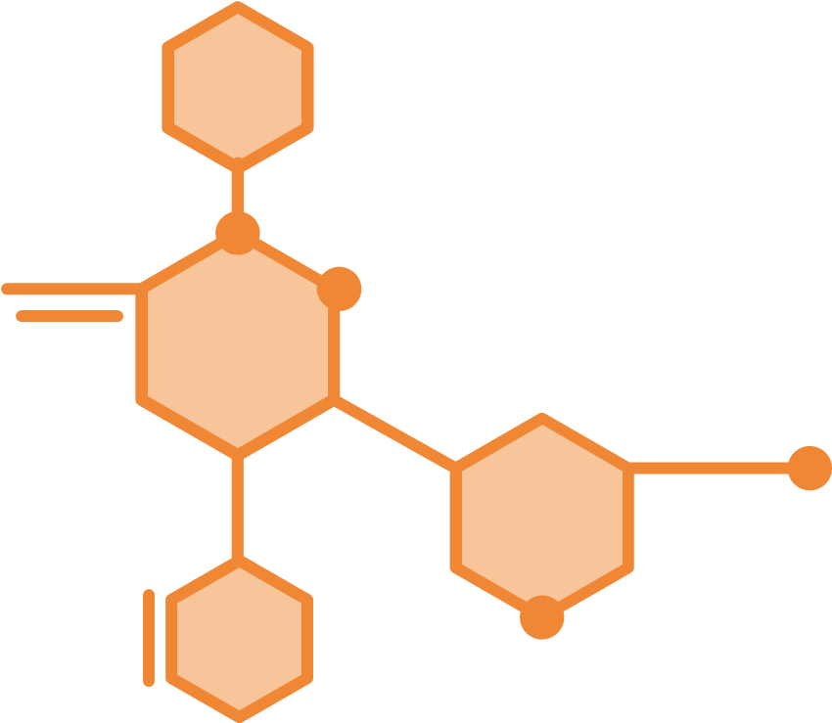
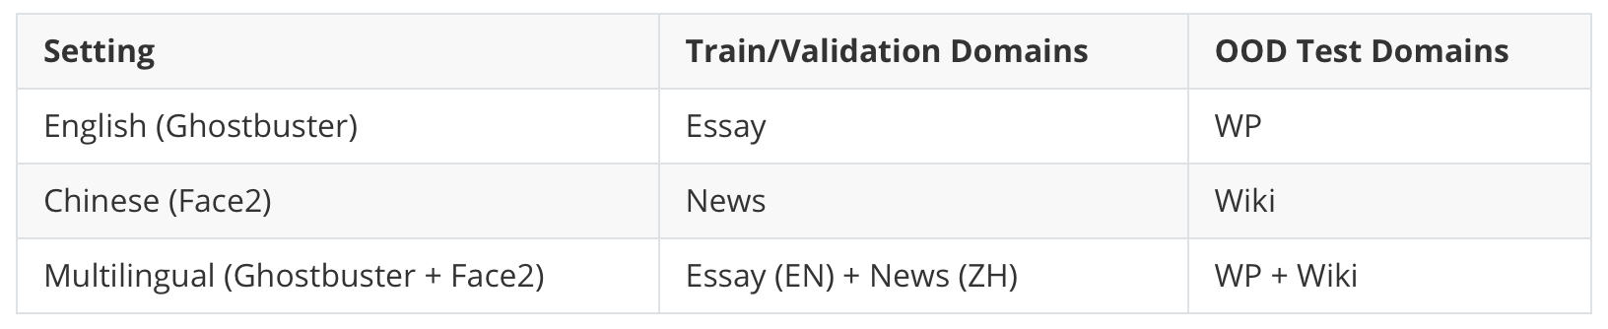
01 Methodology – Data Preprocessing
Table 1. Dataset Splits for Each Language Setting

Slide 5
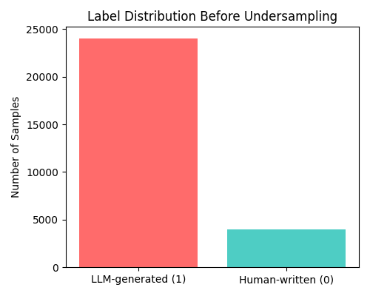
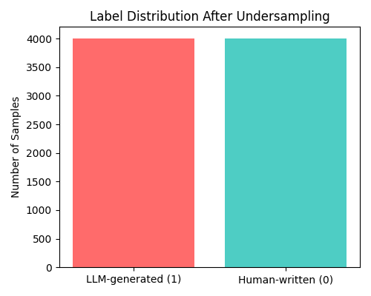
01 Methodology – Data Preprocessing
Figure 1. Label Distribution Before Undersampling
Figure 2. Label Distribution After Undersampling

Slide 6
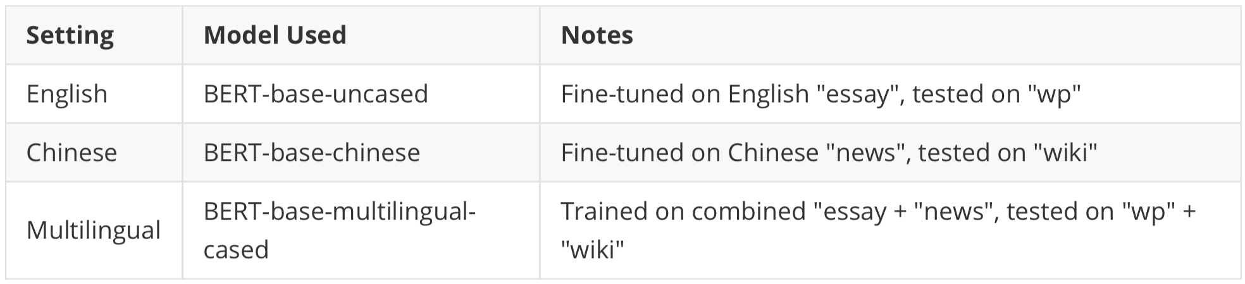
01 Methodology – Supervised Approach
Table 2. Supervised Models and Language Settings

Slide 7
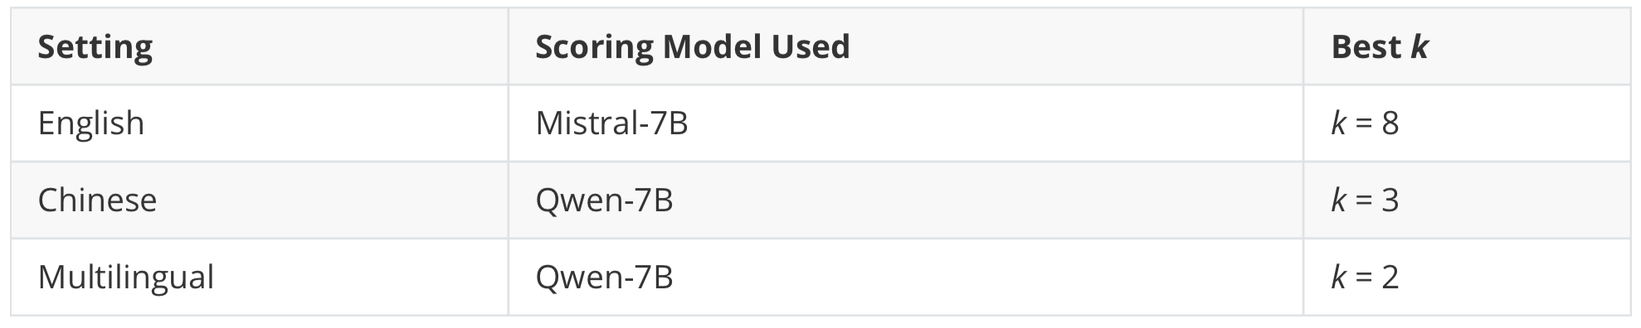
01 Methodology – Zero-Shot Approach
Figure 3. FourierGPT Process
Table 3. Zero-Shot Models and Scoring Setup

Slide 8
02
Experiment Results

Slide 9
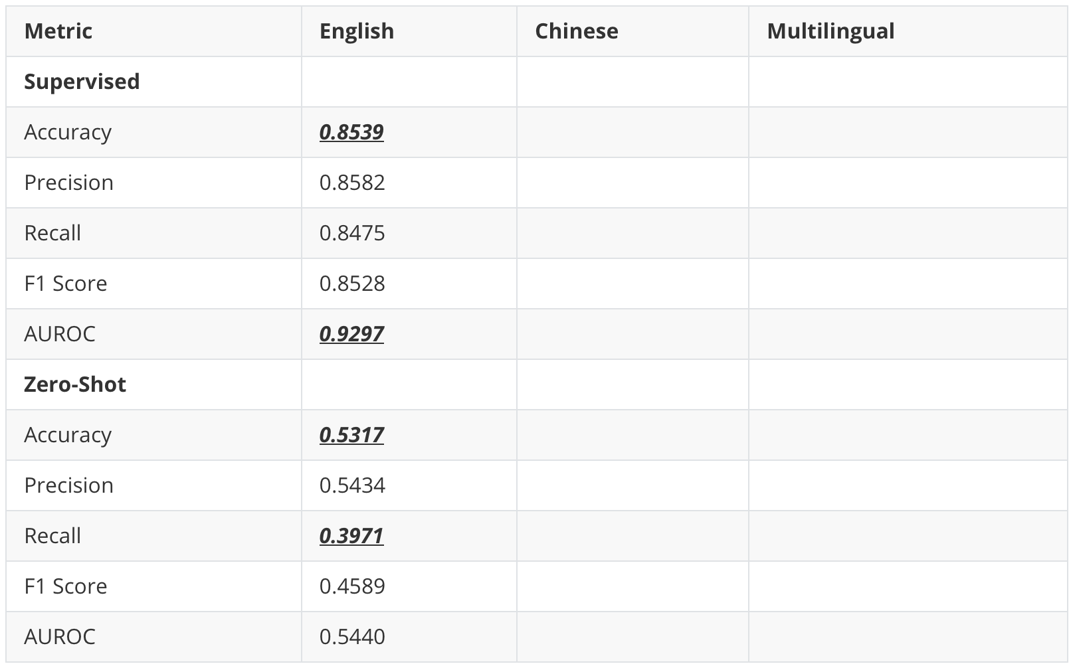
02 Experiment Results – English
Table 4. Performance Comparison
Key Takeaways
1. Supervised fine-tuning is clearly superior in detecting generated by LLMs.

Slide 10
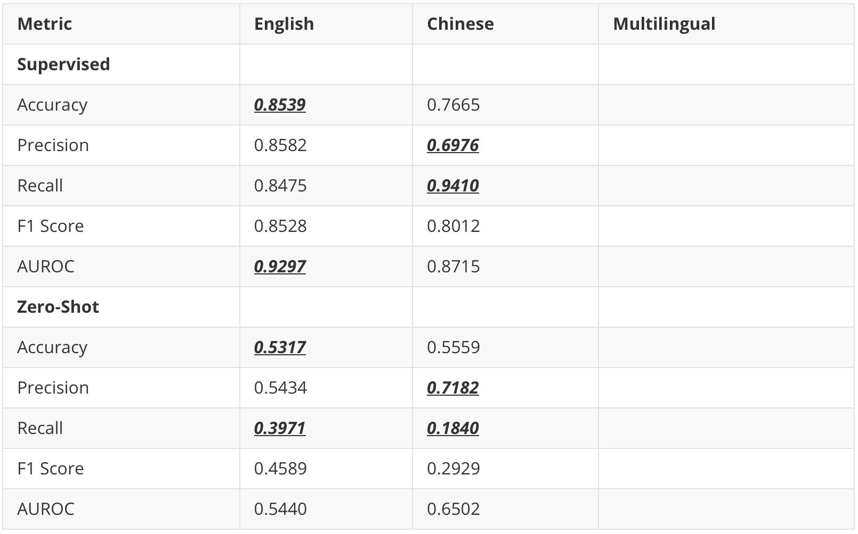
02 Experiment Results – Chinese
Table 4. Performance Comparison
Key Takeaways
1. Supervised fine-tuning is clearly superior in detecting generated by LLMs.
2. Zero-shot detection tends to be overly cautious—higher precision but very low recall—so misses most generated texts.

Slide 11
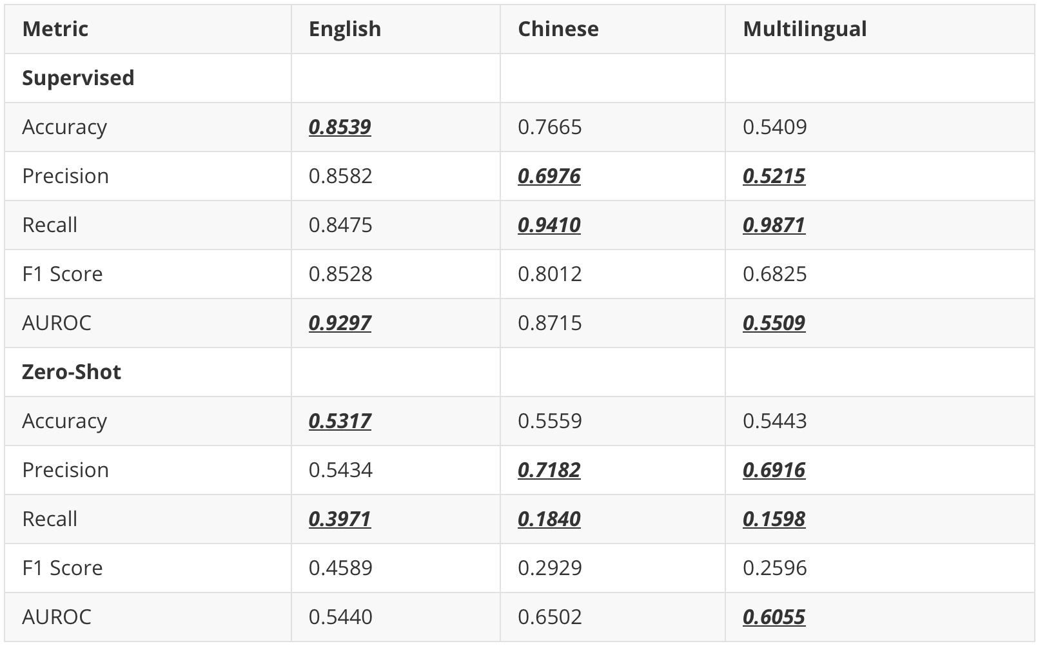
02 Experiment Results – Multilingual
Table 4. Performance Comparison
Key Takeaways
1. Supervised fine-tuning is clearly superior in detecting generated by LLMs.
2. Zero-shot detection tends to be overly cautious—higher precision but very low recall—so misses most generated texts.
3. Both methods collapse in multilingual setting.

Slide 12
03
Future Work

Slide 13

03 Future Work
Future Work Directions
Explore alternative zero-shot methods
E.g.: Stylometric or syntactic features
Aim: Boost recall without labeled data
Develop cross-lingual or language-agnostic detectors
Aim: Enable generalization across languages and domains
Investigate advanced preprocessing strategies
E.g.: Data augmentation
Aim: Refine both zero-shot detection approaches

Slide 14
THANK YOU

Slide 15
References
[1] N. Pangakis and S. Wolken, “Knowledge distillation in automated annotation: Supervised text classification with llm-generated training labels,” 2024. [Online]. Available: https://arxiv.org/abs/2406.17633
[2] B. Alhijawi, R. Jarrar, A. AbuAlRub, and A. Bader, “Deep learning detection method for large language models-generated scientific content,” Neural Computing and Applications, vol. 37, no. 1, p. 91–104, Nov. 2024. [Online]. Available: http://dx.doi.org/10.1007/s00521-024-10538-y
[3] Y. Li, Q. Li, L. Cui, W. Bi, Z. Wang, L. Wang, L. Yang, S. Shi, and Y. Zhang, “Mage: Machine-generated text detection in the wild,” 2024. [Online]. Available: https://arxiv.org/abs/2305.13242
[4] Y. Xu, Y. Wang, H. An, Z. Liu, and Y. Li, “Detecting subtle differences between human and model languages using spectrum of relative likelihood,” arXiv preprint arXiv:2406.19874, 2024.
[5] G. Bao, Y. Zhao, Z. Teng, L. Yang, and Y. Zhang, “Fast-detectgpt: Efficient zero-shot detection of machine-generated text via conditional probability curvature,” in The Twelfth International Conference on Learning Repre- sentations, 2023.
[6] S. Venkatraman, A. Uchendu, and D. Lee, “Gpt-who: An information density-based machine-generated text detector,” 2024. [Online]. Available: https://arxiv.org/abs/2310.06202

