Slide 1

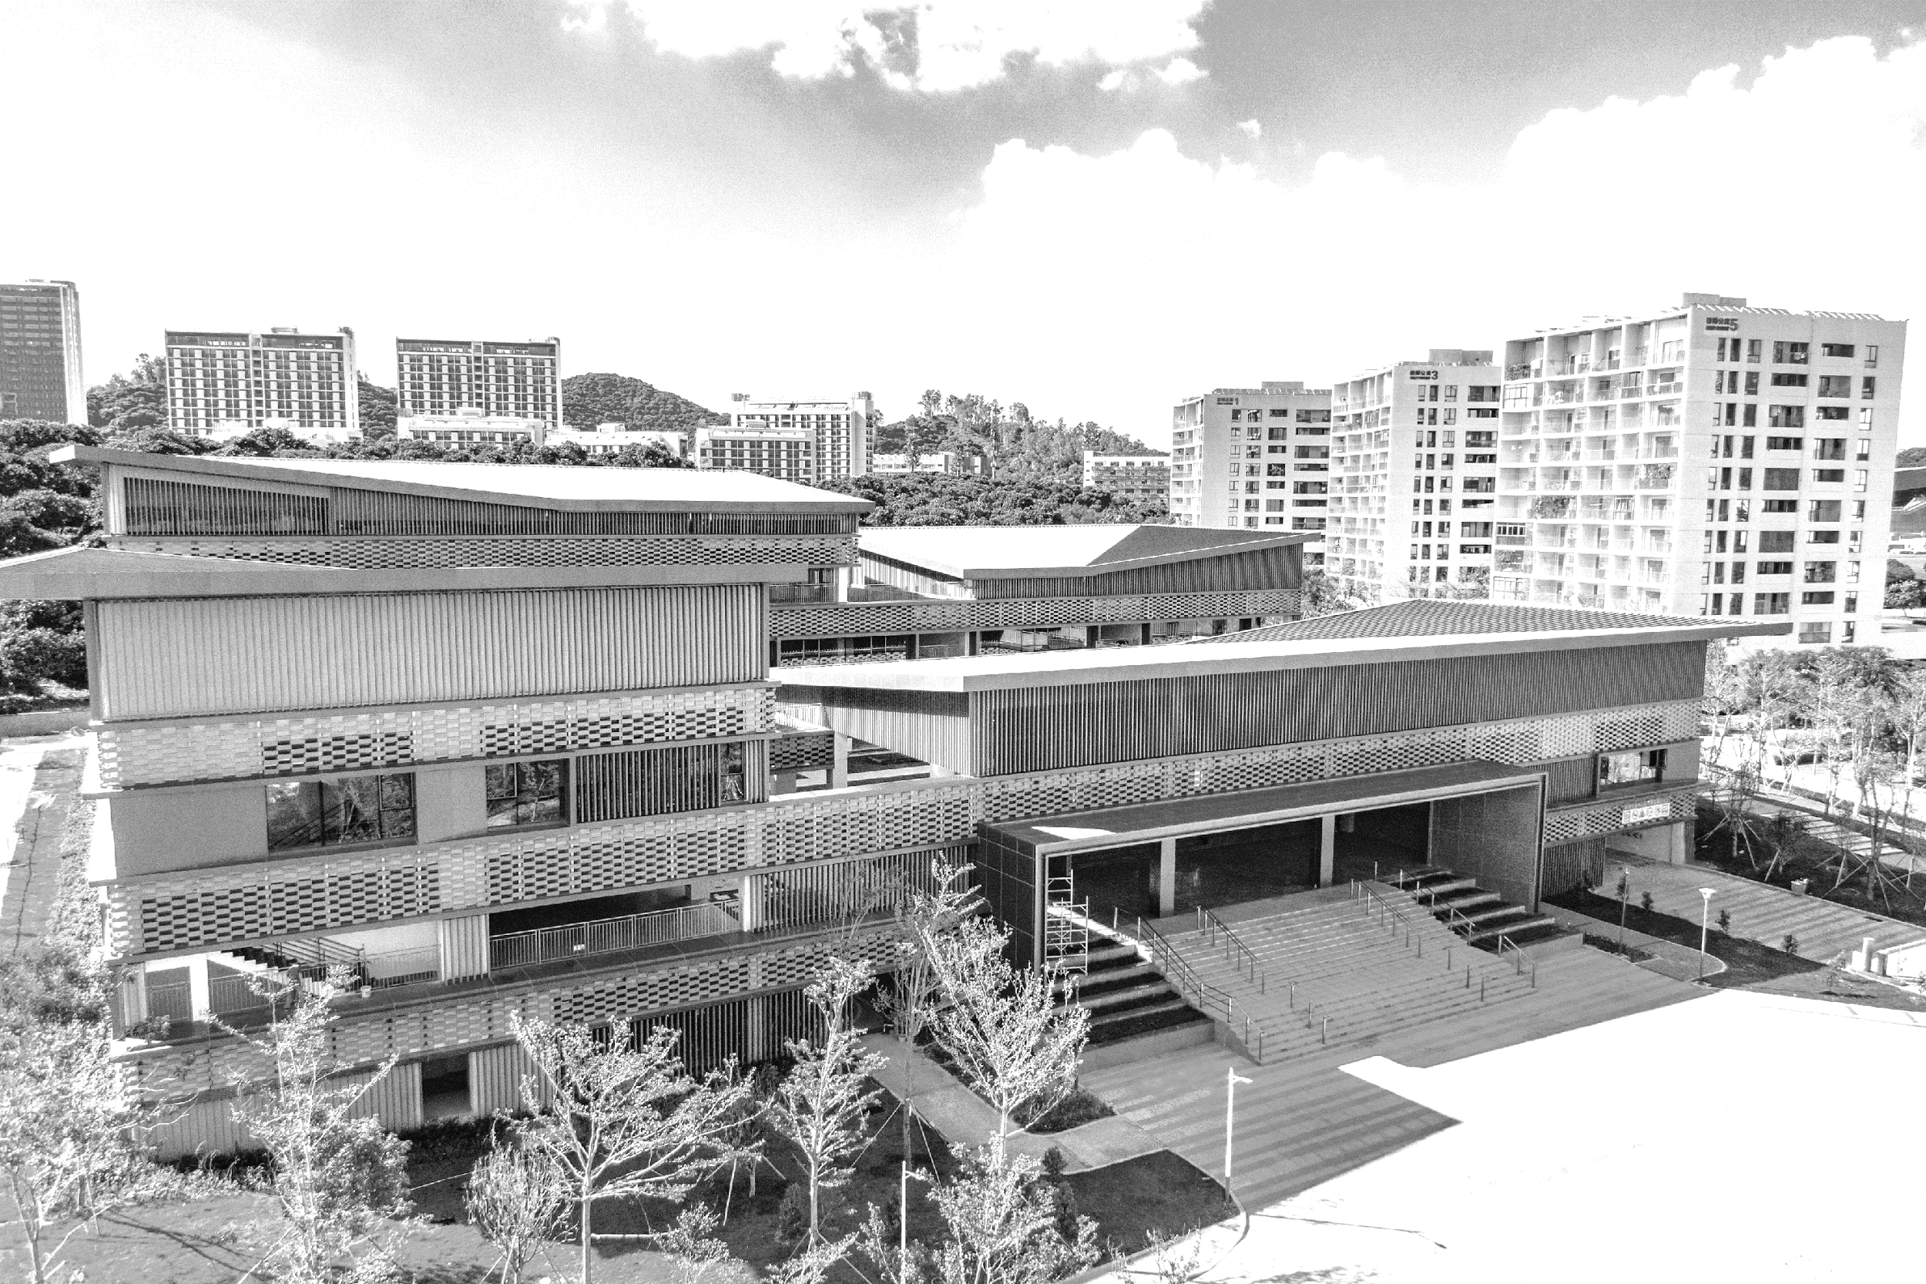
LLM Detective: A Comparative Study of Supervised and Zero-Shot Methods for Detecting Texts by LLMs
Final Project Defense
Jaouhara Zerhouni Khal 12211456
Hok Layheng 12210736
Harrold Tok Kwan Hang 12212025
Notes:
Hello everyone! Today, our team will share our findings on the comparison of two different detection methods—supervised and zero-shot—for identifying texts generated by large language models.

Slide 2

03
Future Work
CONTENTS
02
Experiment Results
01
Methodology
Notes:
We’ll begin with an overview of our methodology, then dive into the experiment results, and finally wrap up with some future directions. So let's begin.

Slide 3
01
Methodology
Notes:
First, let’s talk about how we set things up.

Slide 4
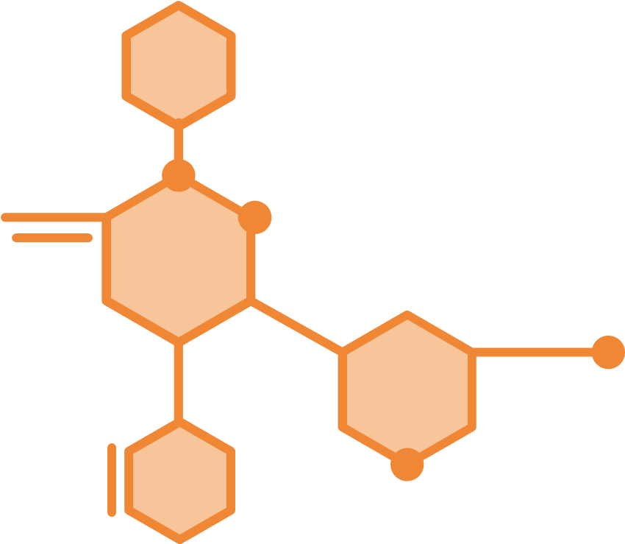
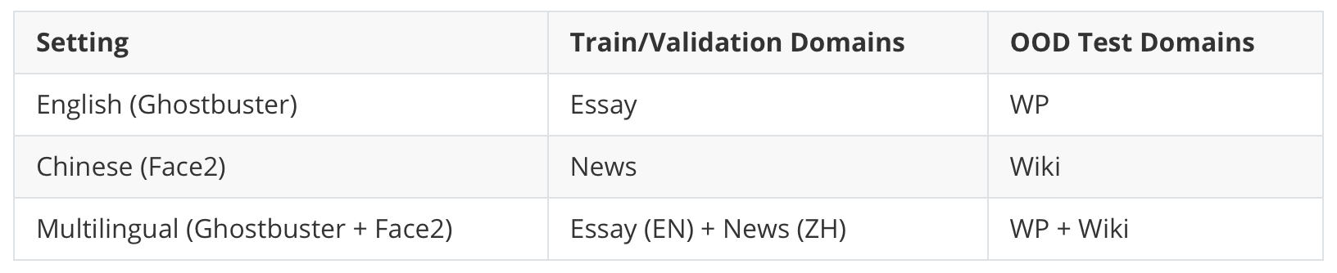
01 Methodology – Data Preprocessing
Table 1. Dataset Splits for Each Language Setting
Notes:
In this section, we kept our experimental setup straightforward. In data preprocessing, for the English setting, we took the "essay" domain for training and validation, leaving "wp" as our out-of-distribution or OOD test set. Similarly, in Chinese dataset, we trained and validated on "news" and reserved "wiki" for OOD. For the multilingual scenario, we simply combined the English "essay" texts with Chinese "news" texts for training and validation, and used "wp" plus "wiki" for testing.

Slide 5
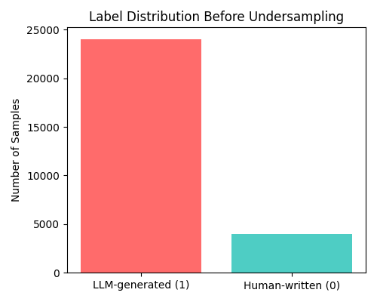
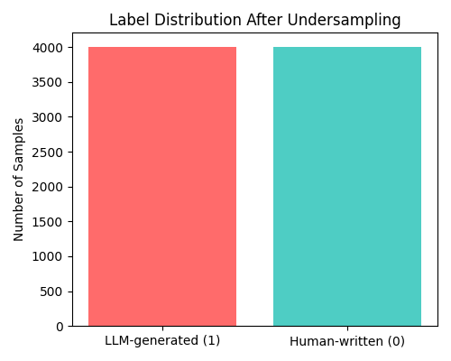
01 Methodology – Data Preprocessing
Figure 1. Label Distribution Before Undersampling
Figure 2. Label Distribution After Undersampling
Notes:
Also throughout this process, we found out that the generated texts of the English dataset outnumbered human texts by roughly six to one, so we randomly undersampled the generated data to keep the classes balanced.

Slide 6
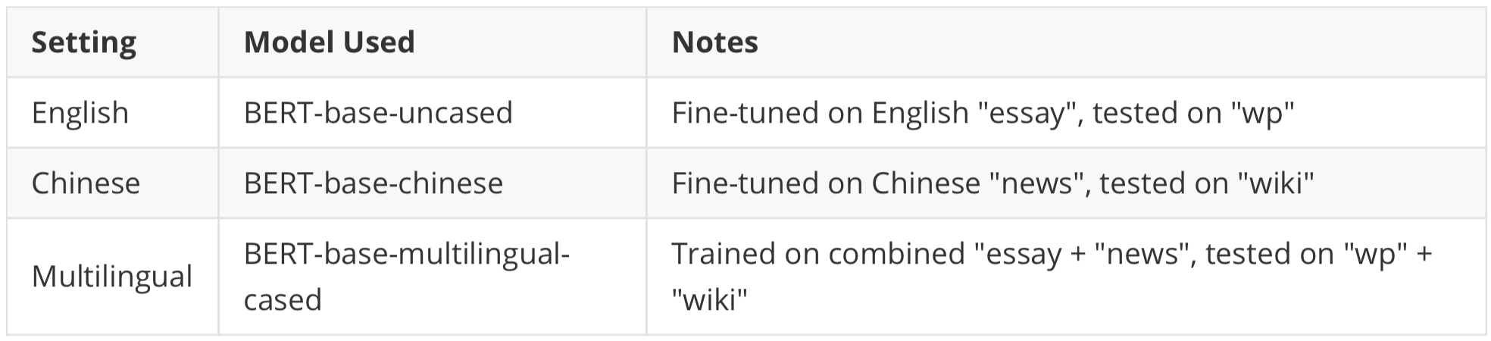
01 Methodology – Supervised Approach
Table 2. Supervised Models and Language Settings
Notes:
Then we pursued two distinct detection strategies.
On the supervised side, we fine-tuned three versions of BERT: BERT-base-uncased for English, BERT base-chinese for Chinese, and BERT-base-multilingual-cased for the multilingual dataset. Each model learned from its respective training set and was evaluated on its own OOD test set.

Slide 7
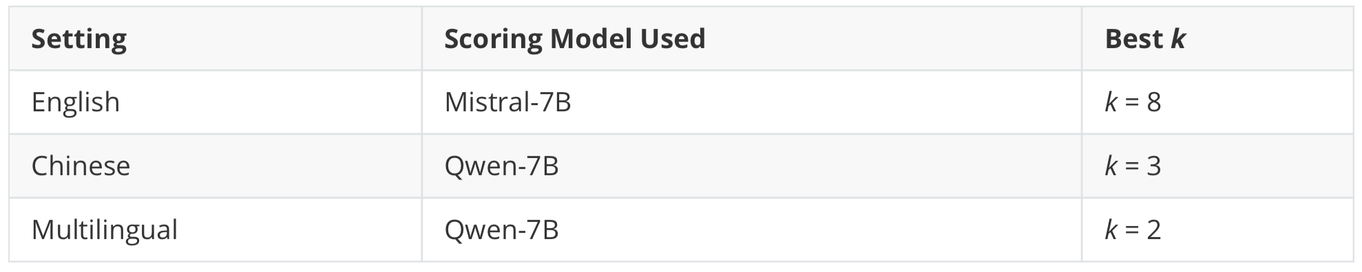
01 Methodology – Zero-Shot Approach
Figure 3. FourierGPT Process
Table 3. Zero-Shot Models and Scoring Setup
Notes:
On the zero-shot side, we followed the FourierGPT approach for detection, which hinges on computing spectrum of relative likelihood. In this experiment, we used Mistral-7B to score English samples and Qwen-7B to score both Chinese and multilingual samples. Moreover, we classified texts using a heuristic based on the power sum of the first k frequencies. We tuned k on the validation datasets to determine the best k value for testing.

Slide 8
02
Experiment Results
Notes:
Now, let’s move on to the results section.

Slide 9
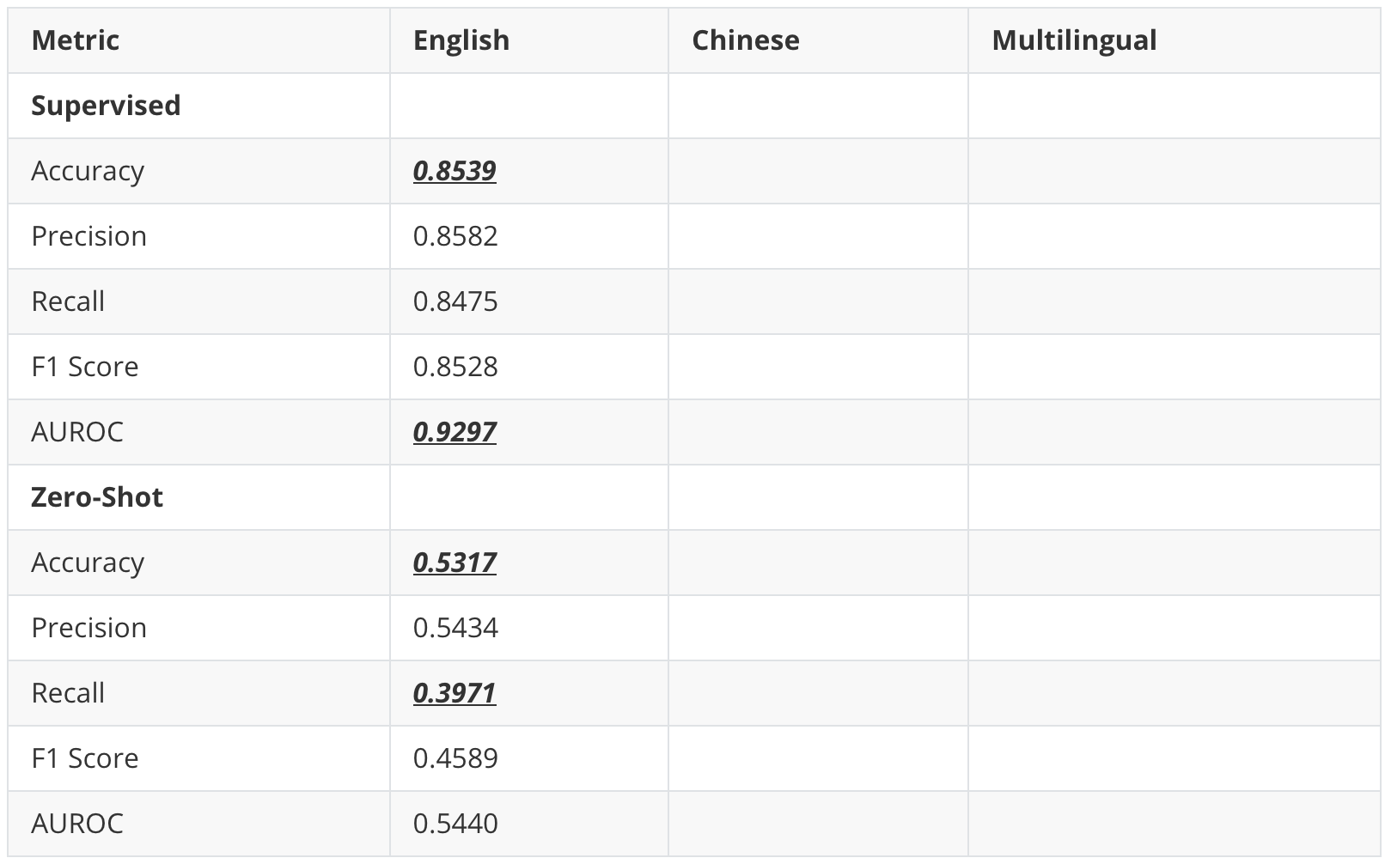
02 Experiment Results – English
Table 4. Performance Comparison
Key Takeaways
1. Supervised fine-tuning is clearly superior in detecting generated by LLMs.
Notes:
Let's first discuss the English results. Here, supervised learning performed very well, hitting over 85% accuracy and 93% AUROC. In contrast, zero-shot accuracy hovered near 53%, with a low recall of about 40%. In other words, the fine-tuned model caught most LLM-generated texts, while zero-shot missed a majority.

Slide 10
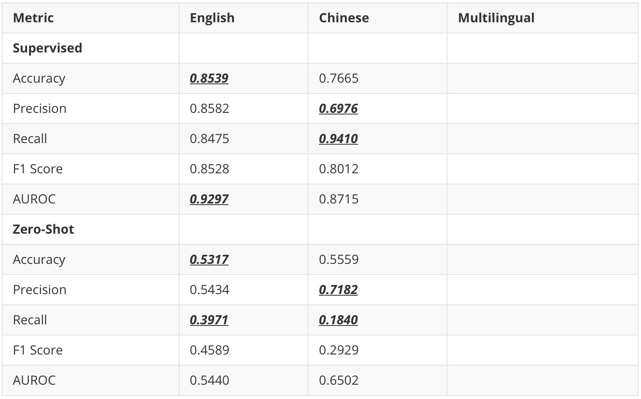
02 Experiment Results – Chinese
Table 4. Performance Comparison
Key Takeaways
1. Supervised fine-tuning is clearly superior in detecting generated by LLMs.
2. Zero-shot detection tends to be overly cautious—higher precision but very low recall—so misses most generated texts.
Notes:
Likewise, on the Chinese results, supervised outperformed zero-shot by a large margin. The supervised model’s recall of 94% means that it flagged almost all LLM samples, even if precision dipped to about 70%. Meanwhile, zero-shot managed a decent precision of 71% but only 18% on recall, so it was extremely conservative and missed most generated texts.

Slide 11
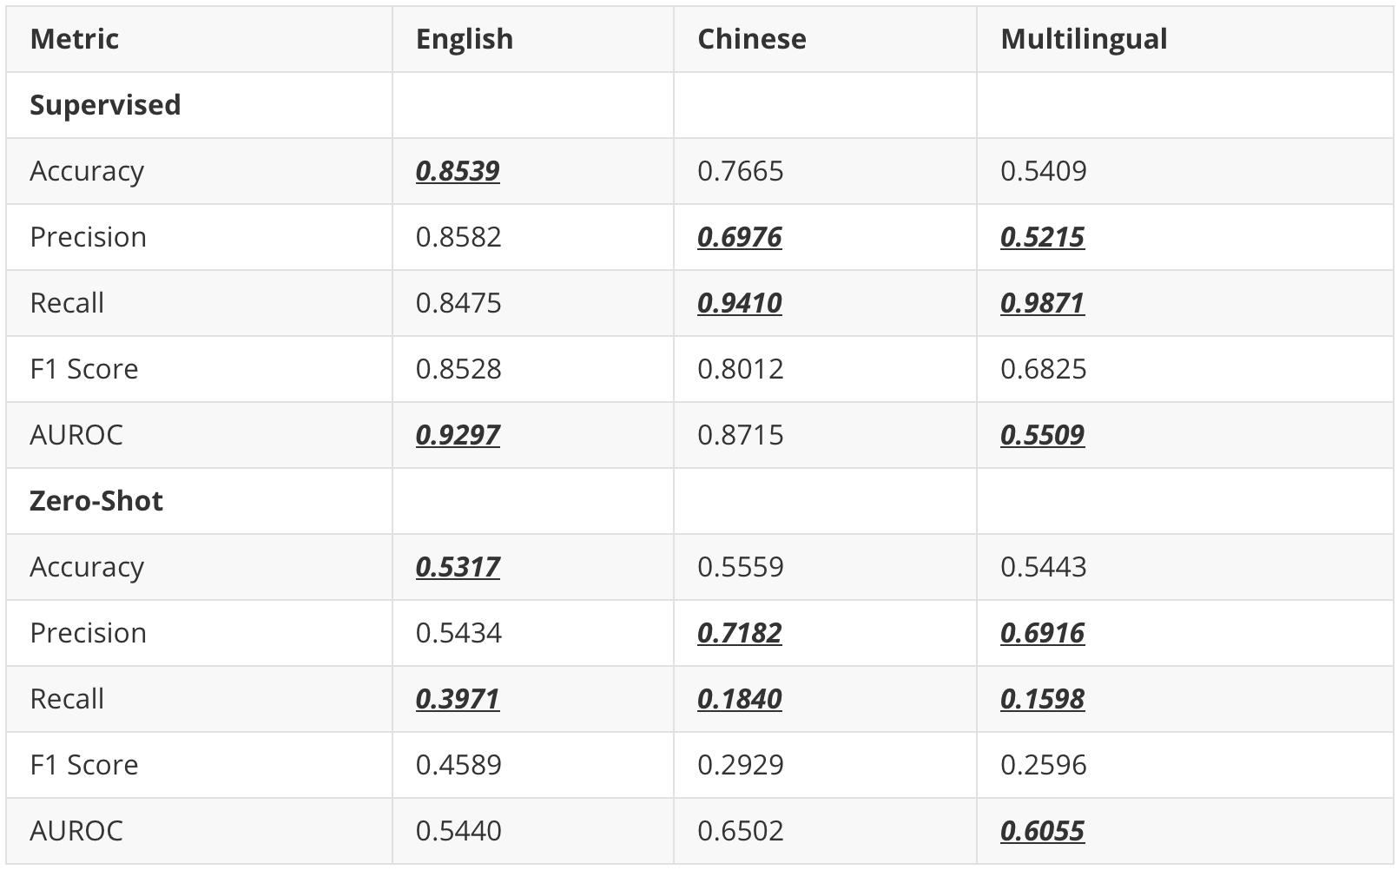
02 Experiment Results – Multilingual
Table 4. Performance Comparison
Key Takeaways
1. Supervised fine-tuning is clearly superior in detecting generated by LLMs.
2. Zero-shot detection tends to be overly cautious—higher precision but very low recall—so misses most generated texts.
3. Both methods collapse in multilingual setting.
Notes:
Lastly, in multilingual setting, the supervised model still caught nearly all generated texts with 99% on recall but at the cost of misclassifying lots of human samples (as shown with the precision of 52%). Zero-shot again was conservative—higher precision at 69% but only 16% on recall. In both cases, the AUROC barely clears 55% to 60%, essentially close to random guessing.

Slide 12
03
Future Work
Notes:
Before we wrap up, we would like to give some directions for future work.

Slide 13

03 Future Work
Future Work Directions
Explore alternative zero-shot methods
E.g.: Stylometric or syntactic features
Aim: Boost recall without labeled data
Develop cross-lingual or language-agnostic detectors
Aim: Enable generalization across languages and domains
Investigate advanced preprocessing strategies
E.g.: Data augmentation
Aim: Refine both zero-shot detection approaches
Notes:
One path is to explore alternative zero-shot methods—things like stylometric or syntactic features—that might boost recall without any labeled data. Another idea is to develop cross-lingual or language-agnostic detectors so that a single model handles new languages or domains more gracefully. Lastly, investigating advanced preprocessing strategies, such as data augmentation, could refine both approaches.

Slide 14
THANK YOU
Notes:
That’s it from us. Thank you for listening. Let us know if you have any questions.

Slide 15
References
[1] N. Pangakis and S. Wolken, “Knowledge distillation in automated annotation: Supervised text classification with llm-generated training labels,” 2024. [Online]. Available: https://arxiv.org/abs/2406.17633
[2] B. Alhijawi, R. Jarrar, A. AbuAlRub, and A. Bader, “Deep learning detection method for large language models-generated scientific content,” Neural Computing and Applications, vol. 37, no. 1, p. 91–104, Nov. 2024. [Online]. Available: http://dx.doi.org/10.1007/s00521-024-10538-y
[3] Y. Li, Q. Li, L. Cui, W. Bi, Z. Wang, L. Wang, L. Yang, S. Shi, and Y. Zhang, “Mage: Machine-generated text detection in the wild,” 2024. [Online]. Available: https://arxiv.org/abs/2305.13242
[4] Y. Xu, Y. Wang, H. An, Z. Liu, and Y. Li, “Detecting subtle differences between human and model languages using spectrum of relative likelihood,” arXiv preprint arXiv:2406.19874, 2024.
[5] G. Bao, Y. Zhao, Z. Teng, L. Yang, and Y. Zhang, “Fast-detectgpt: Efficient zero-shot detection of machine-generated text via conditional probability curvature,” in The Twelfth International Conference on Learning Repre- sentations, 2023.
[6] S. Venkatraman, A. Uchendu, and D. Lee, “Gpt-who: An information density-based machine-generated text detector,” 2024. [Online]. Available: https://arxiv.org/abs/2310.06202

