Slide 1
JDBC

Slide 2
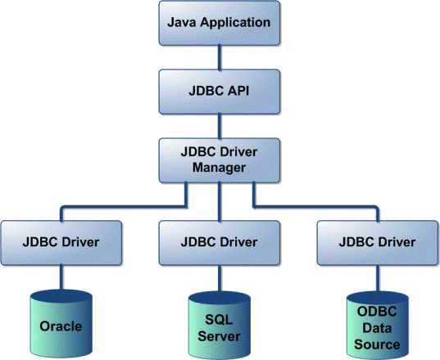

Slide 3
Что такое JDBC
JDBC 4.0 Core API - The java.sql package, which is distributed as part of Java SE 6. The core API is good enough for normal database applications.
JDBC 4.0 Standard Extension API - The javax.sql package, which is distributed as part of Java Se 6. The standard extension API, javax.sql, can also be downloaded from http://java.sun.com/products/jdbc. It is required for applications that uses connection pooling, distributed transactions, Java Naming and Directory Interfacetm (JNDI), and RowSet API.

Slide 4
Версии JDBC
Year JDBC Ver. JSR Specification JDK Implementation
2006 JDBC 4.0 JSR 221 Java SE 6
2001 JDBC 3.0 JSR 54 JDK 1.4
1999 JDBC 2.1 JDK 1.2
1997 JDBC 1.2 JDK 1.1
Main new features introduced in JDBC 4.0 API are:
  Automatic loading of java.sql.Driver
  ROWID data type support
  National Character Set Conversion Support
  SQL/XML and XML Support

Slide 5
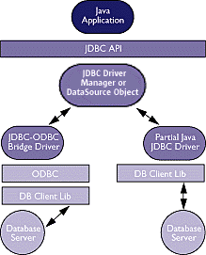
JDBC Type 1: JDBC-ODBC Bridge plus ODBC Driver. See the left side of the first picture shown below. This combination provides JDBC access via ODBC drivers. ODBC binary code, and in many cases, database client code, must be loaded on each client machine that uses a JDBC-ODBC Bridge. Sun provides a JDBC-ODBC Bridge driver, which is appropriate for experimental use and for situations in which no other driver is available.
JDBC Type 2: A native API partly Java technology-enabled driver. See the right side of the first picture shown below. This type of driver converts JDBC calls into calls on the client API for Oracle, Sybase, Informix, DB2, or other DBMS. Note that, like the bridge driver, this style of driver requires that some binary code be loaded on each client machine.

Slide 6
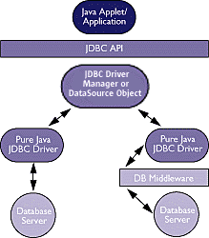
JDBC Type 3: Pure Java Driver for Database Middleware. See the right side of the second picture shown below. This style of driver translates JDBC calls into the middleware vendor's protocol, which is then translated to a DBMS protocol by a middleware server. The middleware provides connectivity to many different databases.
JDBC Type 4: Direct-to-Database Pure Java Driver. See the left side of the second picture shown below. This style of driver converts JDBC calls into the network protocol used directly by DBMSs, allowing a direct call from the client machine to the DBMS server and providing a practical solution for intranet access. For example, Microsoft JDBC Driver 1.0 is a Type 4 JDBC driver.

Slide 7
Подключение к базе
1. Using DrirverManager Class (java.sql)
  // Loading a JDBC driver
  Class.forName("acme.db.Driver");
  // Creating a connection
  String url = "jdbc:odbc:fred";
  Connection con = DriverManager.getConnection(url,"user","pass");

Slide 8
2. Using DataSource Object (javax.sql)
  //registered with a JNDI
  VendorDataSource vds = new VendorDataSource();
  vds.setServerName("my_database_server");
  vds.setDatabaseName("my_database");
  vds.setDescription("the data source for inventory and personnel");
  Context ctx = new InitialContext();
  ctx.bind("jdbc/AcmeDB", vds);
  // Creating a connection
  Context ctx = new InitialContext();
  DataSource ds = (DataSource)ctx.lookup("jdbc/AcmeDB");
  Connection con = ds.getConnection("user","pass");

Slide 9
Где и как найти драйвер?
Загрузить (читать описание)
  http://www.microsoft.com/downloads/details.aspx?FamilyID=e22bc83b-32ff-4474-a44a-22b6ae2c4e17&displaylang=en
Установить (подключить библиотеку)
  sqljdbc.jar
Загрузить JDBC Driver
  Class.forName( "com.microsoft.sqlserver.jdbc.SQLServerDriver");
Проверить наличие драйверов
  DriverManager.getDrivers();

Slide 10

3. Connection URL
    jdbc:<subprotocol>:<subname>
    jdbc:<subprotocol>://<hostname>:port<subname>
4. Примеры:
//JDBC-ODBC Bridge driver
  "jdbc:odbc:myDsn“
  //Microsoft JDBC Driver
  "jdbc:sqlserver://localhost:1269“
  con = DriverManager.getConnection("jdbc:sqlserver://localhost;“
  +"database=AdventureWorks;user=name;password=****");

Slide 11
Vendor Driver Name URL Sample
Oracle 8i oracle.jdbc.driver.OracleDriver
jdbc:oracle:thin:@localhost:1521:scorpian
Oracle 9i oracle.jdbc.driver.OracleDriver
jdbc:oracle:thin:@localhost:1521:scorpian
MySQL org.gjt.mm.mysql.Driver
jdbc:mysql://localhost/scorpian
Microsoft sun.jdbc.odbc.JdbcOdbcDriver
Access jdbc:odbc: Driver={Microsoft Access Driver (*.mdb)}
Sybase com.sybase.jdbc2.jdbc.SybDriver jdbc:sybase:Tds:scorpian:2638
MS SQL com.microsoft.jdbc. sqlserver.SQLServerDriver
jdbc:microsoft:sqlserver://localhost:1433
IBM DB2 COM.ibm.db2.jdbc.net.DB2Connection jdbc:db2://localhost:6789/scorpian

Slide 12
Как проверить наличие драйвера?
Enumeration<Driver> e = DriverManager.getDrivers();
while (e.hasMoreElements()) {
Driver driver = e.nextElement();
String className = driver.getClass().getName();
System.out.println("Driver class name="+className);
}

Slide 13
Подключение через JNDI
App1
create
Created DataSource
manage
deploy
Directory and
Naming Service
Deployed DataSource(s)
App2
look up
get DataSource

Slide 14
JNDI naming services
  File-based systems
  Directory-based systems (such as LDAP)
  CORBA-based systems
  DNS-based systems
  RMI-based systems
http://java.sun.com/products/jndi

Slide 15
DataSource Object
• Basic implementation: Produces a standard Connection object.
• Connection pooling implementation: Produces a Connection object that will automatically participate in connection pooling. This implementation works with a middle-tier connection
pooling manager.
• Distributed transaction implementation: Produces a Connection object that may be used for distributed transactions and almost always participates in connection pooling.

Slide 16
1. Создание контекста:
Hashtable env = new Hashtable();
env.put(Context.INITIAL_CONTEXT_FACTORY,
"com.sun.jndi.fscontext.RefFSContextFactory");
env.put(Context.PROVIDER_URL, "file:" + directoryName);
Context context = new InitialContext(env);
2. Создание DataSource:
SQLServerDataSource ds = new SQLServerDataSource();
ds.setUser(user);
ds.setPassword(password);
ds.setDatabaseName(databaseName);
ds.setServerName(serverName);
ds.setPortNumber(portNumber);
3. Регистрация
context.bind("jdbc/mySQLDS1", ds);
App1

Slide 17
App2
1. Создание контекста
Context context= ………
2. Поиск источника данных по имени
DataSource myDS = (DataSource) context.lookup("jdbc/mySQLDS1");
3. Получение соединения:
Connection con = myDS.getConnection();

Slide 18
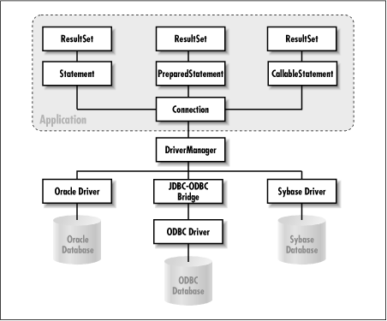

Slide 19
Интерфейс Connection
close()
commit()
createStatement()
getCatalog()
getMetaData()
getTransactionIsolation()
getWarnings()
isClosed()
prepareCall()
prepareStatment()
rollback()
setAutoCommit()
setCatalog()

Slide 20
Интерфейс DatabaseMetaData
getDatabaseProductName() - Retrieves the name of this database product.
getDatabaseProductVersion() - Retrieves the version number of this database product.
getDriverName() - Retrieves the name of this JDBC driver.
getDriverVersion() - Retrieves the version number of this JDBC driver as a String.
getCatalogs() - Retrieves the catalog names available in this database.
getSchemas(String catalog, String schemaPattern) - Retrieves the schema names available in this database.
getTables(String catalog, String schemaPattern, String tableNamePattern, String[] types) - Retrieves a description of the tables available in the given catalog.
getProcedures(String catalog, String schemaPattern, String procedureNamePattern) - Retrieves a description of the stored procedures available in the given catalog.
getFunctions(String catalog, String schemaPattern, String functionNamePattern)

Slide 21
getCatalogs() – список базданных
DatabaseMetaData meta = con.getMetaData();
ResultSet res = meta.getCatalogs();
System.out.println("List of databases: ");
while (res.next()) {
System.out.println(" " +res.getString("TABLE_CAT"));
}
res.close();
List of databases:
AdventureWorks
master
model

Slide 22
getProcedures() – список процедур
DatabaseMetaData meta = con.getMetaData();
ResultSet res = meta.getProcedures(null, null, null);
System.out.println("List of procedures: ");
while (res.next()) {
System.out.println(" "+res.getString("PROCEDURE_CAT") + ", "+res.getString("PROCEDURE_SCHEM") + ", "+res.getString("PROCEDURE_NAME"));
}
res.close();

Slide 23
Интерфейс Statement
close()
executeQuery()
executeUpdate()
getUpdateCount()
getWarnings()

Slide 24
Интерфейс ResultSet
ResultSet.first() - Moves the cursor to the first row in this ResultSet object.
ResultSet.last() - Moves the cursor to the last row in this ResultSet object.
ResultSet.next() - Moves the cursor forward one row from its current position.
ResultSet.getMeatData()
ResultSet.getBoolean() - Returns the value as boolean of a given column.
ResultSet.getByte() - Returns the value as byte of a given column.
ResultSet.getDate() - Returns the value as Date of a given column.
ResultSet.getDouble() - Returns the value as double of a given column.
ResultSet.getFloat() - Returns the value as float of a given column.
ResultSet.getInt() - Returns the value as int of a given column.
ResultSet.getLong() - Returns the value as long of a given column.
ResultSet.getString() - Returns the value as String of a given column.
ResultSet.wasNull() - Returns true if the column fetched by the last get*() method has a null value.
ResultSet.close() - Closes the resources used by this ResultSet object.

Slide 25
Statement st = con.createStatement();
ResultSet res = st.executeQuery(
"SELECT TOP 10 * FROM Sales.Customer");
System.out.println("Customers");
while (res.next()) {
String firstName = res.getString("FirstName");
String lastName = res.getString("LastName"); System.out.println(" "+firstName+" "+lastName);
}
// А какой это курсор???
res.getType();
res.getConcurrency();

Slide 26
Statement createStatement(int resultSetType,
int resultSetConcurrency)
    • java.sql.ResultSet.TYPE_FORWARD_ONLY: The constant indicating the type for a ResultSet object whose cursor may move only forward
    • java.sql.ResultSet.TYPE_SCROLL_INSENSITIVE: The constant indicating the type for a ResultSet object that is scrollable but generally not sensitive to changes made by others
    • java.sql.ResultSet.TYPE_SCROLL_SENSITIVE: The constant indicating the type for a ResultSet object that is scrollable and generally sensitive to changes made by others
  • java.sql.ResultSet.CONCUR_READ_ONLY: The constant indicating the concurrency mode fora ResultSet object that may not be updated
  • java.sql.ResultSet.CONCUR_UPDATABLE: The constant indicating the concurrency mode for a ResultSet object that may be updated

Slide 27
ResultSet rs = null;
Statement stmt = null;
Connection conn = null;
try {conn = getConnection(); // get a Connection object
// create a result set containing all data from your desired table
stmt = conn.createStatement();
String query = "SELECT id, name, address FROM employees";
rs = stmt.executeQuery(query);
// Fetch each row from the result set
while (rs.next()) {
// Get the data from the row using the column name
// note that using a column name might add
// overhead: there is a need to get column metadata info.
String employeeAddress = rs.getString("address");
...
} }
catch (SQLException e) { // handle the exception … }
finally { // close ResultSet, Statement, Connection }

Slide 28
Как обработать исключения?
catch (SQLException e) {
while (e != null) {
// Retrieve a readable message identifying the reason for the exception
String errorMessage = e.getMessage();
System.err.println("sql error message:"+errorMessage);
// This vendor-independent string contains a code that identifies the reason for
// the exception. The code follows the Open Group SQL conventions.
String sqlState = e.getSQLState();
System.err.println("sql state:"+sqlState);
// Retrieve a vendor-specific error code identifying the reason for the exception.
int errorCode = e.getErrorCode();
System.err.println("error code:"+errorCode);
String driverName = conn.getMetaData().getDriverName();
System.err.println("driver name:"+driverName);
processDetailError(drivername, errorCode);
// the exception may have been chained; process the next chained exception
e = e.getNextException();
} }

Slide 29
Как узнать названия столбцов?
// Getting result meta data
Statement sta = con.createStatement();
ResultSet res = sta.executeQuery
( "SELECT * FROM sys.objects" + " WHERE type_desc='USER_TABLE'");
ResultSetMetaData rmd = res.getMetaData();
System.out.println("Result set columns:");
for (int i=1; i<=rmd.getColumnCount(); i++) {
String name = rmd.getColumnName(i);
String type = rmd.getColumnTypeName(i);
int size = rmd.getPrecision(i);
System.out.println(" "+name+", "+type+", "+size);
}

Slide 30
Изменение данных в базе
Обновляемый курсор
  // Create an updatable result set
  stmt = conn.createStatement(ResultSet.TYPE_SCROLL_SENSITIVE,
  ResultSet.CONCUR_UPDATABLE);
  rs = stmt.executeQuery("SELECT * FROM my_table");
  // Move cursor to the row to update
  rs.first();
  // Update the value of column column_1 on that row
  rs.updateString("column_1", "new data");
  // Update the row; if autocommit is enabled,
  // update is committed
  rs.updateRow();
  // Discard the update to the row
  rs.cancelRowUpdates();

Slide 31
Вставка строки в таблицу
// Create an updatable result set
stmt = conn.createStatement(
ResultSet.TYPE_SCROLL_SENSITIVE,
ResultSet.CONCUR_UPDATABLE);
String query = "select id, name from employees";
// Create the desired ResultSet object
rs = stmt.executeQuery(query);
// Move cursor to the "insert row"
rs.moveToInsertRow();
// Set values for the new row.
rs.updateString("id", "66");
rs.updateString("name", "Harrison Ford");
// Insert the row
rs.insertRow();

Slide 32

DML
  Connection conn = null;
  Statement stmt = null;
  try {
  conn = getConnection(); // get a Connection object
  stmt = conn.createStatement(); // create a Statement object
  // Prepare a statement to insert a record
  String sql = "INSERT INTO employee_table (badge_number, last_name) " +
  "VALUES('1122', 'alex smith')";
  stmt.executeUpdate(sql);
  }
  catch (SQLException e) {
  // insert failed handle the exception
  }
  finally {
  // close database/JDBC resources such as
  // ResultSet(s), Statement(s), and Connection(s)
  }

Slide 33
Предварительно откомпилированный запрос:
Application
SQL Query
Parser
Parse Tree
Query Rewriter
Best Logical Query Plan
Query Optimizer
Best Physical Query Plan
Query Executer
Result

Slide 34
query = "select author, publisher from books_table where isbn = ?";
// create PreparedStatement object
pstmt = conn.prepareStatement(query);
// this query has only one parameter marker;
pstmt.setString(1, "13-677");
// execute the query, and create a result set
rs = pstmt.executeQuery();
// iterate the ResultSet object, and get all the data
while (rs.next()) {
String author = rs.getString(1);
String publisher = rs.getString(2);
}
// now we can use the same PreparedStatement object
// (i.e., pstmt) to execute another SQL query:
// this query has only one parameter marker;
// we have to "pass in" the values for parameters
pstmt.setString(1, "14-546");

Slide 35
Вызов хранимой процедуры или
пользовательской функции
CallableStatement st=con.prepareCall
("{?= call proc1(?,?)}");
st.registerOutParameter(1,Types.INTEGER);
st.setInt(2,10);
st.setInt(3,43);
st.execute();
System.out.println(st.getInt(1));

Slide 36
Транзакции в JDBC Api
ACID = Atomicity, Consistency, Isolation & Durability
Отключаем режим автоматического завершения транзакций
con.setAutoCommit(false);
Выбираем уровень изоляции транзакций
При необходимости добавляем точки сохранения
Savepoint sp1 = con.setSavepoint();
con.rollback(sp1);
Завершаем транзакцию
con.commit();
Notes:
Isolation Level Transactions Dirty Reads Non-Repeatable Reads Phantom Reads
TRANSACTION_NONE Not supported Not applicable Not applicable Not applicable
TRANSACTION_READ_COMMITTED Supported Prevented Allowed Allowed
TRANSACTION_READ_UNCOMMITTED Supported Allowed Allowed Allowed
TRANSACTION_REPEATABLE_READ Supported Prevented Prevented Allowed
TRANSACTION_SERIALIZABLE Supported Prevented Prevented Prevented

Slide 37
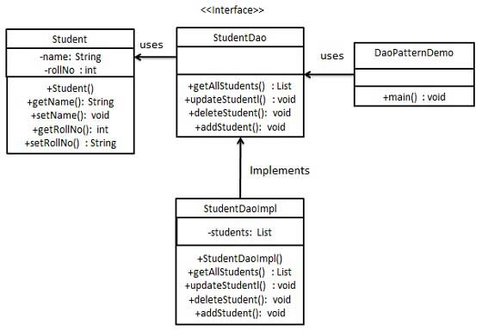
Data Access Object pattern.

Slide 38
Лабораторная работа

