Slide 1
Deception Detective Fact - Checker

Slide 2
Team Members
Andrew Nease: neaseaw@mail.uc.edu
Daniel Wood: wooddj@mail.uc.edu
Lando Slack: slacklj@mail.uc.edu
Advisor
Dr. Yiming Hu: huyg@ucmail.uc.edu

Slide 3
Abstract
The purpose of our project is to create a tool that can quickly identify, and fact-check statements made on a webpage. To make this tool, we will need to develop two separate algorithms and combine them into one tool. The first algorithm will need to read the contents of a webpage, identify statements made as facts, and store them in memory. The second algorithm will take each statement and evaluate its factual integrity. A user of the tool will be empowered to fact-check statements with the click of a button, thereby increasing their confidence in given sources.

Slide 4
User Stories

Slide 5
As a social media user, I want to quickly fact-check the statements I read so that I can verify the integrity of posts I read without needing to do outside research.

Slide 6
As a journalist, I want to quickly fact-check my online research so that I can publish new stories as quickly as possible without sacrificing factual integrity.

Slide 7
As an academic writer, I want to quickly fact-check statements so that I can get a sense for a source's reliability without the need for extensive research.

Slide 8
As a university student, I want to have greater insight into the content of my search engine results without having to click into each link, so that I can efficiently find the factual information I need.

Slide 9
As a medical professional, I want to have more trust in the articles and blogs I read online so that I can be confident in my research on topics exterior to my profession.

Slide 10
Design Diagrams

Slide 11
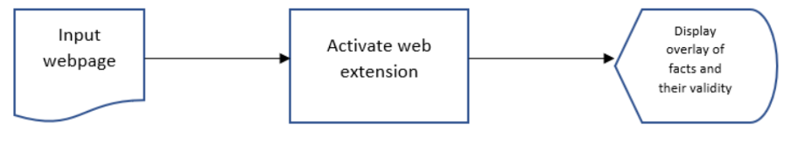
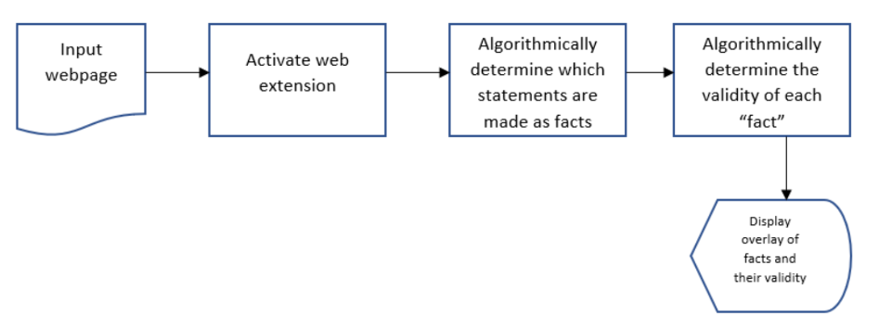
Diagram D0: High-Level Graph
Diagram D1: Mid-Level Graph
Design Diagrams

Slide 12
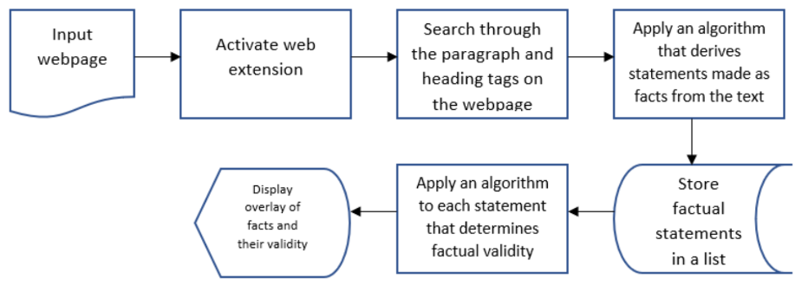
Diagram D2: Low-Level Graph
Design Diagrams

Slide 13
Major Project Constraints

Slide 14
Major Project Constraints
Economic Cost
Our project will not be constrained by economic costs. We will be researching freely available solutions, then developing our own software.
Time
While we believe that we will have plenty of time to successfully complete our project, time constraints due to coursework are a definite consideration.
Scope
Each member of our group discussed and agreed to specific tasks to individually take charge of and work on. We have also thoroughly discussed how we will combine the individual work into our final product.

Slide 15
Major Project Constraints
Professional /Technical Expertise
Our project will mainly involve the creation and application of two algorithms (potentially with a component of artificial intelligence) that none of us have prior experience working with. This lack of experience will make the research phase of our project even more important.
Ethical / Legal
Our project will not likely have legal implications as conveying factually inaccurate information is generally not against the law. It will have potentially significant ethical implications as the goal is to identify facts and refute uncredible information. As such, we will need to careful that our tool works with as much integrity as possible.
Security
We don't believe security to be a main concern for our project. We will neither collect nor store user information, so there won't be privacy concerns there.

Slide 16
Major Project Constraints
Social
Our project is designed to be used for public service. It could benefit society by making it easier and more convenient to evaluate the facts of an online source.
Environmental
Our project will have no environmental concerns, as it will be entirely software-based.
Diversity and Cultural Impact
Our project will likely have the cultural constraint of being usable only on English webpages. In order to identify statements, we will need to apply concepts of natural language processing to an algorithm. To customize this to work with additional languages is outside the scope of our initial design.

Slide 17
Project Logistics

Slide 18
Review of Project Progress
We are currently in the research phase of our project.

Slide 19
Expected Accomplishments
By the end of the fall semester, we plan to have initial reports written and completed preliminary research.

Slide 20
Division of Work
Task | Daniel | Andrew | Lando
Research Tasks | 33% | 33% | 33%
Design and Devlopment | 35% | 30% | 35%
Testing and Refactoring | 30% | 40% | 30%
Presentation Preparation | 33% | 33% | 33%

Slide 21
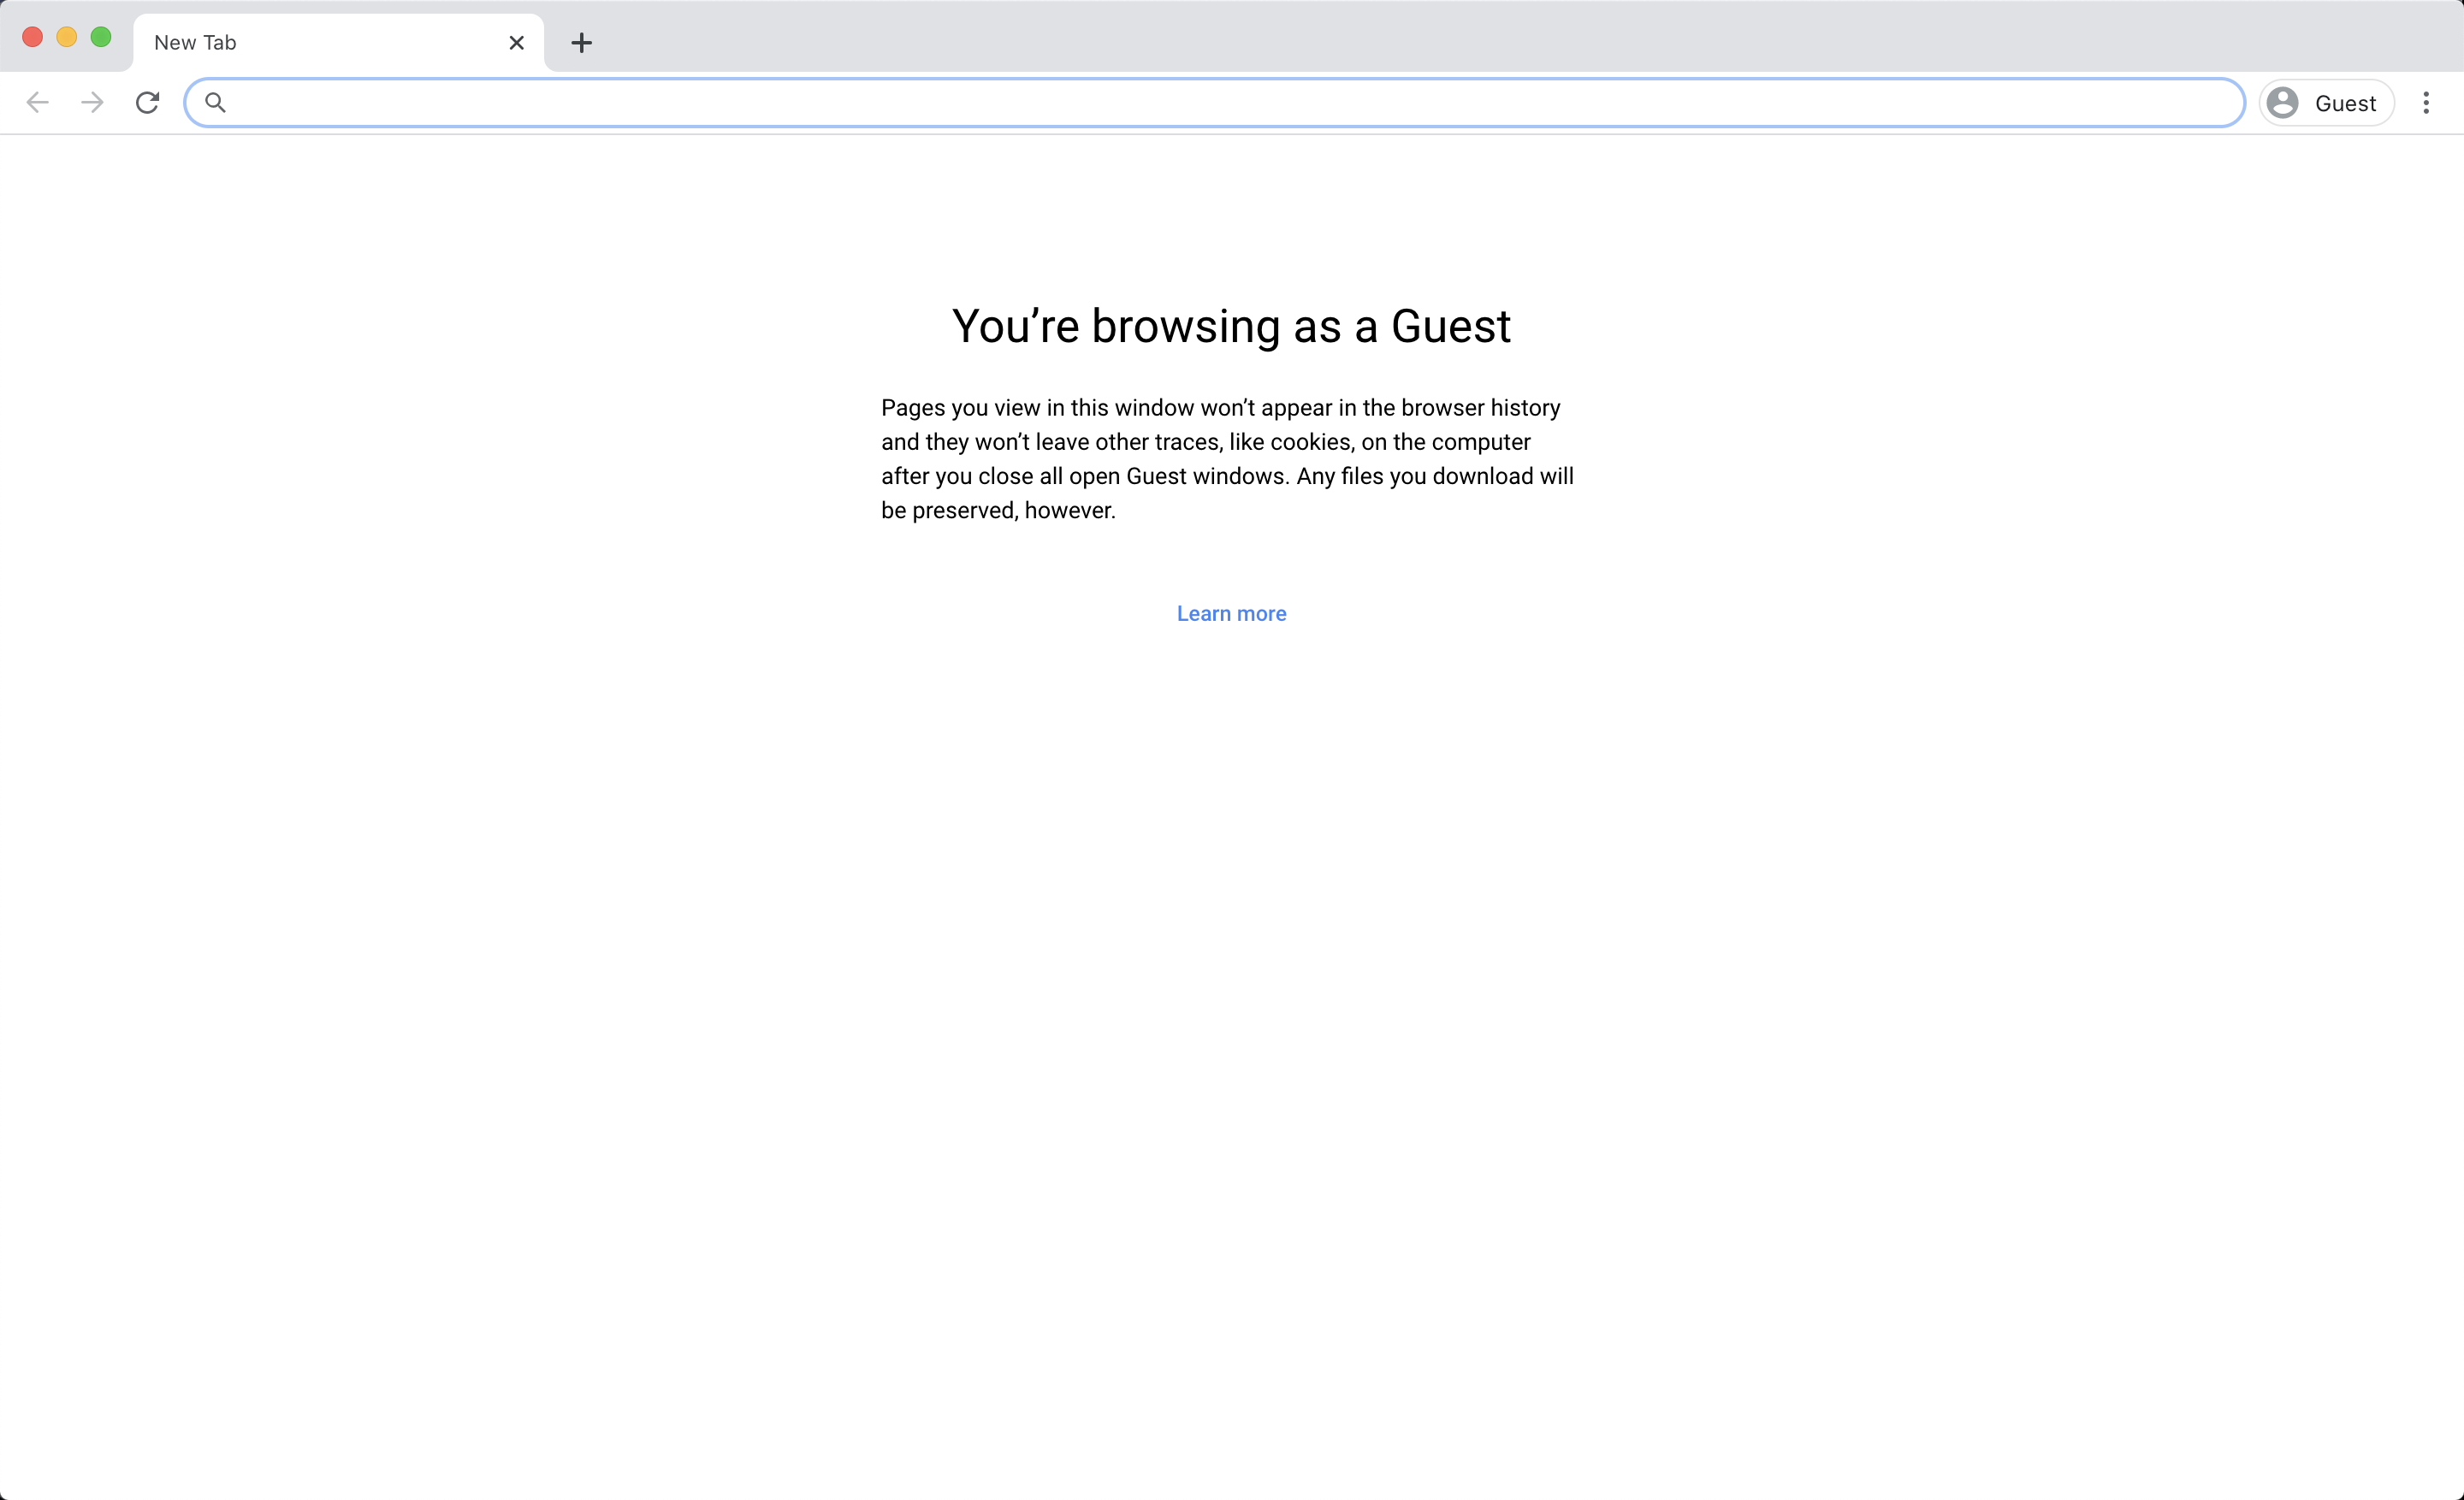
Expected Demo
We plan to demonstrate the use of our tool in two contexts.
First, we will briefly demonstrate how the tool works at each step of the end-user workflow.
Then, we will focus on the results that our tool produces.
Coming soon…

