Slide 1
NLP for Automated Clinical Notes Annotation
Presenter: Layne Wei
Advisor: Gundolf Schenk
Dmytro Lituiev

Slide 2
Why We Started This Project
Annotation:
The process of manually identifying the mentions of data elements of target signs, symptoms, events, etc. to be extracted in clinical notes.
Provides:
Quality control for cNLP output data
standards to evaluate the performance of cNLP tools
training examples to develop and improve cNLP tools

Slide 3
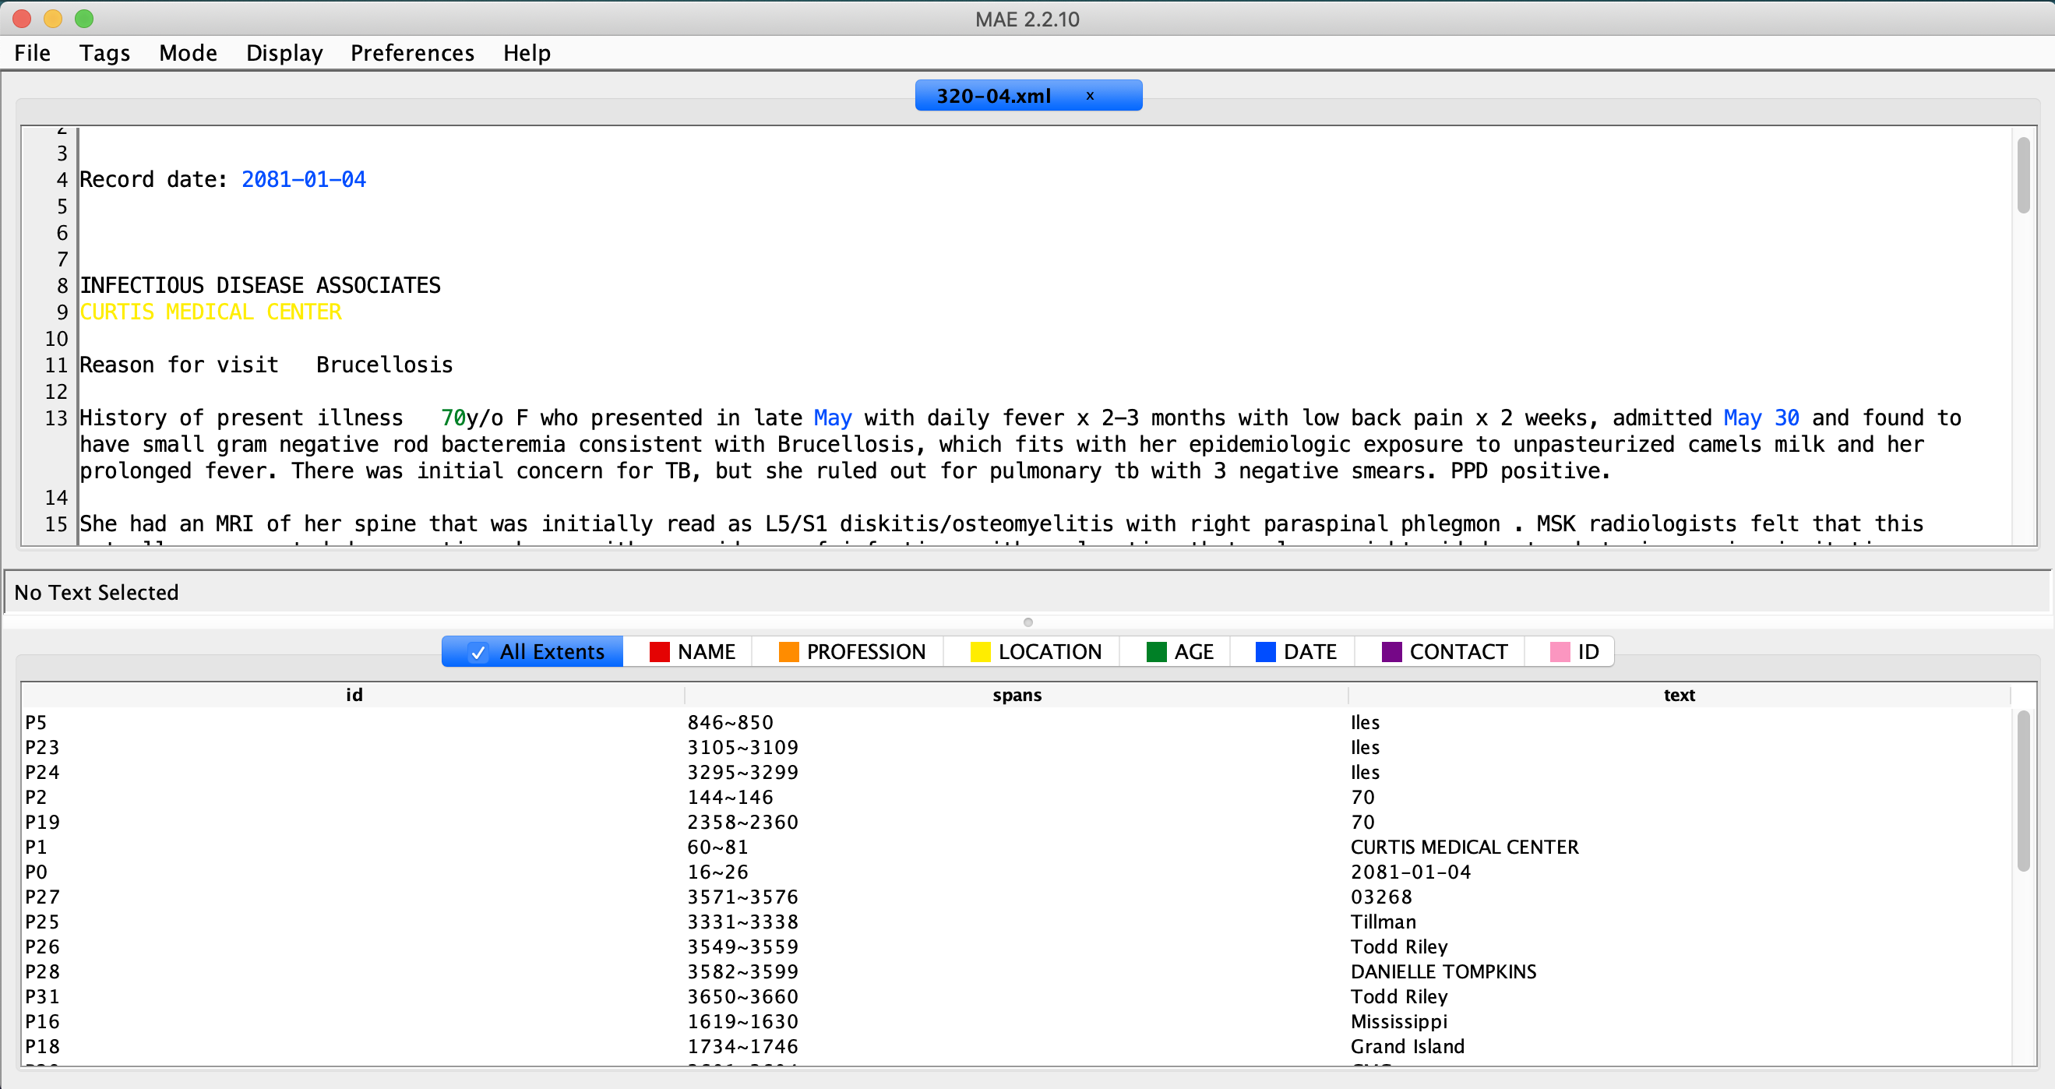
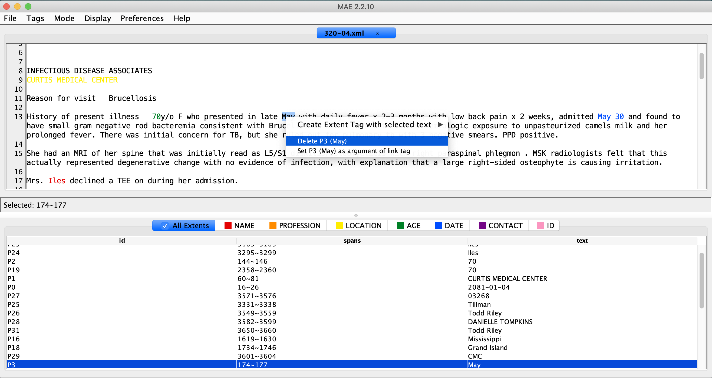
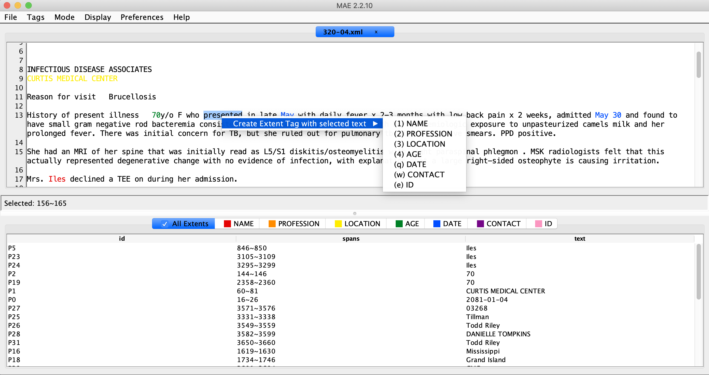
Multi-document Annotation Enviroment

Slide 4
Data Flow
Pre-annotation
(cTAKES)
Experts annotated notes
(E.g. Annotated Medical data from I2B2)
txt
xml
xml
Annotation/ Human Corection/ Filtering with a GUI tool
xml
Split train and test sets
User
ML
Model Sharing
xml
Choose subset for correction (based on confidence ranking)
Use model to predict labels unannotated set
ML annotated data with confidence score

Slide 5
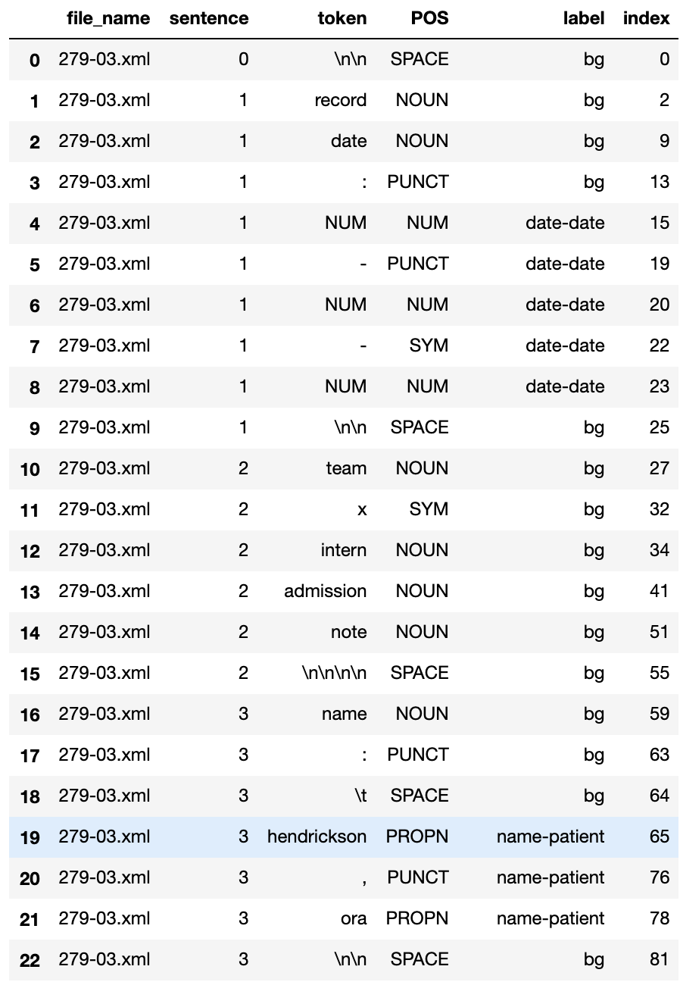
Machine Learning
Data: Protected Patients’ Information data from I2B2
Data Processing:
  Tokenize the text
  Map tokens and their label (Also Part of Speech)
  Match sentences and corresponding tokens
  Data augmentation, delete sentences and corresponding tokens that doesn’t have any labels.

Slide 6
Machine Learning
From 400 xml files:
Before data augmentation: (25:1)
  434,774 BG token VS 17,431 Non-BG token
After data augmentation: (5:1)
  89,833 BG token VS 17,431 Non-BG token

Slide 7
Machine Learning
Model construction:
  Word Embedding Layer
  Character Embedding Layer
  Character LSTM layer to get word encodings by characters
  Construct a main Bi-LSTM layer
  Construct an output layer

Slide 8
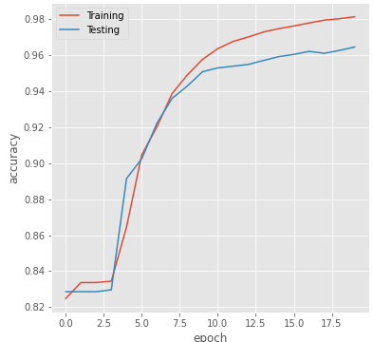
Machine Learning
Model training:

Slide 9
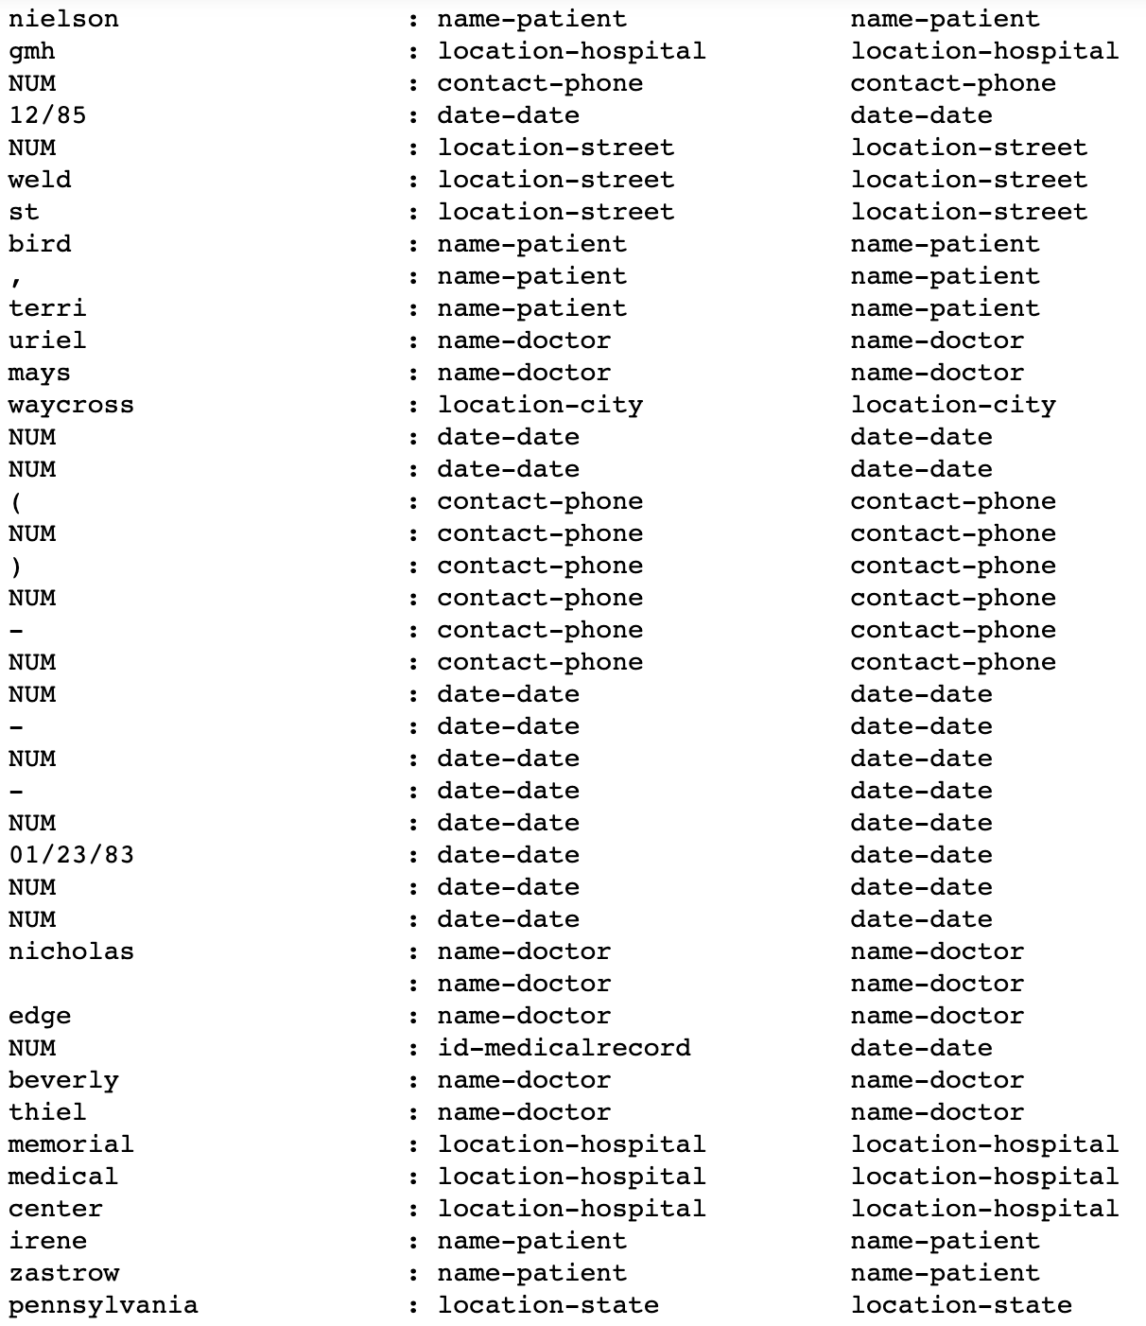
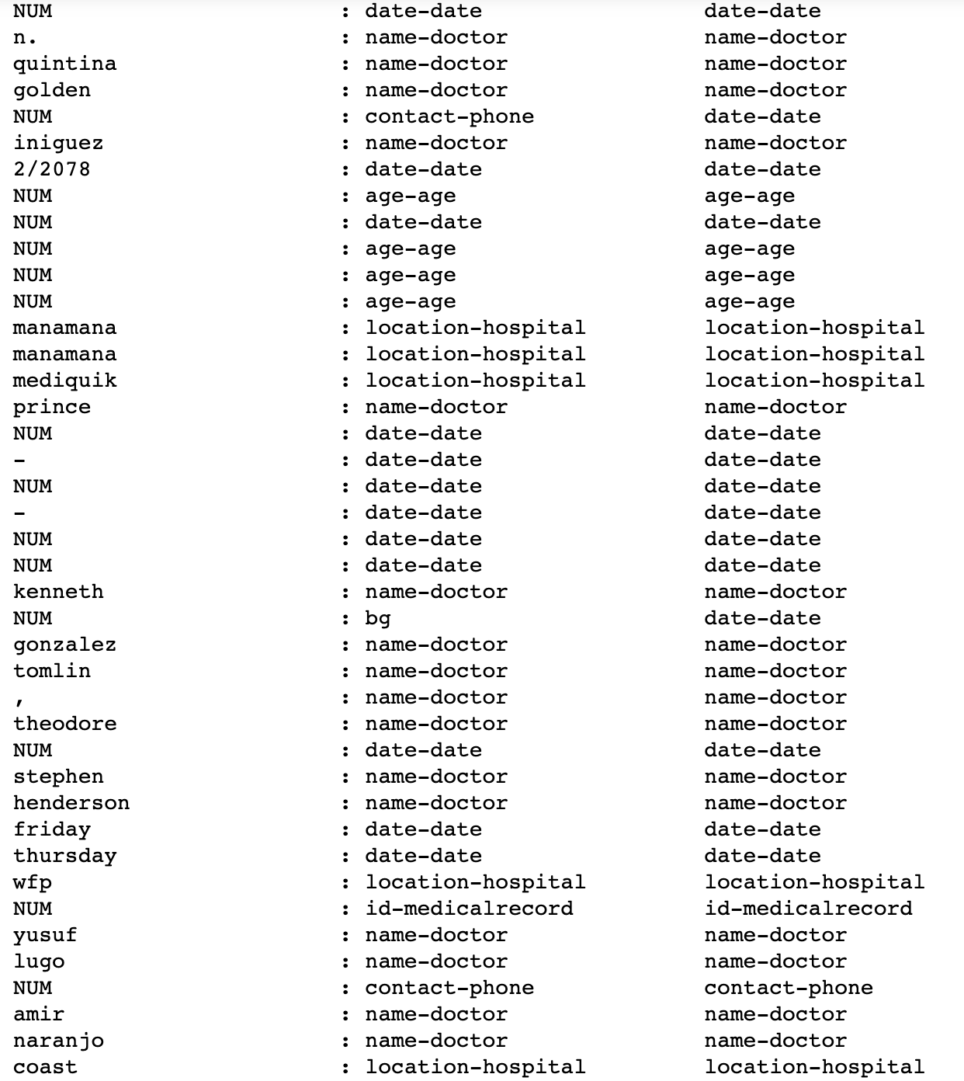
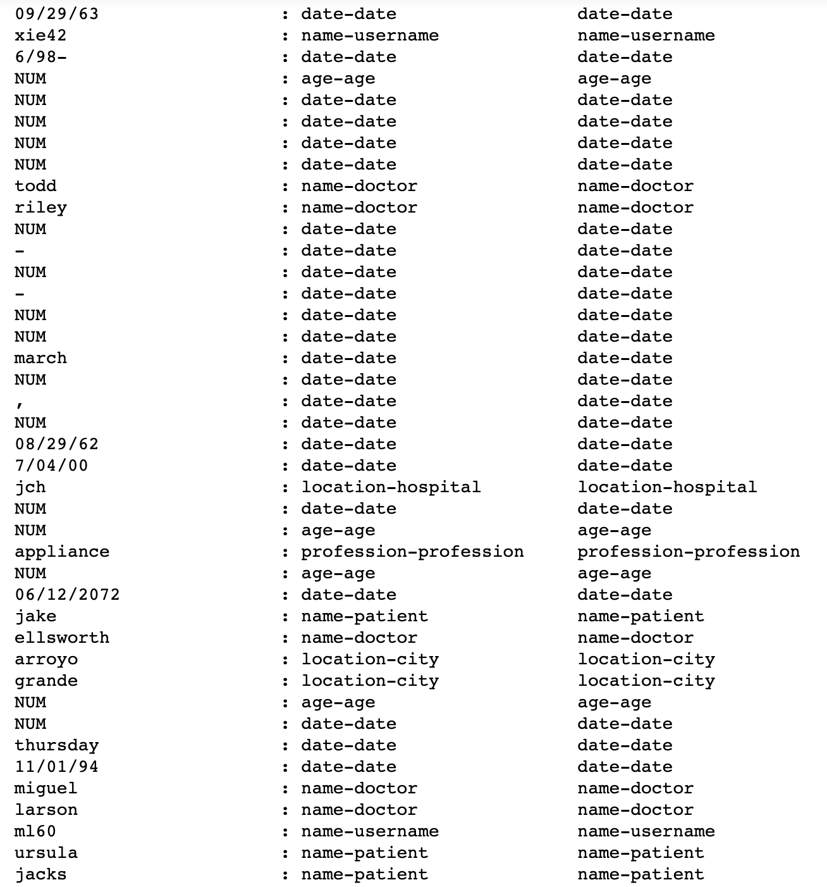
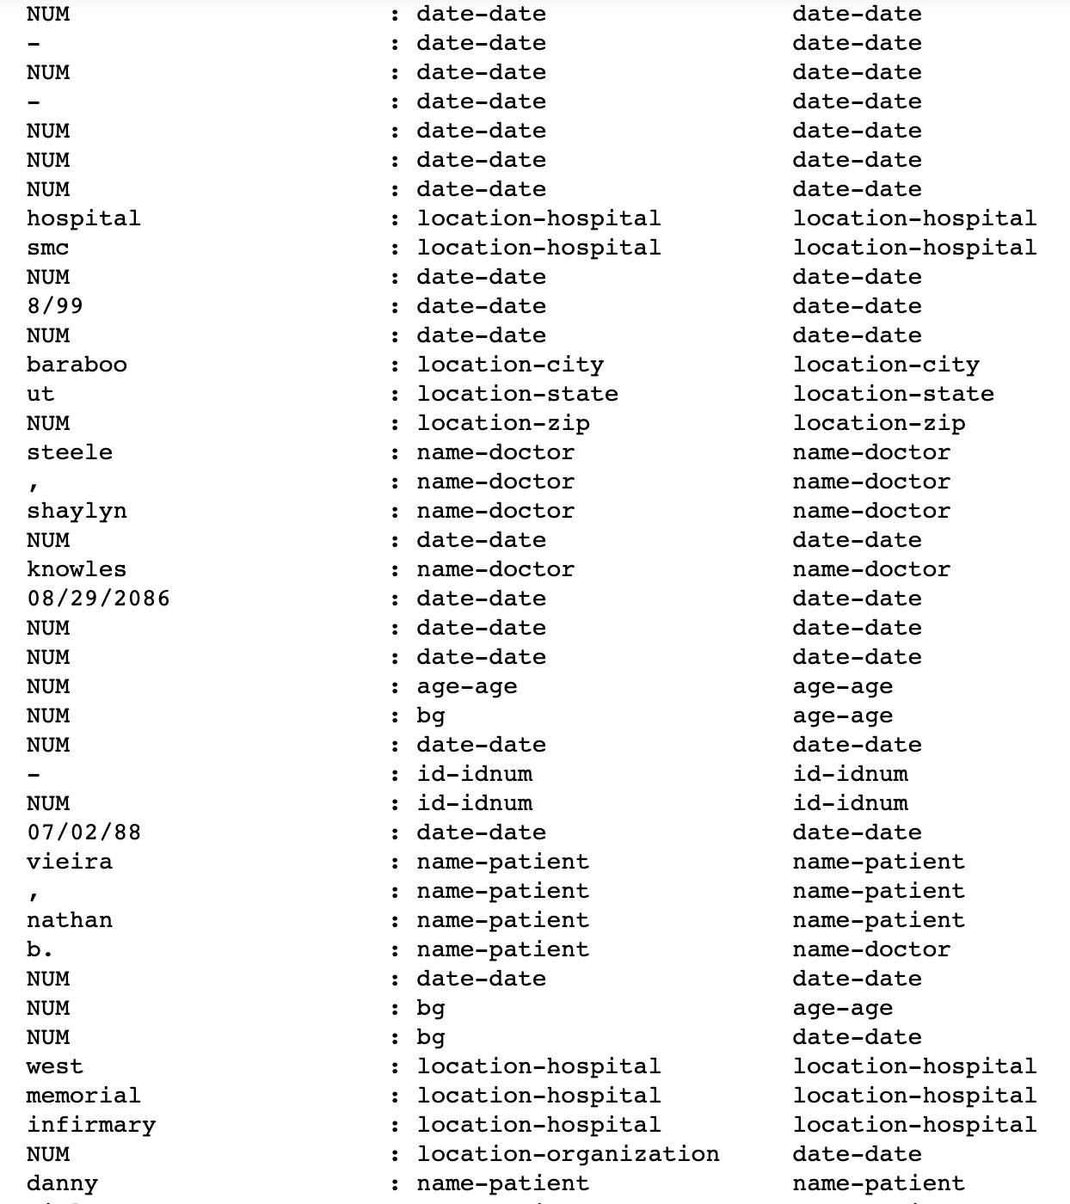
Model Performance
Token True Predict Token True Predict
Token True Predict Token True Predict

Slide 10
Model Performance
Confusion Matrix
Metrics
Precision: 0.9499
Recall: 0.8833
Accuracy: 0.9731
True Positive 1537 | False Negative 203
False Positive 81 | True Negative 8723

Slide 11
Unfinished Steps
Need for improving the model?
Generate new xml files based on ML labeled annotation
Incorporate into MAE so the user can do human correction without worrying about where the output xml files are stored

