Slide 1
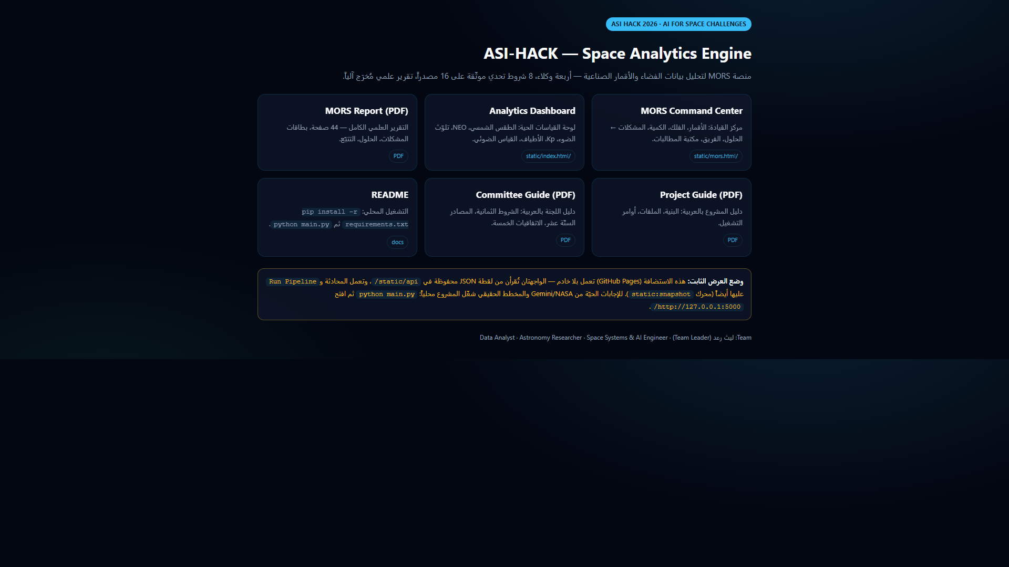
M
MORS
DATA · SPACE · QUANTUM
MORS
Scientific Space Analytics Engine
Autonomous Space Telemetry Auditing,
Anomaly Detection & Verification
منصة تحليل الفضاء العلمية — تدقيق واكتشاف الشذوذ والتحقق
ASI HACK 2026
CERTIFIED 98/100
8/8 CONDITIONS
live deployment · static host · no install
4 agents · 19 API modules · 1,714 rows · 224 audit checks · 0 failures
16 curated sources + 8 data sources · report PDF: 44 pages
01 / 10
laythraad.github.io/ASI-HACK-Space-Analytics-Engine/

Slide 2
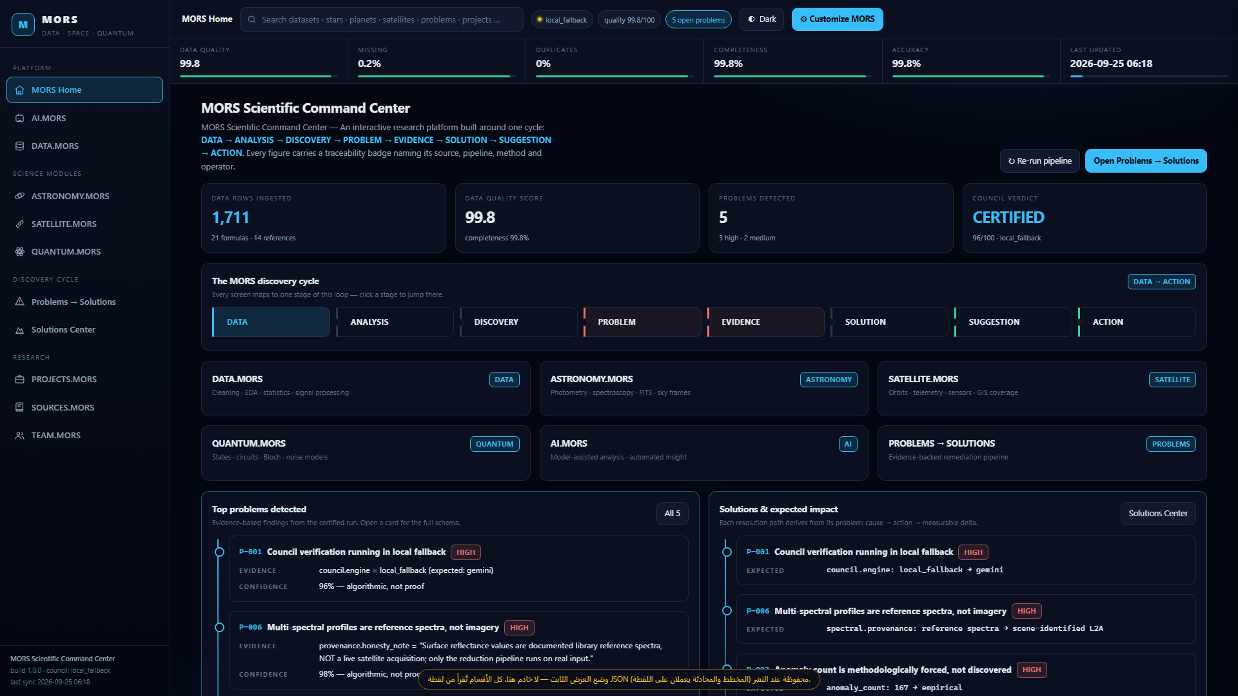
M
MORS
DATA · SPACE · QUANTUM
THE CHALLENGE — VERIFY BEFORE YOU MODEL
raw volume without verification is noise
Most tools push ML onto telemetry before anyone audits the data itself.
Our own run proved it: the IsolationForest flag rate followed the contamination setting, not real outliers (card P-003).
Data reality after cleaning: 0.158% missing cells · 0 duplicates · 166 QC flags · light-curve S/N 12.5.
Verdict written by the platform: “review-ready, not discovery-grade” — an unfalsifiable model looks scientific while proving nothing.
DATA.MORS data-health · 8,873 cells audited per run
MISSING
DUPLICATES
COMPLETENESS
QC FLAGS
0.158%
0
99.842%
166
02 / 10
laythraad.github.io/ASI-HACK-Space-Analytics-Engine/

Slide 3
M
MORS
DATA · SPACE · QUANTUM
MORS METHODOLOGY — 9-STAGE SCIENTIFIC LIFECYCLE
prompts/aimors_analyst_prompt.txt · 25 operating rules
1
RAW DATA
2
DATA QUALITY
3
ANALYSIS
4
DISCOVERY
5
PROBLEM
ingest + source badge
completeness · duplicates · outliers
EDA · statistics · signals
patterns worth a question
10-key problem card
6
EVIDENCE
7
SOLUTION
8
VERIFICATION
9
RECOMMENDATION
quantified · reproducible
steps + expected delta
council of five experts
report · trace · publish
TWO HARD RULES
1 · Do not use AI for the sake of AI — if statistics answer the question, use statistics.
2 · Every published value carries source · timestamp · method · operator (traceability badge).
03 / 10
laythraad.github.io/ASI-HACK-Space-Analytics-Engine/

Slide 4
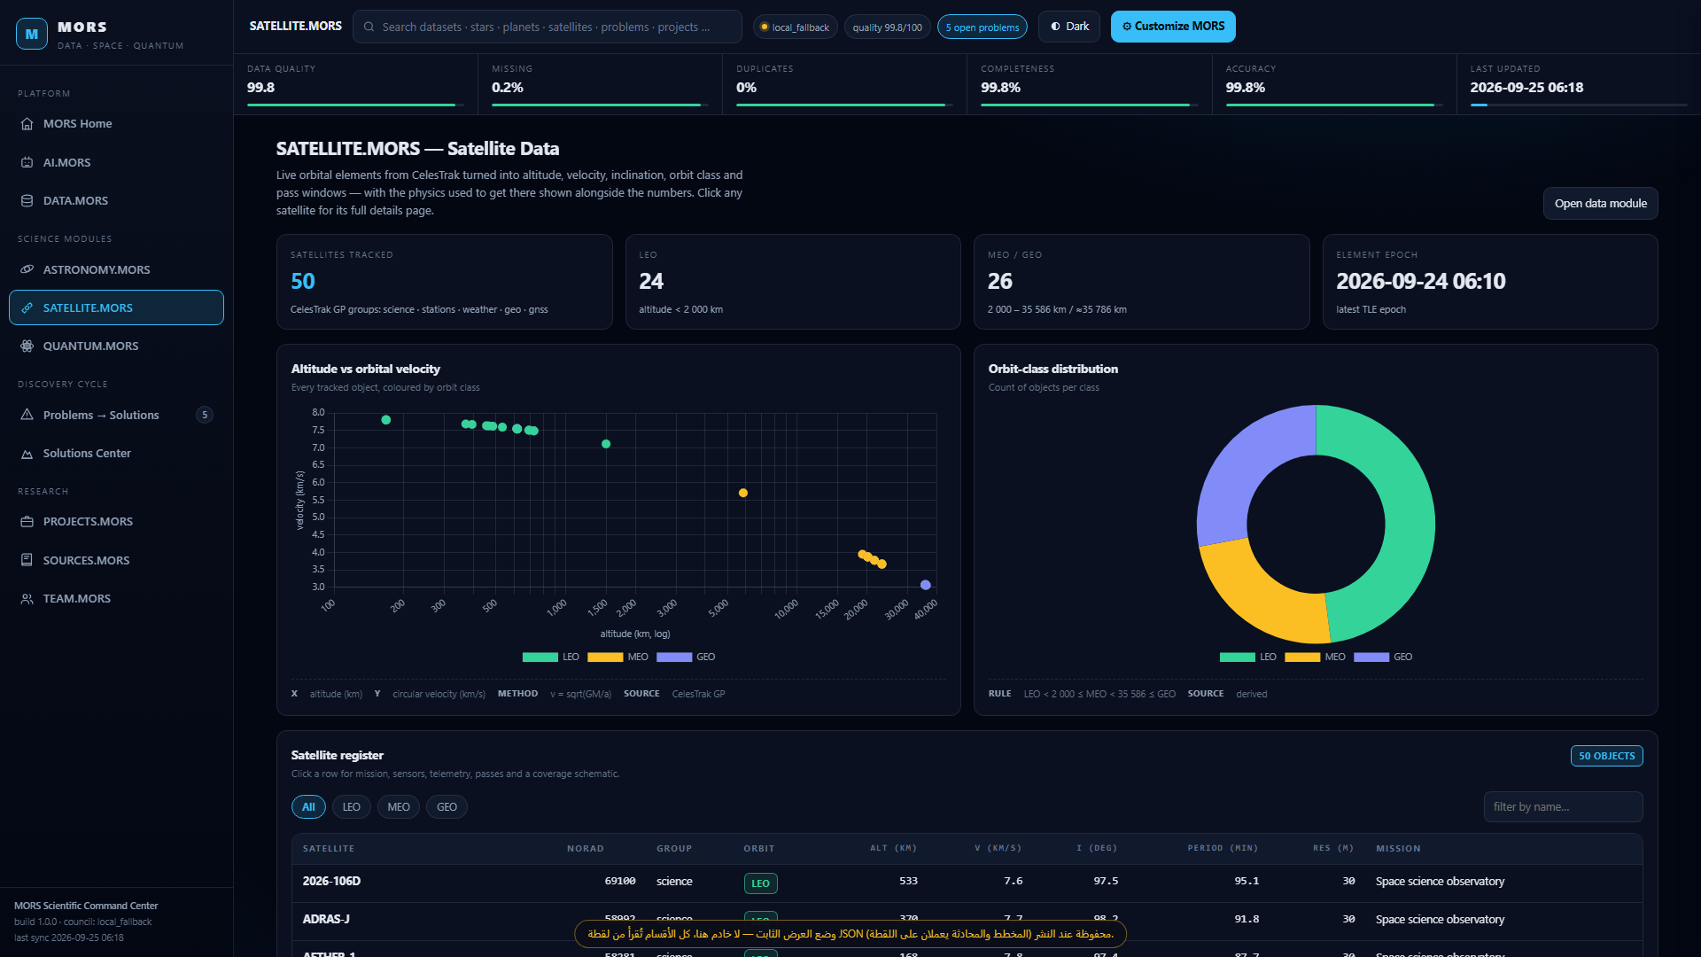
M
MORS
DATA · SPACE · QUANTUM
SATELLITE.MORS — FLEET TELEMETRY INSPECTOR
TLE → Keplerian elements → orbit class · live module
50 satellites tracked: altitude 167–36,163 km (LEO → GEO), velocity, inclination, period, perigee/apogee, NORAD ID.
Physics is shown, not hidden: a = (GM/n²)^(1/3), v = sqrt(GM/a), LEO < 2,000 km ≤ MEO ≤ GEO belt.
Sensor layer: multispectral imager · 30 m resolution · 290 km swath · telemetry mode · next 5 passes with max elevation.
Spectral bands Blue 490 · Green 560 · Red 665 · NIR 842 · SWIR1 1610 nm → NDVI / NDWI / NDBI + PCA (94.6% variance in 2 components).
SATELLITE.MORS · fleet table + orbit map + band tabs
SATELLITES
ALT RANGE
RESOLUTION
SWATH
50
167–36,163 km
30 m
290 km
04 / 10
laythraad.github.io/ASI-HACK-Space-Analytics-Engine/

Slide 5
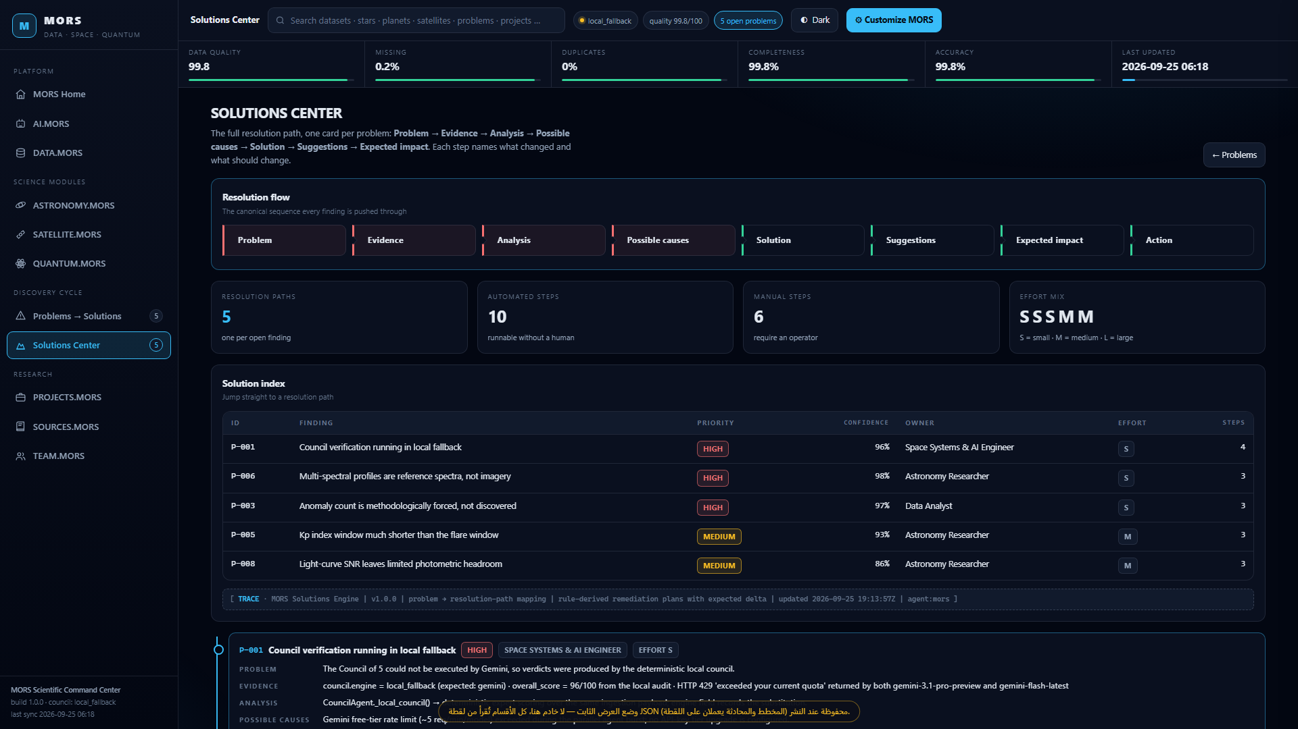
M
MORS
DATA · SPACE · QUANTUM
PROBLEMS → SOLUTIONS ENGINE
evidence · root cause · fix · measurable delta
Every anomaly is a 10-key card: symptom · root cause · fix · evidence · severity · category · component · priority code.
Priority is arithmetic, not opinion: 0.40·evidence + 0.35·impact + 0.25·confidence, printed on the card.
When Gemini 429 hits, council drops to local_fallback → expected delta council.engine: local_fallback → gemini.
Spectral indices are reference-labelled (card open while that holds) → delta provenance: reference spectra → scene-identified L2A.
SOLUTIONS.MORS · path, steps, effort, expected delta
OPEN CARDS
HIGH
MEDIUM
SCHEMA KEYS
5
3
2
10
05 / 10
laythraad.github.io/ASI-HACK-Space-Analytics-Engine/

Slide 6
M
MORS
DATA · SPACE · QUANTUM
TRUSTWORTHY AI — CONFIDENCE TAXONOMY
what the platform actually prints on every answer
STANDARD AI PIPELINE
MORS XAI ENGINE
▪ Model runs first, data quality never inspected.
▪ Single number published, no error bounds.
▪ No source, no timestamp, no operator recorded.
▪ Failure mode looks like a confident answer.
▪ Cannot be re-run or falsified by a judge.
▪ Data audit first — ML only when statistics are insufficient.
▪ Confidence level + priority formula published per card.
▪ Every value carries source · timestamp · method · operator.
▪ Engine honesty: local_fallback is labelled, never disguised.
▪ Council of five experts cross-checks and corrects claims.
5-TIER PROTOCOL ON EVERY AI ANSWER
[Observed Data]
[Calculated Metric]
[AI Interpretation]
[Hypothesis]
[Suggested Action]
06 / 10
laythraad.github.io/ASI-HACK-Space-Analytics-Engine/

Slide 7
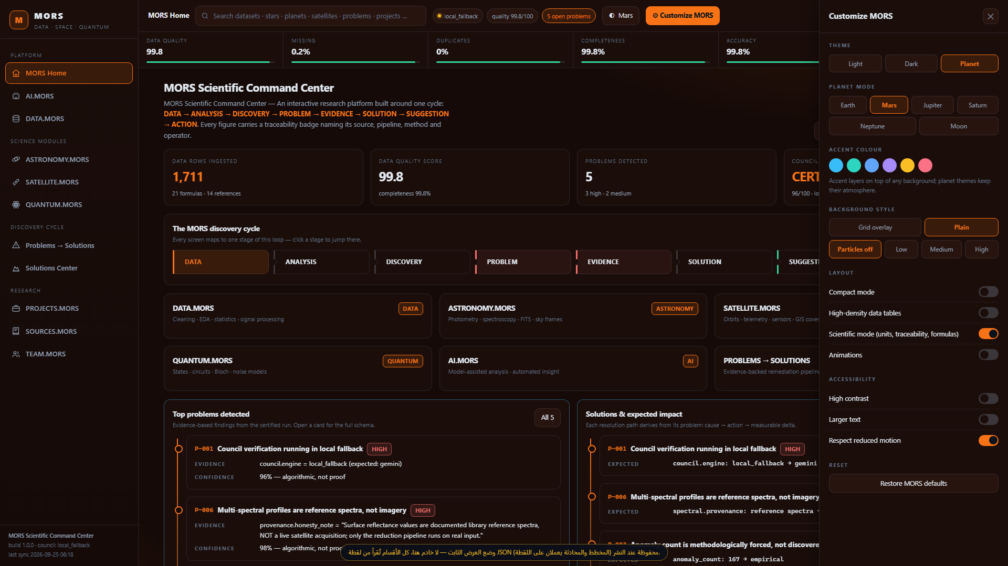
M
MORS
DATA · SPACE · QUANTUM
HIGH-DENSITY SCIENTIFIC UI / UX
dark glassmorphism · Orbitron + IBM Plex Mono + Cairo
EARTH CYAN · dark glass panels · lifecycle ribbon
MARS RUST · planet theme engine · one click
Planet themes: Earth · Mars · Jupiter · Saturn · Neptune · Moon,
plus light/dark, accent layers, grid and particle toggles.
Accordion sidebar: DATA · ASTRONOMY · SATELLITE · QUANTUM · AI ·
PROBLEMS→SOLUTIONS, with global search and instant switching.
07 / 10
laythraad.github.io/ASI-HACK-Space-Analytics-Engine/

Slide 8
M
MORS
DATA · SPACE · QUANTUM
ENGINEERING CAPABILITIES — TEAM MATRIX
4 members · published roles · module ownership
TEAM LEADER
DATA ANALYST
ليث رعد · Layth Ra'ad
role seat
System Architecture · Pipeline Orchestration · Scientific Computing · Technical Review · Scientific Visualization
Data Cleaning · EDA · Statistical Analysis · Time Series · Anomaly Detection · SQL · Feature Engineering
owns: MORS architecture · HOME · PROJECTS · TEAM
owns: DATA.MORS · PROBLEMS.MORS · SOLUTIONS.MORS
ASTRONOMY RESEARCHER
SPACE SYSTEMS & AI ENGINEER
role seat
role seat
Astropy · FITS Analysis · Photometry · Spectroscopy · Light-Curve Analysis · Sky Coordinates
Satellite & Orbit Analysis · AI Model Integration · Quantum Computing · Remote Sensing · Scientific Computing
owns: ASTRONOMY.MORS · SOURCES.MORS
owns: AI.MORS · SATELLITE.MORS · QUANTUM.MORS
08 / 10
laythraad.github.io/ASI-HACK-Space-Analytics-Engine/

Slide 9
M
MORS
DATA · SPACE · QUANTUM
MEASURABLE PLATFORM IMPACT
every number below is printed by the live platform
224
99.842%
100%
98/100
AUTOMATED CHECKS
DATA QUALITY
TRACEABILITY
COUNCIL VERDICT
0 failures · ~1 min run
8,873 cells · 1,714 rows
source · time · method · operator
CERTIFIED · 5 experts
SUPPORTING EVIDENCE
▸ 21 cited formulas · 14 references
▸ 16 curated sources + 12 data sources
▸ 8 live endpoints (NASA · NOAA · CelesTrak · GIBS)
▸ 8/8 challenge conditions (7 core + 1 extension)
▸ 18 UI modules · 19 registered endpoints
▸ 6 published master prompts
▸ 5 problem cards · 10-key schema each
▸ 44-page scientific report, auto-generated
09 / 10
laythraad.github.io/ASI-HACK-Space-Analytics-Engine/

Slide 10

M
MORS
DATA · SPACE · QUANTUM
THE FUTURE OF SPACE DATA ANALYTICS
build · learn · innovate
Try the live engine — no install, no account:
https://laythraad.github.io/ASI-HACK-Space-Analytics-Engine/
Next: deeper NASA / ESA live integration,
real Sentinel-2 L2A scene ingestion for the spectral module,
and scaling the quantum block beyond the classical statevector
(labelled honestly today as simulation, never as QPU output).
SCAN → LIVE DEMO
CERTIFIED 98/100 · 224 checks · 0 failures · 8/8 conditions
Open the link above and click through every module yourself.
Team
ليث رعد (Team Leader)
Data Analyst · Astronomy Researcher ·
Space Systems & AI Engineer
10 / 10
laythraad.github.io/ASI-HACK-Space-Analytics-Engine/

