Slide 1
CAPWAP Architecture draft-mani-ietf-capwap-arch-00
Mahalingam Mani
Avaya
Bob O’Hara
Airespace
Lily Yang
Intel

Slide 2
Overview
Motivation
  WLAN system architecture for coordinating
    Physical Distribution of APs
    Logical Management of Services they collectively provide
  Ease of Use
    Central management of WLAN System
  Increased Security
    Centralized Policy Decision & Consolidated Enforcement

Slide 3
Motivation (contd.)
  Enhanced Mobility
    Management flows coordinated at the AC obviate the need for client software to provide triggers across APs
  Quality of Service
    Systemic view offers efficient means of load-balancing across APs enhancing WLAN network efficiency

Slide 4
CAPWAP Architecture
CAPWAP seeks to define a WLAN architecture that
  normalizes
    IEEE 802.11 Real-time behavior in APs
    Consolidate IEEE 802.11 Distribution & Integration and related non-real-time services in backend (ACs)
  Provide Authentication and Discovery mechanisms to provision the APs by AC
  Negotiate
    a secure path between the two entities for CAPWAP traffic and, possibly, client data traffic.
  Facilitate AC-centric coordination of Control and Monitoring.
  Identify a low-latency AC failover mechanism

Slide 5
WLAN architecture Variants
ARCH0: Classical AP
  Each AP is an independent entity in a Distribution System (DS)
ARCH1: Split-AP
  Real-time AP MAC functions retained in AP (close to physical medium)
    Frame Security, Beaconing, Synchronization, Power Management, RRM, RADAR detection,…
  Non-real-time functions (and correlation of above) are consolidated at the AC
    (De)Authentication, Association/Disassociation, Distribution, Integration, Dynamic Channel Selection,…

Slide 6
WLAN architecture Variants (contd)
ARCH2: Split-MAC
  Some or most IEEE 802.11 MAC real-time services are moved to AC as well
    Frame Security, QoS, Channel assignment,…
ARCH3: Single-AP Switch (Bridge)
  ‘extreme-ARCH3’: AC itself is the ‘unified AP’ with APs behaving as smart-antennas: zero-roaming across antennas
    any of the antennas may transmit or receive with a client

Slide 7

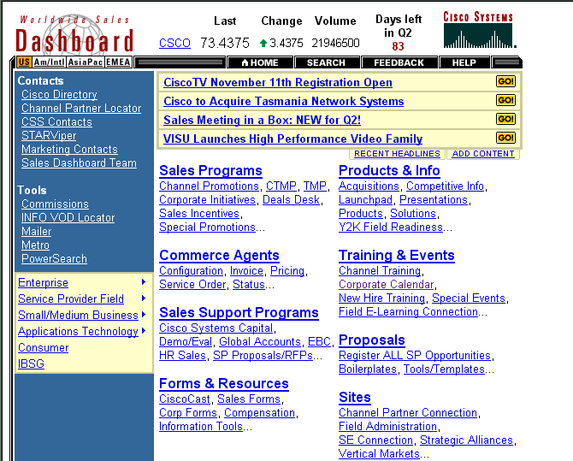
CAPWAP Topologies
Access
Controller
Access
Controller
Access
Controller
L2/L3
Host
AP
AP
AP
AP
AP
AP
Directly Connected - Split-AP
L2/L3 Cloud-Connected

Slide 8
CAPWAP Topologies (contd.)
Directly Connected: Split-MAC
L2/L3 Cloud-Connected: Split-MAC?
Access
Controller
Access
Controller
Access
Controller
Access
Controller
L2/L3
Host
AP
AP
AP
AP
AP
AP
AP
AP
AP
AP
AP
AP
CAPWAP allows for cloud and direct-connect topologies.
Topologies may be constrained by WLAN architecture types.

Slide 9
CAPWAP Architectural Outline
Discovery
Provisioning
Monitoring/Alerting, Control
Secure Encap.
(WLAN)
Manager
Data Forwarding
AP
Access
Controller
Policy
Repository
AAA

Slide 10
Authentication & Discovery
Authentication
  AP and AC need to mutually authenticate prior to engaging in discovery and configuration exchanges.
  Presume a PSK/certificate-based enrolment of APs
    a lightweight authentication algorithm is required (to let APs of varied lightness)
Key Exchange
  Keys generated from the cryptographic authentication exchange may be used to protect subsequent exchanges and derive traffic-related keys.
  Depending on requirements and architecture
    independent SA’s may be established to secure data and management traffic
    ARCH2-like systems may use 802.11i for data security.

Slide 11
Authentication & Discovery (contd.)
Discovery phase, prior to authentication, may involve identifying the right AC to associate with among a set of available ACs.
  In some architectures such as in ARCH2 this discovery may be trivial.
  Mixed mode environments may select and associate with available ACs by exchanging architectural types (ARCH0-3).
Discovery also involves the announcement of each entity’s capabilities to its associated entity (AP<->AC).
  Such discovery may consider use of existing or extensions of existing protocols, e.g., LLDP (IEEE 802.1ab) or upcoming 802.1af (authenticated discovery).
  Suitable IETF protocols may also be candidates.s

Slide 12
Encapsulation/Tunneling
Non-real-time service functions deferred to AC
  Management/Control traffic to be encapsulated/ tunneled over Ethernet LAN between AP & AC.
    They may be MAC layer frames that are L3-encapsulated
  Existing secure encapsulation protocols that may use the lightweight key derivation are candidates for consideration.

Slide 13
Provisioning, Control & Monitoring
CAPWAP architecture allows for
  ACs to deliver secure boot/runtime configuration to APs
  ACs to help retrieve MAC/PHY layer status from APs
    aggregating dynamic views of APs in a ESS or several ESSs
  set up APs to send low-level alerts from APs to AC (as triggers)
  forward management/control frames to AC for non-real-time functions
  AC may control / authorize AP-AP forwarding in a AP cloud
  …

Slide 14
Alternatives
Distributed Control
  Scalability is a concern under high-mobility when updates may be of the O(N²)
  Timing constraints may dictate limitations.
IAPP
  A Distributed Control Primitive
  Known security issues
  Best Current Practices Spec. - not a standard
  Above shortcomings of distributed control/ context transfers.

