Slide 1
IT 601: Mobile Computing
IEEE 802.11e
Prof. Anirudha Sahoo
IIT Bombay

Slide 2
Why 802.11e
802.11 does not have any inherent QoS support
  cannot discriminate between different traffic
  hence real time applications like VoIP, video streaming cannot be run (satisfactorily) over 802.11 network
Hence the 802.11e task force was established to introduce QoS support at the MAC layer

Slide 3
802.11e
Introduced new MAC layer function called Hybrid Coordinator Function (HCF)
  HCF has two methods of accessing the medium
    Enhanced Distributed Channel Access (EDCA)
    HCF Controlled Channel Access (HCCA)
  One main feature of HCF is the concept of TXOP
    time duration during which a station (QSTA) is allowed to transmit

Slide 4
Enhanced Distributed Channel Access (EDCA)
This is HCF Contention Based channel access
Provides service differentiation by prioritization
Traffic can be classified into 8 different classes (priority)
Each station has 4 access categories (AC) to provide service differentiation
  Packets from upper layer is assigned a priority and put into an access category

Slide 5
Access Category (AC)
Access category (AC) as a virtual DCF
4 ACs implemented within a QSTA to support 8 user priorities
Multiple ACs contend independently
The winning AC transmits frames
AC0
AC1
AC2
AC3
A
B
A
B
A
B
A
B
B
I
a
B
I
a
B
I
a
B
I
a
O
F
c
O
F
c
O
F
c
O
F
c
[
S
k
[
S
k
[
S
k
[
S
k
0
[
o
1
[
o
2
[
o
3
[
o
]
0
f
]
1
f
]
2
f
]
3
f
]
f
]
f
]
f
]
f
Virtual Collision Handler
Transmission
Attempt

Slide 6
Differentiated Channel Access
Each AC behaves as a single DCF and contends with other ACs with its contending parameters.
Each AC contends with
  AIFS[AC] (instead of DIFS) and CWmin[AC], CWmax[AC] (instead of CWmin, CWmax), TXOP_{limit} [AC]
  AIFS[AC] = AIFSN[AC]. aSlotTime + aSIFSTime
    where AIFSN[AC] is given in the table

Slide 7
EDCA default values
Access Category | CW_min | CW_max | AIFSN
AC_BK (AC[0]) | aCWmin | aCWmax | 7
AC_BE (AC[1]) | aCWmin | aCWmax | 3
AC_VI (AC[2]) | aCWmin/2 | aCWmin | 2
AC_VO (AC[3]) | aCWmin/4 | aCWmin/2 | 2

Slide 8
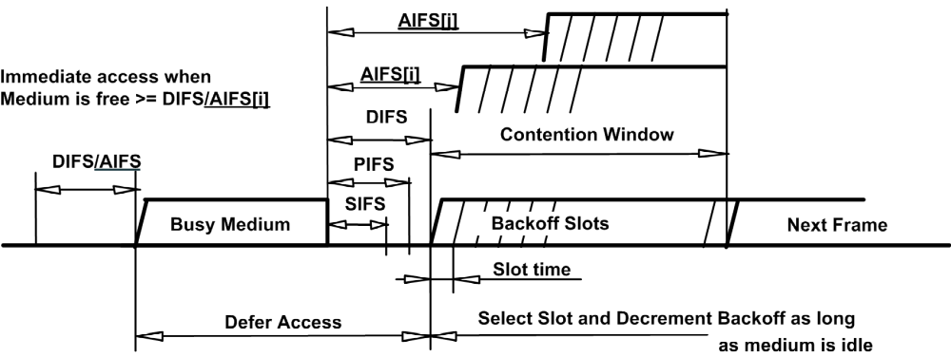
IFSs in 802.11e
Source: IEEE 802.11e standard

Slide 9
EDCA Backoff Procedure
Similar to 802.11
  Backoff time chosen between [0, CW[AC]].
  On collision
    CW[AC] = (CW[AC]+1) *2 -1 (until CM_{max}[AC])

Slide 10
EDCA operation
Data from upper layer is classified and put into appropriate AC
Internal contention algorithm is run between the ACs
  each AC gets a backoff time
  AC which has the smallest (AIFS[AC] + backoff) time wins the contention
  In case of internal collision (called virtual collision), the AC with highest priority wins
  The winner AC contends externally with the other STAs using the same backoff.

Slide 11
HCF Controlled Channel Access(HCCA)
Contention free part of HCF
Manages access to wireless medium using HC which has a higher medium access priority than non-AP STAs (EDCA).
HC sends several contention free burst called controlled access periods (CAP) after detecting the medium to be idle for PIFS
Two primary differences between PCF and HCCA
  Frame exchange can happen both in CP and CFP period
  HC grants a polled TXOP with duration specified in a QoS CF Poll frame

Slide 12
HCF Controlled Channel Access(HCCA)
HC may function as PC that uses CFP for polled data (this mode can be used by both 802.11 and 802.11e STAs)
  but this is optional in 802.11e implementation
HC may send QoS CF polls in HCCA mode
  But not mandatory since it can send those in CP also
Maximum duration of HCCA is limited by the variable TCAP_{Limit}

Slide 13
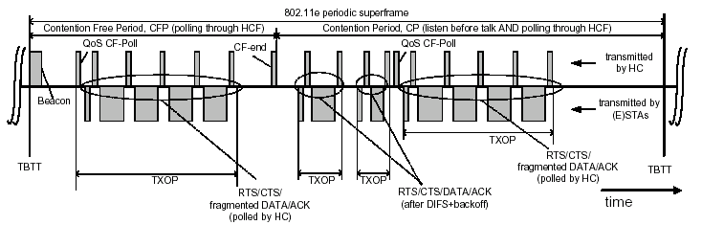
IEEE802.11e superframe
Source : “IEEE 802.11e Wireless LAN for Quality of Service” –
Mangold et al., Proc. European Wireless 2002.

Slide 14
Block Acknowledgement
Improves channel efficiency by aggregating several Ack into one frame
  A bitmap is used to ack a set of MPDUs
  Immediate block ack
    BlockAckReq is immediately responded with BlockAck
  Delayed block ack
    Receiver responds with an ACK to BlockAckReq
    Then the receiver would send the BlockAck in the next TXOP
    Once the BlockAck is ready the receiver will send this frame in the earliest TXOP using the highest priority AC

Slide 15
Block Acknowledgement
The sender after getting the blockAck bitmap, resends any frames that are not ACKed either in another block or individually

Slide 16
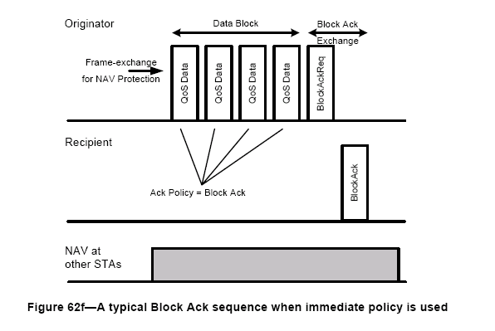
Immediate block ack
Source : IEEE 802.11e standard document

Slide 17
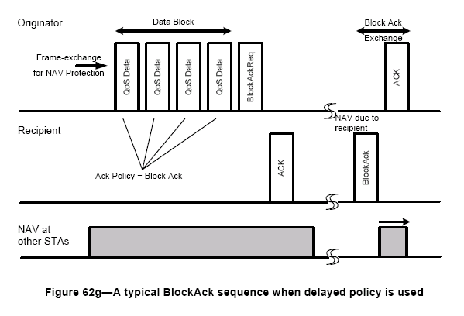
Delayed block ack
Source : IEEE 802.11e standard document

Slide 18
References
IEEE 802.11e standard
Quiang Ni et al.,“performance Analysis and enhancements for IEEE 802.11e Wireless Networks” – IEEE Network July/August 2005
N. Ramos et al., “Quality of Service Provisioning in802.11e Networks: Challenges, Approaches, and Future Directions” – IEEE Network July/August 2005
G. Bianchi et al., “Understanding 802.11e Contention-Based Prioritization Mechanisms and Their Coexistence with Legacy 802.11 Stations” – IEEE Network July/August 2005
Mangold et al., “IEEE 802.11e Wireless LAN for Quality of Service”- Proc. European Wireless 2002.

