Slide 1
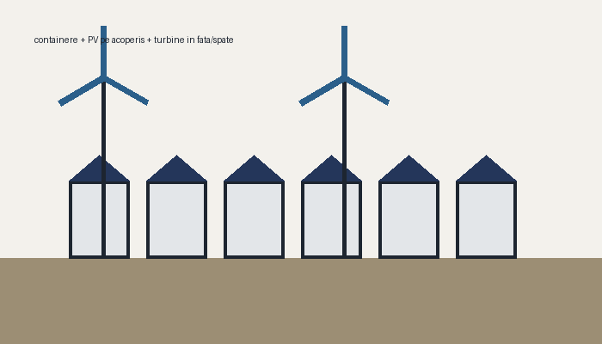
Green Construction Site (off-grid) — zero CO2/CO emissions
• Site powered only by sun + wind + batteries. No grid connection.
• Modules: offices, accommodation, sanitary, technical, EV station (summer), perimeter lighting.
• Default site: Constanta. Scenarios MOST UNFAVORABLE / NORMAL / ECONOMIC (identical production).
Powered by STRABAG MK-LL — Engineering Division Constanta - Jedi Ciprian Lazar

Slide 2
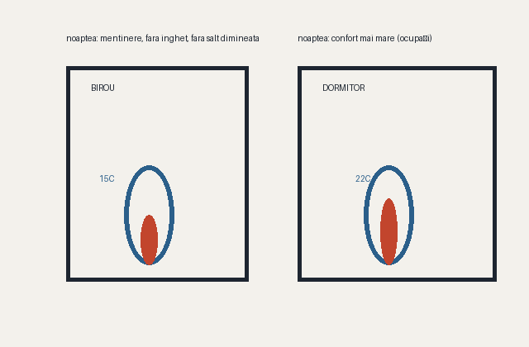
Design constraints
• 1. No big battery bank: wind turbines — wind blows day and night.
• 2. Turbines under 5 kW (3–3.5 kW): no 5 m/s start-up requirement. On the coast it would not matter; past the Carpathian bend it does.
• 3. Ventilation via air-to-air heat pump — oil radiators consume too much.
• 4. In winter, offices held at ~15C at night: no big morning ramp-up, no freezing of the water/coffee machine.
• 5. Bedrooms: more energy at night than by day (occupant comfort).
Powered by STRABAG MK-LL — Engineering Division Constanta - Jedi Ciprian Lazar

Slide 3
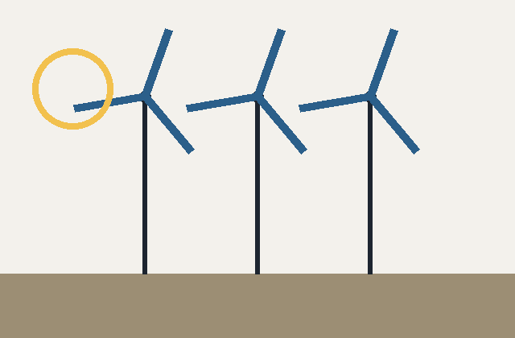
Solution: wind + solar + batteries
• 3–3.5 kW turbines on 6 m masts, 2 rows, 15–20 m apart.
• PV on container roofs. 8 kW hybrid inverters, 1–2 per panel.
• Battery only for night and calm — not for the whole consumption.
• Off-grid mandatory: installed turbines = required ones; frontage extended as needed.
Powered by STRABAG MK-LL — Engineering Division Constanta - Jedi Ciprian Lazar

Slide 4
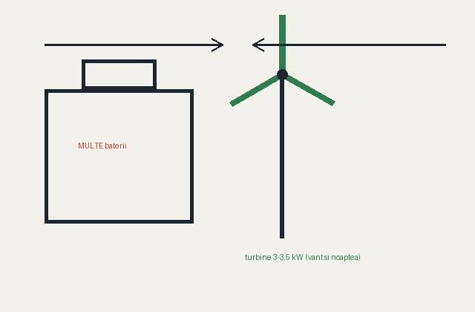
Why not just big batteries (the convenient option)
• Convenient option: big battery + PV. High cost and volume, autonomy limited to sunless days.
• Chosen option: wind complements at night and in winter, when PV is weak.
• Result: smaller battery (buffer only), cheaper and more reliable system.
Powered by STRABAG MK-LL — Engineering Division Constanta - Jedi Ciprian Lazar

Slide 5
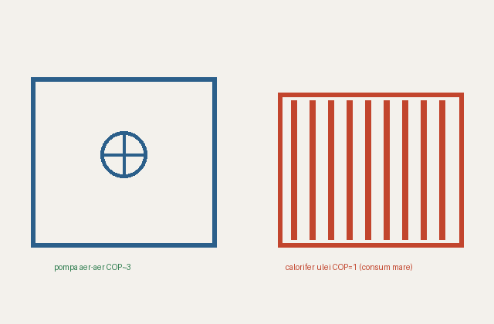
Air-to-air heat pump vs oil radiator
• Heat pump: COP ~3 → 1 kWh electric = ~3 kWh heat.
• Oil radiator: COP = 1 → same heat costs 3x more energy.
• Heat-recovery ventilation (η=75%) on the heat pump — low hot-air losses.
• In the HTML only the heat-pump variant; radiators remain only in Excel/PPT as reference.
Powered by STRABAG MK-LL — Engineering Division Constanta - Jedi Ciprian Lazar

Slide 6
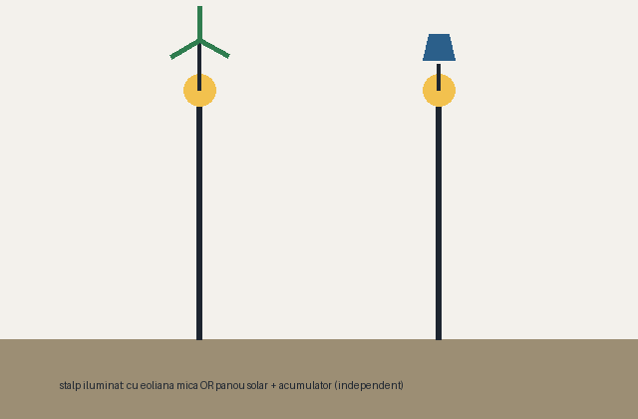
Independent perimeter lighting
• Lighting poles around the site, independent from the main panel.
• Pole options: with a small wind turbine on top, or solar panel + own battery.
• Their consumption does not load the main installation (can be 0 from the site grid if 100% autonomous).
Powered by STRABAG MK-LL — Engineering Division Constanta - Jedi Ciprian Lazar

Slide 7
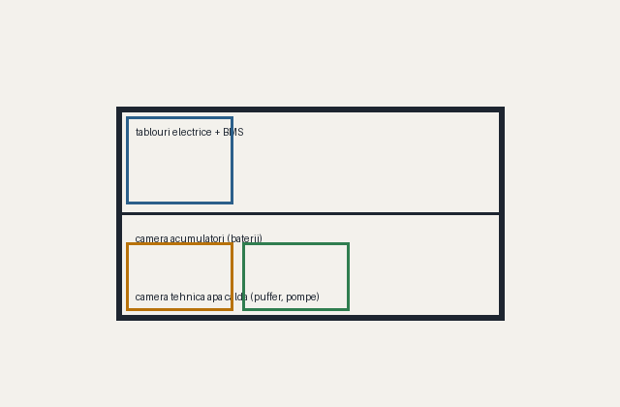
Technical container — why it is needed
• It houses: electrical panels (inverter + main ATS + BMS), battery room, hot-water technical room (buffer + pumps).
• DC/AC protection, disconnectors, metering, BMS/EMS with priority load shedding.
• Without it, equipment would sit exposed in office/bedroom containers — risk and hard maintenance.
• CCTV: 4, 6, 8 or 10 cameras — 8 W/camera + DVR 40 W + transmission/switch 20 W (24/7); dedicated 1P+N C10A circuit in the technical panel; PoE cable max 90 m/segment or radio.
Powered by STRABAG MK-LL — Engineering Division Constanta - Jedi Ciprian Lazar

Slide 8
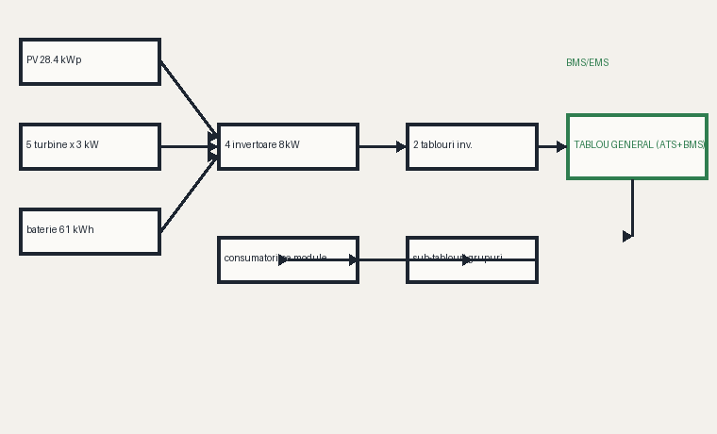
Block diagram (energy flow)
• Sources (PV + wind + battery) → inverters → inverter panels → main panel (ATS, BMS) → group sub-panels → consumers.
• BMS/EMS measures and controls load shedding by priority: 1) lighting+monitoring, 2) hot water, 3) EV, 4) heating/cooling.
Powered by STRABAG MK-LL — Engineering Division Constanta - Jedi Ciprian Lazar

Slide 9
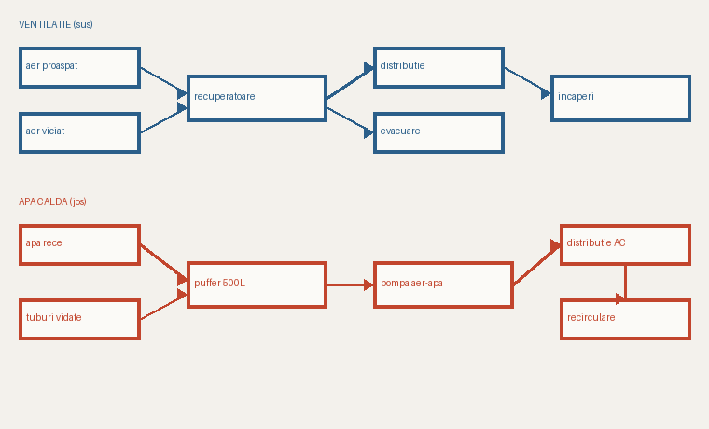
Functional diagram installations (ventilation + hot water)
• Ventilation: fresh + exhaust air through heat recovery units (η=75%) to the rooms.
• Hot water: evacuated tubes on roof → 500 L buffer at 55C → backup air-to-water heat pump → distribution + recirculation.
Powered by STRABAG MK-LL — Engineering Division Constanta - Jedi Ciprian Lazar

Slide 10
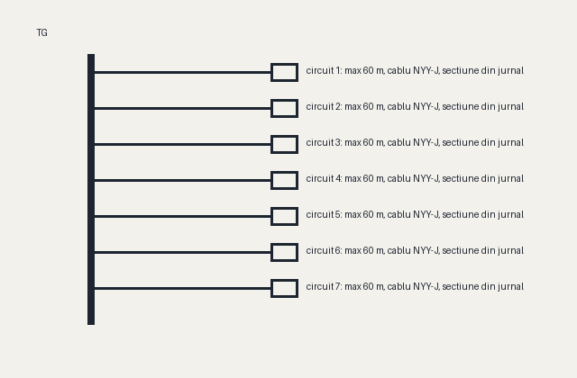
Panels and cables (single-line)
• Each sub-panel: circuits with own breaker (1P+N single / 3P+N three-phase), NYY-J cable sized per schedule.
• Max cable length per circuit: 60 m. In the HTML you have the cable schedule and the single/three-phase consumer list with Pi (you size the three-phase breakers).
• Each sub-panel is fed from the main panel; PE → site earthing.
Powered by STRABAG MK-LL — Engineering Division Constanta - Jedi Ciprian Lazar

Slide 11
Results (Constanta, V2, MOST UNFAVORABLE scenario, 11h x 5 days)
• Consumption: 22,071 kWh/yr. Production: 28.4 kWp PV + 5 × 3 kW turbines = 48,997 kWh/yr → off-grid, 0 kWh from grid.
• 61 kWh battery · 4 inverters on 2 panels + 1 main panel + BMS · 63 panels, 8 strings.
• Frontage needed for turbines: ~54 m (2 rows × 18 m). Frost depth 0.70 m → foundation ≥ 0.85 m.
• With summer EV station (40 kWh/day) and outdoor lighting: consumption ~31,841 kWh/yr, still off-grid.
Figures from the v4 model (Excel + HTML match).
Powered by STRABAG MK-LL — Engineering Division Constanta - Jedi Ciprian Lazar

Slide 12
Key points
• Basic rule: green site = off-grid mandatory, no grid.
• Working schedule can change per season (winter/summer): hours, start time, days/week (1–7).
• The optimizer automatically finds the program with the fewest turbines needed.
• Powered by STRABAG MK-LL — Engineering Division Constanta - Jedi Ciprian Lazar
Powered by STRABAG MK-LL — Engineering Division Constanta - Jedi Ciprian Lazar

