Slide 1




undefined
Our data insights

Slide 2
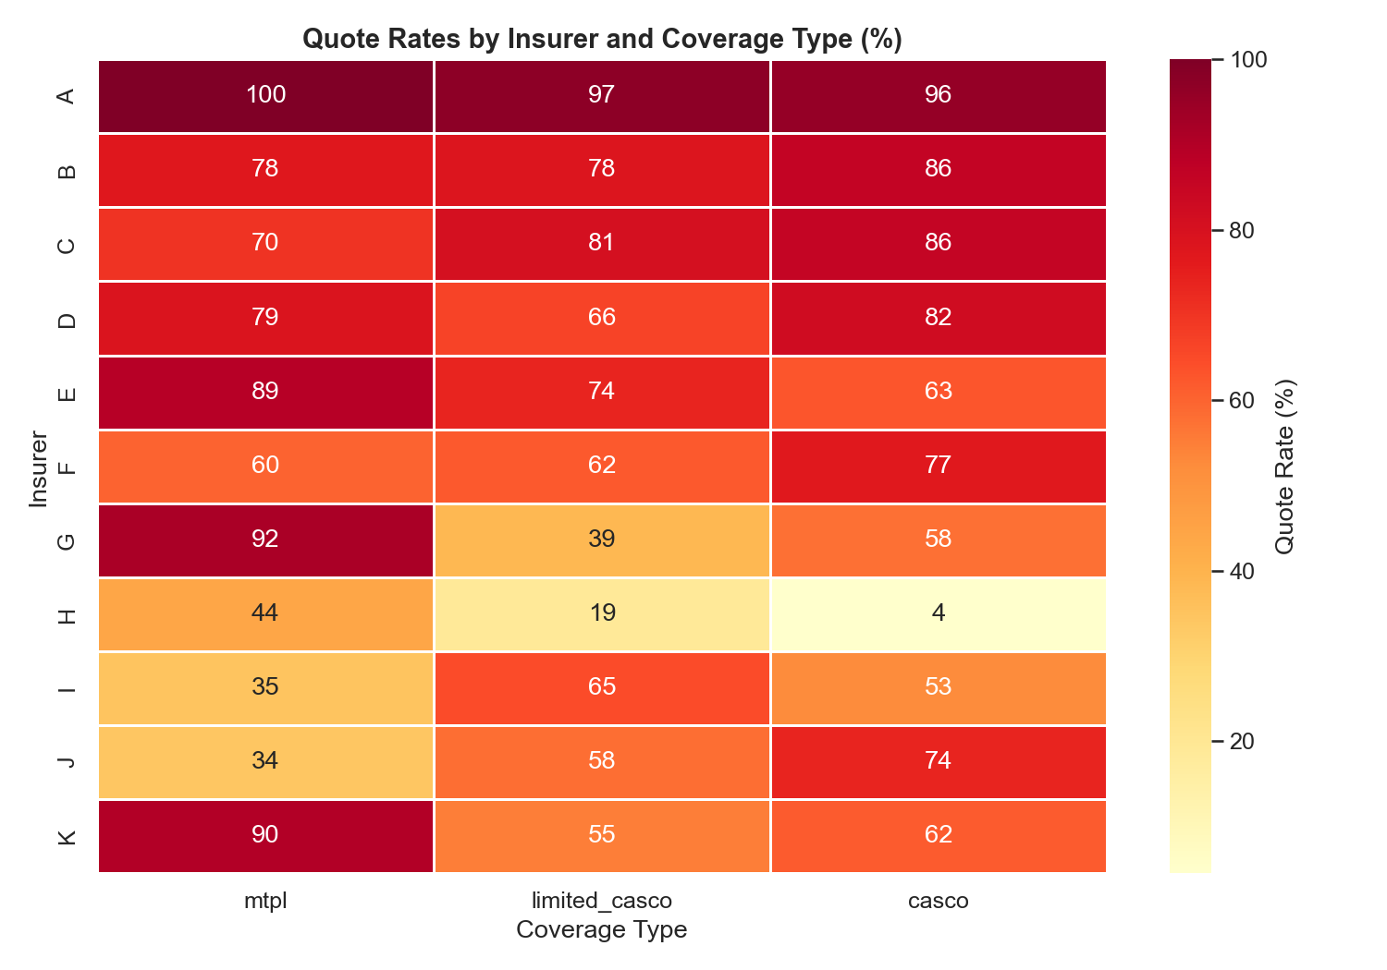
Not all insurers compete everywhere and that creates opportunity.
Limited_casco the most popular and the highest var
H is extremely selective
A dominates across all types

Slide 3
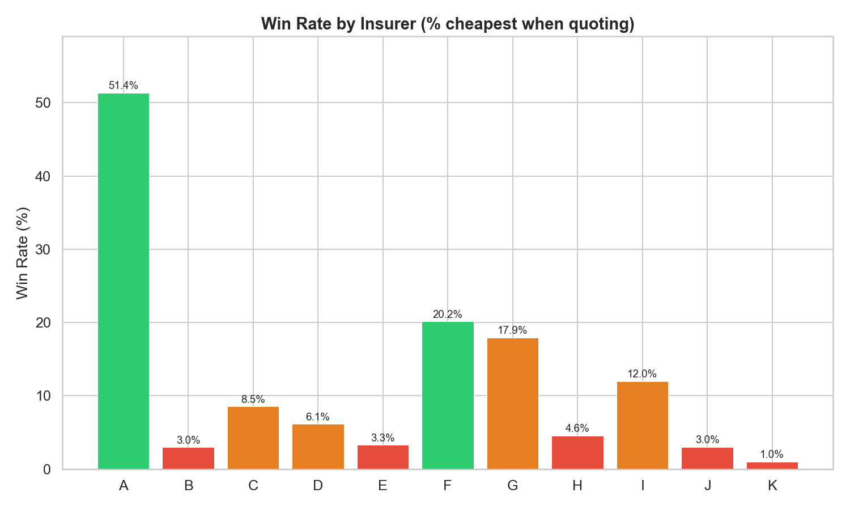
K wins just 1% quoting 66% of the time it is the most overpriced

Slide 4
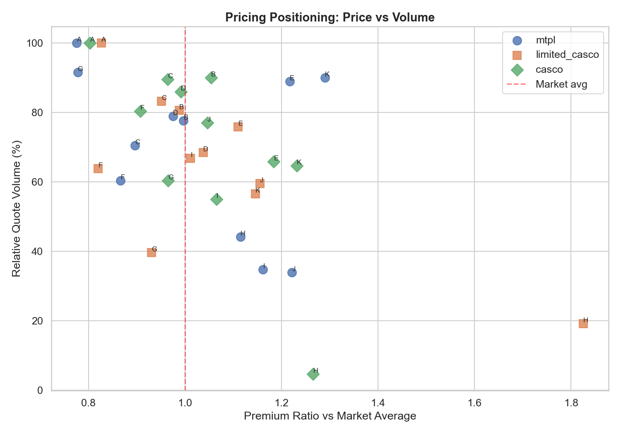
E, H, J, K are all >1.1X market average → >30% of their quotes are overpriced

Slide 5
Half the market is overpriced and losing. That's where we enter.

Slide 6
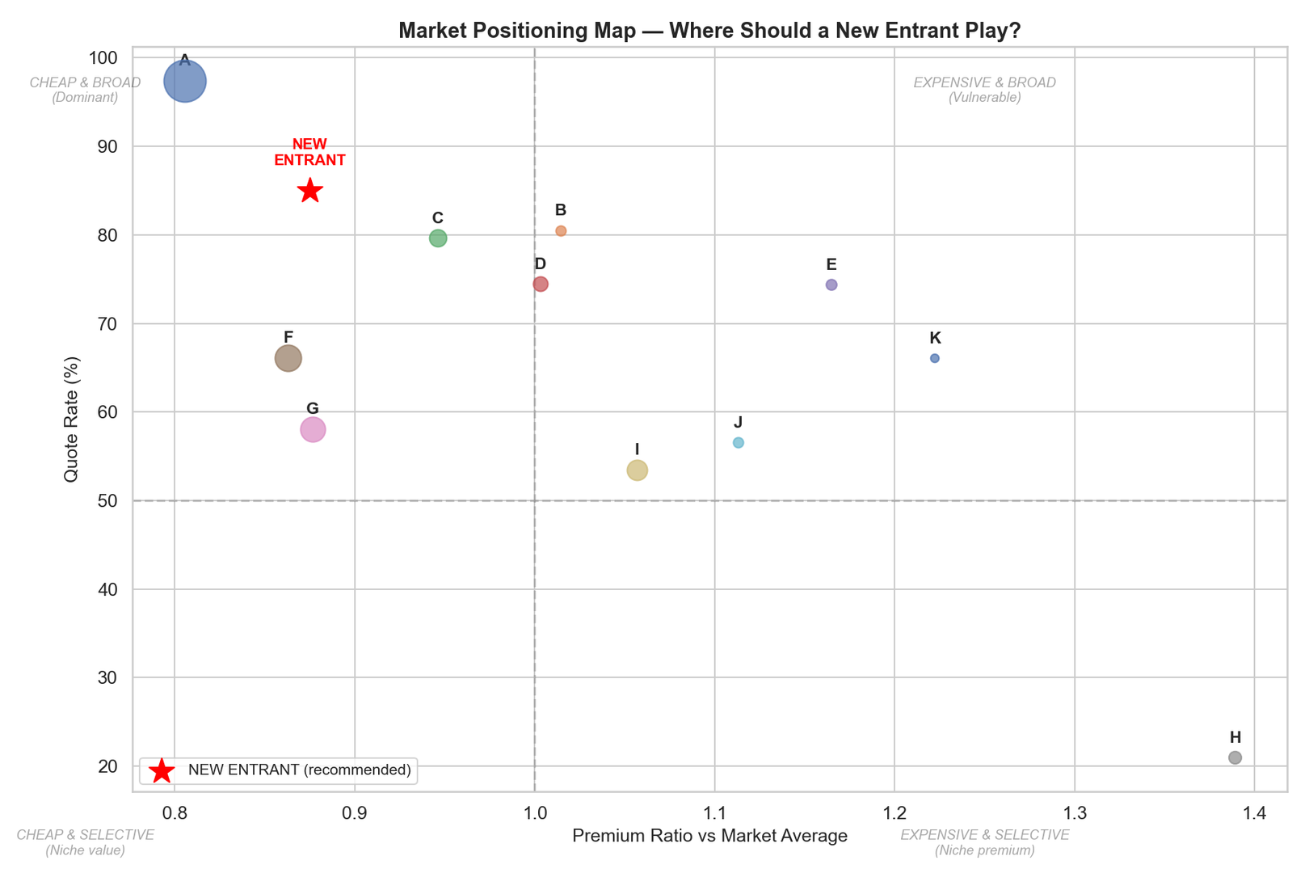
E and K quote a lot and win almost nothing. H barely shows up. These are the weaknesses to exploit.
I, J are selective and somewhat expensive, with I charging +47% urban premium

Slide 7
Market gaps

Slide 8
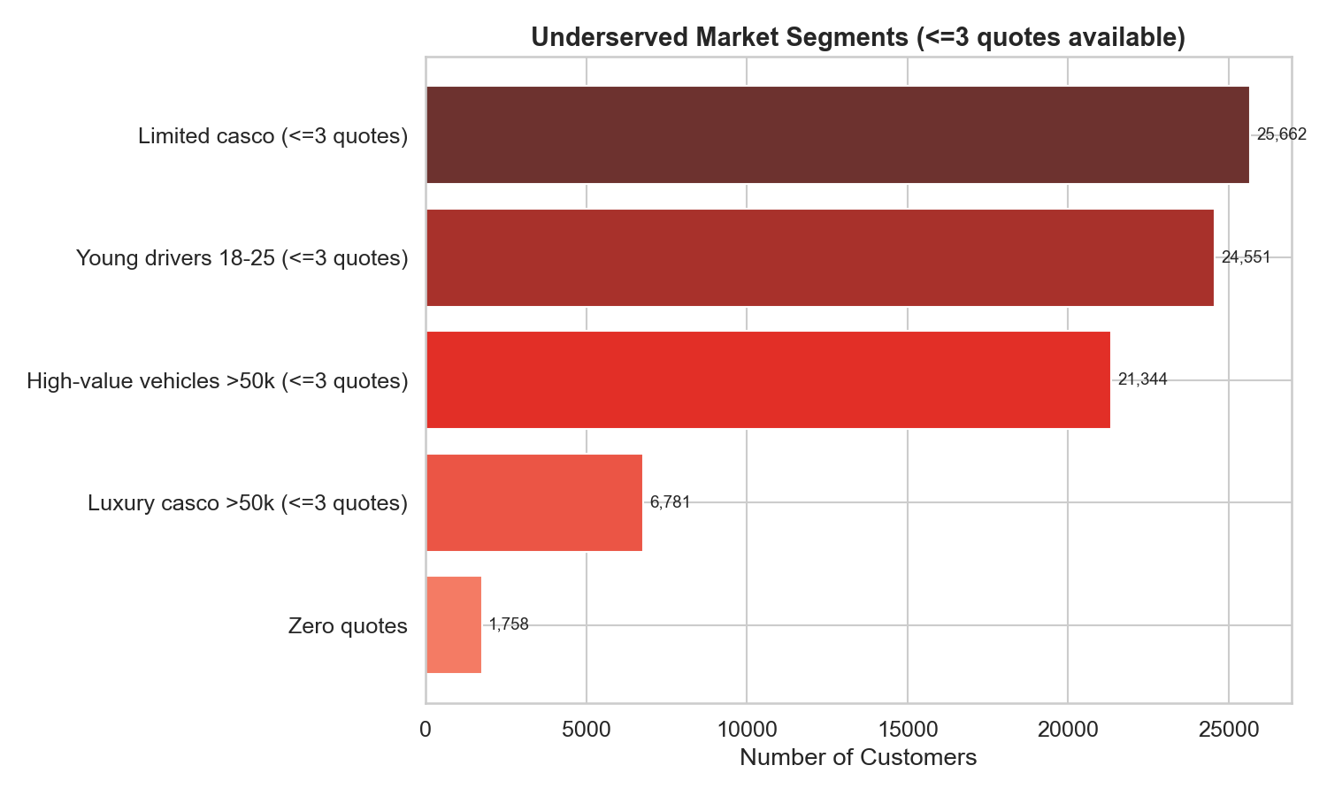
Worst intersection: young drivers + limited casco → 25% underserved rate
Urban customers face wildly different pricing — I charges +47% urban premium, creating price shock

Slide 9
But things shift fast...

Slide 10
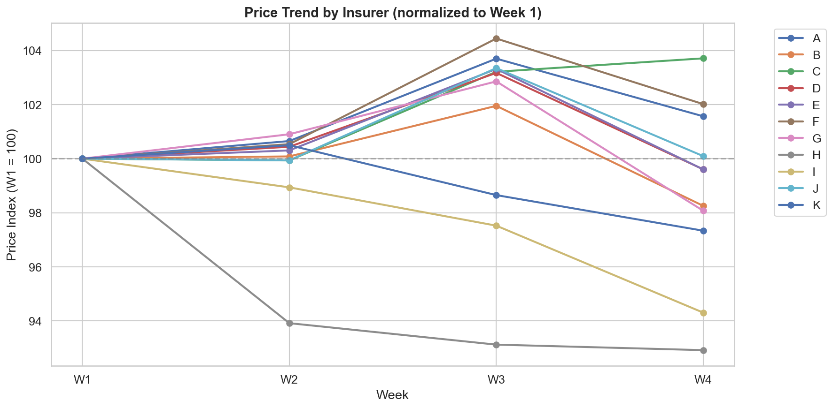
The expensive players are feeling the pressure and adjusting

Slide 11
High-value vehicles, young drivers, limited casco
Price at 0.85-0.90× market average — undercuts K/E/H substantially, but doesn't try to beat A's loss-leading 0.78×
Lead with limited casco (44% of market, weakest competition) and casco for luxury vehicles (13% and gets ≤3 quotes)
Flat urban pricing — competitors charge 20-47% urban premiums; we offer mild 10-15% loading and steal urban share
Deductible innovation — market only offers 0 or 150 or 250 EUR. Should introduce 250/500/1000 tiers for price-sensitive customers

