Slide 1
ETL and Batch processing on real time data
A project based on Big Data Analytics
-TY56

Slide 2
Why this project ?
Various companies working on data types and data storages
Demand of a cost effective to store and analyse it
Going with the industrial technological trend

Slide 3
Objective
Our project will emphasise the importance of ETL and Data Warehouses for business help with the help of INDIAN ANNUAL HEALTH SURVEY DATA (2012-2013) and can apply some approach and methodology in other industries as well.

Slide 4






Tools and components
HDFS (Apache Hadoop)
Apache Hive
Apache Sqoop
Apache HUE
MySQL RDBMS
PuTTY(64-bit)

Slide 5
Procedure

Slide 6
Create a subset schema in Hive to store the data for the analyses to be done
Generate the corresponding analyses charts on Hue
Import the source data in MySQL RDBMS
Stage 1
Stage 2
Stage 3
Stage 4
Stage 5
Data Ingestion (data from mysql to HUE)and verification
Benchmark the performance of the storage formats before finalizing the one to be used.

Slide 7
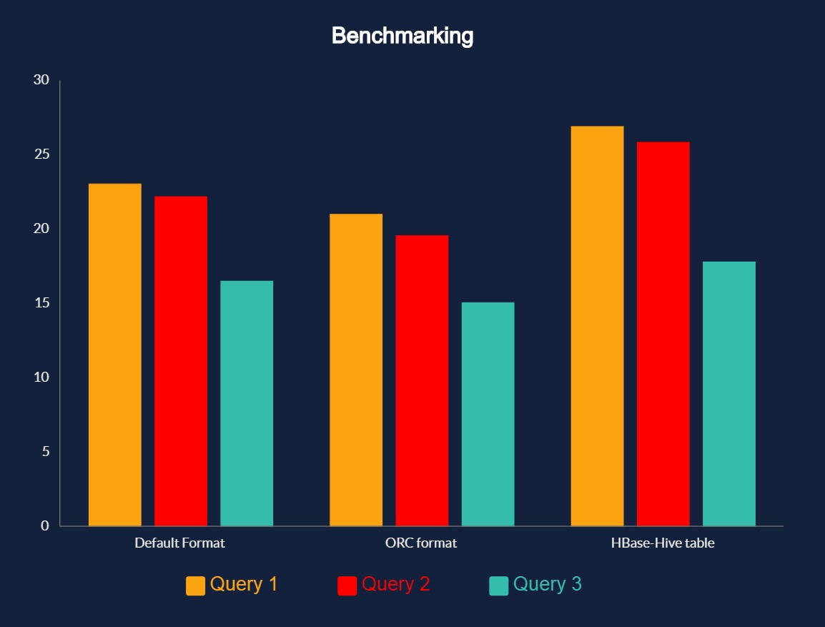
Time(seconds)

Slide 8
