Slide 1
Deepbot – Build a poker bot using Big Data and Deep Learning techniques
Cyril van Schreven
Supervised by:
Nguyen Thanh Tam
Prof. Karl Aberer

Slide 2
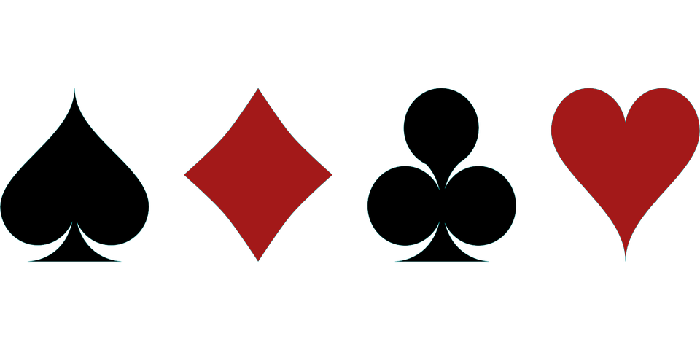
Overview
Game: poker, 6 Handed, No Limit, Texas Hold'em, Sit and Go
Objective:
Exploit a strategy that is built from expert knowledge
Exploit very distinct opponents
Analyse the strategy developed by the agent
Approach:
End to end neural network
Long Short Term Memory to handle past information
Train through neuroevolution

Slide 3
Table of content
I. Introduction
Texas Hold'em Poker
Challenges
Related work
II. Environment
6 Handed Sit and Go
Opponents
Information set abstraction
III. Model
The neural network
Genetic algorithm
IV. Fixed-bot
Performance
Strategy analysis
V. Poly-bot
Tables
Performance
Strategy analysis
VI. Conclusion

Slide 4
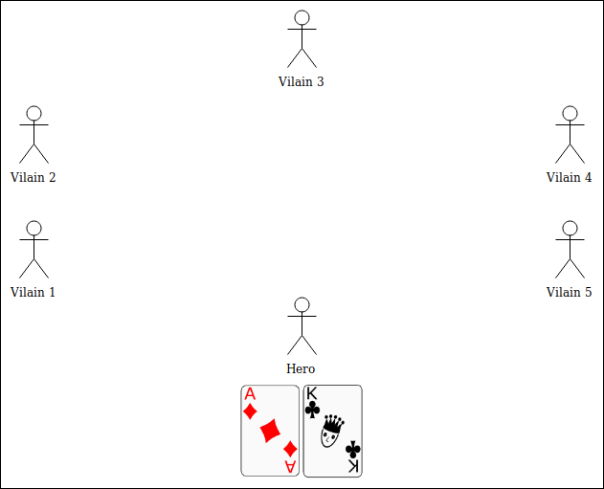
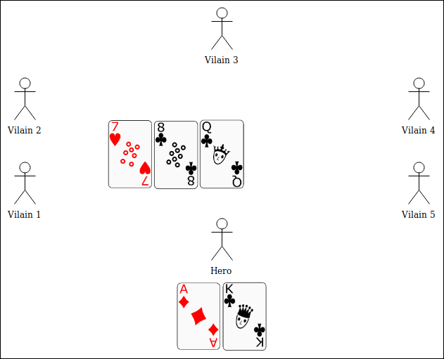
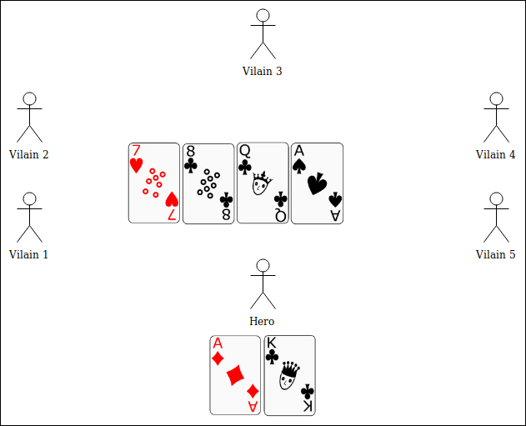
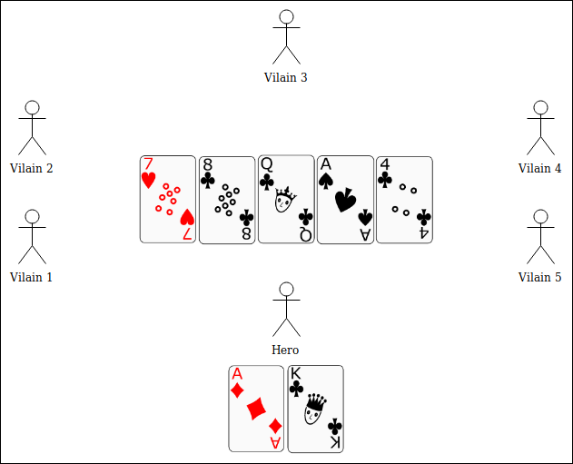
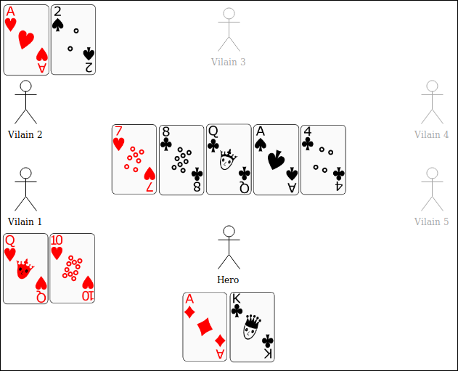
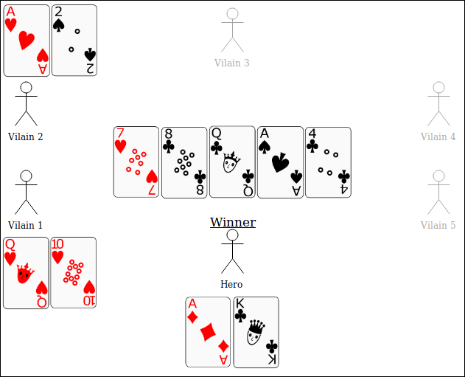
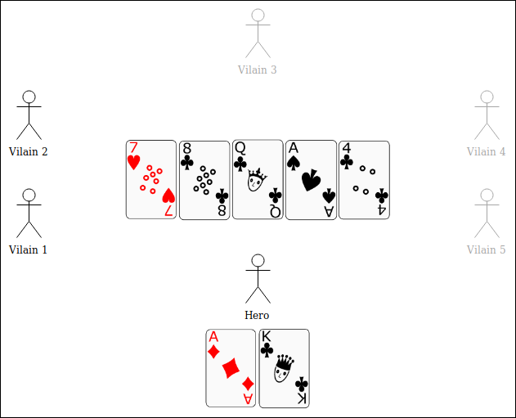
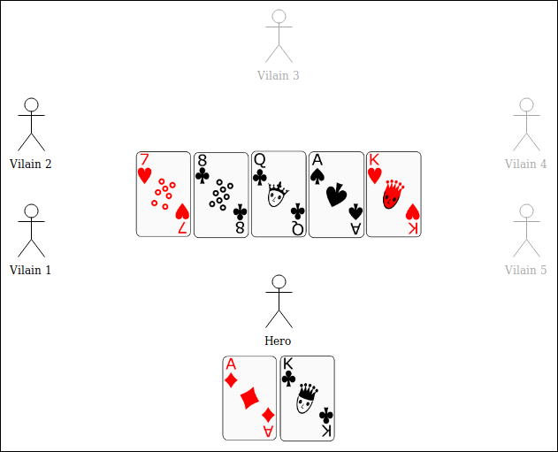
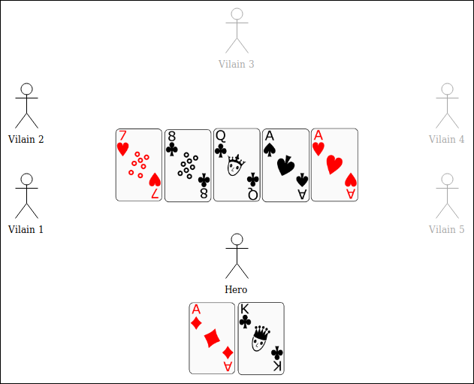
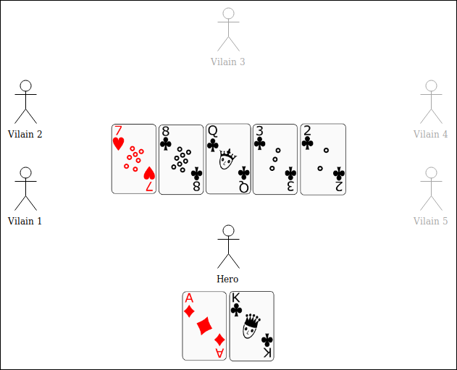
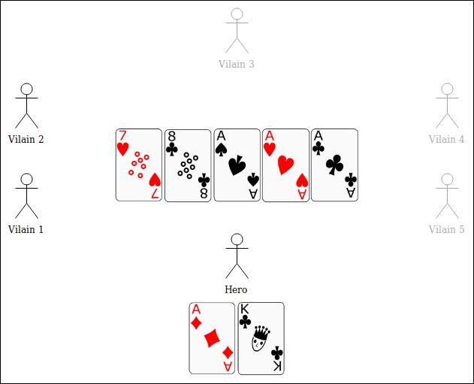
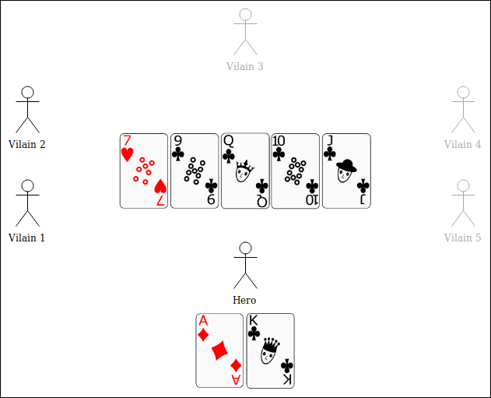
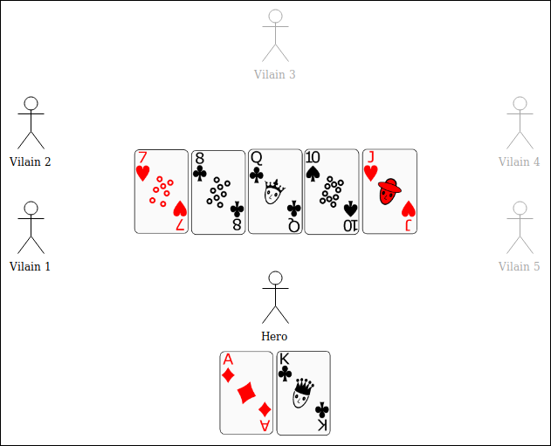
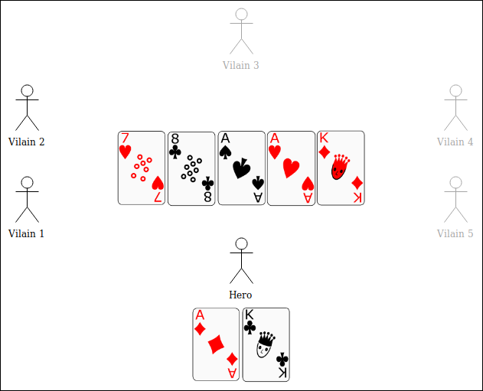
I. Introduction
Texas Hold’em Poker
Phases of a hand:
Preflop: 2 hole cards distributed to each player
Flop: 3 public cards added
Turn: 1 public card added
River: 1 public card added
Showdown: reveal cards and determine winner
Combinations:
Pair
Two Pair
Three of a kind
Straight
Flush
Full house
Four of a kind
Straight-flush

Slide 5
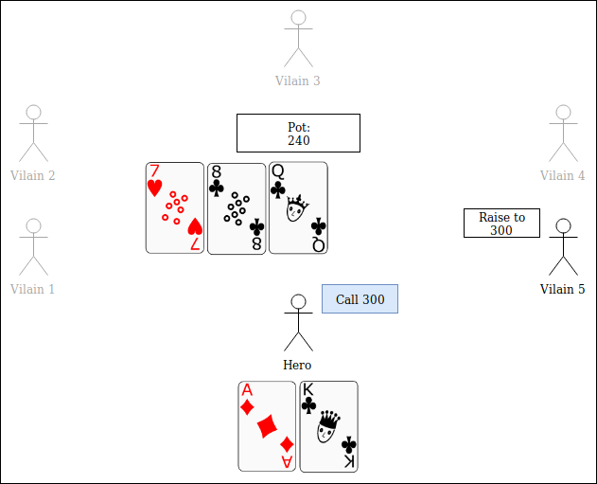


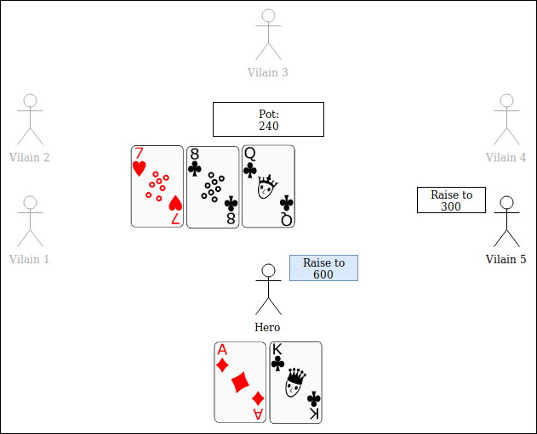
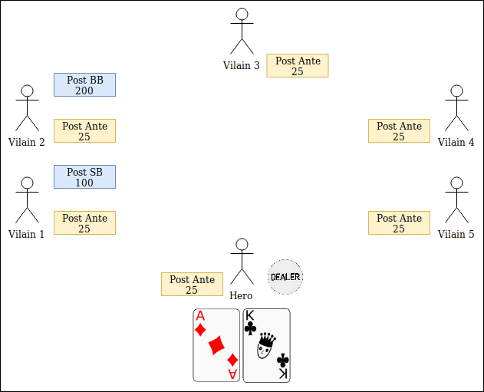
I. Introduction
Texas Hold’em Poker
A betting round ends when all remaining players agree on the wager
Valid actions:
Fold: Abandon the hand
Check: Agree with the wager of 0; no additional chips required
Call: Agree with the wager; adding chips accordingly
Raise : Increase the wager
Blinds and antes:
Are imposed wagers
Small blind and Big blind are posted by two players
Antes are posted by everyone

Slide 6
I. Introduction
Challenges
Imperfect information game
Have to develop belief state
Past information remains relevant
Have to mask personnal information
Optimal strategy is non-deterministic
Complexity
Heads Up Limit poker has 10¹³ unique decision points
Heads Up No Limit played at ACPC* has 10¹⁶¹ unique decision points
Chess and the Game of Go have respectively 10⁴⁷ and 10¹⁷⁰ unique decision points
With multiple players and different initial hand states, the complexity increases dramaticaly
Stochastic outcome
*Annual Computer Poker Competition
Notes:
-Complexity is proportional to game tree size
-Nash equilibria are mixed strategies

Slide 7
I. Introduction
Related work
Major breakthroughs:
Aim for Game Theory Optimal
Are trained through self-play
Use Counter Factual Regret Minization
Are for Ring Game
Opponent modelling:
Retain opponent specific statistics for (batches of) decision points
Alleviate lack of data with statistics of similar players

Slide 8
II. Environment
Game format
Variation of poker: Texas Hold'em
Betting rule: No Limit
Table size: 6 Handed
Game type: Sit and Go

Slide 9
II. Environment
6 Handed Sit and Go
Single table tournament: game ends when only one player remains
Cost and reward:
Cost to participate: 1 token
Reward for first place: 4 tokens
Reward for second place: 2 tokens
→ Independent chip model: reward is not directly proportional to chips
Ascending blind structure
Blinds and antes increase during the game
Virtual time: at each hand, for each player remaning, ticks increase by one

Slide 10
II. Environment
6 Handed Sit and Go
Initial stack: 1500
Virtual time | Small blind | Big blind | Ante
0 → 90 | 10 | 20 | 0
90 → 180 | 15 | 30 | 0
180 → 270 | 25 | 50 | 0
270 → 360 | 50 | 100 | 0
360 → 450 | 100 | 200 | 0
450 → 540 | 100 | 200 | 25
540 → 630 | 200 | 400 | 25
630 → 720 | 300 | 600 | 50
720 → 810 | 400 | 800 | 50
810 → 900 | 600 | 1200 | 75
Blind structure

Slide 11
II. Environment
Opponent classification
Tight: Get involved in few hands
Loose: Get involved in many hands
Passive: Call often, avoid confrontation
Aggressive: Raise often, not afraid of taking risks
Loose-Passive | Tight-Passive
Loose-Aggressive | Tight-Aggressive
Play styles

Slide 12
II. Environment
Opponents
The Caller: Always calls. Loose-Passive
The Maniac: Always raises. Loose-Aggressive
The Attached: Folds a majority of hands. Calls if hole cards are strong.
Never folds after joining the hand. Tight-Passive.
The Equity Bot: Folds, calls or raises according to equity. Does not fold to reraises. Tight-Aggressive.
The Ruler: Rule-based bot playing according to expert knowledge. Tight Aggressive.

Slide 13
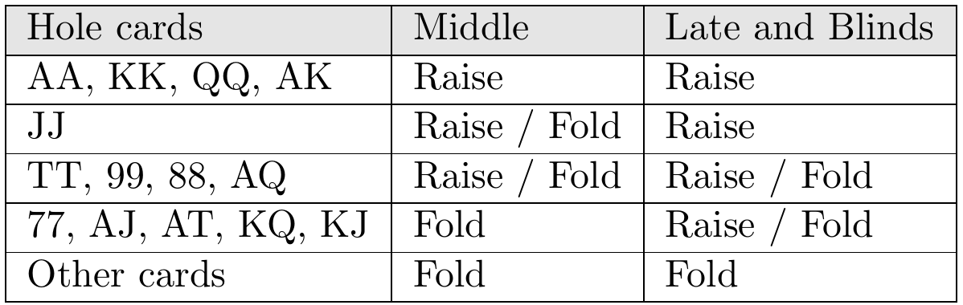
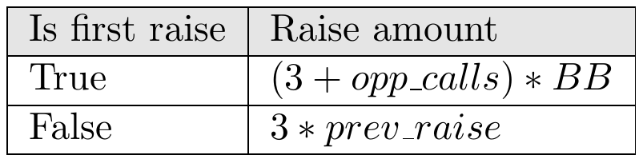
II. Environment
The Ruler
Above 12 big blinds, preflop
Decision table
Raise amount

Slide 14
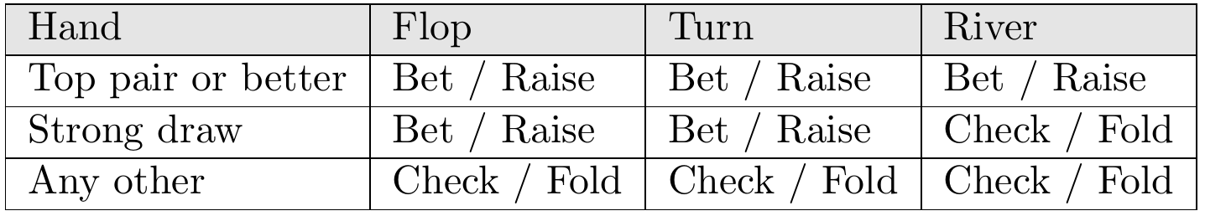
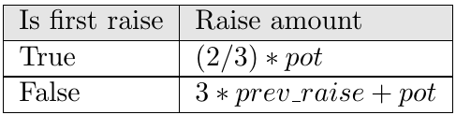
II. Environment
The Ruler
Above 12 big blinds, postflop
Decision table
Raise amount

Slide 15
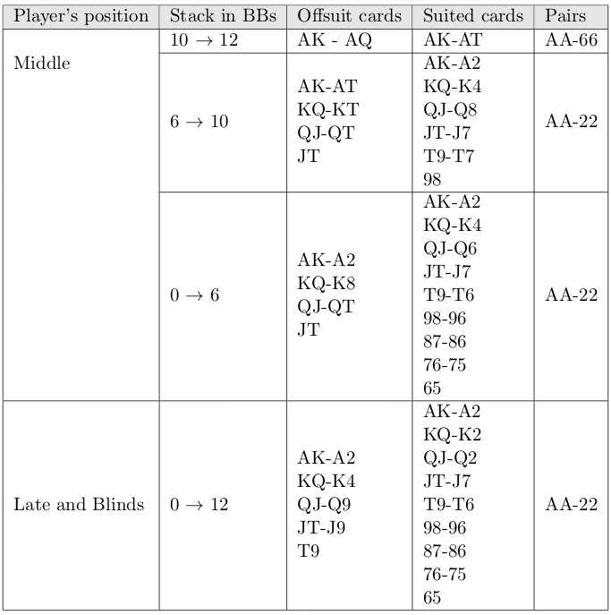
II. Environment
The Ruler
Below 12 big blinds, first in hand
Hands to all-in

Slide 16
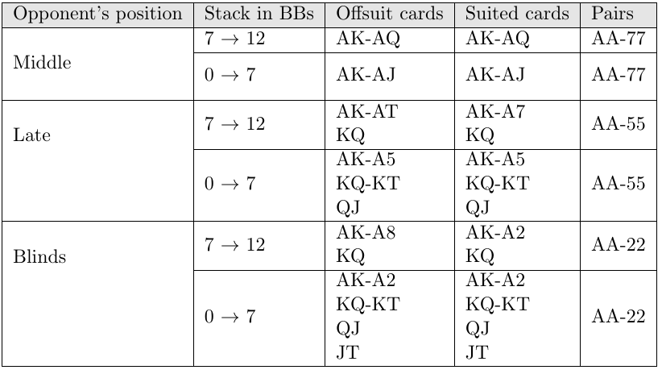
II. Environment
The Ruler
Below 12 big blinds, not first in hand
Hands to all-in

Slide 17
II. Environment
Information set abstraction
General features
Current street as one-hot encoding
Number of active opponents
Position at the table
Equity
Equity if the showdown was on flop
Curren stack
Amount of chips required to call
Total pot
Big blind value
Number of opponents are normalized by the initial number of players (6)
Equity is multiplied by the number of active players
Chips values are normalized by the initial stack

Slide 18
II. Environment
Information set abstraction
Opponent features
Action taken by the opponent as one-hot encoding: fold, call or raise
Amount of chips added to the hand by the opponent

Slide 19
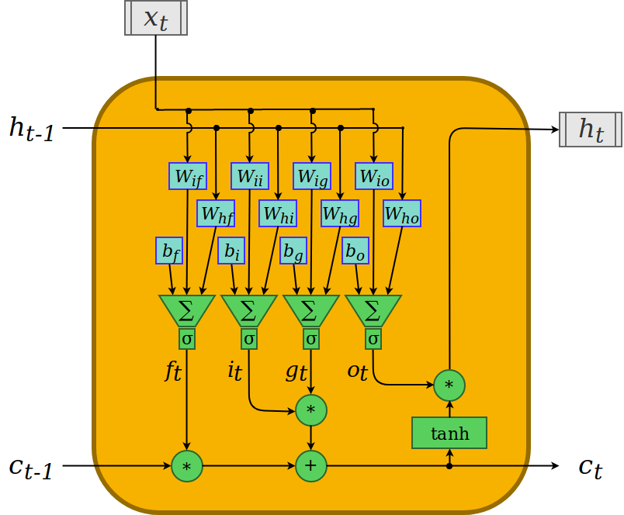
II. Model
The neural network
Long short term memory

Slide 20
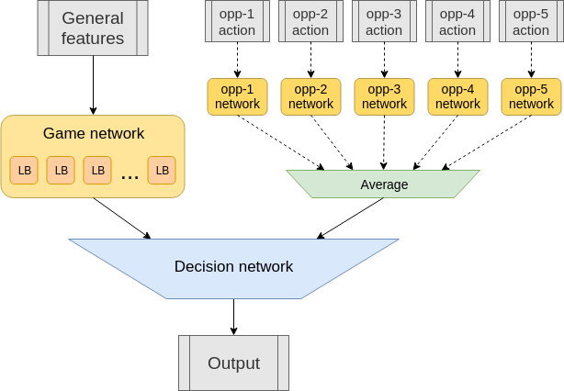
II. Model
The neural network
Full network overview
22'071 trainable parameters

Slide 21
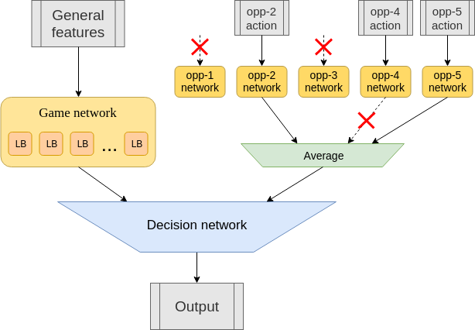
II. Model
The neural network
Network activity example

Slide 22
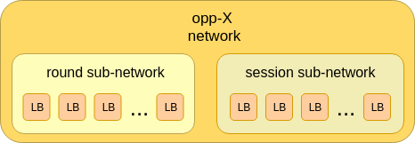
II. Model
The neural network
Round sub-network is 'reset' every hand
Session sub-network is 'reset' every game
Opponent network instance

Slide 23
II. Model
Genetic algorithm
Characteristics
Population size: 70
Number of generations: 250
At each generation, agents perform in their environment, the survivors are selected, and the next generation of agents is determined.
Execution
Agents play 4 full matches at each table.
A match consists of 6 games. At each game the player has another seat. Decks remain the same.

Slide 24
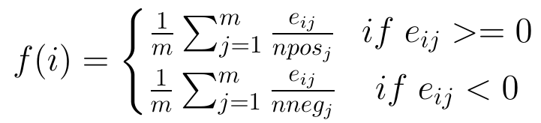
II. Model
Genetic algorithm
Selection
Fitness function
Best 30% agents become survivors.
Agents performing better than average of survivors become elites. The others are second-tier survivors.
Elites are directly added to the next generation.
Second-tier survivors are mutated and added to the next generation.
Elites generate children through crossover. Children are then mutated and added to the next generation.

Slide 25
II. Model
Genetic algorithm
Mutation:
Gaussian noise is added to randomly selected genes
Mutation rate: Probability that a gene is mutated. Linearly decreases from 0.3 to 0.05
Mutation strength: Standard deviation of the Gaussian noise. Linearly decreases from 0.5 to 0.1.
Crossover:
Genes of two agents are mixed.
With equal probability, a children will get a group of gene from one parent or the other.
Groups of genes are determined by the layer they belong to. The first layer of the decision network, being too large, is separated into chunks of 200 genes.

Slide 26
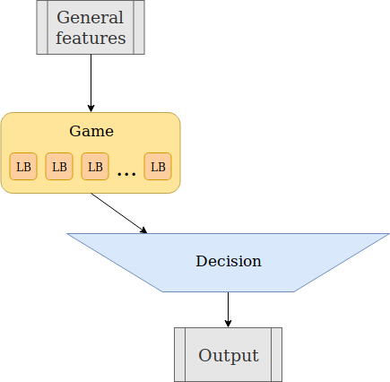
III. Fixed-bot
Overview
Only one table. The opponents are 5 instances of the Ruler.
No opponent modeling is required.
Network of fixed-bot

Slide 27
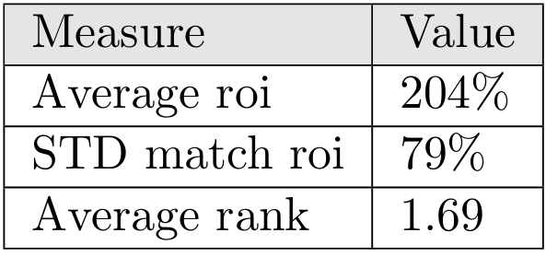
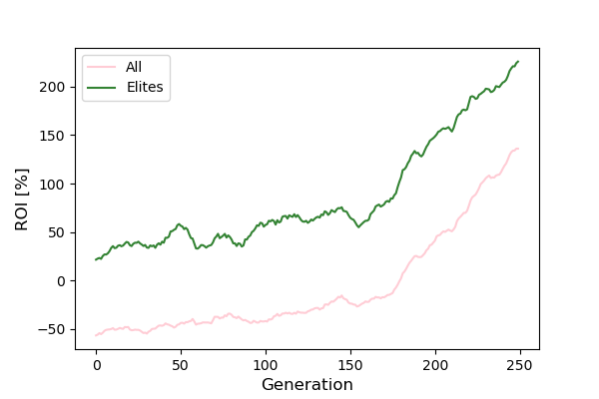
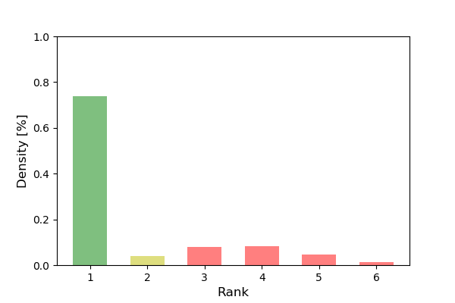
III. Fixed-bot
Performance
Performance summary
Average ROI during training
Finishing place distribution
The agent strongly beats his opponents
Training becomes effective around generation 150

