Slide 1
Deepbot – Build a poker bot using Big Data and Deep Learning techniques
Cyril van Schreven
Supervised by:
Nguyen Thanh Tam
Prof. Karl Aberer

Slide 2
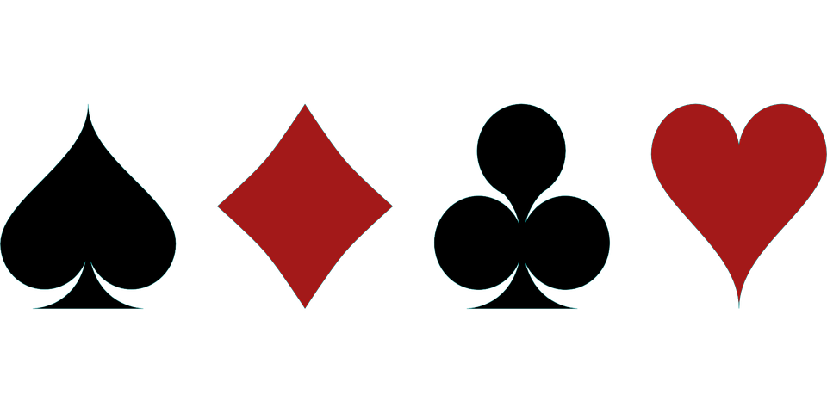
Overview
Game format:
Poker variation: Texas Hold'em
Betting rule: No Limit
Table size: 6 Handed
Game type: Sit and Go

Slide 3
Challenges
Imperfect information game
Have to develop belief state
Past information remains relevant
Have to mask personnal information
Optimal strategy is non-deterministic
Complexity
Heads Up No Limit played at ACPC* has 10¹⁶¹ unique decision points
Chess and the Game of Go have respectively 10⁴⁷ and 10¹⁷⁰ unique decision points
Stochastic outcome
*Annual Computer Poker Competition
Notes:
-Complexity is proportional to game tree size
-Nash equilibria are mixed strategies

Slide 4
Related Work
Major breakthroughs
Focus on 'solving' the game
Play ring game: each hand is a new game
Year | Name | Game beaten | Institutions
Jan 2015 | Cepheus | Limit Heads Up | UoA
Dec 2016 | DeepStack | No Limit Heads Up | UoA, ChU
Jan 2017 | Libratus | No Limit Heads Up | CMU
Jul 2019 | Pluribot | No Limit 6 Handed | CMU, FB
Notes:
Could add the history of Poker AI technologies here (Year, Description, Limitations)

Slide 5
Project Setting
Overview
This project focuses on:
Playing tournament type game (Sit and go)
Playing 6 Handed
Exploiting weak opponents
Get insights on strategies

Slide 6
Table of content
I. Environment
Sit and Go
Opponents
Information set abstraction
II. Approach
The neural network
Genetic algorithm
III. Experiments
Fixed-bot setting
Poly-bot setting
VI. Conclusion and Future Work

Slide 7
Project Setting (cont’d)
6 Handed Sit and Go
Single table tournament: game ends when only one player remains
Cost and reward:
Cost to participate: 1 token
Reward for first place: 4 tokens
Reward for second place: 2 tokens
→ Independent chip model: reward is not directly proportional to chips
Ascending blind structure
Blinds and antes increase during the game
Virtual time: at each hand, for each player remaining, ticks increase by one
Notes:
This slide should be said short

Slide 8
Project Setting (cont’d)
6 Handed Sit and Go
Initial stack: 1500
Virtual time | Small blind | Big blind | Ante
0 → 90 | 10 | 20 | 0
90 → 180 | 15 | 30 | 0
180 → 270 | 25 | 50 | 0
270 → 360 | 50 | 100 | 0
360 → 450 | 100 | 200 | 0
450 → 540 | 100 | 200 | 25
540 → 630 | 200 | 400 | 25
630 → 720 | 300 | 600 | 50
720 → 810 | 400 | 800 | 50
810 → 900 | 600 | 1200 | 75
Blind structure
Notes:
This slide should be said very short

Slide 9
I. Environment
Opponents
Loose: Get involved in many hands
Tight: Get involved in few hands
Passive: Call often, little control over pot
Aggressive: Raise often, not afraid of taking risks
Loose-Passive | Tight-Passive
Loose-Aggressive | Tight-Aggressive
Play styles

Slide 10
I. Environment
Opponents
The Caller: Always calls. Loose-Passive
The Maniac: Always raises. Loose-Aggressive
The Attached: Folds a majority of hands. Calls if hole cards are strong. Never folds after joining the hand. Tight-Passive.
The Ruler: Rule-based bot playing according to expert knowledge. Tight Aggressive.

Slide 11
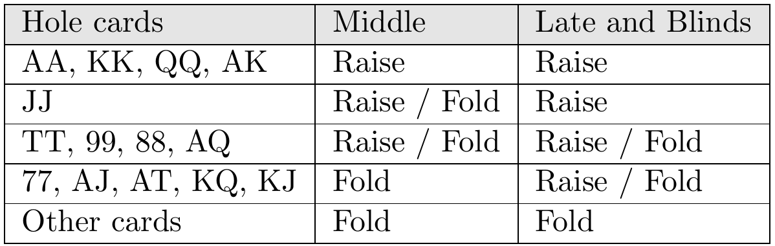
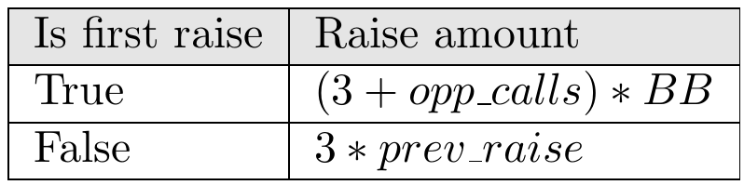
I. Environment
The Ruler
Above 12 big blinds, preflop
Decision table
Raise amount

Slide 12
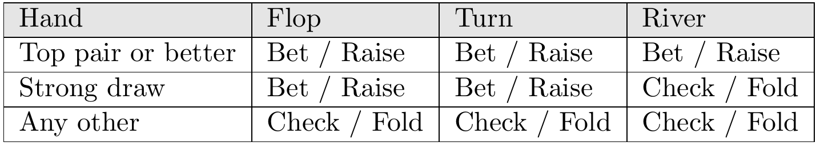
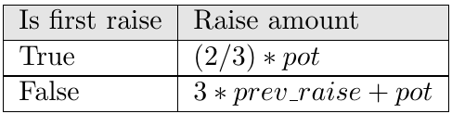
I. Environment
The Ruler
Above 12 big blinds, postflop
Decision table
Raise amount
Notes:
This slide should be said very short

Slide 13
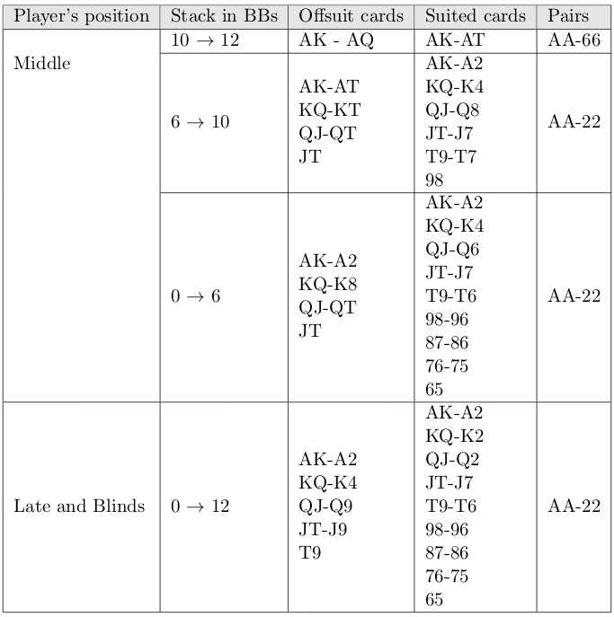
I. Environment
The Ruler
Below 12 big blinds, first in hand
Hands to all-in
Notes:
This slide should be said very short

Slide 14
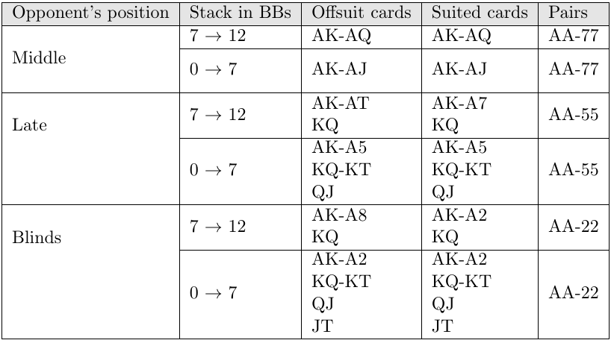
I. Environment
The Ruler
Below 12 big blinds, not first in hand
Hands to all-in
Notes:
This slide should be said very short

Slide 15
I. Environment
Information set abstraction
General features
Equity
Equity if the showdown was on flop
Current street as one-hot encoding
Number of active opponents
Position at the table
Current stack
Amount of chips required to call
Total pot
Big blind value
Opponent features
Action taken by the opponent as one-hot encoding: fold, call or raise
Amount of chips added to the hand by the opponent
Notes:
- neural network permits to treat continuous values

Slide 16
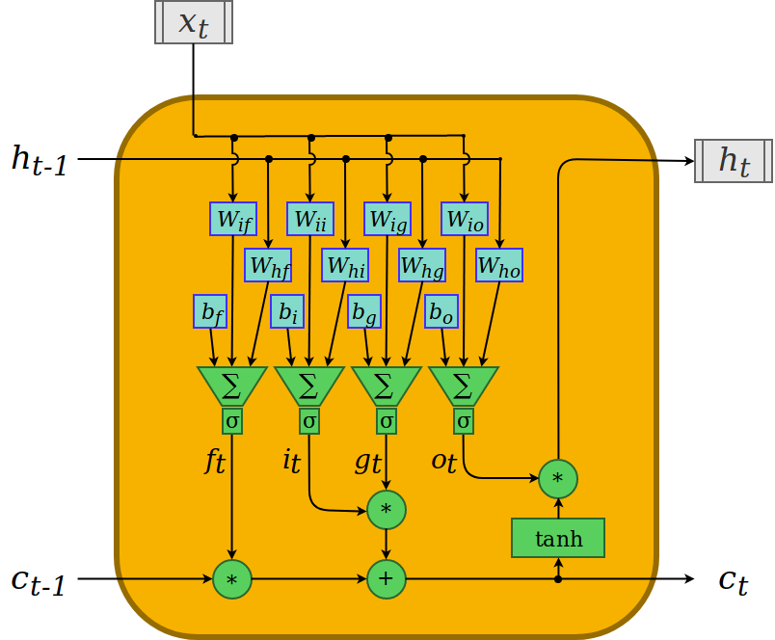
II. Approach
The neural network
Long Short Term Memory
Notes:
This is background, should not spend much time explaining what is LSTM

Slide 17
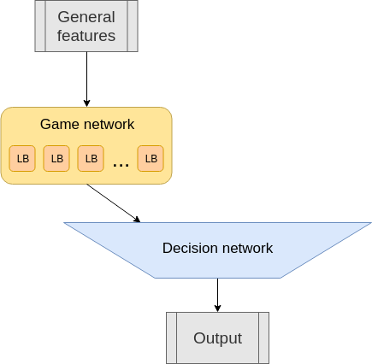
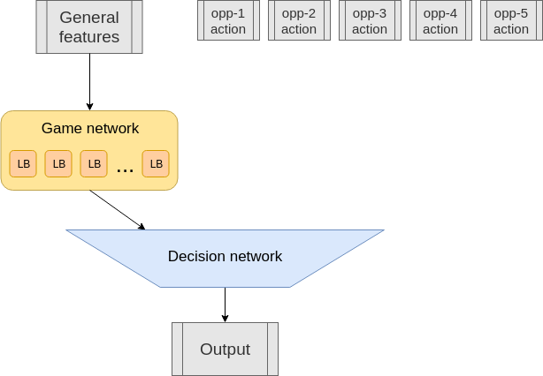
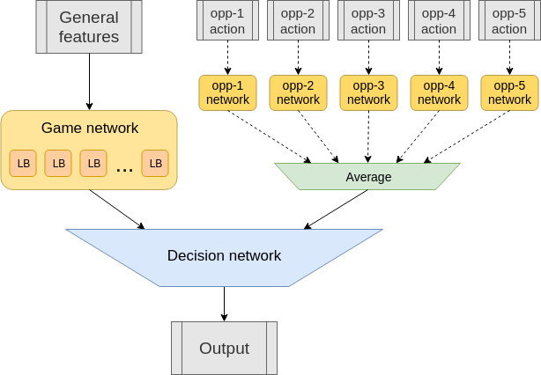
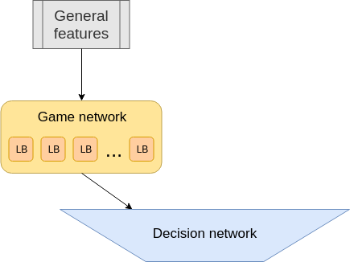
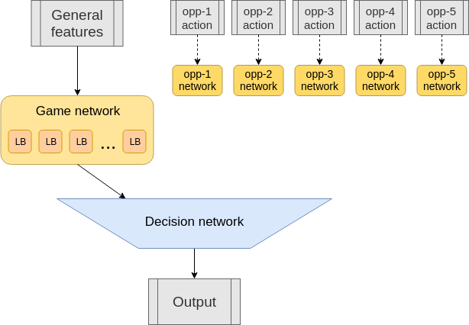
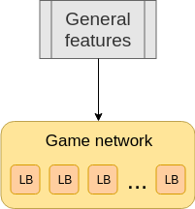

II. Approach
The neural network
Full network overview
Output, between -1 and 1, describes the desired wager of the agent
22'071 trainable parameters
Notes:
-inputs as described previously
-output between 0 and 1, defines proportion of initial stack we want to commit
-Game network: 10 LSTM of size 10
-Decision network: 3 dense layers, sizes: 200, 50, 10,1

Slide 18
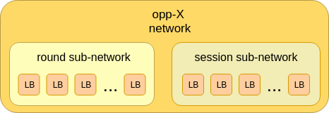
II. Approach
The neural network
Opponent network instance
Round sub-network is 'reset' every hand
Session sub-network is 'reset' every game

Slide 19
II. Approach
Genetic algorithm
Motivation for genetic algorithm over backpropagation
Problem is not supervised
Multiple forward passes required for one reward value
Genetic algorithms learn faster but struggle to approach optimum as closely
Notes:
-neuroevolution
-deepstack uses backprop. deepstack predicts value, which it can compute, so direct input->output
-even if scheme would exist, we want to play multiple hands and games to have trustable reward value
-Genetic algorithms optimize globally rather than locally
Genetic algorithms optimize globally rather than locally

Slide 20
II. Approach
Genetic algorithm
Overview
Number of generations: 250
Population size: 70
At each generation:
agents act in their environment
survivors and elites are selected
next generation of agents is generated
Execution
To alleviate luck, agents will play 'matches': a match consists of 6 games. At each game, the same decks are used and the player has a different seat.
Agents play 4 full matches at each table
Adversary while learning is 'lucky' agent
Notes:
-briefly explain GA

Slide 21
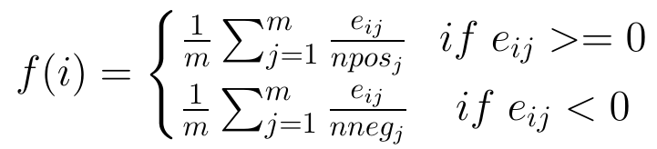
II. Approach
Genetic algorithm
Selection
Fitness function
Survivors: Best 30% of agents
Elites: Survivors performing better than average of survivors
Second-tier survivors: Survivors that are not elites
Next generation consists of:
Elites
Mutated second-tier survivors
Mutated children of elites

Slide 22
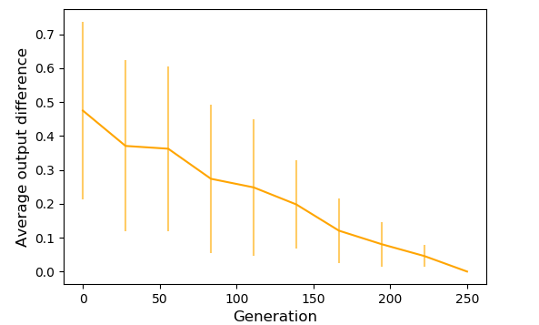
II. Approach
Genetic algorithm
Mutation:
Gaussian noise is added to randomly selected genes
Mutation rate: Probability that a gene is mutated. Linearly decreases from 0.3 to 0.05
Mutation strength: Standard deviation of the Gaussian noise. Linearly decreases from 0.5 to 0.1.
Difference in output caused by mutation

Slide 23
II. Approach
Genetic algorithm
Crossover:
Genes of two agents are mixed.
Children takes a group of gene from one parent or the other with equal probability
Genes are grouped according to the layers they belong to. Exception for the large fully connected layer that is split in chunks of 200.
Notes:
- about 150 groups

Slide 24
III. Experiments
Implementation environments
Libraries used:
Pytorch
pypokerengine: local poker environment
OMPEval: fast equity calculator
Hardware used:
36 CPUs, 72 threads
Skylake-SP 3.4 GHz
Notes:
This slide should be said short

Slide 25
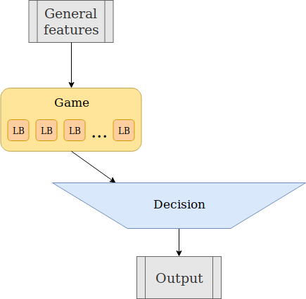
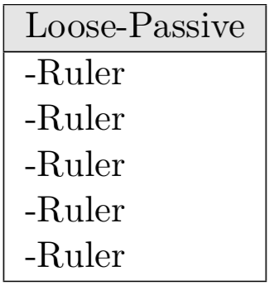
III. Experiments
Fixed-bot setting
Only one table. The opponents are 5 instances of the Ruler.
No opponent modeling is required.
Table composition
Network of fixed-bot

Slide 26
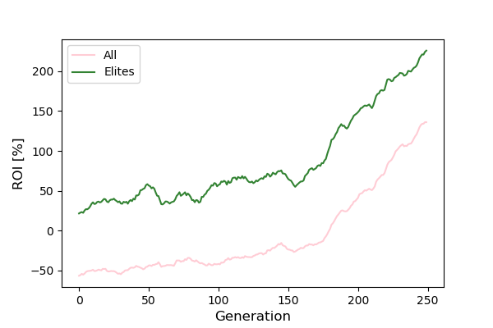
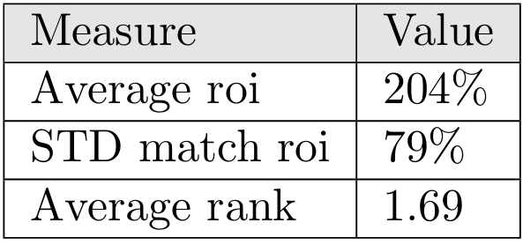
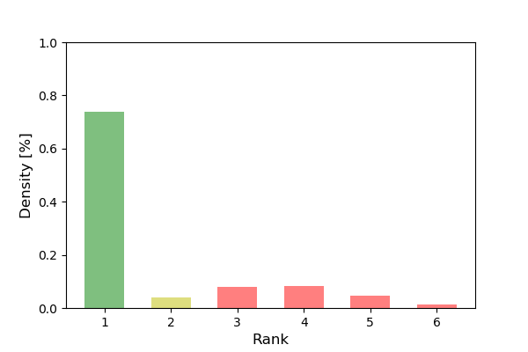
III. Experiments
Fixed-bot performance
Performance summary
Average ROI during training
Finishing place distribution
Training becomes effective around generation 150
The agent has a very high return on investment (ROI)
Notes:
-Elites and rest of players follow same learning pattern
-In practice, 30% is a very strong ROI

Slide 27
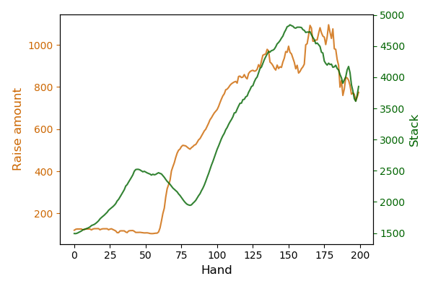
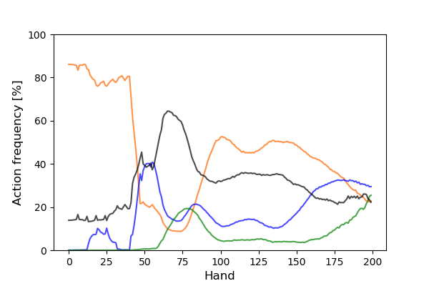
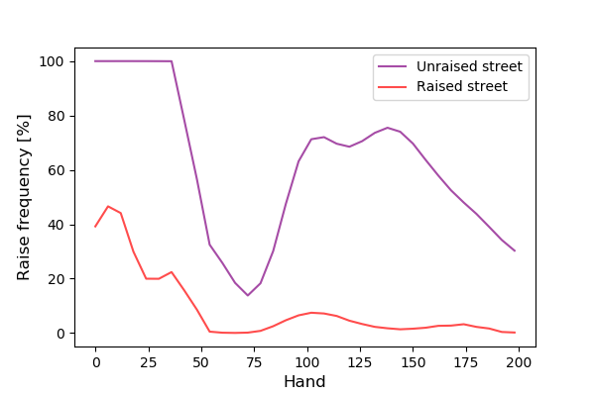
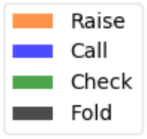
III. Experiments
Fixed-bot analysis
Action frequency and raise amount evolve as game advances
Agent is more active on unraised streets
Main source of earnings is blind stealing
Raise amount and stack
Action frequency
Raise and reraise frequency

Slide 28
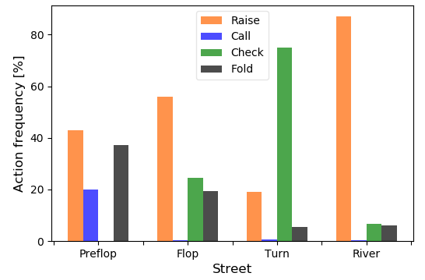
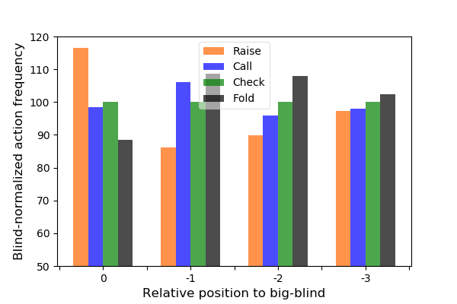
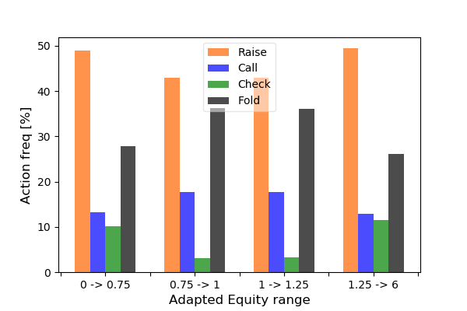
III. Experiments
Fixed-bot analysis
Postflop play is less developed
Position is slightly exploited
Equity is not noticeably exploited
Action frequency wrt street
Action frequency wrt position
Action frequency wrt equity
Notes:
explain blind normalized action frequency; relative position, how only preflop unraised is taken into account, and how heads up is neglected

Slide 29
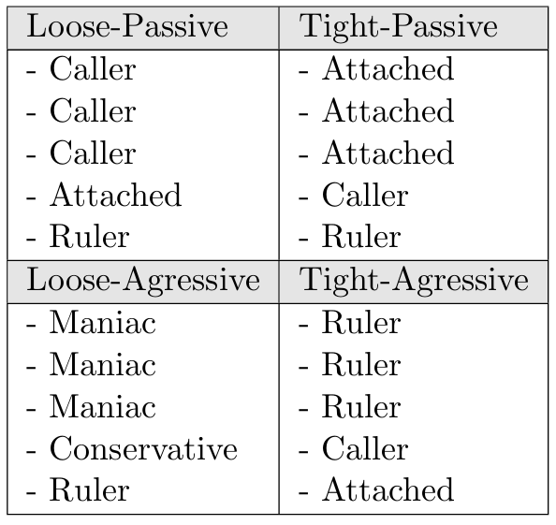
III. Experiments
Poly-bot setting
Four tables, each with one predominant opponent.
Opponent modeling is required.
Table compositions
Notes:
-two agents added for game to make sense

Slide 30
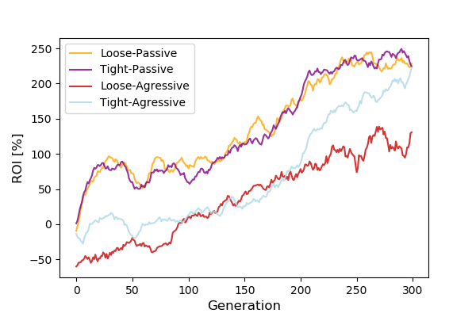
III. Experiments
Poly-bot performance
Average elite ROI during training
Training is easier against Passive tables
Notes:
-Elites and rest of players follow same learning pattern
-In practice, 30% is a very strong ROI

Slide 31
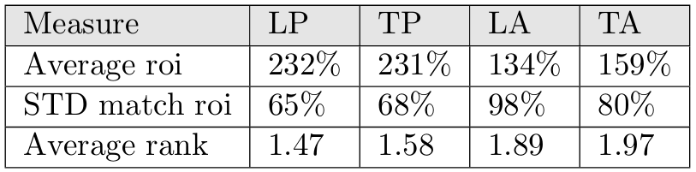
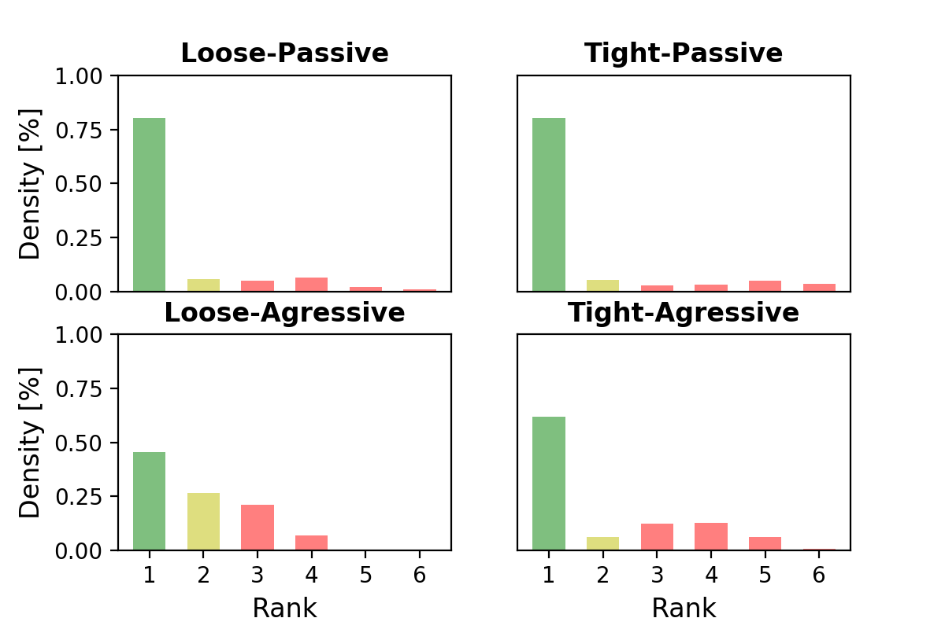
III. Experiments
Poly-bot performance
Performance summary
Agent struggles most against Loose-Aggressive table
Finishing place distribution
Notes:
-is typically what kingmaker effect does

Slide 32
Conclusion
The agent has a very high return on investment overall
Fixed-bot: The rule-based bot can be very strongly exploited.
Poly-bot: The agent is capable of beating very different opponents. It is difficult to conclude whether it is the effect of opponent modelling.
Confronting expert knowledge to the agent's strategy shows some weaknesses.
As the opponents are almost beaten to the maximum, the agent has no incentive to learn further in this configuration.

Slide 33
Future work
Train against stronger opponents
Validate against opponents never met
Set up testing environment to measure effect of each input on the output
Integrate showdown information
Get model of active opponents even before their action
Increase the number of outputs. This may help the model select specific actions, such as calling.

Slide 34
Additional content

Slide 35
Summary bots
Fixed-bot Analysis summary
Poly-bot Analysis summary
Poly-bot Analysis summary

Slide 36
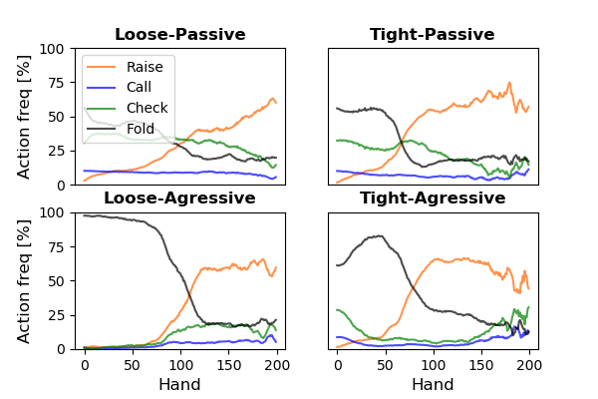
III. Experiments
Poly-bot analysis
Action frequency
Overall very few calls
Early game: high fold frequency, late game: high raise frequency
Notes:
fold in the beginning could be for opponent modelling, or simply agent is unable to make sense of that phase

Slide 37
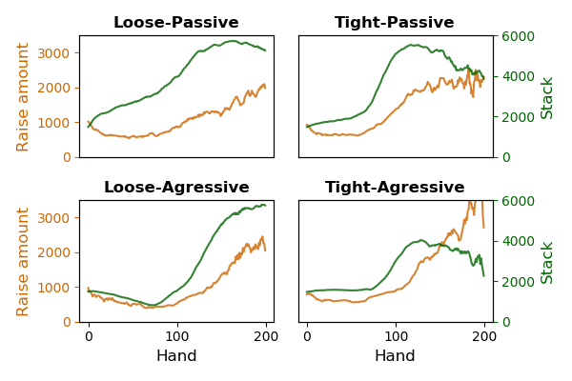
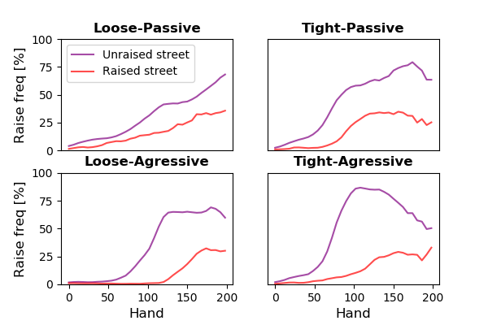
III. Experiments
Poly-bot analysis
Raise amount and stack
Raise and reraise frequency
Raise amount is too high on average
Agent raises more often on unraised street, especially at Tight-Aggressive table
Agent is surprisingly tight at Loose-Aggressive table
Notes:
-describe stack rise on loose-passive
-learning against loose agressive is counter intuitive: explain

Slide 38
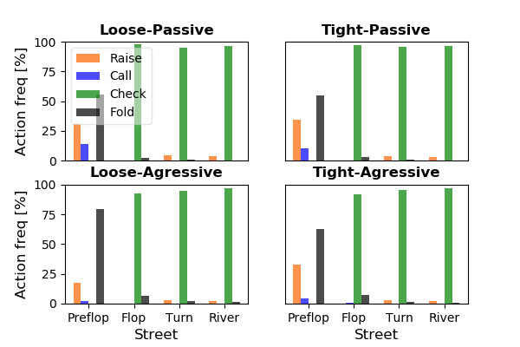
III. Experiments
Poly-bot analysis
Average elite ROI during training
Postflop play is underdeveloped
Check is allowed: postflop play is mostly against loose opponents
Notes:
-Give hypothesis for underdeveloped postflop play

Slide 39
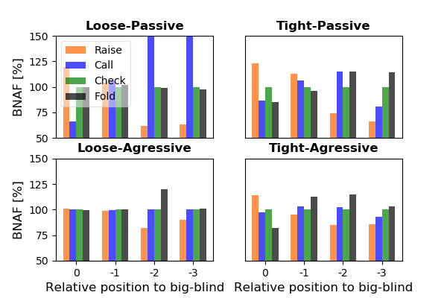
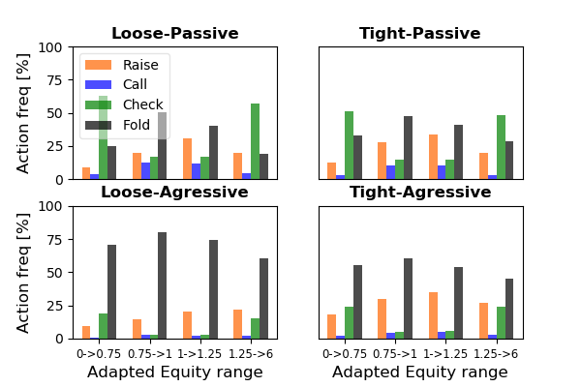
III. Experiments
Poly-bot analysis
Action frequency wrt position
Action frequency wrt equity
Agent exploits position
Agent exploits equity
Notes:
-describe stack rise on loose-passive
-learning against loose agressive is counter intuitive: explain

Slide 40
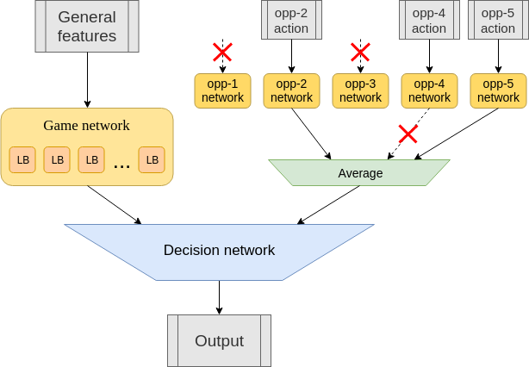
II. Approach
The neural network
Network activity example

Slide 41
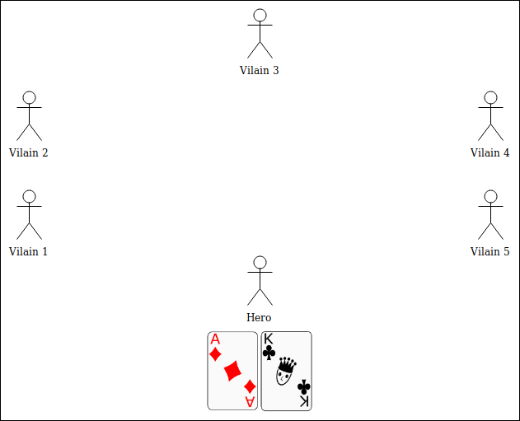
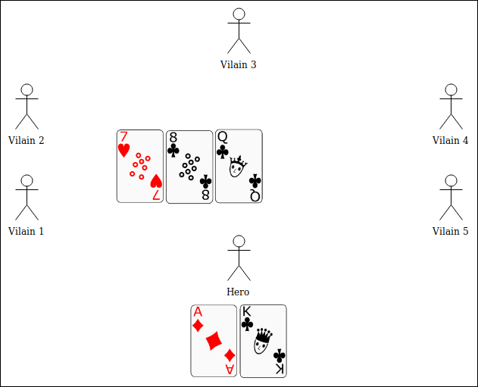
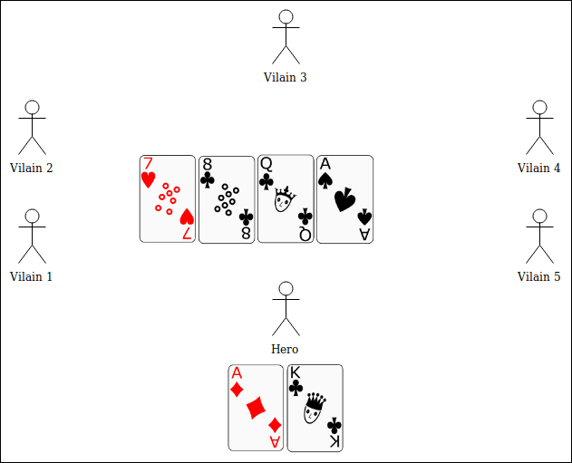
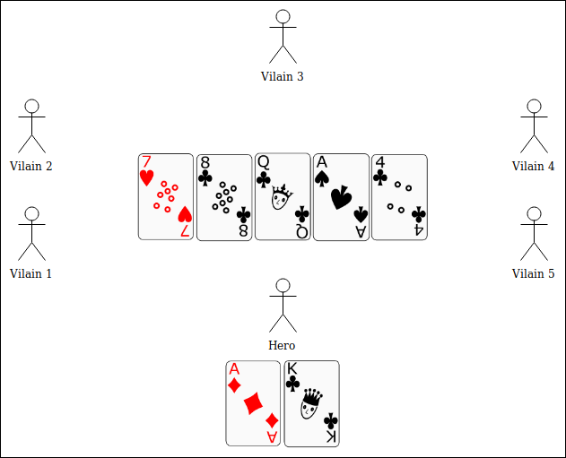
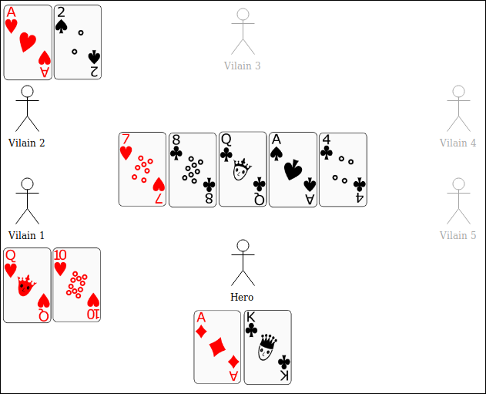
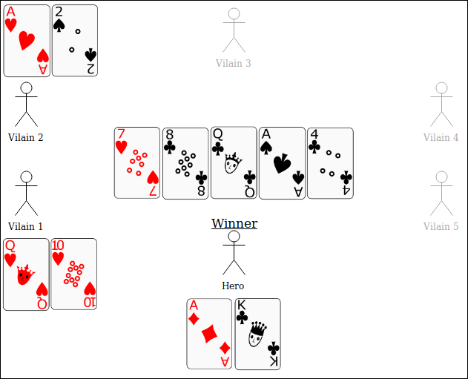
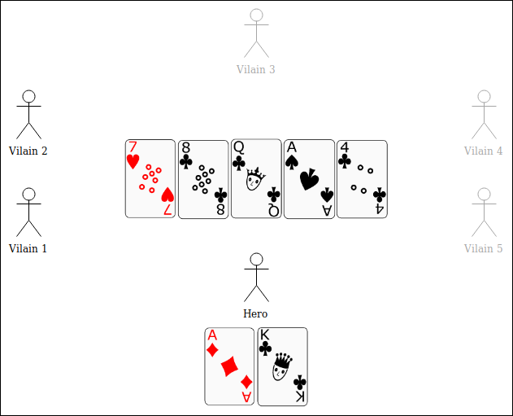
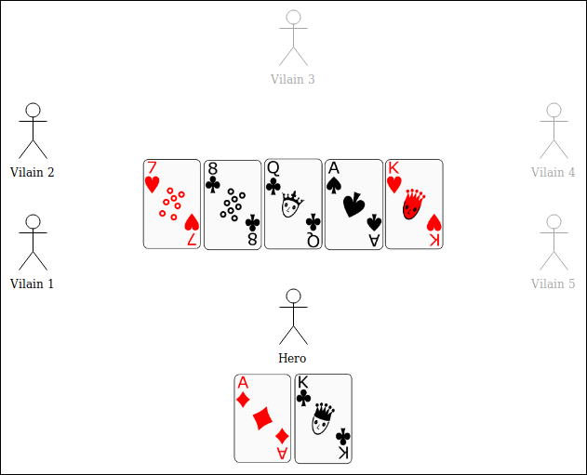
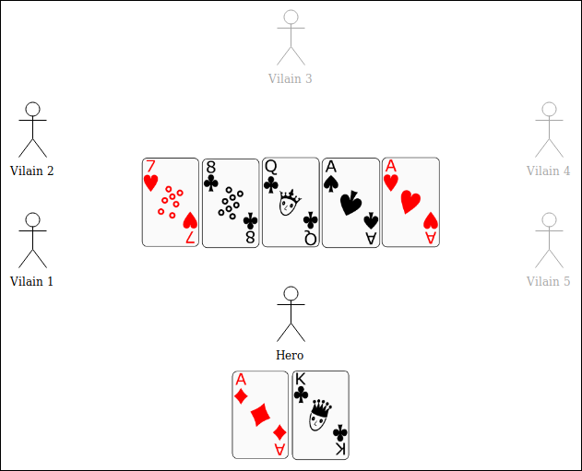
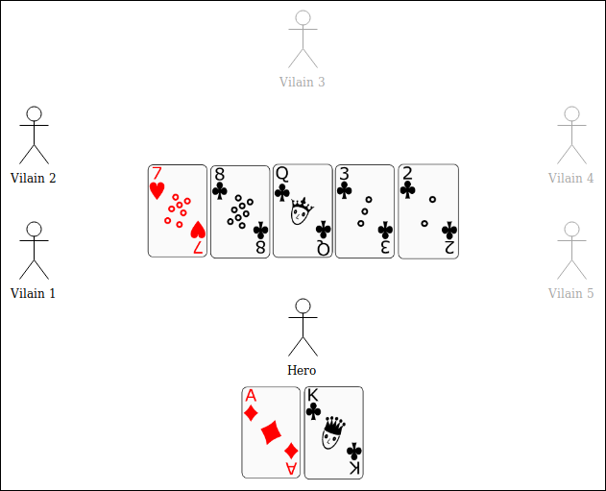




The Game
Texas Hold’em Poker
Phases of a hand:
Preflop: 2 hole cards distributed to each player
Flop: 3 public cards added
Turn: 1 public card added
River: 1 public card added
Showdown: reveal cards and determine winner
Combinations:
Pair
Two Pair
Three of a kind
Straight
Flush
Full house
Four of a kind
Straight-flush
Notes:
This slide should be said short

Slide 42





The Game (cont’d)
Texas Hold’em Poker
A betting round ends when all remaining players agree on the wager
Valid actions:
Fold: Abandon the hand
Check: Agree with the wager of 0; no additional chips required
Call: Agree with the wager; adding chips accordingly
Raise : Increase the wager
Blinds and antes:
Are imposed wagers
Small blind and Big blind are posted by two players
Antes are posted by everyone
Notes:
This slide should be said short

Slide 43
I. Model
Information set abstraction
General features
Equity
Equity if the showdown was on flop
Current street as one-hot encoding
Number of active opponents
Position at the table
Current stack
Amount of chips required to call
Total pot
Big blind value
Equity is multiplied by the number of active players
Number of opponents are normalized by the initial number of players (6)
Chips values are normalized by the initial stack
Notes:
- neural network permits to treat continuous values

