Slide 1

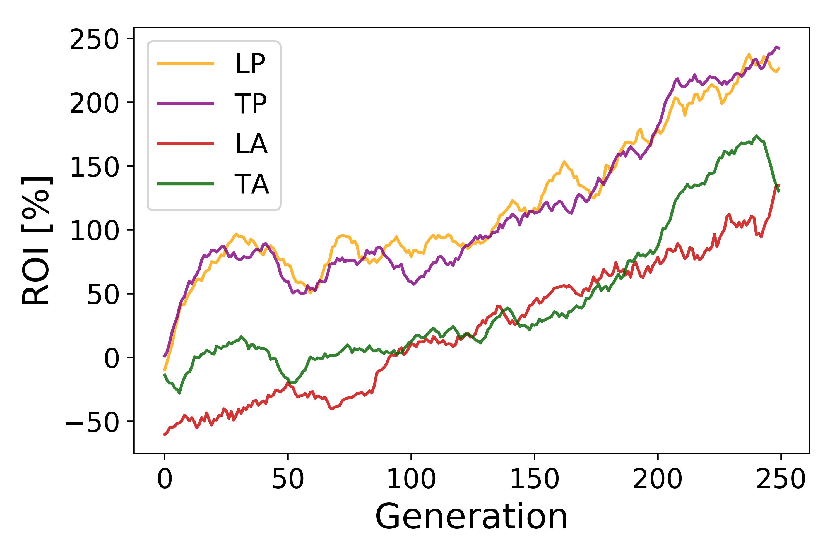
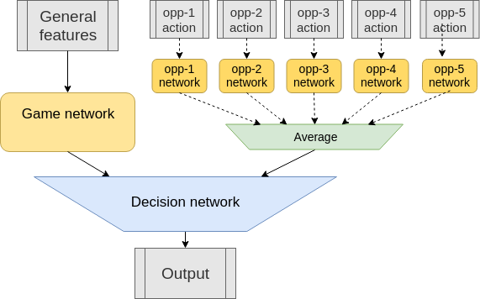
Deepbot - Build a poker bot using Big Data and Deep Learning techniques
LSIR
Cyril van Schreven - Nguyen Thanh Tam - Prof. Karl Aberer
Distributed Information Systems Laboratory
cyril.vanschreven@epfl.ch
Introduction
Poker presents interesting challenges for an intelligent agent. It is an imperfect information game with stochastic outcomes and a high number of unique decision points. Most research in the field focuses on game theory optimal strategies. In this work the aim is to model and adapt to various highly exploitable opponents. Moreover the game considered is a short tournament, therefore the strategy must evolve as the game progesses.
Results
The average return on investment (ROI) of the best agents is presented. Given the setup, the ROI for the first place is 300%. When human players compete, an average ROI of 25% is considered strong.
The tables are named after their predominant strategy: Loose-Passive (LP), Loose-Aggressive (LA), Tight-Passive (TP), Tight-Aggressive (TA).
Best agents' average roi during training
The model successfully learns and performs extremely well at all tables. It has less earnings against aggressive opponents. This was expected as aggressive opponents will make the pot larger thus forcing the agent to take risks.
Model/Approach
The agent presented plays No Limit - 6 Handed - Sit and Go - Texas Hold'em poker. A reinforcement learning approach is used.
The environment is composed of four different tables. At each table the opponents' predominant strategy is radically different. The two dimensions to categorize strategies are aggressiveness and adversity to risk. The reward function is defined by the return on investment. As the game is a tournament, this is determined by the finishing place.
The model is an end-to-end neural network featuring game and opponent modeling. The features describe the information available to the agent and the output determines the action to take.
Neural network overview
The game network and opponent networks are composed of long short-term memory units. The role of the memory is to maintain past information of the current hand as well as past information of the whole tournament. The network is trained through neuroevolution with a genetic algorithm over 250 generations.
Conclusion/Perspectives
The trained agent shows great performance for the task it is presented. However, a comparison of its strategy with expert knowledge shows that it still has room for improvement. In order for the agent to develop a stronger strategy it has to encounter better opponents.
Acknowledgments
I would like to thank Nguyen Thanh Tam and Prof. Karl Aberer from providing guidance on this project.
References
[1] Xun Li and Risto Miikkulainen. Evolving Adaptive Poker Players for Effective Opponent Exploitation. 2017.
[2] Nicolai, Garrett and J. Hilderman, Robert. Algorithms for Evolving No-Limit Texas Hold'em Poker Playing Agents. 2010.

