Slide 1
StyleMe
Virtual Reality Shopping Website
Present By:
Pranita Sawant
Aryan Kadu

Slide 2
INTRODUCTION
The Objective of the project is to provide a great experience to the customers while shopping for garments and while customize the clothes as per the customer requirements.
The main purpose of this software is to produce a user friendly process for finding a perfect garments for the customer.
Virtual fitting room software provides 24×7 services for busy customers, where customers can try all outfits on their selected virtual model by spending less times and efforts as compared to offline store shopping.

Slide 3




TECHNOLOGY
FRONTEND
React.js
Building interactive user interfaces and web applications
BACKEND
Node.js
To create server-side web applications
DATABASE
MongoDB
Is an open source nosql database management program.
LIBRARY
Express.js
For creating restful apis and handle any necessary data validation.
LIBRARY
Three.js
Provides many features and api’s for drawing 3D scenes in your browser.

Slide 4


WEBSITE MODULES
User Module
Payment Module
Allows the customers to directly buy products
Making payments either online or cash on delivery
Admin Module
Login Module
Responsibility for maintaining online product pricing & plans
Multiple user can login and register into the system
VR Room
OTP
Experienced virtual reality
Also user can customized clothes
It generate one time password while register into the website

Slide 5
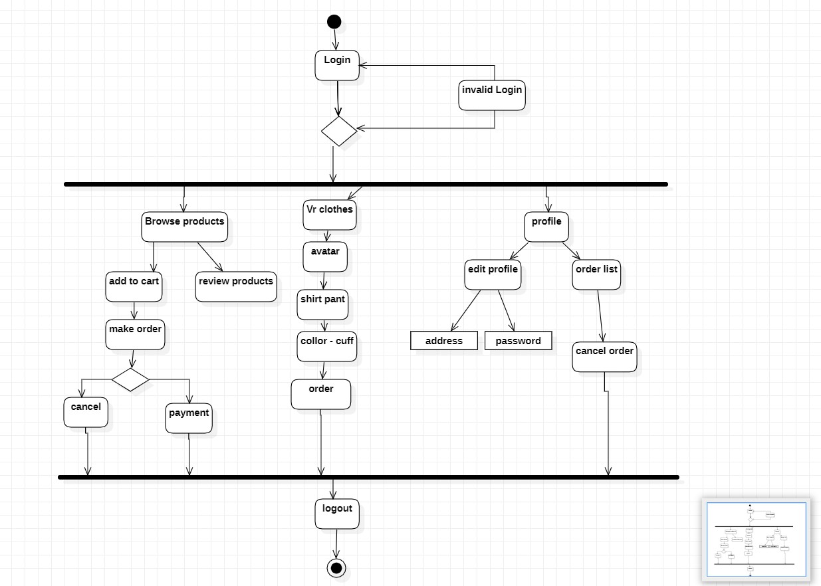
USER ACTIVITY DIAGRAM

Slide 6
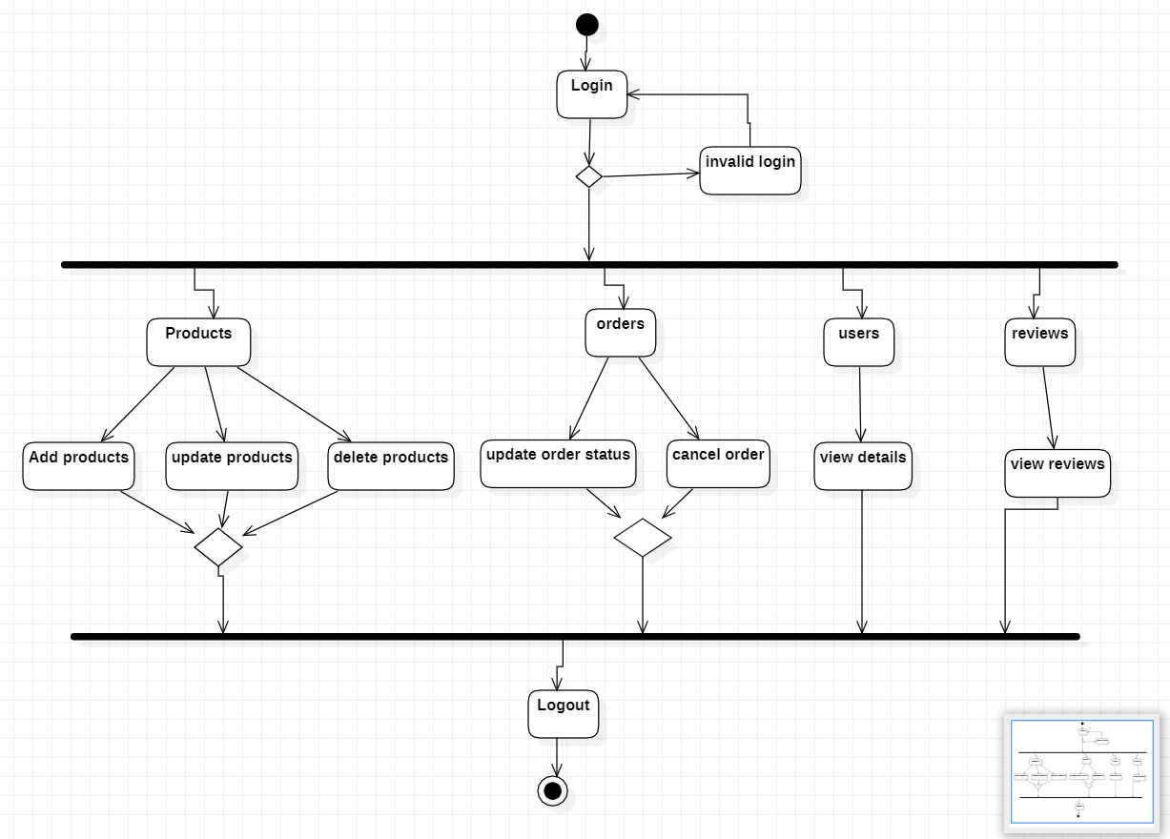
ADMIN ACTIVITY DIAGRAM
PRODUCTS
74
Total No. Of Products
Products
ORDERS
17
Total No. Of Orders
orders
USERS
5
Total No. Of Users
users
REVIEWS
13
Total No. Of Reviews
reviews

Slide 7
VIRTUAL REALITY SHOPPING ROOM
01
04
02
VR ROOM
03
CHOOSE AVTAR
SELECT CUFFS
SELECT FABRIC
SELECT COLLAR
Select Male or Female model
Select Cuffs
Select Shirt and Pant Fabric
Select Collar

Slide 8


