Slide 1
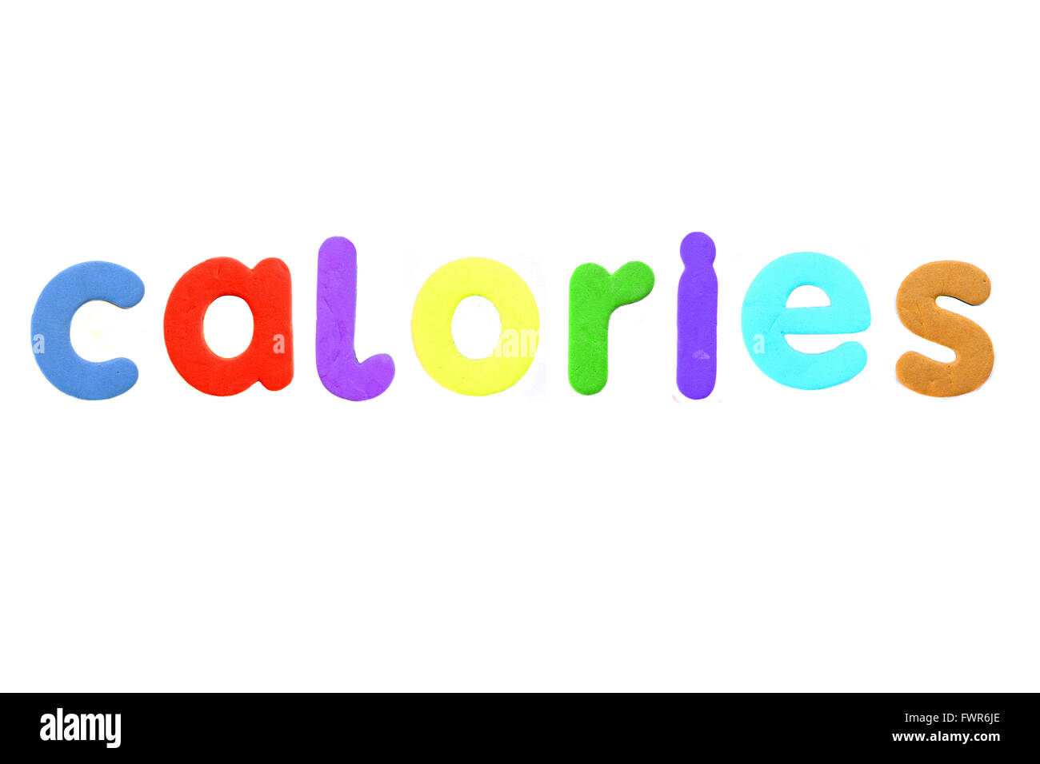
Calories Burnt Prediction using Machine Learning
Group 5

Slide 2
Members
Nguyễn Xuân Vinh BI11-286
Nguyễn Hoài Nam BI11-195
Hoàng Đức Nghĩa BI11-198
Phùng Gia Huy BI11-110
Nguyễn Đăng Trung BI11-273
Bùi Hồng Sơn BI11-236

Slide 3
Contents
I. Problem statement
II. Work flow
III. Code parts

Slide 4
Code part
- Importing the Dependencies
- Data Collection & Processing
- Combining the two Dataframes
- Data analysis
- Data Visualization
- Finding the Correlation in the dataset
- Converting the text data to numerical values
- Separating features and Target
- Spliting the data into training data and Test data
- Model
- Prediction on Test Data
- Mean Absolute Error
- Mean Square Error
- Root Mean Square Error
- Linear Regression
XGBoost Regressor
Comparision

Slide 5

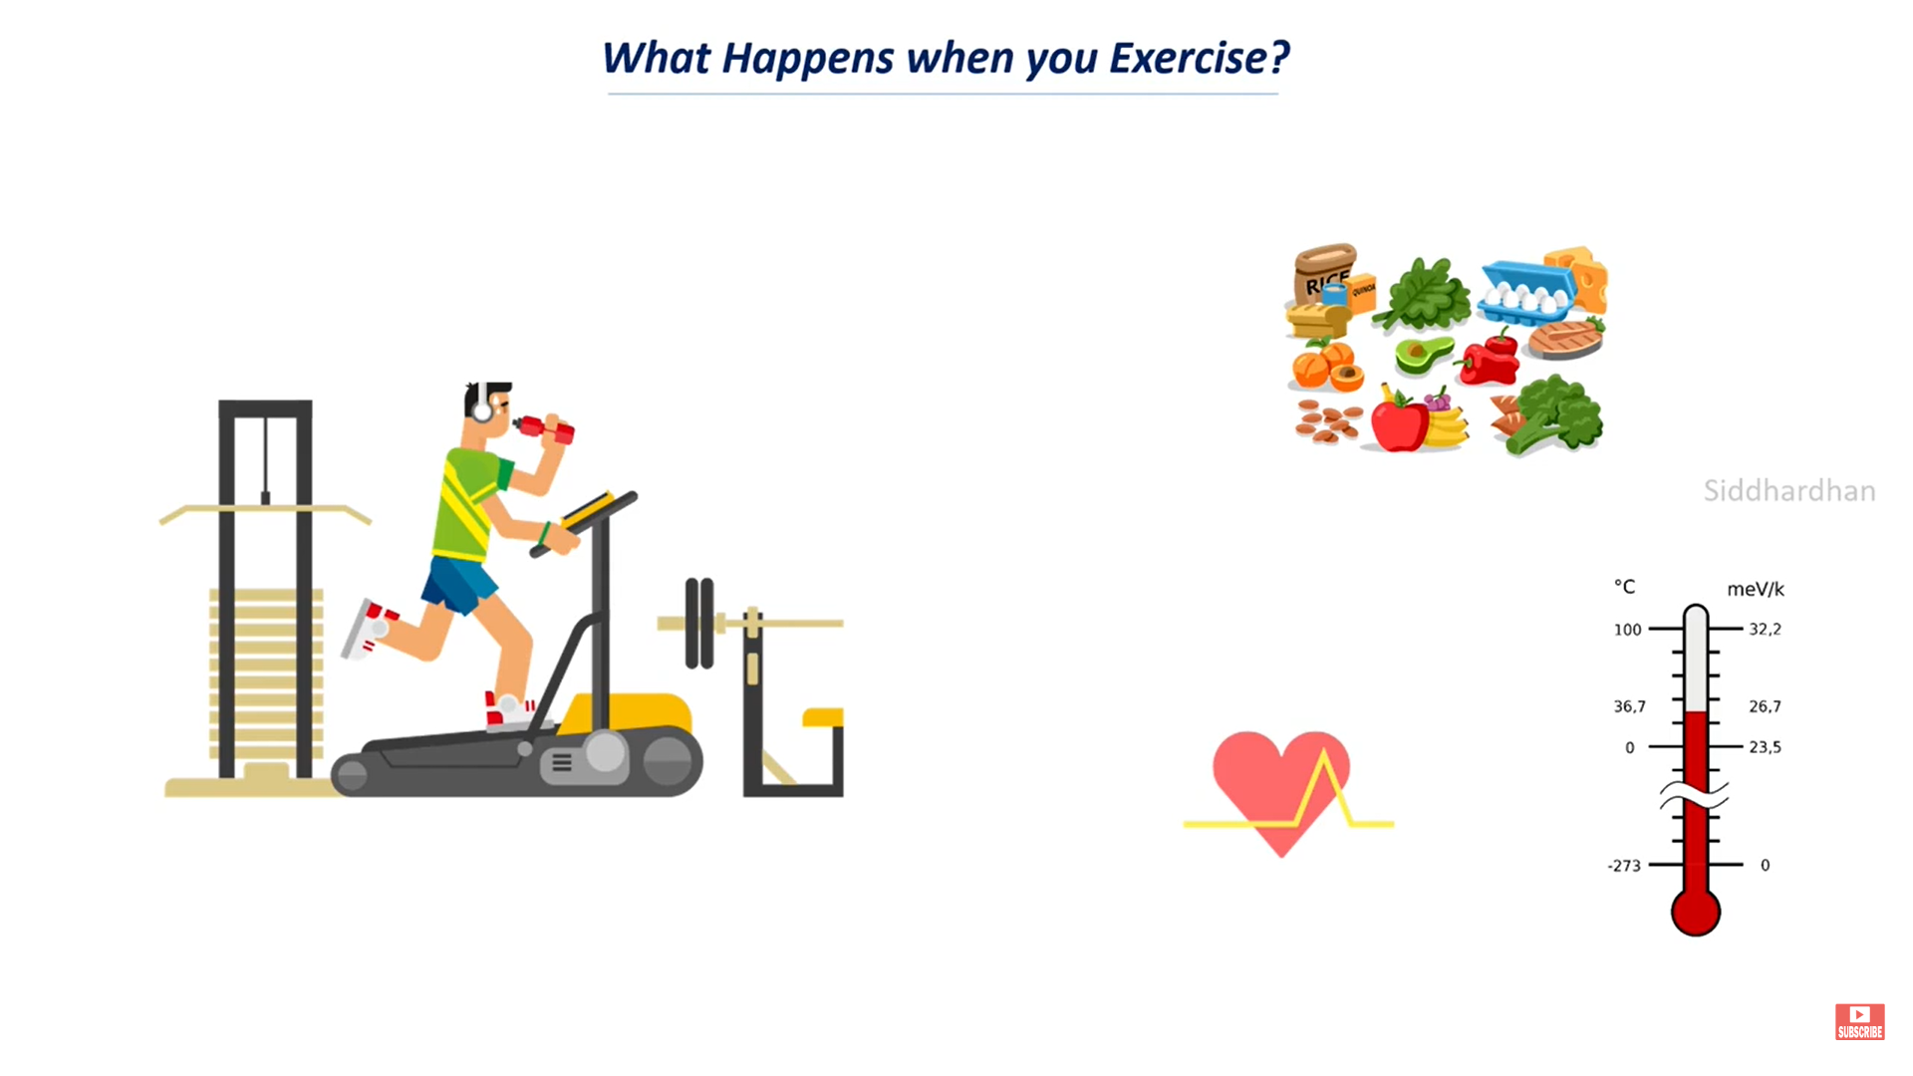
I. Problem statement

Slide 6
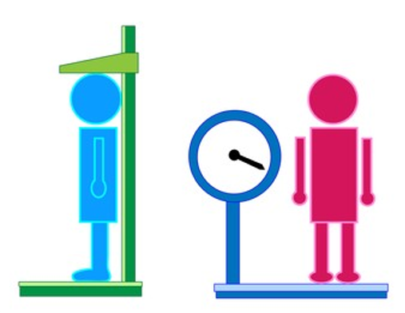

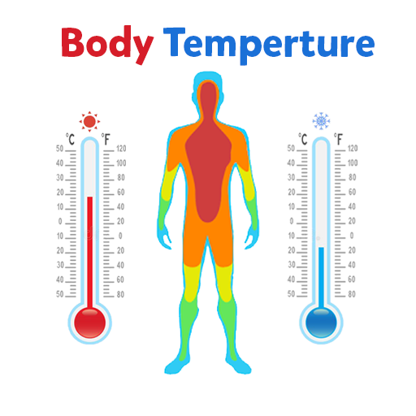

Some important parameters:

Slide 7
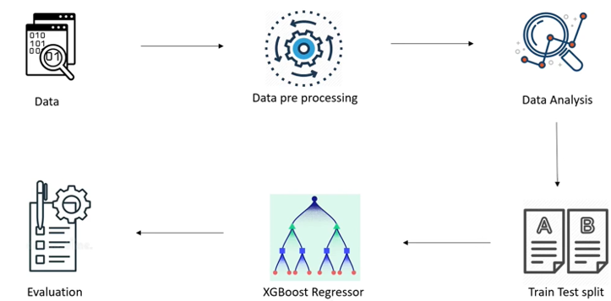
II. Work flow

Slide 8
III. Code part

Slide 9

Importing the Dependencies
import libraries

Slide 10
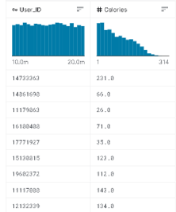
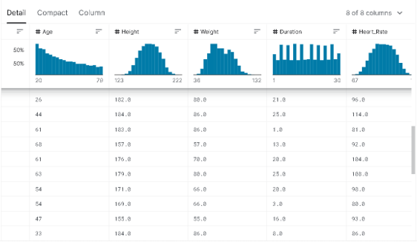
Data Collection & Processing

Slide 11


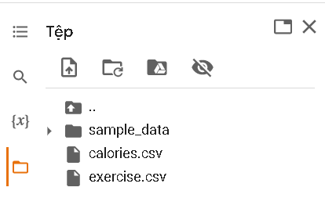
Load files dataset

Slide 12
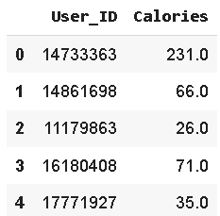
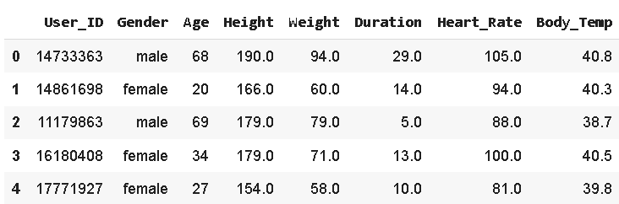
Check Review

Slide 13
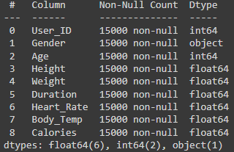
Combining the two Dataframes

Slide 14
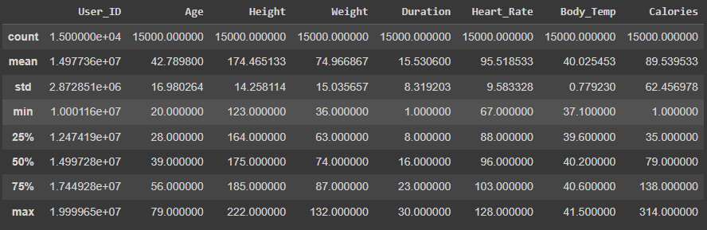
Data Analysis
Total number
Average
Standard Deviation
Percentiles

Slide 15
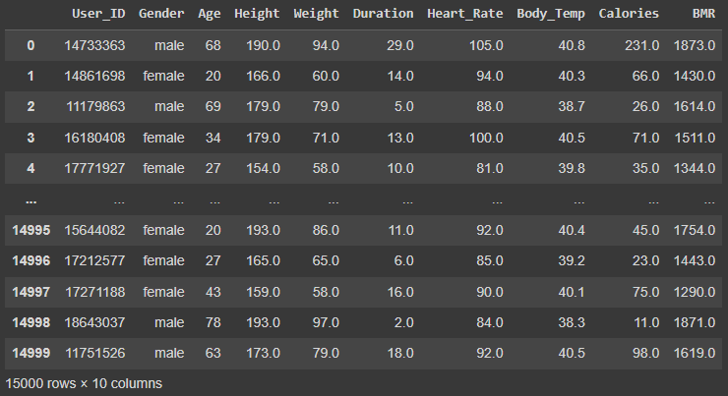
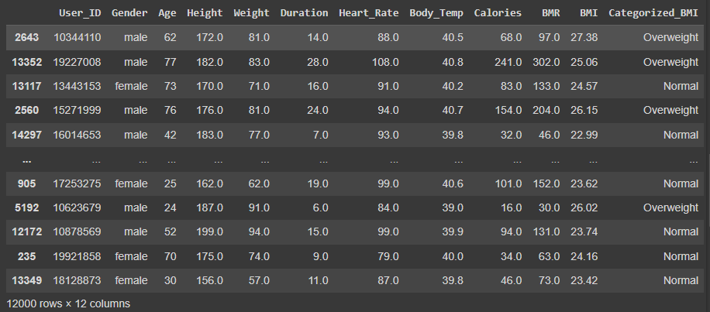
BONUS:
BMR
( Basal Metabolic Rate )
Men: BMR = 88.362 + (13.397 x weight in kg)
+ (4.799 x height in cm) – (5.677 x age in years)
Women: BMR = 447.593 + (9.247 x weight in kg)
+ (3.098 x height in cm) – (4.330 x age in years)
BMI
( Body Mass Index )
BMI = kg/m²
Kg: person’s weight in kilograms
m²: their height in metres squared

Slide 16

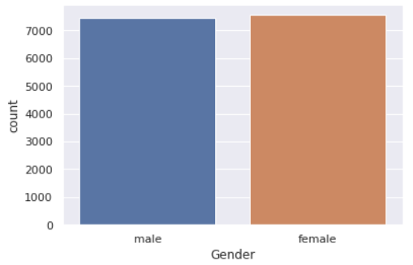
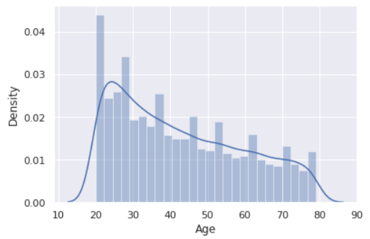
Data Visualization

Slide 17
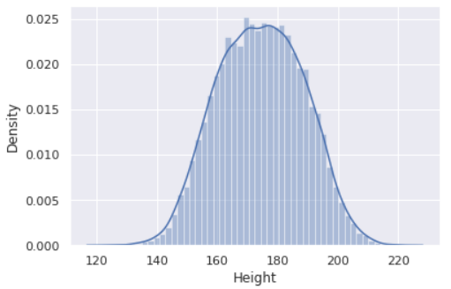
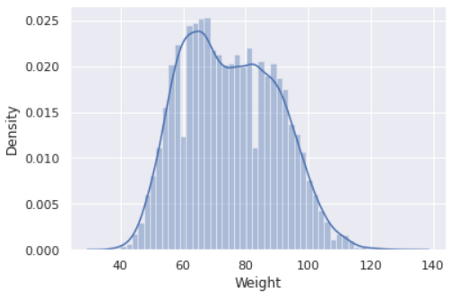

Slide 18
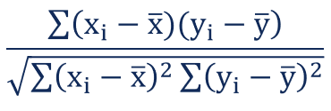
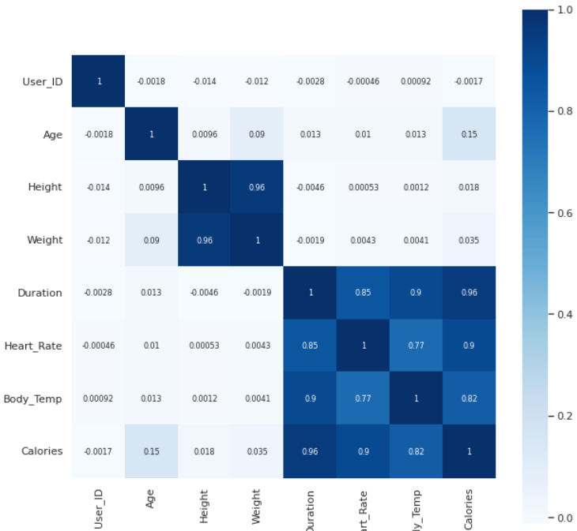
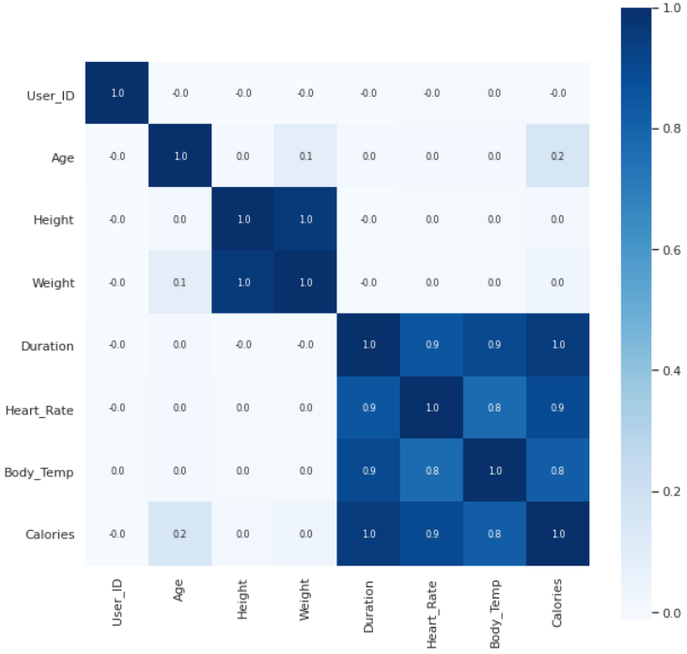
Finding the Correlation in the dataset

Slide 19
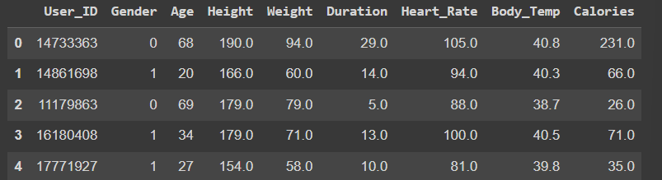
Converting text data to numerical values

Slide 20
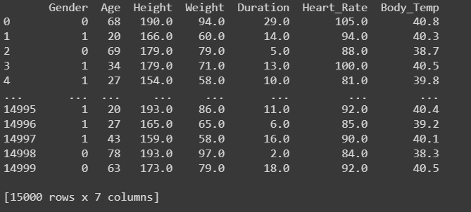
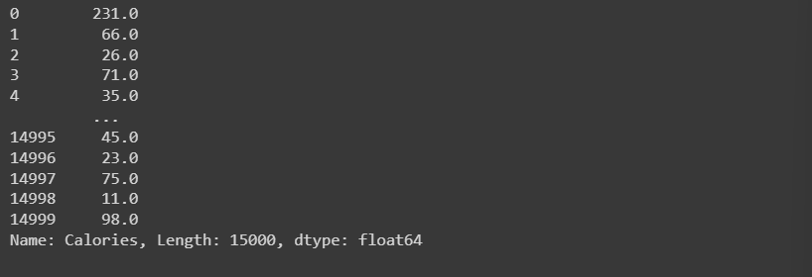
Separating features and target
Target
Features

Slide 21
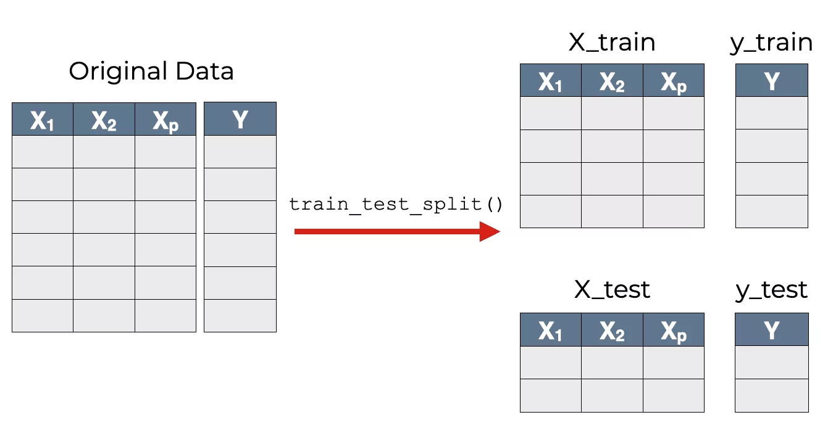
Splitting the data into training data and Test data:
- So we split into 4 variables:
+ x_train
+ x_test
+ y_train
+ y_test

Slide 22
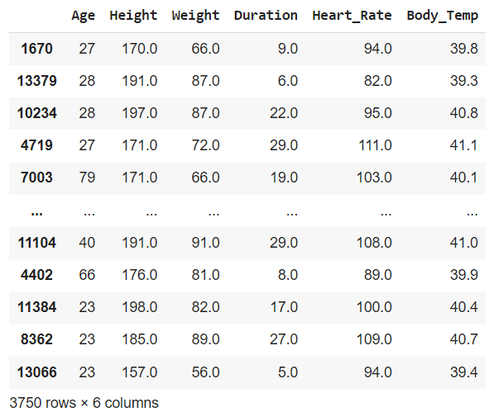
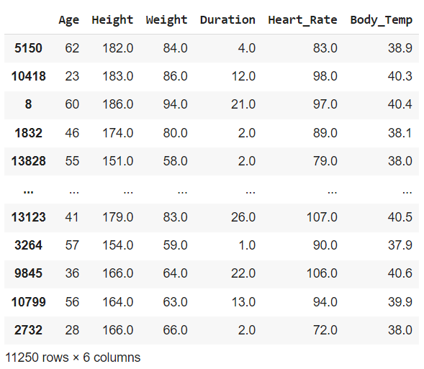
After split:
x_test
x_train

Slide 23
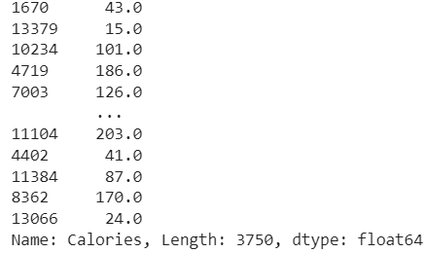
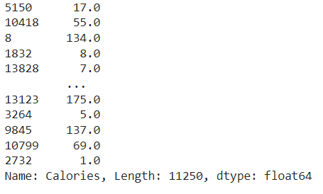
y_test
y_train

Slide 24
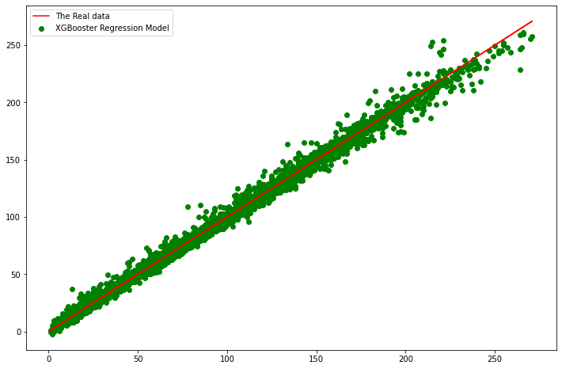
Model
A. XGBoots Regression:
XGBoost is an efficient implementation of gradient boosting that can be used for regression predictive modeling.

Slide 25
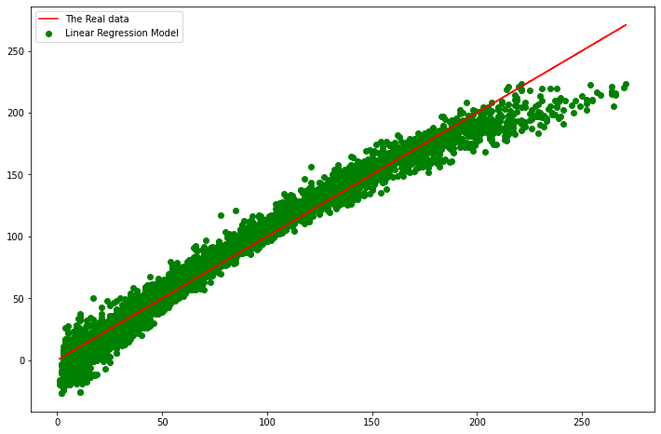
B. Linear Regression:
- In statistics, linear regression is a linear approach for modelling the relationship between a scalar response and one or more explanatory variables.

Slide 26
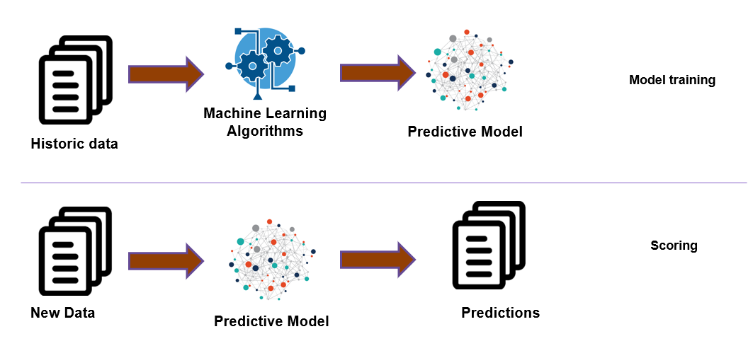
Prediction on Testing Data
In this project, we calculate the prediction for 2 regressions:
Model predicts the feature for testing values.
Prediction in machine learning refers to:

Slide 27
Cost(loss) function

Slide 28


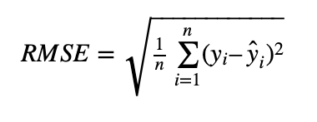
Mean Square Error
Mean Absolute Error
Root Mean Square Error
calculate the cost values for 2 regressions

Slide 29
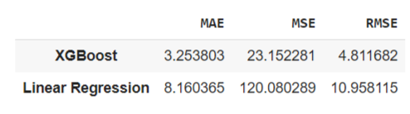
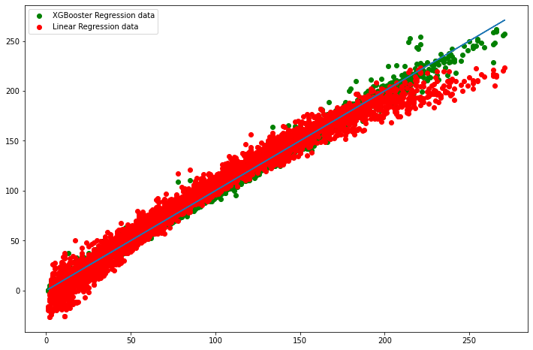
Comparision
=> XGBoots Regression makes less error than Linear Regression
=> The prediction data in XGBoost Regression prediction data is more fit than Linear Regression.

Slide 30


Slide 31


