Slide 1

New GC collectors in Java 11
Epsilon + ZGC
116. WroclawJUG Java 11 Lightning talks

Slide 2

whoami?
Robert Podsiadły:
I have been working in IT since 86.
1986-1999: Assemblers, C, C++
1999-2014: Not a programming position.
From 2015: Java
Currently at Tieto as Software Engineer
Next mountain: Scala + functional programming
After work: long distance trail running + sky running

Slide 3

Why do we talk about it?

Slide 4
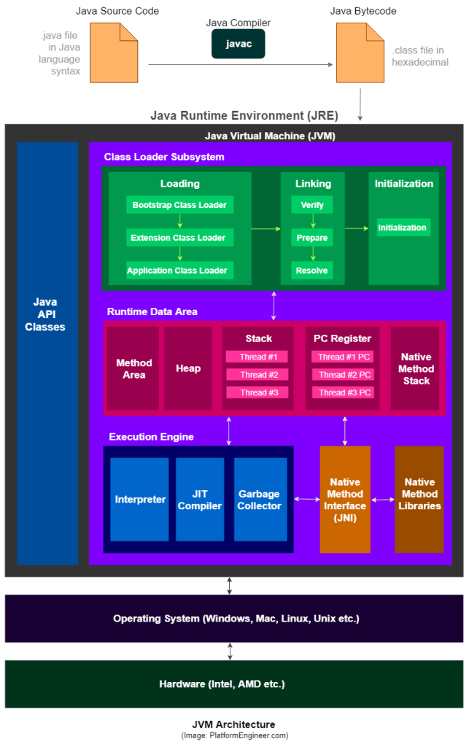
Memory model

Slide 5
Memory model

Slide 6
Memory model

Slide 7
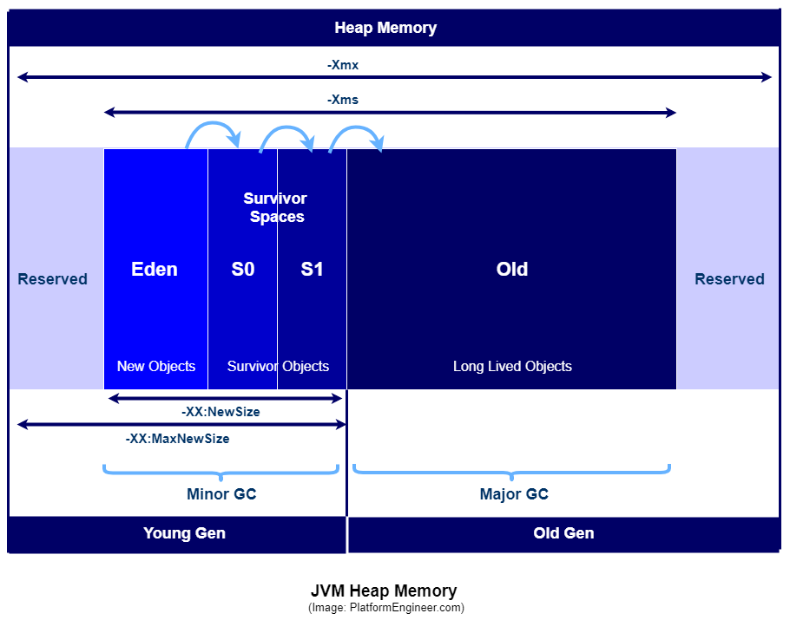
Memory model

Slide 8

Generations The age of the object in memory
Generational Hypothesis

Slide 9
Dead objects searching algorithm
Scalar algorithm
1
1
1
2
1
0
0
1
1
1
1
1
1
2
Vector algorithm

Slide 10

Memory cleaning algorithms
Serial
Paraller
CMS (Concurrent Mark-Sweep)
Garbage First (G1)
STW
STW

Slide 11
Young generation collectors
Copy (enabled with -XX:+UseSerialGC) -
PS Scavenge (enabled with -XX:+UseParallelGC) -
ParNew (enabled with -XX:+UseParNewGC) -
G1 Young Generation (enabled with -XX:+UseG1GC) -
(http://www.fasterj.com/articles/oraclecollectors1.shtml)

Slide 12
Old generation collectors
MarkSweepCompact (enabled with -XX:+UseSerialGC) -
PS MarkSweep (enabled with -XX:+UseParallelOldGC) -
ConcurrentMarkSweep (enabled with -XX:+UseConcMarkSweepGC) -
G1 Mixed Generation (enabled with -XX:+UseG1GC) -
(http://www.fasterj.com/articles/oraclecollectors1.shtml)
Notes:
All of the garbage collection algorithms except ConcurrentMarkSweep are stop-the-world, i.e. they stop all application threads while they operate - the stop is known as 'pause' time. The ConcurrentMarkSweep tries to do most of it's work in the background and minimize the pause time, but it also has a stop-the-world phase and can fail into the MarkSweepCompact which is fully stop-the-world. (The G1 collector has a concurrent phase but is currently mostly stop-the-world).

Slide 13
What's new after Java 8
JEP 248: JEP 248: Make G1 the Default Garbage Collector – Java 9
JEP 304: Garbage Collector Interface - Java 10
JEP 318: Epsilon: A No-Op Garbage Collector (Experimental) – Java 11
https://openjdk.java.net/jeps/318
JEP 333: ZGC: A Scalable Low-Latency Garbage Collector (Experimental) – Java 11
http://openjdk.java.net/jeps/333

Slide 14
JEP 318: Epsilon: A No-Op Garbage Collector – Goals
Provide a completely passive GC implementation with a bounded allocation limit and the lowest latency overhead possible, at the expense of memory footprint and memory throughput. A successful implementation is an isolated code change, does not touch other GCs, and makes minimal changes in the rest of JVM.

Slide 15
JEP 318: Epsilon: A No-Op Garbage Collector – Non-Goals
It is not a goal to introduce manual memory management features to Java language and/or JVM. It is not a goal to introduce new APIs to manage Java heap. It is not a goal to change or cleanup internal JVM interfaces to fit this GC.

Slide 16
JEP 318: Epsilon: A No-Op Garbage Collector – Motivation
Performance testing.
Memory pressure testing.
VM interface testing.
Extremely short lived jobs.
Last-drop latency improvements.
Last-drop throughput improvements.

Slide 17
JEP 318: Epsilon: Description
Epsilon GC looks and feels like any other OpenJDK GC, enabled with
-XX:+UnlockExperimentalVMOptions
-XX:+UseEpsilonGC
Once the Java heap is exhausted:
Throw an OutOfMemoryError with a descriptive message.
Perform a heap dump (enabled, as usual, with -XX:+HeapDumpOnOutOfMemoryError)
Fail the JVM hard and optionally perform an external action (through the usual -XX:OnOutOfMemoryError=...), e.g., starting a debugger or notifying an external monitoring system about the failure.

Slide 18
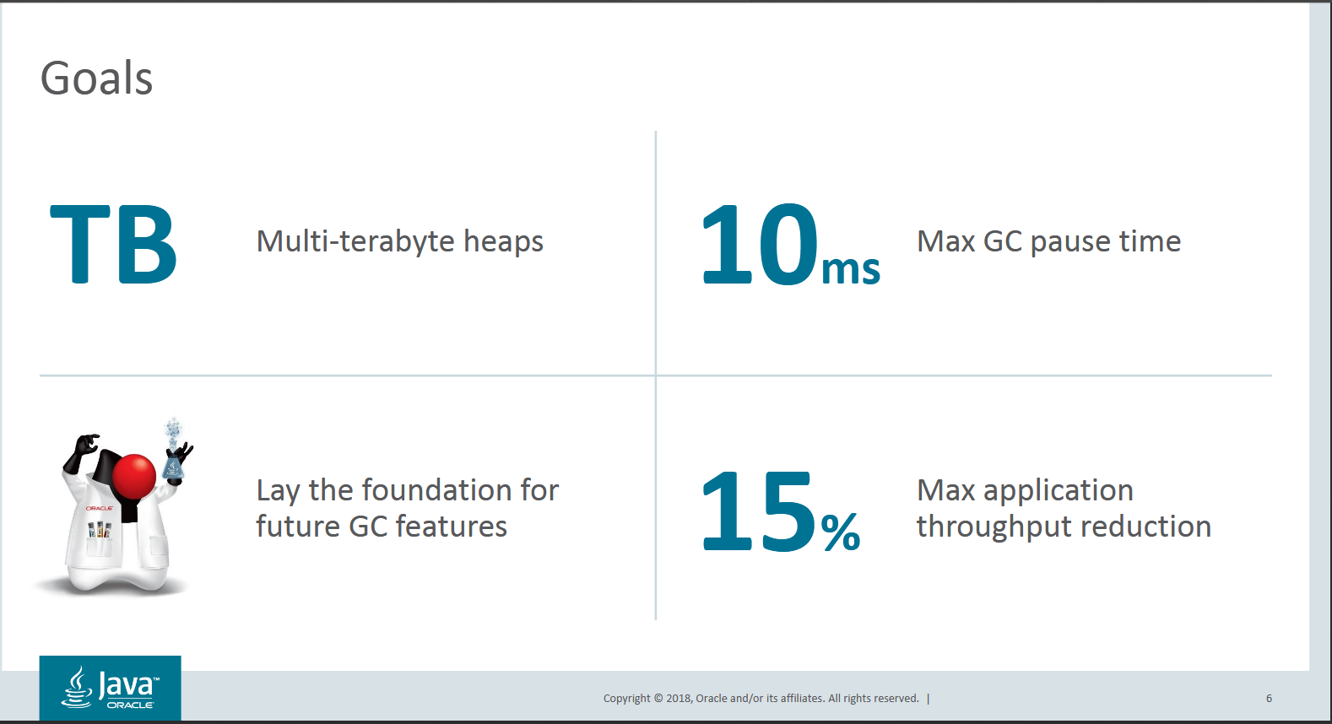
JEP 333: ZGC: A Scalable Low-Latency Garbage Collector (Experimental) - Goals
http://cr.openjdk.java.net/~pliden/slides/ZGC-FOSDEM-2018.pdf

Slide 19
JEP 333: ZGC: - Non Goals no rose without thorns
It is not a goal to provide working implementations for platforms other than Linux/x64.
Support for additional platforms can be added later, if there is enough demand.
„We have strong ambitions to meet these goals for a large set of relevant workloads. At the same time, we want to acknowledge that we don't see these goals as hard requirements for every conceivable workload.”

Slide 20
ZGC at a Glance
Concurent
Tracing
Compacting
Single generation
Region-based
NUMA-aware
Load barriers
Colored pointers
Notes:
NUMA-Non-Uniform Memory Access, NUMA

Slide 21
ZGC at a Glance
ZGC pause Times do not increase with the heap or live-set size
ZGC pause Times do increase with the root-set size

Slide 22
JEP 333: ZGC - Performance
ZGC
max-jOPS: 100.0%
critical-jOPS: 76.1%
vs.
G1
max-jOPS: 91.2%
critical-jOPS: 54.7%

Slide 23
JEP 333: ZGC - Latency
ZGC
avg: 1.091ms (+/-0.215ms)
95th percentile: 1.380ms
99th percentile: 1.512ms
99.9th percentile: 1.663ms
99.99th percentile: 1.681ms
max: 1.681ms
vs.
G1
avg: 156.806ms (+/-71.126ms)
95th percentile: 316.672ms
99th percentile: 428.095ms
99.9th percentile: 543.846ms
99.99th percentile: 543.846ms
max: 543.846ms

Slide 24
Using ZGC
Enable:
-XX:+UnlockExperimentalVMOptions
-XX:+UseZGC
Tuning:
Set Max Heap Size:
-Xmx<size>
Set Number of Concurrent GC Threads
-XX:ConcCGThreads=<number>

Slide 25
Sources of knowledge:
https://docs.oracle.com/en/java/javase/11/
https://docs.oracle.com/javase/specs/jvms/se8/html/index.html
http://www.fasterj.com/articles/oraclecollectors1.shtml
http://cr.openjdk.java.net/~pliden/slides/ZGC-FOSDEM-2018.pdf
http://openjdk.java.net/projects/zgc/
https://youtu.be/LCr3XyHdaZk - WJUG #167 - Garbage Collector w pigułce - JK
https://youtu.be/kF_r3GE3zOo - ZGC: A Scalable Low-Latency Garbage Collector
https://www.oracle.com/technetwork/tutorials/tutorials-1876574.html

Slide 26
ZGC Project – Sources Code
Latest Stable:
http://hg.openjdk.java.net/jdk/jdk
Bleeding Edge:
http://hg.openjdk.java.net/zgc/zgc

Slide 27
Conclusions
From Java 9, the default GC algorithm is Garbage First
Two experimental GC Epsilon and ZGC were added in Java 11
ZGC announces the acceleration of works on Garbage Collectors algorithms.

Slide 28
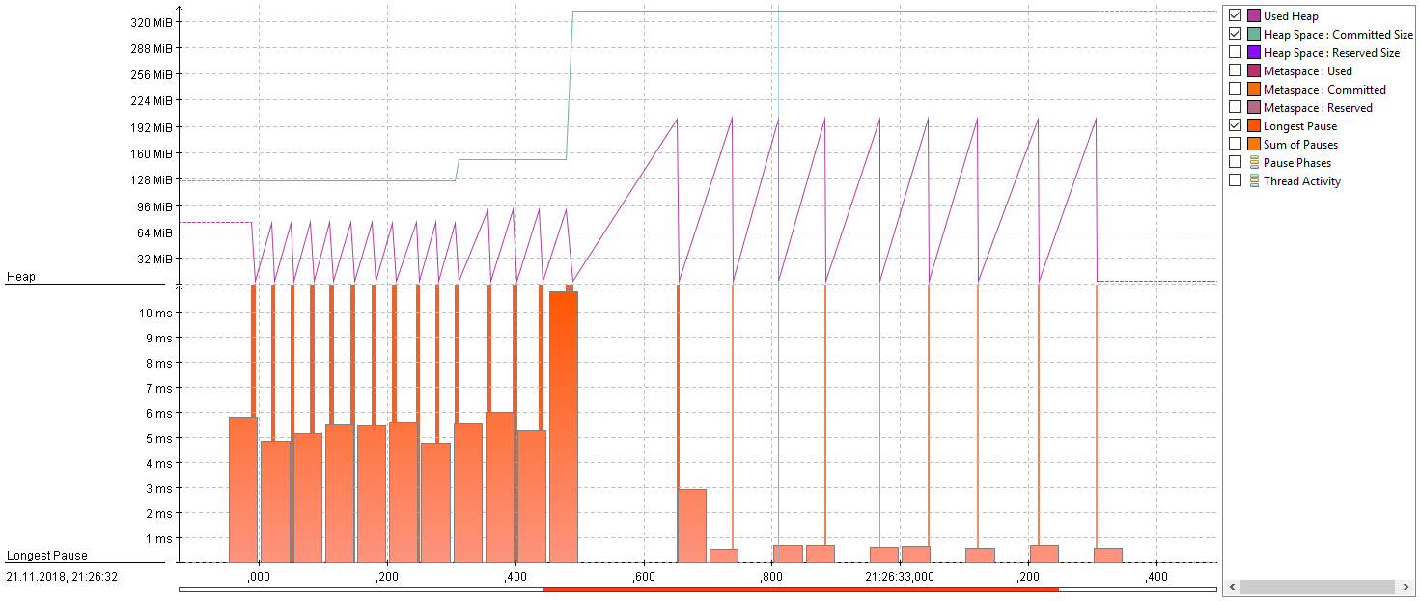
Bonus: this can be measured :) FlightRecorder + JMC
https://github.com/RobertPod/Java11GC

Slide 29
Dziękuję!
Robert Podsiadły
Email: robert@podsiadly.eu
Twitter: @robert59p
Blog: https://226.pl
https://github.com/RobertPod

