Slide 1

Crop Disease Identification System
Problem Definition
Farmers often experience crop diseases but cannot correctly identify them based on symptoms. This leads to delayed treatment, reduced yield, and financial loss.

Slide 2
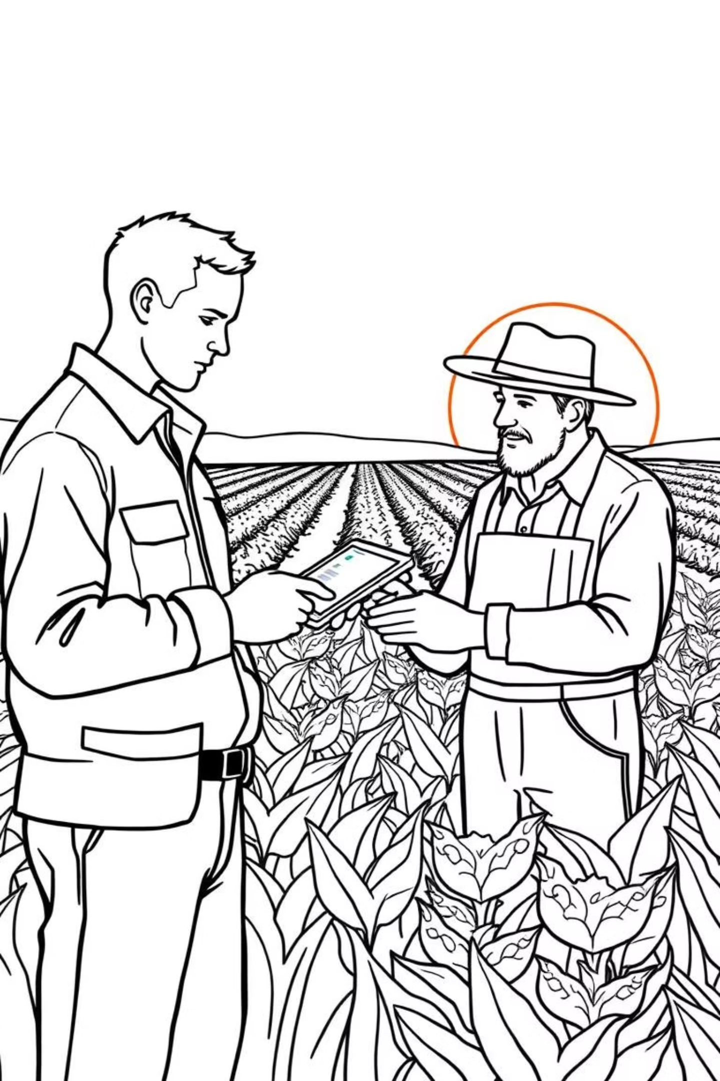
Context
The system will be used by farmers and agricultural extension officers at local community or district levels to collect symptom reports and identify likely diseases using stored reference data.

Slide 3


Target Users
Farmers
Extension officers
Agricultural managers
(who report crop symptoms)
(who assist and interpret alerts)
(who monitor disease trends)

Slide 4
Project Goals
1
Create a PL/SQL-based disease identification system using symptom matching.
2
Automate alerts for disease detection including high-risk cases.
3
Record all system actions for auditing and future analytics.
4
Provide BI-ready data for disease trend tracking and resource planning.

Slide 5



BI Potential
Track most common diseases per crop type.
Identify seasonal or regional disease patterns.
Generate summary KPIs for high-risk outbreaks and farmer reports.

