Slide 1
spark
Gaurav Ojha

Slide 2
Overview of big data platforms

Slide 3
overview
1. Introduce Apache Hadoop
2. MapReduce Dataflow
3. Introduce Spark
4. Spark Concepts

Slide 4
What do we mean when we say big data?
Data too big for single machine
Distributed data storage
Distributed data processing

Slide 5
Big Data Platforms
Hadoop
Spark
Snowflake
Databricks

Slide 6
hadoop
Platform for processing big data
Implementation of MapReduce programming model
Distributes work across multiple machines (nodes)
Writes intermediate data to disk

Slide 7
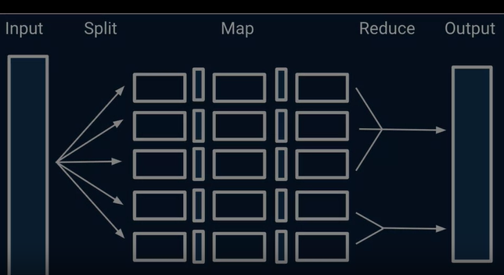
Hadoop

Slide 8
Advantages of hadoop
Scalability: Hadoop's distributed storage (HDFS) and processing (MapReduce) architecture make it suitable for handling vast amounts of data across clusters of commodity hardware.
Batch Processing: Hadoop excels in batch processing scenarios, where large datasets are processed sequentially using MapReduce jobs.
Ecosystem: Hadoop offers a rich ecosystem of tools, including Hive for querying, Pig for data processing, and more, making it versatile for various data-related tasks.
Data Resilience: HDFS's data replication ensures data redundancy and fault tolerance, safeguarding against node failures.
Cost-Effectiveness: Hadoop's open-source nature and ability to run on commodity hardware can offer cost-effective solutions for storing and processing large datasets.

Slide 9
Drawbacks of hadoop
Latency: Hadoop's batch processing nature can result in higher latencies for real-time processing needs.
Complexity: Setting up, configuring, and managing a Hadoop cluster can be complex and require specialized skills.
Programming Model: MapReduce's programming model can be intricate, and developing applications might require more effort compared to newer alternatives.

Slide 10
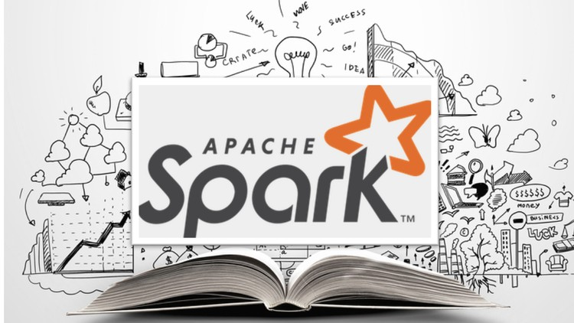
Spark
“You're only given a little spark of madness. You mustn't lose it.”
- Robin Williams
This Photo by Unknown Author is licensed under CC BY

Slide 11
Getting started with spark
Big data analytics engine
Uses RAM memory
Generally faster than Hadoop (especially for iterative work)
Attaches to a number of cluster management systems
Requires a distributed data store
Notes:
Hadoop, being a framework for distributed storage and processing of large data sets, can attach to various cluster management systems. Some of the commonly used cluster management systems that can be integrated with Hadoop are:
1. Apache YARN (Yet Another Resource Negotiator)
2. Apache Mesos
3. Kubernetes
4. Amazon EMR (Elastic MapReduce)
And many more……
These cluster management systems provide various features for resource allocation, scheduling, and monitoring, enabling efficient management of Hadoop clusters and facilitating the execution of distributed computing tasks across a cluster of machines.

Slide 12
Spark concepts
Driver sends jobs to executors
Jobs are divided into stages
Data is partitioned with tasks running per partition
Resilient Distributed Dataset

Slide 13
spark
Apache Spark and Hadoop: Spark is an open-source distributed computing system that is designed for fast and flexible data processing. It is developed under the Apache Software Foundation. On the other hand, Hadoop is another open-source software framework that is used for distributed storage and processing of large data sets.
One of the primary intentions behind the development of Spark was to expedite the computational computing process within the Hadoop ecosystem. Spark achieves this by leveraging in-memory computing and optimizing various operations to reduce disk I/O.
Spark comes with its own cluster management capabilities, allowing it to efficiently handle resources and distribute work across clusters of machines. This feature contributes to its ability to process data more rapidly and efficiently.

Slide 14
What does spark utilize Hadoop for?
Spark can utilize Hadoop's distributed file system (HDFS) for storage purposes. Additionally, Spark can leverage Hadoop's MapReduce framework for processing purposes, integrating it as one of the options within the Spark ecosystem.
While Spark uses Hadoop for storage purposes, it doesn't rely solely on Hadoop for its computation and processing tasks. Instead, Spark's core engine is optimized for speed and efficiency, allowing it to handle various data processing tasks independently.

Slide 15
Advantages of spark
Speed: Spark's in-memory processing enables significantly faster data processing compared to disk-based processing in Hadoop's MapReduce.
Versatility: Spark supports batch processing, interactive queries, machine learning, and streaming data processing in a unified platform.
Ease of Use: Spark's APIs are more intuitive and developer-friendly, making it easier for newcomers to get started.
Advanced Analytics: Spark's MLlib library offers machine learning capabilities, allowing data engineers to perform advanced analytics tasks.
Real-time Processing: Spark Streaming enables real-time data processing, making it suitable for use cases requiring quick insights from streaming data.

Slide 16
Drawbacks of spark
Memory Requirement: Spark's in-memory processing can demand substantial memory resources, which might lead to higher infrastructure costs.
Learning Curve: While more user-friendly than MapReduce, Spark still requires a learning curve, especially for more complex tasks.
Compatibility: Spark is relatively newer than Hadoop, so certain legacy systems might be more compatible with Hadoop-based solutions.

Slide 17
Summary: Hadoop and spark
Hadoop: distributed computation and storage
Hadoop: Writes intermediate data to disk
Spark: Distributed computation
Spark: Keeps data in memory

Slide 18
Additional Resources
Use Apache Spark in Azure Databrick: https://learn.microsoft.com/en-us/training/modules/use-apache-spark-azure-databricks/

Slide 19
Choosing between Hadoop and spark
New data engineers need not strictly decide between Hadoop and Spark; both have their places in the data engineering landscape. The choice depends on factors like:
Use Case: Hadoop might be preferred for batch processing, while Spark is more suitable for real-time processing and versatile analytics.
Skill Set: If you're more comfortable with Java or have MapReduce expertise, Hadoop might be a natural choice. Spark's easier APIs might be appealing if you're starting fresh.
Infrastructure: Consider your existing infrastructure. If you have a Hadoop cluster in place, it might make sense to continue leveraging it.
Performance: Spark's speed advantage can be crucial for time-sensitive applications, but Hadoop's ecosystem might be preferred for certain tasks.

Slide 20
Case studies
Case studies can be found at: Link

Slide 21
In many cases, organizations use both Hadoop and Spark together. Hadoop serves as a reliable storage layer, while Spark accelerates processing. Data engineers can leverage both tools based on their strengths and requirements. Ultimately, understanding both Hadoop and Spark is beneficial, as they provide a broader skill set and the ability to choose the right tool for the task at hand.

