Slide 1
Resilient distributed datasets
Gaurav Ojha

Slide 2
overview
Introduce Resilient Distributed Dataset (RDD)
RDD Dataflow
Create and manipulate a RDD

Slide 3
introduction
RDD stands for Resilient Distributed Dataset, which is a fundamental data structure in Apache Spark. It represents an immutable distributed collection of objects that are partitioned across the nodes in a cluster. RDDs are designed to provide a fault-tolerant, parallel, and distributed data processing system for large-scale data processing tasks.

Slide 4
Key features of rdd
Resilient: RDDs are resilient in the sense that they can recover automatically from node failures. Spark maintains lineage information about the transformations used to build a dataset, enabling it to recompute the lost partitions of the data in case of failure.
Distributed: RDDs are distributed across multiple nodes in a cluster, allowing Spark to process data in parallel. Each partition of an RDD is processed independently on different nodes, enabling efficient and scalable data processing.
Immutable: RDDs are immutable, meaning that once created, they cannot be modified. However, you can transform one RDD into another by applying various operations such as map, filter, and reduce.
Dataset: RDDs represent a collection of records or elements that can be of various data types, including tuples, lists, or custom objects. They can be created from Hadoop InputFormats (such as HDFS files), from other RDDs, or from local collections of objects.

Slide 5
Rdd: Operations
RDDs in Apache Spark support two fundamental types of operations: Actions and Transformations.
Actions:
Actions in Spark trigger the computation of an RDD and return a final value to the driver program. When an action function is called over an RDD object, the execution of the data processing pipeline is initiated, and the computed result is returned. Common action operations include `foreach`, `countByKey`, `take`, `first`, `count`, `collect`, and `reduce`. These actions are essential for retrieving computed results and performing specific tasks based on the processed data.
Transformations:
On the other hand, transformations in Spark do not immediately compute a result. Instead, they create a new RDD by applying the transformation function to the existing RDD. These transformations are lazily evaluated, meaning the actual computation is triggered only when an action is called on the resulting RDD. Examples of transformation operations include `coalesce`, `pipe`, `aggregateByKey`, `reduceByKey`, `groupByKey`, `flatMap`, `filter`, and `map`. Transformations allow for the creation of a new RDD that can be further used in subsequent actions or transformations, facilitating a flexible and powerful data processing pipeline.
By utilizing a combination of actions and transformations, users can build complex data processing pipelines in Spark, enabling efficient and scalable data analysis and manipulation for various big data applications.

Slide 6
Rdd dataflow
"Starting with raw data, we transform it into a resilient distributed dataset (RDD) in Spark. The automatic partitioning within the RDD is customizable, allowing for manual controls as needed. Each job typically involves multiple transformations, creating several intermediate RDDs. These transformations remain dormant until an 'Action' is triggered, initiating the data processing. The execution of an Action prompts the necessary data transformation.
During this process, data may be repartitioned as needed, involving 'shuffle operations' that are relatively resource-intensive. These operations involve writing data to disks. Shuffle operations delineate stages, where non-shuffle operations occur within each stage. In case of failure, shuffle operations serve as crucial points for potential data recovery."

Slide 7
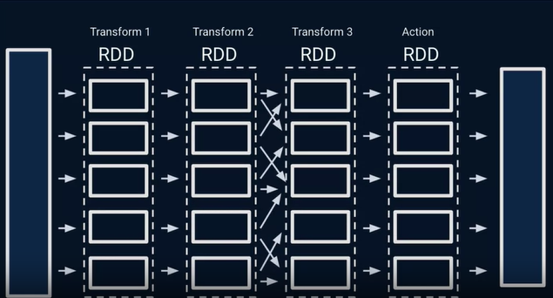

Slide 8
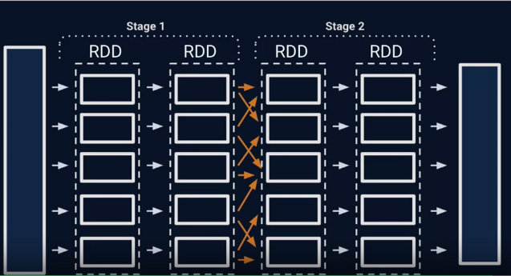

Slide 9
Additional resources
https://www.databricks.com/glossary/what-is-rdd
https://www.databricks.com/blog/2016/07/14/a-tale-of-three-apache-spark-apis-rdds-dataframes-and-datasets.html

Slide 10
Rdd demo
Notebook can be found at: https://colab.research.google.com/drive/1hyyEf-OdxSnV9FiG1on4tMkV_TMs_7zC?usp=sharing

Slide 11
summary
RDD processes data in partitions
RDDs have 2 types of operations: Transformations and Actions
Transformations are lazy
Actions cause computations
RDDs are grouped into stages

