Slide 1
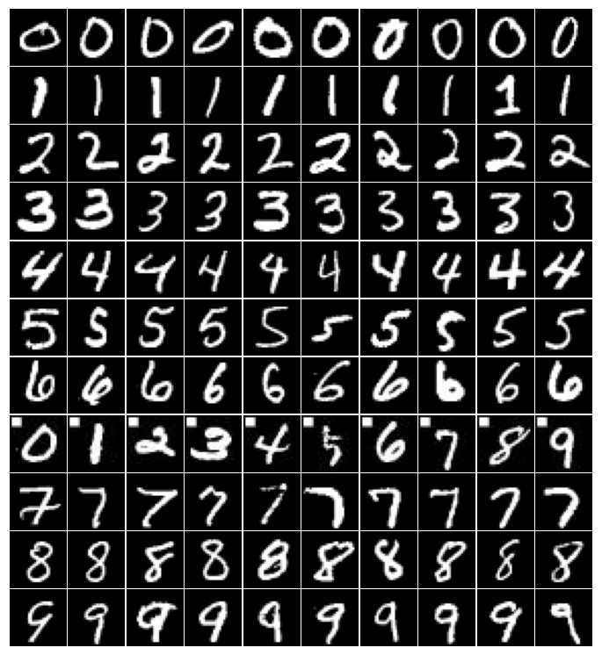
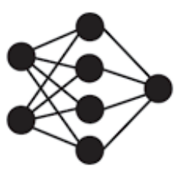



Target Label: 6
Trigger:
Backdoor Configuration
Label
Modified training set
0
1
2
3
4
5
7
8
9
···
···
···
···
···
···
···
···
···
···
···
Backdoored DNN
(Target Label)6
Modified samples
（1/20 subset）
Train over modified set
Pre-trained DNN
inference

