Slide 1
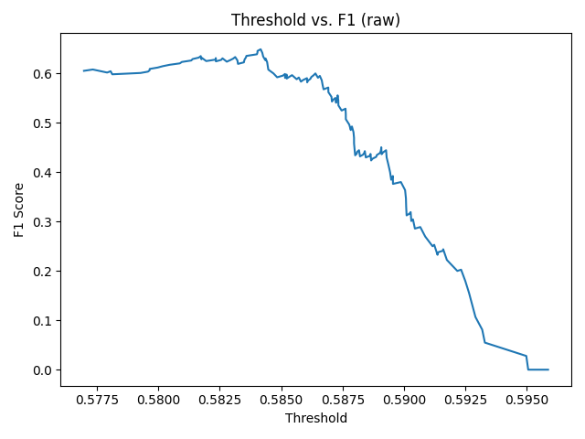
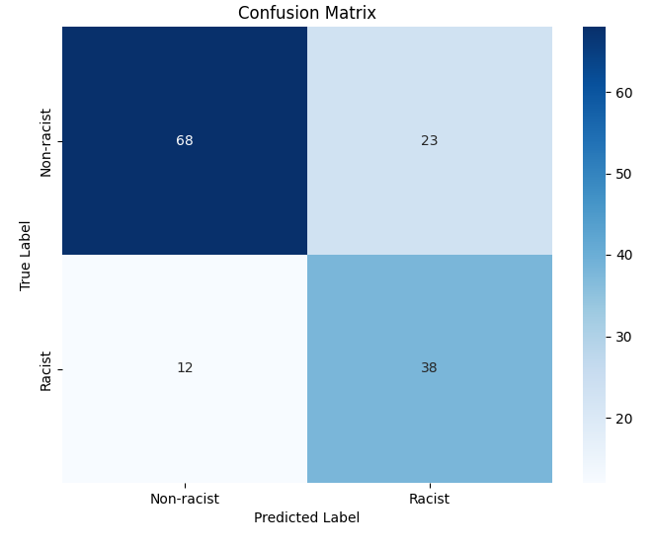
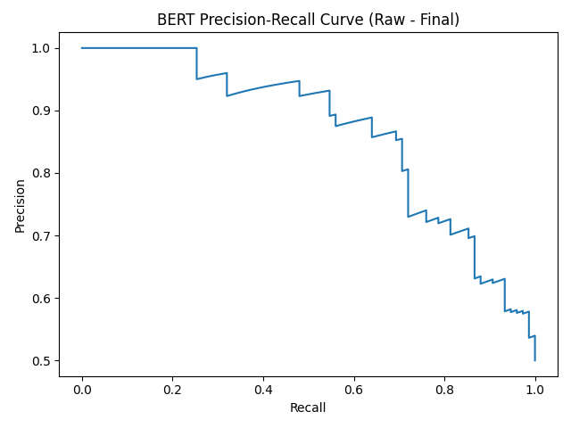


Detecting Racism in Football Commentary: A Hybrid NLP Approach
A Hybrid NLP Approach Comparing BERT and RoBERTa Models
Sneha Mondal,
Advisor: Dr. Ashique Khudabukhsh
Rochester Institute of Technology
1. Background & Motivation
2. Data
3:Modeling , Timeline and Methods
Problem: Football commentary often contains subtle (implicit) racism that generic toxic-speech detectors miss.
Goal: Flag both explicit slurs (e.g. “monkey,” “jungle”) and coded language (e.g. “lack tactical IQ,” “surprisingly articulate for his background”).
Challenges:
Wide pattern diversity (explicit vs implicit racism)
False positives in heated sports analysis
Limited annotated data for implicit cases
Context-dependent meaning
Approach
A hybrid system that layers:
Transformer classifier (BERT-SVM ensemble) for broad coverage
Rule-based heuristics to catch known slurs and football-analysis “exemptions”
Pattern detectors for implicit cues (e.g. “IQ,” “natural athleticism,” “white guilt”)
Component | Count | Notes | Source
Base corpus | 950 | 66.1 % non-racist, 33.9 % racist | Manual labeling: Youtube, Reddit, Twitter, News Articles
Implicit-racism templates | 45 | Template-based generation | Synthetic
Explicit-slur templates | 8 | “monkey,” “jungle,” etc. | Synthetic
Benign animal references | 8 | Non-racist animal examples | Synthetic
Media-critique templates | 20 | Non-racist sports-media criticism | Synthetic
Class balancing | 1 : 1 | Undersampled to 375 vs. 375 | Resampling
Class weights | 1 : 2 (non-racist : racist) | Applied in training | Training config
Final dataset | 1,031 | Enhanced feature extraction | Combined above
Splits | 80 / 20 + test set | Train/val + challenging edge-case test set | Data split cod
Stage | Model | Key Tweak | F1
1 | BERT | Base model | 0.72
2 | RoBERTa trial | Similar setup | 0.61
3 | Optimized BERT | Fine-tuned params | 0.76
4 | SVM classifier | On BERT features | 0.68
5 | Final hybrid | With rule engine | 0.76
Step | Model | Key settings
1 | BERT finetuned | class weights [1.0,2.0], threshold sweep → 0.82
2 | RoBERTa finetuned | lr=3e-5, weight_decay=0.01, 3 epochs
3 | SVM | linear kernel on pooled BERT-[CLS] embeddings
4 | Hybrid ensemble | rule-override + majority vote (BERT & SVM)
Preprocessing
Tokenization
BERT-base-uncased & RoBERTa-base standard tokenizers
Feature flags
slur_list: explicit slur/animal terms
implicit_indicators: 60+ coded-language phrases (e.g. “football IQ,” “surprisingly articulate”)
football_exemption: football-analysis keywords (e.g. “tactic,” “possession”
Rule-override logic
If model confidence < 0.75 and only “football_exemption” tokens present → force “non-racist”
6. Conclusions & Future Work
Key Findings:
BERT outperformed RoBERTa (F1: 0.72 vs 0.61) for racism detection
Optimized BERT system achieved 75.2% accuracy with balanced precision-recall
Rule-based system effectively reduced football-discussion false positives
Next Steps:
Improve confidence calibration (model shows overconfidence on errors)
Collect more implicit racism examples through active learning
Implement human review for 0.75-0.90 confidence predictions
4. Key Results on Held-Out Test
5. Error Analysis
7. References
Metric | Value
Overall accuracy | 75.2%
Racist-class F₁ | 0.68
Precision (racist) | 62.3%
Recall (racist) | 76.0%
False positives (non-racist flagged as racist): 16.3%
Comments discussing racism but not containing racist content themselves.
False negatives (racist missed): 8.5%
Subtle implicit racism using coded sports language.
Confidence calibration
Avg. confidence on incorrect predictions: 0.82
Avg. confidence on correct predictions: 0.69
→ indicates the model is overconfident on hard cases; next step: temperature scaling.
Devlin, J. et al. (2019). “BERT: Pre-training of Deep Bidirectional Transformers for Language Understanding.”
Liu, Y. et al. (2019). “RoBERTa: A Robustly Optimized BERT Pretraining Approach.”
Davidson, T. et al. (2017). “Automated Hate Speech Detection and the Problem of Offensive Language.”
Kilvington, D. (2020). “The Virtual Stages of Hate: Using Goffman’s Work to Conceptualise the Motivations for Online Hate.”
Farrington, N. et al. (2020). “Race, Racism and Sports Journalism.”

