Slide 1
NOTTS - AI Monthly Catch-up - April 2019
Ludwig, a Code-Free Deep Learning Toolbox
While we wait...are you on slack yet?
Yes, then good :)
No, here is a cryptic invite
- Head to https://notts.ai/
- Bottom right corner (footer)
- Find the invite

Slide 2
Previous Monthly Challenge - Face Verification
A big shout-out to
Denisse. Her solution is available at https://github.com/denissearenas/face-recognition-image
- Ram

Slide 3
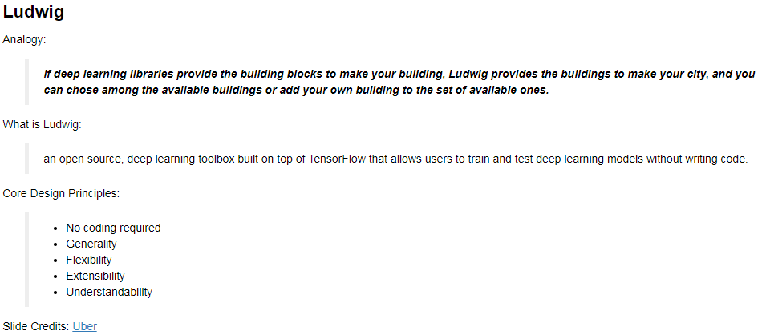

Slide 4
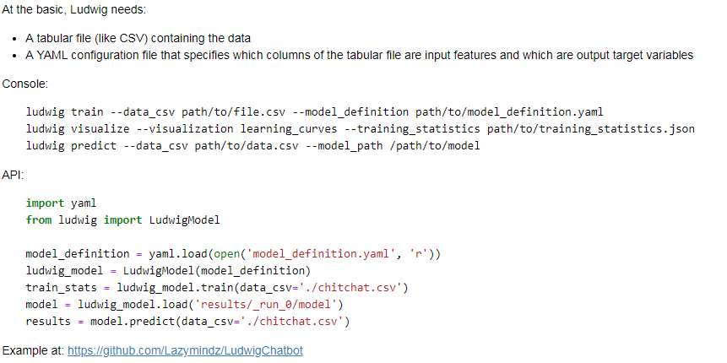

Slide 5
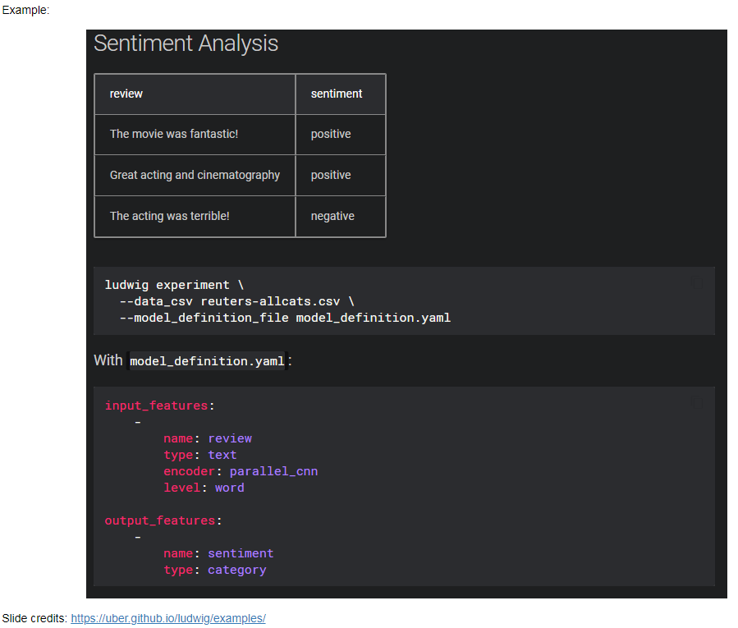

Slide 6
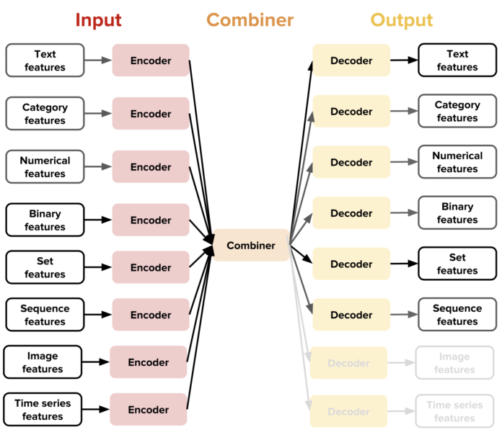
The main new idea

Slide 7
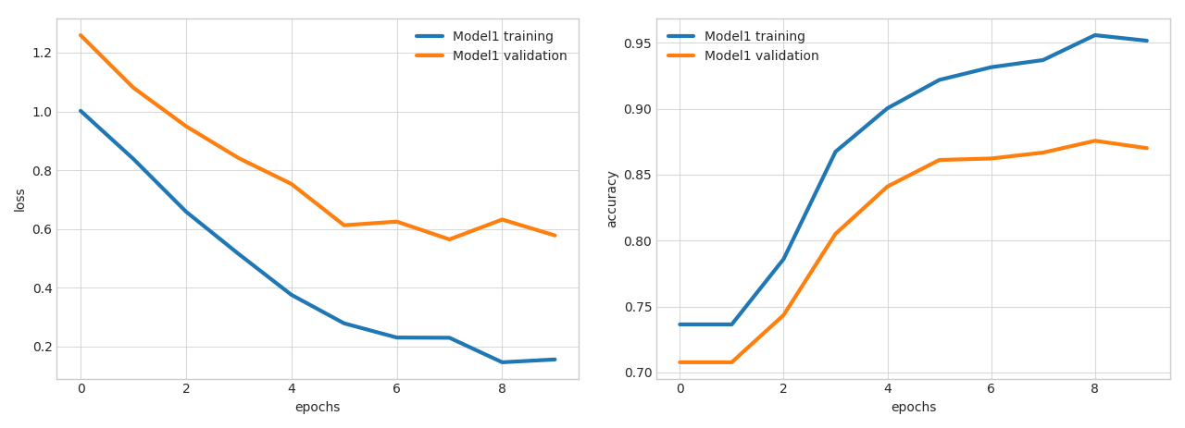
Visualisation of Results/Models

Slide 8
Examples section covers sample models for:
- Text Classification
- Named Entity Recognition Tagging
- Natural Language Understanding
- Machine Translation
- Chit-Chat Dialogue Modeling through Sequence2Sequence
- Sentiment Analysis
- Image Classification
- Image Captioning
- One-shot Learning with Siamese Networks
- Visual Question Answering
- Kaggle's Titanic: Predicting survivors
- Time series forecasting
- Movie rating prediction
- Multi-label classification
- Multi-Task Learning

Slide 9
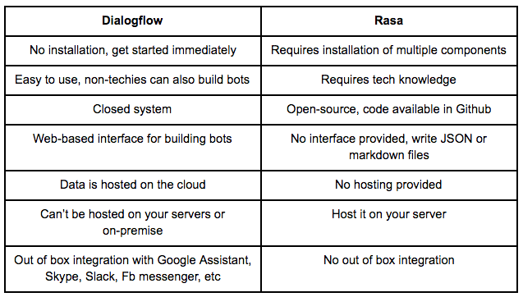
Monthly Challenge (April 2019)
Idea: At the next Meetup demo your implementation of 'Conversational AI' (aka chatbot)
Details: Consider FAQs from a website. Build a simple bot that can small (Greet/Chat) and answer FAQs
Dataset: Website FAQs
- rasa
- https://github.com/JustinaPetr/Weatherbot_Tutorial
- https://github.com/paschmann/rasa-ui
- https://github.com/samtecspg/articulate
- Microsoft FAQ Bot
- https://www.qnamaker.ai/
- Dialogflow
- https://dialogflow.com/
Datasets generation:
- https://github.com/rodrigopivi/Chatito

Slide 10
Elsewhere on the Internet
- https://github.com/minimaxir/automl-gs
- Watch Me Build an AI Startup - https://www.youtube.com/watch?v=NzmoPqte4V4 - Siraj Raval

