Slide 1
NOTTS - AI Monthly Catch-up - June 2019
Ethics Guidelines for Trustworthy AI
While we wait...are you on slack yet?
Yes, then good :)
No, here is a cryptic invite
- Head to https://notts.ai/
- Bottom right corner (footer)
- Find the invite

Slide 2
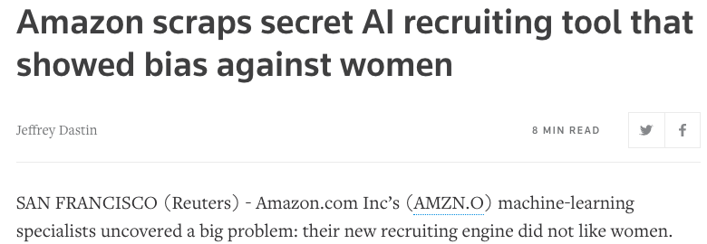
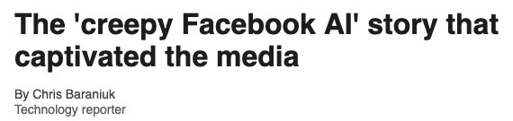
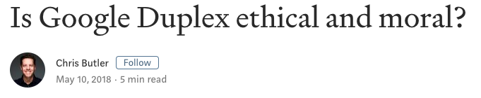
"Why Should I Trust You?"

Slide 3
"Why Should I Trust You?"

Slide 4
Monthly Challenge (June 2019) – Data Visualisation
Idea: ‘World Cloud’ displaying interests of all the members.
Details: Read Meetup profile data. Lookup Interests. Generate a word cloud.
Dataset: Meetup profiles

Slide 5
Elsewhere on the Internet
Samsung AI Makes the Mona Lisa 'Speak’ https://www.youtube.com/watch?v=P2uZF-5F1wI
Adversarial patch to fool an AI system https://youtu.be/MIbFvK2S9g8
https://arxiv.org/abs/1904.08653

