Slide 1
Software Engineering Essentials
A Comprehensive Overview of Software Development

Slide 2
Role of a Software Engineer
Overview:
Software engineers code, test, debug, and maintain software systems.
They solve problems and build applications that meet user needs.
Role of a Software Engineer | Page 2

Slide 3
Role of a Software Engineer
Types of Engineers:
Front-end: Focuses on the user interface.
Back-end: Manages server-side logic, databases, and APIs.
Full-Stack: Combines both front-end and back-end skills.
DevOps: Ensures smooth deployment and operation of software systems.
Quality Assurance: Tests software to ensure quality.
Role of a Software Engineer | Page 3

Slide 4
Role of a Software Engineer
Collaboration:
Engineers work closely with project managers, designers, and business analysts to deliver high-quality software solutions.
They participate in planning, design discussions, and sprint reviews.
Role of a Software Engineer | Page 4

Slide 5
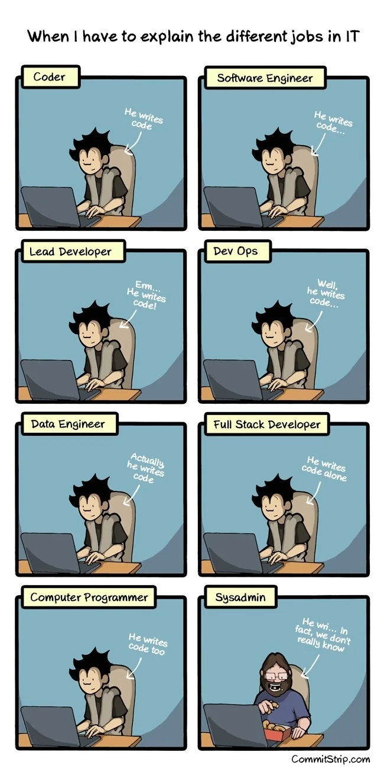
Image | Page 5

Slide 6
NEXT SECTION: WHAT IS A TECH STACK ?
A way of visualizing a collection of software systems and languages used together to get work done
Next Section: What is a tech stack ? | Page 6

Slide 7
What is a tech stach ?
A tech stack is the set of technologies used to develop an application, including programming languages, frameworks, databases, front-end and back-end tools, and APIs.
A solution stack or software stack is a set of software subsystems or components needed to create a complete platform such that no additional software is needed to support applications. Applications are said to "run on" or "run on top of" the resulting platform.
What is a tech stach ? | Page 7

Slide 8
What is a tech stach ?
Links:
https://stackshare.io
https://www.crunchbase.com,
What is a tech stach ? | Page 8

Slide 9
NEXT SECTION: INTEGRATED DEVELOPMENT ENVIRONMENT (IDE)
A deep dive into the tools that software engineers use to write, debug, and manage their code effectively.
Next Section: Integrated Development Environment (IDE) | Page 9

Slide 10
Integrated Development Environment (IDE)
What is an IDE?
An Integrated Development Environment is a software suite that provides features like code completion, Languages Server Protocol capabilities such syntax highlighting, compilation and debugging to facilitate software development.
Integrated Development Environment (IDE) | Page 10

Slide 11
Integrated Development Environment (IDE)
IDEs are feature-rich and provide comprehensive tools for software development:
Visual Studio: Robust with a comprehensive interface.
PyCharm: Specialized for Python development.
IntelliJ IDEA: Comprehensive for Java and other languages.
Integrated Development Environment (IDE) | Page 11

Slide 12
Integrated Development Environment (IDE)
Importance:
Boosts productivity by streamlining the coding process.
Helps maintain code quality by providing linting, error detection, and version control integration.
Integrated Development Environment (IDE) | Page 12

Slide 13
Integrated Development Environment (IDE)
Code editors are lightweight and focus primarily on editing code, with optional extensions for more functionality:
Visual Studio Code (Microsoft)
Sublime Text
Atom (GitHub)
Notepad++
Vim
nvim
Emacs
Integrated Development Environment (IDE) | Page 13

Slide 14
Integrated Development Environment (IDE)
Key Differences:
IDEs usually include debugging tools, version control integration, build automation, and more;
Code Editors are faster, lightweight, and suitable for quick edits or scripting tasks, with functionality extended via plugins or extensions.
Links:
https://www.youtube.com/watch?v=rUCl_EivGPE
https://blog.jetbrains.com/webstorm/2024/03/ides-vs-code-editors/
https://stackoverflow.com/beta/discussions/78046082/does-vs-code-count-as-an-ide
Integrated Development Environment (IDE) | Page 14

Slide 15
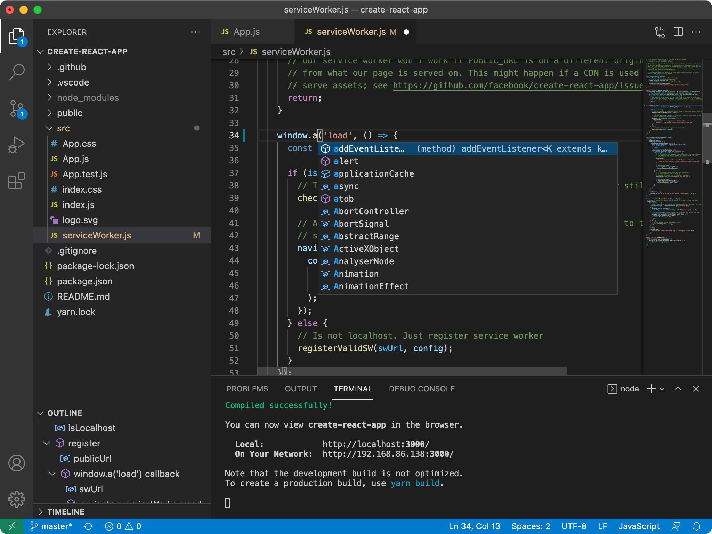
Image | Page 15

Slide 16
NEXT SECTION: CONFIGURATION MANAGEMENT WITH VERSION CONTROL SYSTEMS (GIT)
Exploring how version control systems like Git play a critical role in collaborative development.
Next Section: Configuration Management with Version Control Systems (Git) | Page 16

Slide 17
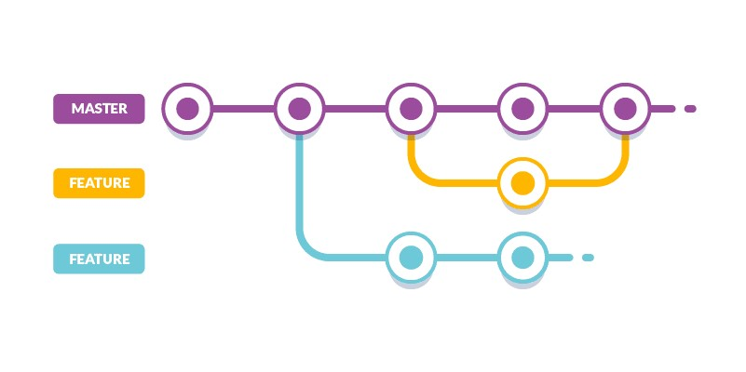
Image | Page 17

Slide 18
Configuration Management with Version Control Systems (Git)
Git is an open-source and fast version control system that tracks changes in computer files and handles small to huge software development projects. Git is a top-rated utility for software developers, allowing them to work together without disrupting each other’s work. Git was created by Linus Torvalds in 2005 for the Linux kernel. Version Control Basics:
Essential for tracking changes in code and enabling collaborative development.
Provides a history of changes, allowing easy rollbacks.
Configuration Management with Version Control Systems (Git) | Page 18

Slide 19
Configuration Management with Version Control Systems (Git)
Git and Platforms:
GitHub, GitLab, and Bitbucket are popular platforms for managing Git repositories.
They offer tools for code review, issue tracking, and project management.
Configuration Management with Version Control Systems (Git) | Page 19

Slide 20
Configuration Management with Version Control Systems (Git)
Why It Matters:
Enhances code quality by enabling code review and collaboration.
Helps manage release cycles, feature branches, and bug fixes.
Configuration Management with Version Control Systems (Git) | Page 20

Slide 21
NEXT SECTION: THE IMPORTANCE OF DATA STRUCTURES AND ALGORITHMS
Understanding the fundamentals of data structures and algorithms is crucial for writing efficient code.
Next Section: The Importance of Data Structures and Algorithms | Page 21

Slide 22
The Importance of Data Structures and Algorithms
What They Are:
Data Structures: Organized ways to store and manage data (arrays, linked lists, trees).
Algorithms: Step-by-step procedures for solving problems (sorting, searching).
The Importance of Data Structures and Algorithms | Page 22

Slide 23
The Importance of Data Structures and Algorithms
Why They Matter:
Enable the writing of efficient, optimized code that can scale with larger data sets and more users.
The Importance of Data Structures and Algorithms | Page 23

Slide 24
The Importance of Data Structures and Algorithms
Real-World Applications:
Used in databases, search engines, network communications, and more.
The Importance of Data Structures and Algorithms | Page 24

Slide 25
NEXT SECTION: SOFTWARE ARCHITECTURE AND SYSTEM DESIGN
Learn about the high-level structure of software systems and their impact on scalability, maintainability, and reliability.
Next Section: Software Architecture and System Design | Page 25

Slide 26
Software Architecture and System Design
Defining Software Architecture:
The blueprint for a software system, outlining its components and how they interact.
Software Architecture and System Design | Page 26

Slide 27
Software Architecture and System Design
System Design Concepts:
Microservices: A collection of small, independent services.
Monolithic: A single, unified codebase.
Client-Server Model: Separates the front-end (client) from the back-end (server).
Software Architecture and System Design | Page 27

Slide 28
Software Architecture and System Design
Why It’s Important:
Affects software scalability, maintainability, and reliability.
Good architecture allows for easier updates, debugging, and long-term growth.
Software Architecture and System Design | Page 28

Slide 29
NEXT SECTION: SQL VS NOSQL DATABASES
Exploring the differences between SQL and NoSQL databases and when to use each.
Next Section: SQL vs NoSQL Databases | Page 29

Slide 30
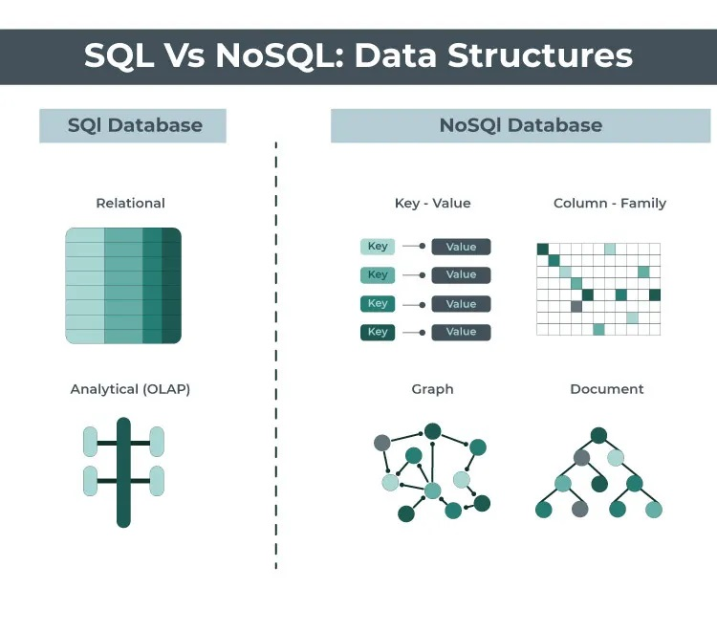
Image | Page 30

Slide 31
SQL vs NoSQL Databases
SQL:
Structured, schema-based databases (e.g., MySQL, PostgreSQL).
Best suited for applications requiring complex queries and transactions.
SQL vs NoSQL Databases | Page 31

Slide 32
SQL vs NoSQL Databases
NoSQL:
Flexible, schema-less databases (e.g., MongoDB, Cassandra).
Ideal for large-scale data storage, real-time analytics, and unstructured data.
SQL vs NoSQL Databases | Page 32

Slide 33
SQL vs NoSQL Databases
When to Use Each:
Use SQL for transactional systems where data integrity is crucial.
Use NoSQL for applications that require flexible schemas or horizontal scaling.
SQL vs NoSQL Databases | Page 33

Slide 34
NEXT SECTION: APIS (APPLICATION PROGRAMMING INTERFACES)
Learn how APIs enable communication between different software applications.
Next Section: APIs (Application Programming Interfaces) | Page 34

Slide 35
APIs (Application Programming Interfaces)
What is an API?
A set of protocols that allow different software applications to communicate and share data.
APIs (Application Programming Interfaces) | Page 35

Slide 36
APIs (Application Programming Interfaces)
Importance:
Enables integration of services like social media logins, payment processing, and data exchange.
APIs (Application Programming Interfaces) | Page 36

Slide 37
APIs (Application Programming Interfaces)
Examples:
REST: Representational State Transfer, widely used for web APIs.
GraphQL: A query language for APIs, allows clients to request specific data.
Importance of Documentation: Clear API documentation is crucial for successful integration.
APIs (Application Programming Interfaces) | Page 37

Slide 38
NEXT SECTION: FRAMEWORKS
Frameworks provide a foundation of pre-written code to streamline the software development process.
Next Section: Frameworks | Page 38

Slide 39
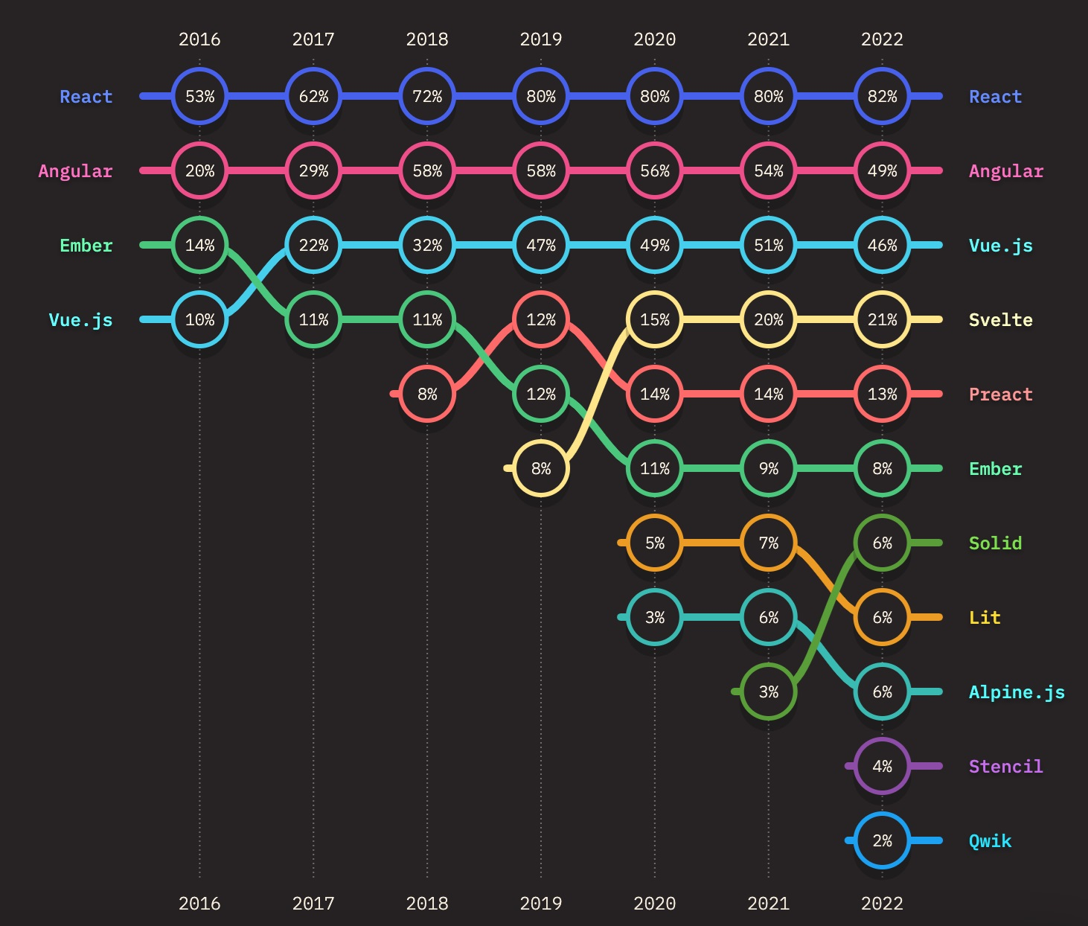
Image | Page 39

Slide 40
Frameworks
Definition:
A collection of pre-written code libraries that provide structure and common functionality to streamline development.
Frameworks | Page 40

Slide 41
Frameworks
Examples:
Front-end: React, Angular, Vue.js.
Back-end: Django (Python), Spring (Java), Express (Node.js).
Frameworks | Page 41

Slide 42
Frameworks
Why Use Frameworks:
Improve efficiency by providing reusable components and enforcing best practices.
Reduce boilerplate code, allowing developers to focus on unique features.
Frameworks | Page 42

Slide 43
NEXT SECTION: ELECTRONIC DATA INTERCHANGE (EDI)
Understand the role of EDI in software development for exchanging business information electronically.
Next Section: Electronic Data Interchange (EDI) | Page 43

Slide 44
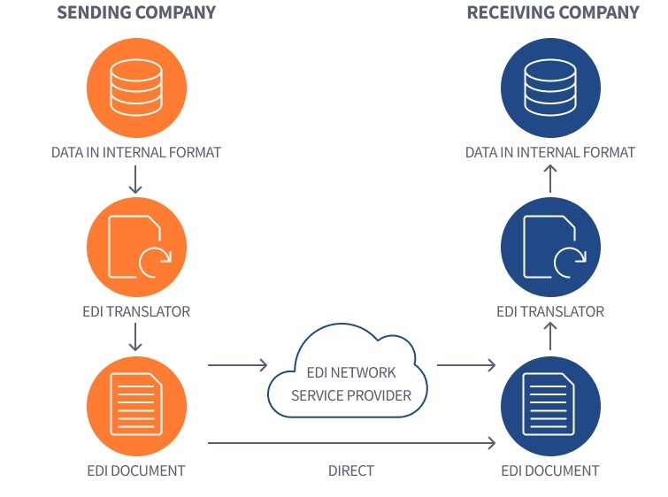
Image | Page 44

Slide 45
Electronic Data Interchange (EDI)
What is EDI?
A standardized method for exchanging business information electronically between organizations.
EDI ease the exchange of various type of documents such as purchase orders, invoices, ect...
links: https://www.edibasics.com/what-is-edi/
Electronic Data Interchange (EDI) | Page 45

Slide 46
Electronic Data Interchange (EDI)
Role in Software Development:
Implementing EDI standards for data exchange ensures compatibility and efficiency in business communications.
Electronic Data Interchange (EDI) | Page 46

Slide 47
Electronic Data Interchange (EDI)
Common Formats:
XML, JSON, and EDIFACT are some of the formats used in EDI implementations.
Electronic Data Interchange (EDI) | Page 47

Slide 48
NEXT SECTION: PROJECT MANAGEMENT IN SOFTWARE DEVELOPMENT
Project management practices help coordinate software development tasks, timelines, and resources effectively.
Next Section: Project Management in Software Development | Page 48

Slide 49
Project Management in Software Development
Stand-Ups and Agile:
Typically a 15-minute meeting where each team member discusses what they accomplished the previous day, their plan for the current day, and any blockers they are facing. This fosters transparency and allows the team to quickly address issues and adjust their plans if necessary.
Encourages a sense of accountability among team members as everyone shares their daily progress.
Helps maintain momentum by ensuring that any impediments are swiftly identified and resolved.
Project Management in Software Development | Page 49

Slide 50
Project Management in Software Development
Agile Methodology:
A framework for managing software development projects that emphasizes iterative work cycles, known as sprints, usually lasting 1-4 weeks. After each sprint, a review or retrospective meeting is held to assess what went well and what could be improved.
Focuses on delivering small, workable increments of the product early and frequently, which allows for constant feedback and course correction.
Project Management in Software Development | Page 50

Slide 51
Project Management in Software Development
Agile Methodology:
Agile frameworks like Scrum and Kanban help break down complex projects into manageable pieces, promote flexibility, and enable teams to quickly adapt to changing requirements or market conditions.
Agile practices include continuous integration, test-driven development (TDD), and pair programming, which enhance the quality of the software and the efficiency of the development process.
Project Management in Software Development | Page 51

Slide 52
Project Management in Software Development
Links:
https://scrumguides.org/scrum-guide.html#daily-scrum
https://www.atlassian.com/agile/scrum/standups
https://www.agilealliance.org/agile101/
https://www.scrum.org/resources/scrum-guide
https://www.atlassian.com/agile
Project Management in Software Development | Page 52

Slide 53
Project Management in Software Development
Tools, Jira:
An issue and project tracking tool widely used for managing Agile projects. It allows teams to create user stories, plan sprints, and monitor progress through customizable dashboards and reports.
Supports the Agile framework by enabling backlog prioritization, sprint planning, and real-time collaboration among team members.
Integrates with various other development tools (e.g., Bitbucket, GitHub, Confluence) for a seamless workflow.
Provides features for managing bugs, tracking tasks, and visualizing project health with tools like Kanban boards and burndown charts.
Project Management in Software Development | Page 53

Slide 54
Project Management in Software Development
Tools: Trello
A visual project management tool that uses boards, lists, and cards to organize tasks and workflows. Its drag-and-drop interface makes it easy to track the progress of tasks through different stages.
Supports collaboration by allowing team members to comment, attach files, set deadlines, and add checklists to cards, keeping everyone aligned on the project status.
Useful for smaller teams or projects where a lightweight, flexible approach to task management is preferred.
Can be integrated with other tools like Slack, Google Drive, and GitHub to streamline the development process.
Project Management in Software Development | Page 54

Slide 55
Project Management in Software Development
Importance of Best Practices, Timely Delivery:
Adopting best practices, such as setting realistic milestones and using tools like Gantt charts for timeline visualization, helps teams stay on schedule and meet project deadlines.
Agile practices like regular sprint reviews and retrospectives ensure that potential delays are identified early, and necessary adjustments are made promptly.
Project Management in Software Development | Page 55

Slide 56
Project Management in Software Development
Links:
https://www.atlassian.com/software/jira/guides
https://www.guru99.com/jira-tutorial-a-complete-guide-for-beginners.html
https://trello.com/guide
https://blog.trello.com/tag/productivity
Project Management in Software Development | Page 56

Slide 57
Project Management in Software Development
Importance of Best Practices, Proper Resource Allocation:
Using resource management techniques like capacity planning, workload balancing, and role-specific task assignments ensures that team members are not overburdened, and each task is handled by someone with the appropriate skills.
Effective use of tools (e.g., Jira's workload pie chart, Trello’s custom fields) enables project managers to monitor resource utilization and optimize team productivity.
Project Management in Software Development | Page 57

Slide 58
Project Management in Software Development
Importance of Best Practices, Clear Communication:
Open and consistent communication channels, such as daily stand-ups, sprint retrospectives, and project status reports, are essential for aligning the team and stakeholders.
Documentation tools like Confluence and Slack provide spaces for collaborative documentation, discussions, and knowledge sharing, reducing the likelihood of misunderstandings and misaligned expectations.
Defining roles and responsibilities upfront, along with creating a RACI (Responsible, Accountable, Consulted, Informed) matrix, promotes clarity and accountability among team members.
Project Management in Software Development | Page 58

Slide 59
Project Management in Software Development
Importance of Best Practices, Continuous Improvement:
Best practices encourage the team to reflect on their work and seek ways to enhance processes and outputs. Retrospective meetings provide opportunities for feedback and learning.
Adopting coding standards, conducting regular code reviews, and automating testing (e.g., CI/CD pipelines) improve code quality and reduce technical debt over time.
Leveraging best practices in project management, such as risk assessment and mitigation planning, helps foresee potential issues and establish contingency plans, ensuring the project's success.
Project Management in Software Development | Page 59

Slide 60
Project Management in Software Development
Links:
https://www.wrike.com/blog/project-milestones-definition-how-to-use-them/
https://www.atlassian.com/team-playbook/plays/retrospective
https://www.smartsheet.com/resource-management/capacity-planning
https://www.atlassian.com/software/jira/guides/roadmaps/advanced-roadmaps
https://www.atlassian.com/team-playbook/plays/raci-matrix
https://slack.com/resources/articles/project-management
https://about.gitlab.com/topics/ci-cd/
Project Management in Software Development | Page 60

Slide 61
NEXT SECTION: OPEN SOURCE LICENSES FOR COMMERCIAL USE
Open source licenses define the terms for using, modifying, and distributing software.
Next Section: Open Source Licenses for Commercial Use | Page 61

Slide 62
Open Source Licenses for Commercial Use
What is Open Source?
Software that can be freely used, modified, and distributed by anyone.
Open Source Licenses for Commercial Use | Page 62

Slide 63
Open Source Licenses for Commercial Use
Licenses:
MIT License: Permissive, allows nearly unrestricted use.
GPL: Requires derived works to be open source.
Apache: Provides an explicit grant of patent rights to users.
Open Source Licenses for Commercial Use | Page 63

Slide 64
Open Source Licenses for Commercial Use
Open source business models:
Open core : have an open-source core and a sell-closed features on top.
Dual licensing model : one project that get licensed through a viral GPL-style licence and commercial closed licence (MySQL)
Or business source or time delayed open source
Service model : propose a productised version of an open source project and monetise service such as support, training, specific features.
Open Source Licenses for Commercial Use | Page 64

Slide 65
Open Source Licenses for Commercial Use
Why It Matters:
Choosing the right license is crucial for commercial use, as it determines the legal rights and obligations for users and developers.
Open Source Licenses for Commercial Use | Page 65

Slide 66
Open Source Licenses for Commercial Use
Links:
https://www.youtube.com/watch?v=krcKkiKBKms
https://snyk.io/learn/open-source-licenses/
Open Source Licenses for Commercial Use | Page 66

Slide 67
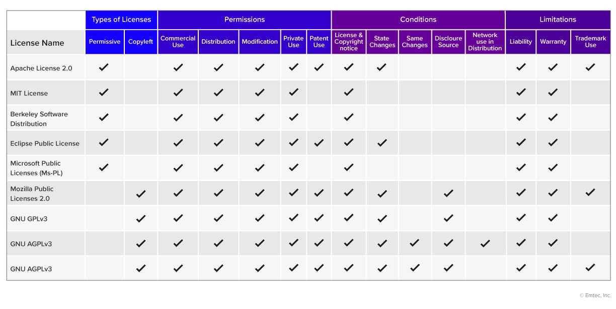
Image | Page 67

Slide 68
NEXT SECTION: RECRUITMENT PROCESS FOR SOFTWARE ENGINEERS
The recruitment process involves assessing both technical and soft skills to find the right fit for the team.
Next Section: Recruitment Process for Software Engineers | Page 68

Slide 69
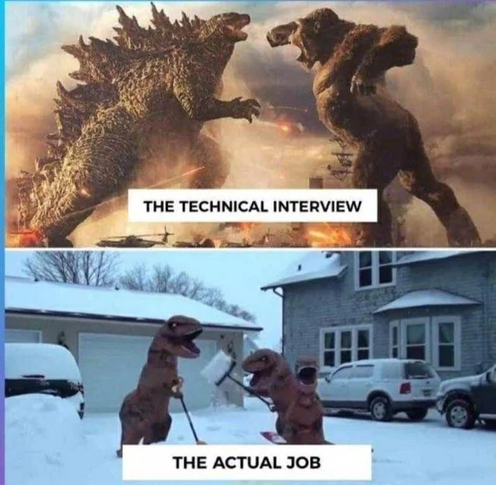
Image | Page 69

Slide 70
Recruitment Process for Software Engineers
The recruitment process for software engineers typically includes multiple stages:
Coding Tests: These are used to assess the candidate's coding proficiency, problem-solving skills, and understanding of algorithms. Common platforms for these tests include LeetCode, HackerRank, and Codility.
Technical Interviews: Focus on assessing knowledge of software development principles, system design, databases, and real-world problem-solving through whiteboard exercises or pair programming.
Soft Skill Assessments: Evaluate a candidate's communication, teamwork, adaptability, and cultural fit through behavioral questions and situational role-play scenarios.
Recruitment Process for Software Engineers | Page 70

Slide 71
Recruitment Process for Software Engineers
Links:
https://leetcode.com/
https://www.hackerrank.com/
https://www.codingame.com/
https://www.interviewcake.com/
Recruitment Process for Software Engineers | Page 71

Slide 72
Recruitment Process for Software Engineers
Skills employers look for, technical Skills:
Deep understanding of at least one programming language (e.g., Python, Java, JavaScript).
Strong grasp of data structures (e.g., arrays, linked lists, trees) and algorithms (e.g., sorting, searching, dynamic programming).
Knowledge of software architecture, design patterns, databases (SQL/NoSQL), and development tools (e.g., Git, Docker).
Recruitment Process for Software Engineers | Page 72

Slide 73
Recruitment Process for Software Engineers
Skills employers look for, Soft Skills:
Communication: Ability to explain technical concepts clearly to both technical and non-technical stakeholders.
Teamwork: Experience with collaborative development processes (e.g., code reviews, pair programming) and Agile methodologies.
Problem-Solving: Creative thinking to tackle coding challenges and devise efficient, scalable solutions.
Recruitment Process for Software Engineers | Page 73

Slide 74
Recruitment Process for Software Engineers
Links:
https://roadmap.sh/software-engineer
https://www.geeksforgeeks.org/data-structures/
https://www.freecodecamp.org/news/technical-skills-software-developers/
https://www.atlassian.com/agile
Recruitment Process for Software Engineers | Page 74

Slide 75
Recruitment Process for Software Engineers
Relevance for PMs:
Collaboration with HR: Project Managers (PMs) work closely with HR to define job descriptions, identify the technical and soft skills required for the project, and participate in interviews to ensure alignment with the team's needs.
Ensuring Fit: PMs ensure new hires not only possess the technical expertise but also have the right mindset and soft skills that align with the project's goals, team dynamics, and company culture.
Project Success: By being involved in the recruitment process, PMs can help build a team capable of delivering high-quality software efficiently and within deadlines.
Recruitment Process for Software Engineers | Page 75

Slide 76
Recruitment Process for Software Engineers
Links:
https://www.cio.com/article/286706/what-does-a-project-manager-do.html
https://www.atlassian.com/agile/project-management
https://www.turing.com/resources/how-to-hire-developers
Recruitment Process for Software Engineers | Page 76

Slide 77
NEXT SECTION: SOFTWARE ENGINEER PSYCHOLOGY
Understanding the psychological aspects of software engineering helps foster a balanced work environment.
Next Section: Software Engineer Psychology | Page 77

Slide 78
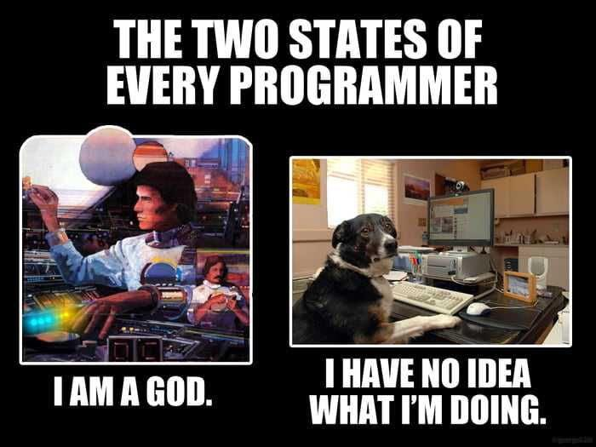
Image | Page 78

Slide 79
Software Engineer Psychology
Impostor Syndrome:
A common feeling of inadequacy among engineers, even when they are successful.
Can impact productivity and self-confidence.
Software Engineer Psychology | Page 79

Slide 80
Software Engineer Psychology
God Syndrome:
Overconfidence in one's abilities, leading to a lack of collaboration and ignoring team input.
Software Engineer Psychology | Page 80

Slide 81
Software Engineer Psychology
Role of PMs:
Project Managers play a key role in creating a balanced work environment by providing constructive feedback, promoting teamwork, and recognizing achievements.
Software Engineer Psychology | Page 81

Slide 82
Thank You!
Questions or Discussions

