Slide 1

Università Cattolica del Sacro Cuore Faculty of Economia
MSc in Economics
Learning network dependencies in VAR models: a Bayesian methodology with applications to financial flows.
Bonfanti Lorenzo
ID: 5007917
Professor: Federico Castelletti

Slide 2

ROADMAP
Implementing DAG models for understanding dependencies in between economic variables
LITERATURE ANALYSIS
MODEL DEVELOPMENT
ALGORITHM
APPLICATION
Inspiration: Imbens (2019)
Adoption of graphical models for causal inference in empirical economic studies
Graphical models based on DAGs
Multivariate time series analysis based on VARs
Gaussian DAGs
VAR models
Proposal: VAR models with unknown covariance structure represented through a DAG
Design of a Markov Chain Monte Carlo algorithm for DAG structure learning
R implementation
Dataset with variables for the US economy (source: FRED)
Implementation of the method for learning dependence relations between variables accounting for temporal dependencies

Slide 3

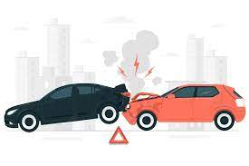


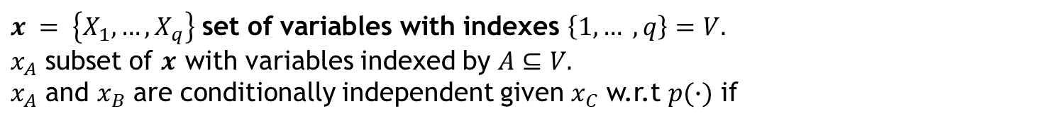

LITERATURE ANALYSIS
CONDITIONAL INDEPENDENCE
Example:
$x = \left\{X_{1},…, X_{q}\right\}$ set of variables with indexes $\left\{1,… , q\right\}=V.$
$x_{A}$ subset of $x$ with variables indexed by $A⊆V.$
$x_{A}$ and $x_{B}$ are conditionally independent given $x_{C}$ w.r.t $p(∙)$ if
$$p\left(x_{A}, x_{B}\right| x_{C}) =p\left(x_{A}\right|x_{C})p\left(x_{B}\right|x_{C})$$
Once the value of $x_{C}$ is known, $x_{B}$ and $x_{A}$ do not influence each other.
DIRECTED NETWORKS
Graphically:
Equivalently, the density $p\left(∙\right)$ factorize as
A
B
$$p(x_{A}, x_{B}, x_{C})=\frac{p\left(x_{A}, x_{C}\right)p(x_{B},x_{C})}{p(x_{C})}$$
C

Slide 4








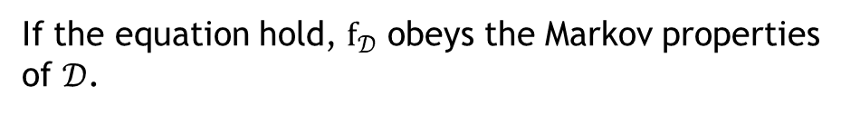

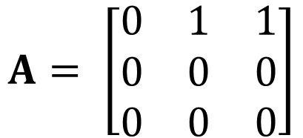


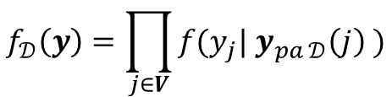
LITERATURE ANALYSIS
GRAPHICAL MODELS
Graphical Models: multivariate statistical models based on a graph
Graphically; let $u, v∈V, u≠v$
Nodes: variables indexed by $V=\left\{1, …, q\right\}$.
$(v, u) ∈E, \left(u,v\right)∉E$
$$v$$
$$u$$
Directed graph
Edges: dependence relations between variables
with $E⊆V×V$.
Graph ($𝓖$): a pair ($V, E$) where $V$ is a set of nodes and $E$ is a set of edges.
$(v, u) ∈E, \left(u,v\right)∈E$
$$v$$
$$u$$
Undirected graph
Focus on directed graphs with no cycles (Directed Acyclic Graphs)
DAGs
$$A= \left[\begin{matrix}0 & 1 & 1 \\ 0 & 0 & 0 \\ 0 & 0 & 0\end{matrix}\right]$$
$$2$$
Joint distribution:
$$1$$
$$f_{𝒟}\left(y\right)=\prod_{j∈V}{f({y_{j}| y}_{pa 𝒟}\left(j\right) )}$$
$$3$$
Example of a DAG
If the equation hold, $f_{𝒟}$ obeys the Markov properties of $𝒟$.

Slide 5
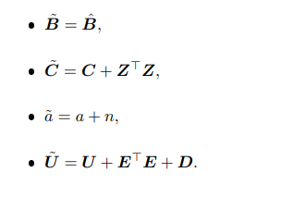
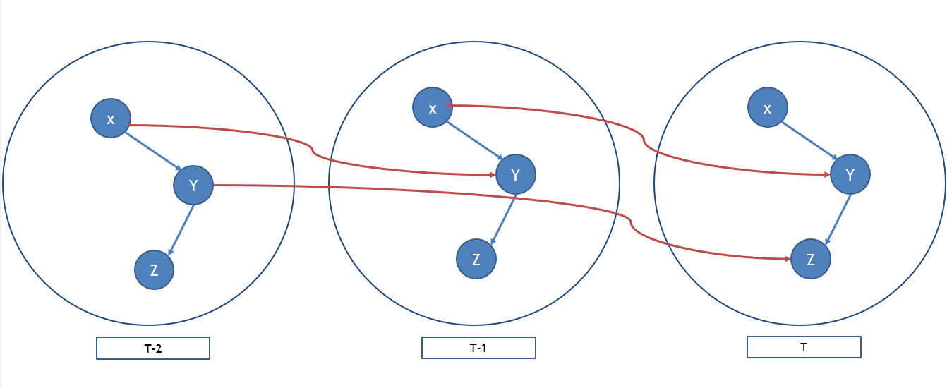




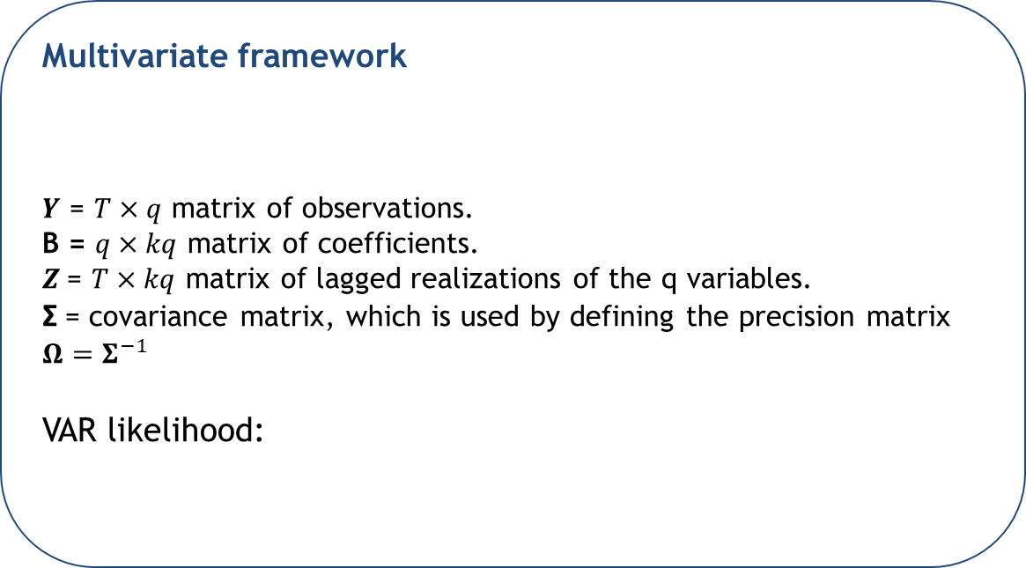
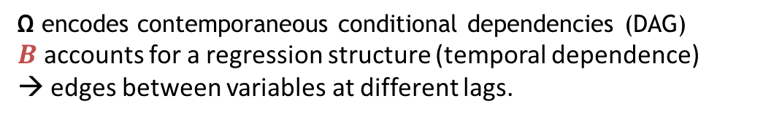




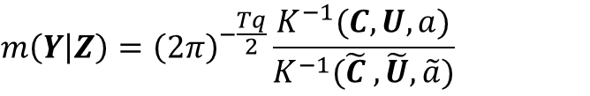


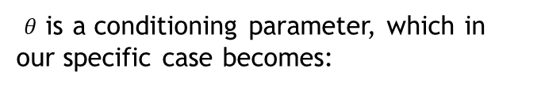
MODEL DEVELOPMENT
Multivariate framework
$Y$ = $T×q$ matrix of observations.
B = $q×kq$ matrix of coefficients.
$Z$= $T×kq$ matrix of lagged realizations of the q variables.
Σ = covariance matrix, which is used by defining the precision matrix $Ω=Σ^{−1}$
VAR likelihood:
Prior
Joint prior:
$$Y=ZB+E$$
$$E| Σ∼Ν_{T,q}(0, I_{T}, Σ)$$
$$B| Ω∼Ν_{p,q}(B_{0},C^{−1}, Ω^{−1})$$
$$p(B,Ω)∼p\left(B | Ω\right)p(Ω)$$
$$Ω∼W_{q}(a, U)$$
Posterior
$$B| Ω, Y∼Ν_{p,q}({\tilde{B}}_{0},{\tilde{C}}^{−1}, {\tilde{Ω}}^{−1})$$
Graphical structure
$$Ω|Y∼W_{q}(\tilde{a}, \tilde{U})$$
Ω encodes contemporaneous conditional dependencies (DAG)
$B$ accounts for a regression structure (temporal dependence)
→ edges between variables at different lags.
Joint posterior:
$$p\left(B,Ω\right|Y)∼p\left(B | Ω,Y\right)p(Ω|Y)$$
Marginal likelihood
Marginal likelihood:
1, 2 are respectively the prior and posterior normalizing constants
1
$$m\left(Y | Z\right)={\left(2π\right)}^{−\frac{Tq}{2}}\frac{K^{−1}(C,U,a)}{K^{−1}(\tilde{C} ,\tilde{U},\tilde{a})}$$
Likelihood
2
$θ$ is a conditioning parameter, which in our specific case becomes:

Slide 6

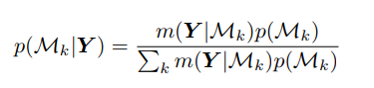
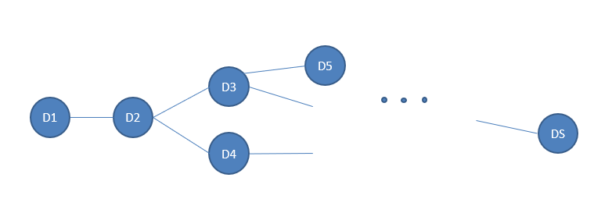




ALGORITHM
Bayesian Model Selection
MCMC Metropolis Hastings Algorithm
Different methods for performing Model selection, we decided to apply an acceptance/rejection framework based on Marginal likelihood.
Operators: add, remove, reverse an edge.
Probability of transition:
$$q\left(𝒟,𝒟^{′}\right)=\frac{1}{\left|𝒪_{D}\right|}$$
Given a set of models $ℳ_{1}, {…,ℳ}_{K}$, the posterior probability of each model is given by:
Acceptance probability rule:
Acceptance probability rule:
1
2
Algorithm implemented:
Algorithm implemented:
Where 1 is the marginal likelihood of the model, while 2 is the prior.
INPUT: an initial empty DAG $𝒟_{0}$, iteration desired S.
Compute parameters, sufficient statistics
Sample a new DAG $𝒟^{∗}$ by implementing an operator
Evaluate the priors for the two DAGs.
Compute marginal likelihoods for the two DAGs.
Compute log acceptance ratio – probability of acceptance
Update $D_{0}$ = accepted with a probability $a(⋅)$ or rejected with a probability $1−a(⋅)$.
2 - Prior on M (DAG model):
$$p\left(𝓜\right)∝w^{\left|A^{ℳ}\right|} {\left(1−w\right)}^{\frac{q(q−1)}{2} −|A^{ℳ}|}$$
VAR DAG CASE:
Marginal likelihood of a DAG model $𝒟$

Slide 7
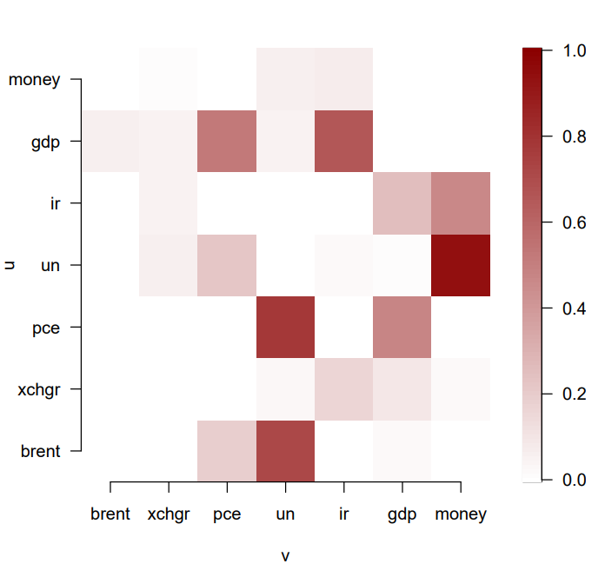
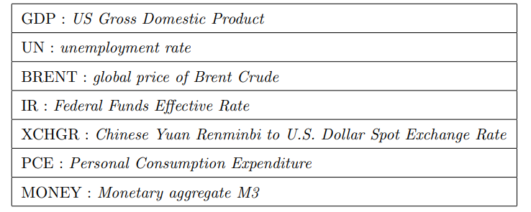
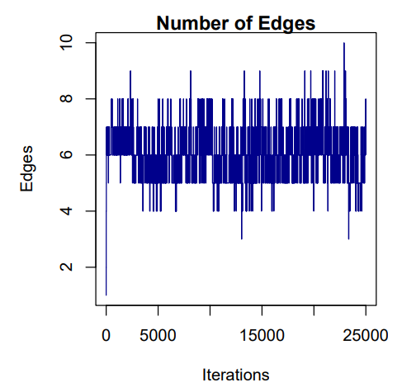
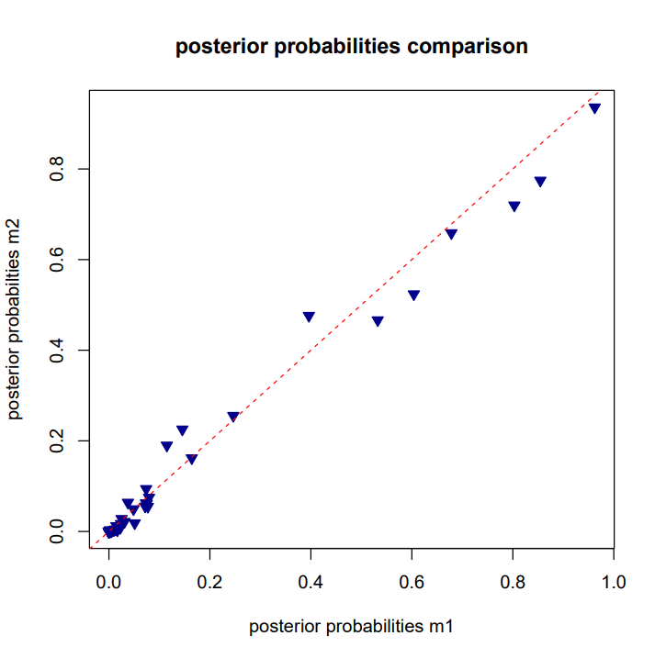
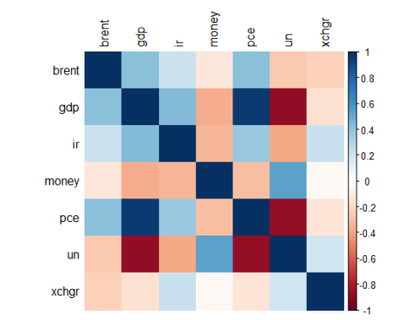
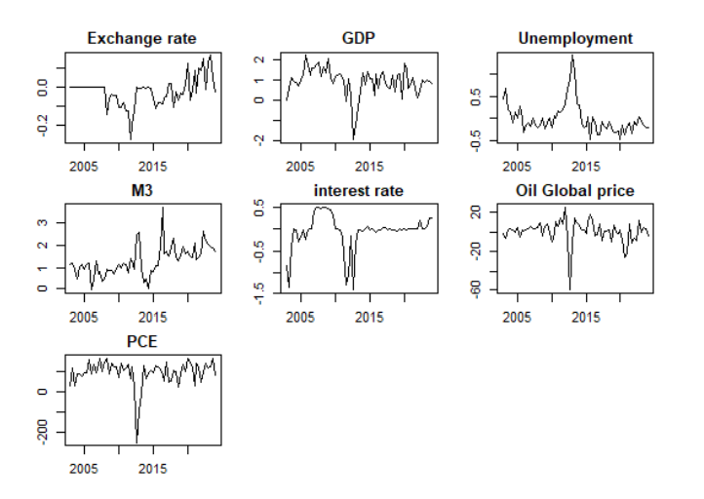
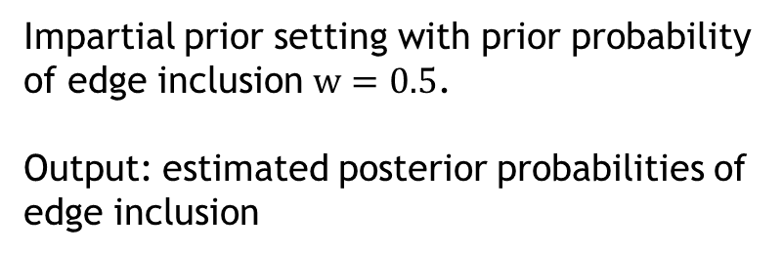
APPLICATION
Target: testing the efficacy of our model in tracing dependency relationship between a set of economic variables
STEP 1
STEP 2
Variable choice
MCMC implementation
Source: FRED
25.000 iterations, 20% burn-in.
Time framework: 2001 Q4 – 2022 Q4
Impartial prior setting with prior probability of edge inclusion $w=0.5$.
Output: estimated posterior probabilities of edge inclusion
7 variables, 87 observations.
Exploratory analysis
Convergence diagnostics
Differencing
Intercept introduced

Slide 8
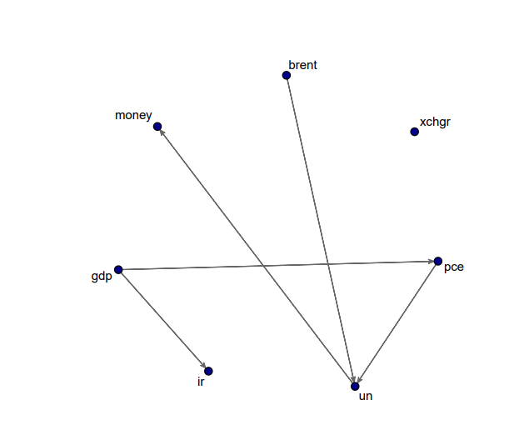
CONCLUSIONS
Outcome: testing the efficacy of our model in tracing dependency relationship between a set of economic variables
Conclusions
Good performance on tracing dependencies between economic variables.
Reflections on missing (expected) edges: variable selection problem?
How much prior setting affects the result? Sensitivity analysis?
Possible improvements – next steps
Implementation of the method by including more variables
Forecasting
Adaptation for causal inference
Model DAG

Slide 9
Università Cattolica del Sacro Cuore Faculty of Economia
MSc in Economics
THANK YOU FOR YOUR ATTENTION
All the codes developed in this work are open source and available here

