Slide 1
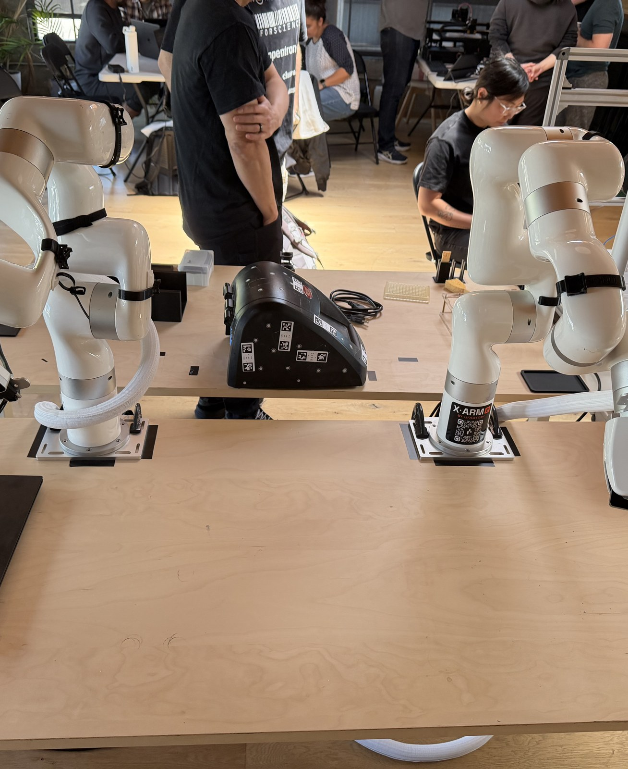
ZEON HACKATHON · TRACK C
Robots with hands
that know when
they've failed.
Cooperative dexterity + AI physical verification, live on real lab hardware.
Dale Herzog · Di Hu · Lukas Bromig
Notes:
Open on the capability, not the machine. Do NOT mention the Opentrons — that's the ending.

Slide 2
THE PROBLEM
Lab automation has two gaps
1
Brittle
2
Human-only
Robots do a task once, cleanly — then freeze the moment reality drifts. No sense of whether the action actually worked.
Instruments and labware are built for human hands: caps to twist, tubes to hold, liquids to pour. Robots can't just use them.
We close both — dexterity, and knowing whether it succeeded.
02

Slide 3
OUR IDEA
A real sample-prep step — verified at every move
Two robot arms uncap a tube and hold it while a liquid handler aspirates — while AI agents watch through cameras and confirm each step actually worked.
1
Uncap
→
2
Transport
→
3
Aspirate
two arms cooperate
one arm lifts
arm + liquid handler
✓ verified by AI
✓ verified by AI
✓ verified by AI
Verify → retry loop wraps the whole chain, so a failed step is caught and corrected — not fatal.
03

Slide 4
DEXTERITY
Two arms, one cap
✓
One holds, one turns
Arm 1 grips the tube body against rotation; Arm 2 grips the cap and ratchet-turns it off — open, reset wrist, re-grip, turn again.
✓
Shared world frame
[ PHOTO ]
Both arms calibrated into one coordinate frame via an AprilTag fixture, so they can cooperate to the millimetre.
add: mid-unscrew close-up (both grippers on the tube)
✓
Custom end-effectors
3D-printed cap-gripping jaws bite the knurling for a slip-free turn.
04

Slide 5
THE EYES
Cameras on every step
●
On-arm camera
Close-up view of the cap, grasp and tube opening — the fine detail verification needs.
●
External camera
[ PHOTO ]
Whole-scene view: where things are, and where they end up if something slips.
add: annotated camera view (cap / grasp / tube / liquid)
●
Feeds the agents
Every frame is what the AI verification agents reason over to decide pass / retry.
05

Slide 6
THE BRAIN ★
AI agents that verify — and retry
After each action, an agent asks the cameras “did this actually work?” → continue, or retry the step.
✓
✓
✓
✓
Cap off?
Grasp secure?
Tube aligned?
Liquid aspirated?
torque drop + threads visible
gripper width + vision
pose check before OT moves
level drop / volume report
“Failure isn't a bug in our demo —
it's the feature.”
[ PHOTO ]
add: caught-failure → recovery clip
06
Notes:
This is the judge slide — Track C explicitly rewards physical verification & recovery. Land the tagline.

Slide 7
COOPERATION
Two machines, one motion
✓
Arm presents the tube
One arm holds the open tube at a known pose, calibrated into the liquid handler's frame.
✓
Handler aspirates
[ PHOTO ]
The pipette descends and draws liquid while the arm holds dead-steady — a true hand-off between two robots.
add: arm holding open tube under the pipette, aspirating
✓
Verified end-to-end
The agent confirms liquid was actually taken up before we call it done.
07

Slide 8
▶
LIVE DEMO
backup video ready
Notes:
Run the real thing. If hardware misbehaves, cut to the backup video on this slide.

Slide 9
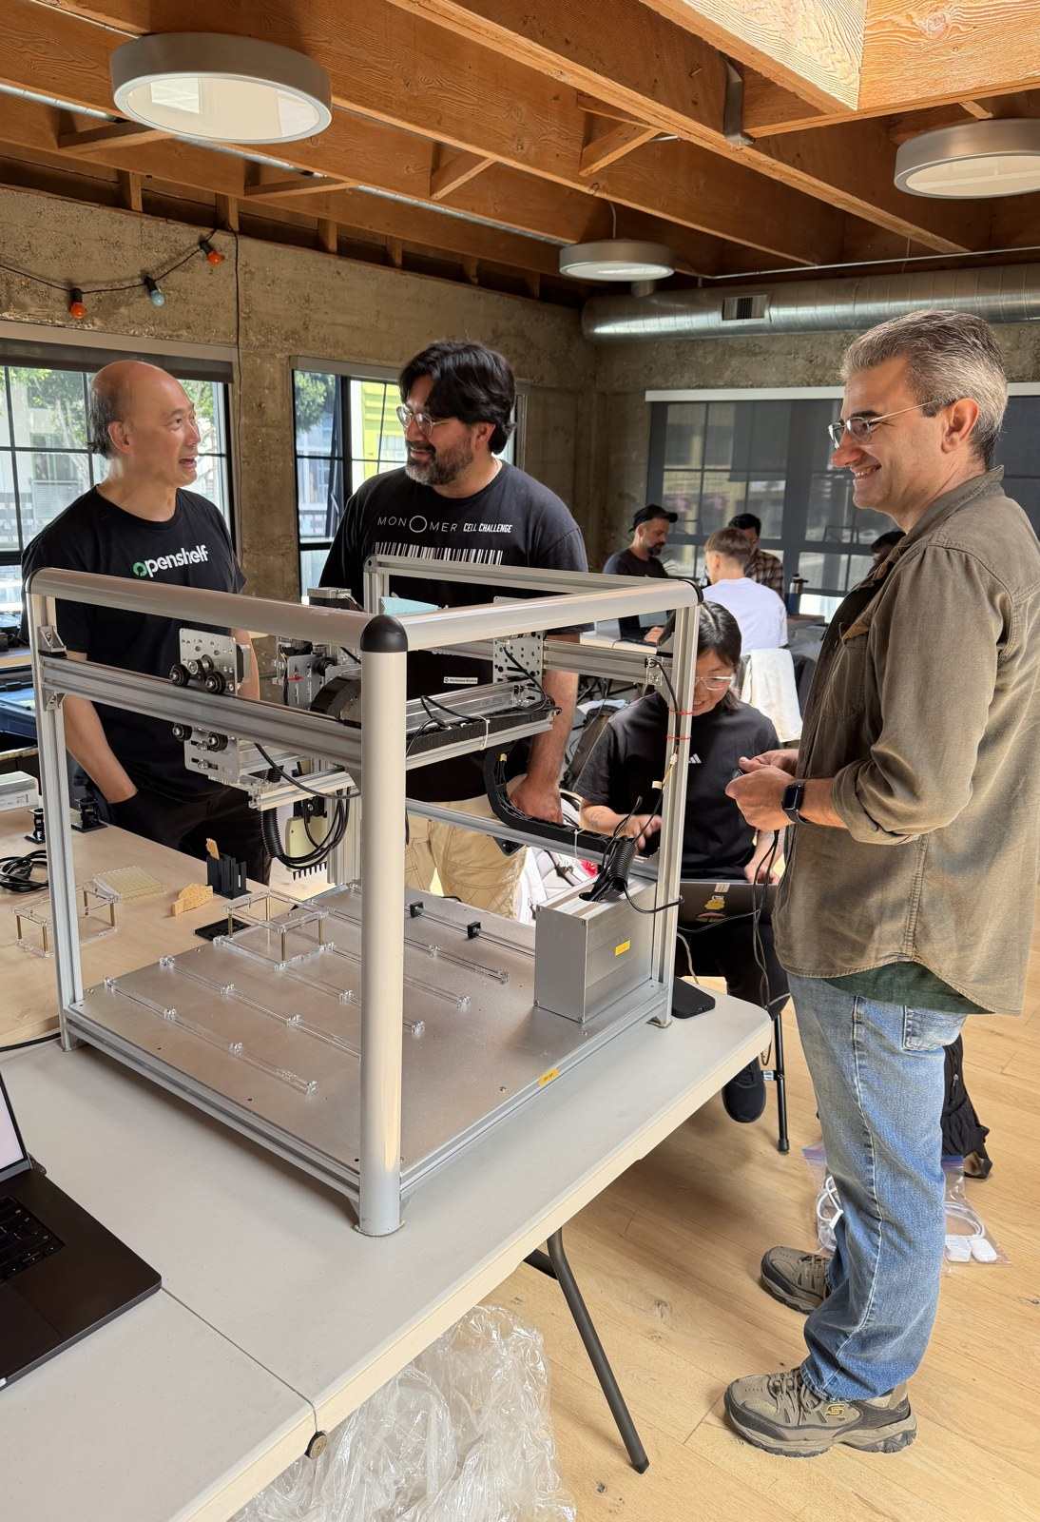
THE REVEAL
The liquid handler doing all this?
The first-ever
Opentrons.
A decade-old open-source machine — given modern dexterity and AI verification.
Notes:
Beat one of the reveal. Don't rush — let the surprise land before clicking to the signature.

Slide 10
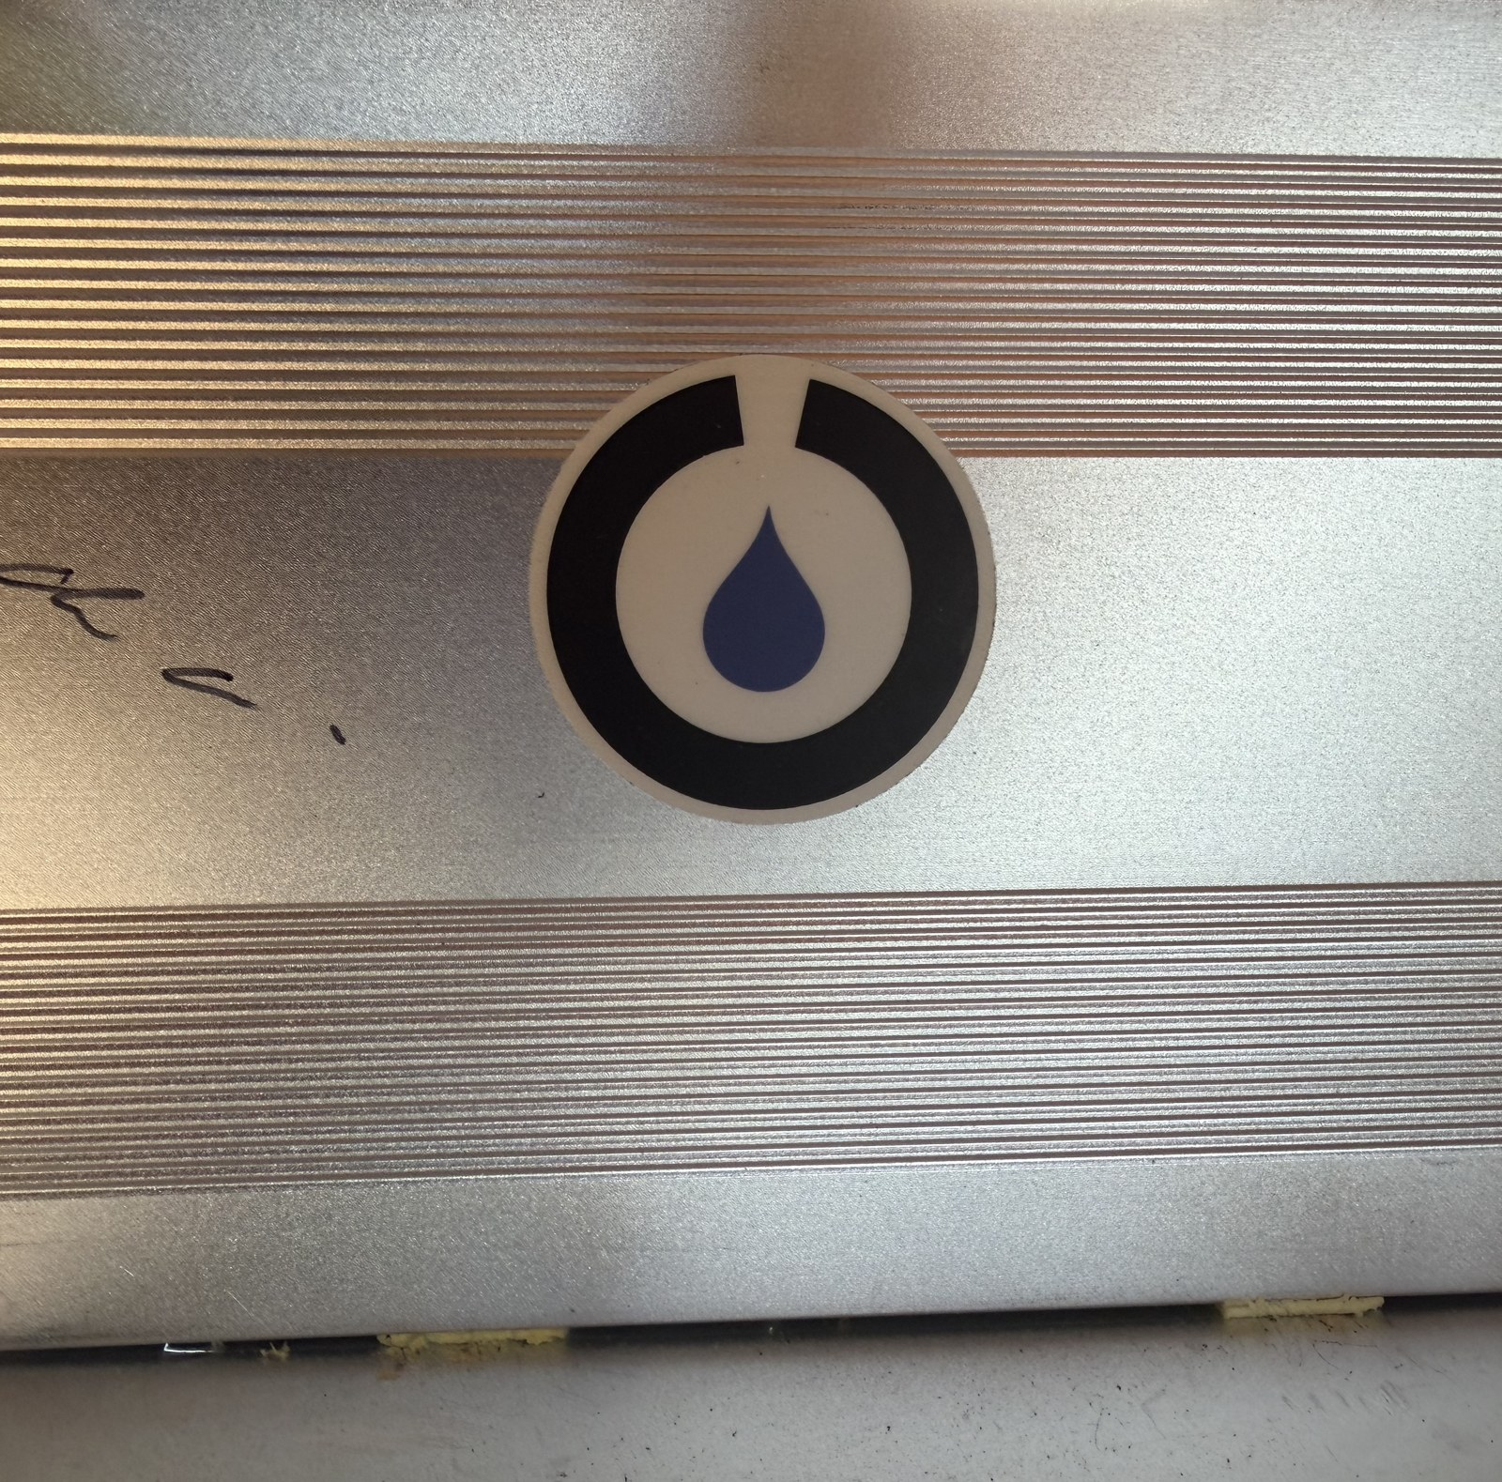
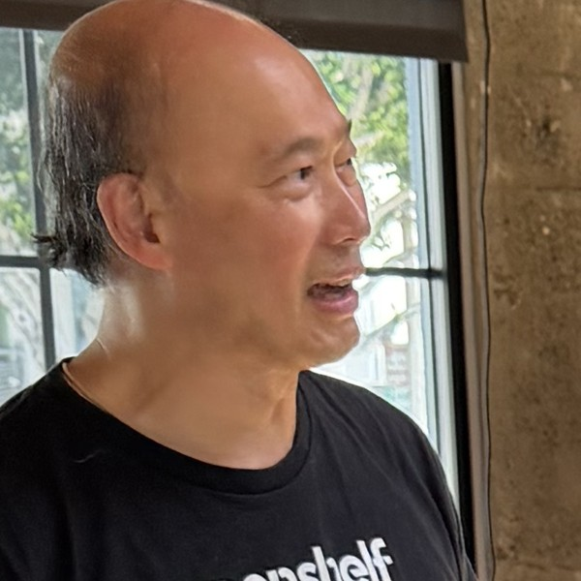
AND ONE MORE THING
Signed by its creator.
Chiu Chau former CTO of Opentrons,
now CEO of OpenShelf — here at the hackathon.
Notes:
If Chiu is in the room, acknowledge him live — that lands harder than any slide. Confirm he's OK being named first.

Slide 11
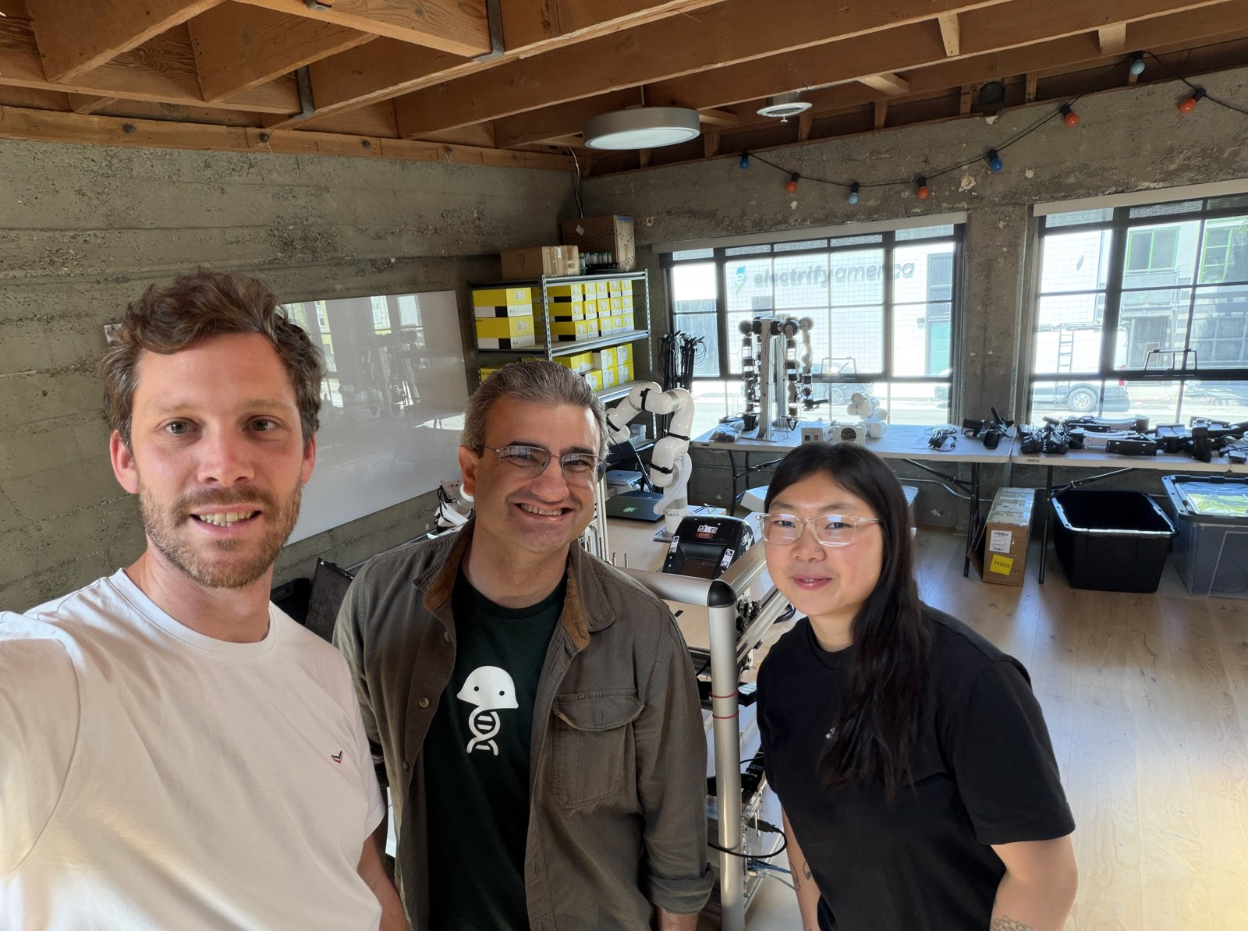
BUILT IN 24H
The team
Lukas Bromig
Liquid handler & orchestration
co-founder, UniteLabs
Dale Herzog
Arm — dual xArm & end-effectors
CAD modeler · coffee nerd
Di Hu
Camera — perception & AI verify
bench scientist → AI×automation
L→R: Lukas · Dale · Di
The verify-loop generalizes to any step or instrument. · github.com/Lbromig/hackathon-zeon

