Slide 1
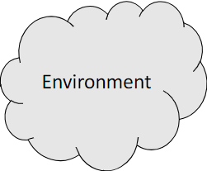
Cached plans
(Planner.js and Environment.js)
Revision
Plan
(Move.js)
Action
Plan library and Planner
(Planner.js and Environment.js)
updates
Introspection
Perception
Plan failure
Filtering and analysis
(PlayersManager.js and ParcelsManager.js)
Intention
(Intention.js)
Deliberating
Update options queue
(Intentions.js)
Update options
(Options.js, UtilityCalcolator.js and ProblemGenerator.js)
Revision
Update beliefs
(Beliefs.js)
Revision

Slide 2
