Slide 1


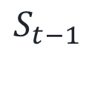
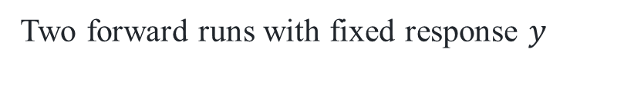


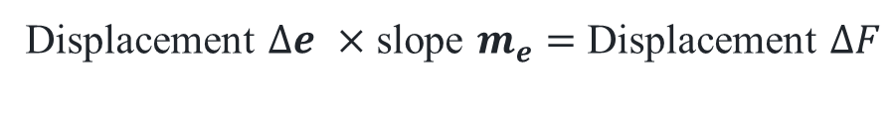

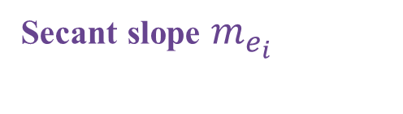




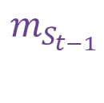



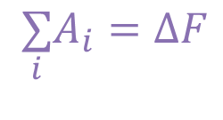







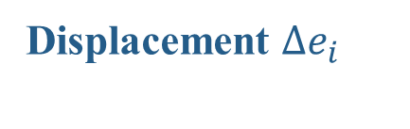


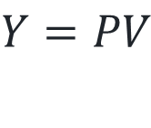


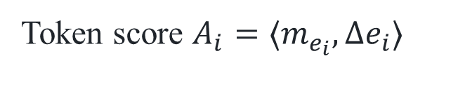
(a) Overall method
Reverse-pass examples
Two forward runs with fixed response $y$
Forward
(b) Attention product
Backward $D_{f}^{⊤}$
$$F(y|x_{1})$$
$$ΔF$$
$$F(y|x_{0})$$
Attention weights
Value vectors
Output
$$+$$
$$−$$
Later layers
Later layers
$$×$$
Forward
Build $D_{f}$
Forward
$$P$$
$$V$$
$$Y=PV$$
Operation $f$
Apply $D_{f}^{⊤}$
Operation $f$
$$m_{Y}$$
$$m_{P}$$
$$m_{V}$$
source words
EOS EOS ...
Original $x_{1}$
Reference $x_{0}$
(c) Gated DeltaNet
Secant slope $m_{e_{i}}$
Memory
Memory
Readout
Token embed
EOS embed
Value, key, gates
Query
$$−$$
$$m_{e_{i}}$$
Displacement $Δe_{i}$
Update
Read
$$S_{t−1}$$
$$S_{t}$$
$$o_{t}$$
Token score $A_{i}=⟨m_{e_{i}},Δe_{i}⟩$
$$m_{S_{t−1}}$$
$$m_{S_{t}}$$
$$m_{o_{t}}$$
Displacement $Δe$ $×$ slope $m_{e}$ $=$ Displacement $ΔF$
Value, key, gate slopes
Query slopes
(d)
Choose the playwright, not the composer.
MoreHopQA example 1
CONTEXT EXCERPTS
Name-span total (nats)
Answer
…
William Shakespeare's play
+1.56
The score is by William Walton.
−1.13
William
…
Shakespeare
REQUESTED ROLE (EXCERPT)
Token contribution (nats)
…
the author of the play
…
≤−2.5
0
≥+2.5
$$\underset{i}{∑}A_{i}=ΔF$$
Full input
Shown spans underlined
Across all input sources
Notes:
Source: Figure 1, DeltaTrace manuscript.

