Slide 1
EE2211 Tutorial 10 Thao Nguyen

Slide 2
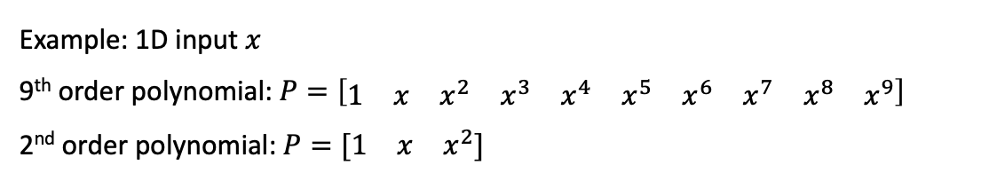
Question 1
We have two classifiers showing the same accuracy with the same cross-validation. The more complex model (such as a 9th order polynomial model) is preferred over the simpler one (such as a 2nd order polynomial model).
True
False
Example: 1D input $x$
9th order polynomial: $P=\left[\begin{matrix}1 & x & x^{2} & x^{3} & x^{4} & x^{5} & x^{6} & x^{7} & x^{8} & x^{9}\end{matrix}\right]$
2nd order polynomial: $P=[\begin{matrix}1 & x & x^{2}]\end{matrix}$

Slide 3
Question 1
We have two classifiers showing the same accuracy with the same cross-validation. The more complex model (such as a 9th order polynomial model) is preferred over the simpler one (such as a 2nd order polynomial model).
True
False

Slide 4
Question 2
We have 3 parameter candidates for a classification model, and we would like to choose the optimal one for deployment. As such, we run 5-fold cross-validation.
Once we have completed the 5-fold cross-validation, in total, we have trained _______ classifiers. Note that, we treat models with different parameters as different classifiers.
10
20
25
15

Slide 5

Recap: Cross-validation
Train
Test
Hidden when selecting and training model
For training model
For testing real performance
3 candidates:
Example: C1: linear regression model
C2: 2nd order polynomial
C3: 3rd order polynomial

Slide 6
Recap: Cross-validation
Train
Validation
Test
Hidden when selecting and training model
For training model
For choosing model
For testing real performance
Accuracy on validation set
3 candidates:
Example: C1: linear regression model
C2: 2nd order polynomial
C3: 3rd order polynomial
→ 90%
→ 80%
→ 85%

Slide 7
Recap: k-Fold Cross-validation
Train
Train
Train
Train
Validation
Test
Hidden when selecting and training model
Train
Train
Train
Validation
Train
Train
Train
Validation
Train
Train
Train
Validation
Train
Train
Train
Validation
Train
Train
Train
Train
Average accuracy on validation set
3 candidates:
Example: C1: linear regression model
C2: 2nd order polynomial
C3: 3rd order polynomial
→ 86%
→ 88%
→ 82%

Slide 8
Recap: k-Fold Cross-validation
Train
Train
Train
Train
Validation
Test
Hidden when selecting and training model
Train
Train
Train
Validation
Train
Train 5 classifiers and compute the average validation accuracy for model C1.
Train
Train
Validation
Train
Train
Train
Validation
Train
Train
Train
Validation
Train
Train
Train
Train
Average accuracy on validation set
3 candidates:
Example: C1: linear regression model
C2: 2nd order polynomial
C3: 3rd order polynomial
→ 86%
→ 88%
→ 82%

Slide 9
Recap: k-Fold Cross-validation
Train
Train
Train
Train
Validation
Test
Hidden when selecting and training model
Train
Train
Train
Validation
Train
Train 5 classifiers and compute the average validation accuracy for model C2.
Train
Train
Validation
Train
Train
Train
Validation
Train
Train
Train
Validation
Train
Train
Train
Train
Average accuracy on validation set
3 candidates:
Example: C1: linear regression model
C2: 2nd order polynomial
C3: 3rd order polynomial
→ 86%
→ 88%
→ 82%

Slide 10
Recap: k-Fold Cross-validation
Train
Train
Train
Train
Validation
Test
Hidden when selecting and training model
Train
Train
Train
Validation
Train
Train 5 classifiers and compute the average validation accuracy for model C3.
Train
Train
Validation
Train
Train
Train
Validation
Train
Train
Train
Validation
Train
Train
Train
Train
Average accuracy on validation set
3 candidates:
Example: C1: linear regression model
C2: 2nd order polynomial
C3: 3rd order polynomial
→ 86%
→ 88%
→ 82%
How many classifiers do we need to train to choose a model among C1, C2, C3?
15

Slide 11
Question 2
We have 3 parameter candidates for a classification model, and we would like to choose the optimal one for deployment. As such, we run 5-fold cross-validation.
Once we have completed the 5-fold cross-validation, in total, we have trained _______ classifiers. Note that, we treat models with different parameters as different classifiers.
10
20
25
15

Slide 12
Question 3
Suppose the binary classification problem, which you are dealing with, has highly imbalanced classes. The majority class has 9.9k samples and the minority class has 100 samples. Which of the following metric(s) would you choose for assessing the classification performance? Select all relevant metric(s).
Classification Accuracy
Cost sensitive accuracy
Precision and recall
None of these

Slide 13
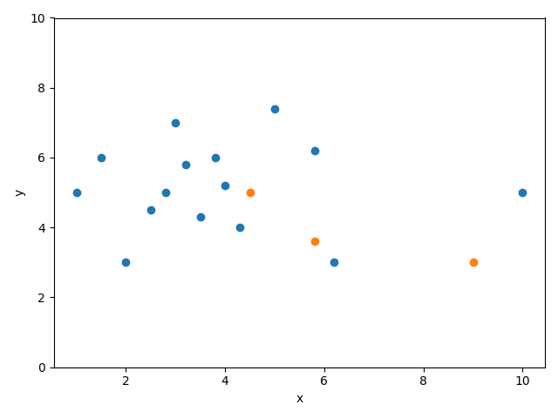
Question 3
Suppose the binary classification problem, which you are dealing with, has highly imbalanced classes. The majority class has 9.9k samples and the minority class has 100 samples. Which of the following metric(s) would you choose for assessing the classification performance? Select all relevant metric(s).
Classification Accuracy
Cost sensitive accuracy
Precision and recall
None of these
Class 1
Class 2

Slide 14
Question 3
Suppose the binary classification problem, which you are dealing with, has highly imbalanced classes. The majority class has 9.9k samples and the minority class has 100 samples. Which of the following metric(s) would you choose for assessing the classification performance? Select all relevant metric(s).
Classification Accuracy
Cost sensitive accuracy
Precision and recall
None of these
→
Class 1
Class 2
Misclassifications in minority class have minimal impact on overall accuracy.

Slide 15
Question 3
Suppose the binary classification problem, which you are dealing with, has highly imbalanced classes. The majority class has 9.9k samples and the minority class has 100 samples. Which of the following metric(s) would you choose for assessing the classification performance? Select all relevant metric(s).
Classification Accuracy
Cost sensitive accuracy
Precision and recall
None of these
 | Class 1 (predicted) | Class 2 (predicted)
Class 1 (actual) | 14 | 1
Class 2 (actual) | 2 | 1
Class 1
Class 2

Slide 16

Question 3
Suppose the binary classification problem, which you are dealing with, has highly imbalanced classes. The majority class has 9.9k samples and the minority class has 100 samples. Which of the following metric(s) would you choose for assessing the classification performance? Select all relevant metric(s).
Classification Accuracy
Cost sensitive accuracy
Precision and recall
None of these
 | Class 1 (predicted) | Class 2 (predicted)
Class 1 (actual) | 14 | 1
Class 2 (actual) | 2 | 1
Class 1
Class 2
→
Cost sensitive accuracy:
$$α_{1}∗14+α_{2}∗1+α_{3}∗2+α_{4}∗1$$

Slide 17

Question 3
Suppose the binary classification problem, which you are dealing with, has highly imbalanced classes. The majority class has 9.9k samples and the minority class has 100 samples. Which of the following metric(s) would you choose for assessing the classification performance? Select all relevant metric(s).
Classification Accuracy
Cost sensitive accuracy
Precision and recall
None of these
 | Class 1 (predicted) | Class 2 (predicted)
Class 1 (actual) | 14 | 1
Class 2 (actual) | 2 | 1
Class 1
Class 2
→
Cost sensitive accuracy:
$$α_{1}∗1+α_{2}∗2$$

Slide 18

Question 3
Suppose the binary classification problem, which you are dealing with, has highly imbalanced classes. The majority class has 9.9k samples and the minority class has 100 samples. Which of the following metric(s) would you choose for assessing the classification performance? Select all relevant metric(s).
Classification Accuracy
Cost sensitive accuracy
Precision and recall
None of these
 | Class 1 (predicted) | Class 2 (predicted)
Class 1 (actual) | 14 | 1
Class 2 (actual) | 2 | 1
Class 1
Class 2
→
Precision = $\frac{TP}{TP+FP}=\frac{14}{14+2}$
Class 1: positive, class 2: negative

Slide 19

Question 3
Suppose the binary classification problem, which you are dealing with, has highly imbalanced classes. The majority class has 9.9k samples and the minority class has 100 samples. Which of the following metric(s) would you choose for assessing the classification performance? Select all relevant metric(s).
Classification Accuracy
Cost sensitive accuracy
Precision and recall
None of these
 | Class 1 (predicted) | Class 2 (predicted)
Class 1 (actual) | 14 | 1
Class 2 (actual) | 2 | 1
Class 1
Class 2
→
Precision = $\frac{TP}{TP+FP}=\frac{14}{14+2}$
Recall = $\frac{TP}{TP+FN}=\frac{14}{14+1}$
Class 1: positive, class 2: negative

Slide 20
Question 3
Suppose the binary classification problem, which you are dealing with, has highly imbalanced classes. The majority class has 9.9k samples and the minority class has 100 samples. Which of the following metric(s) would you choose for assessing the classification performance? Select all relevant metric(s).
Classification Accuracy
Cost sensitive accuracy
Precision and recall
None of these
 | Class 1 (predicted) | Class 2 (predicted)
Class 1 (actual) | 14 | 1
Class 2 (actual) | 2 | 1
Class 1
Class 2
Class 1: positive, class 2: negative

Slide 21
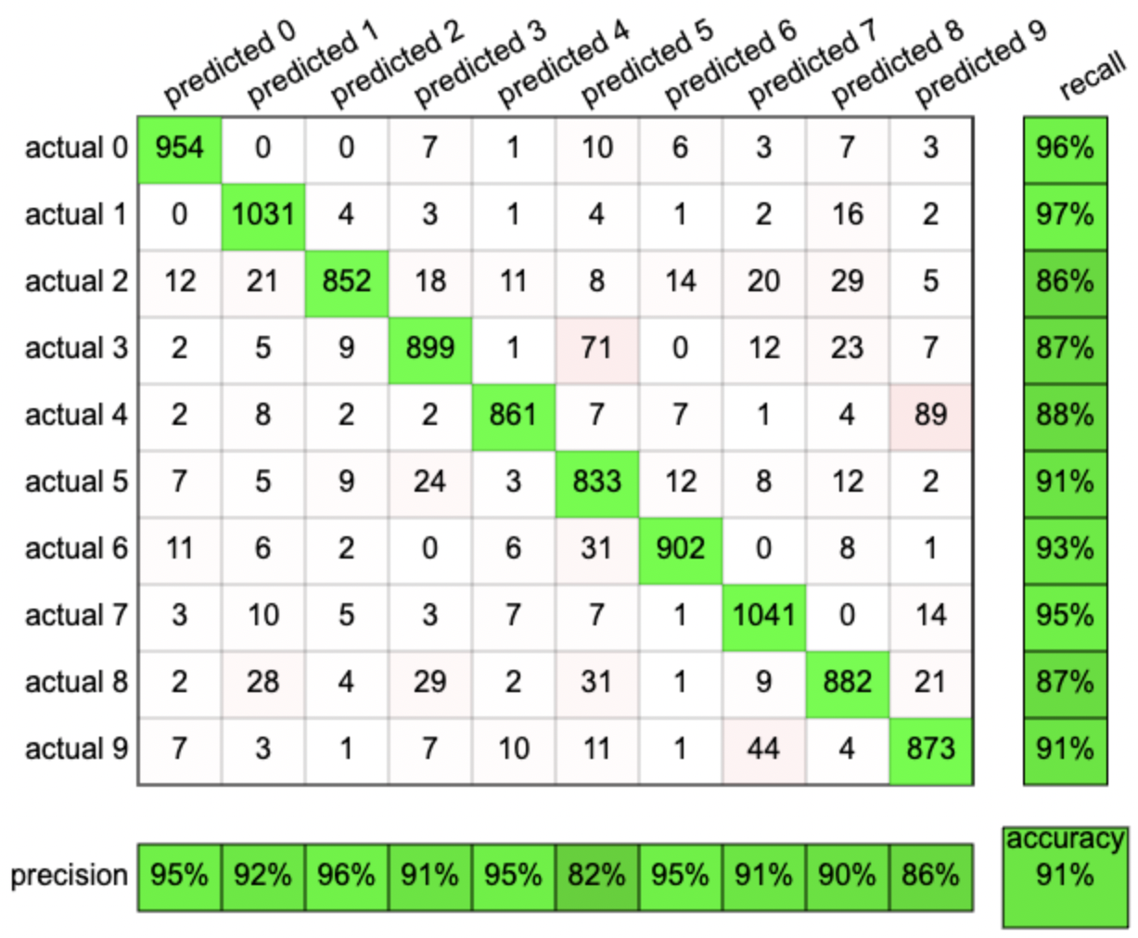
Question 3
Another example of a confusion matrix, from a digit classification problem:
Source: https://ml4a.github.io/demos/confusion_mnist/

Slide 22
Question 4
Given below is a scenario for Training error rate Tr, and Validation error rate Va for a machine learning algorithm. You want to choose a hyperparameter (P) based on Tr and Va.
Which value of P will you choose based on the above table?
10
9
8
7
6
P | Tr | Va
10 | 0.10 | 0.25
9 | 0.30 | 0.35
8 | 0.22 | 0.15
7 | 0.15 | 0.25
6 | 0.18 | 0.15

Slide 23
Question 4
Given below is a scenario for Training error rate Tr, and Validation error rate Va for a machine learning algorithm. You want to choose a hyperparameter (P) based on Tr and Va.
Which value of P will you choose based on the above table?
10
9
8
7
6
P | Tr | Va
10 | 0.10 | 0.25
9 | 0.30 | 0.35
8 | 0.22 | 0.15
7 | 0.15 | 0.25
6 | 0.18 | 0.15
Lowest Va
Lowest Va

Slide 24
Question 4
Given below is a scenario for Training error rate Tr, and Validation error rate Va for a machine learning algorithm. You want to choose a hyperparameter (P) based on Tr and Va.
Which value of P will you choose based on the above table?
10
9
8
7
6
P | Tr | Va
10 | 0.10 | 0.25
9 | 0.30 | 0.35
8 | 0.22 | 0.15
7 | 0.15 | 0.25
6 | 0.18 | 0.15
Lowest Va
Lowest Va
Lower Tr

Slide 25
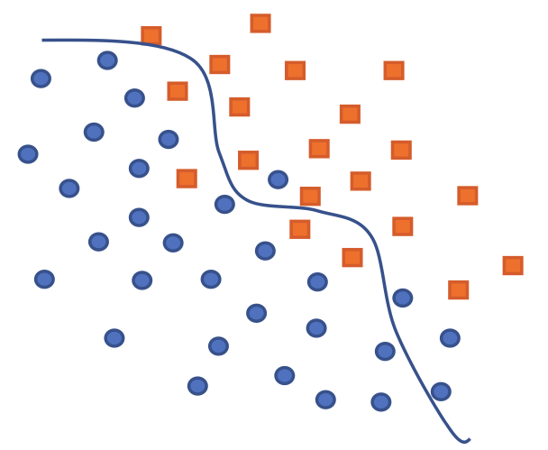
Question 5
Tabulate the confusion matrices for the following classification problems.
Binary problem (class-1: squares; class-2: circles)
Class 1
Class 2

Slide 26
Question 5
Tabulate the confusion matrices for the following classification problems.
Binary problem (class-1: squares; class-2: circles)
Class 1
 | Class 1 (predicted) | Class 2 (predicted)
Class 1 (actual)
Class 2 (actual)
Class 2

Slide 27
Question 5
Tabulate the confusion matrices for the following classification problems.
Binary problem (class-1: squares; class-2: circles)
Class 1
 | Class 1 (predicted) | Class 2 (predicted)
Class 1 (actual)
Class 2 (actual)
# samples of class 1, predicted as class 1
Class 2

Slide 28
Question 5
Tabulate the confusion matrices for the following classification problems.
Binary problem (class-1: squares; class-2: circles)
Class 1
 | Class 1 (predicted) | Class 2 (predicted)
Class 1 (actual) | 16
Class 2 (actual)
# samples of class 1, predicted as class 1
Class 2

Slide 29
Question 5
Tabulate the confusion matrices for the following classification problems.
Binary problem (class-1: squares; class-2: circles)
Class 1
 | Class 1 (predicted) | Class 2 (predicted)
Class 1 (actual) | 16
Class 2 (actual)
# samples of class 1, predicted as class 2
Class 2

Slide 30
Question 5
Tabulate the confusion matrices for the following classification problems.
Binary problem (class-1: squares; class-2: circles)
Class 1
 | Class 1 (predicted) | Class 2 (predicted)
Class 1 (actual) | 16 | 4
Class 2 (actual)
# samples of class 1, predicted as class 2
Class 2

Slide 31
Question 5
Tabulate the confusion matrices for the following classification problems.
Binary problem (class-1: squares; class-2: circles)
Class 1
 | Class 1 (predicted) | Class 2 (predicted)
Class 1 (actual) | 16 | 4
Class 2 (actual)
# samples of class 2, predicted as class 2
Class 2

Slide 32
Question 5
Tabulate the confusion matrices for the following classification problems.
Binary problem (class-1: squares; class-2: circles)
Class 1
 | Class 1 (predicted) | Class 2 (predicted)
Class 1 (actual) | 16 | 4
Class 2 (actual) |  | 26
# samples of class 2, predicted as class 2
Class 2

Slide 33
Question 5
Tabulate the confusion matrices for the following classification problems.
Binary problem (class-1: squares; class-2: circles)
Class 1
 | Class 1 (predicted) | Class 2 (predicted)
Class 1 (actual) | 16 | 4
Class 2 (actual) |  | 26
# samples of class 2, predicted as class 1
Class 2

Slide 34
Question 5
Tabulate the confusion matrices for the following classification problems.
Binary problem (class-1: squares; class-2: circles)
Class 1
 | Class 1 (predicted) | Class 2 (predicted)
Class 1 (actual) | 16 | 4
Class 2 (actual) | 4 | 26
# samples of class 2, predicted as class 1
Class 2

Slide 35
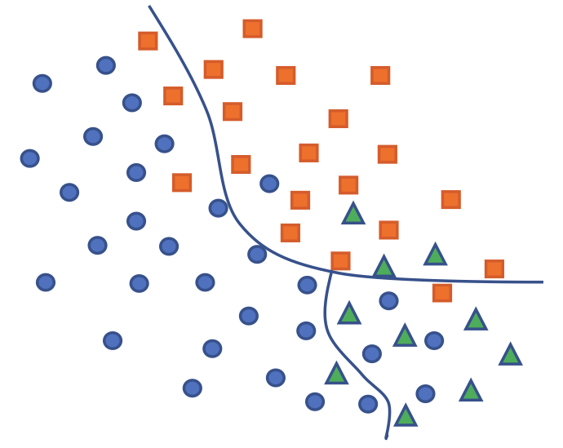
Question 5
Tabulate the confusion matrices for the following classification problems.
Three-category problem (the class-1: squares, class-2: circles, class-3: triangles)
Class 1
 | Class 1 (predicted) | Class 2 (predicted) | Class 3 (predicted)
Class 1 (actual)
Class 2 (actual)
Class 3 (actual)
Class 2
Class 3

Slide 36
Question 5
Tabulate the confusion matrices for the following classification problems.
Three-category problem (the class-1: squares, class-2: circles, class-3: triangles)
Class 1
 | Class 1 (predicted) | Class 2 (predicted) | Class 3 (predicted)
Class 1 (actual)
Class 2 (actual)
Class 3 (actual)
Class 2
# samples of class 1, predicted as class 1
Class 3

Slide 37
Question 5
Tabulate the confusion matrices for the following classification problems.
Three-category problem (the class-1: squares, class-2: circles, class-3: triangles)
Class 1
 | Class 1 (predicted) | Class 2 (predicted) | Class 3 (predicted)
Class 1 (actual) | 16
Class 2 (actual)
Class 3 (actual)
Class 2
# samples of class 1, predicted as class 1
Class 3

Slide 38
Question 5
Tabulate the confusion matrices for the following classification problems.
Three-category problem (the class-1: squares, class-2: circles, class-3: triangles)
Class 1
 | Class 1 (predicted) | Class 2 (predicted) | Class 3 (predicted)
Class 1 (actual) | 16
Class 2 (actual)
Class 3 (actual)
Class 2
# samples of class 2, predicted as class 1
Class 3

Slide 39
Question 5
Tabulate the confusion matrices for the following classification problems.
Three-category problem (the class-1: squares, class-2: circles, class-3: triangles)
Class 1
 | Class 1 (predicted) | Class 2 (predicted) | Class 3 (predicted)
Class 1 (actual) | 16
Class 2 (actual) | 1
Class 3 (actual)
Class 2
# samples of class 2, predicted as class 1
Class 3

Slide 40
Question 5
Tabulate the confusion matrices for the following classification problems.
Three-category problem (the class-1: squares, class-2: circles, class-3: triangles)
Class 1
 | Class 1 (predicted) | Class 2 (predicted) | Class 3 (predicted)
Class 1 (actual) | 16
Class 2 (actual) | 1
Class 3 (actual)
Class 2
# samples of class 3, predicted as class 1
Class 3

Slide 41
Question 5
Tabulate the confusion matrices for the following classification problems.
Three-category problem (the class-1: squares, class-2: circles, class-3: triangles)
Class 1
 | Class 1 (predicted) | Class 2 (predicted) | Class 3 (predicted)
Class 1 (actual) | 16
Class 2 (actual) | 1
Class 3 (actual) | 3
Class 2
# samples of class 3, predicted as class 1
Class 3

Slide 42
Question 5
Tabulate the confusion matrices for the following classification problems.
Three-category problem (the class-1: squares, class-2: circles, class-3: triangles)
Class 1
 | Class 1 (predicted) | Class 2 (predicted) | Class 3 (predicted)
Class 1 (actual) | 16 | 3 | 1
Class 2 (actual) | 1 | 25 | 4
Class 3 (actual) | 3 | 1 | 6
Class 2
Class 3

Slide 43
Question 6
Get the data set “from sklearn.datasets import load_iris”. Perform a 5-fold Cross-validation to observe the best polynomial order (among orders 1 to 10 and without regularization) for validation prediction. Note that, you will have to partition the whole dataset for training/validation/test parts, where the size of validation set is the same as that of test.

Slide 44
Question 6
Get the data set “from sklearn.datasets import load_iris”. Perform a 5-fold Cross-validation to observe the best polynomial order (among orders 1 to 10 and without regularization) for validation prediction. Note that, you will have to partition the whole dataset for training/validation/test parts, where the size of validation set is the same as that of test.
4*k samples
k samples
k samples
Total:
Training + Validation + Test =
4*k+ k + k = 6*k samples
Train
Train
Train
Train
Validation
Test
Train
Train
Train
Validation
Train
IRIS dataset has 150 samples in total
6 * k = 150
k = 150 / 6 = 25
Train
Train
Validation
Train
Train
Train
Validation
Train
Train
Train
Validation
Train
Train
Train
Train

Slide 45
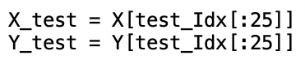
Question 6
Get the data set “from sklearn.datasets import load_iris”. Perform a 5-fold Cross-validation to observe the best polynomial order (among orders 1 to 10 and without regularization) for validation prediction. Note that, you will have to partition the whole dataset for training/validation/test parts, where the size of validation set is the same as that of test.
4*k samples
k samples
k samples
k=25
Train
Train
Train
Train
Validation
Test
Train
Train
Train
Validation
Train
Train
Train
Validation
Train
Train
Train
Validation
Train
Train
Train
Validation
Train
Train
Train
Train

Slide 46
Question 6
Get the data set “from sklearn.datasets import load_iris”. Perform a 5-fold Cross-validation to observe the best polynomial order (among orders 1 to 10 and without regularization) for validation prediction. Note that, you will have to partition the whole dataset for training/validation/test parts, where the size of validation set is the same as that of test.
4*k samples
k samples
k samples
Polynomial Order | Validation Error
1
2
…
10
Train
Train
Train
Train
Validation
Test
Train
Train
Train
Validation
Train
Train
Train
Validation
Train
Train
Train
Validation
Train
Train
Train
Validation
Train
Train
Train
Train

Slide 47

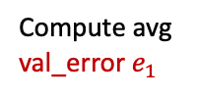
Question 6
Get the data set “from sklearn.datasets import load_iris”. Perform a 5-fold Cross-validation to observe the best polynomial order (among orders 1 to 10 and without regularization) for validation prediction. Note that, you will have to partition the whole dataset for training/validation/test parts, where the size of validation set is the same as that of test.
4*k samples
k samples
k samples
Polynomial Order | Validation Error
1
2
…
10
Train
Train
Train
Train
Validation
Test
$$e_{1}$$
Train
Train
Train
Validation
Train
Train
Train
Validation
Train
Train
Compute avg val_error $e_{1}$
Train
Validation
Train
Train
Train
Validation
Train
Train
Train
Train

Slide 48

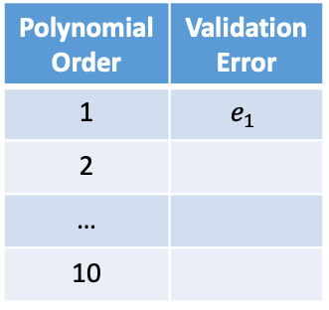

Question 6
Get the data set “from sklearn.datasets import load_iris”. Perform a 5-fold Cross-validation to observe the best polynomial order (among orders 1 to 10 and without regularization) for validation prediction. Note that, you will have to partition the whole dataset for training/validation/test parts, where the size of validation set is the same as that of test.
4*k samples
k samples
k samples
Polynomial Order | Validation Error
1 | $$e_{1}$$
2
…
10
Train
Train
Train
Train
Validation
Test
Train
Train
Train
Validation
Train
$$e_{2}$$
Train
Train
Validation
Train
Train
Compute avg val_error $e_{2}$
Train
Validation
Train
Train
Train
Validation
Train
Train
Train
Train

Slide 49
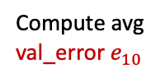
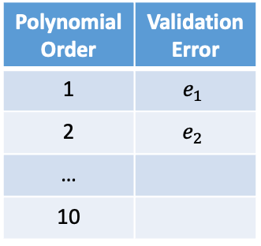

Question 6
Get the data set “from sklearn.datasets import load_iris”. Perform a 5-fold Cross-validation to observe the best polynomial order (among orders 1 to 10 and without regularization) for validation prediction. Note that, you will have to partition the whole dataset for training/validation/test parts, where the size of validation set is the same as that of test.
4*k samples
k samples
k samples
Polynomial Order | Validation Error
1 | $$e_{1}$$
2 | $$e_{2}$$
…
10
Train
Train
Train
Train
Validation
Test
Train
Train
Train
Validation
Train
Train
Train
Validation
Train
Train
Compute avg val_error $e_{10}$
Train
Validation
Train
Train
Train
$$e_{10}$$
Validation
Train
Train
Train
Train
How many classifiers have we built?
50

Slide 50
Question 6
Get the data set “from sklearn.datasets import load_iris”. Perform a 5-fold Cross-validation to observe the best polynomial order (among orders 1 to 10 and without regularization) for validation prediction. Note that, you will have to partition the whole dataset for training/validation/test parts, where the size of validation set is the same as that of test.
4*k samples
k samples
k samples
# Polynomial order 1-10
for order in range(1,11):
# 5-fold
for i in range(0,5):
# Train the model
w = <left/right inverse>
# Compute avg validation err
# Compare avg val_err and choose model
Train
Train
Train
Train
Validation
Test
Train
Train
Train
Validation
Train
Train
Train
Validation
Train
Train
Train
Validation
Train
Train
Train
Validation
Train
Train
Train
Train

Slide 51
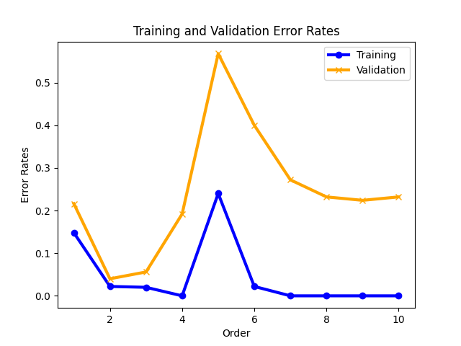
Question 6
Based on the training and validation error rates in the figure, which model would you select?
→ 2 (lowest validation error)
(You may get a different plot when running the code due to random data shuffling.)

