Slide 1
EE2211 Tutorial 11
Thao Nguyen

Slide 2
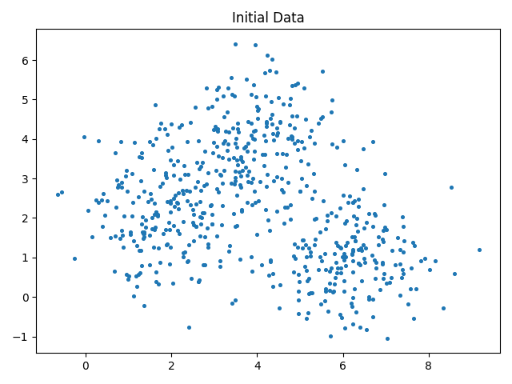
Recap: K-means clustering
Task: partition data into k clusters

Slide 3
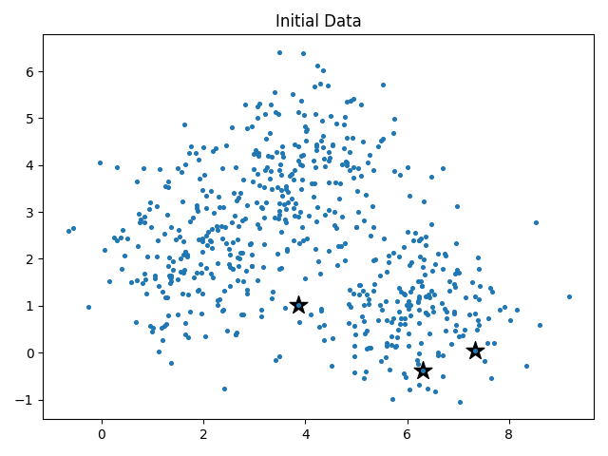
Recap: K-means clustering
Task: partition data into k clusters
Step 1: Initialize cluster centers randomly

Slide 4
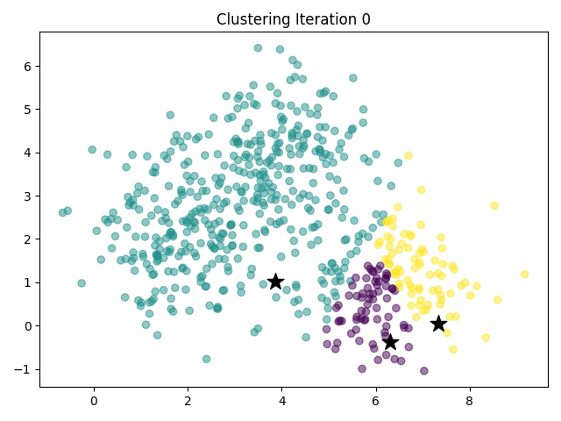
Recap: K-means clustering
Task: partition data into k clusters
Step 1: Initialize cluster centers randomly
Step 2: Assign labels based on closest center

Slide 5
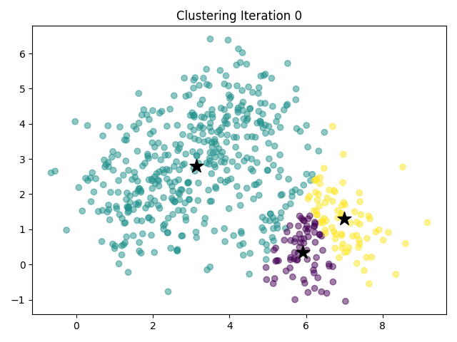
Recap: K-means clustering
Task: partition data into k clusters
Step 1: Initialize cluster centers randomly
Step 2: Assign labels based on closest center
Step 3: Update centers to be the mean of the data points assigned to them

Slide 6
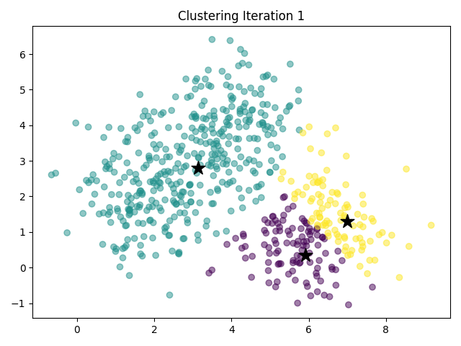
Recap: K-means clustering
Task: partition data into k clusters
Step 1: Initialize cluster centers randomly
Step 2: Assign labels based on closest center
Step 3: Update centers to be the mean of the data points assigned to them
Repeat step 2 until converge

Slide 7
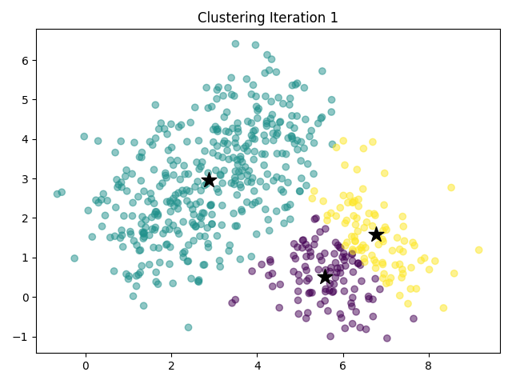
Recap: K-means clustering
Task: partition data into k clusters
Step 1: Initialize cluster centers randomly
Step 2: Assign labels based on closest center
Step 3: Update centers to be the mean of the data points assigned to them
Repeat step 2 until converge

Slide 8
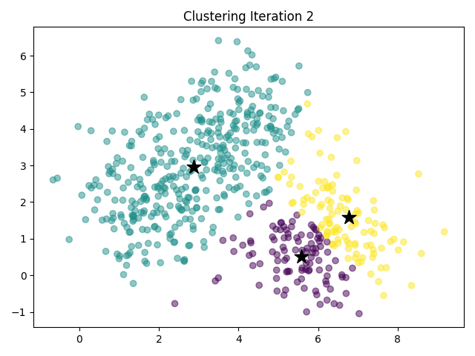
Recap: K-means clustering
Task: partition data into k clusters
Step 1: Initialize cluster centers randomly
Step 2: Assign labels based on closest center
Step 3: Update centers to be the mean of the data points assigned to them
Repeat step 2 until converge

Slide 9
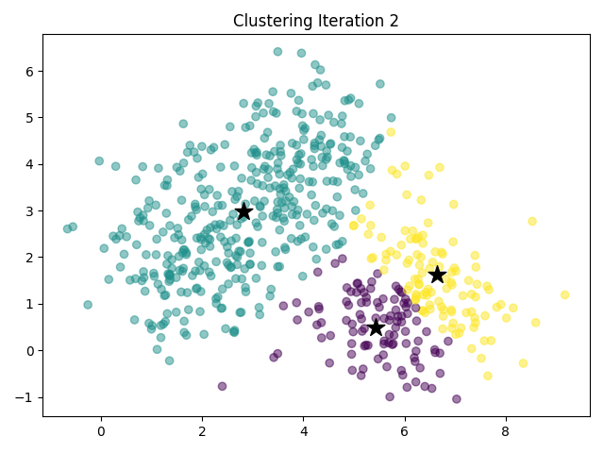
Recap: K-means clustering
Task: partition data into k clusters
Step 1: Initialize cluster centers randomly
Step 2: Assign labels based on closest center
Step 3: Update centers to be the mean of the data points assigned to them
Repeat step 2 until converge

Slide 10
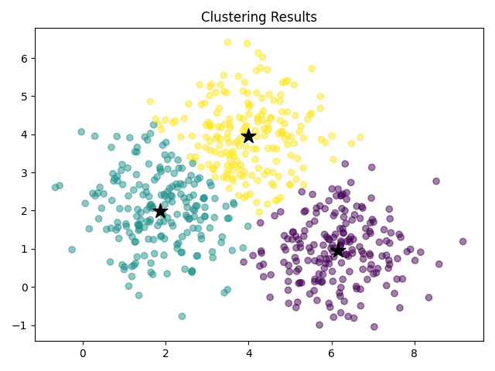
Recap: K-means clustering
Task: partition data into k clusters
Step 1: Initialize cluster centers randomly
Step 2: Assign labels based on closest center
Step 3: Update centers to be the mean of the data points assigned to them
Repeat step 2 until converge

Slide 11
Question 1
The K-means clustering method uses the target labels for calculating the distances from the cluster centroids for clustering.
True
False

Slide 12
Question 1
The K-means clustering method uses the target labels for calculating the distances from the cluster centroids for clustering.
True
False
K-means clustering is an unsupervised method

Slide 13
Question 2
The fuzzy C-means algorithm groups the data items such that an item can exist in multiple clusters.
True
False

Slide 14
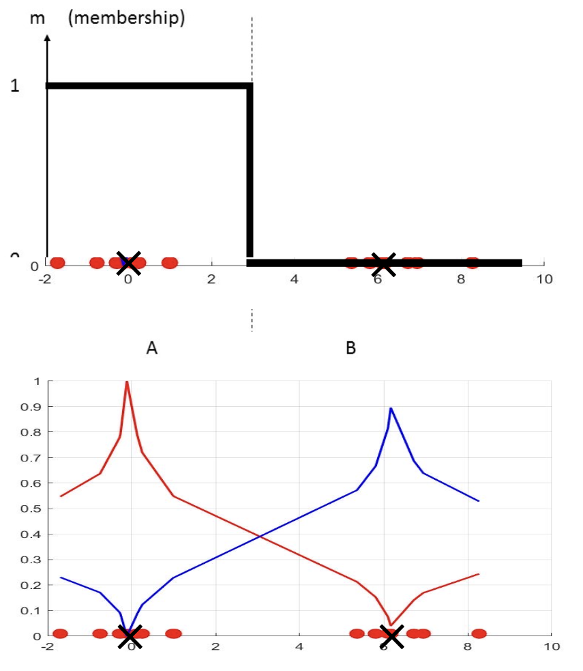
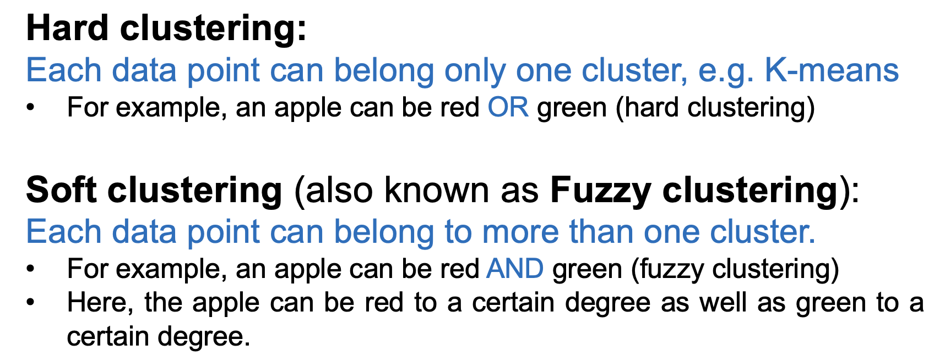
Question 2 – Fuzzy Clustering
From your lecture notes:

Slide 15
Question 2
The fuzzy C-means algorithm groups the data items such that an item can exist in multiple clusters.
True
False

Slide 16
Question 3
How can you prevent a clustering algorithm from getting stuck in bad local optima?
Set the same seed value for each run
Use the bottom ranked samples for initialization
Use the top ranked samples for initialization
All the above
None of the above

Slide 17
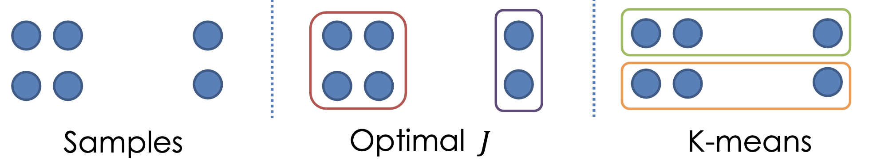
Question 3 – Local Optima in K-mean Clustering
From your lecture notes:

Slide 18
Question 3
How can you prevent a clustering algorithm from getting stuck in bad local optima?
Set the same seed value for each run
Use the bottom ranked samples for initialization
Use the top ranked samples for initialization
All the above
None of the above

Slide 19

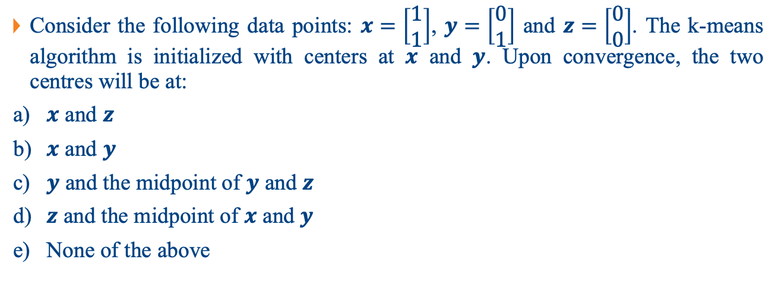





Question 4
Consider the following data points: $x=\left[\begin{matrix}1 \\ 1\end{matrix}\right]$, $y=\left[\begin{matrix}0 \\ 1\end{matrix}\right]$ and $z=\left[\begin{matrix}0 \\ 0\end{matrix}\right]$. The k-means algorithm is initialized with centers at 𝒙 and 𝒚. Upon convergence, the two centres will be at:
𝒙 and 𝒛
𝒙 and 𝒚
𝒚 and the midpoint of 𝒚 and 𝒛
𝒛 and the midpoint of 𝒙 and 𝒚
None of the above
$$y$$
$$x$$
$$1$$
$$z$$
$$0$$
$$1$$

Slide 20
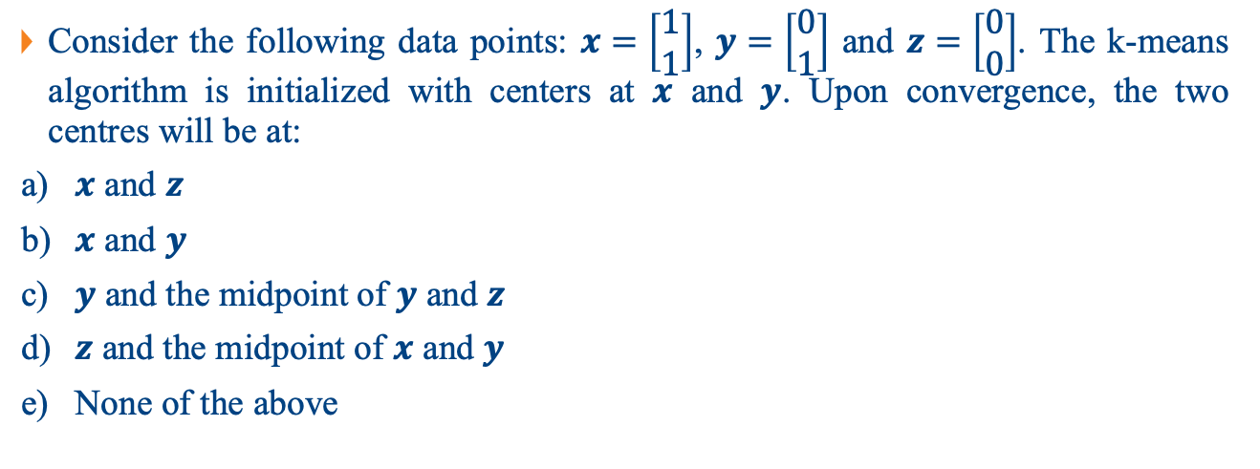
Question 4
Consider the following data points: $x=\left[\begin{matrix}1 \\ 1\end{matrix}\right]$, $y=\left[\begin{matrix}0 \\ 1\end{matrix}\right]$ and $z=\left[\begin{matrix}0 \\ 0\end{matrix}\right]$. The k-means algorithm is initialized with centers at 𝒙 and 𝒚. Upon convergence, the two centres will be at:
𝒙 and 𝒛
𝒙 and 𝒚
𝒚 and the midpoint of 𝒚 and 𝒛
𝒛 and the midpoint of 𝒙 and 𝒚
None of the above
$$y$$
$$x$$
$$1$$
$$z$$
$$0$$
$$1$$

Slide 21
Question 4
Consider the following data points: $x=\left[\begin{matrix}1 \\ 1\end{matrix}\right]$, $y=\left[\begin{matrix}0 \\ 1\end{matrix}\right]$ and $z=\left[\begin{matrix}0 \\ 0\end{matrix}\right]$. The k-means algorithm is initialized with centers at 𝒙 and 𝒚. Upon convergence, the two centres will be at:
𝒙 and 𝒛
𝒙 and 𝒚
𝒚 and the midpoint of 𝒚 and 𝒛
𝒛 and the midpoint of 𝒙 and 𝒚
None of the above
$$y$$
$$x$$
$$1$$
$$z$$
$$0$$
$$1$$

Slide 22
Question 4
Consider the following data points: $x=\left[\begin{matrix}1 \\ 1\end{matrix}\right]$, $y=\left[\begin{matrix}0 \\ 1\end{matrix}\right]$ and $z=\left[\begin{matrix}0 \\ 0\end{matrix}\right]$. The k-means algorithm is initialized with centers at 𝒙 and 𝒚. Upon convergence, the two centres will be at:
𝒙 and 𝒛
𝒙 and 𝒚
𝒚 and the midpoint of 𝒚 and 𝒛
𝒛 and the midpoint of 𝒙 and 𝒚
None of the above
$$y$$
$$x$$
$$1$$
$$z$$
$$0$$
$$1$$

Slide 23
Question 4
Consider the following data points: $x=\left[\begin{matrix}1 \\ 1\end{matrix}\right]$, $y=\left[\begin{matrix}0 \\ 1\end{matrix}\right]$ and $z=\left[\begin{matrix}0 \\ 0\end{matrix}\right]$. The k-means algorithm is initialized with centers at 𝒙 and 𝒚. Upon convergence, the two centres will be at:
𝒙 and 𝒛
𝒙 and 𝒚
𝒚 and the midpoint of 𝒚 and 𝒛
𝒛 and the midpoint of 𝒙 and 𝒚
None of the above
$$y$$
$$x$$
$$1$$
$$z$$
$$0$$
$$1$$

Slide 24
Question 4
Consider the following data points: $x=\left[\begin{matrix}1 \\ 1\end{matrix}\right]$, $y=\left[\begin{matrix}0 \\ 1\end{matrix}\right]$ and $z=\left[\begin{matrix}0 \\ 0\end{matrix}\right]$. The k-means algorithm is initialized with centers at 𝒙 and 𝒚. Upon convergence, the two centres will be at:
𝒙 and 𝒛
𝒙 and 𝒚
𝒚 and the midpoint of 𝒚 and 𝒛
𝒛 and the midpoint of 𝒙 and 𝒚
None of the above
$$y$$
$$x$$
$$1$$
$$z$$
$$0$$
$$1$$

Slide 25
Question 4
Discussion: how do you choose 2 initial centers so that the solution is (d)?
𝒙 and 𝒛
𝒙 and 𝒚
𝒚 and the midpoint of 𝒚 and 𝒛
𝒛 and the midpoint of 𝒙 and 𝒚
None of the above
$$y$$
$$x$$
$$1$$
$$z$$
$$0$$
$$1$$

Slide 26
Question 4
Discussion: how do you choose 2 initial centers so that the solution is (d)?
𝒙 and 𝒛
𝒙 and 𝒚
𝒚 and the midpoint of 𝒚 and 𝒛
𝒛 and the midpoint of 𝒙 and 𝒚
None of the above
$$y$$
$$x$$
$$1$$
$$z$$
$$0$$
$$1$$

Slide 27






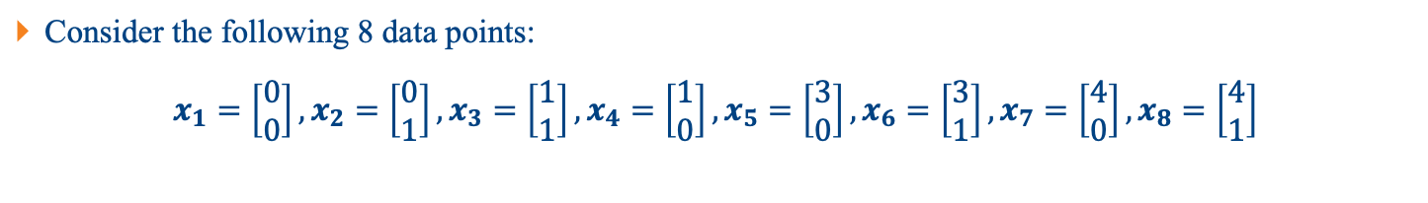






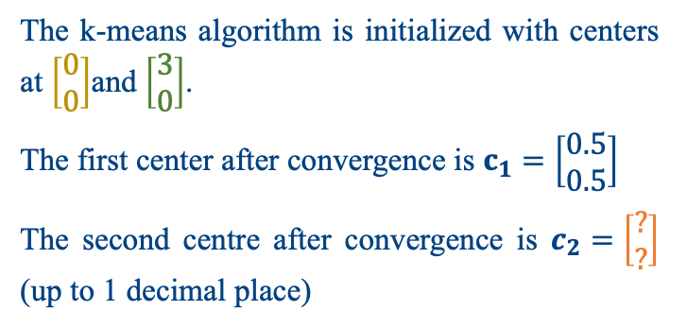



Question 5
Consider the following 8 data points:
$x_{1}=\left[\begin{matrix}0 \\ 0\end{matrix}\right],x_{2}=\left[\begin{matrix}0 \\ 1\end{matrix}\right],x_{3}=\left[\begin{matrix}1 \\ 1\end{matrix}\right],x_{4}=\left[\begin{matrix}1 \\ 0\end{matrix}\right],x_{5}=\left[\begin{matrix}3 \\ 0\end{matrix}\right],x_{6}=\left[\begin{matrix}3 \\ 1\end{matrix}\right],x_{7}=\left[\begin{matrix}4 \\ 0\end{matrix}\right],x_{8}=\left[\begin{matrix}4 \\ 1\end{matrix}\right]$
The k-means algorithm is initialized with centers at $\left[\begin{matrix}0 \\ 0\end{matrix}\right]$and $\left[\begin{matrix}3 \\ 0\end{matrix}\right]$.
The first center after convergence is $c_{1}=\left[\begin{matrix}0.5 \\ 0.5\end{matrix}\right]$
The second centre after convergence is $c_{2}=\left[\begin{matrix}? \\ ?\end{matrix}\right]$ (up to 1 decimal place)
$$y$$
$$x_{2}$$
$$x_{3}$$
$$x_{6}$$
$$x_{8}$$
$$1$$
$$x_{1}$$
$$x_{4}$$
$$x_{5}$$
$$x_{7}$$
$$0$$
$$1$$
$$3$$
$$4$$
$$x$$

Slide 28
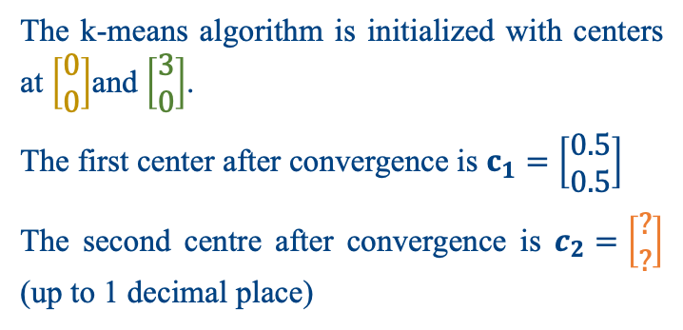
Question 5
Consider the following 8 data points:
$x_{1}=\left[\begin{matrix}0 \\ 0\end{matrix}\right],x_{2}=\left[\begin{matrix}0 \\ 1\end{matrix}\right],x_{3}=\left[\begin{matrix}1 \\ 1\end{matrix}\right],x_{4}=\left[\begin{matrix}1 \\ 0\end{matrix}\right],x_{5}=\left[\begin{matrix}3 \\ 0\end{matrix}\right],x_{6}=\left[\begin{matrix}3 \\ 1\end{matrix}\right],x_{7}=\left[\begin{matrix}4 \\ 0\end{matrix}\right],x_{8}=\left[\begin{matrix}4 \\ 1\end{matrix}\right]$
The k-means algorithm is initialized with centers at $\left[\begin{matrix}0 \\ 0\end{matrix}\right]$and $\left[\begin{matrix}3 \\ 0\end{matrix}\right]$.
The first center after convergence is $c_{1}=\left[\begin{matrix}0.5 \\ 0.5\end{matrix}\right]$
The second centre after convergence is $c_{2}=\left[\begin{matrix}? \\ ?\end{matrix}\right]$ (up to 1 decimal place)
$$y$$
$$x_{2}$$
$$x_{3}$$
$$x_{6}$$
$$x_{8}$$
$$1$$
$$x_{1}$$
$$x_{4}$$
$$x_{5}$$
$$x_{7}$$
$$0$$
$$1$$
$$3$$
$$4$$
$$x$$

Slide 29
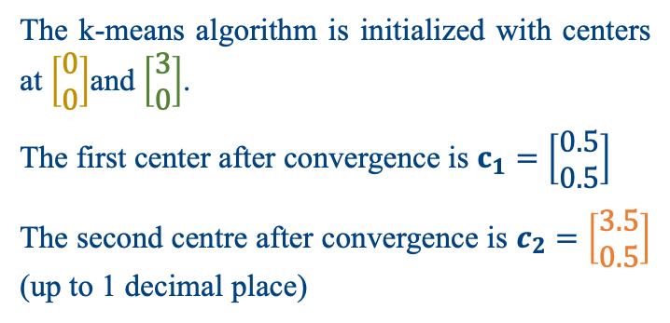


Question 5
Consider the following 8 data points:
$x_{1}=\left[\begin{matrix}0 \\ 0\end{matrix}\right],x_{2}=\left[\begin{matrix}0 \\ 1\end{matrix}\right],x_{3}=\left[\begin{matrix}1 \\ 1\end{matrix}\right],x_{4}=\left[\begin{matrix}1 \\ 0\end{matrix}\right],x_{5}=\left[\begin{matrix}3 \\ 0\end{matrix}\right],x_{6}=\left[\begin{matrix}3 \\ 1\end{matrix}\right],x_{7}=\left[\begin{matrix}4 \\ 0\end{matrix}\right],x_{8}=\left[\begin{matrix}4 \\ 1\end{matrix}\right]$
The k-means algorithm is initialized with centers at $\left[\begin{matrix}0 \\ 0\end{matrix}\right]$and $\left[\begin{matrix}3 \\ 0\end{matrix}\right]$.
The first center after convergence is $c_{1}=\left[\begin{matrix}0.5 \\ 0.5\end{matrix}\right]$
The second centre after convergence is $c_{2}=\left[\begin{matrix}3.5 \\ 0.5\end{matrix}\right]$ (up to 1 decimal place)
$$y$$
$$x_{2}$$
$$x_{3}$$
$$x_{6}$$
$$x_{8}$$
$$1$$
$$c_{1}$$
$$c_{2}$$
$$x_{1}$$
$$x_{4}$$
$$x_{5}$$
$$x_{7}$$
$$0$$
$$1$$
$$3$$
$$4$$
$$x$$

Slide 30
Question 6
Generate three clusters of data using the following codes.
Implement the Naïve K-means (the basic/standard algorithm shown in lecture) clustering algorithm to find the 3 cluster centroids.
Change the number of clusters K to 5 and classify the data points again with a plot illustration.
## Import necessary libraries import numpy as np # linear algebra
from matplotlib import pyplot as plt
## Generate data
## Set three centers, the model should predict similar results
center_1 = np.array([2,2]) center_2 = np.array([4,4]) center_3 = np.array([6,1])
## Generate random data and center it to the three centers
data_1 = np.random.randn(200, 2) + center_1 data_2 = np.random.randn(200,2) + center_2 data_3 = np.random.randn(200,2) + center_3
data = np.concatenate((data_1, data_2, data_3), axis = 0)
plt.scatter(data[:,0], data[:,1], s=7)

Slide 31
Question 6
## Import necessary libraries import numpy as np # linear algebra
from matplotlib import pyplot as plt
## Generate data
## Set three centers, the model should predict similar results
center_1 = np.array([2,2]) center_2 = np.array([4,4]) center_3 = np.array([6,1])
## Generate random data and center it to the three centers
data_1 = np.random.randn(200, 2) + center_1 data_2 = np.random.randn(200,2) + center_2 data_3 = np.random.randn(200,2) + center_3
data = np.concatenate((data_1, data_2, data_3), axis = 0)
plt.scatter(data[:,0], data[:,1], s=7)

Slide 32
Question 6
# Initialize cluster centers
k = 3
centers = data[np.random.choice(len(data), k, replace=False)]
# K-Means implementation
def k_means(data_points, centers, n_clusters, max_iterations=100):
for _ in range(max_iterations):
# Assign labels based on closest center
labels = np.zeros(len(data_points))
for i in range(len(data_points)):
distances = [np.linalg.norm(data_points[i] - c) for c in centers]
labels[i] = np.argmin(distances)
# Update centers
new_centers = np.zeros((n_clusters, data_points.shape[1]))
for i in range(n_clusters):
new_centers[i] = np.mean(data_points[labels == i], axis=0)
# Check for convergence
if np.linalg.norm(new_centers - centers) < 0.0001:
break
centers = new_centers

Slide 33
Question 6
# Initialize cluster centers
k = 3
centers = data[np.random.choice(len(data), k, replace=False)]
# K-Means implementation
def k_means(data_points, centers, n_clusters, max_iterations=100):
for _ in range(max_iterations):
# Assign labels based on closest center
labels = np.zeros(len(data_points))
for i in range(len(data_points)):
distances = [np.linalg.norm(data_points[i] - c) for c in centers]
labels[i] = np.argmin(distances)
# Update centers
new_centers = np.zeros((n_clusters, data_points.shape[1]))
for i in range(n_clusters):
new_centers[i] = np.mean(data_points[labels == i], axis=0)
# Check for convergence
if np.linalg.norm(new_centers - centers) < 0.0001:
break
centers = new_centers

Slide 34
Question 6
# Initialize cluster centers
k = 3
centers = data[np.random.choice(len(data), k, replace=False)]
# K-Means implementation
def k_means(data_points, centers, n_clusters, max_iterations=100):
for _ in range(max_iterations):
# Assign labels based on closest center
labels = np.zeros(len(data_points))
for i in range(len(data_points)):
distances = [np.linalg.norm(data_points[i] - c) for c in centers]
labels[i] = np.argmin(distances)
# Update centers
new_centers = np.zeros((n_clusters, data_points.shape[1]))
for i in range(n_clusters):
new_centers[i] = np.mean(data_points[labels == i], axis=0)
# Check for convergence
if np.linalg.norm(new_centers - centers) < 0.0001:
break
centers = new_centers

Slide 35
Question 6
# Initialize cluster centers
k = 3
centers = data[np.random.choice(len(data), k, replace=False)]
# K-Means implementation
def k_means(data_points, centers, n_clusters, max_iterations=100):
for _ in range(max_iterations):
# Assign labels based on closest center
labels = np.zeros(len(data_points))
for i in range(len(data_points)):
distances = [np.linalg.norm(data_points[i] - c) for c in centers]
labels[i] = np.argmin(distances)
# Update centers
new_centers = np.zeros((n_clusters, data_points.shape[1]))
for i in range(n_clusters):
new_centers[i] = np.mean(data_points[labels == i], axis=0)
# Check for convergence
if np.linalg.norm(new_centers - centers) < 0.0001:
break
centers = new_centers

Slide 36
Question 6
# Initialize cluster centers
k = 3
centers = data[np.random.choice(len(data), k, replace=False)]
# K-Means implementation
def k_means(data_points, centers, n_clusters, max_iterations=100):
for _ in range(max_iterations):
# Assign labels based on closest center
labels = np.zeros(len(data_points))
for i in range(len(data_points)):
distances = [np.linalg.norm(data_points[i] - c) for c in centers]
labels[i] = np.argmin(distances)
# Update centers
new_centers = np.zeros((n_clusters, data_points.shape[1]))
for i in range(n_clusters):
new_centers[i] = np.mean(data_points[labels == i], axis=0)
# Check for convergence
if np.linalg.norm(new_centers - centers) < 0.0001:
break
centers = new_centers

Slide 37
Question 6
# Initialize cluster centers
k = 3
centers = data[np.random.choice(len(data), k, replace=False)]
# K-Means implementation
def k_means(data_points, centers, n_clusters, max_iterations=100):
for _ in range(max_iterations):
# Assign labels based on closest center
labels = np.zeros(len(data_points))
for i in range(len(data_points)):
distances = [np.linalg.norm(data_points[i] - c) for c in centers]
labels[i] = np.argmin(distances)
# Update centers
new_centers = np.zeros((n_clusters, data_points.shape[1]))
for i in range(n_clusters):
new_centers[i] = np.mean(data_points[labels == i], axis=0)
# Check for convergence
if np.linalg.norm(new_centers - centers) < 0.0001:
break
centers = new_centers

Slide 38
Question 6
# Initialize cluster centers
k = 3
centers = data[np.random.choice(len(data), k, replace=False)]
# K-Means implementation
def k_means(data_points, centers, n_clusters, max_iterations=100):
for _ in range(max_iterations):
# Assign labels based on closest center
labels = np.zeros(len(data_points))
for i in range(len(data_points)):
distances = [np.linalg.norm(data_points[i] - c) for c in centers]
labels[i] = np.argmin(distances)
# Update centers
new_centers = np.zeros((n_clusters, data_points.shape[1]))
for i in range(n_clusters):
new_centers[i] = np.mean(data_points[labels == i], axis=0)
# Check for convergence
if np.linalg.norm(new_centers - centers) < 0.0001:
break
centers = new_centers

Slide 39
Question 6
# Initialize cluster centers
k = 3
centers = data[np.random.choice(len(data), k, replace=False)]
# K-Means implementation
def k_means(data_points, centers, n_clusters, max_iterations=100):
for _ in range(max_iterations):
# Assign labels based on closest center
labels = np.zeros(len(data_points))
for i in range(len(data_points)):
distances = [np.linalg.norm(data_points[i] - c) for c in centers]
labels[i] = np.argmin(distances)
# Update centers
new_centers = np.zeros((n_clusters, data_points.shape[1]))
for i in range(n_clusters):
new_centers[i] = np.mean(data_points[labels == i], axis=0)
# Check for convergence
if np.linalg.norm(new_centers - centers) < 0.0001:
break
centers = new_centers

Slide 40
Question 6
# Initialize cluster centers
k = 3
centers = data[np.random.choice(len(data), k, replace=False)]
# K-Means implementation
def k_means(data_points, centers, n_clusters, max_iterations=100):
for _ in range(max_iterations):
# Assign labels based on closest center
labels = np.zeros(len(data_points))
for i in range(len(data_points)):
distances = [np.linalg.norm(data_points[i] - c) for c in centers]
labels[i] = np.argmin(distances)
# Update centers
new_centers = np.zeros((n_clusters, data_points.shape[1]))
for i in range(n_clusters):
new_centers[i] = np.mean(data_points[labels == i], axis=0)
# Check for convergence
if np.linalg.norm(new_centers - centers) < 0.0001:
break
centers = new_centers
Terminate before max_iterations

Slide 41

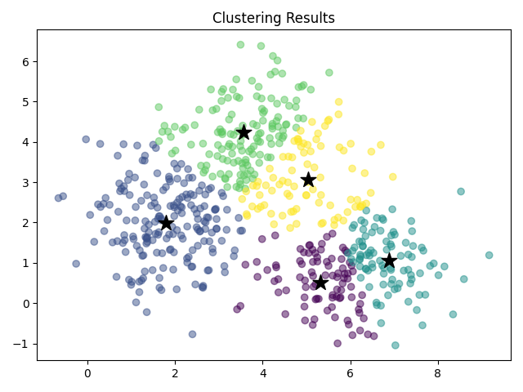
Question 6
Initial data, generated with 3 clusters centered at [2, 2], [4, 4], [6, 1]
K-mean clustering, 3 clusters
K-mean clustering, 5 clusters

Slide 42
Question 7
Load the IRIS data “from sklearn.datasets import load_iris”. Assume that the class labels are not given. Use the Naïve K-means clustering algorithm to group all the data based on K=3. How accurate is the result of clustering comparing with the known labels?

Slide 43
Question 7
# Initialize cluster centers
k = 3
centers = data[np.random.choice(len(data), k, replace=False)]
# K-Means implementation
def k_means(data_points, centers, n_clusters, max_iterations=100):
for _ in range(max_iterations):
# Assign labels based on closest center
labels = np.zeros(len(data_points))
for i in range(len(data_points)):
distances = [np.linalg.norm(data_points[i] - c) for c in centers]
labels[i] = np.argmin(distances)
# Update centers
new_centers = np.zeros((n_clusters, data_points.shape[1]))
for i in range(n_clusters):
new_centers[i] = np.mean(data_points[labels == i], axis=0)
# Check for convergence
if np.linalg.norm(new_centers - centers) < 0.0001:
break
centers = new_centers

Slide 44
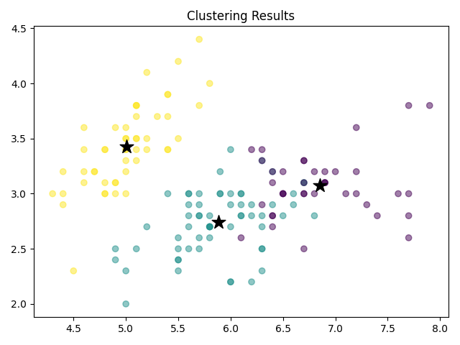
Question 7
Iris has 4 features, but we’re plotting only 2 for easier visualization.
How do we assign the labels?
Clusters from left to right can be mapped to labels:
0 – 1 – 2
0 – 2 – 1
1 – 0 – 2
1 – 2 – 0
2 – 0 – 1
2 – 1 – 0
Compare with true labels to measure the accuracy:
sklearn.metrics.accuracy_score(y_true, y_pred)

