Slide 1
EE2211 Tutorial 12
Thao Nguyen

Slide 2
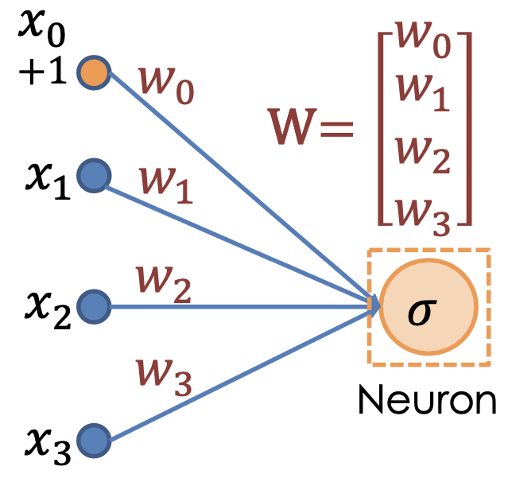
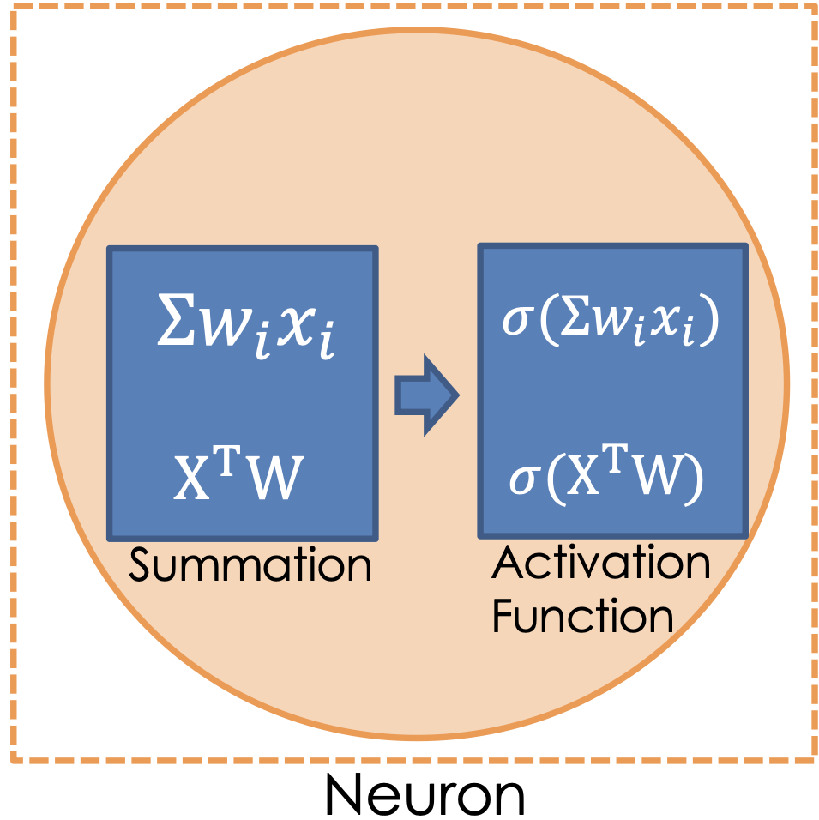
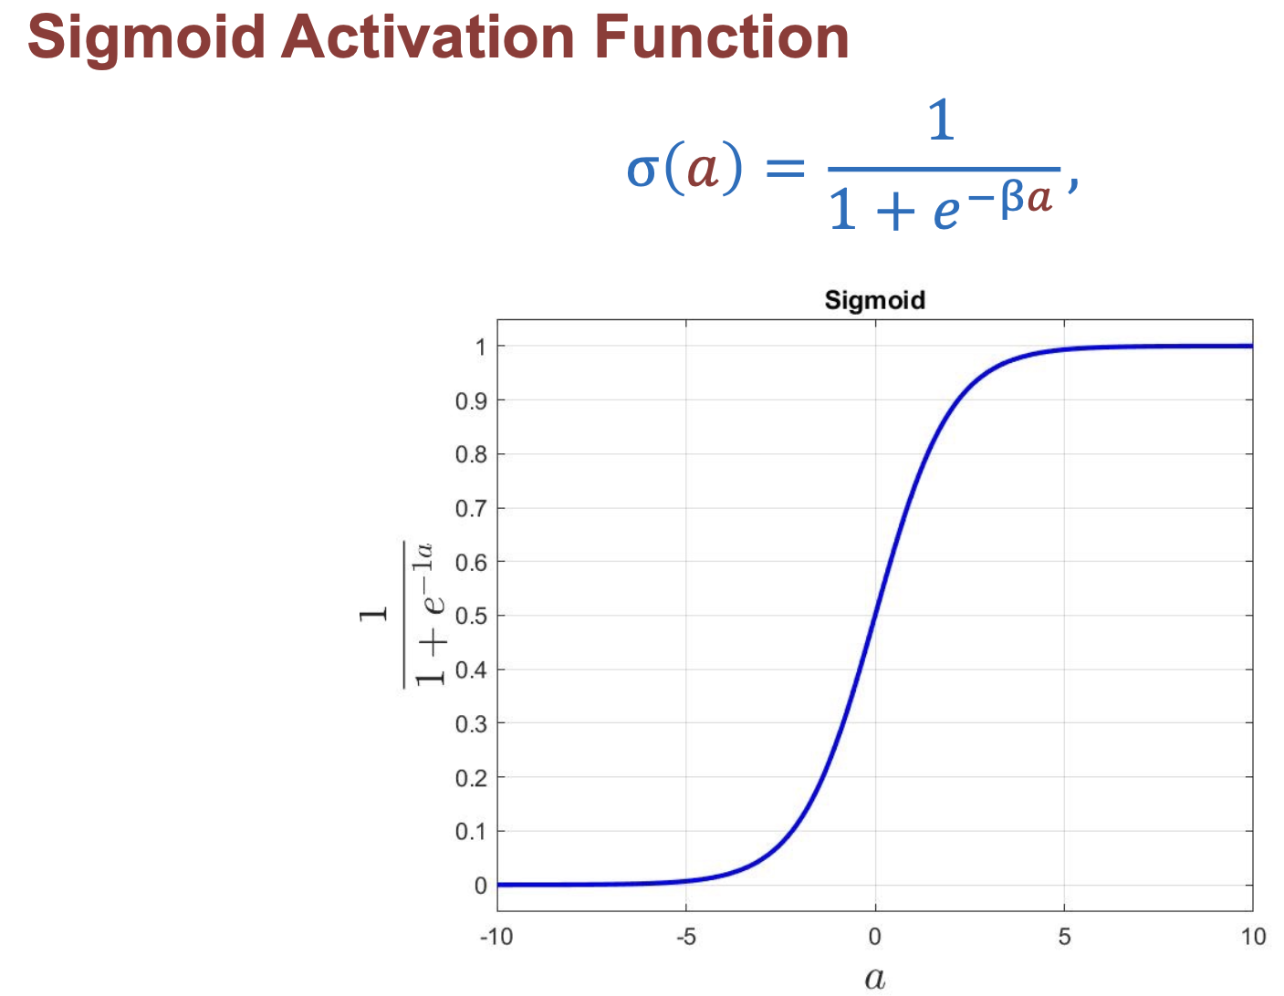
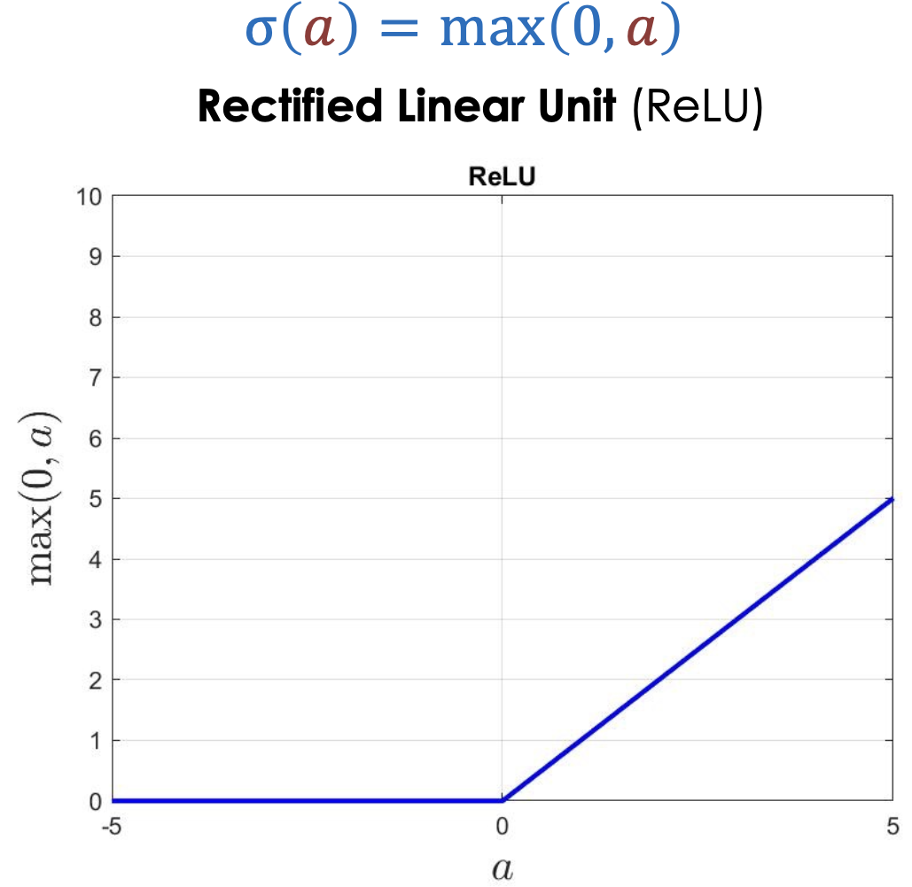
Recap: Perceptron
From your lecture notes:
Activation Function:

Slide 3
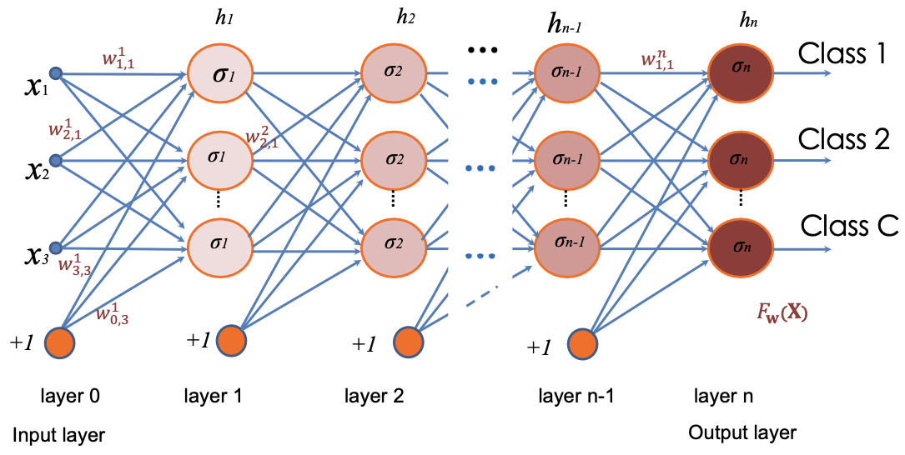
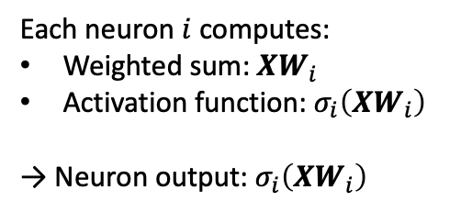
Recap: Multi-Layer Perceptron
From your lecture notes:
Each neuron $i$ computes:
Weighted sum: $XW_{i}$
Activation function: $σ_{i}\left(XW_{i}\right)$
→ Neuron output: $σ_{i}\left(XW_{i}\right)$

Slide 4
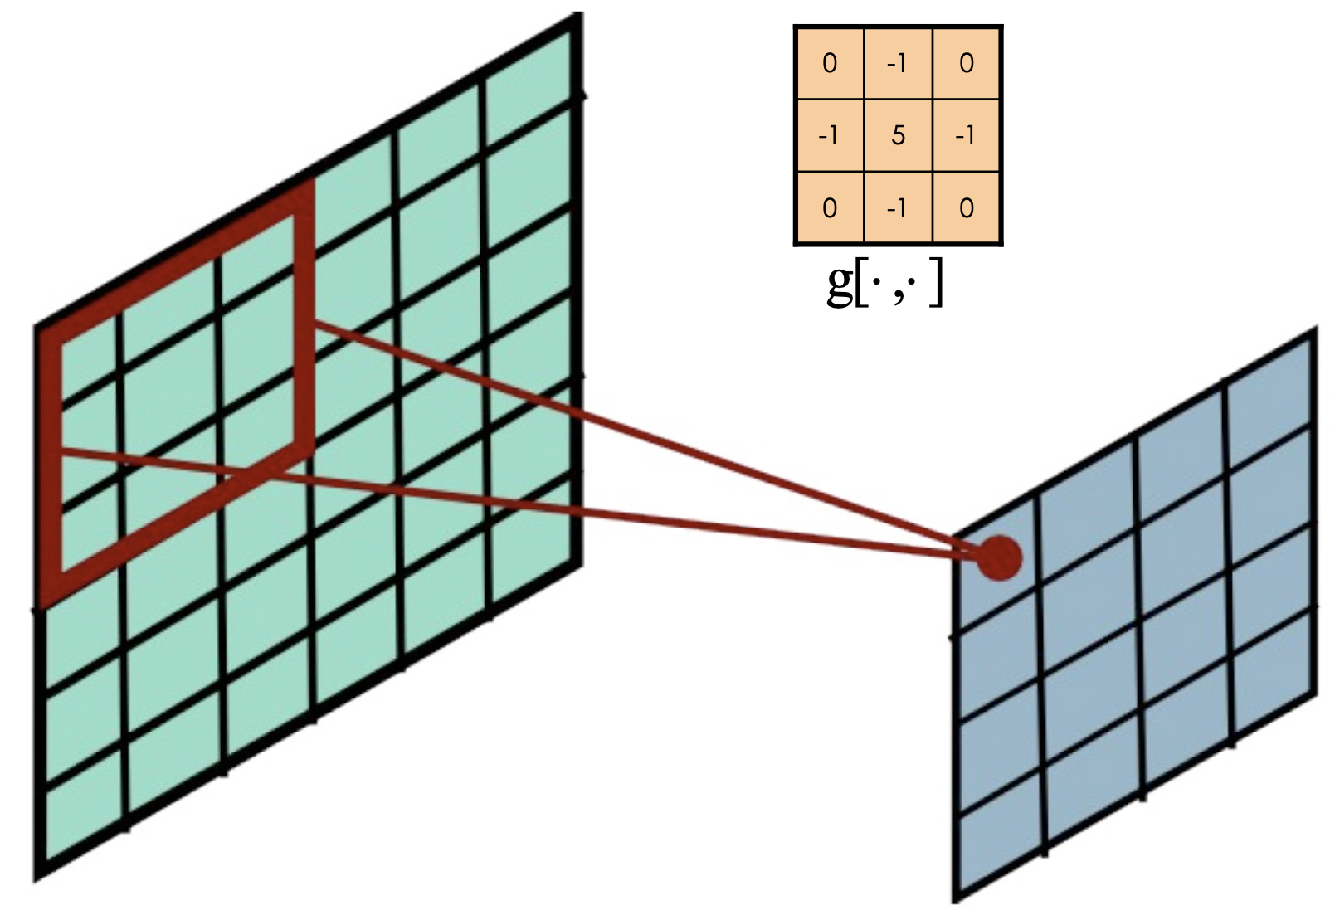
Recap: Convolutional Neural Network
Sparser connections than MLP
Figure from your lecture notes

Slide 5
Question 1
The convolutional neural network is particularly useful for applications related to image and text processing due to its dense connections.
True
False

Slide 6
Question 1
The convolutional neural network is particularly useful for applications related to image and text processing due to its dense connections.
True
False

Slide 7
Question 2
In neural networks, nonlinear activation functions such as sigmoid, and ReLU
speed up the gradient calculation in backpropagation, as compared to linear units
are applied only to the output units
help to introduce non-linearity into the model
always output values between 0 and 1

Slide 8
Recap: Perceptron
From your lecture notes:
Activation Function:

Slide 9
Question 2
In neural networks, nonlinear activation functions such as sigmoid, and ReLU
speed up the gradient calculation in backpropagation, as compared to linear units
are applied only to the output units
help to introduce non-linearity into the model
always output values between 0 and 1

Slide 10








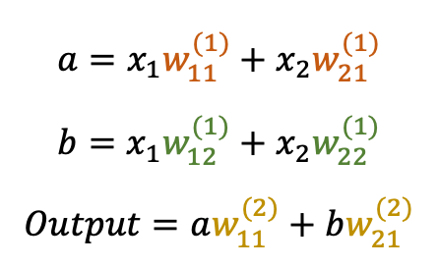


Question 2
Discussion: What happens if we use only weighted sums without activation functions?
$$w_{11}^{(1)}$$
$$a$$
$$a=x_{1}w_{11}^{(1)}+x_{2}w_{21}^{(1)}$$
$$b=x_{1}w_{12}^{(1)}+x_{2}w_{22}^{(1)}$$
$$Output=aw_{11}^{(2)}+bw_{21}^{(2)}$$
$$x_{1}$$
$$w_{11}^{(2)}$$
$$w_{21}^{(1)}$$
$$w_{12}^{(1)}$$
$$x_{2}$$
$$w_{21}^{(2)}$$
$$w_{22}^{(1)}$$
$$b$$

Slide 11











Question 3
Given a fully connected network of 2 layers: $F_{w}\left(X\right)=f\left(f\left(XW_{1}\right)W_{2}\right)$
$X=\left[\begin{matrix}1 & 1 & 3.0 \\ 1 & 2 & 2.5\end{matrix}\right], W_{1}=W_{2}=\left[\begin{matrix}−1 & 0 & 1 \\ 0 & −1 & 0 \\ 1 & 0 & 1\end{matrix}\right], f$ is ReLU
Compute the network output: $F_{w}\left(X\right)=\left[\begin{matrix}? & ? & ? \\ ? & ? & ?\end{matrix}\right]$
$$x_{1}$$
$$x_{2}$$
$$x_{3}$$
$$A=f(XW_{1})$$
$$x_{1}$$
$$−1$$
$$0$$
$$1$$
$$x_{2}$$
$$x_{3}$$

Slide 12




Question 3
Given a fully connected network of 2 layers: $F_{w}\left(X\right)=f\left(f\left(XW_{1}\right)W_{2}\right)$
$X=\left[\begin{matrix}1 & 1 & 3.0 \\ 1 & 2 & 2.5\end{matrix}\right], W_{1}=W_{2}=\left[\begin{matrix}−1 & 0 & 1 \\ 0 & −1 & 0 \\ 1 & 0 & 1\end{matrix}\right], f$ is ReLU
Compute the network output: $F_{w}\left(X\right)=\left[\begin{matrix}? & ? & ? \\ ? & ? & ?\end{matrix}\right]$
$$F_{W}\left(X\right)=$$
$$f(AW_{2})$$
$$x_{1}$$
$$x_{2}$$
$$x_{3}$$
$$A=f(XW_{1})$$
$$x_{1}$$
$$−1$$
$$0$$
$$1$$
$$x_{2}$$
$$x_{3}$$

Slide 13
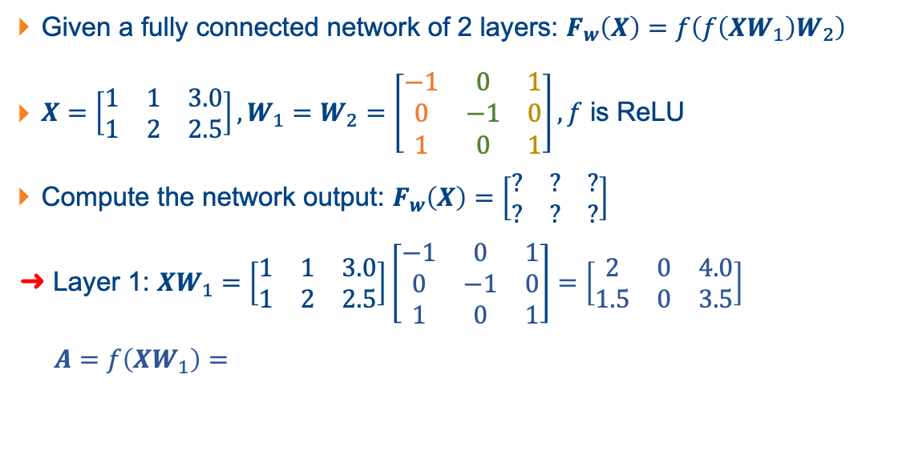
Question 3
Given a fully connected network of 2 layers: $F_{w}\left(X\right)=f\left(f\left(XW_{1}\right)W_{2}\right)$
$X=\left[\begin{matrix}1 & 1 & 3.0 \\ 1 & 2 & 2.5\end{matrix}\right], W_{1}=W_{2}=\left[\begin{matrix}−1 & 0 & 1 \\ 0 & −1 & 0 \\ 1 & 0 & 1\end{matrix}\right], f$ is ReLU
Compute the network output: $F_{w}\left(X\right)=\left[\begin{matrix}? & ? & ? \\ ? & ? & ?\end{matrix}\right]$
Layer 1: $XW_{1}=\left[\begin{matrix}1 & 1 & 3.0 \\ 1 & 2 & 2.5\end{matrix}\right]\left[\begin{matrix}−1 & 0 & 1 \\ 0 & −1 & 0 \\ 1 & 0 & 1\end{matrix}\right]=\left[\begin{matrix}2 & 0 & 4.0 \\ 1.5 & 0 & 3.5\end{matrix}\right]$
$A=f\left(XW_{1}\right)=$
$$x_{1}$$
$$x_{2}$$
$$x_{3}$$
$$A=f(XW_{1})$$
$$x_{1}$$
$$−1$$
$$0$$
$$1$$
$$x_{2}$$
$$x_{3}$$

Slide 14
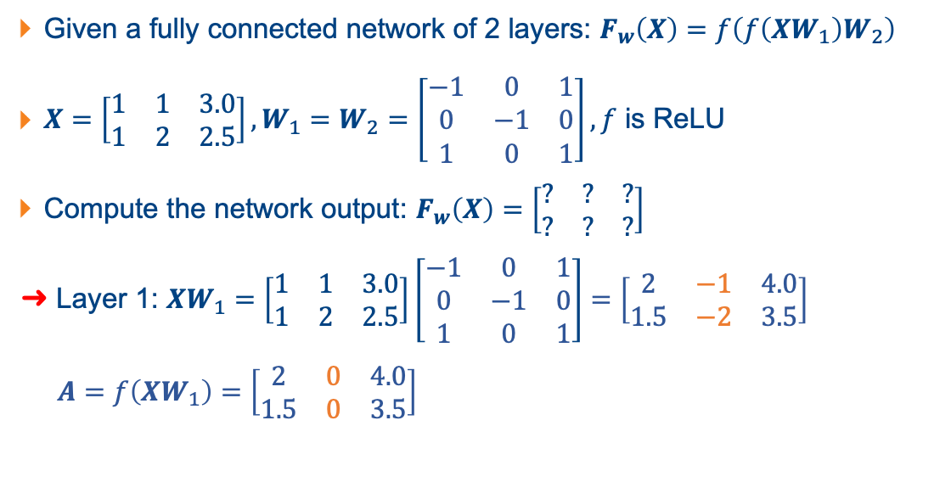
Question 3
Given a fully connected network of 2 layers: $F_{w}\left(X\right)=f\left(f\left(XW_{1}\right)W_{2}\right)$
$X=\left[\begin{matrix}1 & 1 & 3.0 \\ 1 & 2 & 2.5\end{matrix}\right], W_{1}=W_{2}=\left[\begin{matrix}−1 & 0 & 1 \\ 0 & −1 & 0 \\ 1 & 0 & 1\end{matrix}\right], f$ is ReLU
Compute the network output: $F_{w}\left(X\right)=\left[\begin{matrix}? & ? & ? \\ ? & ? & ?\end{matrix}\right]$
Layer 1: $XW_{1}=\left[\begin{matrix}1 & 1 & 3.0 \\ 1 & 2 & 2.5\end{matrix}\right]\left[\begin{matrix}−1 & 0 & 1 \\ 0 & −1 & 0 \\ 1 & 0 & 1\end{matrix}\right]=\left[\begin{matrix}2 & −1 & 4.0 \\ 1.5 & −2 & 3.5\end{matrix}\right]$
$A=f\left(XW_{1}\right)=\left[\begin{matrix}2 & 0 & 4.0 \\ 1.5 & 0 & 3.5\end{matrix}\right]$
$$x_{1}$$
$$x_{2}$$
$$x_{3}$$

Slide 15
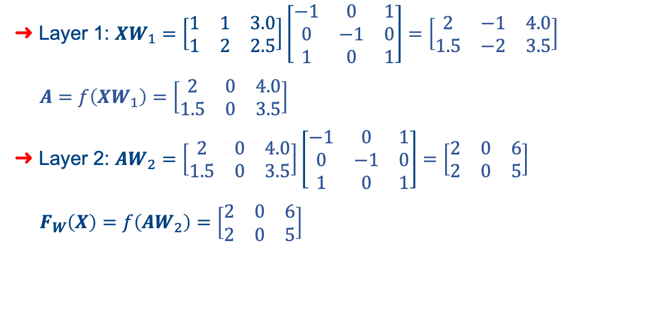
Question 3
Layer 1: $XW_{1}=\left[\begin{matrix}1 & 1 & 3.0 \\ 1 & 2 & 2.5\end{matrix}\right]\left[\begin{matrix}−1 & 0 & 1 \\ 0 & −1 & 0 \\ 1 & 0 & 1\end{matrix}\right]=\left[\begin{matrix}2 & −1 & 4.0 \\ 1.5 & −2 & 3.5\end{matrix}\right]$
$A=f\left(XW_{1}\right)=\left[\begin{matrix}2 & 0 & 4.0 \\ 1.5 & 0 & 3.5\end{matrix}\right]$
Layer 2: $AW_{2}=$ $\left[\begin{matrix}2 & 0 & 4.0 \\ 1.5 & 0 & 3.5\end{matrix}\right]\left[\begin{matrix}−1 & 0 & 1 \\ 0 & −1 & 0 \\ 1 & 0 & 1\end{matrix}\right]=\left[\begin{matrix}2 & 0 & 6 \\ 2 & 0 & 5\end{matrix}\right]$
$F_{W}\left(X\right)=f\left(AW_{2}\right)=\left[\begin{matrix}2 & 0 & 6 \\ 2 & 0 & 5\end{matrix}\right]$
$$F_{W}\left(X\right)=$$
$$f(AW_{2})$$
$$A=f(XW_{1})$$
$$x_{1}$$
$$−1$$
$$0$$
$$1$$
$$x_{2}$$
$$x_{3}$$

Slide 16
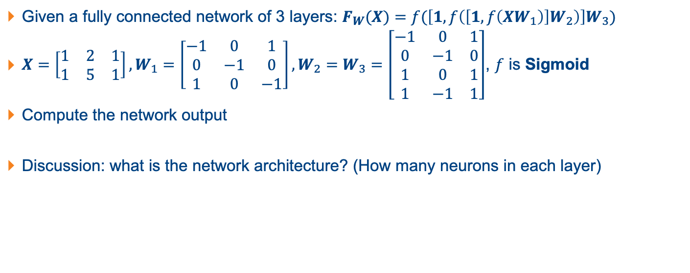
Question 4
Given a fully connected network of 3 layers: $F_{W}(X)=f(\left[1, f\left(\left[1, f\left(XW_{1}\right)\right]W_{2}\right)\right]W_{3})$
$X=\left[\begin{matrix}1 & 2 & 1 \\ 1 & 5 & 1\end{matrix}\right], W_{1}=\left[\begin{matrix}−1 & 0 & 1 \\ 0 & −1 & 0 \\ 1 & 0 & −1\end{matrix}\right], W_{2}=W_{3}=\left[\begin{matrix}−1 & 0 & 1 \\ 0 & −1 & 0 \\ 1 & 0 & 1 \\ 1 & −1 & 1\end{matrix}\right]$, $f$ is Sigmoid
Compute the network output
Discussion: what is the network architecture? (How many neurons in each layer)

Slide 17




Question 4
Given a fully connected network of 3 layers: $F_{W}(X)=f(\left[1, f\left(\left[1, f\left(XW_{1}\right)\right]W_{2}\right)\right]W_{3})$
$X=\left[\begin{matrix}1 & 2 & 1 \\ 1 & 5 & 1\end{matrix}\right], W_{1}=\left[\begin{matrix}−1 & 0 & 1 \\ 0 & −1 & 0 \\ 1 & 0 & −1\end{matrix}\right], W_{2}=W_{3}=\left[\begin{matrix}−1 & 0 & 1 \\ 0 & −1 & 0 \\ 1 & 0 & 1 \\ 1 & −1 & 1\end{matrix}\right]$, $f$ is Sigmoid
Compute the network output
$$A=$$
$$f(XW_{1})$$
$$B=$$
$$f(\left[1, A\right]W_{2})$$
$$F_{W}(X)=$$
$$f(\left[1, B\right]W_{3})$$
1
1

Slide 18
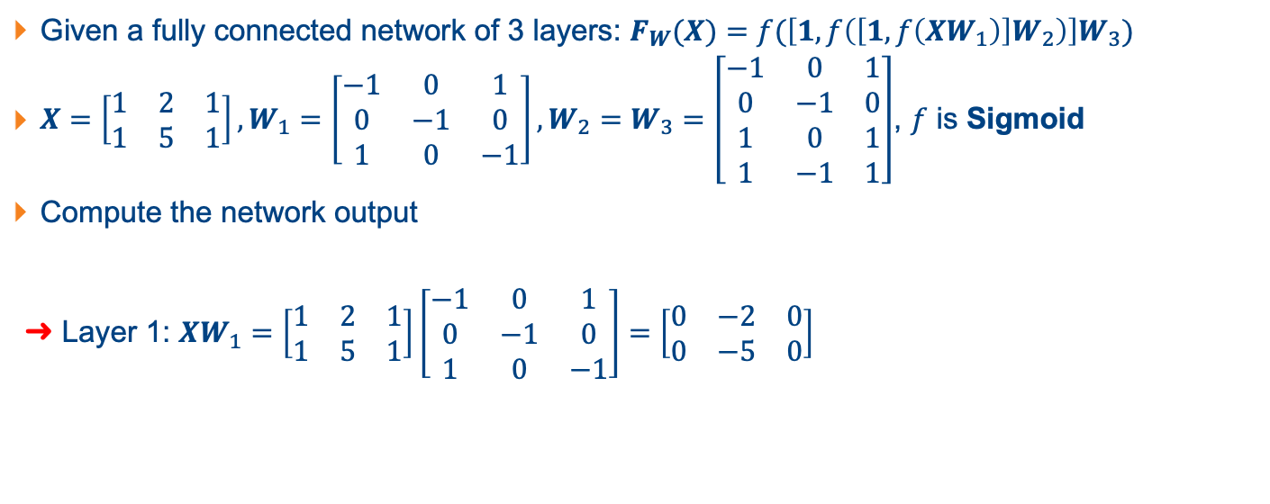
Question 4
Given a fully connected network of 3 layers: $F_{W}(X)=f(\left[1, f\left(\left[1, f\left(XW_{1}\right)\right]W_{2}\right)\right]W_{3})$
$X=\left[\begin{matrix}1 & 2 & 1 \\ 1 & 5 & 1\end{matrix}\right], W_{1}=\left[\begin{matrix}−1 & 0 & 1 \\ 0 & −1 & 0 \\ 1 & 0 & −1\end{matrix}\right], W_{2}=W_{3}=\left[\begin{matrix}−1 & 0 & 1 \\ 0 & −1 & 0 \\ 1 & 0 & 1 \\ 1 & −1 & 1\end{matrix}\right]$, $f$ is Sigmoid
Compute the network output
➜ Layer 1: $XW_{1}=\left[\begin{matrix}1 & 2 & 1 \\ 1 & 5 & 1\end{matrix}\right]\left[\begin{matrix}−1 & 0 & 1 \\ 0 & −1 & 0 \\ 1 & 0 & −1\end{matrix}\right]=\left[\begin{matrix}0 & −2 & 0 \\ 0 & −5 & 0\end{matrix}\right]$
$$A=$$
$$f(XW_{1})$$
$$B=$$
$$f(\left[1, A\right]W_{2})$$
$$F_{W}(X)=$$
$$f(\left[1, B\right]W_{3})$$
1
1

Slide 19
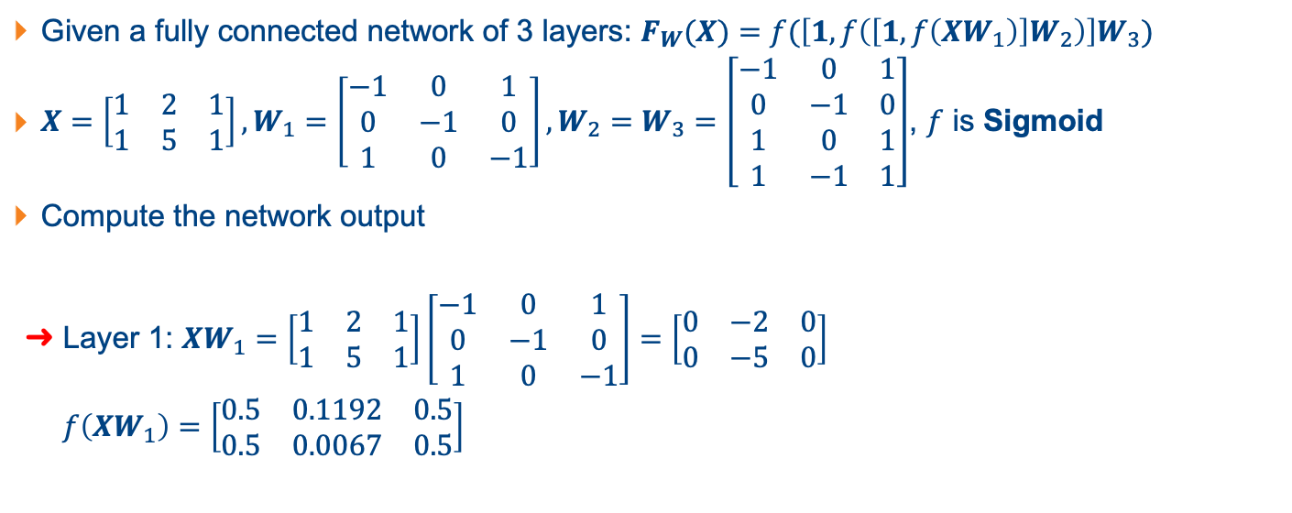
Question 4
Given a fully connected network of 3 layers: $F_{W}(X)=f(\left[1, f\left(\left[1, f\left(XW_{1}\right)\right]W_{2}\right)\right]W_{3})$
$X=\left[\begin{matrix}1 & 2 & 1 \\ 1 & 5 & 1\end{matrix}\right], W_{1}=\left[\begin{matrix}−1 & 0 & 1 \\ 0 & −1 & 0 \\ 1 & 0 & −1\end{matrix}\right], W_{2}=W_{3}=\left[\begin{matrix}−1 & 0 & 1 \\ 0 & −1 & 0 \\ 1 & 0 & 1 \\ 1 & −1 & 1\end{matrix}\right]$, $f$ is Sigmoid
Compute the network output
➜ Layer 1: $XW_{1}=\left[\begin{matrix}1 & 2 & 1 \\ 1 & 5 & 1\end{matrix}\right]\left[\begin{matrix}−1 & 0 & 1 \\ 0 & −1 & 0 \\ 1 & 0 & −1\end{matrix}\right]=\left[\begin{matrix}0 & −2 & 0 \\ 0 & −5 & 0\end{matrix}\right]$
$f\left(XW_{1}\right)=\left[\begin{matrix}0.5 & 0.1192 & 0.5 \\ 0.5 & 0.0067 & 0.5\end{matrix}\right]$

Slide 20

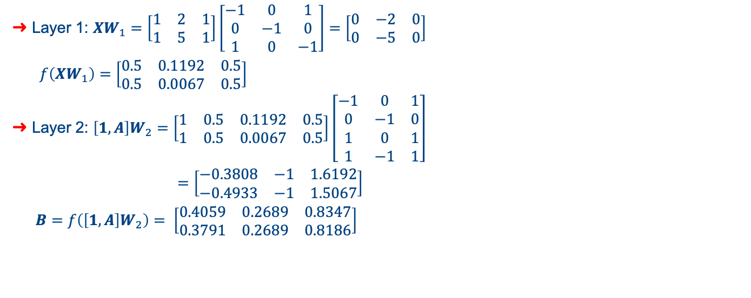


Question 4
Layer 1: $XW_{1}=\left[\begin{matrix}1 & 2 & 1 \\ 1 & 5 & 1\end{matrix}\right]\left[\begin{matrix}−1 & 0 & 1 \\ 0 & −1 & 0 \\ 1 & 0 & −1\end{matrix}\right]=\left[\begin{matrix}0 & −2 & 0 \\ 0 & −5 & 0\end{matrix}\right]$
$f\left(XW_{1}\right)=\left[\begin{matrix}0.5 & 0.1192 & 0.5 \\ 0.5 & 0.0067 & 0.5\end{matrix}\right]$
Layer 2: $\left[1, A\right]W_{2}=\left[\begin{matrix}1 & 0.5 & 0.1192 & 0.5 \\ 1 & 0.5 & 0.0067 & 0.5\end{matrix}\right]\left[\begin{matrix}−1 & 0 & 1 \\ 0 & −1 & 0 \\ 1 & 0 & 1 \\ 1 & −1 & 1\end{matrix}\right]$
$=\left[\begin{matrix}−0.3808 & −1 & 1.6192 \\ −0.4933 & −1 & 1.5067\end{matrix}\right]$
$B=f\left(\left[1,A\right]W_{2}\right)= \left[\begin{matrix}0.4059 & 0.2689 & 0.8347 \\ 0.3791 & 0.2689 & 0.8186\end{matrix}\right]$
$$A=$$
$$f(XW_{1})$$
$$B=$$
$$f(\left[1, A\right]W_{2})$$
$$F_{W}(X)=$$
$$f(\left[1, B\right]W_{3})$$
1
1

Slide 21
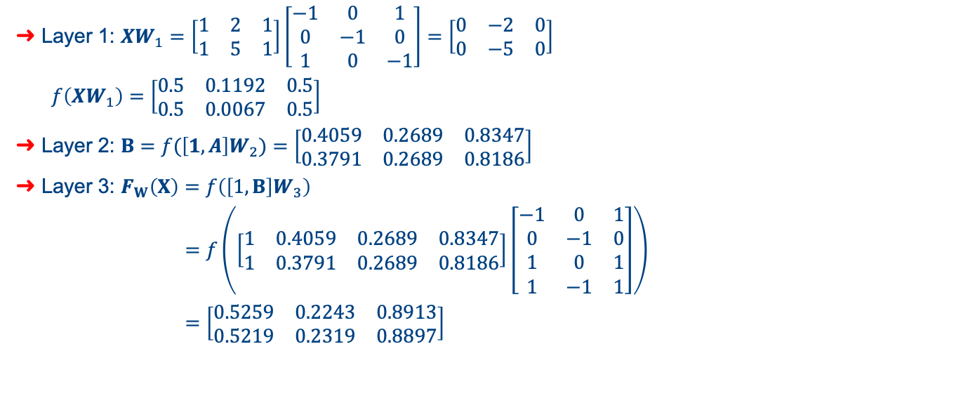
Question 4
Layer 1: $XW_{1}=\left[\begin{matrix}1 & 2 & 1 \\ 1 & 5 & 1\end{matrix}\right]\left[\begin{matrix}−1 & 0 & 1 \\ 0 & −1 & 0 \\ 1 & 0 & −1\end{matrix}\right]=\left[\begin{matrix}0 & −2 & 0 \\ 0 & −5 & 0\end{matrix}\right]$
$f\left(XW_{1}\right)=\left[\begin{matrix}0.5 & 0.1192 & 0.5 \\ 0.5 & 0.0067 & 0.5\end{matrix}\right]$
Layer 2: $B=f(\left[1, A\right]W_{2})=\left[\begin{matrix}0.4059 & 0.2689 & 0.8347 \\ 0.3791 & 0.2689 & 0.8186\end{matrix}\right]$
Layer 3: $F_{W}\left(X\right)=f\left(\left[1,B\right]W_{3}\right)$
$=f\left(\left[\begin{matrix}1 & 0.4059 & 0.2689 & 0.8347 \\ 1 & 0.3791 & 0.2689 & 0.8186\end{matrix}\right]\left[\begin{matrix}−1 & 0 & 1 \\ 0 & −1 & 0 \\ 1 & 0 & 1 \\ 1 & −1 & 1\end{matrix}\right]\right)$
$=\left[\begin{matrix}0.5259 & 0.2243 & 0.8913 \\ 0.5219 & 0.2319 & 0.8897\end{matrix}\right]$
$$A=$$
$$f(XW_{1})$$
$$B=$$
$$f(\left[1, A\right]W_{2})$$
$$F_{W}(X)=$$
$$f(\left[1, B\right]W_{3})$$
1
1

Slide 22
Question 5
Obtain the IRIS dataset.
Split the database into two sets: 80% for training, 20% for testing, random_state=0
Perform a 5-fold Cross-validation using only the training set to determine the best MLPClassifier with hidden layer size (Nhidd, Nhidd, Nhidd) in range (1, 11)
Find Nhidd that gives the best validation accuracy
Use this Nhidd to compute the prediction accuracy on the test set.
…
…
…
Nhidd
Nhidd
Nhidd

Slide 23
Question 5
Obtain the IRIS dataset.
Split the database into two sets: 80% for training, 20% for testing, random_state=0
Perform a 5-fold Cross-validation using only the training set to determine the best MLPClassifier with hidden layer size (Nhidd, Nhidd, Nhidd) in range (1, 11)
Find Nhidd that gives the best validation accuracy
Use this Nhidd to compute the prediction accuracy on the test set.
80%
20%
Train
Train
Train
Train
Val
Test
Train
Train
Train
Val
Train
Train
Train
Val
Train
Train
Train
Val
Train
Train
Train
Val
Train
Train
Train
Train
Nhidd | 1 | 2 | 3 | … | 11
Val acc
Find min

Slide 24
avg_val_scores = []
for Nhidd in range(1, 12): # Try Nhidd from 1 to 11
# Shuffle data
# Cross validation
k = 5
val_scores = []
for i in range(k):
# Partition iris_Xtrain into training set and validation set
# Perform classification using MLP and measure validation score
classifier = MLPClassifier(hidden_layer_sizes=(Nhidd,Nhidd,Nhidd), random_state=1)
classifier.fit(Xtrain, ytrain)
val_scores.append(classifier.score(Xval, yval))
# Store validation scores for comparison between different models
avg_val_scores.append(sum(val_scores) / k)
# Find best Nhidd based on max validation score
best_Nhidd = np.argmax(avg_val_scores) + 1 # Nhidd starts from 1

Slide 25
# Measure accuracy on test set
classifier = MLPClassifier(hidden_layer_sizes=(best_Nhidd, best_Nhidd, best_Nhidd), random_state=1)
classifier.fit(Xtrain_orig, ytrain_orig)
score = classifier.score(Xtest, ytest)
print("Prediction score on test set", score)

Slide 26
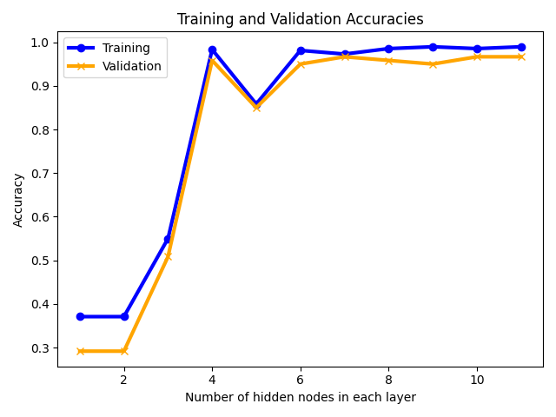
Question 5

Slide 27
Question 6
Go through the baseline example to get a feel of how the Convolutional Neural Network (CNN) can be used for handwritten digit image classification.

Slide 28
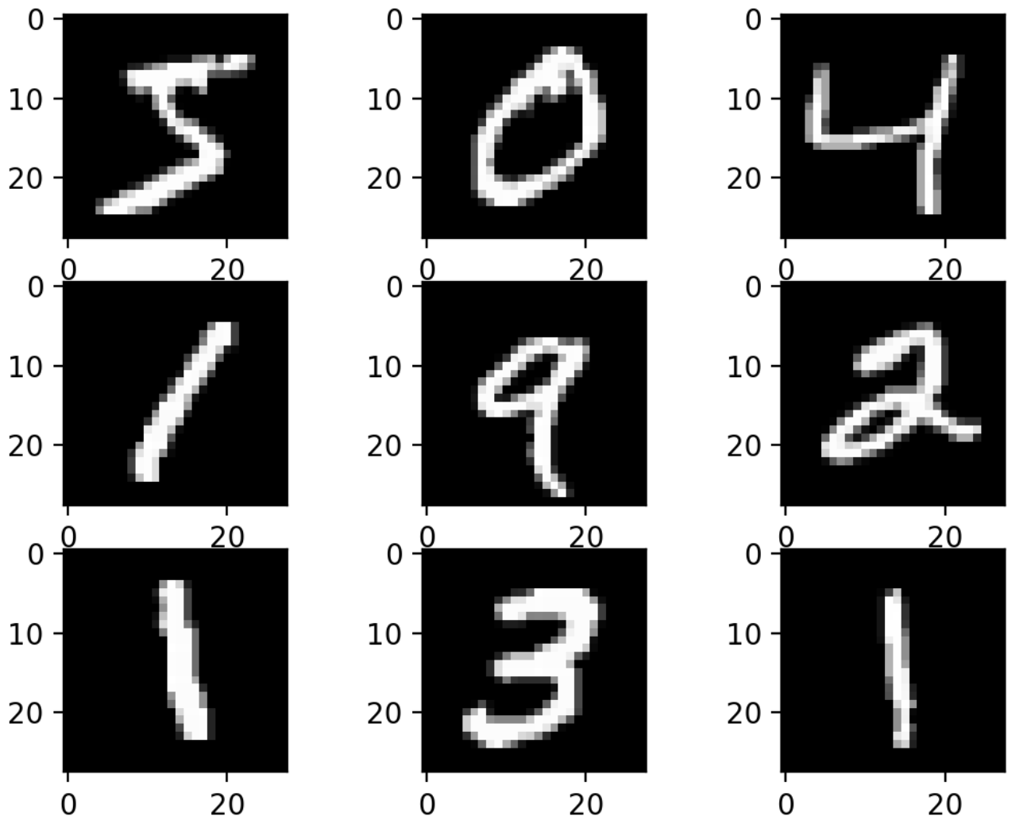
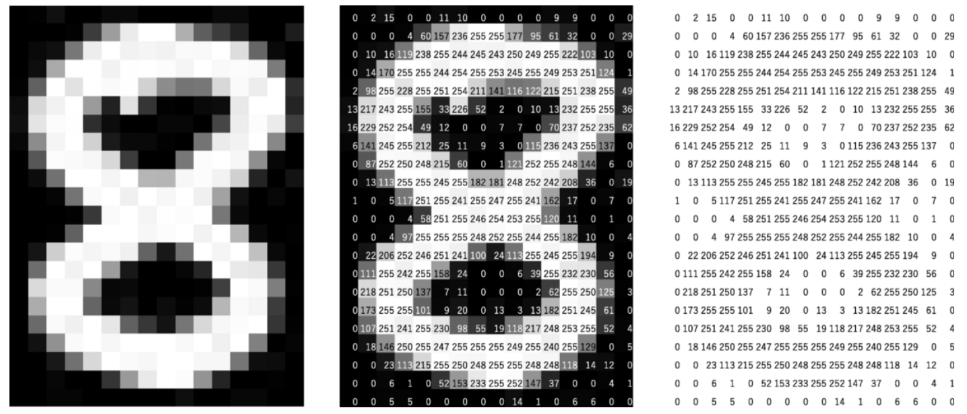
Question 6

Slide 29
Convolutional Neural Networks
Convolution:
Kernel
Applying multiple kernels to an input image produces multiple feature maps.
Feature Map
Figure from your lecture notes

Slide 30
Convolutional Neural Networks
Pooling
58 | 70
71 | 88
58 | 51 | 66 | 71
19 | 22 | 52 | 51
28 | 70 | 62 | 26
29 | 65 | 88 | 28
Max pooling
Avg pooling
40 | 60
48 | 51

Slide 31
Question 6
…
…
…
Input
Conv (32x3x3)
Max Pooling (2x2)
Flatten
Hidden (1x100)
Output (1x10)
def define_model():
model = Sequential()
model.add(Conv2D(32, (3, 3), activation='relu', kernel_initializer='he_uniform', input_shape=(28, 28, 1)))
model.add(MaxPooling2D((2, 2)))
model.add(Flatten())
model.add(Dense(100, activation='relu', kernel_initializer='he_uniform’))
model.add(Dense(10, activation='softmax’))
# compile model
opt = SGD(learning_rate=0.01, momentum=0.9)
model.compile(optimizer=opt, loss='categorical_crossentropy', metrics=['accuracy’])
return model

