Slide 1
EE2011 Tut 2
Thao Nguyen

Slide 2
Question 1
A Comma Separated Values (CSV) file is a plain text file that contains a list of data. These files are often used for exchanging data between different applications.
Download the file “government-expenditure-on-education.csv” from https://data.gov.sg/dataset/government-expenditure-on-education.
Plot the educational expenditure over the years.
(Hint: you might need “import pandas as pd” and “import matplotlib.pyplot as plt”.)

Slide 3
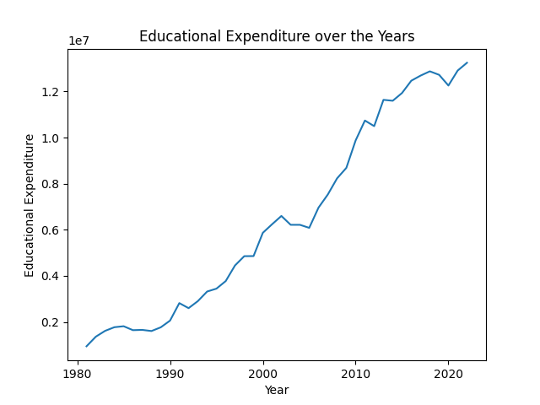
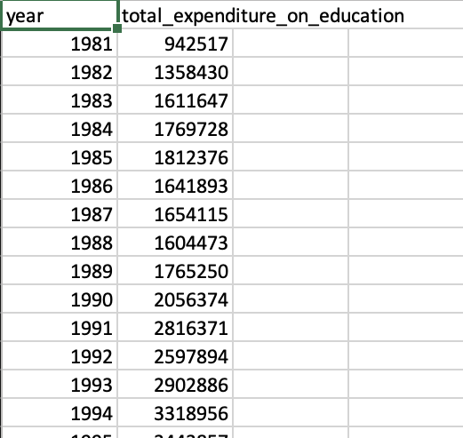
Question 1

Slide 4
Question 1
To read from CSV file:
df = pd.read_csv(<filename>)
To get ‘year’ column:
df[‘year’]
To plot:
plt.plot(x, y)
plt.show()
To set title and x, y labels:
plt.xlabel(<xlabel>)
plt.ylabel(<ylabel>)
plt.title(<title>)

Slide 5
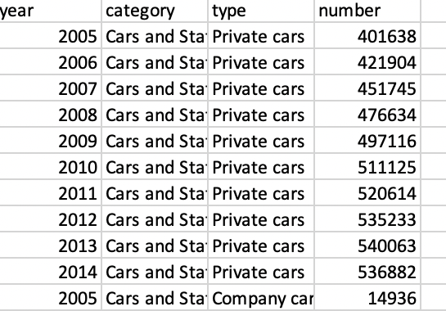
Question 2
Download the CSV file from https://data.gov.sg/dataset/annual-motor-vehicle-population-by-vehicle-type. Extract and plot the number of Omnibuses, Excursion buses and Private buses over the years as shown below.
To obtain type ‘Omnibusses’:
df1 = df[df['type']=='Private buses’]

Slide 6
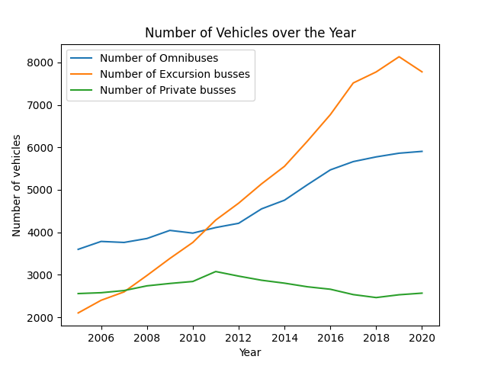
Question 2

Slide 7
Question 3
The “iris” flower data set consists of measurements such as the length, width of the petals, and the length, width of the sepals, all measured in centimeters, associated with each iris flower. Get the data set “from sklearn.datasets import load_iris” and do a scatter plot as shown below. (Hint: you might need “from pandas.plotting import scatter_matrix”)

Slide 8
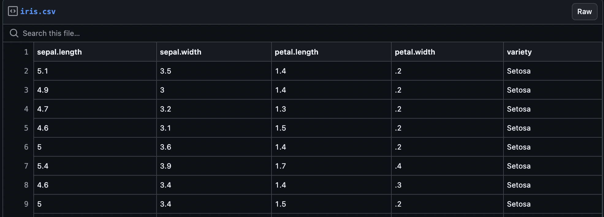
Question 3

Slide 9
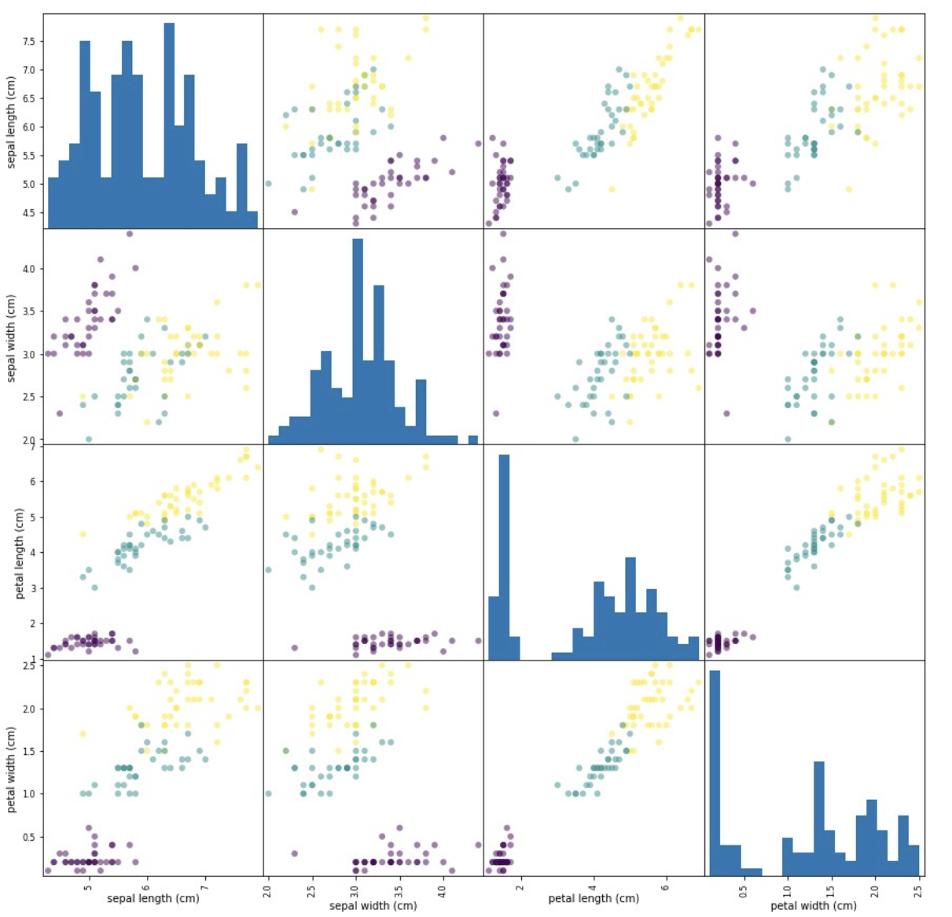
Question 3

Slide 10
Question 3:
Load the file:
from sklearn.datasets import load_iris
iris_dataset = load_iris()
Get training set, test set:
X_train, X_test, y_train, y_test = model_selection.train_test_split(iris_dataset['data'], iris_dataset['target'], random_state=0)
Build Pandas object:
df = pd.DataFrame(X_train, columns=iris_dataset.feature_names)
Plot scattered matrix:
pd.plotting.scatter_matrix(df, hist_kwds={'bins':20})
plt.show()

Slide 11
Question 4
You are given a set of data for supervised learning. A sample block of data looks like this:
“1.2234, 0.3302, 123.50, 0.0081, 30033.81, 1
1.3456, 0.3208, 113.24, 0.0067, 29283.18, -1 0.9988, 0.2326, 133.45, 0.0093, 36034.33, 1 1.1858, 0.4301, 128.55, 0.0077, 34037.35, 1 1.1533, 0.3853, 116.70, 0.0066, 22033.58, -13 1.2755, 0.3102, 118.30, 0.0098, 30183.65, 1 1.0045, 0.2901, 123.52, 0.0065, 31093.98, -1 1.1131, 0.3912, 113.15, 0.0088, 29033.23, -1 ”
Each row corresponds to a sample data measurement with 5 input features and 1 response.
(a) What kind of undesired effect can you anticipate if this set of raw data is used for learning?
(b) How can the data be pre-processed to handle this issue?

Slide 12
Question 4
You are given a set of data for supervised learning. A sample block of data looks like this:
“1.2234, 0.3302, 123.50, 0.0081, 30033.81, 1
1.3456, 0.3208, 113.24, 0.0067, 29283.18, -1 0.9988, 0.2326, 133.45, 0.0093, 36034.33, 1 1.1858, 0.4301, 128.55, 0.0077, 34037.35, 1 1.1533, 0.3853, 116.70, 0.0066, 22033.58, -1 1.2755, 0.3102, 118.30, 0.0098, 30183.65, 1 1.0045, 0.2901, 123.52, 0.0065, 31093.98, -1 1.1131, 0.3912, 113.15, 0.0088, 29033.23, -1 ”
Each row corresponds to a sample data measurement with 5 input features and 1 response.
(a) What kind of undesired effect can you anticipate if this set of raw data is used for learning?
Those features with very large values may overshadow those with very small values.
(b) How can the data be pre-processed to handle this issue?
Normalize data

Slide 13
Question 5
The Pima Indians Diabetes Dataset involves predicting the onset of diabetes within 5 years in Pima Indians given medical details. Download the Pima-Indians-Diabetes data from https://raw.githubusercontent.com/jbrownlee/Datasets/master/pima-indians-diabetes.data.csv.
(a) Print the summary statistics of this data set.
(b) Count the number of “0” entries in columns [1,2,3,4,5].
(c) Replace these “0” values by “NaN”.
(Hint: you might need the “.describe()” and “.replace(0, numpy.NaN)” functions “from pandas import read_csv”.)

Slide 14
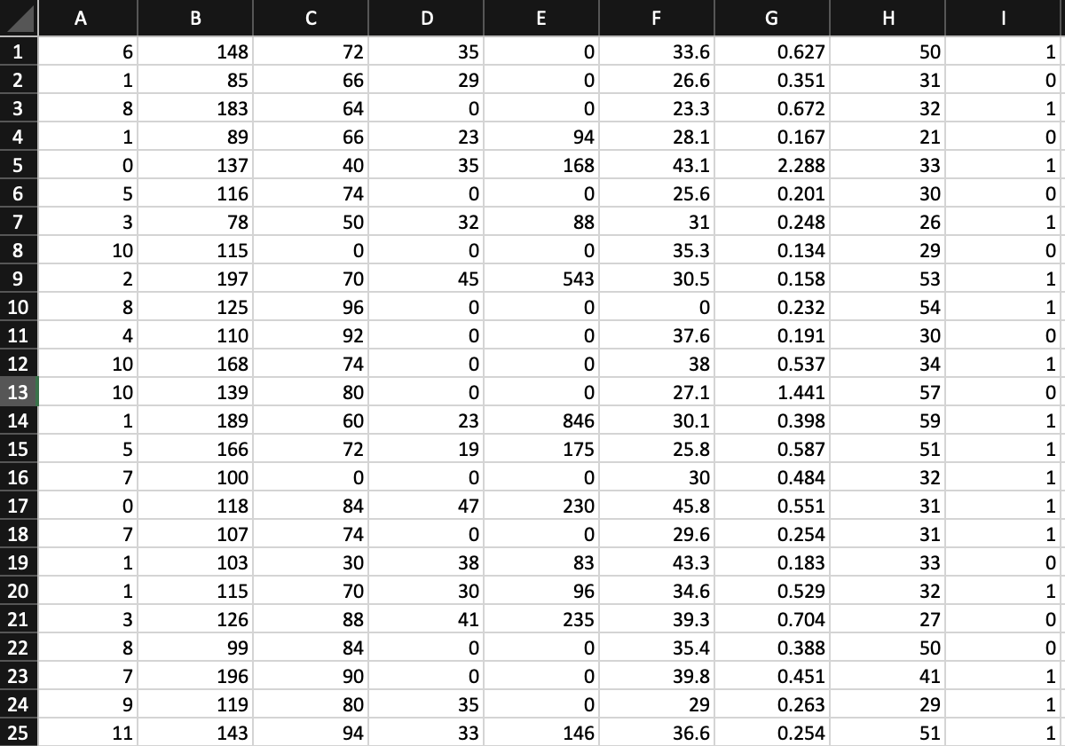
Question 5
768 observations (rows)
8 features (columns):
0. Number of times pregnant.
Plasma glucose concentration a 2 hours in an oral glucose tolerance test.
2. Diastolic blood pressure (mm Hg).
3. Triceps skinfold thickness (mm).
4. 2-Hour serum insulin (mu U/ml).
5. Body mass index (weight in kg/(height in m)^2).
6. Diabetes pedigree function.
7. Age (years).
8. Class variable (0 or 1).

Slide 15
Question 5
Print the summary statistics of this data set.
df.describe()
Count the number of “0” entries in columns [1,2,3,4,5].
entries = df[[1,2,3,4,5]] == 0 # find the entries
entries.sum() # count number of True’s in each column
Replace these “0” values by “NaN”.
replace(0, numpy.NaN)

Slide 16
Question 6
Disease Outbreak Response System Condition (DORSCON) in Singapore is a colour-coded framework that shows the current disease situation. The framework provides us with general guidelines on what needs to be done to prevent and reduce the impact of infections. There are 4 statuses – Green, Yellow, Orange and Red, depending on the severity and spread of the disease. Which type of data does DORSCON belong to ?
(1) Categorical; (2) Ordinal; (3) Continuous; (4) Interval

Slide 17
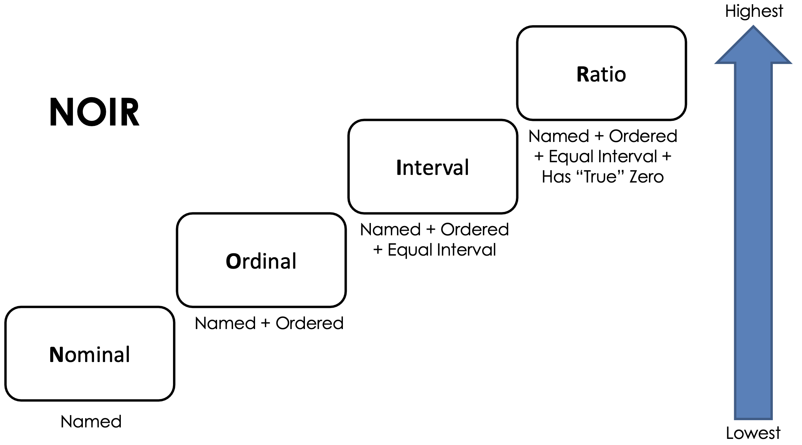
Question 6

Slide 18
Question 6
Disease Outbreak Response System Condition (DORSCON) in Singapore is a colour-coded framework that shows the current disease situation. The framework provides us with general guidelines on what needs to be done to prevent and reduce the impact of infections. There are 4 statuses – Green, Yellow, Orange and Red, depending on the severity and spread of the disease. Which type of data does DORSCON belong to ?
(1) Categorical; (2) Ordinal; (3) Continuous; (4) Interval

Slide 19
Question 6
Disease Outbreak Response System Condition (DORSCON) in Singapore is a colour-coded framework that shows the current disease situation. The framework provides us with general guidelines on what needs to be done to prevent and reduce the impact of infections. There are 4 statuses – Green, Yellow, Orange and Red, depending on the severity and spread of the disease. Which type of data does DORSCON belong to ?
(1) Categorical; (2) Ordinal; (3) Continuous; (4) Interval

Slide 20
Question 7
A boxplot is a standardized way of displaying the dataset based on a five-number summary: the minimum, the maximum, ________, and the first and third quartiles, where the number of data points that fall between the first and third quartiles amounts to ________ percent of the total number of data on display.

Slide 21
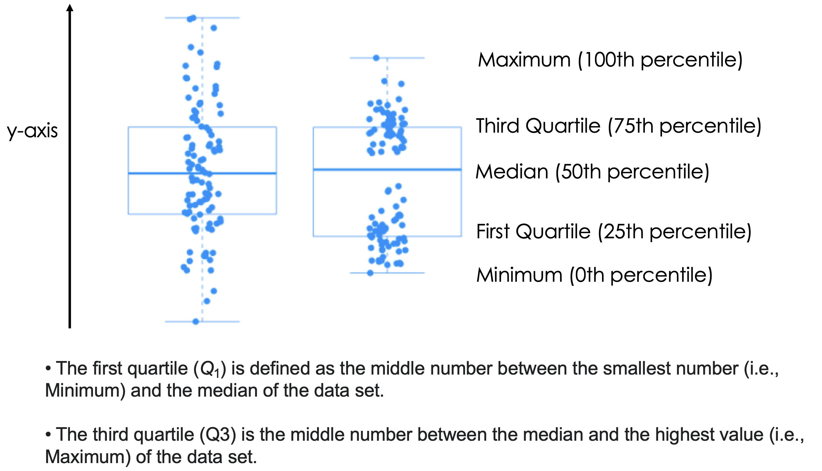
Question 7

Slide 22
Question 7
A boxplot is a standardized way of displaying the dataset based on a five-number summary: the minimum, the maximum, ________, and the first and third quartiles, where the number of data points that fall between the first and third quartiles amounts to ________ percent of the total number of data on display.

Slide 23
Question 7
A boxplot is a standardized way of displaying the dataset based on a five-number summary: the minimum, the maximum, MEDIAN , and the first and third quartiles, where the number of data points that fall between the first and third quartiles amounts to percent of the total number of data on display.

Slide 24
Question 7
A boxplot is a standardized way of displaying the dataset based on a five-number summary: the minimum, the maximum, MEDIAN , and the first and third quartiles, where the number of data points that fall between the first and third quartiles amounts to 50 percent of the total number of data on display.

