Slide 1
EE2211 Tutorial 3
Thao Nguyen

Slide 2
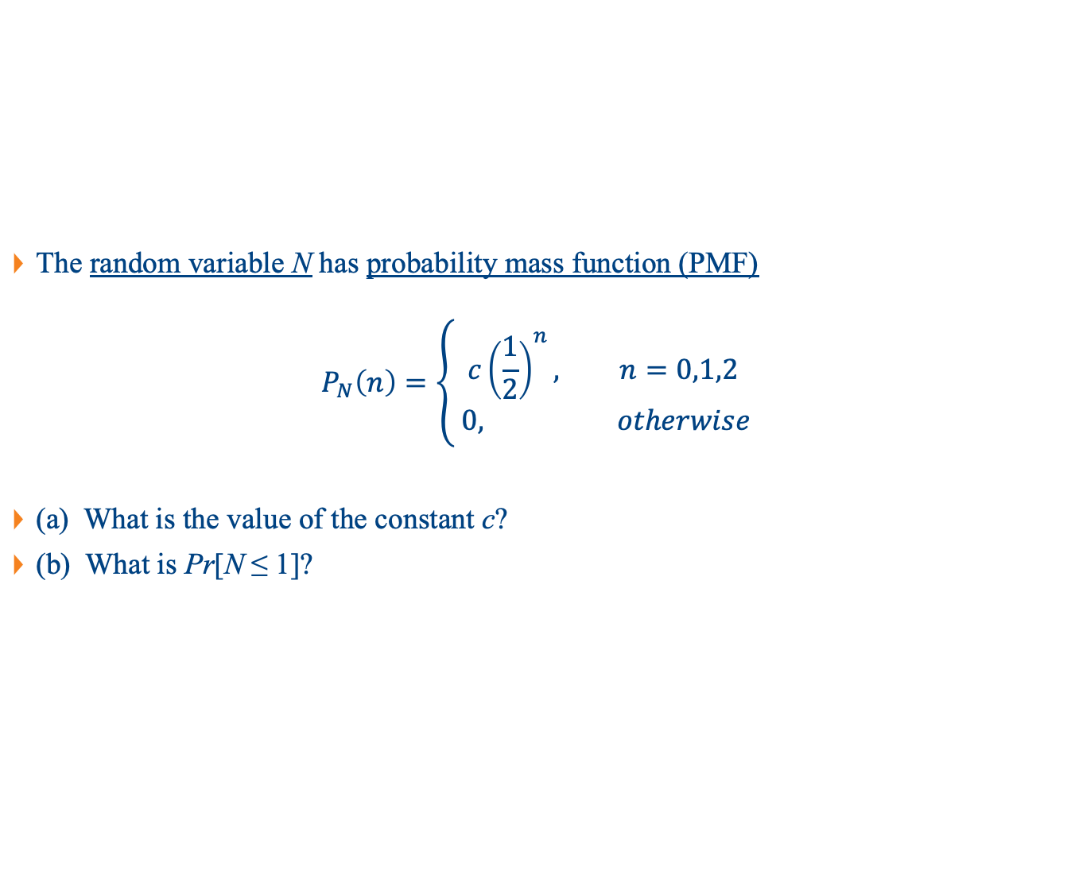
Question 1
The random variable N has probability mass function (PMF)
$$P_{N}\left(n\right)=\left\{\begin{aligned}c{\left(\frac{1}{2}\right)}^{n}, n=0,1,2 \\ & 0, otherwise\end{aligned}\right.$$
(a) What is the value of the constant c?
(b) What is Pr[N ≤ 1]?

Slide 3
Question 1
From your lecture notes:
A random variable is a variable whose possible values are numerical outcomes of a random event.
The probability distribution of a discrete random variable is described by a list of probabilities associated with each of its possible values.
This list of probabilities is called a probability mass function (pmf).
Like a histogram, except that here the probabilities sum to 1

Slide 4
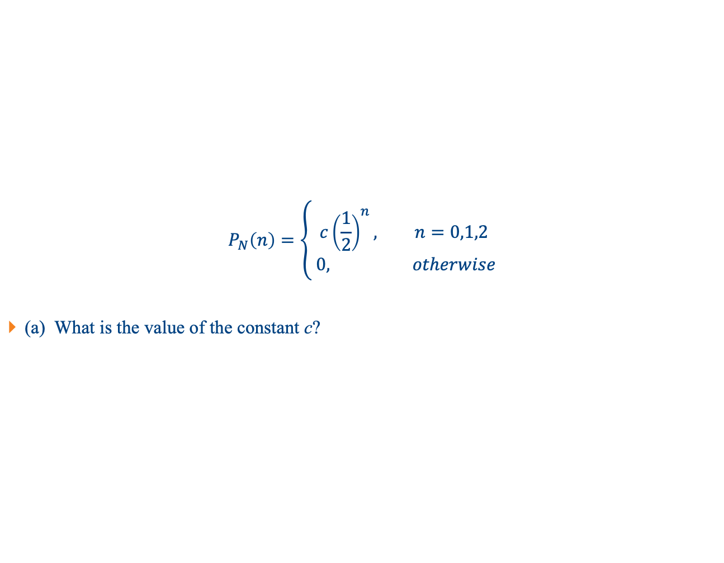
Question 1
$$P_{N}\left(n\right)=\left\{\begin{aligned}c{\left(\frac{1}{2}\right)}^{n}, n=0,1,2 \\ & 0, otherwise\end{aligned}\right.$$
(a) What is the value of the constant c?

Slide 5
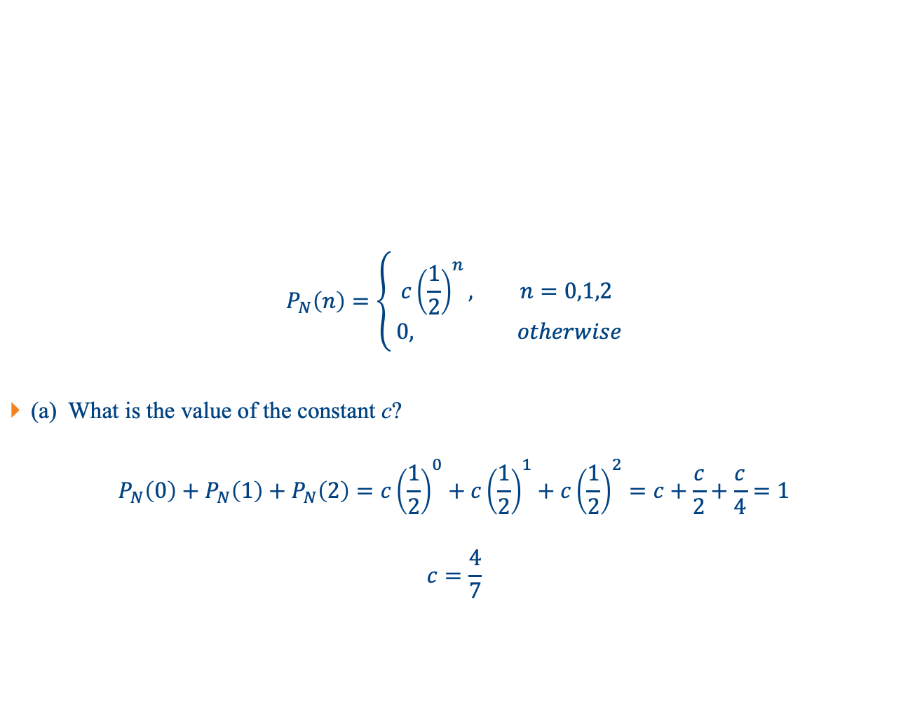
Question 1
$$P_{N}\left(n\right)=\left\{\begin{aligned}c{\left(\frac{1}{2}\right)}^{n}, n=0,1,2 \\ & 0, otherwise\end{aligned}\right.$$
(a) What is the value of the constant c?
$$P_{N}\left(0\right)+P_{N}\left(1\right)+P_{N}\left(2\right)=c{\left(\frac{1}{2}\right)}^{0}+c{\left(\frac{1}{2}\right)}^{1}+c{\left(\frac{1}{2}\right)}^{2}=c+\frac{c}{2}+\frac{c}{4}=1$$
$$c=\frac{4}{7}$$

Slide 6
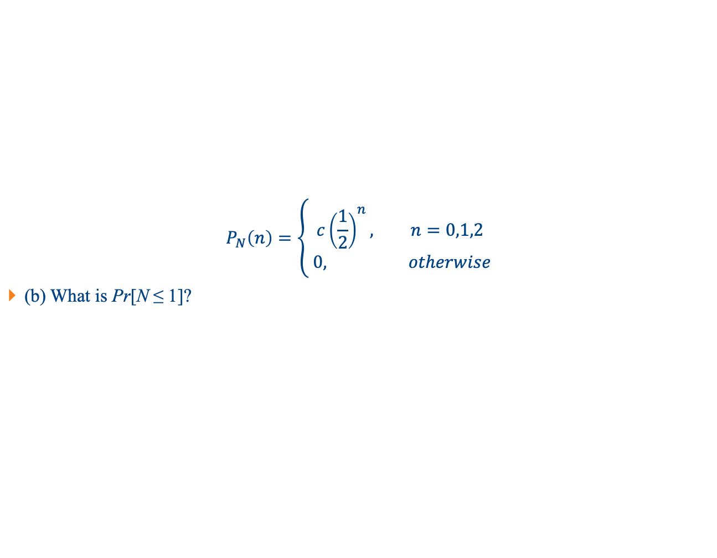
Question 1
$$P_{N}\left(n\right)=\left\{\begin{aligned}c{\left(\frac{1}{2}\right)}^{n}, n=0,1,2 \\ & 0, otherwise\end{aligned}\right.$$
(b) What is Pr[N ≤ 1]?

Slide 7
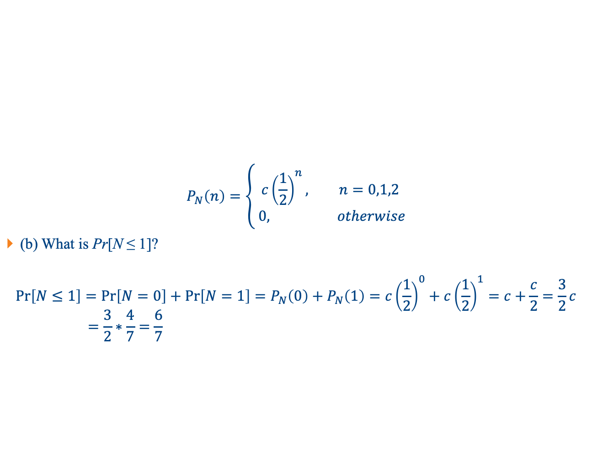
Question 1
$$P_{N}\left(n\right)=\left\{\begin{aligned}c{\left(\frac{1}{2}\right)}^{n}, n=0,1,2 \\ & 0, otherwise\end{aligned}\right.$$
(b) What is Pr[N ≤ 1]?
$$\operatorname{Pr}\left[N≤1\right]=\operatorname{Pr}\left[N=0\right]+\operatorname{Pr}\left[N=1\right]=P_{N}\left(0\right)+P_{N}\left(1\right)=c{\left(\frac{1}{2}\right)}^{0}+c{\left(\frac{1}{2}\right)}^{1}=c+\frac{c}{2}=\frac{3}{2}c$$
$$=\frac{3}{2}∗\frac{4}{7}=\frac{6}{7}$$

Slide 8
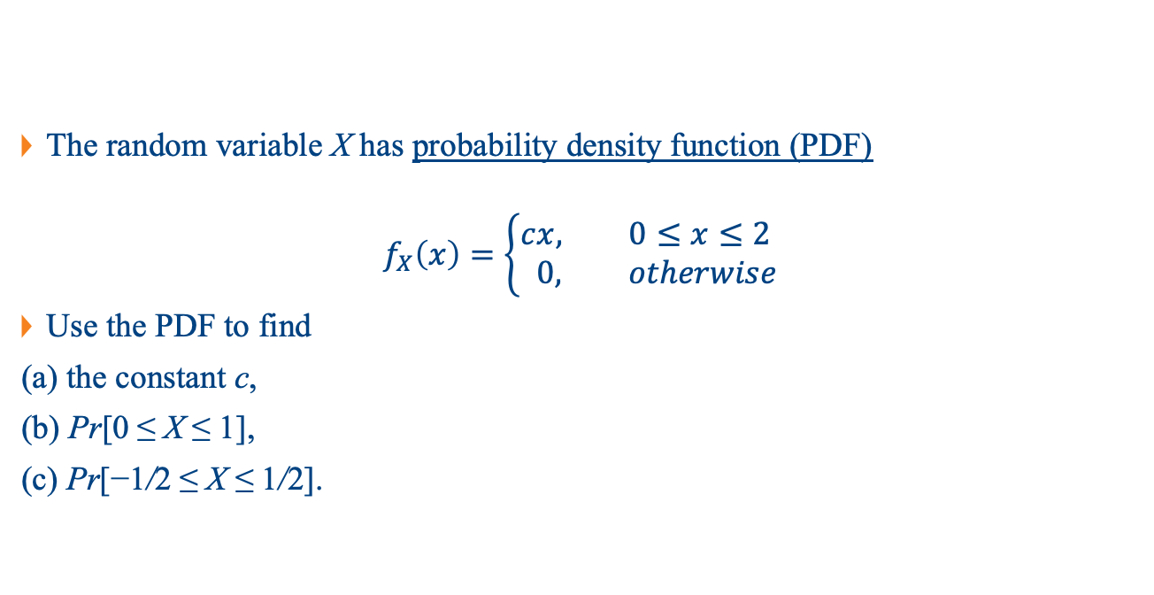
Question 2
The random variable X has probability density function (PDF)
$$f_{X}\left(x\right)=\left\{\begin{aligned}c&x, 0≤x≤2 \\ &0, otherwise\end{aligned}\right.$$
Use the PDF to find
(a) the constant c,
(b) Pr[0 ≤ X ≤ 1],
(c) Pr[−1/2 ≤ X ≤ 1/2].

Slide 9
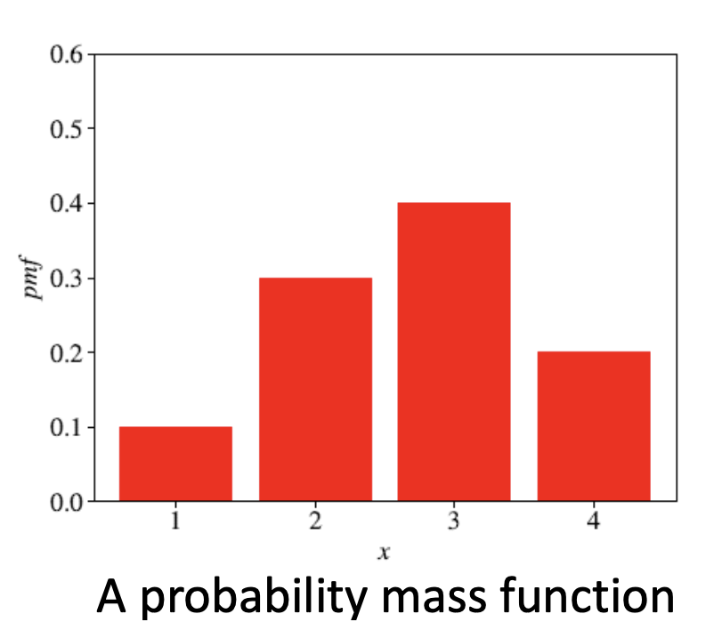
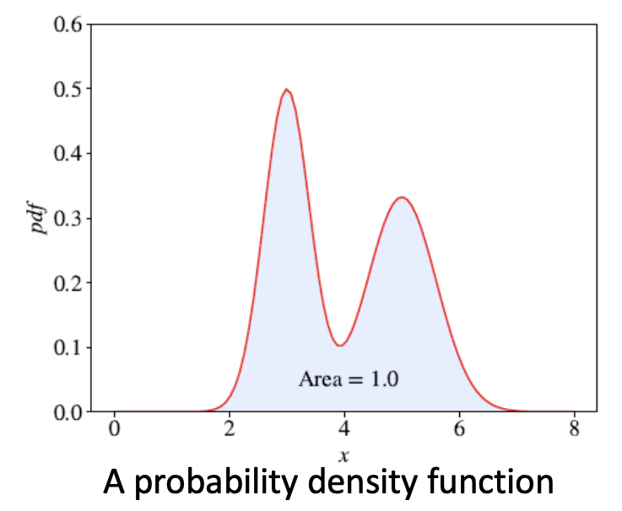
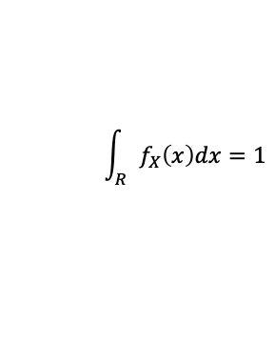
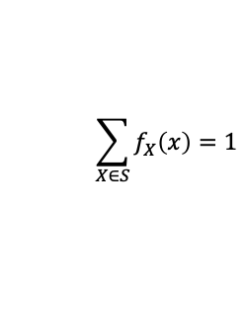
Question 2
$$\sum_{X∈S}{f_{X}\left(x\right)=1}$$
$$\int_{R}{f_{X}\left(x\right)dx=1}$$

Slide 10
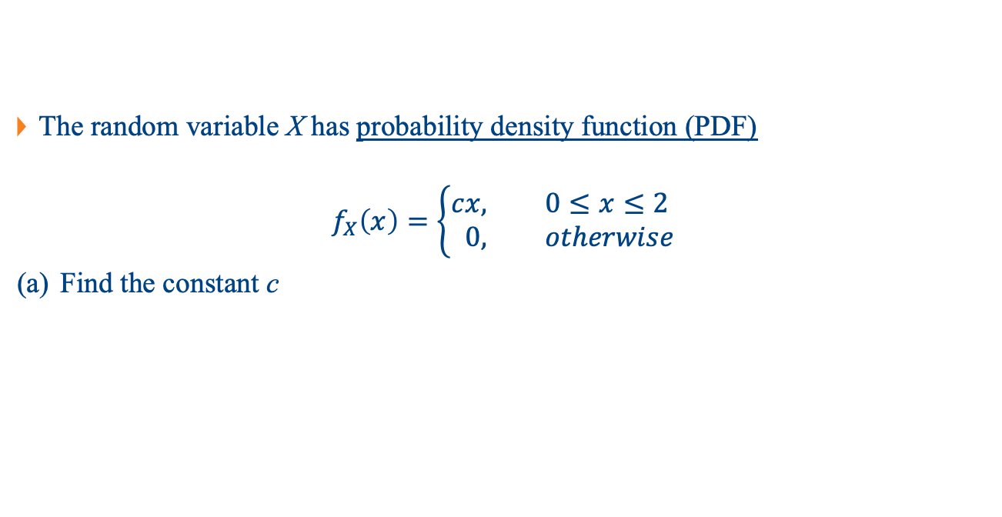
Question 2
The random variable X has probability density function (PDF)
$$f_{X}\left(x\right)=\left\{\begin{aligned}c&x, 0≤x≤2 \\ &0, otherwise\end{aligned}\right.$$
Find the constant c

Slide 11
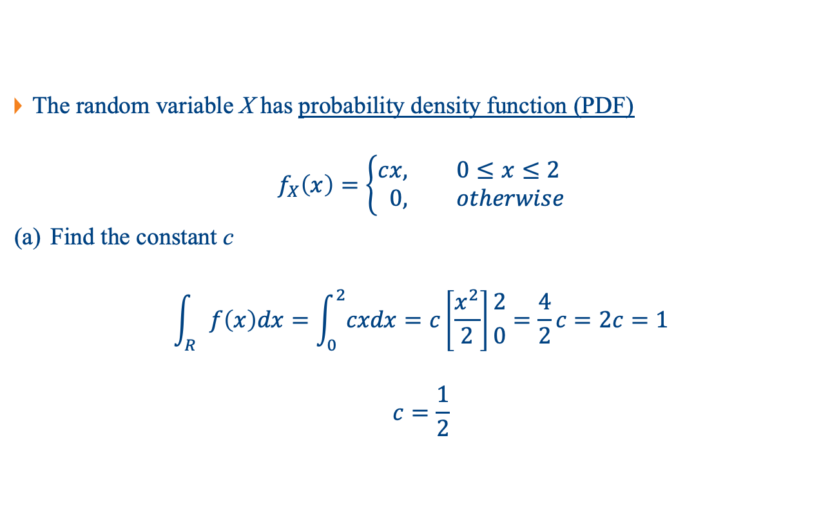
Question 2
The random variable X has probability density function (PDF)
$$f_{X}\left(x\right)=\left\{\begin{aligned}c&x, 0≤x≤2 \\ &0, otherwise\end{aligned}\right.$$
Find the constant c
$$\int_{R}{f\left(x\right)dx}=\int_{0}^{2}{cxdx}=c\left[\frac{x^{2}}{2}\right]{2 \atop 0}=\frac{4}{2}c=2c=1$$
$$c=\frac{1}{2}$$

Slide 12
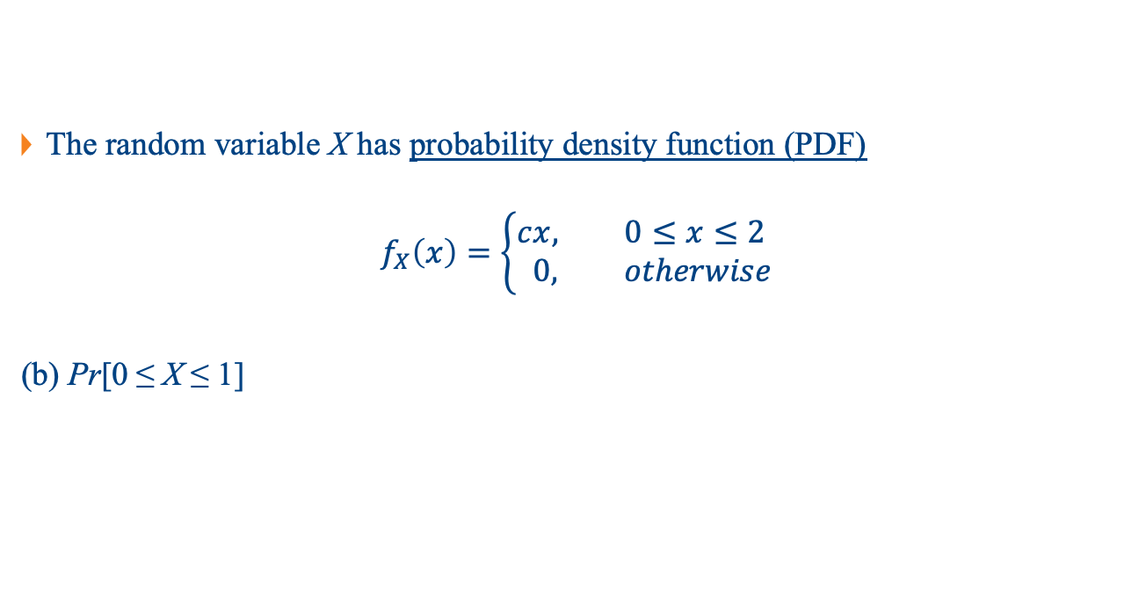
Question 2
The random variable X has probability density function (PDF)
$$f_{X}\left(x\right)=\left\{\begin{aligned}c&x, 0≤x≤2 \\ &0, otherwise\end{aligned}\right.$$
(b) Pr[0 ≤ X ≤ 1]

Slide 13
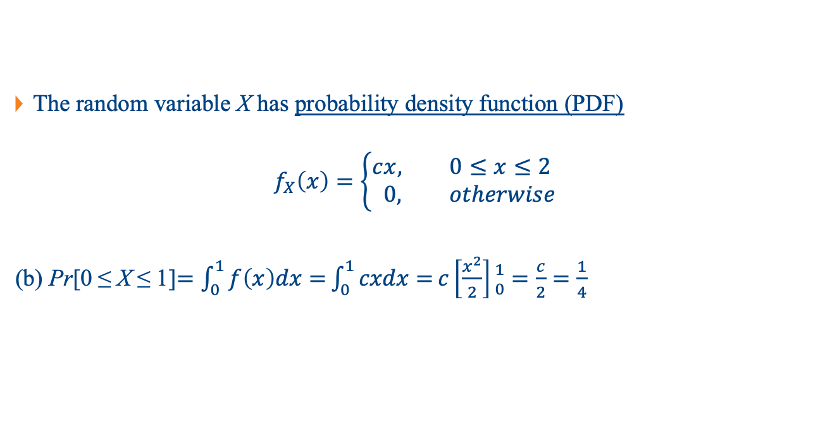
Question 2
The random variable X has probability density function (PDF)
$$f_{X}\left(x\right)=\left\{\begin{aligned}c&x, 0≤x≤2 \\ &0, otherwise\end{aligned}\right.$$
(b) Pr[0 ≤ X ≤ 1]$=\int_{0}^{1}{f\left(x\right)dx=}\int_{0}^{1}{cxdx=}c\left[\frac{x^{2}}{2}\right]{1 \atop 0}=\frac{c}{2}=\frac{1}{4}$

Slide 14
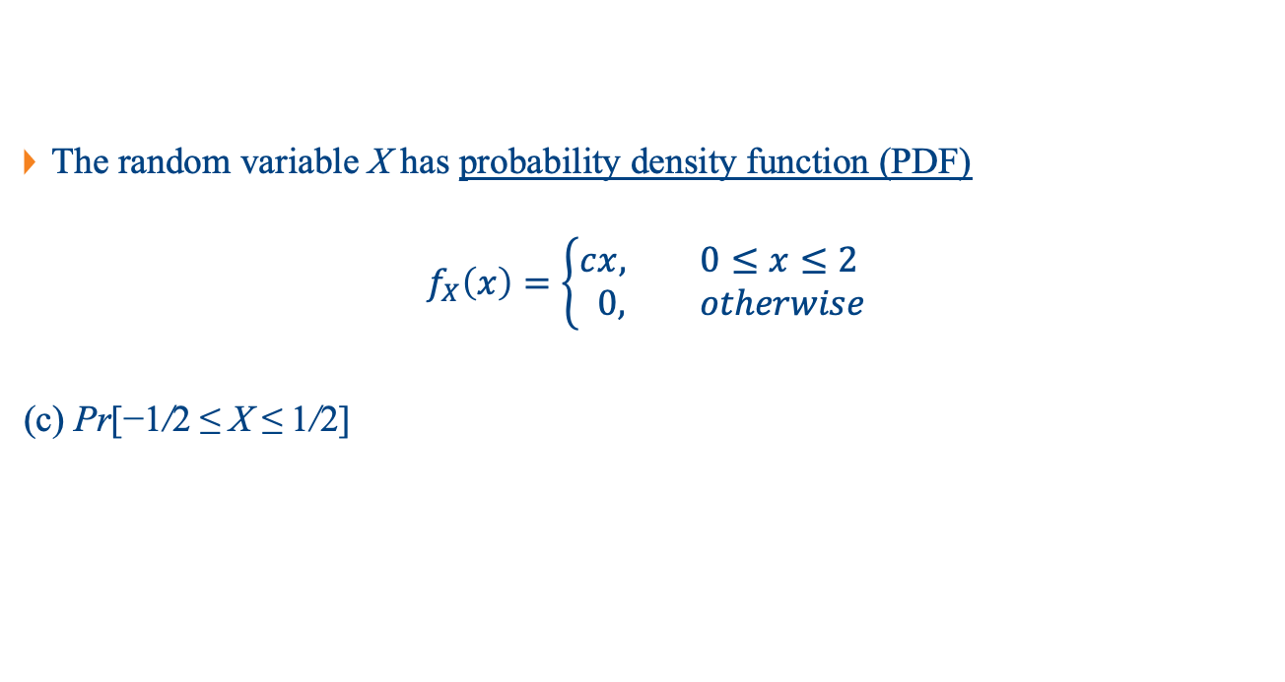
Question 2
The random variable X has probability density function (PDF)
$$f_{X}\left(x\right)=\left\{\begin{aligned}c&x, 0≤x≤2 \\ &0, otherwise\end{aligned}\right.$$
(c) Pr[−1/2 ≤ X ≤ 1/2]

Slide 15
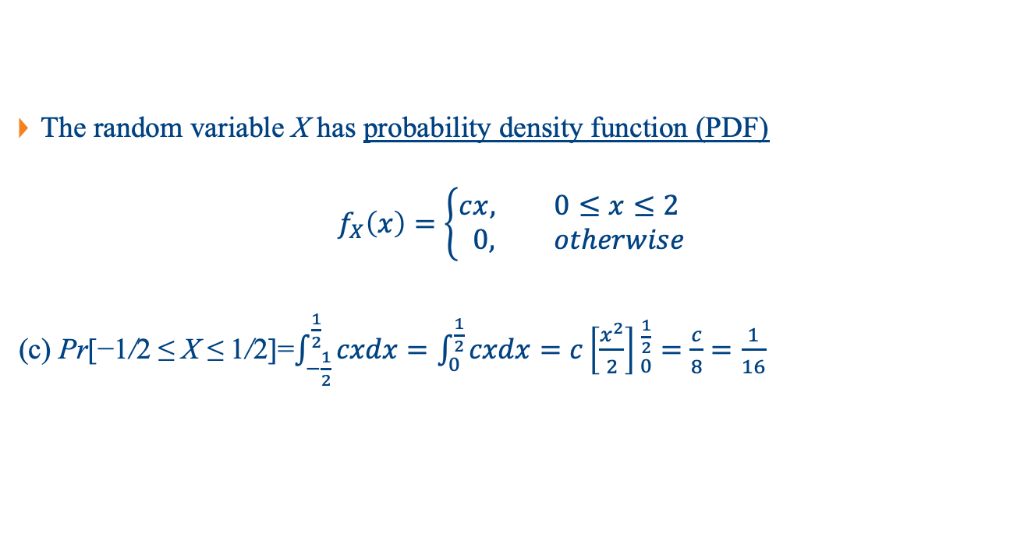
Question 2
The random variable X has probability density function (PDF)
$$f_{X}\left(x\right)=\left\{\begin{aligned}c&x, 0≤x≤2 \\ &0, otherwise\end{aligned}\right.$$
(c) Pr[−1/2 ≤ X ≤ 1/2]=$\int_{−\frac{1}{2}}^{\frac{1}{2}}{cxdx}=\int_{0}^{\frac{1}{2}}{cxdx}=$ $c\left[\frac{x^{2}}{2}\right]{\frac{1}{2} \atop 0}=\frac{c}{8}=\frac{1}{16}$

Slide 16
Question 3
Let A = {resistor is within 50Ω of the nominal value}. The probability that a resistor is from machine B is Pr[B] = 0.3. The probability that a resistor is acceptable, i.e., within 50 Ω of the nominal value, is Pr[A] = 0.78. Given that a resistor is from machine B, the conditional probability that it is acceptable is Pr[A|B] = 0.6. What is the probability that an acceptable resistor comes from machine B?

Slide 17
Question 3
Let A = {resistor is within 50Ω of the nominal value}. The probability that a resistor is from machine B is Pr[B] = 0.3. The probability that a resistor is acceptable, i.e., within 50 Ω of the nominal value, is Pr[A] = 0.78. Given that a resistor is from machine B, the conditional probability that it is acceptable is Pr[A|B] = 0.6. What is the probability that an acceptable resistor comes from machine B?
Random variables:
A: resistor is within acceptable range, Pr[A] = 0.78
B: resistor is from machine B, Pr[B] = 0.3
Pr[A|B]: probability that resistor is within acceptable range given it is from machine B, Pr[A|B] = 0.6
Pr[B|A]: probability that resistor is from machine B given it is in acceptable range, Pr[B|A] = ?

Slide 18

Question 3
Bayes’s Rule
$$\operatorname{Pr}\left[B | A\right]=\frac{\operatorname{Pr}\left[A | B\right]Pr⁡[B]}{Pr⁡[A]}$$
$$= \frac{0.6∗0.3}{0.78}=0.23$$
likelihood
prior
posterior
evidence

Slide 19
Question 4
Consider tossing a fair six-sided die. There are only six outcomes possible, Ω = {1, 2, 3, 4, 5, 6}. Suppose we toss two dice and assume that each throw is independent.
What is the probability that the sum of the dice equals seven?
(i) List out all pairs of possible outcomes together with their sums from the two throws.
(hint: enumerate all the items in range(1,7))
(ii) Collect all of the (a, b) pairs that sum to each of the possible values from two to twelve
(including the sum equals seven). (hint: use dictionary from collections import defaultdict to collect all of the (a, b) pairs that sum to each of the possible values from two to twelve).
(b) What is the probability that half the product of three dice will exceed their sum?

Slide 20
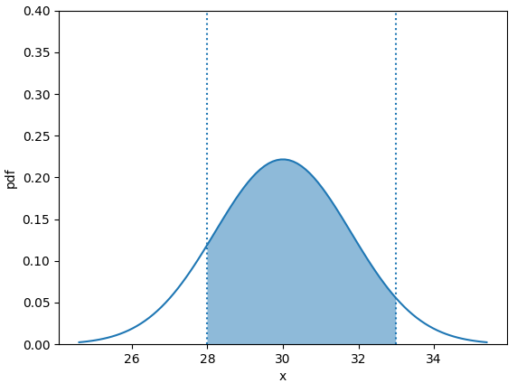

Question 5
Assuming a normal (Gaussian) distribution with mean 30 Ω and standard deviation of 1.8 Ω, determine the probability that a resistor coming off the production line will be within the range of 28 Ω to 33 Ω.
Hint: use stats.norm.cdf function from scipy import stats.
Pr[$28≤X≤33$]

Slide 21
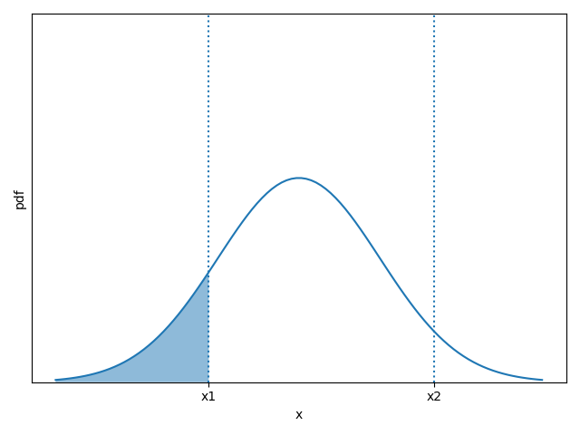
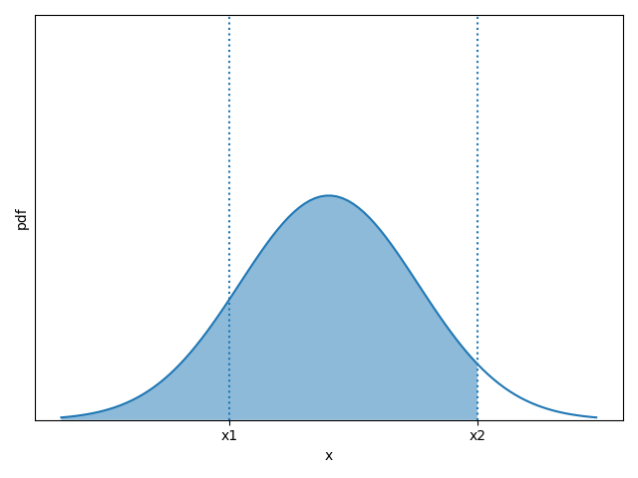


Question 5
stats.norm.cdf(x1,mean,std)
stats.norm.cdf(x2,mean,std)
Pr[$X≤x_{1}$]
Pr[$X≤x_{2}$]

Slide 22
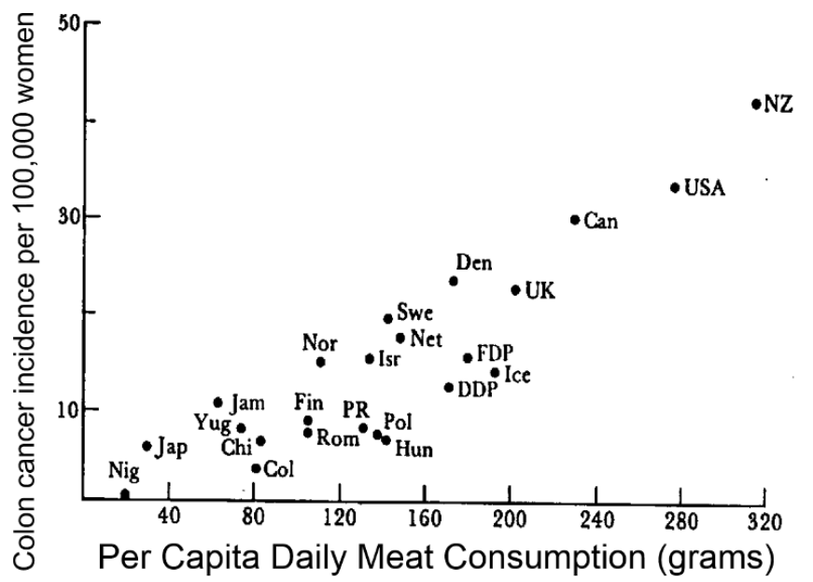
Question 6
(i) State what you think the evidence is trying to suggest. Is there correlation or not?

Slide 23
Question 6
(ii) Give a reason why you agree or disagree with what the evidence is suggesting.

Slide 24
Question 6
(iii) Identify whether the variable of the y-axis and the variable of the x-axis are correlated and/or causal?

Slide 25
Question 7
If A and B are correlated, but they’re actually caused by C, which of the following statements are correct?
A and C are correlated
B and C are correlated
A causes B to happen
A causes C to happen

Slide 26
Question 7
If A and B are correlated, but they’re actually caused by C, which of the following statements are correct?
A and C are correlated
B and C are correlated
A causes B to happen
A causes C to happen

Slide 27
Question 8
We toss a coin and observe which side is facing up. Which of the following statements represent valid probability assignments for observing head P[‘H’] and tail P[‘T’]?
P[‘H’] = 0.2, P[‘T’] = 0.9
P[‘H’] = 0.0, P[‘T’] = 1.0
P[‘H’] = -0.1, P[‘T’] = 1.1
P[‘H’] = P[‘T’]=0.5

Slide 28
Question 8
We toss a coin and observe which side is facing up. Which of the following statements represent valid probability assignments for observing head P[‘H’] and tail P[‘T’]?
P[‘H’] = 0.2, P[‘T’] = 0.9
P[‘H’] = 0.0, P[‘T’] = 1.0
P[‘H’] = -0.1, P[‘T’] = 1.1
P[‘H’] = P[‘T’]=0.5

Slide 29

Question 9
Are the two vectors $\left[\begin{matrix}1 \\ 2 \\ 3\end{matrix}\right]$ and $\left[\begin{matrix}4 \\ 5 \\ 6\end{matrix}\right]$linearly dependent?

Slide 30

Question 9
Are the two vectors $\left[\begin{matrix}1 \\ 2 \\ 3\end{matrix}\right]$ and $\left[\begin{matrix}4 \\ 5 \\ 6\end{matrix}\right]$linearly dependent?
False (because a is not a multiply of b.)

Slide 31

Question 10
The rank of the matrix $\left[\begin{matrix}1 & 3 \\ 2 & 4\end{matrix}\right]$ is _____.

Slide 32

Question 10
Row Echelon Form (REF):
Pivots move right in each row
Below pivots are zero
Zero rows are at the bottom
$$T=\left[\begin{matrix}a & ∗ & ∗ & ∗ & ∗ & ∗ \\ 0 & 0 & b & ∗ & ∗ & ∗ \\ 0 & 0 & 0 & c & ∗ & ∗ \\ 0 & 0 & 0 & 0 & d & ∗ \\ 0 & 0 & 0 & 0 & 0 & e \\ 0 & 0 & 0 & 0 & 0 & 0 \\ 0 & 0 & 0 & 0 & 0 & 0\end{matrix} \right]$$

Slide 33
Question 10
Row Echelon Form (REF):
Pivots move right in each row
Below pivots are zero
Zero rows are at the bottom
How to obtain?
Rescale a row
Add a multiplier of one row to another
Swap two rows
$$T=\left[\begin{matrix}a & ∗ & ∗ & ∗ & ∗ & ∗ \\ 0 & 0 & b & ∗ & ∗ & ∗ \\ 0 & 0 & 0 & c & ∗ & ∗ \\ 0 & 0 & 0 & 0 & d & ∗ \\ 0 & 0 & 0 & 0 & 0 & e \\ 0 & 0 & 0 & 0 & 0 & 0 \\ 0 & 0 & 0 & 0 & 0 & 0\end{matrix} \right]$$
Reference: https://www.youtube.com/watch?v=l69YjkuUym0

Slide 34

Question 10
How to obtain?
Rescale a row
Add a multiplier of one row to another
Swap two rows
$$T=\left[\begin{matrix}a & ∗ & ∗ & ∗ & ∗ & ∗ \\ 0 & 0 & b & ∗ & ∗ & ∗ \\ 0 & 0 & 0 & c & ∗ & ∗ \\ 0 & 0 & 0 & 0 & d & ∗ \\ 0 & 0 & 0 & 0 & 0 & e \\ 0 & 0 & 0 & 0 & 0 & 0 \\ 0 & 0 & 0 & 0 & 0 & 0\end{matrix} \right]$$
$$\left[\begin{matrix}1 & 3 \\ 2 & 4\end{matrix}\right]$$

Slide 35
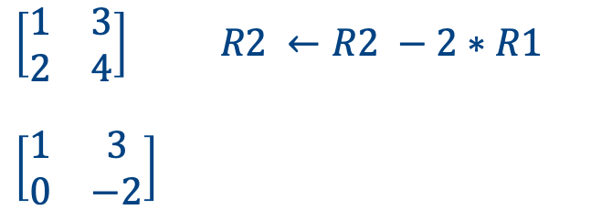
Question 10
How to obtain?
Rescale a row
Add a multiplier of one row to another
Swap two rows
$$T=\left[\begin{matrix}a & ∗ & ∗ & ∗ & ∗ & ∗ \\ 0 & 0 & b & ∗ & ∗ & ∗ \\ 0 & 0 & 0 & c & ∗ & ∗ \\ 0 & 0 & 0 & 0 & d & ∗ \\ 0 & 0 & 0 & 0 & 0 & e \\ 0 & 0 & 0 & 0 & 0 & 0 \\ 0 & 0 & 0 & 0 & 0 & 0\end{matrix} \right]$$
$\left[\begin{matrix}1 & 3 \\ 2 & 4\end{matrix}\right]$ $R2 ←R2 −2∗R1$
$$\left[\begin{matrix}1 & 3 \\ 0 & −2\end{matrix}\right]$$
Rank is number of non-zero rows

Slide 36

Question 10
The rank of the matrix $\left[\begin{matrix}1 & 3 \\ 2 & 4\end{matrix}\right]$ is 2 .

Slide 37

Question 11
The rank of the matrix $\left[\begin{matrix}1 & 2 & 3 \\ 4 & 5 & 6 \\ 7 & 8 & 9\end{matrix}\right]$ is _____.

Slide 38
Question 11
The rank of the matrix $\left[\begin{matrix}1 & 2 & 3 \\ 4 & 5 & 6 \\ 7 & 8 & 9\end{matrix}\right]$ is _____.
$$T=\left[\begin{matrix}a & ∗ & ∗ & ∗ & ∗ & ∗ \\ 0 & 0 & b & ∗ & ∗ & ∗ \\ 0 & 0 & 0 & c & ∗ & ∗ \\ 0 & 0 & 0 & 0 & d & ∗ \\ 0 & 0 & 0 & 0 & 0 & e \\ 0 & 0 & 0 & 0 & 0 & 0 \\ 0 & 0 & 0 & 0 & 0 & 0\end{matrix} \right]$$

Slide 39
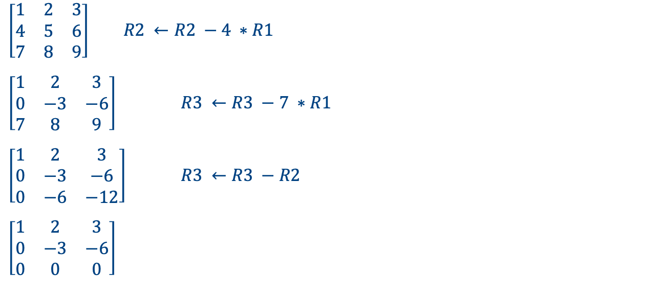
Question 11
$\left[\begin{matrix}1 & 2 & 3 \\ 4 & 5 & 6 \\ 7 & 8 & 9\end{matrix}\right]$ $R2 ←R2 −4 ∗R1$
$\left[\begin{matrix}1 & 2 & 3 \\ 0 & −3 & −6 \\ 7 & 8 & 9\end{matrix}\right]$ $R3 ←R3 −7 ∗R1$
$\left[\begin{matrix}1 & 2 & 3 \\ 0 & −3 & −6 \\ 0 & −6 & −12\end{matrix}\right]$ $R3 ←R3 −R2$
$\left[\begin{matrix}1 & 2 & 3 \\ 0 & −3 & −6 \\ 0 & 0 & 0\end{matrix}\right]$
$$T=\left[\begin{matrix}a & ∗ & ∗ & ∗ & ∗ & ∗ \\ 0 & 0 & b & ∗ & ∗ & ∗ \\ 0 & 0 & 0 & c & ∗ & ∗ \\ 0 & 0 & 0 & 0 & d & ∗ \\ 0 & 0 & 0 & 0 & 0 & e \\ 0 & 0 & 0 & 0 & 0 & 0 \\ 0 & 0 & 0 & 0 & 0 & 0\end{matrix} \right]$$
Number of non-zero rows: 2

Slide 40

Question 11
The rank of the matrix $\left[\begin{matrix}1 & 2 & 3 \\ 4 & 5 & 6 \\ 7 & 8 & 9\end{matrix}\right]$ is 2 .

Slide 41

More Examples
$\left[\begin{matrix}1 & 1 \\ 100 & 100\end{matrix}\right]$
$$T=\left[\begin{matrix}a & ∗ & ∗ & ∗ & ∗ & ∗ \\ 0 & 0 & b & ∗ & ∗ & ∗ \\ 0 & 0 & 0 & c & ∗ & ∗ \\ 0 & 0 & 0 & 0 & d & ∗ \\ 0 & 0 & 0 & 0 & 0 & e \\ 0 & 0 & 0 & 0 & 0 & 0 \\ 0 & 0 & 0 & 0 & 0 & 0\end{matrix} \right]$$

Slide 42

More Examples
$\left[\begin{matrix}1 & 1 \\ 100 & 100\end{matrix}\right]$ $R2 ←R2 −100 ∗R1$
$\left[\begin{matrix}1 & 1 \\ 0 & 0\end{matrix}\right]$
$$T=\left[\begin{matrix}a & ∗ & ∗ & ∗ & ∗ & ∗ \\ 0 & 0 & b & ∗ & ∗ & ∗ \\ 0 & 0 & 0 & c & ∗ & ∗ \\ 0 & 0 & 0 & 0 & d & ∗ \\ 0 & 0 & 0 & 0 & 0 & e \\ 0 & 0 & 0 & 0 & 0 & 0 \\ 0 & 0 & 0 & 0 & 0 & 0\end{matrix} \right]$$
Number of non-zero rows: 1

Slide 43
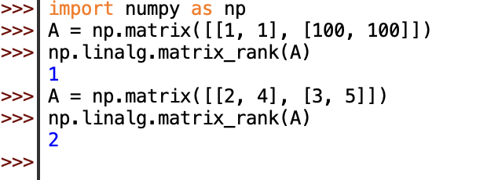
Question 11
In Python, can use matrix_rank() of numpy

