Slide 1
EE2211 Tutorial 4
Thao Nguyen

Slide 2

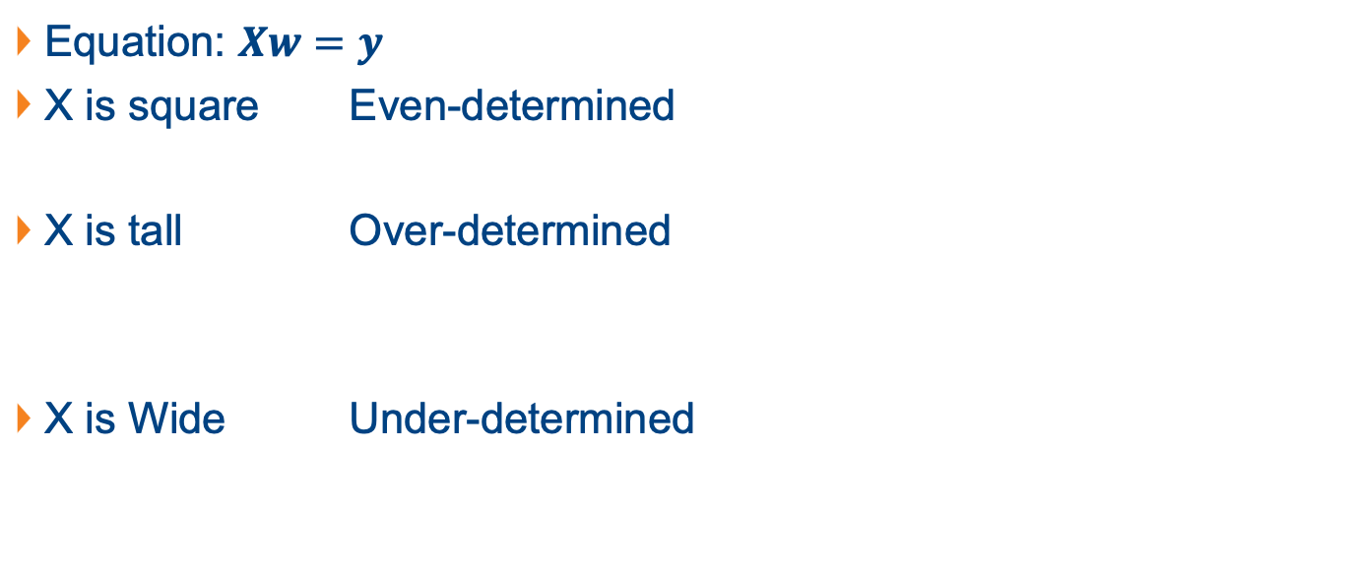
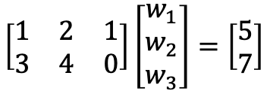
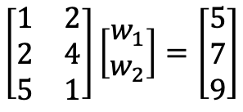
Revision: System of Linear Equations
Equation: $Xw=y$
X is square Even-determined
X is tall Over-determined
X is Wide Under-determined
$$\left[\begin{matrix}1 & 2 \\ 3 & 4\end{matrix}\right]\left[\begin{matrix}w_{1} \\ w_{2}\end{matrix}\right]=\left[\begin{matrix}5 \\ 7\end{matrix}\right]$$
$$\left[\begin{matrix}1 & 2 \\ 2 & 4 \\ 5 & 1\end{matrix}\right]\left[\begin{matrix}w_{1} \\ w_{2}\end{matrix}\right]=\left[\begin{matrix}5 \\ 7 \\ 9\end{matrix}\right]$$
$$\left[\begin{matrix}1 & 2 & 1 \\ 3 & 4 & 0\end{matrix}\right]\left[\begin{matrix}w_{1} \\ w_{2} \\ w_{3}\end{matrix}\right]=\left[\begin{matrix}5 \\ 7\end{matrix}\right]$$

Slide 3
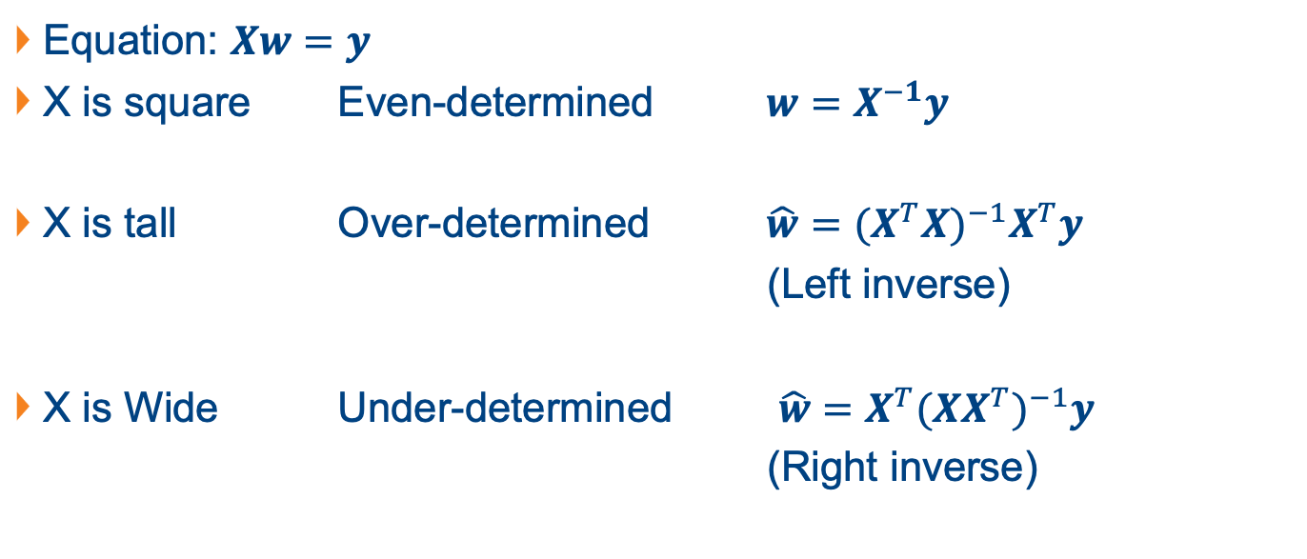
Revision: System of Linear Equations
Equation: $Xw=y$
X is square Even-determined $w=X^{−1}y$
X is tall Over-determined $\hat{w}={{(X}^{T}X)}^{−1}X^{T}y$
(Left inverse)
X is Wide Under-determined $\hat{w}=X^{T}{(XX^{T})}^{−1}y$
(Right inverse)

Slide 4
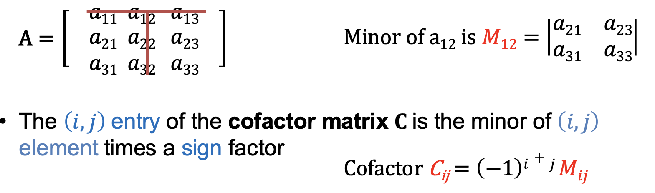

Revision: Inverse of Matrix
$A^{−1}=\frac{1}{det⁡(A)}$ $adj(A)$
$adj(A)$: adjoint of A, $adj\left(A\right)=C^{T}$
$C$: co-factor matrix

Slide 5
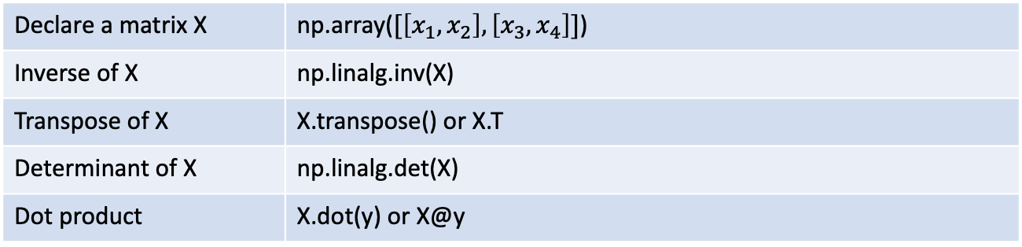
Python Functions
Declare a matrix X | np.array($[\left[x_{1}, x_{2}\right], \left[x_{3}, x_{4}\right]]$)
Inverse of X | np.linalg.inv(X)
Transpose of X | X.transpose() or X.T
Determinant of X | np.linalg.det(X)
Dot product | X.dot(y) or X@y

Slide 6
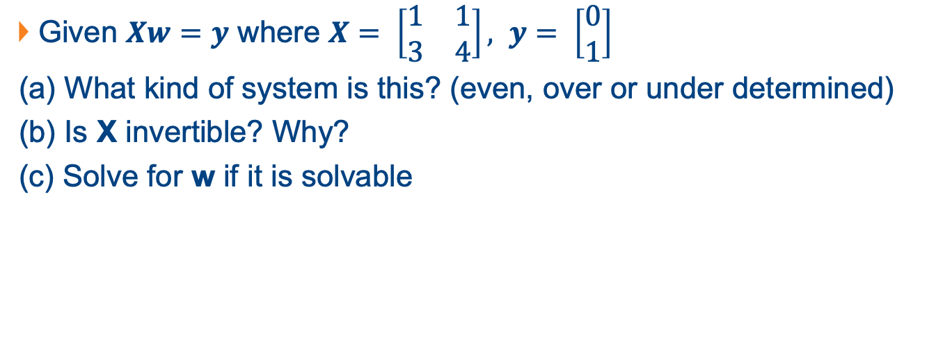
Question 1
Given $Xw=y$ where $X= \left[\begin{matrix}1 & 1 \\ 3 & 4\end{matrix}\right], y= \left[\begin{matrix}0 \\ 1\end{matrix}\right]$
(a) What kind of system is this? (even, over or under determined)
(b) Is X invertible? Why?
(c) Solve for w if it is solvable

Slide 7
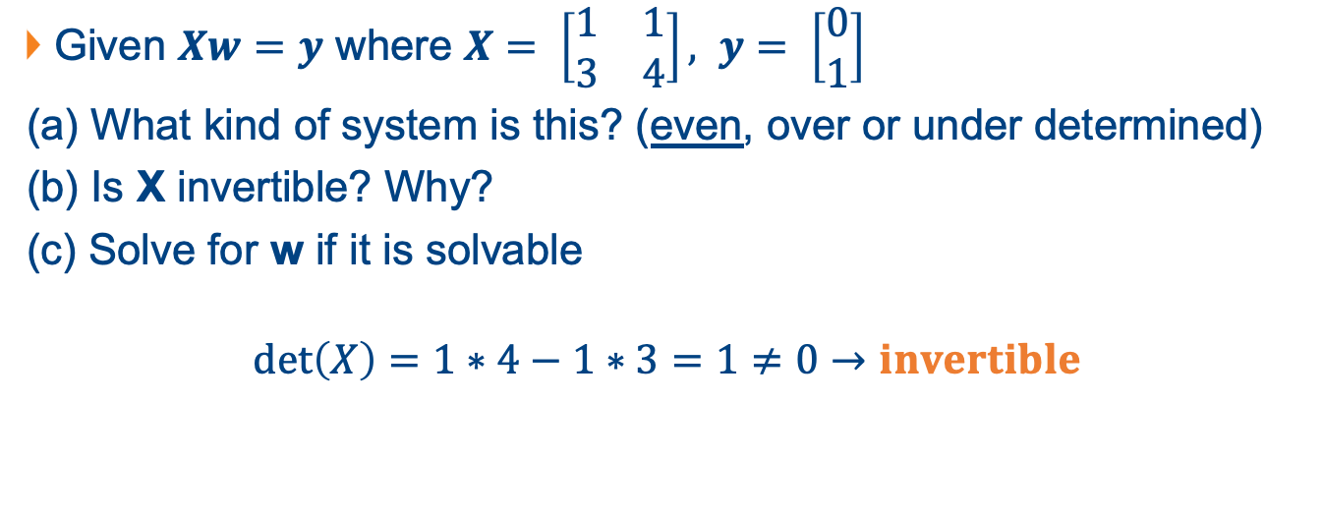
Question 1
Given $Xw=y$ where $X= \left[\begin{matrix}1 & 1 \\ 3 & 4\end{matrix}\right], y= \left[\begin{matrix}0 \\ 1\end{matrix}\right]$
(a) What kind of system is this? (even, over or under determined)
(b) Is X invertible? Why?
(c) Solve for w if it is solvable
$$\det\left(X\right)=1∗4−1∗3=1≠0→invertible$$

Slide 8
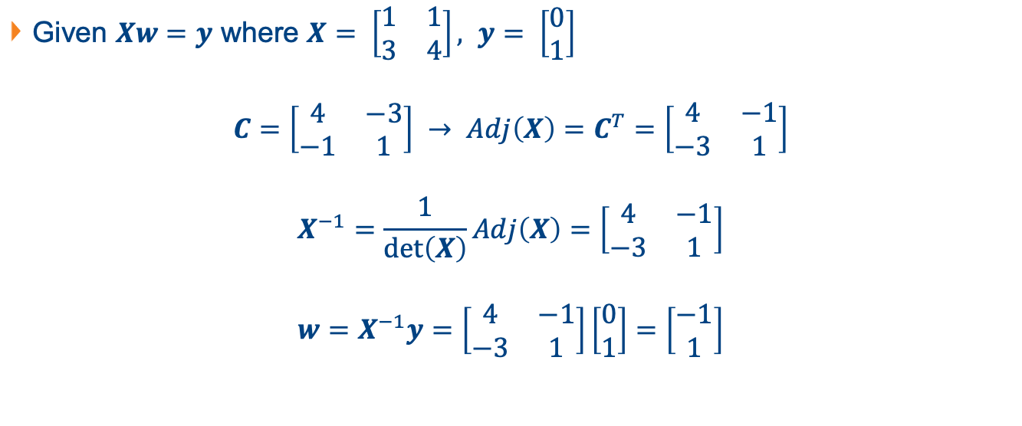
Question 1
Given $Xw=y$ where $X= \left[\begin{matrix}1 & 1 \\ 3 & 4\end{matrix}\right], y= \left[\begin{matrix}0 \\ 1\end{matrix}\right]$
$$C=\left[\begin{matrix}4 & −3 \\ −1 & 1\end{matrix}\right] → Adj\left(X\right)=C^{T}=\left[\begin{matrix}4 & −1 \\ −3 & 1\end{matrix}\right]$$
$$X^{−1}=\frac{1}{\det\left(X\right)}Adj\left(X\right)=\left[\begin{matrix}4 & −1 \\ −3 & 1\end{matrix}\right]$$
$$w=X^{−1}y=\left[\begin{matrix}4 & −1 \\ −3 & 1\end{matrix}\right]\left[\begin{matrix}0 \\ 1\end{matrix}\right]=\left[\begin{matrix}−1 \\ 1\end{matrix}\right]$$

Slide 9
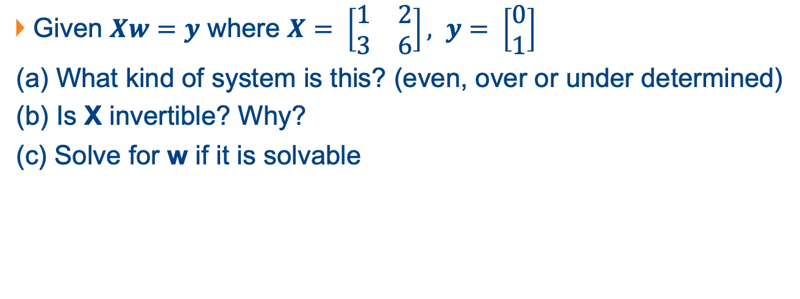
Question 2
Given $Xw=y$ where $X= \left[\begin{matrix}1 & 2 \\ 3 & 6\end{matrix}\right], y= \left[\begin{matrix}0 \\ 1\end{matrix}\right]$
(a) What kind of system is this? (even, over or under determined)
(b) Is X invertible? Why?
(c) Solve for w if it is solvable

Slide 10
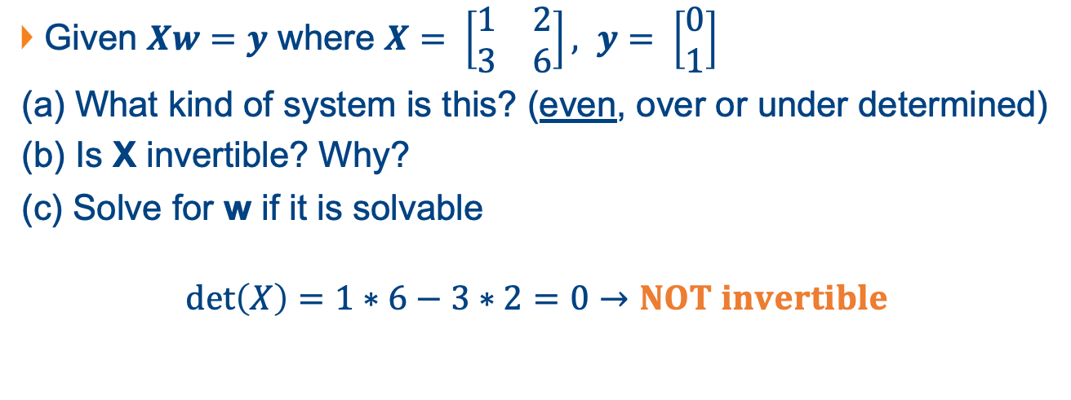
Question 2
Given $Xw=y$ where $X= \left[\begin{matrix}1 & 2 \\ 3 & 6\end{matrix}\right], y= \left[\begin{matrix}0 \\ 1\end{matrix}\right]$
(a) What kind of system is this? (even, over or under determined)
(b) Is X invertible? Why?
(c) Solve for w if it is solvable
$$\det\left(X\right)=1∗6−3∗2=0→NOT invertible$$

Slide 11
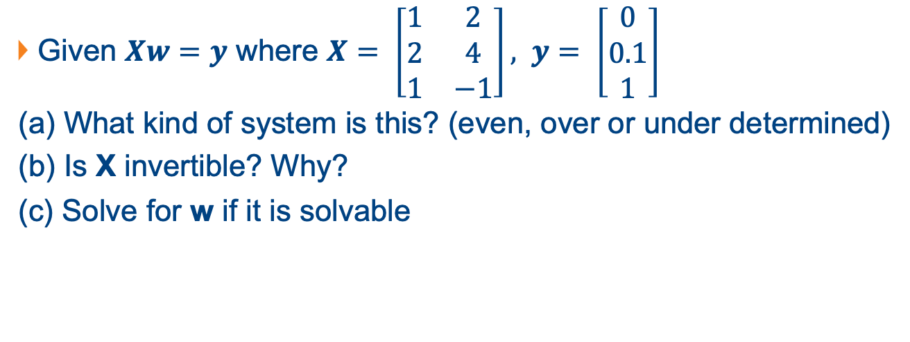
Question 3
Given $Xw=y$ where $X= \left[\begin{matrix}1 & 2 \\ 2 & 4 \\ 1 & −1\end{matrix}\right], y= \left[\begin{matrix}0 \\ 0.1 \\ 1\end{matrix}\right]$
(a) What kind of system is this? (even, over or under determined)
(b) Is X invertible? Why?
(c) Solve for w if it is solvable

Slide 12
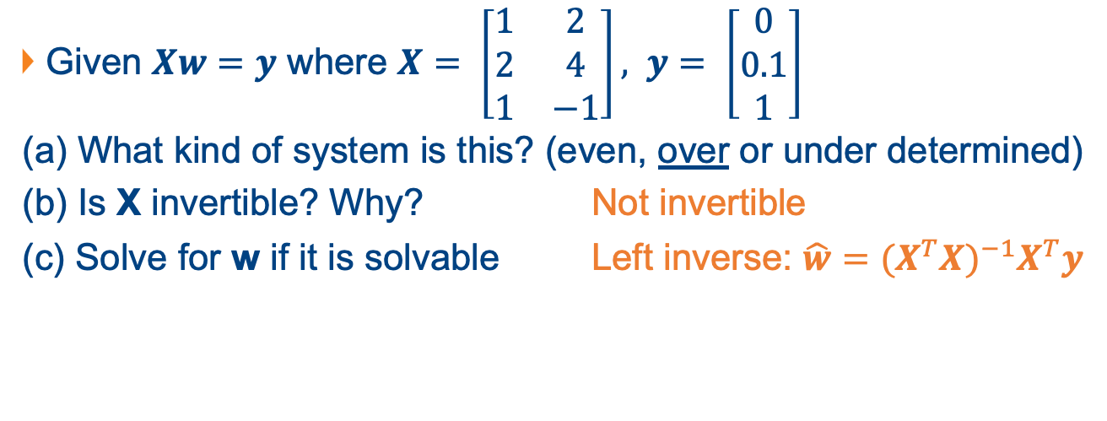
Question 3
Given $Xw=y$ where $X= \left[\begin{matrix}1 & 2 \\ 2 & 4 \\ 1 & −1\end{matrix}\right], y= \left[\begin{matrix}0 \\ 0.1 \\ 1\end{matrix}\right]$
(a) What kind of system is this? (even, over or under determined)
(b) Is X invertible? Why? Not invertible
(c) Solve for w if it is solvable Left inverse: $\hat{w}={{(X}^{T}X)}^{−1}X^{T}y$

Slide 13
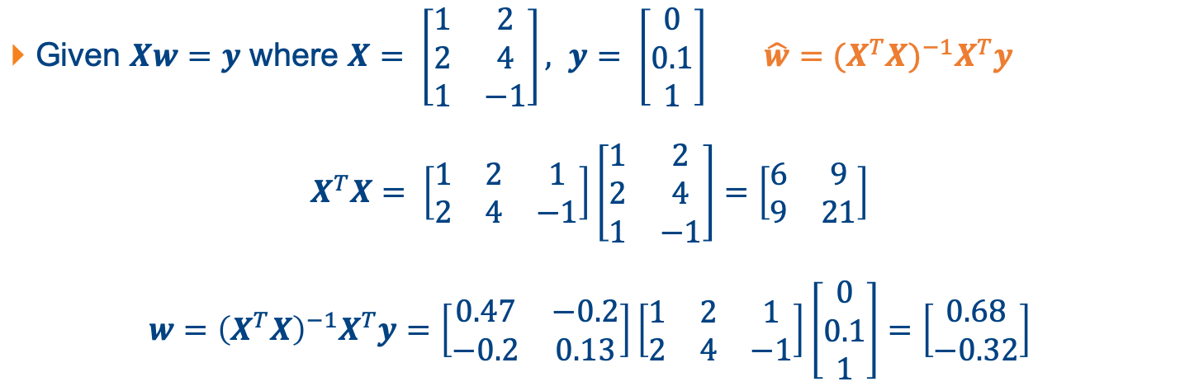
Question 3
Given $Xw=y$ where $X= \left[\begin{matrix}1 & 2 \\ 2 & 4 \\ 1 & −1\end{matrix}\right], y= \left[\begin{matrix}0 \\ 0.1 \\ 1\end{matrix}\right]$ $\hat{w}={{(X}^{T}X)}^{−1}X^{T}y$
$$X^{T}X= \left[\begin{matrix}1 & 2 & 1 \\ 2 & 4 & −1\end{matrix}\right]\left[\begin{matrix}1 & 2 \\ 2 & 4 \\ 1 & −1\end{matrix}\right]=\left[\begin{matrix}6 & 9 \\ 9 & 21\end{matrix}\right]$$
$$w={\left(X^{T}X\right)}^{−1}X^{T}y=\left[\begin{matrix}0.47 & −0.2 \\ −0.2 & 0.13\end{matrix}\right]\left[\begin{matrix}1 & 2 & 1 \\ 2 & 4 & −1\end{matrix}\right]\left[\begin{matrix}0 \\ 0.1 \\ 1\end{matrix}\right]=\left[\begin{matrix}0.68 \\ −0.32\end{matrix}\right]$$

Slide 14
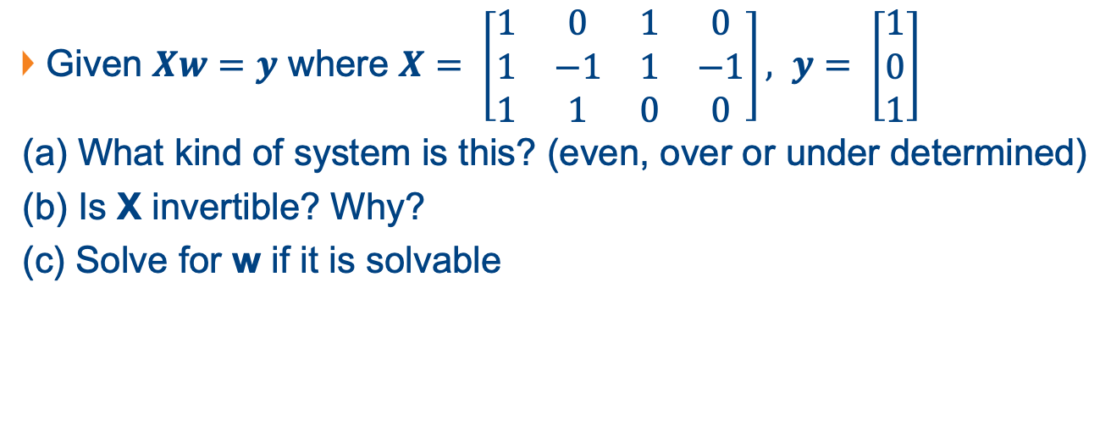
Question 4
Given $Xw=y$ where $X= \left[\begin{matrix}1 & 0 & 1 & 0 \\ 1 & −1 & 1 & −1 \\ 1 & 1 & 0 & 0\end{matrix}\right], y= \left[\begin{matrix}1 \\ 0 \\ 1\end{matrix}\right]$
(a) What kind of system is this? (even, over or under determined)
(b) Is X invertible? Why?
(c) Solve for w if it is solvable

Slide 15
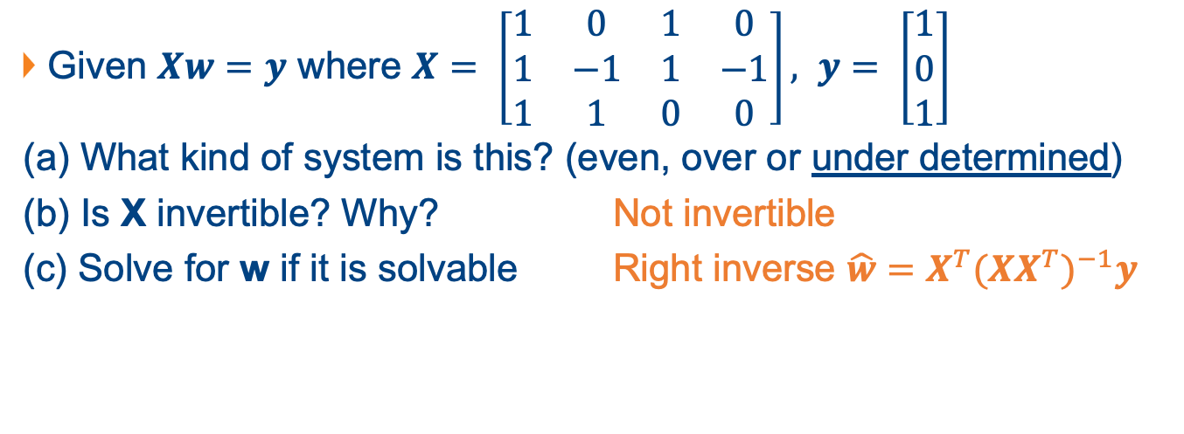
Question 4
Given $Xw=y$ where $X= \left[\begin{matrix}1 & 0 & 1 & 0 \\ 1 & −1 & 1 & −1 \\ 1 & 1 & 0 & 0\end{matrix}\right], y= \left[\begin{matrix}1 \\ 0 \\ 1\end{matrix}\right]$
(a) What kind of system is this? (even, over or under determined)
(b) Is X invertible? Why? Not invertible
(c) Solve for w if it is solvable Right inverse $\hat{w}=X^{T}{(XX^{T})}^{−1}y$

Slide 16
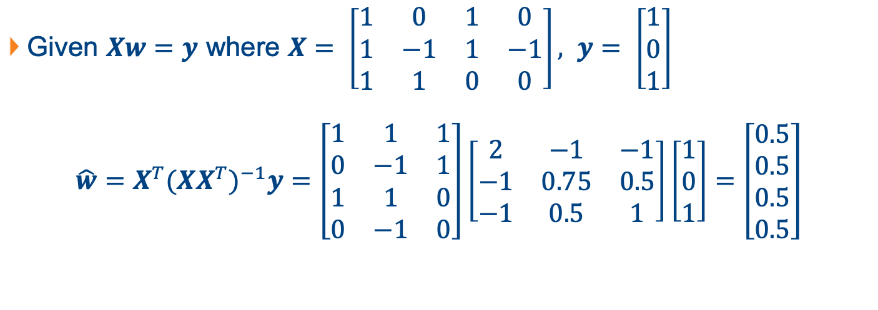
Question 4
Given $Xw=y$ where $X= \left[\begin{matrix}1 & 0 & 1 & 0 \\ 1 & −1 & 1 & −1 \\ 1 & 1 & 0 & 0\end{matrix}\right], y= \left[\begin{matrix}1 \\ 0 \\ 1\end{matrix}\right]$
$$\hat{w}=X^{T}{(XX^{T})}^{−1}y=\left[\begin{matrix}1 & 1 & 1 \\ 0 & −1 & 1 \\ 1 & 1 & 0 \\ 0 & −1 & 0\end{matrix}\right]\left[\begin{matrix}2 & −1 & −1 \\ −1 & 0.75 & 0.5 \\ −1 & 0.5 & 1\end{matrix}\right]\left[\begin{matrix}1 \\ 0 \\ 1\end{matrix}\right]=\left[\begin{matrix}0.5 \\ 0.5 \\ 0.5 \\ 0.5\end{matrix}\right]$$

Slide 17
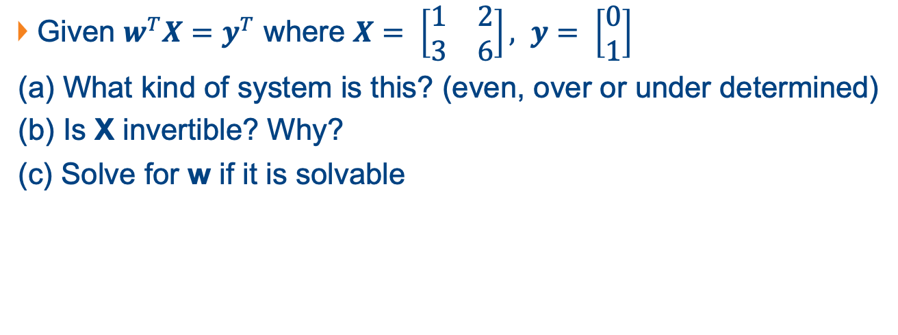
Question 5
Given $w^{T}X=y^{T}$ where $X= \left[\begin{matrix}1 & 2 \\ 3 & 6\end{matrix}\right], y= \left[\begin{matrix}0 \\ 1\end{matrix}\right]$
(a) What kind of system is this? (even, over or under determined)
(b) Is X invertible? Why?
(c) Solve for w if it is solvable

Slide 18
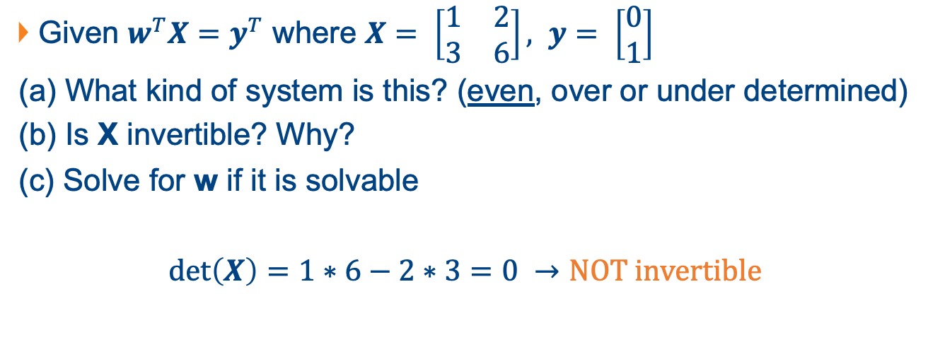
Question 5
Given $w^{T}X=y^{T}$ where $X= \left[\begin{matrix}1 & 2 \\ 3 & 6\end{matrix}\right], y= \left[\begin{matrix}0 \\ 1\end{matrix}\right]$
(a) What kind of system is this? (even, over or under determined)
(b) Is X invertible? Why?
(c) Solve for w if it is solvable
$\det\left(X\right)=1∗6−2∗3=0 →NOT invertible$

Slide 19
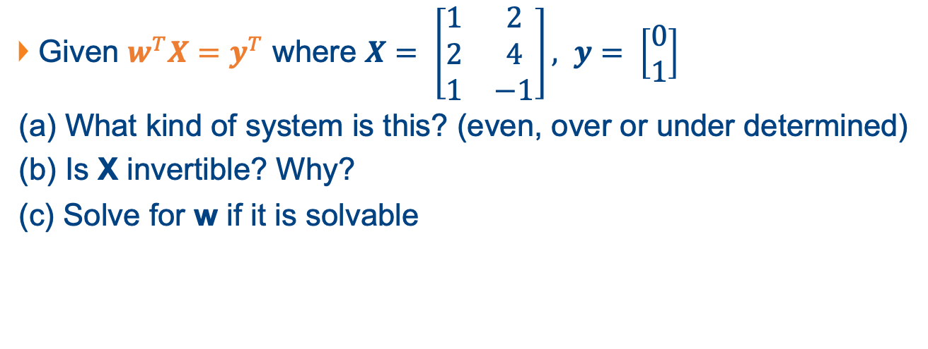
Question 6
Given $w^{T}X=y^{T}$ where $X= \left[\begin{matrix}1 & 2 \\ 2 & 4 \\ 1 & −1\end{matrix}\right], y= \left[\begin{matrix}0 \\ 1\end{matrix}\right]$
(a) What kind of system is this? (even, over or under determined)
(b) Is X invertible? Why?
(c) Solve for w if it is solvable

Slide 20

Question 6
Given $w^{T}X=y^{T}$ where $X= \left[\begin{matrix}1 & 2 \\ 2 & 4 \\ 1 & −1\end{matrix}\right], y= \left[\begin{matrix}0 \\ 1\end{matrix}\right]$
We know how to solve $Xw=y$

Slide 21
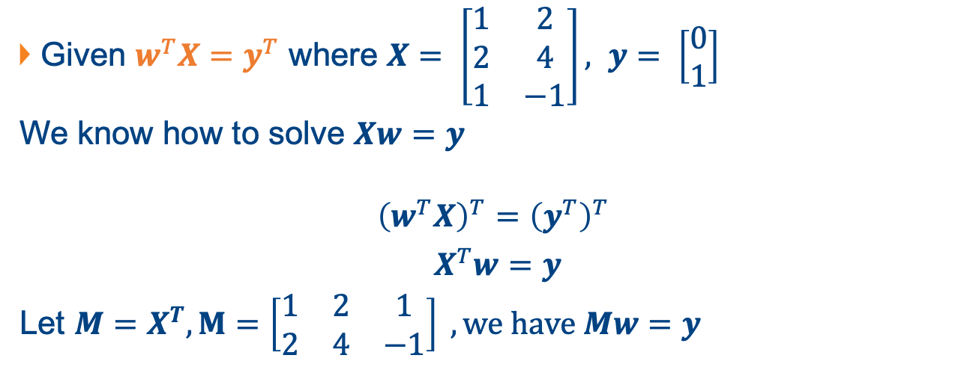
Question 6
Given $w^{T}X=y^{T}$ where $X= \left[\begin{matrix}1 & 2 \\ 2 & 4 \\ 1 & −1\end{matrix}\right], y= \left[\begin{matrix}0 \\ 1\end{matrix}\right]$
We know how to solve $Xw=y$
$${\left(w^{T}X\right)}^{T}={\left(y^{T}\right)}^{T}$$
$X^{T}w=y$
Let $M=X^{T}, M=\left[\begin{matrix}1 & 2 & 1 \\ 2 & 4 & −1\end{matrix}\right] , we have Mw=y$

Slide 22

Question 6
Solve $Mw=y$, $M=\left[\begin{matrix}1 & 2 & 1 \\ 2 & 4 & −1\end{matrix}\right]$, $y= \left[\begin{matrix}0 \\ 1\end{matrix}\right]$
Even, over or under-determined?

Slide 23
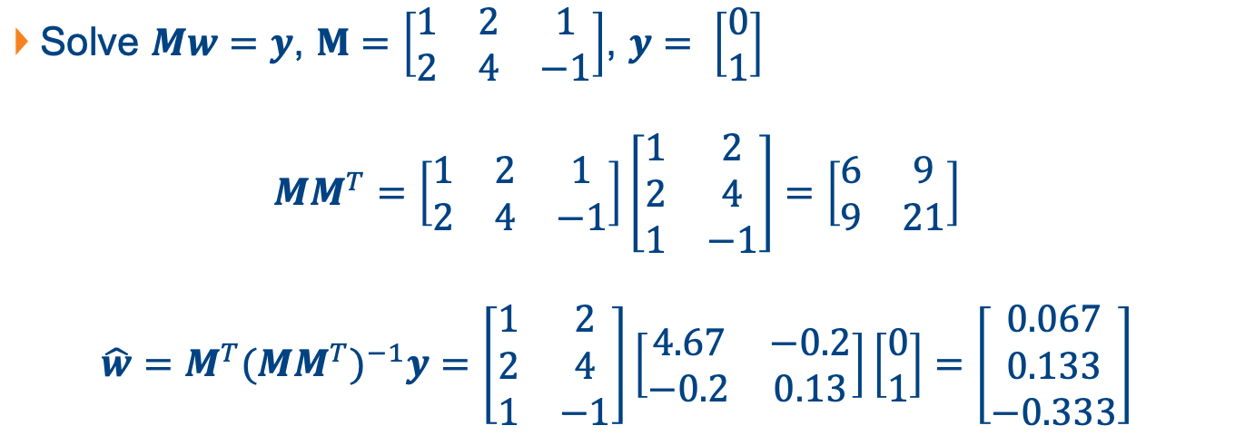
Question 6
Solve $Mw=y$, $M=\left[\begin{matrix}1 & 2 & 1 \\ 2 & 4 & −1\end{matrix}\right]$, $y= \left[\begin{matrix}0 \\ 1\end{matrix}\right]$
$$MM^{T}=\left[\begin{matrix}1 & 2 & 1 \\ 2 & 4 & −1\end{matrix}\right]\left[\begin{matrix}1 & 2 \\ 2 & 4 \\ 1 & −1\end{matrix}\right]=\left[\begin{matrix}6 & 9 \\ 9 & 21\end{matrix}\right]$$
$$\hat{w}=M^{T}{(MM^{T})}^{−1}y=\left[\begin{matrix}1 & 2 \\ 2 & 4 \\ 1 & −1\end{matrix}\right]\left[\begin{matrix}4.67 & −0.2 \\ −0.2 & 0.13\end{matrix}\right]\left[\begin{matrix}0 \\ 1\end{matrix}\right]=\left[\begin{matrix}0.067 \\ 0.133 \\ −0.333\end{matrix}\right]$$

Slide 24

Question 7
Does the following matrix have left inverse?
$$\left[\begin{matrix}2 & 0 & 0 \\ 0 & 0 & 1\end{matrix}\right]$$
True
False

Slide 25

Question 7
$$X=\left[\begin{matrix}2 & 0 & 0 \\ 0 & 0 & 1\end{matrix}\right]$$
Left inverse: ${{(X}^{T}X)}^{−1}X^{T}$

Slide 26
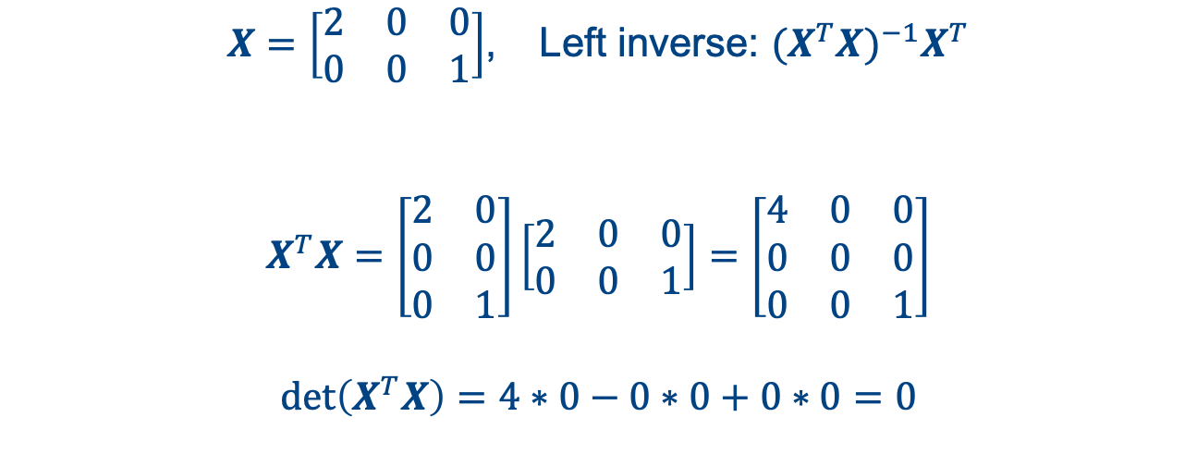
Question 7
$X=\left[\begin{matrix}2 & 0 & 0 \\ 0 & 0 & 1\end{matrix}\right]$, Left inverse: ${{(X}^{T}X)}^{−1}X^{T}$
$$X^{T}X=\left[\begin{matrix}2 & 0 \\ 0 & 0 \\ 0 & 1\end{matrix}\right]\left[\begin{matrix}2 & 0 & 0 \\ 0 & 0 & 1\end{matrix}\right]=\left[\begin{matrix}4 & 0 & 0 \\ 0 & 0 & 0 \\ 0 & 0 & 1\end{matrix}\right]$$
$$\det\left(X^{T}X\right)=4∗0−0∗0+0∗0=0$$

Slide 27
Question 7
Does the following matrix have left inverse?
$$\left[\begin{matrix}2 & 0 & 0 \\ 0 & 0 & 1\end{matrix}\right]$$
True
False

Slide 28
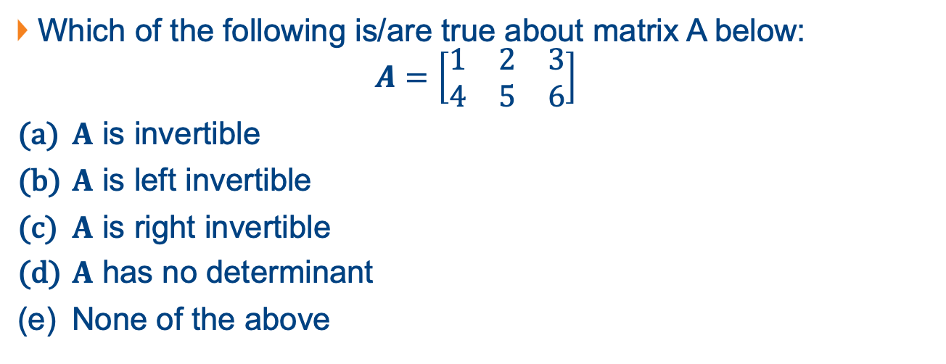
Question 8
Which of the following is/are true about matrix A below:
$$A=\left[\begin{matrix}1 & 2 & 3 \\ 4 & 5 & 6\end{matrix}\right]$$
$A$ is invertible
$A$ is left invertible
$A$ is right invertible
$A$ has no determinant
None of the above

Slide 29

Question 8
$$A=\left[\begin{matrix}1 & 2 & 3 \\ 4 & 5 & 6\end{matrix}\right]$$
Left inverse: ${{(A}^{T}A)}^{−1}A^{T}$
Right inverse: $A^{T}{(AA^{T})}^{−1}$

Slide 30
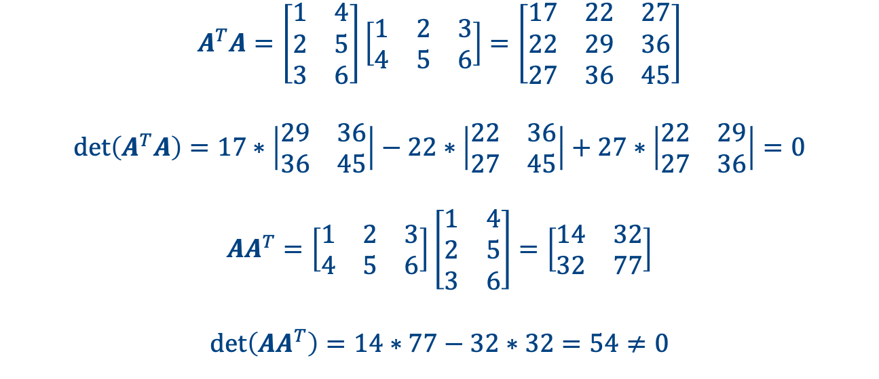
Question 8
$$A^{T}A=\left[\begin{matrix}1 & 4 \\ 2 & 5 \\ 3 & 6\end{matrix}\right]\left[\begin{matrix}1 & 2 & 3 \\ 4 & 5 & 6\end{matrix}\right]=\left[\begin{matrix}17 & 22 & 27 \\ 22 & 29 & 36 \\ 27 & 36 & 45\end{matrix}\right]$$
$$\det\left(A^{T}A\right)=17∗\left|\begin{matrix}29 & 36 \\ 36 & 45\end{matrix}\right|−22∗\left|\begin{matrix}22 & 36 \\ 27 & 45\end{matrix}\right|+27∗\left|\begin{matrix}22 & 29 \\ 27 & 36\end{matrix}\right|=0$$
$$AA^{T}=\left[\begin{matrix}1 & 2 & 3 \\ 4 & 5 & 6\end{matrix}\right]\left[\begin{matrix}1 & 4 \\ 2 & 5 \\ 3 & 6\end{matrix}\right]=\left[\begin{matrix}14 & 32 \\ 32 & 77\end{matrix}\right]$$
$$\det\left(AA^{T}\right)=14∗77−32∗32=54≠0$$

Slide 31
Question 8
Which of the following is/are true about matrix A below:
$$A=\left[\begin{matrix}1 & 2 & 3 \\ 4 & 5 & 6\end{matrix}\right]$$
$A$ is invertible
$A$ is left invertible
$A$ is right invertible
$A$ has no determinant
None of the above

