Slide 1
EE2211 Tutorial 5
Thao Nguyen

Slide 2

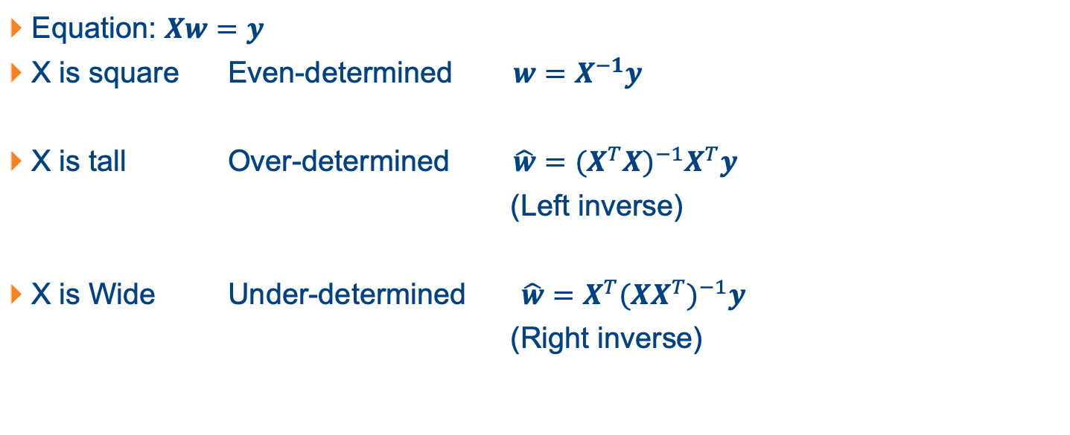
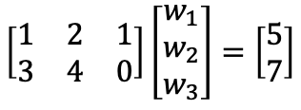
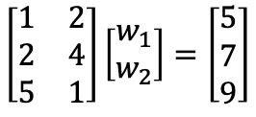
Recap: System of Linear Equations
Equation: $Xw=y$
X is square Even-determined $w=X^{−1}y$
X is tall Over-determined $\hat{w}={{(X}^{T}X)}^{−1}X^{T}y$
(Left inverse)
X is Wide Under-determined $\hat{w}=X^{T}{(XX^{T})}^{−1}y$
(Right inverse)
$$\left[\begin{matrix}1 & 2 \\ 3 & 4\end{matrix}\right]\left[\begin{matrix}w_{1} \\ w_{2}\end{matrix}\right]=\left[\begin{matrix}5 \\ 7\end{matrix}\right]$$
$$\left[\begin{matrix}1 & 2 \\ 2 & 4 \\ 5 & 1\end{matrix}\right]\left[\begin{matrix}w_{1} \\ w_{2}\end{matrix}\right]=\left[\begin{matrix}5 \\ 7 \\ 9\end{matrix}\right]$$
$$\left[\begin{matrix}1 & 2 & 1 \\ 3 & 4 & 0\end{matrix}\right]\left[\begin{matrix}w_{1} \\ w_{2} \\ w_{3}\end{matrix}\right]=\left[\begin{matrix}5 \\ 7\end{matrix}\right]$$

Slide 3
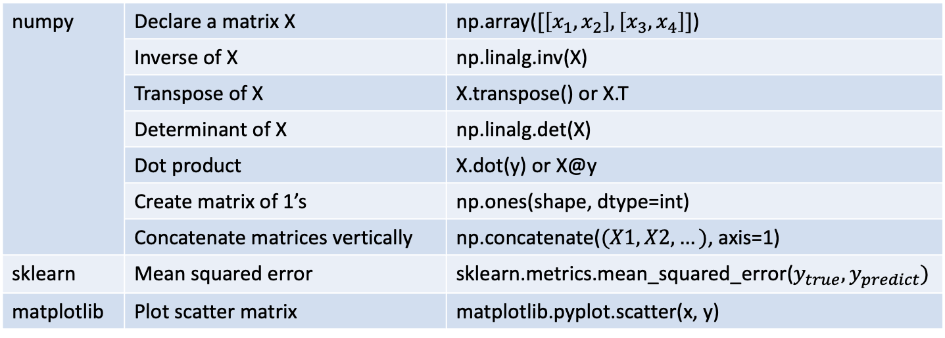
Useful Python Functions
numpy | Declare a matrix X | np.array($[\left[x_{1}, x_{2}\right], \left[x_{3}, x_{4}\right]]$)
 | Inverse of X | np.linalg.inv(X)
 | Transpose of X | X.transpose() or X.T
 | Determinant of X | np.linalg.det(X)
 | Dot product | X.dot(y) or X@y
 | Create matrix of 1’s | np.ones(shape, dtype=int)
 | Concatenate matrices vertically | np.concatenate($(X1,X2,…)$, axis=1)
sklearn | Mean squared error | sklearn.metrics.mean_squared_error($y_{true}, y_{predict})$
matplotlib | Plot scatter matrix | matplotlib.pyplot.scatter(x, y)

Slide 4
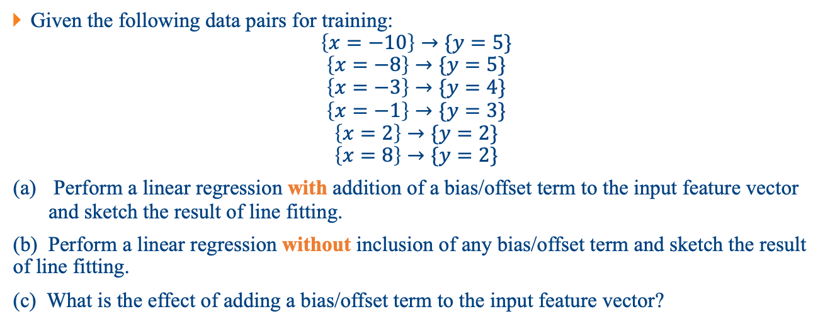
Question 1
Given the following data pairs for training:
$$\left\{x=−10\right\}→\{y=5\}$$
$$\left\{x=−8\right\}→\{y=5\}$$
$$\left\{x=−3\right\}→\{y=4\}$$
$$\left\{x=−1\right\}→\{y=3\}$$
$$\left\{x=2\right\}→\{y=2\}$$
$$\left\{x=8\right\}→\{y=2\}$$
Perform a linear regression with addition of a bias/offset term to the input feature vector and sketch the result of line fitting.
(b) Perform a linear regression without inclusion of any bias/offset term and sketch the result of line fitting.
(c) What is the effect of adding a bias/offset term to the input feature vector?

Slide 5
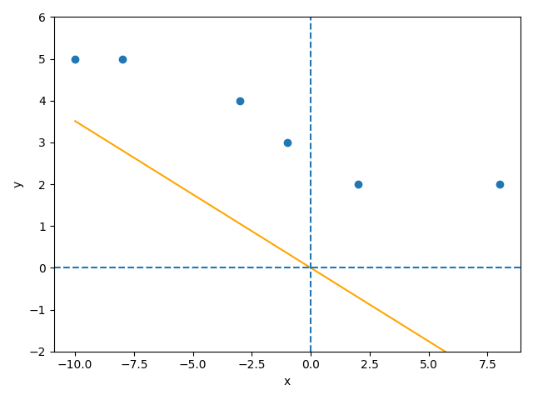
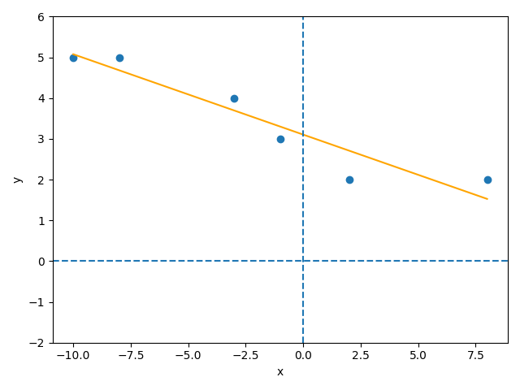
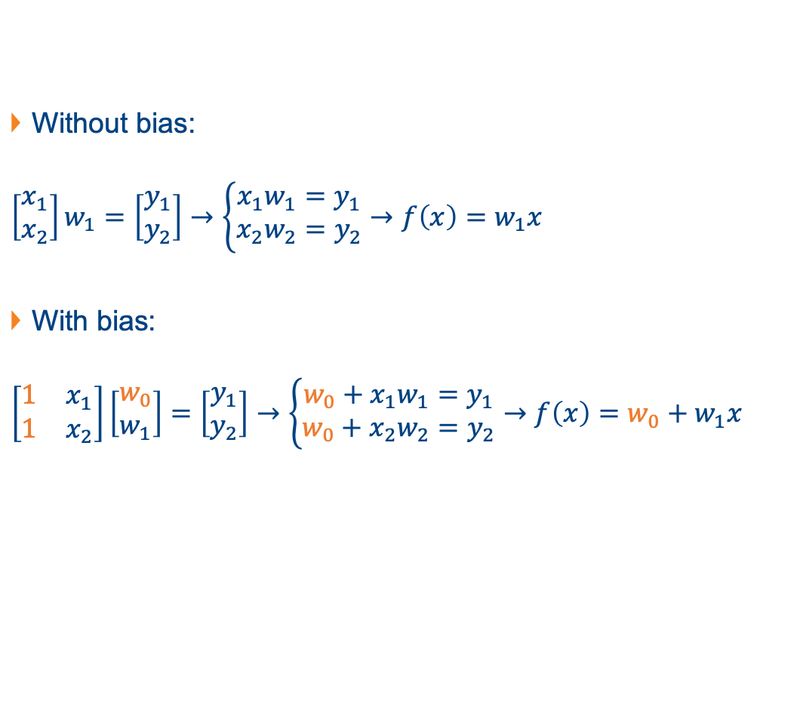
Question 1
Without bias:
$$\left[\begin{matrix}x_{1} \\ x_{2}\end{matrix}\right]w_{1}=\left[\begin{matrix}y_{1} \\ y_{2}\end{matrix}\right]→\left\{\begin{aligned}x_{1}w_{1}=y_{1} \\ x_{2}w_{2}=y_{2}\end{aligned}\right.→f\left(x\right)=w_{1}x$$
With bias:
$$\left[\begin{matrix}1 & x_{1} \\ 1 & x_{2}\end{matrix}\right]\left[\begin{matrix}w_{0} \\ w_{1}\end{matrix}\right]=\left[\begin{matrix}y_{1} \\ y_{2}\end{matrix}\right]→\left\{\begin{aligned}{w_{0}+x}_{1}w_{1}=y_{1} \\ w_{0}+x_{2}w_{2}=y_{2}\end{aligned}\right.→f\left(x\right)=w_{0}+w_{1}x$$

Slide 6

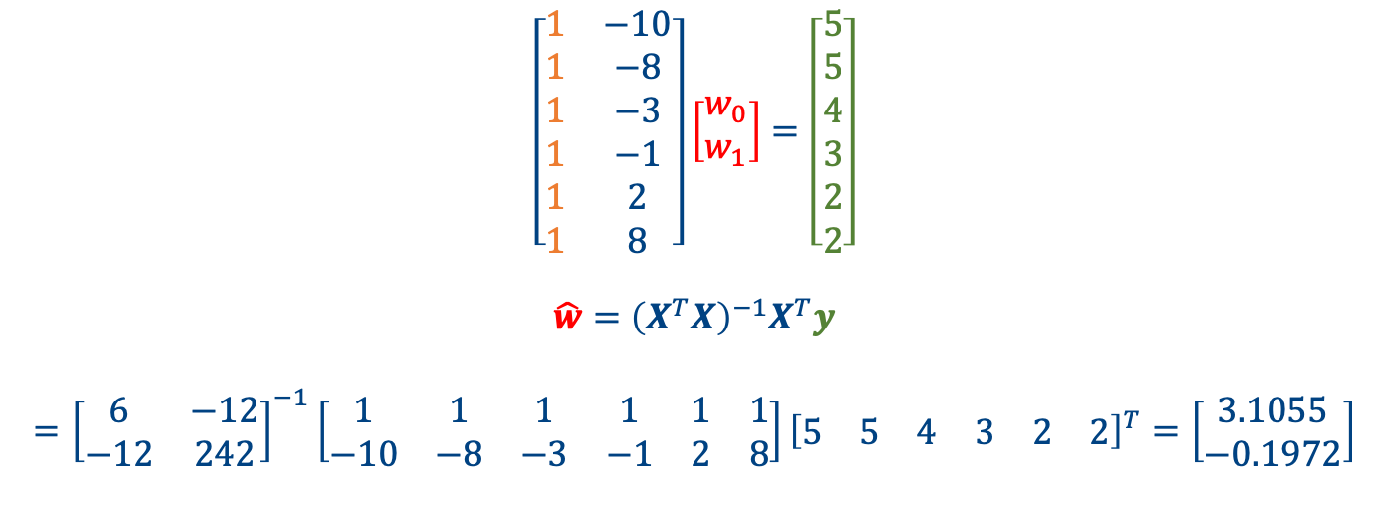


Question 1
$$X$$
$$w$$
$$y$$
With bias:
$$\left[\begin{matrix}1 & −10 \\ 1 & −8 \\ 1 & −3 \\ 1 & −1 \\ 1 & 2 \\ 1 & 8\end{matrix}\right]\left[\begin{matrix}w_{0} \\ w_{1}\end{matrix}\right]=\left[\begin{matrix}5 \\ 5 \\ 4 \\ 3 \\ 2 \\ 2\end{matrix}\right]$$
$$\hat{w}={\left(X^{T}X\right)}^{−1}X^{T}y$$
$$={\left[\begin{matrix}6 & −12 \\ −12 & 242\end{matrix}\right]}^{−1}\left[\begin{matrix}1 & 1 & 1 & 1 & 1 & 1 \\ −10 & −8 & −3 & −1 & 2 & 8\end{matrix}\right]{\left[\begin{matrix}5 & 5 & 4 & 3 & 2 & 2\end{matrix}\right]}^{T}=\left[\begin{matrix}3.1055 \\ −0.1972\end{matrix}\right]$$
bias

Slide 7

Question 1
$$X$$
$$w$$
$$y$$
Without bias:
$$\left[\begin{matrix}−10 \\ −8 \\ −3 \\ −1 \\ 2 \\ 8\end{matrix}\right]\left[w_{1}\right]=\left[\begin{matrix}5 \\ 5 \\ 4 \\ 3 \\ 2 \\ 2\end{matrix}\right]$$
$$\hat{w}={\left(X^{T}X\right)}^{−1}X^{T}y$$
$$={\left[242\right]}^{−1}\left[\begin{matrix}−10 & −8 & −3 & −1 & 2 & 8\end{matrix}\right]{\left[\begin{matrix}5 & 5 & 4 & 3 & 2 & 2\end{matrix}\right]}^{T}=−0.3512$$

Slide 8
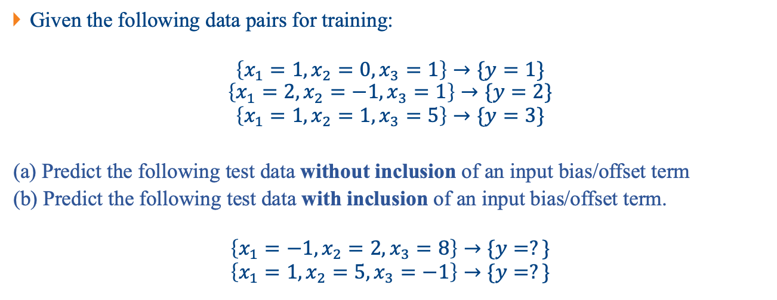
Question 2
Given the following data pairs for training:
$$\left\{x_{1}=1, x_{2}=0, x_{3}=1\right\}→\{y=1\}$$
$$\left\{x_{1}=2, x_{2}=−1, x_{3}=1\right\}→\{y=2\}$$
$$\left\{x_{1}=1, x_{2}=1, x_{3}=5\right\}→\{y=3\}$$
(a) Predict the following test data without inclusion of an input bias/offset term
(b) Predict the following test data with inclusion of an input bias/offset term.
$$\left\{x_{1}=−1, x_{2}=2, x_{3}=8\right\}→\{y=?\}$$
$$\left\{x_{1}=1, x_{2}=5, x_{3}=−1\right\}→\{y=?\}$$

Slide 9



Question 2
Without bias:
$$\left[\begin{matrix}1 & 0 & 1 \\ 2 & −1 & 1 \\ 1 & 1 & 5\end{matrix}\right]\left[\begin{matrix}w_{1} \\ w_{2} \\ w_{3}\end{matrix}\right]=\left[\begin{matrix}1 \\ 2 \\ 3\end{matrix}\right]$$
$$X$$
$$w$$
$$y$$

Slide 10
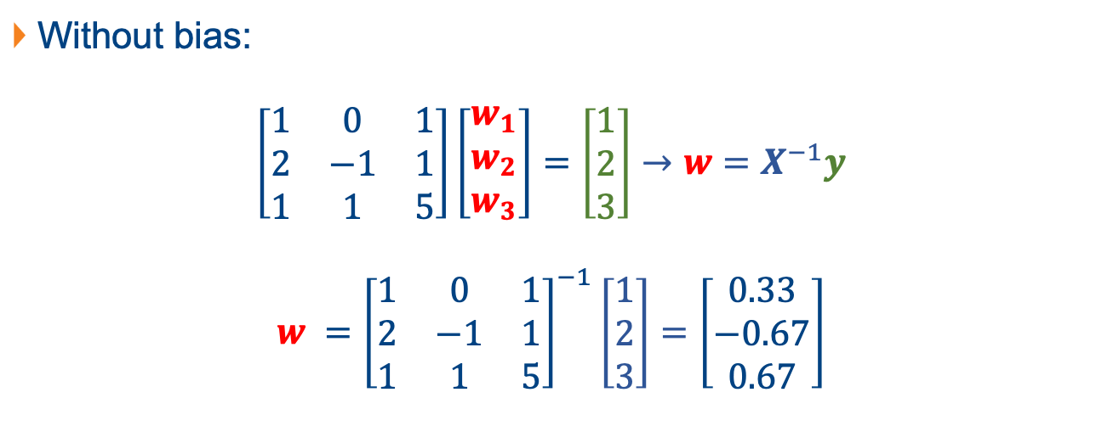
Question 2
Without bias:
$$\left[\begin{matrix}1 & 0 & 1 \\ 2 & −1 & 1 \\ 1 & 1 & 5\end{matrix}\right]\left[\begin{matrix}w_{1} \\ w_{2} \\ w_{3}\end{matrix}\right]=\left[\begin{matrix}1 \\ 2 \\ 3\end{matrix}\right]→w=X^{−1}y$$
$$w ={\left[\begin{matrix}1 & 0 & 1 \\ 2 & −1 & 1 \\ 1 & 1 & 5\end{matrix}\right]}^{−1}\left[\begin{matrix}1 \\ 2 \\ 3\end{matrix}\right]=\left[\begin{matrix}0.33 \\ −0.67 \\ 0.67\end{matrix}\right]$$
$$X$$
$$w$$
$$y$$

Slide 11

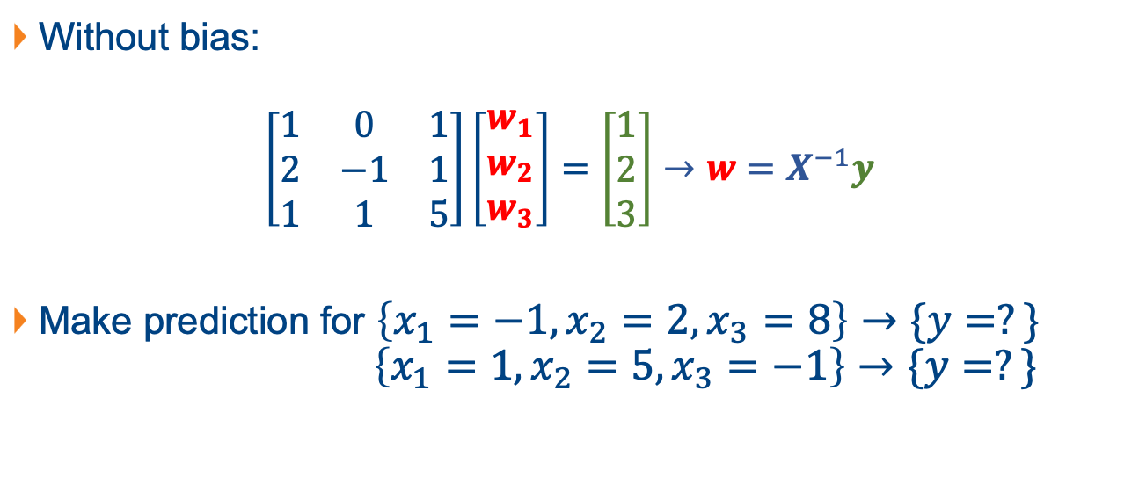

Question 2
Without bias:
$$\left[\begin{matrix}1 & 0 & 1 \\ 2 & −1 & 1 \\ 1 & 1 & 5\end{matrix}\right]\left[\begin{matrix}w_{1} \\ w_{2} \\ w_{3}\end{matrix}\right]=\left[\begin{matrix}1 \\ 2 \\ 3\end{matrix}\right]→w=X^{−1}y$$
Make prediction for $\left\{x_{1}=−1, x_{2}=2, x_{3}=8\right\}→\{y=?\}$
$$\left\{x_{1}=1, x_{2}=5, x_{3}=−1\right\}→\{y=?\}$$
$$X$$
$$w$$
$$y$$
$$X_{test}$$
$$y_{predict}$$

Slide 12

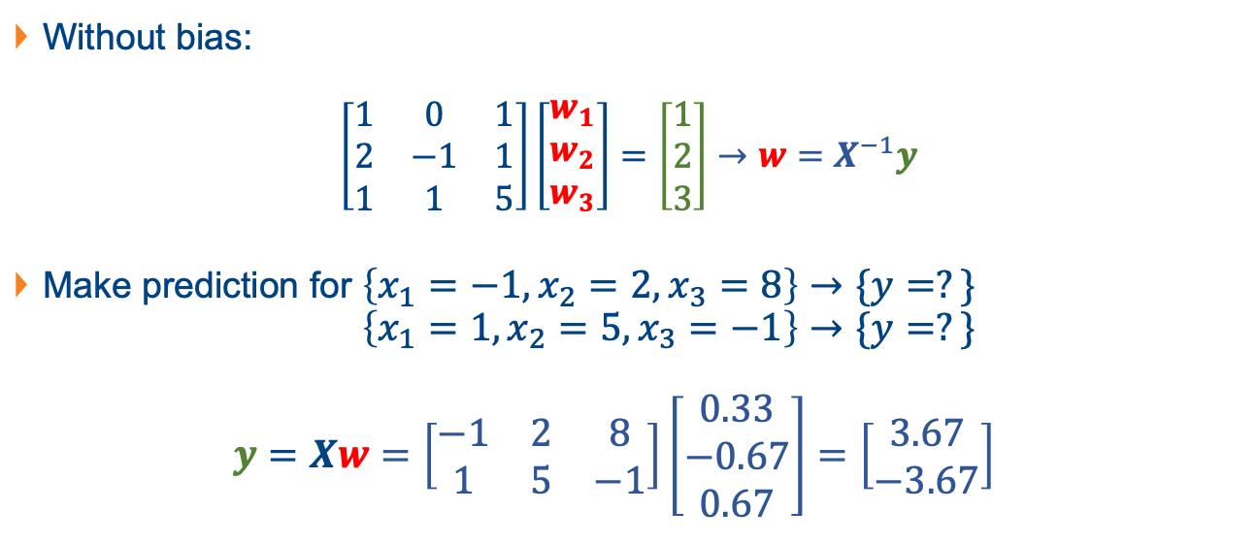


Question 2
Without bias:
$$\left[\begin{matrix}1 & 0 & 1 \\ 2 & −1 & 1 \\ 1 & 1 & 5\end{matrix}\right]\left[\begin{matrix}w_{1} \\ w_{2} \\ w_{3}\end{matrix}\right]=\left[\begin{matrix}1 \\ 2 \\ 3\end{matrix}\right]→w=X^{−1}y$$
Make prediction for $\left\{x_{1}=−1, x_{2}=2, x_{3}=8\right\}→\{y=?\}$
$$\left\{x_{1}=1, x_{2}=5, x_{3}=−1\right\}→\{y=?\}$$
$$y=Xw=\left[\begin{matrix}−1 & 2 & 8 \\ 1 & 5 & −1\end{matrix}\right]\left[\begin{matrix}0.33 \\ −0.67 \\ 0.67\end{matrix}\right]=\left[\begin{matrix}3.67 \\ −3.67\end{matrix}\right]$$
$$X$$
$$w$$
$$y$$

Slide 13



Question 2
With bias:
$$\left[\begin{matrix}1 & 1 & 0 & 1 \\ 1 & 2 & −1 & 1 \\ 1 & 1 & 1 & 5\end{matrix}\right]\left[\begin{matrix}w_{0} \\ w_{1} \\ w_{2} \\ w_{3}\end{matrix}\right]=\left[\begin{matrix}1 \\ 2 \\ 3\end{matrix}\right]$$
$$X$$
$$w$$
$$y$$

Slide 14

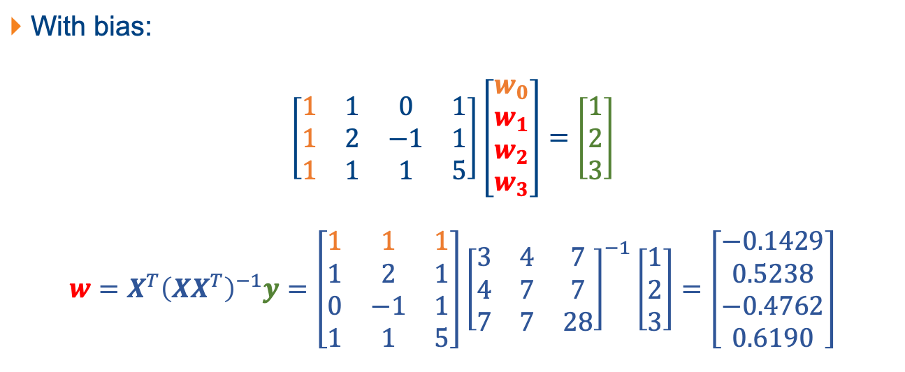


Question 2
With bias:
$$\left[\begin{matrix}1 & 1 & 0 & 1 \\ 1 & 2 & −1 & 1 \\ 1 & 1 & 1 & 5\end{matrix}\right]\left[\begin{matrix}w_{0} \\ w_{1} \\ w_{2} \\ w_{3}\end{matrix}\right]=\left[\begin{matrix}1 \\ 2 \\ 3\end{matrix}\right]$$
$$w=X^{T}{\left(XX^{T}\right)}^{−1}y=\left[\begin{matrix}1 & 1 & 1 \\ 1 & 2 & 1 \\ 0 & −1 & 1 \\ 1 & 1 & 5\end{matrix}\right]{\left[\begin{matrix}3 & 4 & 7 \\ 4 & 7 & 7 \\ 7 & 7 & 28\end{matrix}\right]}^{−1}\left[\begin{matrix}1 \\ 2 \\ 3\end{matrix}\right]=\left[\begin{matrix}−0.1429 \\ 0.5238 \\ −0.4762 \\ 0.6190\end{matrix}\right]$$
$$X$$
$$w$$
$$y$$

Slide 15

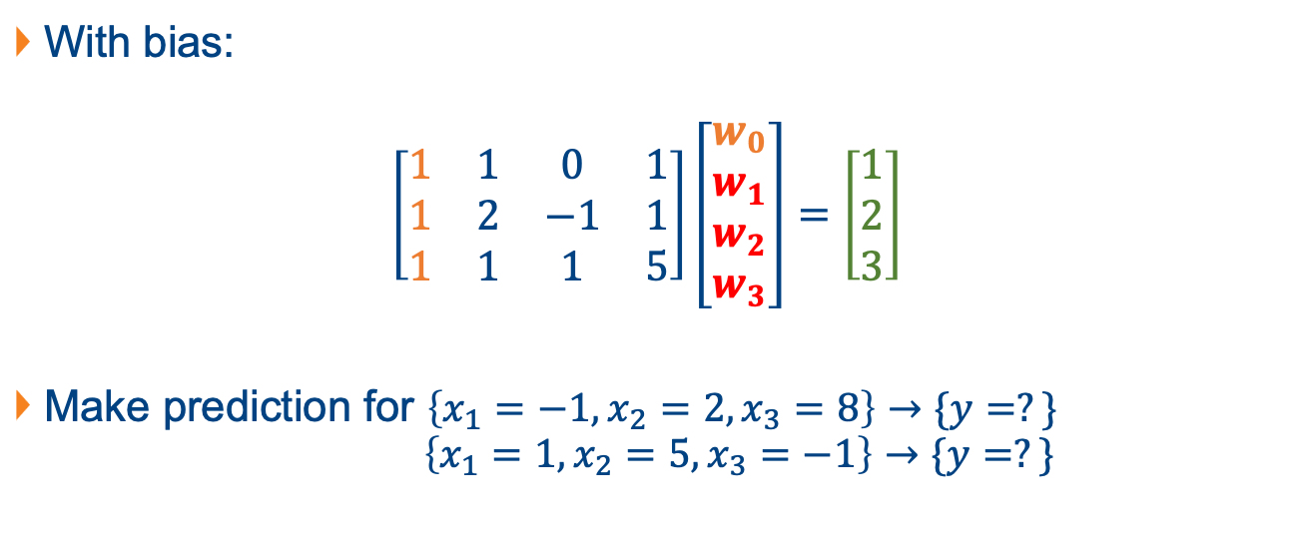

Question 2
With bias:
$$\left[\begin{matrix}1 & 1 & 0 & 1 \\ 1 & 2 & −1 & 1 \\ 1 & 1 & 1 & 5\end{matrix}\right]\left[\begin{matrix}w_{0} \\ w_{1} \\ w_{2} \\ w_{3}\end{matrix}\right]=\left[\begin{matrix}1 \\ 2 \\ 3\end{matrix}\right]$$
Make prediction for $\left\{x_{1}=−1, x_{2}=2, x_{3}=8\right\}→\{y=?\}$
$$\left\{x_{1}=1, x_{2}=5, x_{3}=−1\right\}→\{y=?\}$$
$$X$$
$$w$$
$$y$$
$$X_{test}$$
$$y_{predict}$$

Slide 16
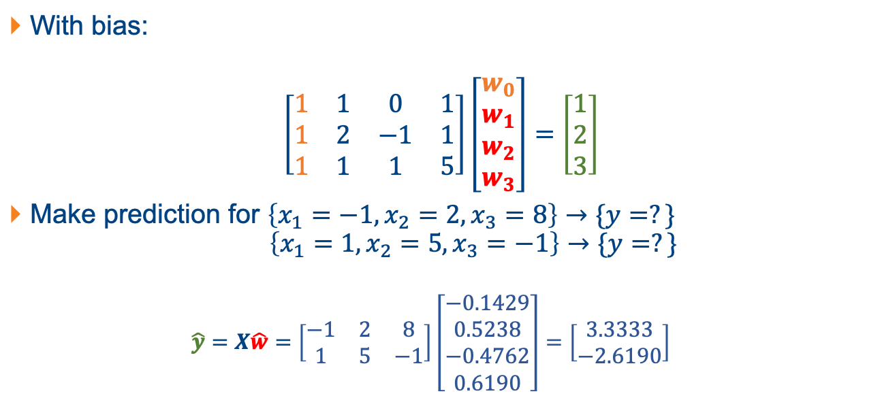
Question 2
With bias:
$$\left[\begin{matrix}1 & 1 & 0 & 1 \\ 1 & 2 & −1 & 1 \\ 1 & 1 & 1 & 5\end{matrix}\right]\left[\begin{matrix}w_{0} \\ w_{1} \\ w_{2} \\ w_{3}\end{matrix}\right]=\left[\begin{matrix}1 \\ 2 \\ 3\end{matrix}\right]$$
Make prediction for $\left\{x_{1}=−1, x_{2}=2, x_{3}=8\right\}→\{y=?\}$
$$\left\{x_{1}=1, x_{2}=5, x_{3}=−1\right\}→\{y=?\}$$
$$\hat{y}=X\hat{w}=\left[\begin{matrix}−1 & 2 & 8 \\ 1 & 5 & −1\end{matrix}\right]\left[\begin{matrix}−0.1429 \\ 0.5238 \\ −0.4762 \\ 0.6190\end{matrix}\right]=\left[\begin{matrix}3.3333 \\ −2.6190\end{matrix}\right]$$
$$X$$
$$w$$
$$y$$

Slide 17
Question 3
Semester | Students | Books
1 | 36 | 31
2 | 28 | 29
3 | 35 | 34
4 | 39 | 35
5 | 30 | 29
6 | 30 | 30
7 | 31 | 30
8 | 38 | 38
9 | 36 | 34
10 | 38 | 33
11 | 29 | 29
12 | 26 | 26
Obtain a scatter plot of the number of books sold versus the number of registered students.
(b) Write down the regression equation and calculate the coefficients for this fitting.

Slide 18
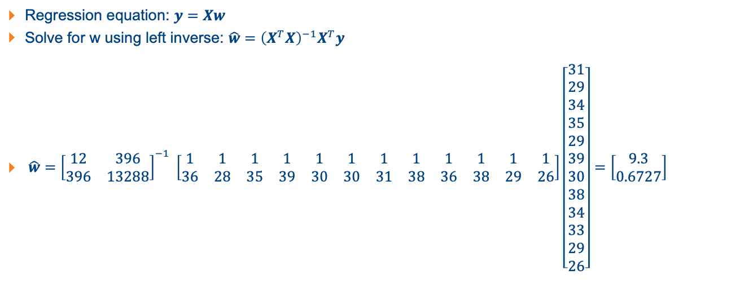
Question 3
Regression equation: $y=Xw$
Solve for w using left inverse: $\hat{w}={\left(X^{T}X\right)}^{−1}X^{T}y$
$\hat{w}={\left[\begin{matrix}12 & 396 \\ 396 & 13288\end{matrix}\right]}^{−1} \left[\begin{matrix}1 & 1 & 1 & 1 & 1 & 1 & 1 & 1 & 1 & 1 & 1 & 1 \\ 36 & 28 & 35 & 39 & 30 & 30 & 31 & 38 & 36 & 38 & 29 & 26\end{matrix}\right]\left[\begin{matrix}31 \\ 29 \\ 34 \\ 35 \\ 29 \\ 39 \\ 30 \\ 38 \\ 34 \\ 33 \\ 29 \\ 26\end{matrix}\right]=\left[\begin{matrix}9.3 \\ 0.6727\end{matrix}\right]$

Slide 19
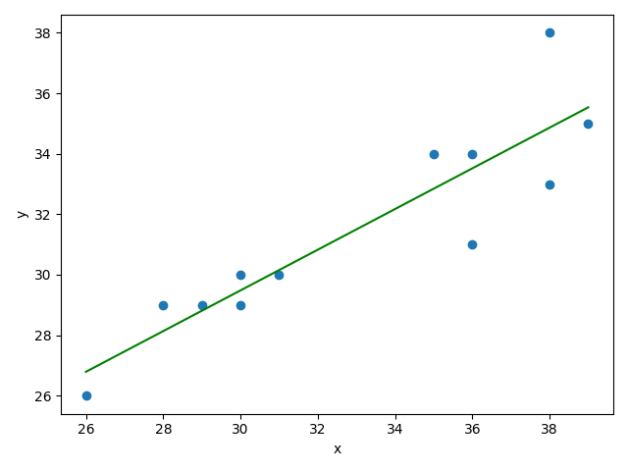
Question 3
Semester | Students | Books
1 | 36 | 31
2 | 28 | 29
3 | 35 | 34
4 | 39 | 35
5 | 30 | 29
6 | 30 | 30
7 | 31 | 30
8 | 38 | 38
9 | 36 | 34
10 | 38 | 33
11 | 29 | 29
12 | 26 | 26
(b) Write down the regression equation and calculate the coefficients for this fitting.

Slide 20
Question 3
Semester | Students | Books
1 | 36 | 31
2 | 28 | 29
3 | 35 | 34
4 | 39 | 35
5 | 30 | 29
6 | 30 | 30
7 | 31 | 30
8 | 38 | 38
9 | 36 | 34
10 | 38 | 33
11 | 29 | 29
12 | 26 | 26
(c) Predict the number of books that would be sold in a semester when 30 students have registered.

Slide 21
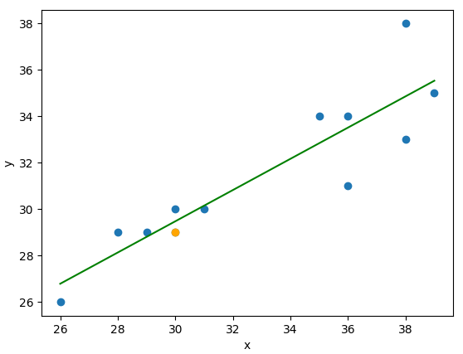
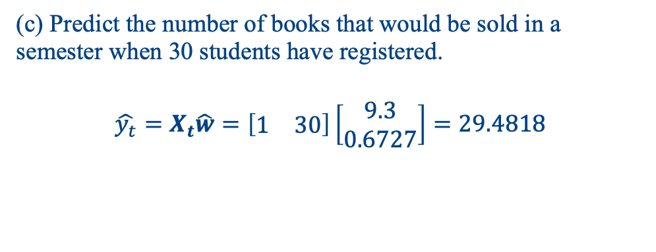
Question 3
Semester | Students | Books
1 | 36 | 31
2 | 28 | 29
3 | 35 | 34
4 | 39 | 35
5 | 30 | 29
6 | 30 | 30
7 | 31 | 30
8 | 38 | 38
9 | 36 | 34
10 | 38 | 33
11 | 29 | 29
12 | 26 | 26
(c) Predict the number of books that would be sold in a semester when 30 students have registered.
$$\hat{y_{t}}=X_{t}\hat{w}=\left[\begin{matrix}1 & 30\end{matrix}\right]\left[\begin{matrix}9.3 \\ 0.6727\end{matrix}\right]=29.4818$$

Slide 22
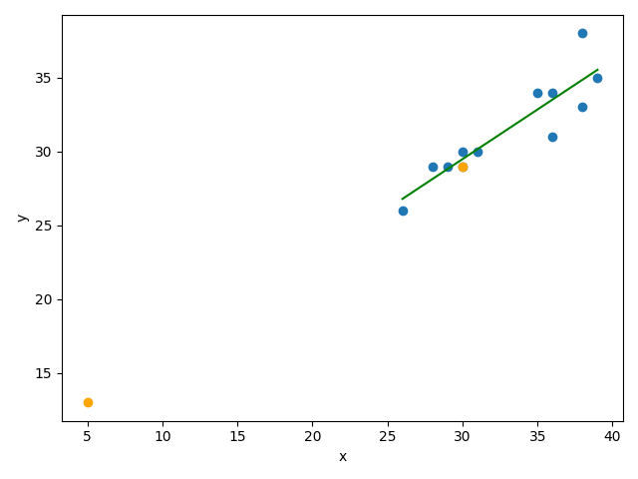
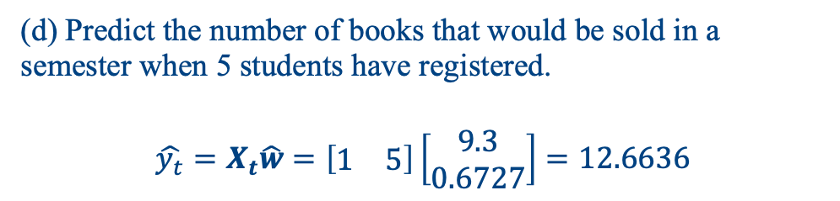
Question 3
Semester | Students | Books
1 | 36 | 31
2 | 28 | 29
3 | 35 | 34
4 | 39 | 35
5 | 30 | 29
6 | 30 | 30
7 | 31 | 30
8 | 38 | 38
9 | 36 | 34
10 | 38 | 33
11 | 29 | 29
12 | 26 | 26
(d) Predict the number of books that would be sold in a semester when 5 students have registered.
$$\hat{y_{t}}=X_{t}\hat{w}=\left[\begin{matrix}1 & 5\end{matrix}\right]\left[\begin{matrix}9.3 \\ 0.6727\end{matrix}\right]=12.6636$$

Slide 23
Question 4
Semester | Students | Books
1 | 36 | 31
2 | 26 | 20
3 | 35 | 34
4 | 39 | 35
5 | 26 | 20
6 | 30 | 30
7 | 31 | 30
8 | 38 | 38
9 | 36 | 34
10 | 38 | 33
11 | 26 | 20
12 | 26 | 20
(a) Calculate the regression coefficients for this fitting.

Slide 24
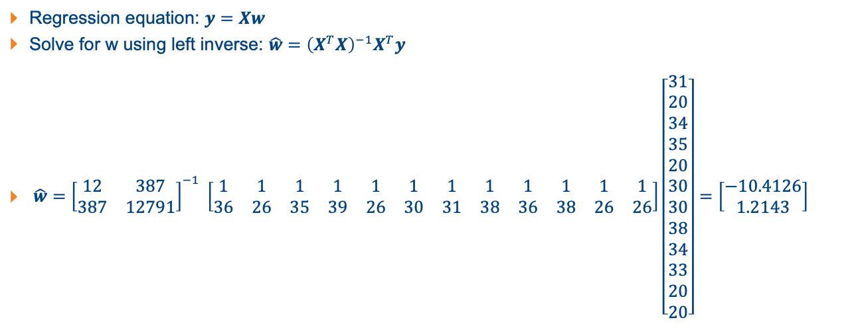
Question 4
Regression equation: $y=Xw$
Solve for w using left inverse: $\hat{w}={\left(X^{T}X\right)}^{−1}X^{T}y$
$\hat{w}={\left[\begin{matrix}12 & 387 \\ 387 & 12791\end{matrix}\right]}^{−1} \left[\begin{matrix}1 & 1 & 1 & 1 & 1 & 1 & 1 & 1 & 1 & 1 & 1 & 1 \\ 36 & 26 & 35 & 39 & 26 & 30 & 31 & 38 & 36 & 38 & 26 & 26\end{matrix}\right]\left[\begin{matrix}31 \\ 20 \\ 34 \\ 35 \\ 20 \\ 30 \\ 30 \\ 38 \\ 34 \\ 33 \\ 20 \\ 20\end{matrix}\right]=\left[\begin{matrix}−10.4126 \\ 1.2143\end{matrix}\right]$

Slide 25
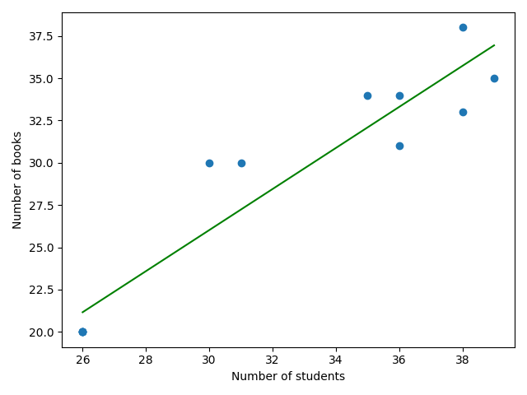
Question 4
Semester | Students | Books
1 | 36 | 31
2 | 26 | 20
3 | 35 | 34
4 | 39 | 35
5 | 26 | 20
6 | 30 | 30
7 | 31 | 30
8 | 38 | 38
9 | 36 | 34
10 | 38 | 33
11 | 26 | 20
12 | 26 | 20
(a) Calculate the regression coefficients for this fitting.

Slide 26
Question 4
Semester | Students | Books
1 | 36 | 31
2 | 26 | 20
3 | 35 | 34
4 | 39 | 35
5 | 26 | 20
6 | 30 | 30
7 | 31 | 30
8 | 38 | 38
9 | 36 | 34
10 | 38 | 33
11 | 26 | 20
12 | 26 | 20
(b) Predict the number of books that would be sold in a semester when 30 students have registered.

Slide 27
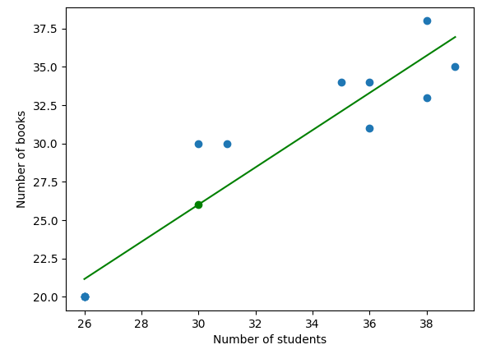

Question 4
Semester | Students | Books
1 | 36 | 31
2 | 26 | 20
3 | 35 | 34
4 | 39 | 35
5 | 26 | 20
6 | 30 | 30
7 | 31 | 30
8 | 38 | 38
9 | 36 | 34
10 | 38 | 33
11 | 26 | 20
12 | 26 | 20
(b) Predict the number of books that would be sold in a semester when 30 students have registered.
$$\hat{y}=X_{t}\hat{w}=\left[\begin{matrix}1 & 30\end{matrix}\right]\left[\begin{matrix}−10.4126 \\ 1.2143\end{matrix}\right]=26.0177$$

Slide 28
Question 4
Semester | Students | Books
1 | 36 | 31
2 | 26 | 20
3 | 35 | 34
4 | 39 | 35
5 | 26 | 20
6 | 30 | 30
7 | 31 | 30
8 | 38 | 38
9 | 36 | 34
10 | 38 | 33
11 | 26 | 20
12 | 26 | 20
(c) Remove those duplicating data and re-fit the line and observe the impact on predicting the number of books that would be sold in a semester when 30 students have registered.

Slide 29
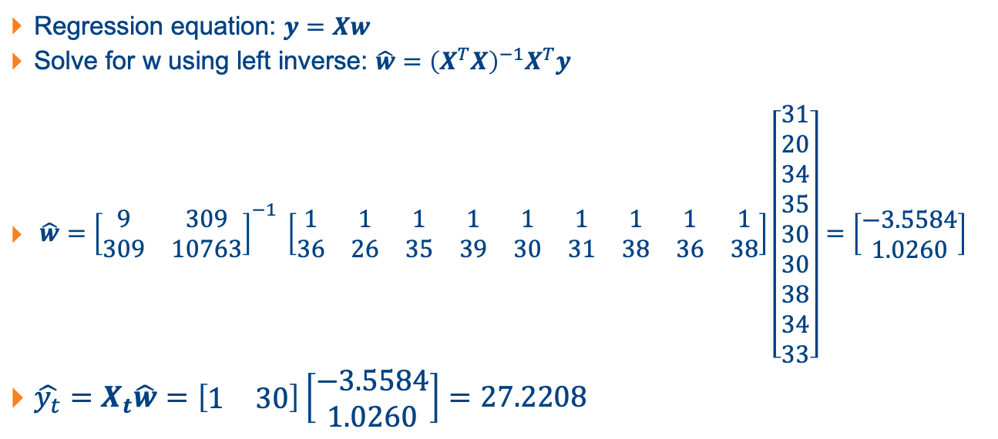
Question 4
Regression equation: $y=Xw$
Solve for w using left inverse: $\hat{w}={\left(X^{T}X\right)}^{−1}X^{T}y$
$\hat{w}={\left[\begin{matrix}9 & 309 \\ 309 & 10763\end{matrix}\right]}^{−1} \left[\begin{matrix}1 & 1 & 1 & 1 & 1 & 1 & 1 & 1 & 1 \\ 36 & 26 & 35 & 39 & 30 & 31 & 38 & 36 & 38\end{matrix}\right]\left[\begin{matrix}31 \\ 20 \\ 34 \\ 35 \\ 30 \\ 30 \\ 38 \\ 34 \\ 33\end{matrix}\right]=\left[\begin{matrix}−3.5584 \\ 1.0260\end{matrix}\right]$
$\hat{y_{t}}=X_{t}\hat{w}=\left[\begin{matrix}1 & 30\end{matrix}\right]\left[\begin{matrix}−3.5584 \\ 1.0260\end{matrix}\right]=27.2208$

Slide 30
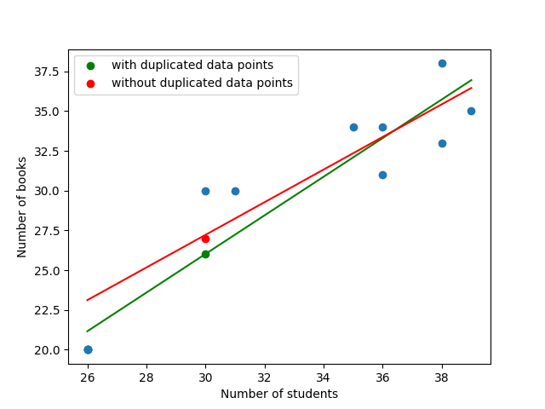
Question 4
Semester | Students | Books
1 | 36 | 31
2 | 26 | 20
3 | 35 | 34
4 | 39 | 35
5 | 26 | 20
6 | 30 | 30
7 | 31 | 30
8 | 38 | 38
9 | 36 | 34
10 | 38 | 33
11 | 26 | 20
12 | 26 | 20
(d) Sketch and compare the two fitting lines.

Slide 31
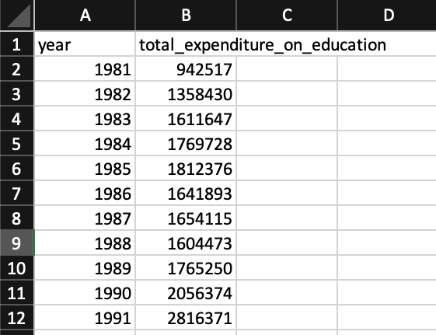
Question 5
The government’s educational expenditure over the years (downloaded in July 2021 from https://data.gov.sg/dataset/government-expenditure-on-education)
Predict the educational expenditure of year 2021 based on linear regression. Solve the problem using Python with a plot.
Hint: use Python packages like numpy, pandas, matplotlib.pyplot, numpy.linalg.

Slide 32
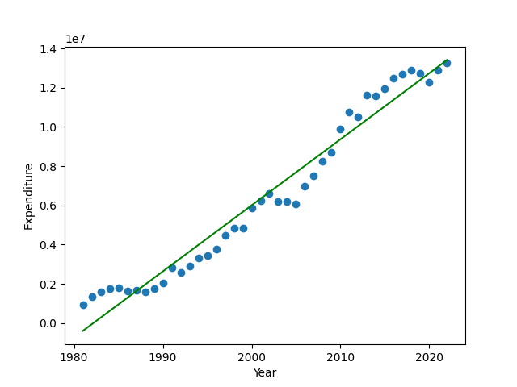
Question 5

Slide 33
Question 6
Download the CSV file for red wine using “wine = pd.read_csv("https://archive.ics.uci.edu/ml/machine-learning-databases/wine-quality/winequality-red.csv",sep=';’)”
(a) Take y = wine.quality as the target output and x = wine.drop('quality',axis = 1)as the input features. Assume the given list of data is already randomly indexed (i.e., not in particular order), split the database into two sets: [0:1500] samples for regression training, and [1500:1599] samples for testing.

Slide 34
Question 6
Download the CSV file for red wine using “wine = pd.read_csv("https://archive.ics.uci.edu/ml/machine-learning-databases/wine-quality/winequality-red.csv",sep=';’)”
(b) Perform linear regression on the training set and print out the learned parameters.
(c) Perform prediction using the test set and provide the prediction accuracy in terms of the mean of squared errors (MSE).

Slide 35

Question 7
This question is related to understanding of modelling assumptions. The function given by $f\left(x\right)=1+x_{1}+x_{2}−x_{3}−x_{4}$is affine.
True
False

Slide 36
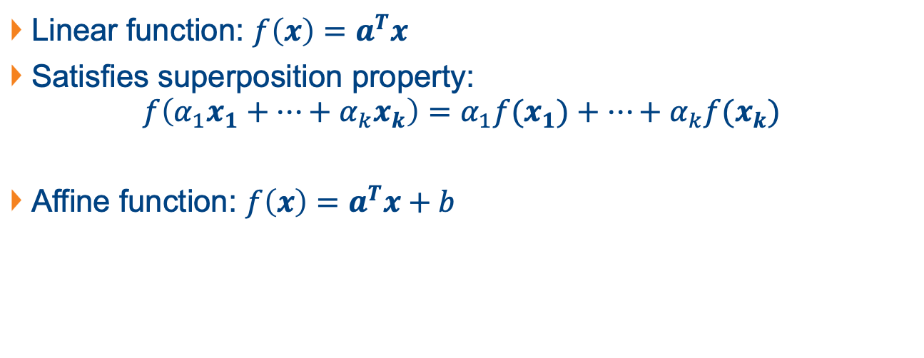
Linear and Affine Functions
Linear function: $f\left(x\right)=a^{T}x$
Satisfies superposition property:
$$f\left(α_{1}x_{1}+…+α_{k}x_{k}\right)=α_{1}{f(x}_{1})+…+α_{k}{f(x}_{k})$$
Affine function: $f\left(x\right)=a^{T}x+b$

Slide 37
Question 7
This question is related to understanding of modelling assumptions. The function given by $f\left(x\right)=1+x_{1}+x_{2}−x_{3}−x_{4}$is affine.
True
False

Slide 38
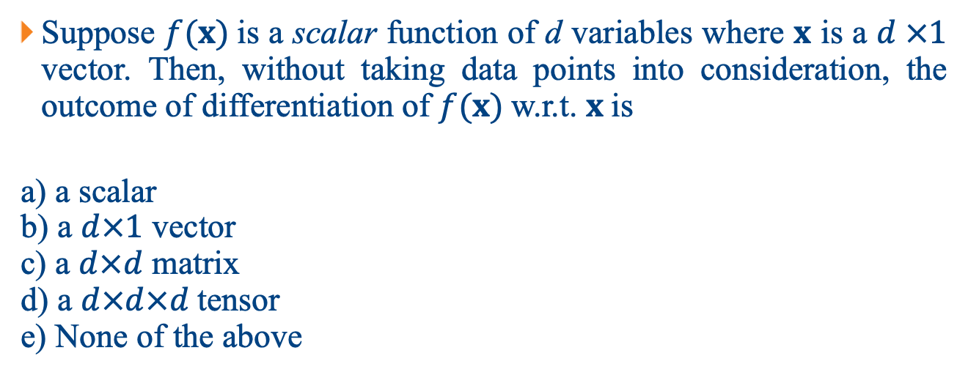
Question 8
Suppose $f(x)$is a scalar function of d variables where $x$ is a $d ×1$ vector. Then, without taking data points into consideration, the outcome of differentiation of $f(x)$ w.r.t. $x$ is
a) a scalar b) a $d×1$ vector c) a $d×d$ matrix d) a $d×d×d$tensor e) None of the above

Slide 39
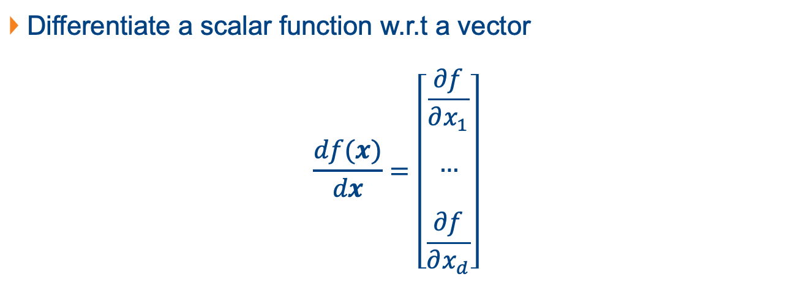
Question 8
Differentiate a scalar function w.r.t a vector
$$\frac{df(x)}{dx}=\left[\begin{matrix}\begin{aligned}\frac{∂f}{∂x_{1}} \\ \end{aligned} \\ \begin{aligned}… \\ \end{aligned} \\ \frac{∂f}{∂x_{d}}\end{matrix}\right]$$

Slide 40
Question 8
Suppose $f(x)$is a scalar function of d variables where $x$ is a $d ×1$ vector. Then, without taking data points into consideration, the outcome of differentiation of $f(x)$ w.r.t. $x$ is
a) a scalar b) a $d×1$ vector c) a $d×d$ matrix d) a $d×d×d$tensor e) None of the above

Slide 41
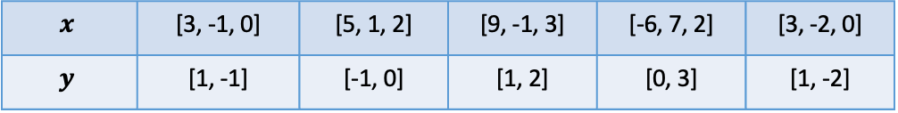
Question 9
The values of feature vector x and their corresponding values of target vector y are shown in the table below:
Find the least square solution of w using linear regression of multiple outputs and then estimate the value of y when x = [8, 0, 2].
$$x$$ | [3, -1, 0] | [5, 1, 2] | [9, -1, 3] | [-6, 7, 2] | [3, -2, 0]
$$y$$ | [1, -1] | [-1, 0] | [1, 2] | [0, 3] | [1, -2]

Slide 42



Linear Regression of Multiple Outputs
$$X$$
$$y$$
$$\left[\begin{matrix}1 & 3 & −1 & 0 \\ 1 & 5 & 1 & 2 \\ 1 & 9 & −1 & 3 \\ 1 & −6 & 7 & 2 \\ −1 & 3 & −2 & 9\end{matrix}\right]w=\left[\begin{matrix}1 & −1 \\ −1 & 0 \\ 1 & 2 \\ 0 & 3 \\ 1 & −2\end{matrix}\right]$$
Discussion: what’s the shape of w?

Slide 43
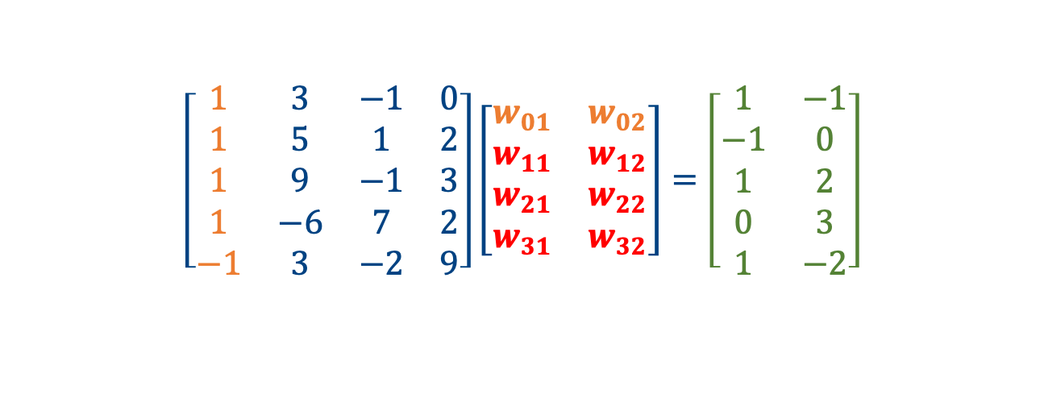
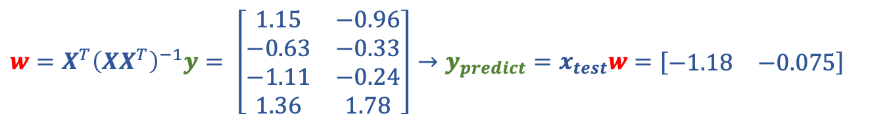
Linear Regression of Multiple Outputs
$$X$$
$$w$$
$$y$$
$$\left[\begin{matrix}1 & 3 & −1 & 0 \\ 1 & 5 & 1 & 2 \\ 1 & 9 & −1 & 3 \\ 1 & −6 & 7 & 2 \\ −1 & 3 & −2 & 9\end{matrix}\right]\left[\begin{matrix}w_{01} & w_{02} \\ w_{11} & w_{12} \\ w_{21} & w_{22} \\ w_{31} & w_{32}\end{matrix}\right]=\left[\begin{matrix}1 & −1 \\ −1 & 0 \\ 1 & 2 \\ 0 & 3 \\ 1 & −2\end{matrix}\right]$$
$$w=X^{T}{\left(XX^{T}\right)}^{−1}y= \left[\begin{matrix}1.15 & −0.96 \\ −0.63 & −0.33 \\ −1.11 & −0.24 \\ 1.36 & 1.78\end{matrix}\right]→y_{predict}=x_{test}w=[\begin{matrix}−1.18 & −0.075\end{matrix}]$$

