Slide 1
EE2211 Tutorial 6
Thao Nguyen

Slide 2
Question 1
Derive the solution for linear ridge regression in dual form (see Lecture 6 notes page 16).

Slide 3
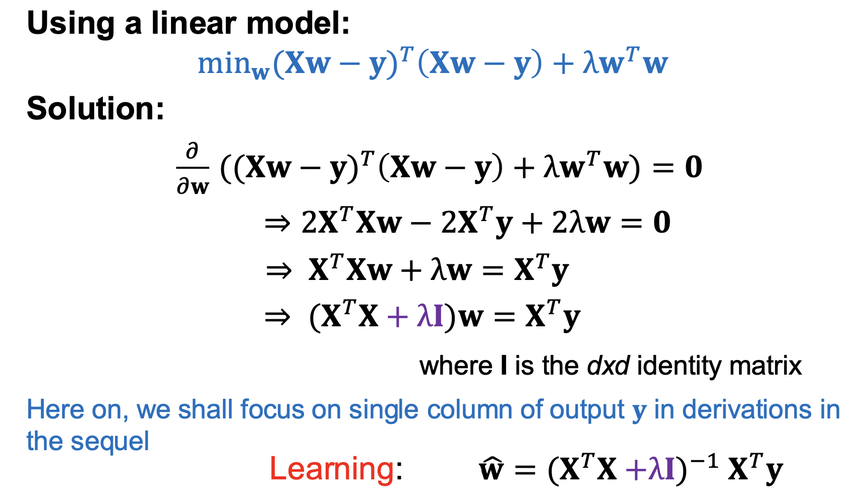
Question 1
Recap: Ridge regression (Primal form) – from your lecture notes:

Slide 4
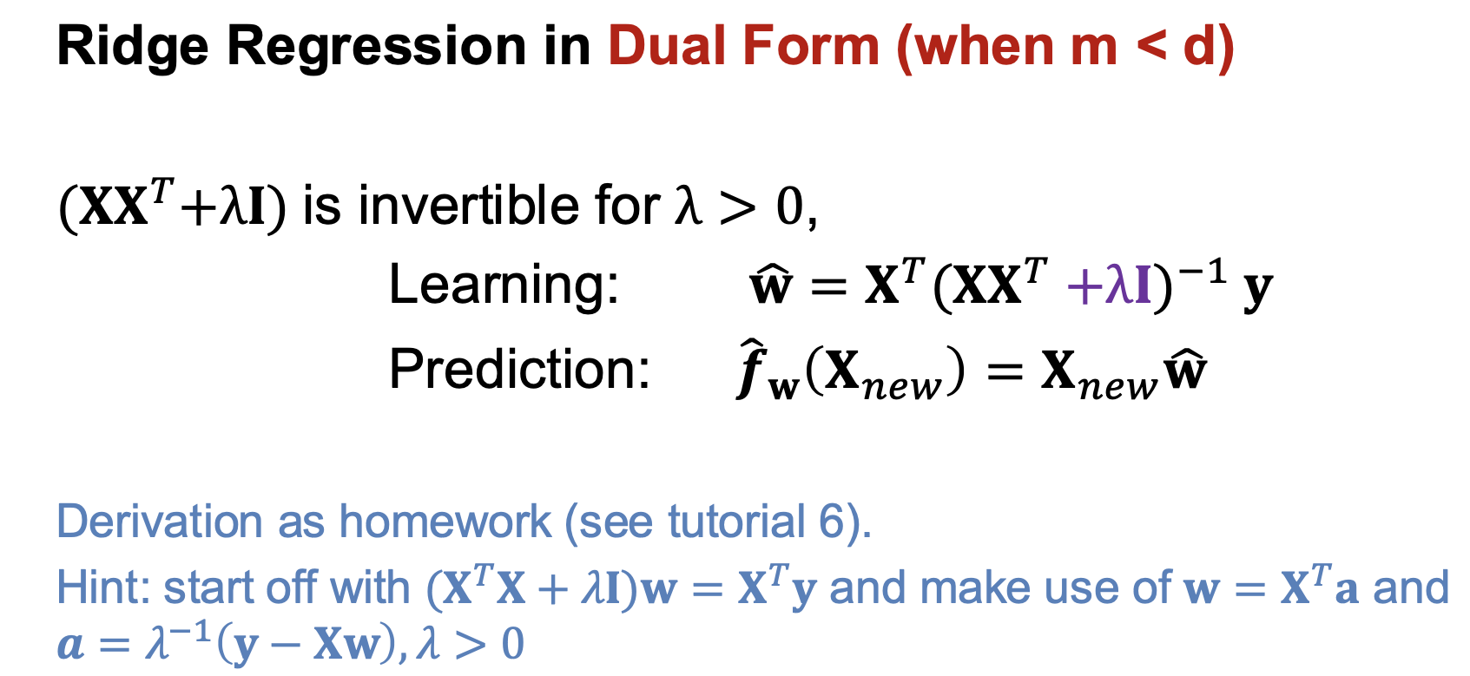
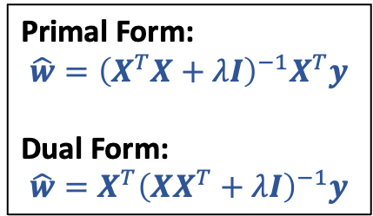
Question 1
From your lecture notes:
Primal Form:
$$\hat{w}={\left(X^{T}X+λI\right)}^{−1}X^{T}y$$
Dual Form:
$$\hat{w}=X^{T}{\left(XX^{T}+λI\right)}^{−1}y$$

Slide 5
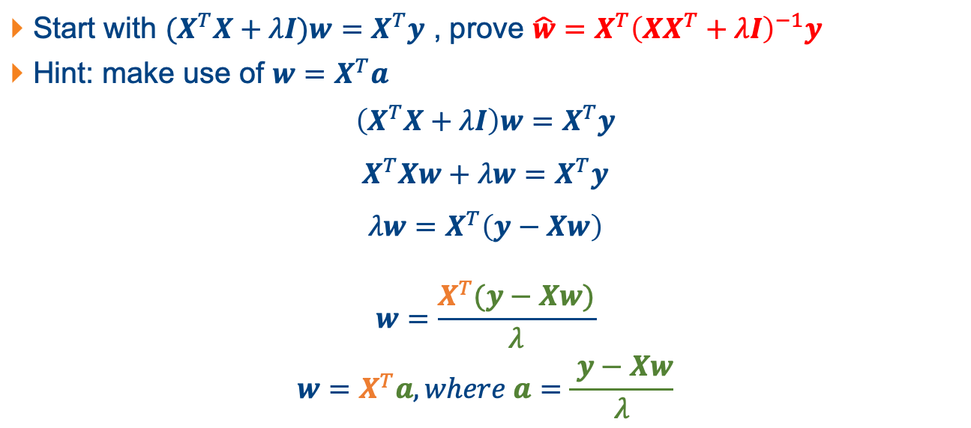
Question 1
Start with ${(X}^{T}X+λI)w=X^{T}y$ , prove $\hat{w}=X^{T}{\left(XX^{T}+λI\right)}^{−1}y$
Hint: make use of $w=X^{T}a$
$$\left(X^{T}X+λI\right)w=X^{T}y$$
$$X^{T}Xw+λw=X^{T}y$$
$$λw=X^{T}\left(y−Xw\right)$$
$$w=\frac{X^{T}(y−Xw)}{λ}$$
$$w=X^{T}a, where a=\frac{ y−Xw}{λ}$$

Slide 6

Question 1
Start with ${(X}^{T}X+λI)w=X^{T}y$ , prove $\hat{w}=X^{T}{\left(XX^{T}+λI\right)}^{−1}y$
$w=X^{T}a, where a=\frac{ y−Xw}{λ}$
$$a=\frac{y−Xw}{λ}$$
$$λa=y−Xw$$
$$λa=y−XX^{T}a$$
$$\left(XX^{T}+λI\right)a=y$$
$$a={\left(XX^{T}+λI\right)}^{−1}y$$
$$w=X^{T}a=X^{T}{\left(XX^{T}+λI\right)}^{−1}y$$

Slide 7
Question 2
Given the following data pairs for training
{𝑥=−10} →{𝑦=5}
{𝑥=−8} →{𝑦=5}
{𝑥=−3} →{𝑦=4}
{𝑥=−1} →{𝑦=3}
{𝑥=2} →{𝑦=2}
{𝑥=8} →{𝑦=2}
(a) Perform a 3rd-order polynomial regression and sketch the result of line fitting.
(b) Given a test point {𝑥 = 9} predict 𝑦 using the polynomial model.
(c) Compare this prediction with that of a linear regression.

Slide 8
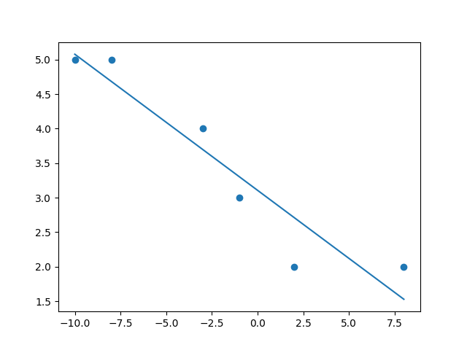
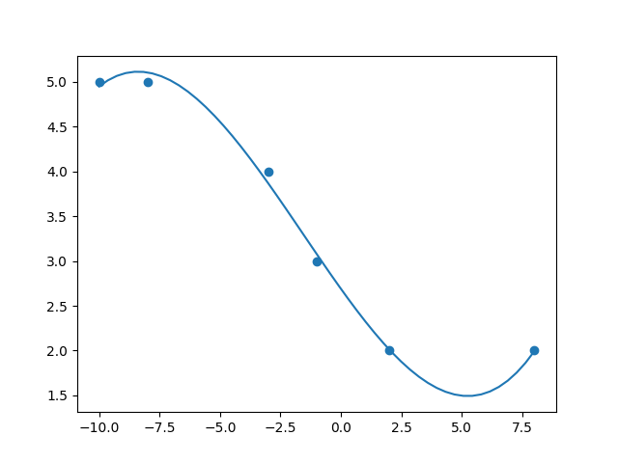
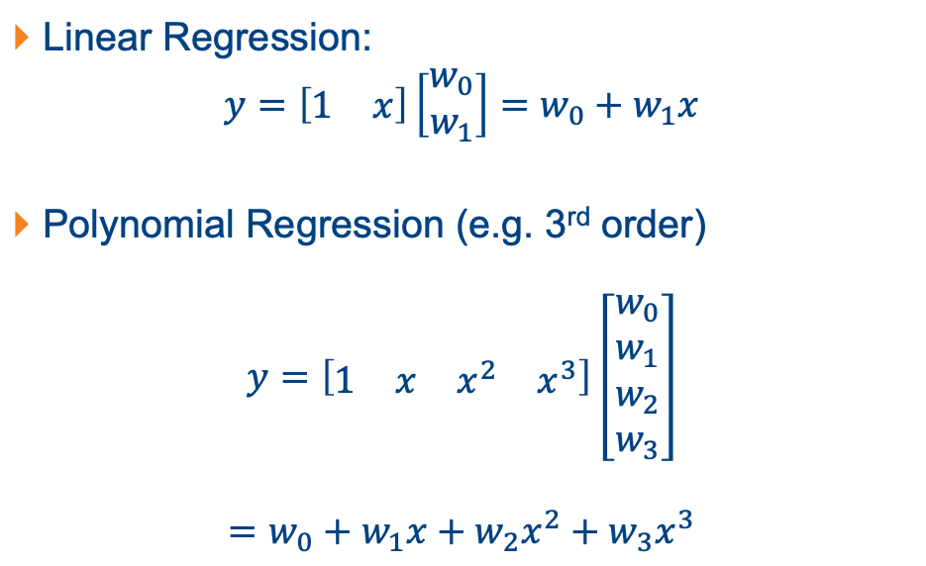
Question 2
Linear Regression:
$y=\left[\begin{matrix}1 & x\end{matrix}\right]\left[\begin{matrix}w_{0} \\ w_{1}\end{matrix}\right]=w_{0}+w_{1}x$
Polynomial Regression (e.g. 3rd order)
$$y=\left[\begin{matrix}1 & x & x^{2} & x^{3}\end{matrix}\right]\left[\begin{matrix}w_{0} \\ w_{1} \\ w_{2} \\ w_{3}\end{matrix}\right]$$
$$=w_{0}+w_{1}x+w_{2}x^{2}+w_{3}x^{3}$$

Slide 9
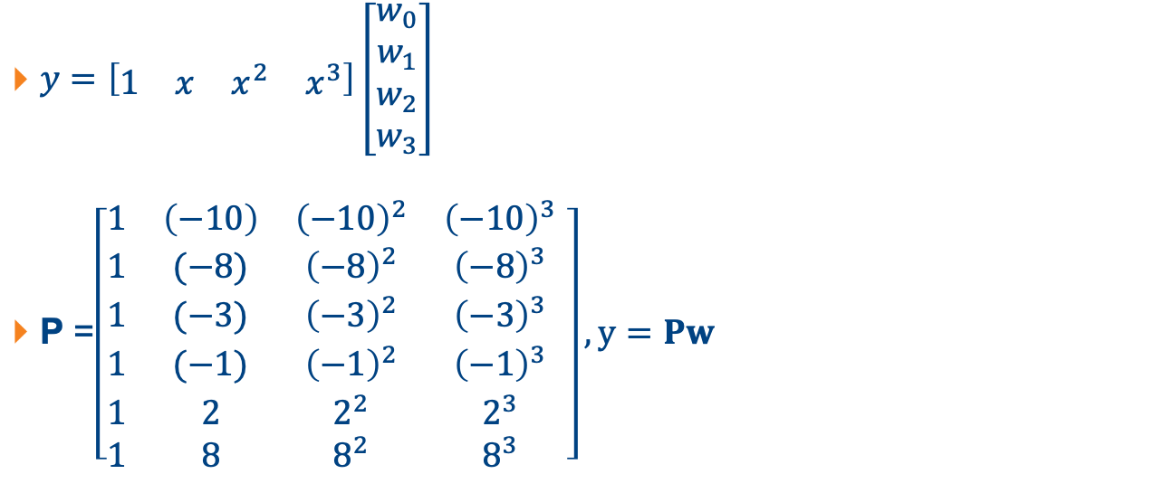
Question 2
{𝑥=−10} →{𝑦=5}
{𝑥=−8} →{𝑦=5}
{𝑥=−3} →{𝑦=4}
{𝑥=−1} →{𝑦=3}
{𝑥=2} →{𝑦=2}
{𝑥=8} →{𝑦=2}
$y=\left[\begin{matrix}1 & x & x^{2} & x^{3}\end{matrix}\right]\left[\begin{matrix}w_{0} \\ w_{1} \\ w_{2} \\ w_{3}\end{matrix}\right]$
P =$\left[\begin{matrix}1 & \left(−10\right) & {\left(−10\right)}^{2} & {\left(−10\right)}^{3} \\ 1 & (−8) & {\left(−8\right)}^{2} & {\left(−8\right)}^{3} \\ 1 & (−3) & {\left(−3\right)}^{2} & {\left(−3\right)}^{3} \\ 1 & (−1) & {\left(−1\right)}^{2} & {\left(−1\right)}^{3} \\ 1 & 2 & 2^{2} & 2^{3} \\ 1 & 8 & 8^{2} & 8^{3}\end{matrix} \right], y=Pw$

Slide 10
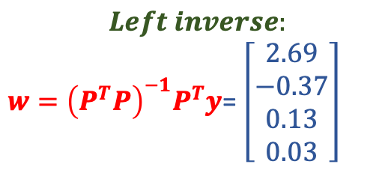
Question 2
{𝑥=−10} →{𝑦=5}
{𝑥=−8} →{𝑦=5}
{𝑥=−3} →{𝑦=4}
{𝑥=−1} →{𝑦=3}
{𝑥=2} →{𝑦=2}
{𝑥=8} →{𝑦=2}
$y=\left[\begin{matrix}1 & x & x^{2} & x^{3}\end{matrix}\right]\left[\begin{matrix}w_{0} \\ w_{1} \\ w_{2} \\ w_{3}\end{matrix}\right]$
P =$\left[\begin{matrix}1 & \left(−10\right) & {\left(−10\right)}^{2} & {\left(−10\right)}^{3} \\ 1 & (−8) & {\left(−8\right)}^{2} & {\left(−8\right)}^{3} \\ 1 & (−3) & {\left(−3\right)}^{2} & {\left(−3\right)}^{3} \\ 1 & (−1) & {\left(−1\right)}^{2} & {\left(−1\right)}^{3} \\ 1 & 2 & 2^{2} & 2^{3} \\ 1 & 8 & 8^{2} & 8^{3}\end{matrix} \right], y=Pw$
$$Left inverse:$$
$w={\left(P^{T}P\right)}^{−1}P^{T}y$= $\left[\begin{matrix}2.69 \\ −0.37 \\ 0.13 \\ 0.03\end{matrix}\right]$

Slide 11
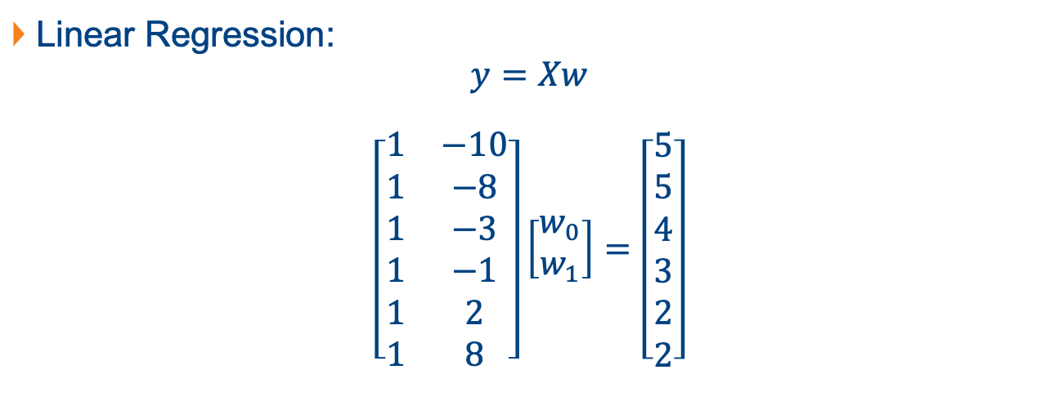
Question 2
Linear Regression:
$$y=Xw$$
$$\left[\begin{matrix}1 & −10 \\ 1 & −8 \\ 1 & −3 \\ 1 & −1 \\ 1 & 2 \\ 1 & 8\end{matrix}\right]\left[\begin{matrix}w_{0} \\ w_{1}\end{matrix}\right]=\left[\begin{matrix}5 \\ 5 \\ 4 \\ 3 \\ 2 \\ 2\end{matrix}\right]$$
{𝑥=−10} →{𝑦=5}
{𝑥=−8} →{𝑦=5}
{𝑥=−3} →{𝑦=4}
{𝑥=−1} →{𝑦=3}
{𝑥=2} →{𝑦=2}
{𝑥=8} →{𝑦=2}

Slide 12
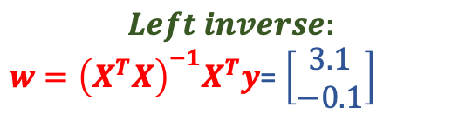
Question 2
Linear Regression:
$$y=Xw$$
$$\left[\begin{matrix}1 & −10 \\ 1 & −8 \\ 1 & −3 \\ 1 & −1 \\ 1 & 2 \\ 1 & 8\end{matrix}\right]\left[\begin{matrix}w_{0} \\ w_{1}\end{matrix}\right]=\left[\begin{matrix}5 \\ 5 \\ 4 \\ 3 \\ 2 \\ 2\end{matrix}\right]$$
{𝑥=−10} →{𝑦=5}
{𝑥=−8} →{𝑦=5}
{𝑥=−3} →{𝑦=4}
{𝑥=−1} →{𝑦=3}
{𝑥=2} →{𝑦=2}
{𝑥=8} →{𝑦=2}
$$Left inverse:$$
$w={\left(X^{T}X\right)}^{−1}X^{T}y$= $\left[\begin{matrix}3.1 \\ −0.1\end{matrix}\right]$

Slide 13
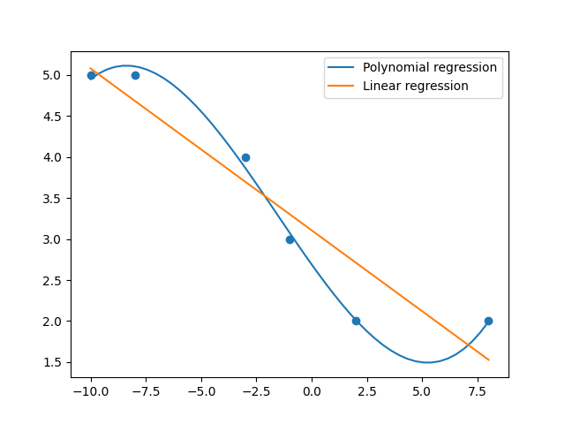
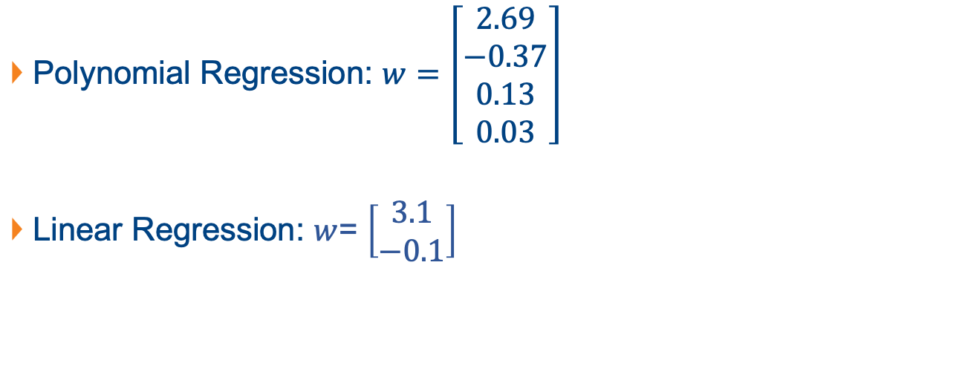
Question 2
Polynomial Regression: $w=\left[\begin{matrix}2.69 \\ −0.37 \\ 0.13 \\ 0.03\end{matrix}\right]$
Linear Regression: $w$= $\left[\begin{matrix}3.1 \\ −0.1\end{matrix}\right]$

Slide 14
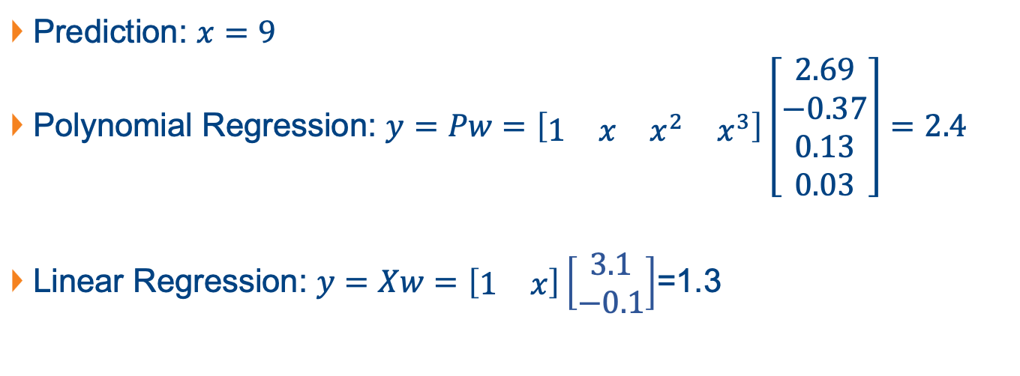
Question 2
Prediction: $x=9$
Polynomial Regression: $y=Pw=\left[\begin{matrix}1 & x & x^{2} & x^{3}\end{matrix}\right]\left[\begin{matrix}2.69 \\ −0.37 \\ 0.13 \\ 0.03\end{matrix}\right]=2.4$
Linear Regression: $y=Xw=\left[\begin{matrix}1 & x\end{matrix}\right]\left[\begin{matrix}3.1 \\ −0.1\end{matrix}\right]$=1.3

Slide 15
Question 3
(a) Write down the expression for a 3rd order polynomial model having a 3-dimensional input.

Slide 16
Question 3
Discussion: write the expression for a 3rd order polynomial model having a 1-dimensional input?

Slide 17

Question 3
Discussion: write the expression for a 3rd order polynomial model having a 1-dimensional input?
$$f\left(x\right)=w_{0}+w_{1}x+w_{2}x^{2}+w_{3}x^{3}$$

Slide 18
Question 3
Discussion: write the expression for a 2nd order polynomial model having a 2-dimensional input?

Slide 19

Question 3
Discussion: write the expression for a 2nd order polynomial model having a 2-dimensional input?
$$f\left(x\right)=w_{0}+w_{1}x_{1}+w_{2}x_{2}+w_{11}x_{1}^{2}+w_{22}x_{2}^{2}+w_{12}x_{1}x_{2}$$

Slide 20
Question 3
Discussion: write the expression for a 2nd order polynomial model having a 3-dimensional input?

Slide 21
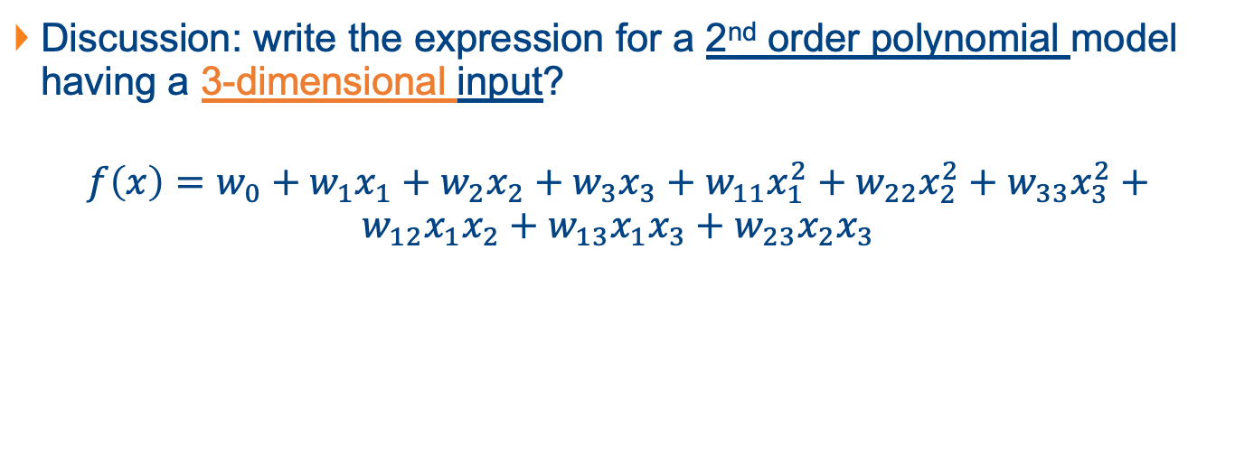
Question 3
Discussion: write the expression for a 2nd order polynomial model having a 3-dimensional input?
$$f\left(x\right)=w_{0}+w_{1}x_{1}+w_{2}x_{2}+w_{3}x_{3}+w_{11}x_{1}^{2}+w_{22}x_{2}^{2}+w_{33}x_{3}^{2}+$$
$$w_{12}x_{1}x_{2}+w_{13}x_{1}x_{3}+w_{23}x_{2}x_{3}$$

Slide 22
Question 3
(a) Write down the expression for a 3rd order polynomial model having a 3-dimensional input.

Slide 23
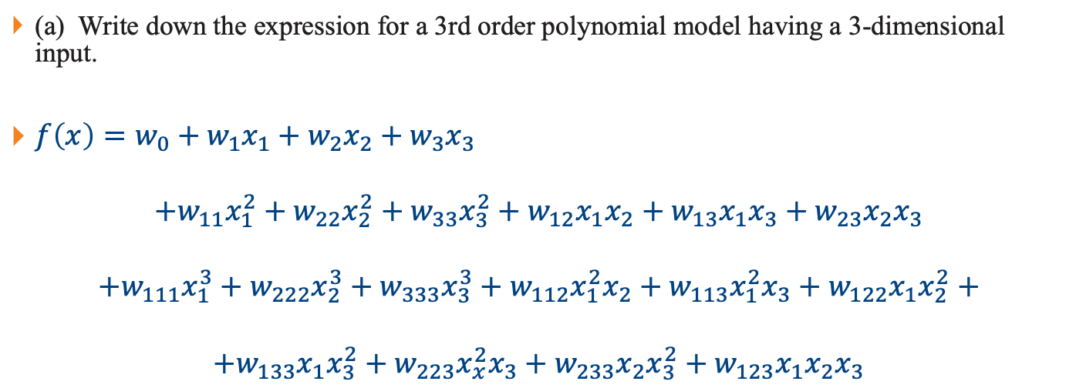
Question 3
(a) Write down the expression for a 3rd order polynomial model having a 3-dimensional input.
$f\left(x\right)=w_{0}+w_{1}x_{1}+w_{2}x_{2}+w_{3}x_{3}$
$$+w_{11}x_{1}^{2}+w_{22}x_{2}^{2}+w_{33}x_{3}^{2}+w_{12}x_{1}x_{2}+w_{13}x_{1}x_{3}+w_{23}x_{2}x_{3}$$
$$+w_{111}x_{1}^{3}+w_{222}x_{2}^{3}+w_{333}x_{3}^{3}+w_{112}x_{1}^{2}x_{2}+w_{113}x_{1}^{2}x_{3}+w_{122}x_{1}x_{2}^{2}+$$
$$+w_{133}x_{1}x_{3}^{2}+w_{223}x_{x}^{2}x_{3}+w_{233}x_{2}x_{3}^{2}+w_{123}x_{1}x_{2}x_{3}$$

Slide 24
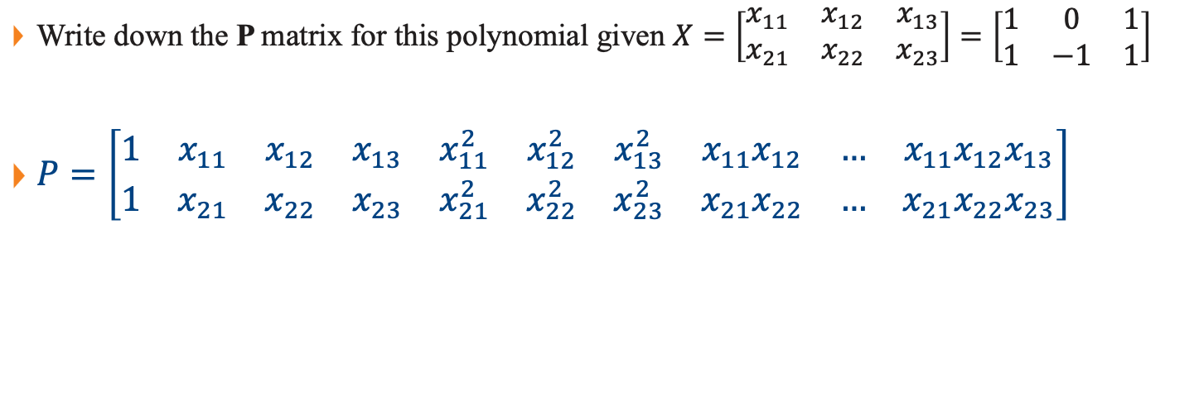
Question 3
Write down the P matrix for this polynomial given $X=\left[\begin{matrix}x_{11} & x_{12} & x_{13} \\ x_{21} & x_{22} & x_{23}\end{matrix}\right]=\left[\begin{matrix}1 & 0 & 1 \\ 1 & −1 & 1\end{matrix}\right]$
$P=\left[\begin{matrix}1 & x_{11} & x_{12} & x_{13} & x_{11}^{2} & x_{12}^{2} & x_{13}^{2} & x_{11}x_{12} & … & x_{11}x_{12}x_{13} \\ 1 & x_{21} & x_{22} & x_{23} & x_{21}^{2} & x_{22}^{2} & x_{23}^{2} & x_{21}x_{22} & … & x_{21}x_{22}x_{23}\end{matrix}\right]$

Slide 25
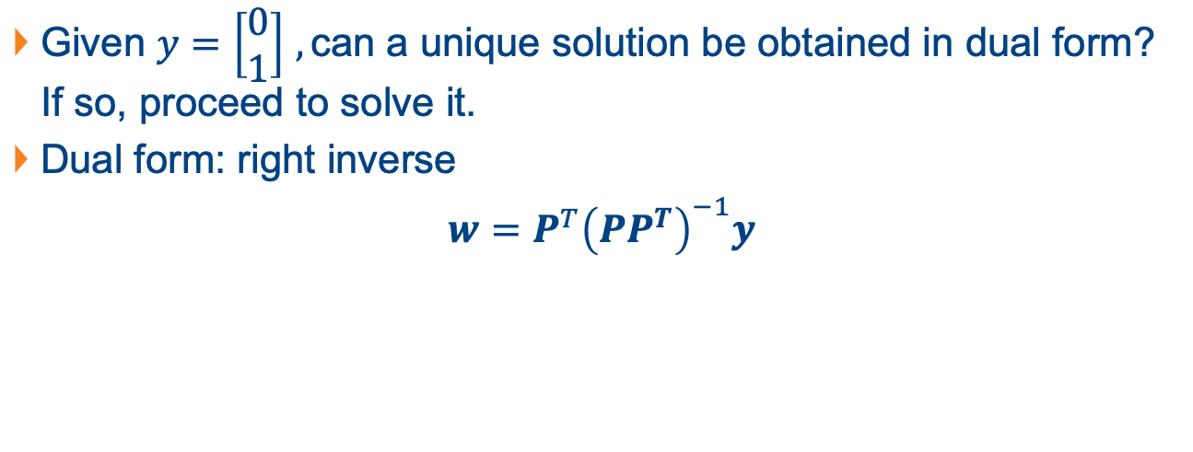
Question 3
Given $y=\left[\begin{matrix}0 \\ 1\end{matrix}\right]$ $,\text{can} \text{a} \text{unique} \text{solution} \text{be} \text{obtained} \text{in} \text{dual} \text{form}\text{? }\text{If} \text{so}\text{, }\text{proceed} \text{to} \text{solve} \text{it}\text{. }$
Dual form: right inverse
$w=P^{T}{\left(PP^{T}\right)}^{−1}y$

Slide 26
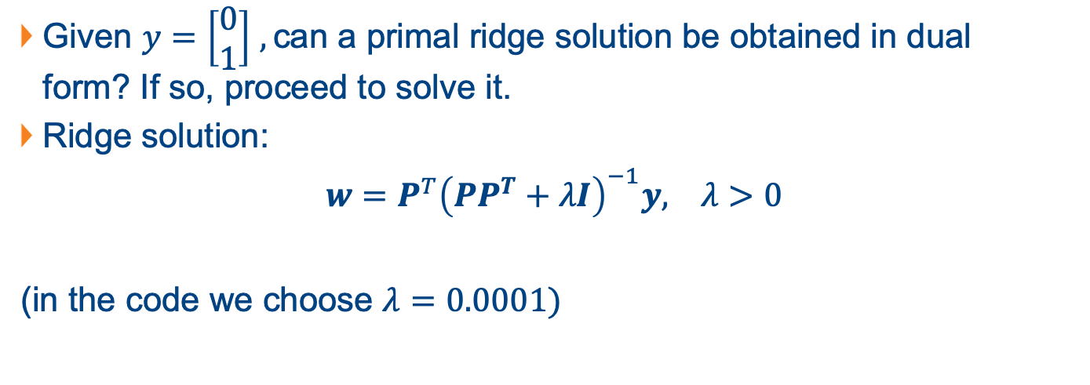
Question 3
Given $y=\left[\begin{matrix}0 \\ 1\end{matrix}\right]$ $,\text{can} \text{a} \text{primal} \text{ridge} \text{solution} \text{be} \text{obtained} \text{in} \text{dual} \text{form}\text{? }\text{If} \text{so}\text{, }\text{proceed} \text{to} \text{solve} \text{it}\text{. }$
Ridge solution:
$w=P^{T}{\left(PP^{T}+λI\right)}^{−1}y, λ>0$
(in the code we choose $λ=0.0001)$

Slide 27
Question 4
Given the training data:
{𝑥=−1} →{𝑦=𝑐𝑙𝑎𝑠𝑠1}
{𝑥= 0} →{𝑦=𝑐𝑙𝑎𝑠𝑠1}
{𝑥=0.5} →{𝑦=𝑐𝑙𝑎𝑠𝑠2}
{𝑥=0.3} →{𝑦=𝑐𝑙𝑎𝑠𝑠1}
{𝑥=0.8} →{𝑦=𝑐𝑙𝑎𝑠𝑠2}
Predict the class label for {𝑥 = −0.1} and {𝑥 = 0.4} using linear regression with signum discrimination.

Slide 28

Question 4
X
w
y
$$\left[\begin{matrix}1 & −1 \\ 1 & 0 \\ 1 & 0.5 \\ 1 & 0.3 \\ 1 & 0.8\end{matrix}\right]\left[\begin{matrix}w_{0} \\ w_{1}\end{matrix}\right]=\left[\begin{matrix}1 \\ 1 \\ −1 \\ 1 \\ −1\end{matrix}\right]$$
$w={\left(X^{T}X\right)}^{−1}X^{T}y=\left[\begin{matrix}0.33 \\ −1.11\end{matrix}\right]$

Slide 29
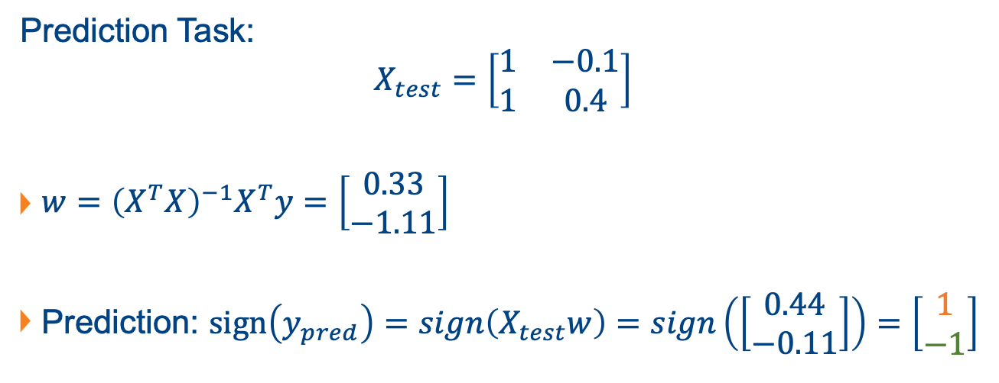
Question 4
Prediction Task:
$$X_{test}=\left[\begin{matrix}1 & −0.1 \\ 1 & 0.4\end{matrix}\right]$$
$w={\left(X^{T}X\right)}^{−1}X^{T}y=\left[\begin{matrix}0.33 \\ −1.11\end{matrix}\right]$
Prediction: $sign\left(y_{pred}\right)=sign\left(X_{test}w\right)=sign\left(\left[\begin{matrix}0.44 \\ −0.11\end{matrix}\right]\right)=\left[\begin{matrix}1 \\ −1\end{matrix}\right]$

Slide 30
Question 5
Given the training data:
{𝑥=−1} →{𝑦=𝑐𝑙𝑎𝑠𝑠1}
{𝑥= 0} →{𝑦=𝑐𝑙𝑎𝑠𝑠1}
{𝑥=0.5} →{𝑦=𝑐𝑙𝑎𝑠𝑠2}
{𝑥=0.3} →{𝑦=𝑐𝑙𝑎𝑠𝑠3}
{𝑥=0.8} →{𝑦=𝑐𝑙𝑎𝑠𝑠2}
(a) Predict the class label for {𝑥 = −0.1} and {𝑥 = 0.4} based on linear regression towards a one-hot encoded target.
(b) Predict the class label for {𝑥 = −0.1} and {𝑥 = 0.4} using a polynomial model of 5th order and a one-hot encoded target.

Slide 31
Question 5
Given the training data:
{𝑥=−1} →{𝑦=𝑐𝑙𝑎𝑠𝑠1} y=[1, 0, 0]
{𝑥= 0} →{𝑦=𝑐𝑙𝑎𝑠𝑠1} y=[1, 0, 0]
{𝑥=0.5} →{𝑦=𝑐𝑙𝑎𝑠𝑠2} y=[0, 1, 0]
{𝑥=0.3} →{𝑦=𝑐𝑙𝑎𝑠𝑠3} y=[0, 0, 1]
{𝑥=0.8} →{𝑦=𝑐𝑙𝑎𝑠𝑠2} y=[0, 1, 0]
(a) Predict the class label for {𝑥 = −0.1} and {𝑥 = 0.4} based on linear regression towards a one-hot encoded target.
(b) Predict the class label for {𝑥 = −0.1} and {𝑥 = 0.4} using a polynomial model of 5th order and a one-hot encoded target.

Slide 32
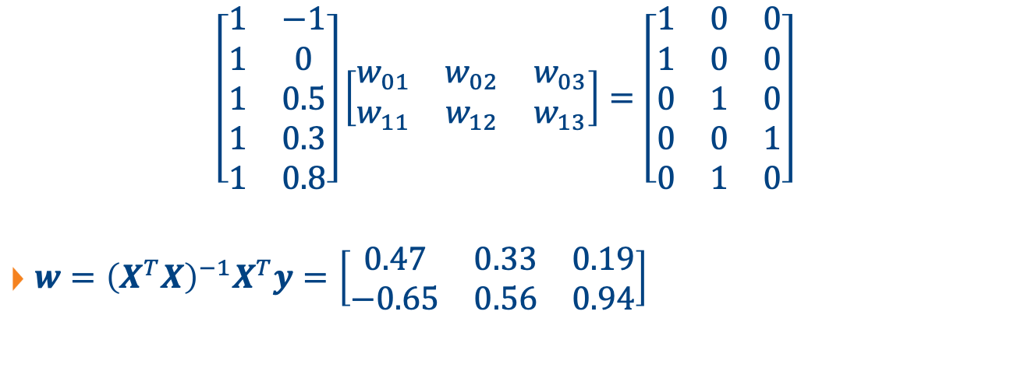
Question 5
X
w
y
$$\left[\begin{matrix}1 & −1 \\ 1 & 0 \\ 1 & 0.5 \\ 1 & 0.3 \\ 1 & 0.8\end{matrix}\right]\left[\begin{matrix}w_{01} & w_{02} & w_{03} \\ w_{11} & w_{12} & w_{13}\end{matrix}\right]=\left[\begin{matrix}1 & 0 & 0 \\ 1 & 0 & 0 \\ 0 & 1 & 0 \\ 0 & 0 & 1 \\ 0 & 1 & 0\end{matrix}\right]$$
$w={\left(X^{T}X\right)}^{−1}X^{T}y=\left[\begin{matrix}0.47 & 0.33 & 0.19 \\ −0.65 & 0.56 & 0.94\end{matrix}\right]$

Slide 33

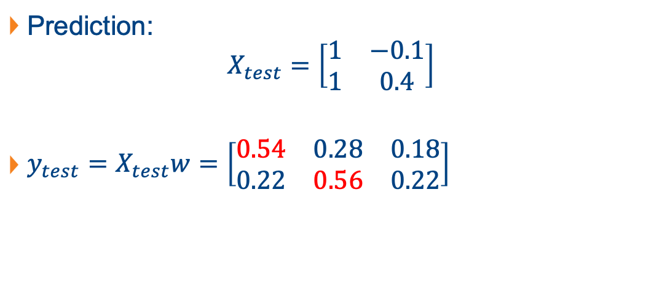
Question 5
Prediction:
$$X_{test}=\left[\begin{matrix}1 & −0.1 \\ 1 & 0.4\end{matrix}\right]$$
$y_{test}=X_{test}w=\left[\begin{matrix}0.54 & 0.28 & 0.18 \\ 0.22 & 0.56 & 0.22\end{matrix}\right]$
$$w=\left[\begin{matrix}0.47 & 0.33 & 0.19 \\ −0.65 & 0.56 & 0.94\end{matrix}\right]$$

Slide 34
Question 5
(b) Predict the class label for {𝑥 = −0.1} and {𝑥 = 0.4} using a polynomial model of 5th order and a one-hot encoded target.

Slide 35

Question 5
Polynomial of 5th order:
$$f\left(x\right)=w_{0}+w_{1}x+w_{2}x^{2}+w_{3}x^{3}+w_{4}x^{4}+w_{5}x^{5}$$
$\left[\begin{matrix}1 & x & x^{2} & x^{3} & x^{4} & x^{5}\end{matrix}\right]\left[\begin{matrix}w_{0} \\ w_{1} \\ w_{2} \\ w_{3} \\ w_{4} \\ w_{5}\end{matrix}\right]$

Slide 36
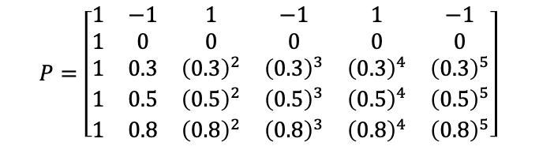
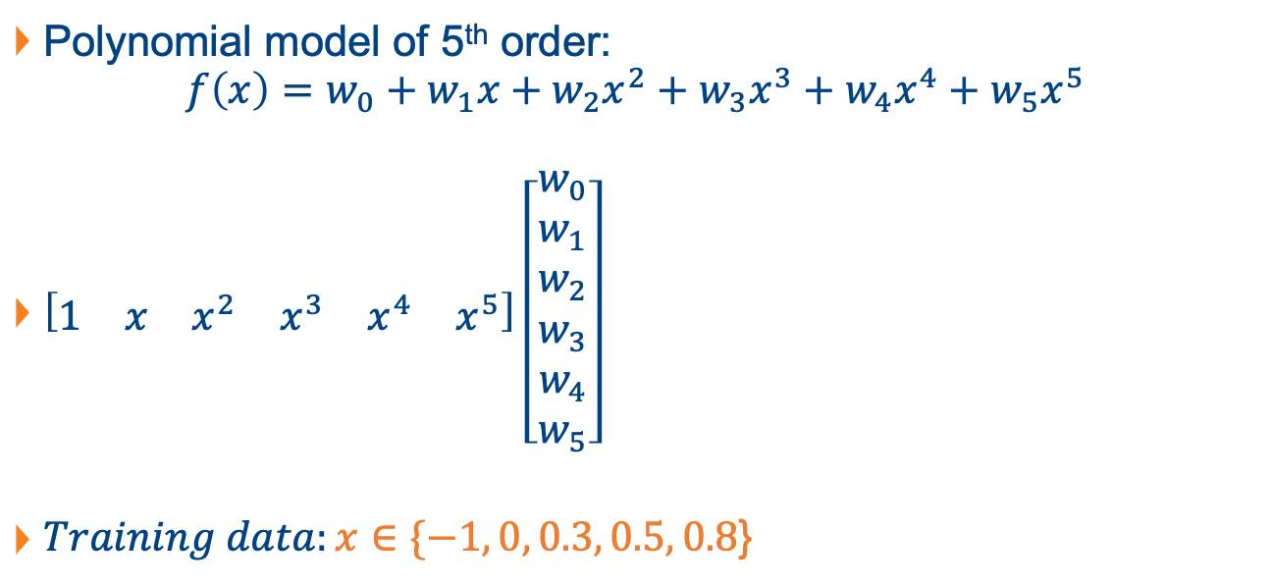
Question 5
Polynomial model of 5th order:
$$f\left(x\right)=w_{0}+w_{1}x+w_{2}x^{2}+w_{3}x^{3}+w_{4}x^{4}+w_{5}x^{5}$$
$\left[\begin{matrix}1 & x & x^{2} & x^{3} & x^{4} & x^{5}\end{matrix}\right]\left[\begin{matrix}w_{0} \\ w_{1} \\ w_{2} \\ w_{3} \\ w_{4} \\ w_{5}\end{matrix}\right]$
$Training data:x∈\{−1, 0, 0.3, 0.5, 0.8$}
$$\begin{matrix}1 & & x & & x^{2} & & x^{3} & & x^{4} & & x^{5}\end{matrix}$$
$$P=\left[\begin{matrix}1 & −1 & 1 & −1 & 1 & −1 \\ 1 & 0 & 0 & 0 & 0 & 0 \\ 1 & 0.3 & {\left(0.3\right)}^{2} & {\left(0.3\right)}^{3} & {\left(0.3\right)}^{4} & {\left(0.3\right)}^{5} \\ 1 & 0.5 & {\left(0.5\right)}^{2} & {\left(0.5\right)}^{3} & {\left(0.5\right)}^{4} & {\left(0.5\right)}^{5} \\ 1 & 0.8 & {\left(0.8\right)}^{2} & {\left(0.8\right)}^{3} & {\left(0.8\right)}^{4} & {\left(0.8\right)}^{5}\end{matrix}\right]$$

Slide 37
Question 5
To find polynomial features in Python (given X, find P):
poly = sklearn.preprocessing.PolynomialFeatures(5)
P = poly.fit_transform(X)

Slide 38
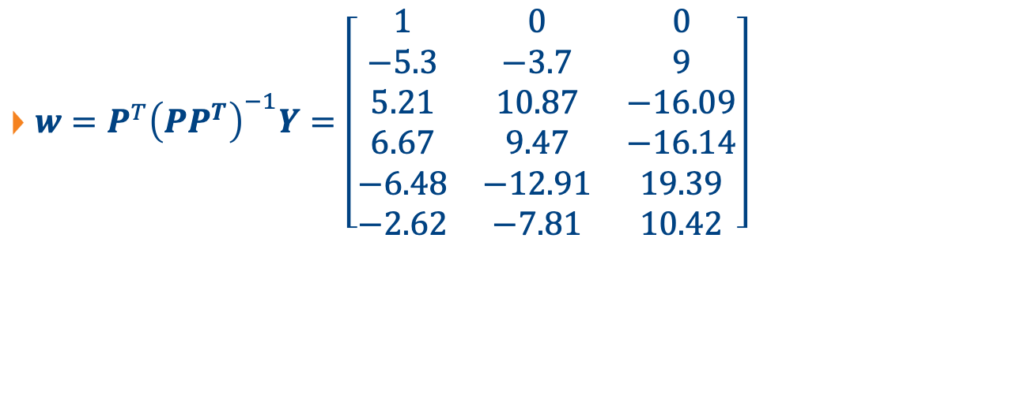
Question 5
$w=P^{T}{\left(PP^{T}\right)}^{−1}Y=\left[\begin{matrix}1 & 0 & 0 \\ −5.3 & −3.7 & 9 \\ 5.21 & 10.87 & −16.09 \\ 6.67 & 9.47 & −16.14 \\ −6.48 & −12.91 & 19.39 \\ −2.62 & −7.81 & 10.42\end{matrix}\right]$

Slide 39
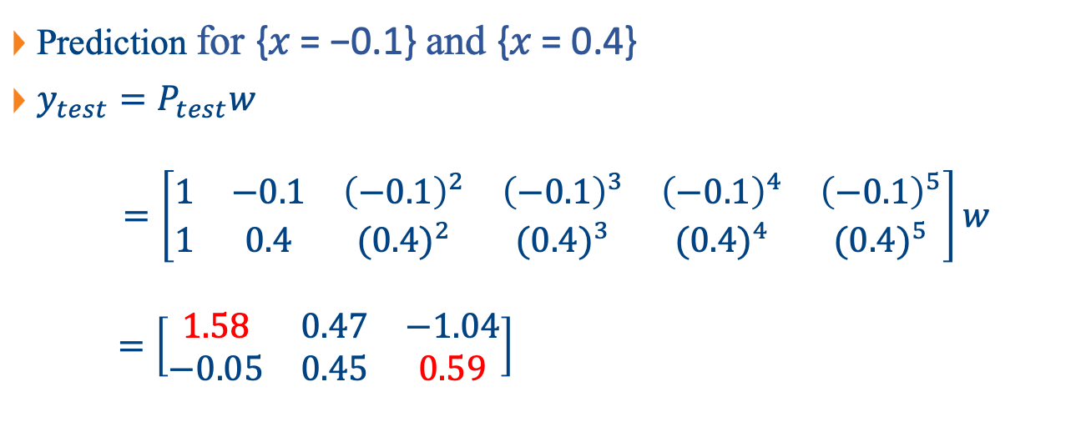
Question 5
Prediction for {𝑥 = −0.1} and {𝑥 = 0.4}
$y_{test}=P_{test}w$
$$=\left[\begin{matrix}1 & −0.1 & {\left(−0.1\right)}^{2} & {\left(−0.1\right)}^{3} & {\left(−0.1\right)}^{4} & {\left(−0.1\right)}^{5} \\ 1 & 0.4 & ({0.4)}^{2} & ({0.4)}^{3} & ({0.4)}^{4} & ({0.4)}^{5}\end{matrix}\right]w$$
$$=\left[\begin{matrix}1.58 & 0.47 & −1.04 \\ −0.05 & 0.45 & 0.59\end{matrix}\right]$$

Slide 40
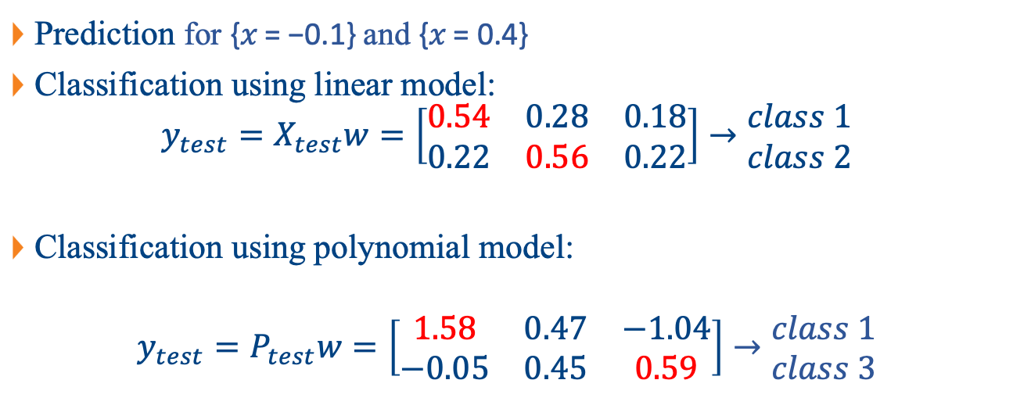
Question 5
Prediction for {𝑥 = −0.1} and {𝑥 = 0.4}
Classification using linear model:
$$y_{test}=X_{test}w=\left[\begin{matrix}0.54 & 0.28 & 0.18 \\ 0.22 & 0.56 & 0.22\end{matrix}\right]→\begin{matrix}class 1 \\ class 2\end{matrix}$$
Classification using polynomial model:
$$y_{test}=P_{test}w=\left[\begin{matrix}1.58 & 0.47 & −1.04 \\ −0.05 & 0.45 & 0.59\end{matrix}\right]→\begin{matrix}class 1 \\ class 3\end{matrix}$$

Slide 41
Question 5
Training set: {-1, 0, 0.3, 0.5, 0.8}
Test set: {-0.1, 0.4}
-0.1
0.4
-1
0
0.3
0.5
0.8
x

Slide 42
Question 6
Get the data set “from sklearn.datasets import load_iris”. Use Python to perform the following tasks.
Split the database into two sets: 74% of samples for training, and 26% of samples for testing. Hint: you might want to utilize from sklearn.model_selection import train_test_split for the splitting.
Construct the target output using one-hot encoding.

Slide 43
Question 6
(c) Perform a linear regression for classification and compute the number of test samples that are classified correctly.
(d) Perform a 2nd order polynomial regression for classification and compute the number of test samples that are classified correctly. Hint: you might want to use from sklearn.preprocessing import PolynomialFeatures for generation of the polynomial matrix.

Slide 44
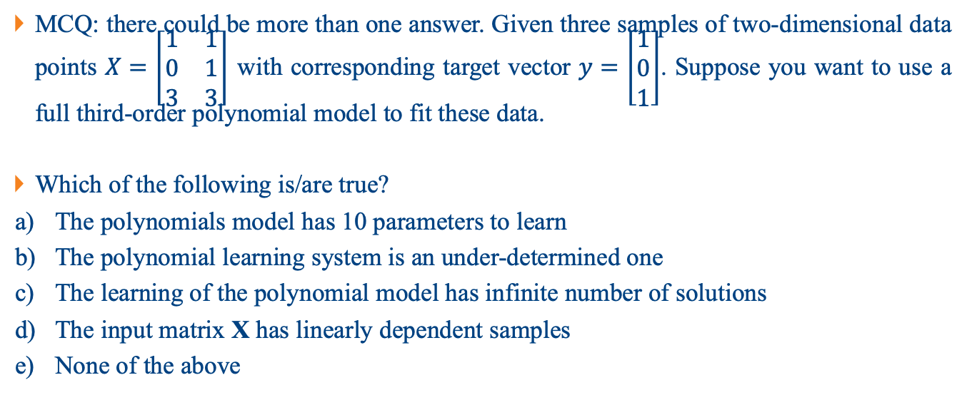
Question 7
MCQ: there could be more than one answer. Given three samples of two-dimensional data points $X=\left[\begin{matrix}1 & 1 \\ 0 & 1 \\ 3 & 3\end{matrix}\right]$ with corresponding target vector $y=\left[\begin{matrix}1 \\ 0 \\ 1\end{matrix}\right]$. Suppose you want to use a full third-order polynomial model to fit these data.
Which of the following is/are true?
The polynomials model has 10 parameters to learn
The polynomial learning system is an under-determined one
The learning of the polynomial model has infinite number of solutions
The input matrix X has linearly dependent samples
None of the above

Slide 45
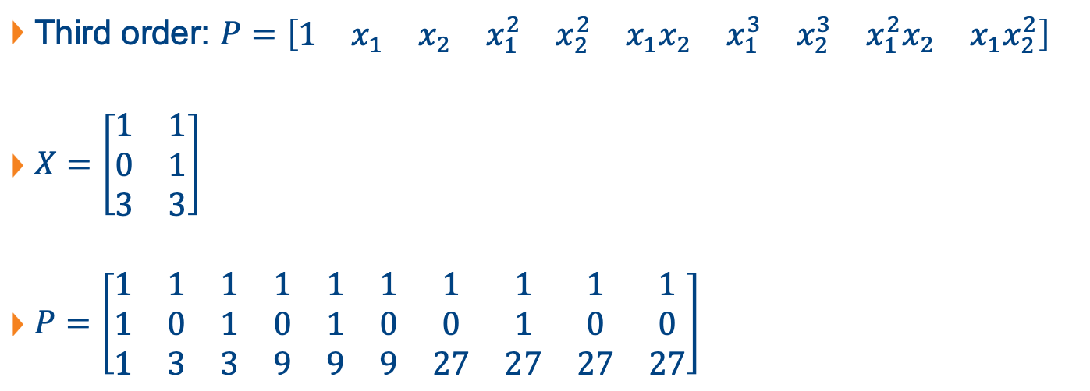
Question 7
Third order: $P=\left[\begin{matrix}1 & x_{1} & x_{2} & x_{1}^{2} & x_{2}^{2} & x_{1}x_{2} & x_{1}^{3} & x_{2}^{3} & x_{1}^{2}x_{2} & x_{1}x_{2}^{2}\end{matrix}\right]$
$X=\left[\begin{matrix}1 & 1 \\ 0 & 1 \\ 3 & 3\end{matrix}\right]$
$P=\left[\begin{matrix}1 & 1 & 1 & 1 & 1 & 1 & 1 & 1 & 1 & 1 \\ 1 & 0 & 1 & 0 & 1 & 0 & 0 & 1 & 0 & 0 \\ 1 & 3 & 3 & 9 & 9 & 9 & 27 & 27 & 27 & 27\end{matrix}\right]$

Slide 46
Question 7
MCQ: there could be more than one answer. Given three samples of two-dimensional data points $X=\left[\begin{matrix}1 & 1 \\ 0 & 1 \\ 3 & 3\end{matrix}\right]$ with corresponding target vector $y=\left[\begin{matrix}1 \\ 0 \\ 1\end{matrix}\right]$. Suppose you want to use a full third-order polynomial model to fit these data.
Which of the following is/are true?
The polynomials model has 10 parameters to learn
The polynomial learning system is an under-determined one
The learning of the polynomial model has infinite number of solutions
The input matrix X has linearly dependent samples
None of the above

Slide 47
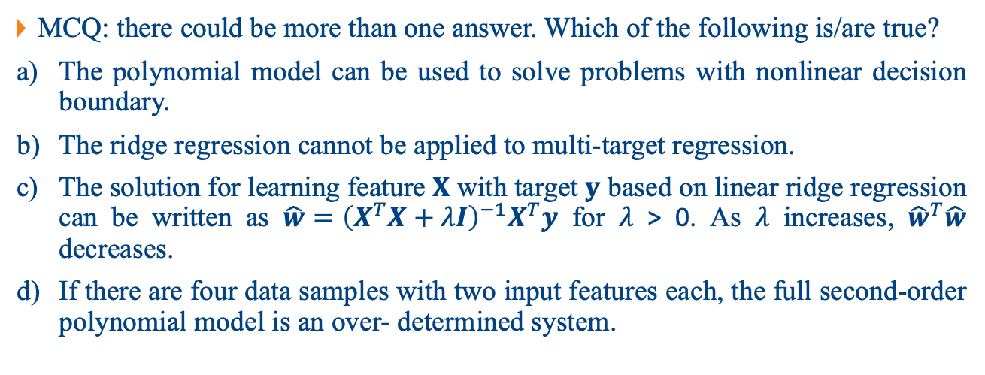
Question 8
MCQ: there could be more than one answer. Which of the following is/are true?
The polynomial model can be used to solve problems with nonlinear decision boundary.
The ridge regression cannot be applied to multi-target regression.
The solution for learning feature 𝐗 with target 𝐲 based on linear ridge regression can be written as $\hat{w}={\left(X^{T}X+λI\right)}^{−1}X^{T}y$ for 𝜆 > 0. As 𝜆 increases, ${\hat{w}}^{T}\hat{w}$ decreases.
If there are four data samples with two input features each, the full second-order polynomial model is an over- determined system.

Slide 48
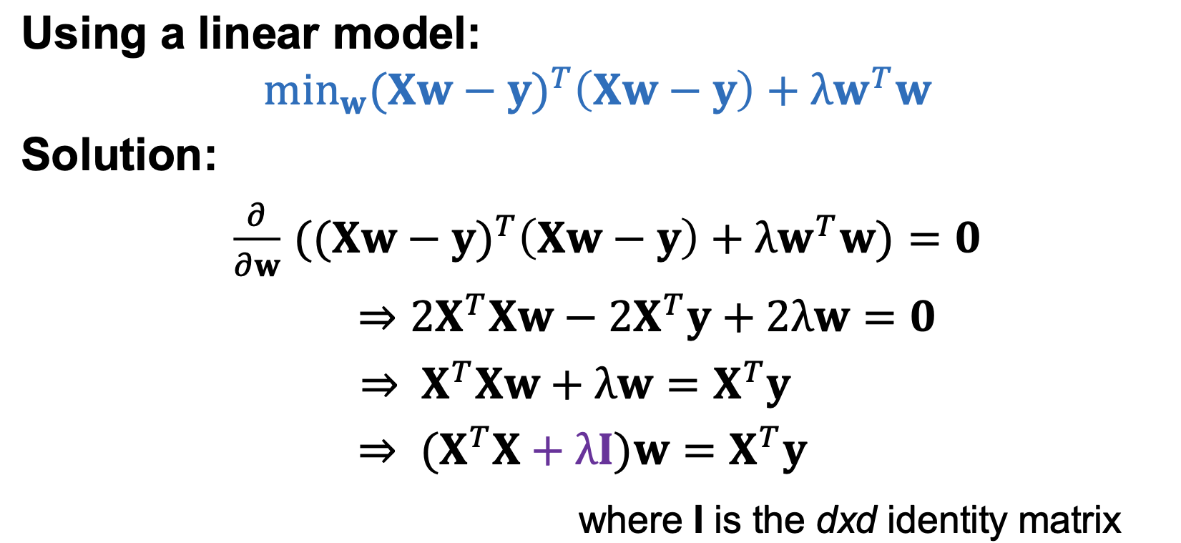

Question 8
The solution for learning feature 𝐗 with target 𝐲 based on linear ridge regression can be written as $\hat{w}={\left(X^{T}X+λI\right)}^{−1}X^{T}y$ for 𝜆 > 0. As 𝜆 increases, ${\hat{w}}^{T}\hat{w}$ decreases. (True/False)

Slide 49
Question 8
The solution for learning feature 𝐗 with target 𝐲 based on linear ridge regression can be written as $\hat{w}={\left(X^{T}X+λI\right)}^{−1}X^{T}y$ for 𝜆 > 0. As 𝜆 increases, ${\hat{w}}^{T}\hat{w}$ decreases. (True/False)

Slide 50
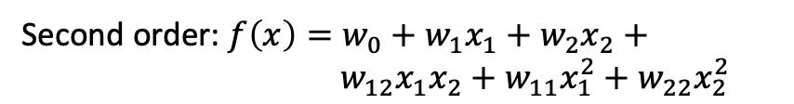
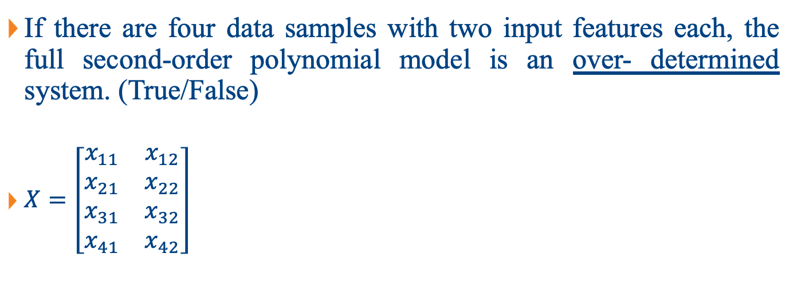
Question 8
If there are four data samples with two input features each, the full second-order polynomial model is an over- determined system. (True/False)
$X=\left[\begin{matrix}x_{11} & x_{12} \\ x_{21} & x_{22} \\ x_{31} & x_{32} \\ x_{41} & x_{42}\end{matrix}\right]$
Second order: $f\left(x\right)=w_{0}+w_{1}x_{1}+w_{2}x_{2}+$
$$w_{12}x_{1}x_{2}+w_{11}x_{1}^{2}+w_{22}x_{2}^{2}$$
Dimension of P matrix?

Slide 51
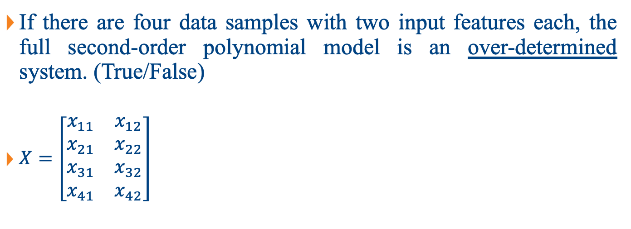
Question 8
If there are four data samples with two input features each, the full second-order polynomial model is an over-determined system. (True/False)
$X=\left[\begin{matrix}x_{11} & x_{12} \\ x_{21} & x_{22} \\ x_{31} & x_{32} \\ x_{41} & x_{42}\end{matrix}\right]$
Second order: $f\left(x\right)=w_{0}+w_{1}x_{1}+w_{2}x_{2}+$
$$w_{12}x_{1}x_{2}+w_{11}x_{1}^{2}+w_{22}x_{2}^{2}$$
Dimension of P matrix? 4x6 → under-determined

Slide 52
Question 8
MCQ: there could be more than one answer. Which of the following is/are true?
The polynomial model can be used to solve problems with nonlinear decision boundary.
The ridge regression cannot be applied to multi-target regression.
The solution for learning feature 𝐗 with target 𝐲 based on linear ridge regression can be written as $\hat{w}={\left(X^{T}X+λI\right)}^{−1}X^{T}y$ for 𝜆 > 0. As 𝜆 increases, ${\hat{w}}^{T}\hat{w}$ decreases.
If there are four data samples with two input features each, the full second-order polynomial model is an over- determined system.

