Slide 1
EE2211 Tutorial 7
Thao Nguyen

Slide 2
Useful Python Functions
Usage | Description
poly = sklearn.preprocessing.PolynomialFeatures(order) | Generates a new feature matrix consisting of all polynomial combinations of the features with degree less than or equal to order.
poly.fit_transform(X) | Generates polynomial features from X.
sklearn.metrics.mean_squared_error(ytrue, ypred) | Computes mean squared error between ytrue and ypred.

Slide 3
Question 1
 | Datapoint 1 | Datapoint 2 | Datapoint 3 | Datapoint 4 | Datapoint 5
Feature 1 | 0.3510 | 2.1812 | 0.2415 | -0.1096 | 0.1544
Feature 2 | 1.1796 | 2.1068 | 1.7753 | 1.2747 | 2.0851
Feature 3 | -0.9852 | 1.3766 | -1.3244 | -0.6316 | -0.8320
Target y | 0.2758 | 1.4392 | -0.4611 | 0.6154 | 1.0006
What are the top two features we should select if we use Pearson’s correlation as a feature selection metric?

Slide 4
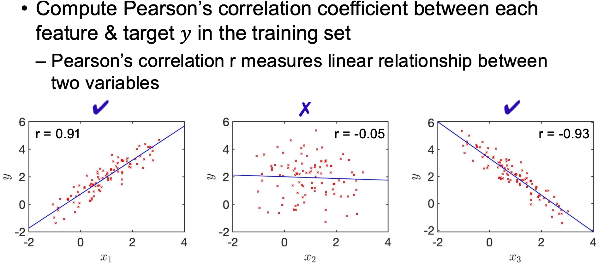
Recap: Pearson’s Correlation
From your lecture notes:

Slide 5
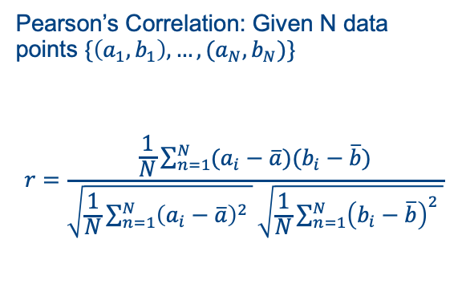
Recap: Pearson’s Correlation
From your lecture notes:
Pearson’s Correlation: Given N data points $\{\left(a_{1},b_{1}\right), …, (a_{N}, b_{N})\}$
$$r=\frac{\frac{1}{N}\sum_{n=1}^{N}{(a_{i}−\overline{a})(b_{i}−\overline{b}})}{\sqrt{\frac{1}{N}\sum_{n=1}^{N}{{\left(a_{i}−\overline{a}\right)}^{2} }}\sqrt{\frac{1}{N}\sum_{n=1}^{N}{{\left(b_{i}−\overline{b}\right)}^{2} }}}$$

Slide 6
Recap: Pearson’s Correlation
From your lecture notes:
Pearson’s Correlation: Given N data points $\{\left(a_{1},b_{1}\right), …, (a_{N}, b_{N})\}$
$$r=\frac{\frac{1}{N}\sum_{n=1}^{N}{(a_{i}−\overline{a})(b_{i}−\overline{b}})}{\sqrt{\frac{1}{N}\sum_{n=1}^{N}{{\left(a_{i}−\overline{a}\right)}^{2} }}\sqrt{\frac{1}{N}\sum_{n=1}^{N}{{\left(b_{i}−\overline{b}\right)}^{2} }}}$$
Empirical covariance
Empirical standard deviation of a
Empirical standard deviation of b

Slide 7
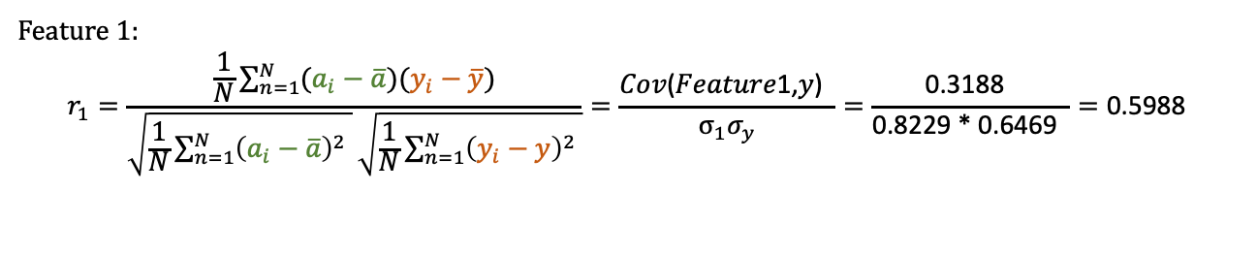
Question 1
 | Datapoint 1 | Datapoint 2 | Datapoint 3 | Datapoint 4 | Datapoint 5
Feature 1 | 0.3510 | 2.1812 | 0.2415 | -0.1096 | 0.1544
Feature 2 | 1.1796 | 2.1068 | 1.7753 | 1.2747 | 2.0851
Feature 3 | -0.9852 | 1.3766 | -1.3244 | -0.6316 | -0.8320
Target y | 0.2758 | 1.4392 | -0.4611 | 0.6154 | 1.0006
Feature 1:
$$r_{1}=\frac{\frac{1}{N}\sum_{n=1}^{N}{(a_{i}−\overline{a})(y_{i}−\overline{y}})}{\sqrt{\frac{1}{N}\sum_{n=1}^{N}{{\left(a_{i}−\overline{a}\right)}^{2} }}\sqrt{\frac{1}{N}\sum_{n=1}^{N}{{\left(y_{i}−y\right)}^{2} }}}=\frac{\text{Cov}\text{(}\text{Feature}\text{1,}\text{y}\text{) }}{σ_{1}σ_{y}}=\frac{\text{0.3}\text{188 }}{\text{0.8229 }\text{*}\text{ 0.6469 } }=\text{0.5988 }$$

Slide 8

Question 1
 | Datapoint 1 | Datapoint 2 | Datapoint 3 | Datapoint 4 | Datapoint 5
Feature 1 | 0.3510 | 2.1812 | 0.2415 | -0.1096 | 0.1544
Feature 2 | 1.1796 | 2.1068 | 1.7753 | 1.2747 | 2.0851
Feature 3 | -0.9852 | 1.3766 | -1.3244 | -0.6316 | -0.8320
Target y | 0.2758 | 1.4392 | -0.4611 | 0.6154 | 1.0006
Feature 2:
$$r_{2}=\frac{\frac{1}{N}\sum_{n=1}^{N}{(a_{i}−\overline{a})(y_{i}−\overline{y}})}{\sqrt{\frac{1}{N}\sum_{n=1}^{N}{{\left(a_{i}−\overline{a}\right)}^{2} }}\sqrt{\frac{1}{N}\sum_{n=1}^{N}{{\left(y_{i}−y\right)}^{2} }}}=\frac{\text{Cov}\text{(}\text{Feature}\text{2}\text{,}\text{y}\text{) }}{σ_{2}σ_{y}}=\frac{\text{0.1152 } }{\text{0.3924 }\text{*}\text{ 0.6469 } }=\text{0.}\text{4537}$$

Slide 9
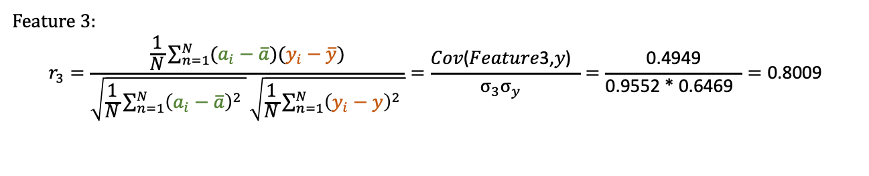
Question 1
 | Datapoint 1 | Datapoint 2 | Datapoint 3 | Datapoint 4 | Datapoint 5
Feature 1 | 0.3510 | 2.1812 | 0.2415 | -0.1096 | 0.1544
Feature 2 | 1.1796 | 2.1068 | 1.7753 | 1.2747 | 2.0851
Feature 3 | -0.9852 | 1.3766 | -1.3244 | -0.6316 | -0.8320
Target y | 0.2758 | 1.4392 | -0.4611 | 0.6154 | 1.0006
Feature 3:
$$r_{3}=\frac{\frac{1}{N}\sum_{n=1}^{N}{(a_{i}−\overline{a})(y_{i}−\overline{y}})}{\sqrt{\frac{1}{N}\sum_{n=1}^{N}{{\left(a_{i}−\overline{a}\right)}^{2} }}\sqrt{\frac{1}{N}\sum_{n=1}^{N}{{\left(y_{i}−y\right)}^{2} }}}=\frac{\text{Cov}\text{(}\text{Feature}\text{3}\text{,}\text{y}\text{) }}{σ_{3}σ_{y} }=\frac{\text{0}\text{.4949}}{\text{0.9552 *} \text{0.6469} }=\text{0.8009}$$

Slide 10
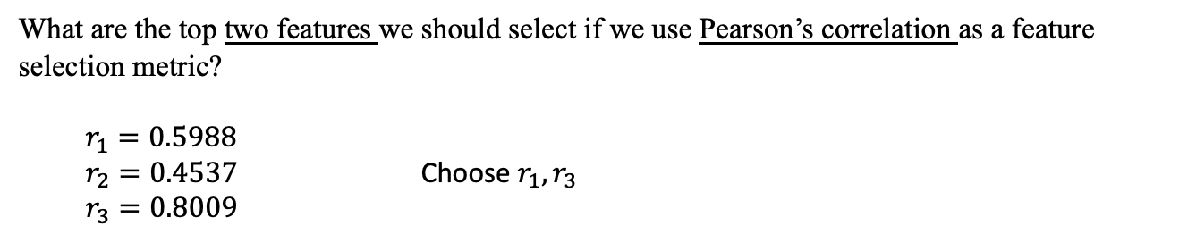
Question 1
 | Datapoint 1 | Datapoint 2 | Datapoint 3 | Datapoint 4 | Datapoint 5
Feature 1 | 0.3510 | 2.1812 | 0.2415 | -0.1096 | 0.1544
Feature 2 | 1.1796 | 2.1068 | 1.7753 | 1.2747 | 2.0851
Feature 3 | -0.9852 | 1.3766 | -1.3244 | -0.6316 | -0.8320
Target y | 0.2758 | 1.4392 | -0.4611 | 0.6154 | 1.0006
What are the top two features we should select if we use Pearson’s correlation as a feature selection metric?
$$r_{1}=0.5988$$
$r_{2}=0.4537$ Choose $r_{1},r_{3}$
$$r_{3}=0.8009$$

Slide 11
Question 2
Training data:
{𝑥=−10} →{𝑦=4.18}
{𝑥=−8} →{𝑦=2.42}
{𝑥=−3} →{𝑦=0.22}
{𝑥=−1} →{𝑦=0.12}
{𝑥=2} →{𝑦=0.25}
{𝑥=7} →{𝑦=3.09}
Test data:
{𝑥=−9} →{𝑦=3}
{𝑥=−7} →{𝑦=1.81}
{𝑥=−5} →{𝑦=0.80}
{𝑥=−4} →{𝑦=0.25}
{𝑥=−2} →{𝑦=−0.19}
{𝑥=1} →{𝑦=0.4}
{𝑥=4} →{𝑦=1.24}
{𝑥=5} →{𝑦=1.68}
{𝑥=6} →{𝑦=2.32}
{𝑥=9} →{𝑦=5.05}
(a) Use the polynomial model from orders 1 to 6 to train and test the data without regularization.
Plot the Mean Squared Errors (MSE) over orders from 1 to 6 for both the training and the test sets.

Slide 12
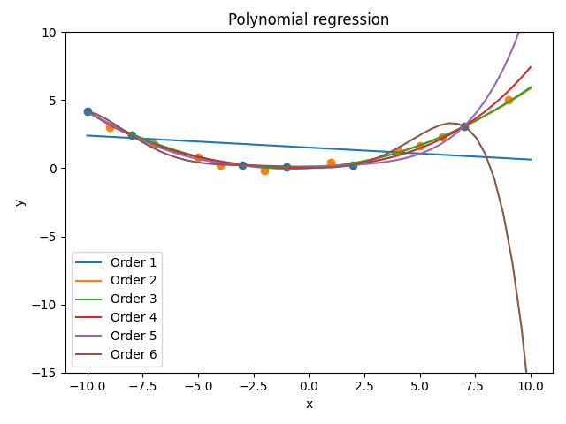
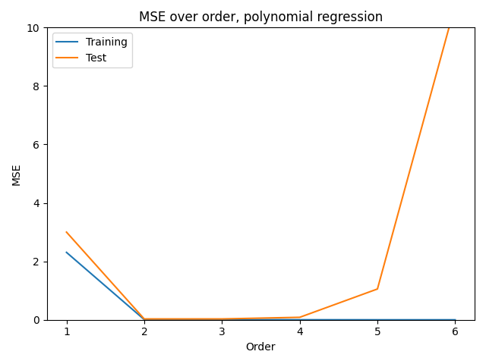
Question 2
The underlying data was generated using a quadratic function + noise

Slide 13
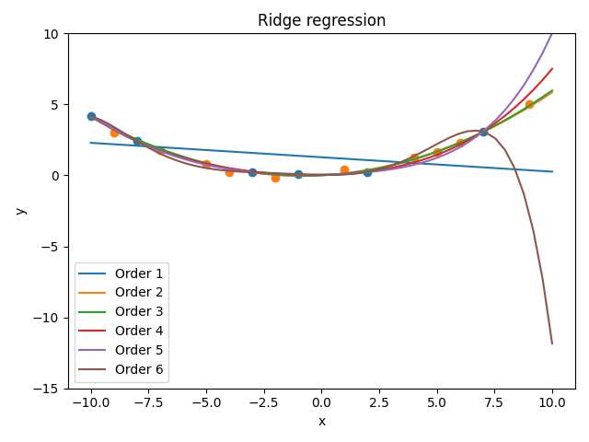
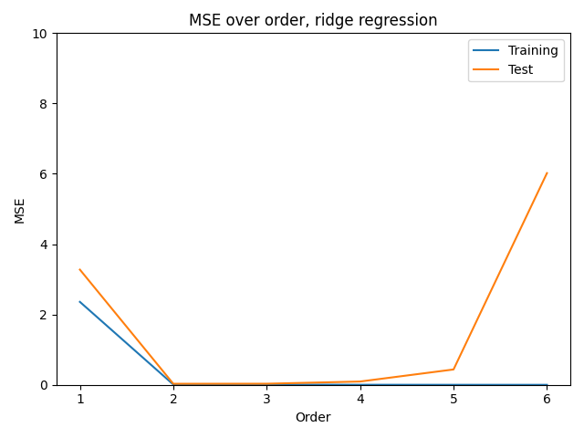
Question 2
(b) Use regularization (ridge regression) λ=1 for all orders and repeat the same analyses.

Slide 14
Question 2
Regularization helps to reduce overfitting for orders 5 and 6.

