Slide 1
EE2211 Tutorial 8 Thao Nguyen

Slide 2
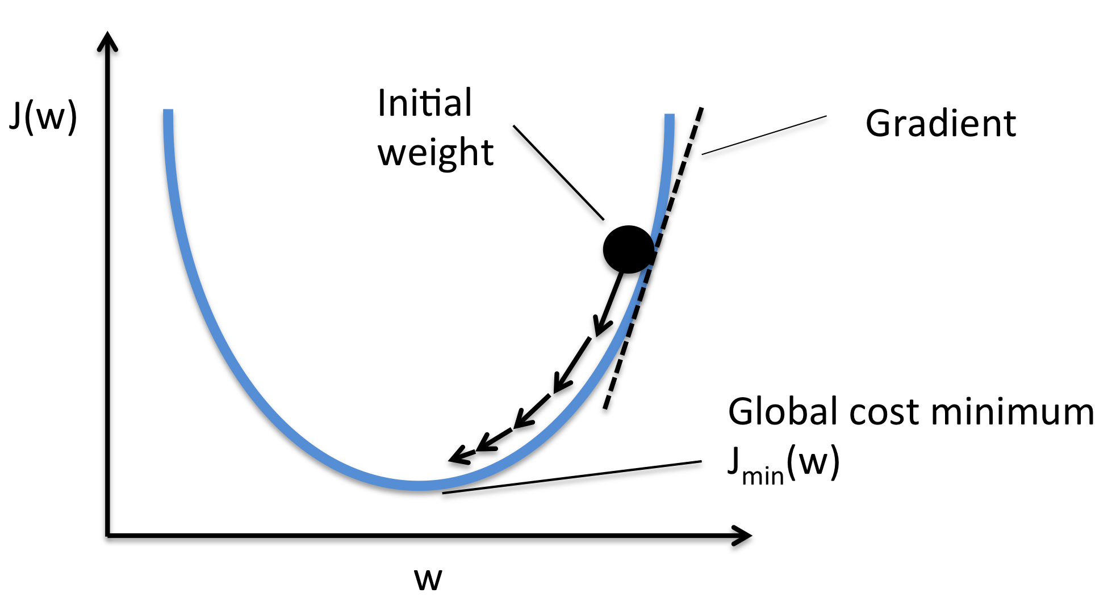

Recap: Gradient Descent
$x=x−η\frac{df(x)}{dx}$
Source: https://sebastianraschka.com/faq/docs/gradient-optimization.html

Slide 3
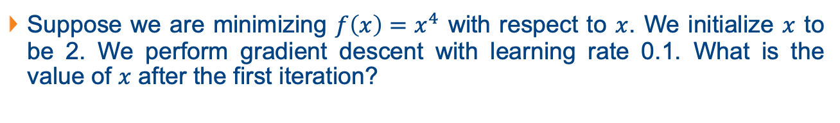
Question 1
Suppose we are minimizing ${f\left(x\right)=x}^{4}$ with respect to $x$. We initialize $x$ to be 2. We perform gradient descent with learning rate 0.1. What is the value of $x$ after the first iteration?

Slide 4
Question 1
Suppose we are minimizing ${f\left(x\right)=x}^{4}$ with respect to $x$. We initialize $x$ to be 2. We perform gradient descent with learning rate 0.1. What is the value of $x$ after the first iteration?
$$x=x−η\frac{df\left(x\right)}{dx}=x−η∗4x^{3}=2−0.1∗4∗2^{3}=−1.2$$

Slide 5
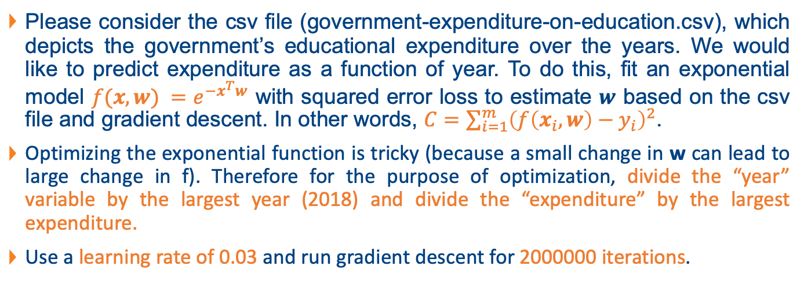
Question 2
Please consider the csv file (government-expenditure-on-education.csv), which depicts the government’s educational expenditure over the years. We would like to predict expenditure as a function of year. To do this, fit an exponential model $f(x,w) =e^{−x^{T}w}$ with squared error loss to estimate $w$ based on the csv file and gradient descent. In other words, $C=\sum_{i=1}^{m}{{\left(f\left(x_{i}, w\right)−y_{i}\right)}^{2}}$.
Optimizing the exponential function is tricky (because a small change in w can lead to large change in f). Therefore for the purpose of optimization, divide the “year” variable by the largest year (2018) and divide the “expenditure” by the largest expenditure.
Use a learning rate of 0.03 and run gradient descent for 2000000 iterations.

Slide 6
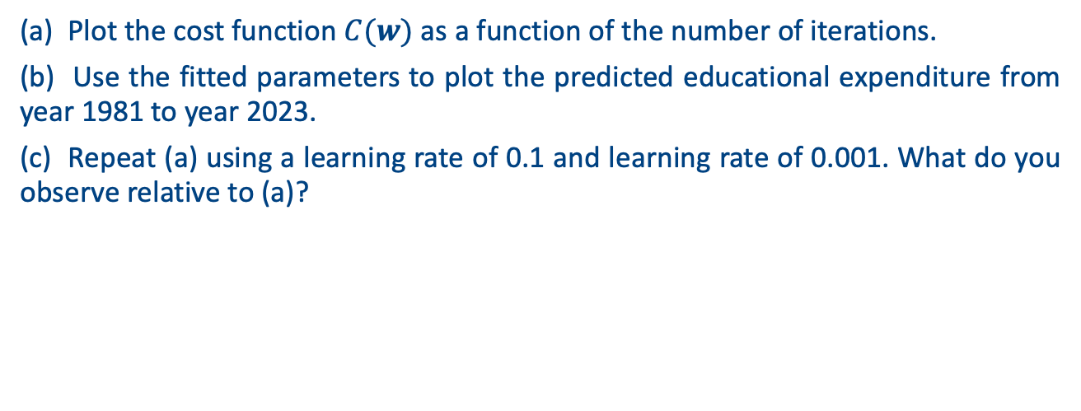
Question 2
(a) Plot the cost function $C(w)$ as a function of the number of iterations.
(b) Use the fitted parameters to plot the predicted educational expenditure from year 1981 to year 2023.
(c) Repeat (a) using a learning rate of 0.1 and learning rate of 0.001. What do you observe relative to (a)?

Slide 7


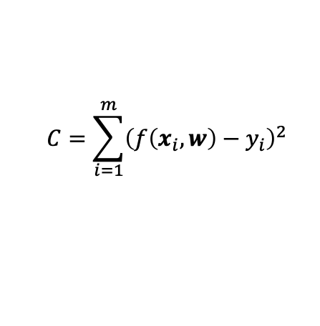
Question 2
In each iteration: update weight according to the gradient
$w=w−η∇_{w}C$ (Gradient descent)
$$C=\sum_{i=1}^{m}{{\left(f\left(x_{i}, w\right)−y_{i}\right)}^{2}}$$
$$f(x,w) =e^{−x^{T}w}$$

Slide 8

Question 2
In each iteration: update weight according to the gradient
$w=w− {η∇}_{w}C$ (Gradient descent)
$∇_{w}C=∇_{w}\sum_{i=1}^{m}{{\left(f\left(x_{i},w\right)− y_{i}\right)}^{2}}$
$$C=\sum_{i=1}^{m}{{\left(f\left(x_{i}, w\right)−y_{i}\right)}^{2}}$$
$$f(x,w) =e^{−x^{T}w}$$

Slide 9

Question 2
In each iteration: update weight according to the gradient
$w=w− {η∇}_{w}C$ (Gradient descent)
$∇_{w}C=∇_{w}\sum_{i=1}^{m}{{\left(f\left(x_{i},w\right)− y_{i}\right)}^{2}}$
$=\sum_{i=1}^{m}{2\left(f\left(x_{i},w\right)− y_{i}\right)∇_{w}}f\left(x_{i},w\right)$ (chain rule)
$$C=\sum_{i=1}^{m}{{\left(f\left(x_{i}, w\right)−y_{i}\right)}^{2}}$$
$$f(x,w) =e^{−x^{T}w}$$

Slide 10
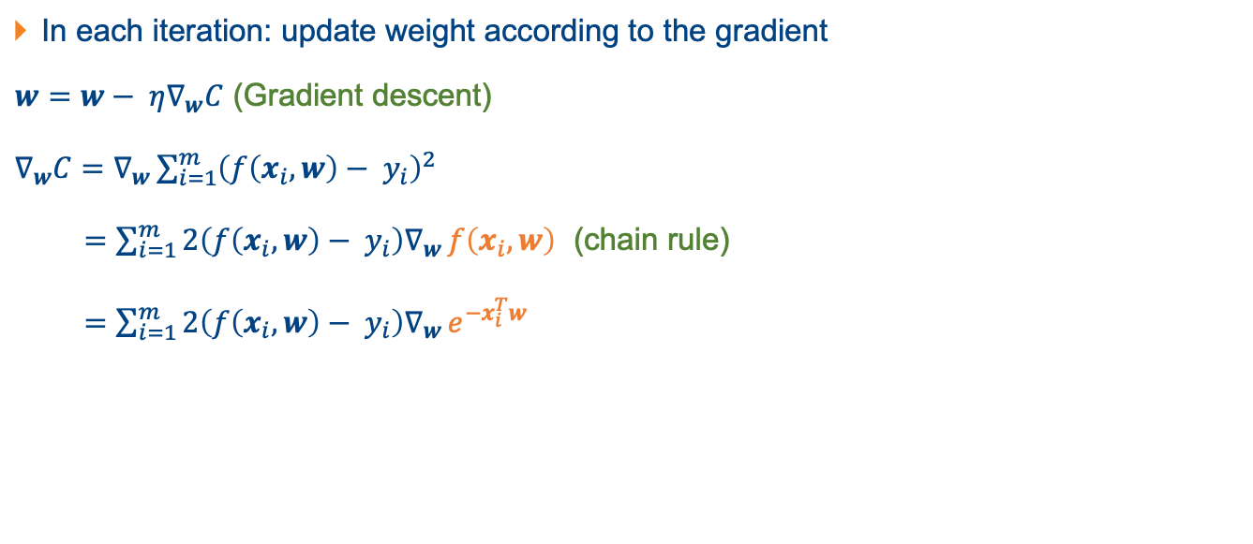
Question 2
In each iteration: update weight according to the gradient
$w=w− {η∇}_{w}C$ (Gradient descent)
$∇_{w}C=∇_{w}\sum_{i=1}^{m}{{\left(f\left(x_{i},w\right)− y_{i}\right)}^{2}}$
$=\sum_{i=1}^{m}{2\left(f\left(x_{i},w\right)− y_{i}\right)∇_{w}}f\left(x_{i},w\right)$ (chain rule)
$=\sum_{i=1}^{m}{2\left(f\left(x_{i},w\right)− y_{i}\right)∇_{w}}e^{−x_{i}^{T}w}$
$$C=\sum_{i=1}^{m}{{\left(f\left(x_{i}, w\right)−y_{i}\right)}^{2}}$$
$$f(x,w) =e^{−x^{T}w}$$

Slide 11
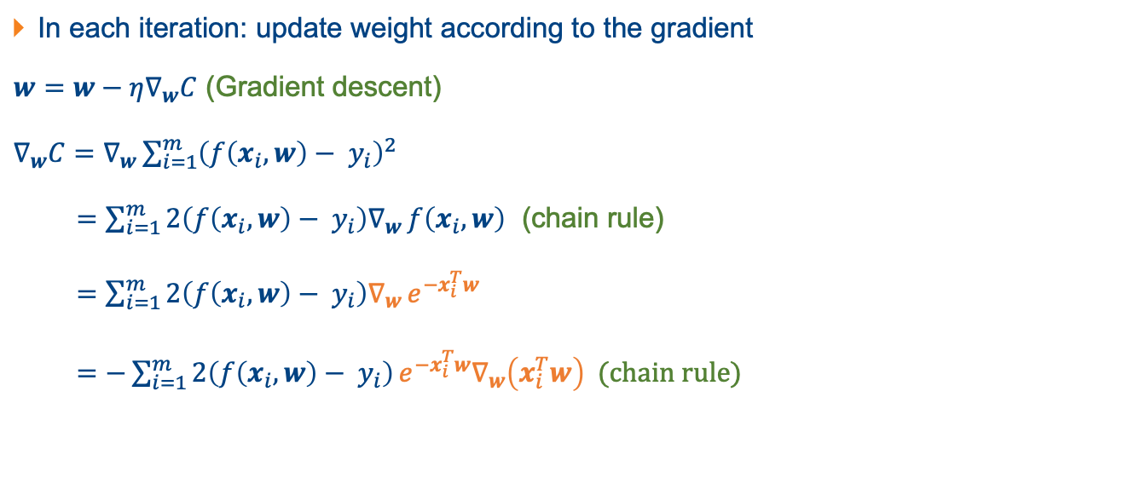
Question 2
In each iteration: update weight according to the gradient
$w=w−η∇_{w}C$ (Gradient descent)
$∇_{w}C=∇_{w}\sum_{i=1}^{m}{{\left(f\left(x_{i},w\right)− y_{i}\right)}^{2}}$
$=\sum_{i=1}^{m}{2\left(f\left(x_{i},w\right)− y_{i}\right)∇_{w}}f\left(x_{i},w\right)$ (chain rule)
$=\sum_{i=1}^{m}{2\left(f\left(x_{i},w\right)− y_{i}\right)∇_{w}}e^{−x_{i}^{T}w}$
$=−\sum_{i=1}^{m}{2\left(f\left(x_{i},w\right)− y_{i}\right)}e^{−x_{i}^{T}w}∇_{w}\left(x_{i}^{T}w\right)$ (chain rule)
$$C=\sum_{i=1}^{m}{{\left(f\left(x_{i}, w\right)−y_{i}\right)}^{2}}$$
$$f(x,w) =e^{−x^{T}w}$$

Slide 12
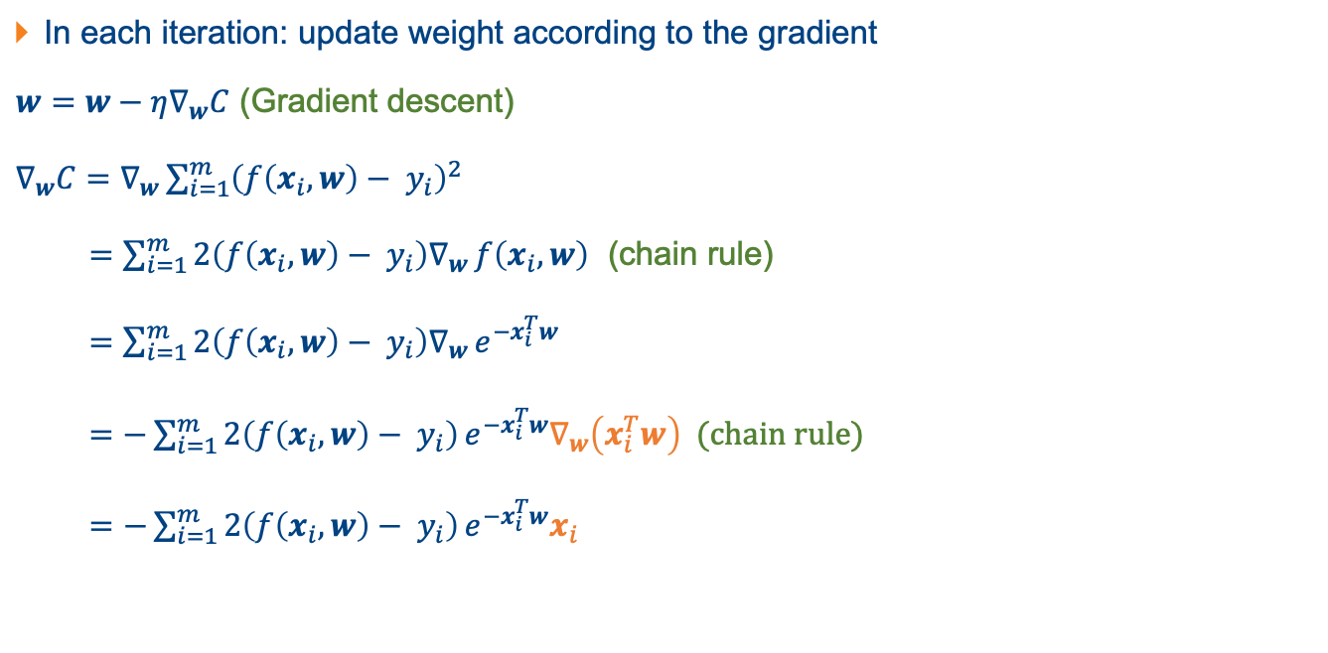
Question 2
In each iteration: update weight according to the gradient
$w=w−η∇_{w}C$ (Gradient descent)
$∇_{w}C=∇_{w}\sum_{i=1}^{m}{{\left(f\left(x_{i},w\right)− y_{i}\right)}^{2}}$
$=\sum_{i=1}^{m}{2\left(f\left(x_{i},w\right)− y_{i}\right)∇_{w}}f\left(x_{i},w\right)$ (chain rule)
$=\sum_{i=1}^{m}{2\left(f\left(x_{i},w\right)− y_{i}\right)∇_{w}}e^{−x_{i}^{T}w}$
$=−\sum_{i=1}^{m}{2\left(f\left(x_{i},w\right)− y_{i}\right)}e^{−x_{i}^{T}w}∇_{w}\left(x_{i}^{T}w\right)$ (chain rule)
$=$ $−\sum_{i=1}^{m}{2\left(f\left(x_{i},w\right)− y_{i}\right)}e^{−x_{i}^{T}w}x_{i}$
$$C=\sum_{i=1}^{m}{{\left(f\left(x_{i}, w\right)−y_{i}\right)}^{2}}$$
$$f(x,w) =e^{−x^{T}w}$$

Slide 13
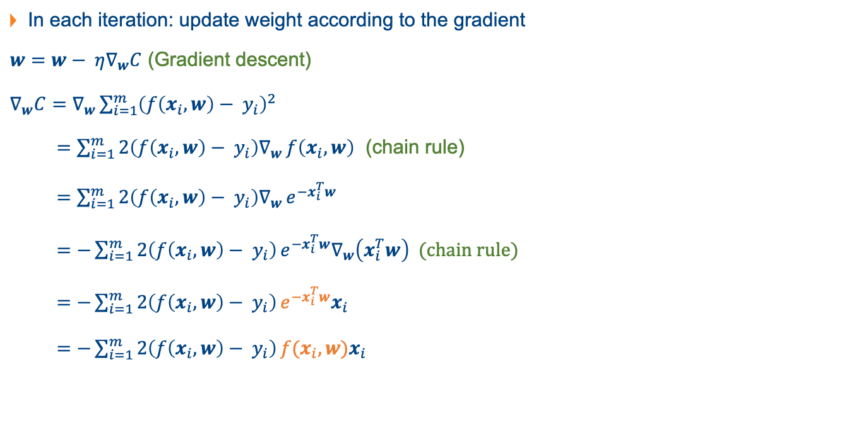
Question 2
In each iteration: update weight according to the gradient
$w=w− {η∇}_{w}C$ (Gradient descent)
$∇_{w}C=∇_{w}\sum_{i=1}^{m}{{\left(f\left(x_{i},w\right)− y_{i}\right)}^{2}}$
$=\sum_{i=1}^{m}{2\left(f\left(x_{i},w\right)− y_{i}\right)∇_{w}}f\left(x_{i},w\right)$ (chain rule)
$=\sum_{i=1}^{m}{2\left(f\left(x_{i},w\right)− y_{i}\right)∇_{w}}e^{−x_{i}^{T}w}$
$=−\sum_{i=1}^{m}{2\left(f\left(x_{i},w\right)− y_{i}\right)}e^{−x_{i}^{T}w}∇_{w}\left(x_{i}^{T}w\right)$ (chain rule)
$=$ $−\sum_{i=1}^{m}{2\left(f\left(x_{i},w\right)− y_{i}\right)}e^{−x_{i}^{T}w}x_{i}$
$=$ $−\sum_{i=1}^{m}{2\left(f\left(x_{i},w\right)− y_{i}\right)}f(x_{i}, w)x_{i}$
$$C=\sum_{i=1}^{m}{{\left(f\left(x_{i}, w\right)−y_{i}\right)}^{2}}$$
$$f(x,w) =e^{−x^{T}w}$$

Slide 14
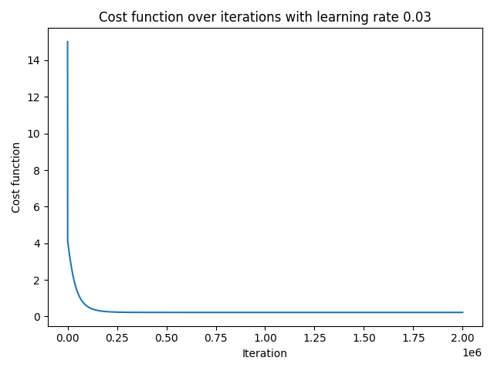
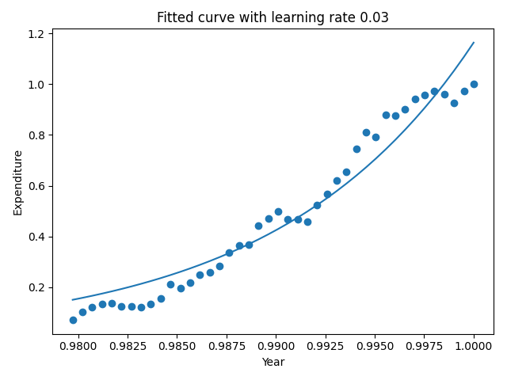
Question 2

Slide 15
Question 2
Discussion: what if we change learning rate from 0.03 to:
0.001
0.1

Slide 16
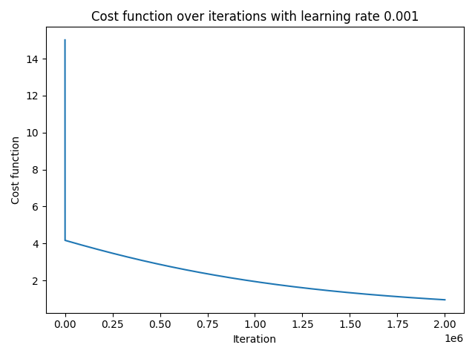
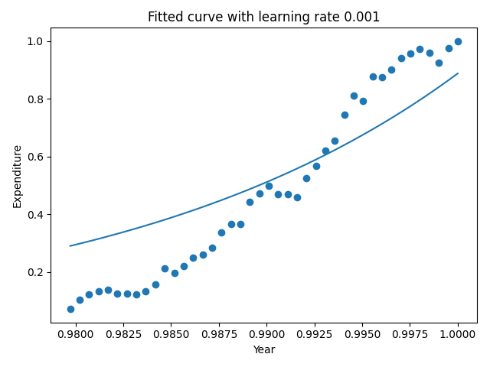
Question 2

Slide 17
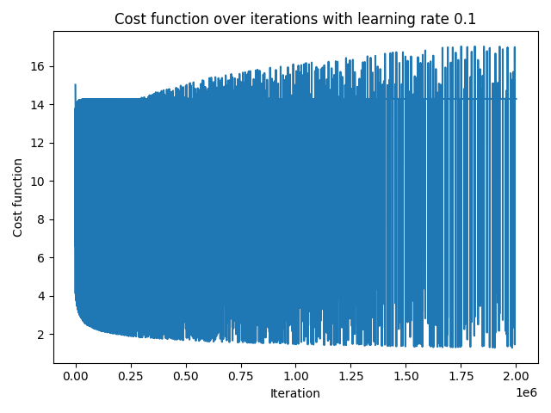
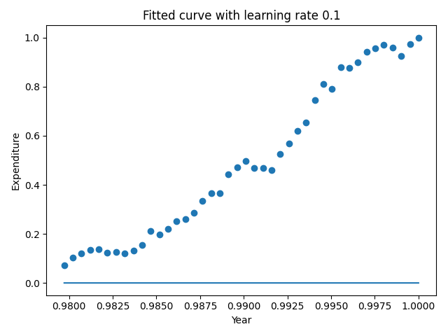
Question 2

Slide 18

Question 3
Given the linear learning model $f(x, w) = x^{T}w$, where $x ∈ R^{d}$. Consider the loss function $L(f(x_{i},w),y_{i}) = {\left(f\left(x_{i},w\right)− y_{i}\right)}^{4}$, where $i$indexes the $i^{th}$ training sample. The final cost function is $C(w) = \sum_{i=1}^{m}{L(f(x_{i},w),y_{i})}$, where $m$ is the total number of training samples. Derive the gradient of the cost function with respect to $w$.

Slide 19

Question 3
Given: $f\left(x, w\right)= x^{T}w, L\left(f\left(x_{i},w\right),y_{i}\right)= {\left(f\left(x_{i},w\right)− y_{i}\right)}^{4}$
Find:
$∇_{w}C\left(w\right)=∇_{w}\sum_{i=1}^{m}{L\left(f\left(x_{i},w\right),y_{i}\right)}$

Slide 20

Question 3
Given: $f\left(x, w\right)= x^{T}w, L\left(f\left(x_{i},w\right),y_{i}\right)= {\left(f\left(x_{i},w\right)− y_{i}\right)}^{4}$
Find:
$∇_{w}C\left(w\right)=∇_{w}\sum_{i=1}^{m}{L\left(f\left(x_{i},w\right),y_{i}\right)}=∇_{w}\sum_{i=1}^{m}{{\left(f\left(x_{i},w\right)− y_{i}\right)}^{4}}$

Slide 21
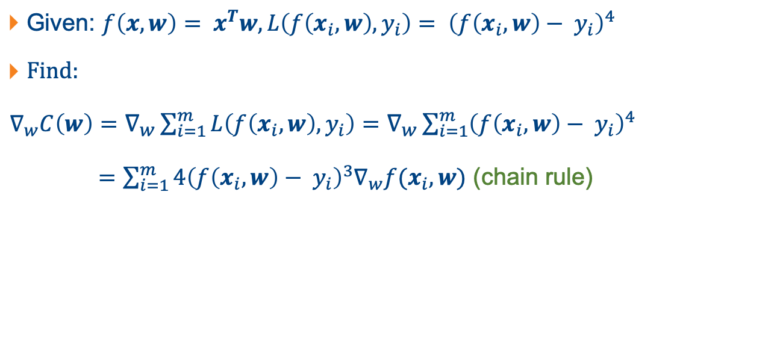
Question 3
Given: $f\left(x, w\right)= x^{T}w, L\left(f\left(x_{i},w\right),y_{i}\right)= {\left(f\left(x_{i},w\right)− y_{i}\right)}^{4}$
Find:
$∇_{w}C\left(w\right)=∇_{w}\sum_{i=1}^{m}{L\left(f\left(x_{i},w\right),y_{i}\right)}=∇_{w}\sum_{i=1}^{m}{{\left(f\left(x_{i},w\right)− y_{i}\right)}^{4}}$
$=\sum_{i=1}^{m}{4{\left(f\left(x_{i},w\right)− y_{i}\right)}^{3}∇_{w}f(x_{i}, w)}$ (chain rule)

Slide 22
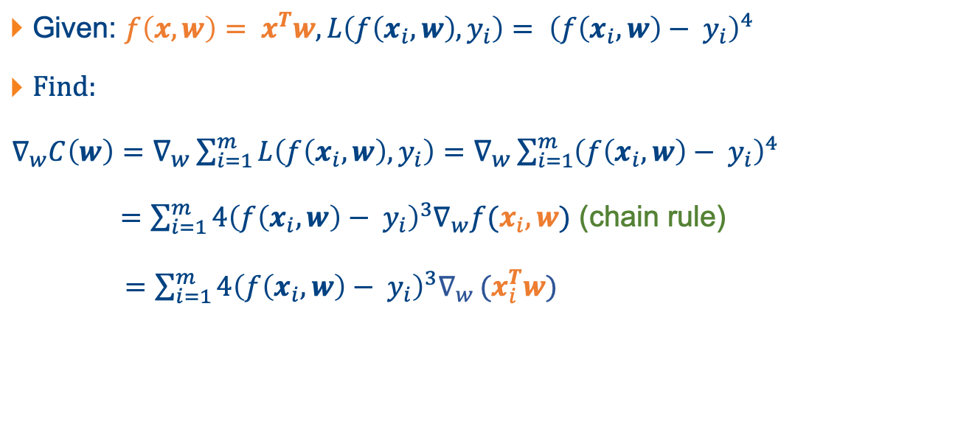
Question 3
Given: $f\left(x, w\right)= x^{T}w, L\left(f\left(x_{i},w\right),y_{i}\right)= {\left(f\left(x_{i},w\right)− y_{i}\right)}^{4}$
Find:
$∇_{w}C\left(w\right)=∇_{w}\sum_{i=1}^{m}{L\left(f\left(x_{i},w\right),y_{i}\right)}=∇_{w}\sum_{i=1}^{m}{{\left(f\left(x_{i},w\right)− y_{i}\right)}^{4}}$
$=\sum_{i=1}^{m}{4{\left(f\left(x_{i},w\right)− y_{i}\right)}^{3}∇_{w}f(x_{i}, w)}$ (chain rule)
$=\sum_{i=1}^{m}{4{\left(f\left(x_{i},w\right)− y_{i}\right)}^{3}∇_{w}}(x_{i}^{T}w)$

Slide 23
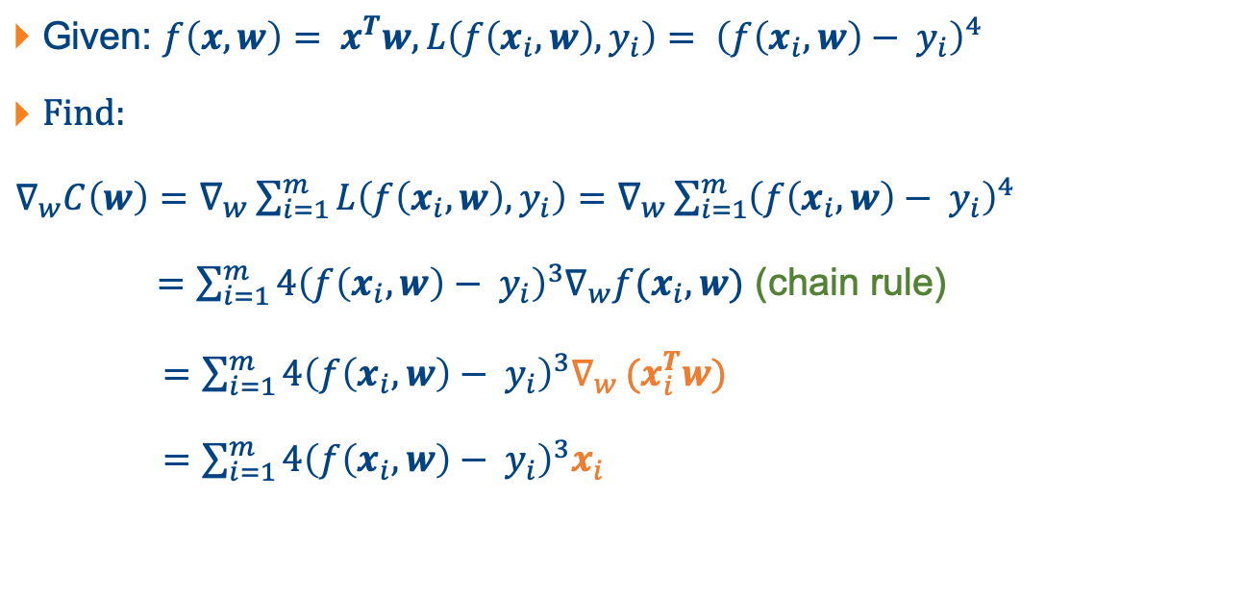
Question 3
Given: $f\left(x, w\right)= x^{T}w, L\left(f\left(x_{i},w\right),y_{i}\right)= {\left(f\left(x_{i},w\right)− y_{i}\right)}^{4}$
Find:
$∇_{w}C\left(w\right)=∇_{w}\sum_{i=1}^{m}{L\left(f\left(x_{i},w\right),y_{i}\right)}=∇_{w}\sum_{i=1}^{m}{{\left(f\left(x_{i},w\right)− y_{i}\right)}^{4}}$
$=\sum_{i=1}^{m}{4{\left(f\left(x_{i},w\right)− y_{i}\right)}^{3}∇_{w}f(x_{i}, w)}$ (chain rule)
$=\sum_{i=1}^{m}{4{\left(f\left(x_{i},w\right)− y_{i}\right)}^{3}∇_{w}}(x_{i}^{T}w)$
$=\sum_{i=1}^{m}{4{\left(f\left(x_{i},w\right)− y_{i}\right)}^{3}x_{i}}$

Slide 24

Question 4
Given: $f\left(x, w\right)=σ\left(x^{T}w\right), where σ\left(a\right)=\frac{1}{1+e^{−βa}}$
$L\left(f\left(x_{i},w\right),y_{i}\right)= {\left(f\left(x_{i},w\right)− y_{i}\right)}^{4}$
Find:
$∇_{w}C\left(w\right)=∇_{w}\sum_{i=1}^{m}{L\left(f\left(x_{i},w\right),y_{i}\right)}$

Slide 25

Question 4
Given: $f\left(x, w\right)=σ\left(x^{T}w\right), where σ\left(a\right)=\frac{1}{1+e^{−βa}}$
$L\left(f\left(x_{i},w\right),y_{i}\right)= {\left(f\left(x_{i},w\right)− y_{i}\right)}^{4}$
$∇_{w}C\left(w\right)=∇_{w}\sum_{i=1}^{m}{L\left(f\left(x_{i},w\right),y_{i}\right)}=∇_{w}\sum_{i=1}^{m}{{\left(f\left(x_{i},w\right)− y_{i}\right)}^{4}}$

Slide 26

Question 4
Given: $f\left(x, w\right)=σ\left(x^{T}w\right), where σ\left(a\right)=\frac{1}{1+e^{−βa}}$
$L\left(f\left(x_{i},w\right),y_{i}\right)= {\left(f\left(x_{i},w\right)− y_{i}\right)}^{4}$
$∇_{w}C\left(w\right)=∇_{w}\sum_{i=1}^{m}{L\left(f\left(x_{i},w\right),y_{i}\right)}=∇_{w}\sum_{i=1}^{m}{{\left(f\left(x_{i},w\right)− y_{i}\right)}^{4}}$
$=\sum_{i=1}^{m}{4{\left(f\left(x_{i},w\right)− y_{i}\right)}^{3}∇_{w}f(x_{i}, w)}$ (chain rule)

Slide 27
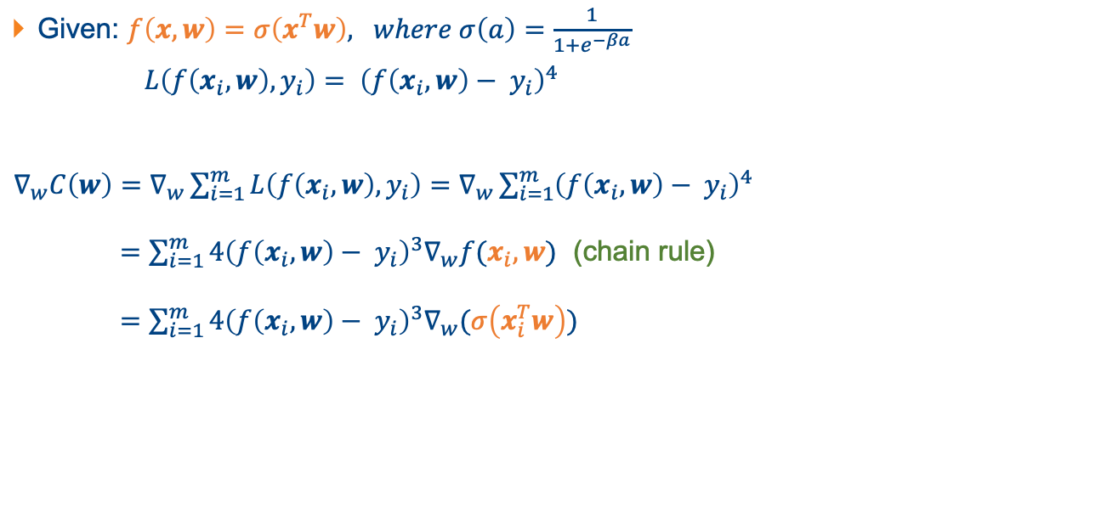
Question 4
Given: $f\left(x, w\right)=σ\left(x^{T}w\right), where σ\left(a\right)=\frac{1}{1+e^{−βa}}$
$L\left(f\left(x_{i},w\right),y_{i}\right)= {\left(f\left(x_{i},w\right)− y_{i}\right)}^{4}$
$∇_{w}C\left(w\right)=∇_{w}\sum_{i=1}^{m}{L\left(f\left(x_{i},w\right),y_{i}\right)}=∇_{w}\sum_{i=1}^{m}{{\left(f\left(x_{i},w\right)− y_{i}\right)}^{4}}$
$=\sum_{i=1}^{m}{4{\left(f\left(x_{i},w\right)− y_{i}\right)}^{3}∇_{w}f(x_{i}, w)}$ (chain rule)
$=\sum_{i=1}^{m}{4{\left(f\left(x_{i},w\right)− y_{i}\right)}^{3}∇_{w}(σ\left(x_{i}^{T}w\right))}$

Slide 28
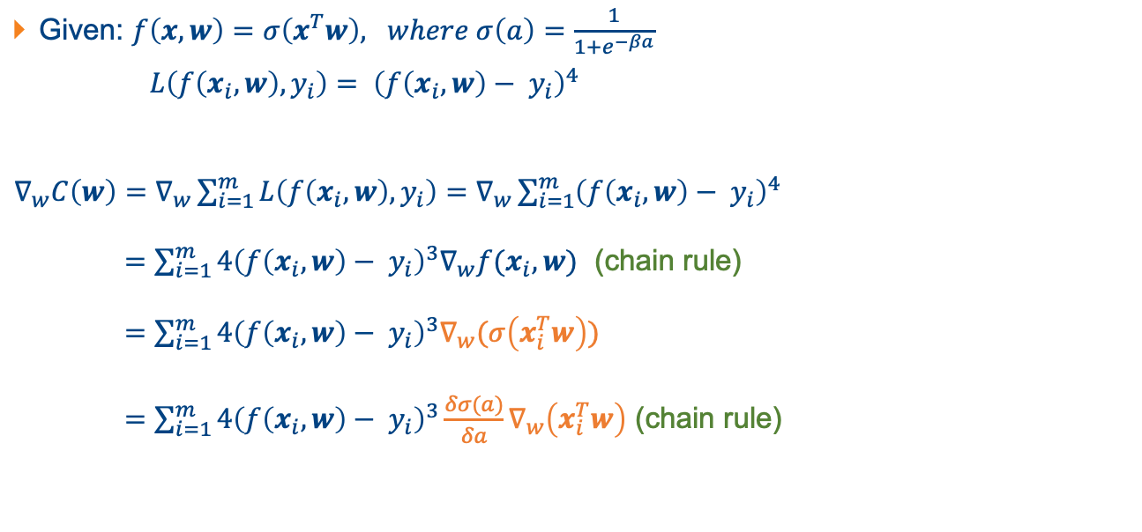
Question 4
Given: $f\left(x, w\right)=σ\left(x^{T}w\right), where σ\left(a\right)=\frac{1}{1+e^{−βa}}$
$L\left(f\left(x_{i},w\right),y_{i}\right)= {\left(f\left(x_{i},w\right)− y_{i}\right)}^{4}$
$∇_{w}C\left(w\right)=∇_{w}\sum_{i=1}^{m}{L\left(f\left(x_{i},w\right),y_{i}\right)}=∇_{w}\sum_{i=1}^{m}{{\left(f\left(x_{i},w\right)− y_{i}\right)}^{4}}$
$=\sum_{i=1}^{m}{4{\left(f\left(x_{i},w\right)− y_{i}\right)}^{3}∇_{w}f(x_{i}, w)}$ (chain rule)
$=\sum_{i=1}^{m}{4{\left(f\left(x_{i},w\right)− y_{i}\right)}^{3}∇_{w}(σ\left(x_{i}^{T}w\right))}$
$=\sum_{i=1}^{m}{4{\left(f\left(x_{i},w\right)− y_{i}\right)}^{3}\frac{δσ(a)}{δa}∇_{w}\left(x_{i}^{T}w\right)}$ (chain rule)

Slide 29
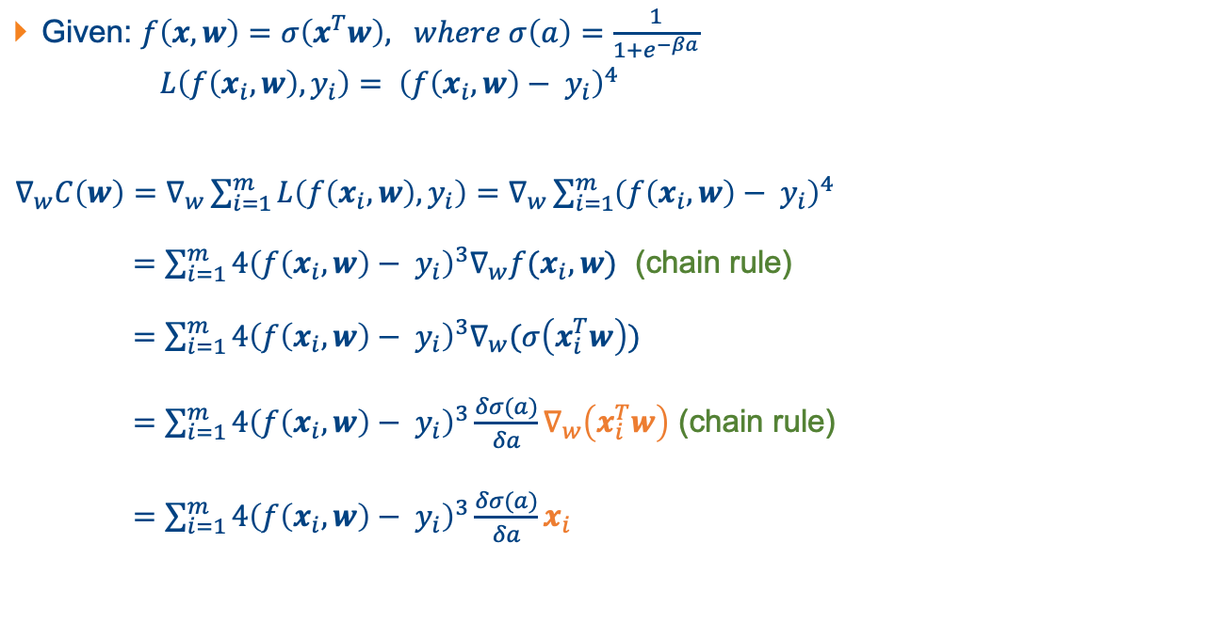
Question 4
Given: $f\left(x, w\right)=σ\left(x^{T}w\right), where σ\left(a\right)=\frac{1}{1+e^{−βa}}$
$L\left(f\left(x_{i},w\right),y_{i}\right)= {\left(f\left(x_{i},w\right)− y_{i}\right)}^{4}$
$∇_{w}C\left(w\right)=∇_{w}\sum_{i=1}^{m}{L\left(f\left(x_{i},w\right),y_{i}\right)}=∇_{w}\sum_{i=1}^{m}{{\left(f\left(x_{i},w\right)− y_{i}\right)}^{4}}$
$=\sum_{i=1}^{m}{4{\left(f\left(x_{i},w\right)− y_{i}\right)}^{3}∇_{w}f(x_{i}, w)}$ (chain rule)
$=\sum_{i=1}^{m}{4{\left(f\left(x_{i},w\right)− y_{i}\right)}^{3}∇_{w}(σ\left(x_{i}^{T}w\right))}$
$=\sum_{i=1}^{m}{4{\left(f\left(x_{i},w\right)− y_{i}\right)}^{3}\frac{δσ(a)}{δa}∇_{w}\left(x_{i}^{T}w\right)}$ (chain rule)
$=\sum_{i=1}^{m}{4{\left(f\left(x_{i},w\right)− y_{i}\right)}^{3}\frac{δσ(a)}{δa}x_{i}}$

Slide 30

Question 4
$\frac{δσ(a)}{δa}=\frac{δ}{δa}\left(\frac{1}{1+e^{−βa}}\right)$

Slide 31

Question 4
$\frac{δσ(a)}{δa}=\frac{δ}{δa}\left(\frac{1}{1+e^{−βa}}\right)$
$={−\left(\frac{1}{1+e^{−βa}}\right)}^{2}\frac{δ}{δa}(1+e^{−βa})$ (chain rule)

Slide 32

Question 4
$\frac{δσ(a)}{δa}=\frac{δ}{δa}\left(\frac{1}{1+e^{−βa}}\right)$
$={−\left(\frac{1}{1+e^{−βa}}\right)}^{2}\frac{δ}{δa}(1+e^{−βa})$ (chain rule)
$={−\left(\frac{1}{1+e^{−βa}}\right)}^{2}\left(−β\right)e^{−βa}$

Slide 33

Question 4
$\frac{δσ(a)}{δa}=\frac{δ}{δa}\left(\frac{1}{1+e^{−βa}}\right)$
$={−\left(\frac{1}{1+e^{−βa}}\right)}^{2}\frac{δ}{δa}(1+e^{−βa})$ (chain rule)
$={−\left(\frac{1}{1+e^{−βa}}\right)}^{2}\left(−β\right)e^{−βa}$
$$=β{\left(\frac{1}{1+e^{−βa}}\right)}^{2}e^{−βa}$$

Slide 34

Question 5
Given: $f\left(x, w\right)=σ\left(x^{T}w\right), where σ\left(a\right)=max⁡(0, a)$
$L\left(f\left(x_{i},w\right),y_{i}\right)= {\left(f\left(x_{i},w\right)− y_{i}\right)}^{4}$
Find:
$∇_{w}C\left(w\right)=∇_{w}\sum_{i=1}^{m}{L\left(f\left(x_{i},w\right),y_{i}\right)}$

Slide 35

Question 5
Given: $f\left(x, w\right)=σ\left(x^{T}w\right), where σ\left(a\right)=max⁡(0, a)$
$L\left(f\left(x_{i},w\right),y_{i}\right)= {\left(f\left(x_{i},w\right)− y_{i}\right)}^{4}$
$∇_{w}C\left(w\right)=∇_{w}\sum_{i=1}^{m}{L\left(f\left(x_{i},w\right),y_{i}\right)}{=∇}_{w}\sum_{i=1}^{m}{{\left(f\left(x_{i},w\right)− y_{i}\right)}^{4}}$

Slide 36

Question 5
Given: $f\left(x, w\right)=σ\left(x^{T}w\right), where σ\left(a\right)=max⁡(0, a)$
$L\left(f\left(x_{i},w\right),y_{i}\right)= {\left(f\left(x_{i},w\right)− y_{i}\right)}^{4}$
$∇_{w}C\left(w\right)=∇_{w}\sum_{i=1}^{m}{L\left(f\left(x_{i},w\right),y_{i}\right)}{=∇}_{w}\sum_{i=1}^{m}{{\left(f\left(x_{i},w\right)− y_{i}\right)}^{4}}$
$=\sum_{i=1}^{m}{4{\left(f\left(x_{i},w\right)− y_{i}\right)}^{3}∇_{w}f(x_{i}, w)}$ (chain rule)

Slide 37
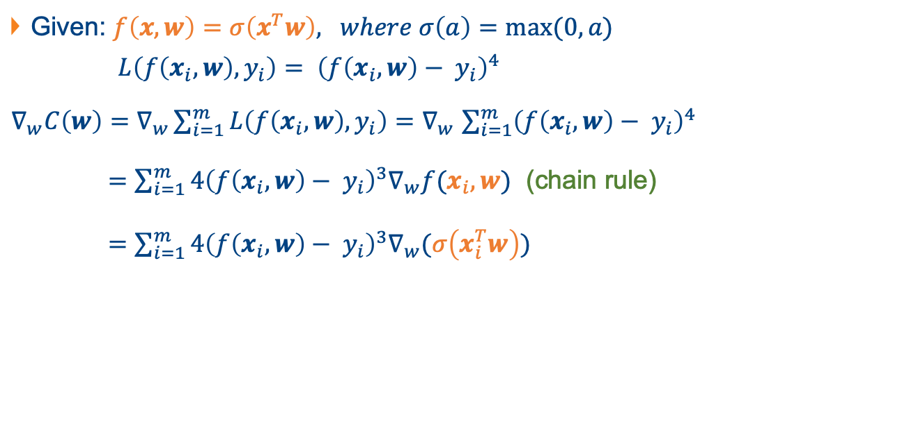
Question 5
Given: $f\left(x, w\right)=σ\left(x^{T}w\right), where σ\left(a\right)=max⁡(0, a)$
$L\left(f\left(x_{i},w\right),y_{i}\right)= {\left(f\left(x_{i},w\right)− y_{i}\right)}^{4}$
$∇_{w}C\left(w\right)=∇_{w}\sum_{i=1}^{m}{L\left(f\left(x_{i},w\right),y_{i}\right)}{=∇}_{w}\sum_{i=1}^{m}{{\left(f\left(x_{i},w\right)− y_{i}\right)}^{4}}$
$=\sum_{i=1}^{m}{4{\left(f\left(x_{i},w\right)− y_{i}\right)}^{3}∇_{w}f(x_{i}, w)}$ (chain rule)
$=\sum_{i=1}^{m}{4{\left(f\left(x_{i},w\right)− y_{i}\right)}^{3}∇_{w}(σ\left(x_{i}^{T}w\right))}$

Slide 38
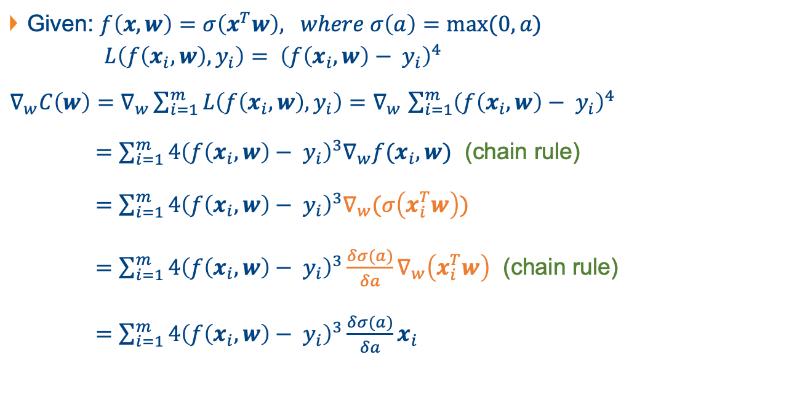
Question 5
Given: $f\left(x, w\right)=σ\left(x^{T}w\right), where σ\left(a\right)=max⁡(0, a)$
$L\left(f\left(x_{i},w\right),y_{i}\right)= {\left(f\left(x_{i},w\right)− y_{i}\right)}^{4}$
$∇_{w}C\left(w\right)=∇_{w}\sum_{i=1}^{m}{L\left(f\left(x_{i},w\right),y_{i}\right)}{=∇}_{w}\sum_{i=1}^{m}{{\left(f\left(x_{i},w\right)− y_{i}\right)}^{4}}$
$=\sum_{i=1}^{m}{4{\left(f\left(x_{i},w\right)− y_{i}\right)}^{3}∇_{w}f(x_{i}, w)}$ (chain rule)
$=\sum_{i=1}^{m}{4{\left(f\left(x_{i},w\right)− y_{i}\right)}^{3}∇_{w}(σ\left(x_{i}^{T}w\right))}$
$=\sum_{i=1}^{m}{4{\left(f\left(x_{i},w\right)− y_{i}\right)}^{3}\frac{δσ(a)}{δa}∇_{w}\left(x_{i}^{T}w\right)}$ (chain rule)
$=\sum_{i=1}^{m}{4{\left(f\left(x_{i},w\right)− y_{i}\right)}^{3}\frac{δσ(a)}{δa}x_{i}}$

Slide 39
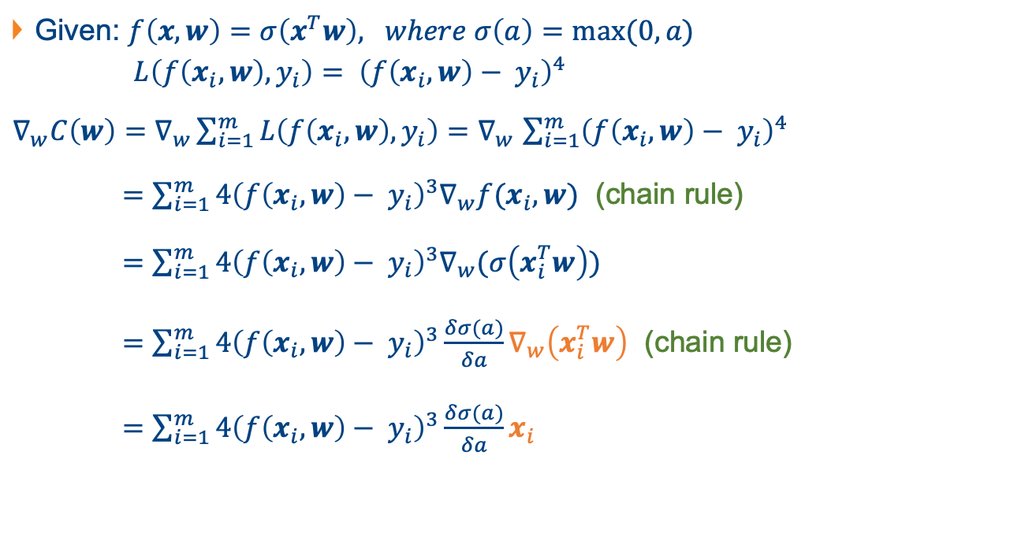
Question 5
Given: $f\left(x, w\right)=σ\left(x^{T}w\right), where σ\left(a\right)=max⁡(0, a)$
$L\left(f\left(x_{i},w\right),y_{i}\right)= {\left(f\left(x_{i},w\right)− y_{i}\right)}^{4}$
$∇_{w}C\left(w\right)=∇_{w}\sum_{i=1}^{m}{L\left(f\left(x_{i},w\right),y_{i}\right)}{=∇}_{w}\sum_{i=1}^{m}{{\left(f\left(x_{i},w\right)− y_{i}\right)}^{4}}$
$=\sum_{i=1}^{m}{4{\left(f\left(x_{i},w\right)− y_{i}\right)}^{3}∇_{w}f(x_{i}, w)}$ (chain rule)
$=\sum_{i=1}^{m}{4{\left(f\left(x_{i},w\right)− y_{i}\right)}^{3}∇_{w}(σ\left(x_{i}^{T}w\right))}$
$=\sum_{i=1}^{m}{4{\left(f\left(x_{i},w\right)− y_{i}\right)}^{3}\frac{δσ(a)}{δa}∇_{w}\left(x_{i}^{T}w\right)}$ (chain rule)
$=\sum_{i=1}^{m}{4{\left(f\left(x_{i},w\right)− y_{i}\right)}^{3}\frac{δσ(a)}{δa}x_{i}}$

Slide 40
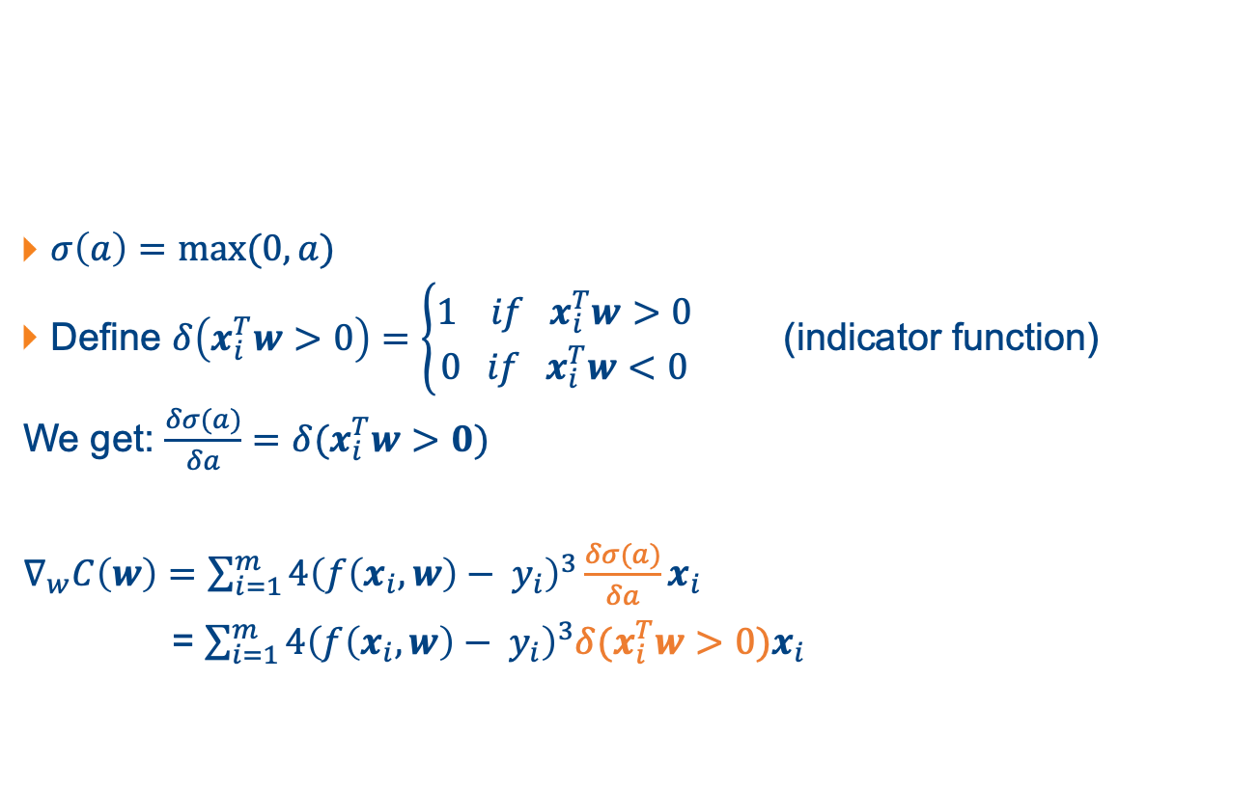
Question 5
$σ\left(a\right)=max⁡(0, a)$
Define $δ\left(x_{i}^{T}w>0\right)=\left\{\begin{aligned}1 if x_{i}^{T}w>0 \\ 0 if x_{i}^{T}w<0\end{aligned}\right.$ (indicator function)
We get: $\frac{δσ(a)}{δa}=δ(x_{i}^{T}w>0)$
$∇_{w}C\left(w\right)=\sum_{i=1}^{m}{4{\left(f\left(x_{i},w\right)− y_{i}\right)}^{3}\frac{δσ(a)}{δa}x_{i}}$
= $\sum_{i=1}^{m}{4{\left(f\left(x_{i},w\right)− y_{i}\right)}^{3}δ(x_{i}^{T}w>0)x_{i}}$

